Slide 1
Typ1 Diabetes
Rabizadeh S.,MD, Endocrinologist,
Tehran University of Medical Sciences

Slide 2
Diabetes Mellitus
10% of diabetes is Type 1
  Genetic link (chromosome 6HLA region)
  Presence of islet cell autoantibodies
  Autoimmune destruction of the beta cells
Notes:
Diabetes Mellitus
Diabetes mellitus is a metabolic disease with pathology that includes chronic episodes of hyperglycemia. Type 1 diabetes results from the autoimmune destruction of pancreatic beta cells. The autoimmune component appears to be influenced by genetic predisposition, as it is strongly associated with the major histocompatibility complex HLA class II region on chromosome 6p21. These genes are involved in the immune response of T lymphocytes, but their role in the pathogenesis of Type 1 diabetes remains to be elucidated. In addition to the known risk associated with alleles DR3 and DR4, additional susceptibility is associated with DQalpha and DQbeta chains.¹
The attack on the beta cells appears to be triggered or modified by environmental or biologic events. Research on environmental risk determinants focus on 1) viral infections, 2) early infant diet, and 3) toxins.
Type 2 diabetes is associated with older age, obesity, family history of diabetes, personal history of gestational diabetes, impaired glucose metabolism, physical inactivity, and race/ethnicity (African-Americans, Latino-Hispanic Americans, Native Americans, and Native Hawaiians are at higher risk).²
Atkinson MA, Eisenbarth GS. Type 1 diabetes: new perspectives on disease pathogenesis and treatment. Lancet. 2001;358:221−229.
Centers for Disease Control and Prevention. National Diabetes Fact Sheet. November 2003. Atlanta, GA: US Dept. of Health and Human Services, CDCP, 2003.

Slide 3
Classification
The two broad categories of DM are designated
Type 1 ( A or B)
Type 2
Type 1A DM results from
Autoimmune β cell destruction
Usually leads to insulin deficiency

Slide 4
DM Type 1 B
Type 1B DM is also characterized by
Insulin deficiency
Tendency to develop ketosis
Lack immunologic markers of an autoimmune destructive process of the beta cells.
The mechanisms leading to beta cell destruction are unknown.
Relatively few patients fall into type 1B idiopathic

Slide 5
Classification - Age
Age is no longer used as a criterion in the new classification system.
An autoimmune β cell destructive process can develop at any age.
Although type 1 DM most commonly develops < age of 30
It is estimated that 5 - 10% of individuals who develop DM > age 30 have type 1A DM.
Although type 2 DM more typically develops with increasing age, it occurs in children, particularly in obese adolescents.

Slide 6
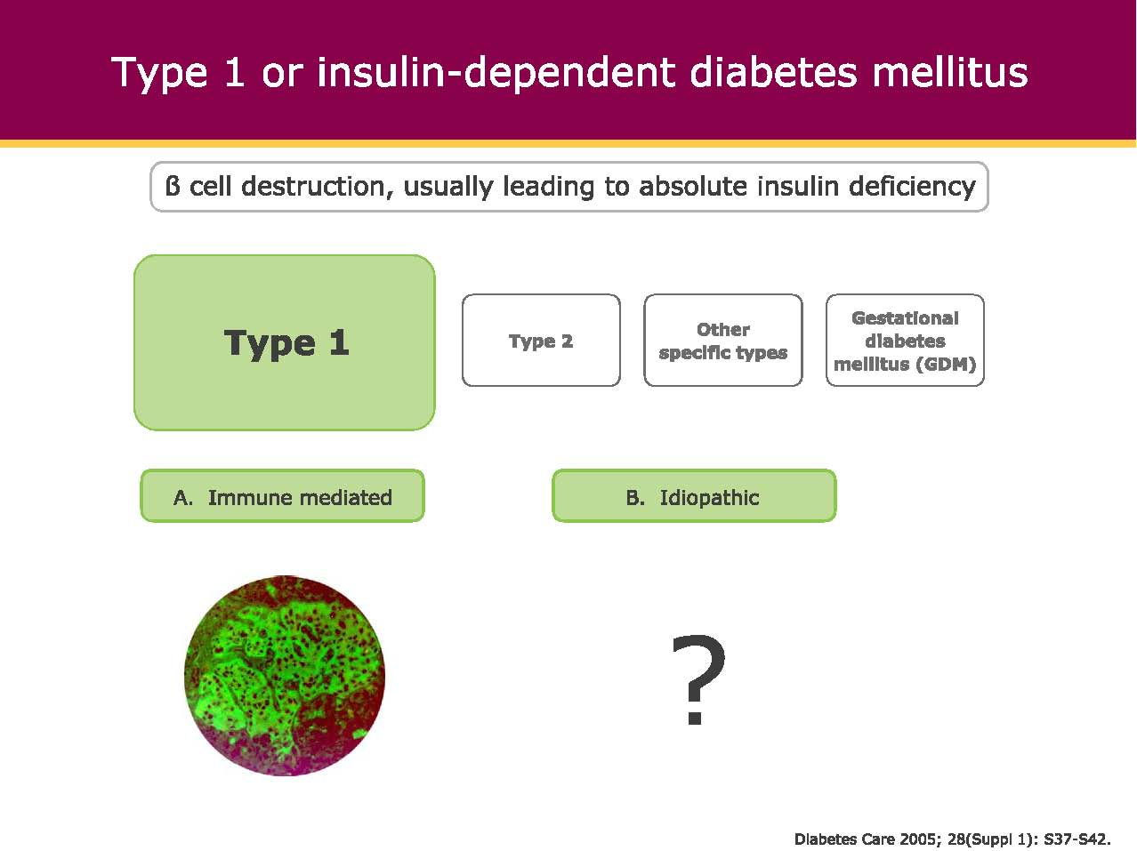
Type 1 DM

Slide 7
Differential Diagnosis
Type 1 and Type 2 Diabetes
Type 1 Diabetes Type 2 Diabetes
Usual clinical course Insulin-dependent Initially non-insulin-
dependent
Usual age of onset <20 years (but ~50% >40 years but
over 20 years) increasingly earlier
Body weight Usually lean Usually obese
Clinical onset Often acute Subtle, slow
Ketosis-prone Yes No
Family history ≤15% with 1° relative Common
Frequency of HLA-DR3, Increased Not increased
DR4, DQB1*0201, *0302
Islet autoantibodies Present Absent
(GADA, ICA, IA-2A, IAA)

Slide 8
Diagnostic Criteria Associated with Glucose Abnormalities
FPG
2-Hour PG on OGTT
Diabetes Mellitus
Diabetes Mellitus
126 mg/dL
7.0 mmol/L
200 mg/dL
11.1
mmol/L
Prediabetes
Impaired Glucose
Tolerance
100 mg/dL
5.6 mmol/L
140 mg/dL
7.8
mmol/L
Normal
Normal

Slide 9
Type 1 Diabetes: Recommendations
Plasma blood glucose rather than A1C should be used to diagnose type 1 diabetes in individuals with symptoms of hyperglycemia.
Screening for type 1 diabetes with a panel of autoantibodies is currently recommended only in the setting of a research trial study or in first-degree family members of a proband with type 1 diabetes.
Persistence of two or more autoantibodies predicts clinical diabetes.
Classification and Diagnosis of Diabetes:
Standards of Medical Care in Diabetes - 2018. Diabetes Care 2018; 41 (Suppl. 1): S13-S27
Notes:
Moving on to type 1 diabetes diagnosis and screening recommendations, these patients often present with acute symptoms of diabetes and markedly elevated blood glucose levels, and some cases are diagnosed with life-threatening ketoacidosis.
In these cases, knowing the blood glucose level is critical because, in addition to confirming that symptoms are due to diabetes mellitus, this will inform management decisions. Some providers may also want to know the A1C to determine how long a patient has had hyperglycemia. Therefore the Association recommends that blood glucose rather than A1c should be used to diagnose acute onset type 1 diabetes in those with symptoms of hyperglycemia. [CLICK]
While there is currently a lack of accepted screening programs, consider referring relatives of those with type 1 diabetes for antibody testing for risk assessment in the setting of a clinical research study, which can be identified at diabetestrialnet.org. [CLICK]
Persistence of two or more autoantibodies predicts clinical diabetes and may serve as an indication for intervention in the setting of a clinical trial.
[SLIDE]
9
References
American Diabetes Association. Standards of medical care in diabetes—2014. Diabetes Care 2014;37(suppl 1):S18
Imperatore G, Boyle JP, Thompson TJ, et al.; SEARCH for Diabetes in Youth Study Group. Projections of type 1 and type 2 diabetes burden in the U.S. population aged <20 years through 2050: dynamic modeling of incidence, mortality, and population growth. Diabetes Care 2012;35:2515–2520
Lipman TH, Levitt Katz LE, Ratcliffe SJ, et al. Increasing incidence of type 1 diabetes in youth: twenty years of the Philadelphia Pediatric Diabetes Registry. Diabetes Care 2013;36:1597–1603
Pettitt DJ, Talton J, Dabelea D, et al. Prevalence of diabetes mellitus in U.S. youth in 2009: the SEARCH for Diabetes in Youth Study. Diabetes Care. 16 September 2013 [Epub ahead of print]

Slide 10
Pathogenesis
TYPE 1 DM
Type 1A DM develops as a result of the synergistic effects of
Genetic
Environmental
Immunologic factors
that ultimately destroy the pancreatic beta cells.

Slide 11
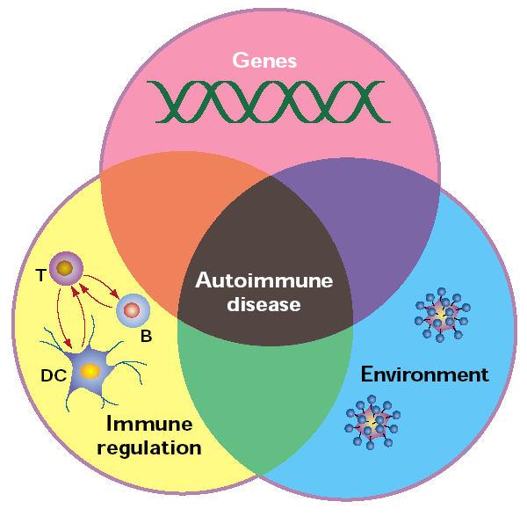
Requirements for the development of an autoimmune disease
Nature Immunology (9): 759-761 (2001)
Fathman

Slide 12
Pathogenesis of Type 1 DM
Genetic
HLA-DR3/DR4
Environment ?
Viral infe..??
Autoimmune Insulitis
ß cell Destruction
Severe Insulin deficiency
Type 1 DM

Slide 13
Features of Type 1 Diabetes
80% occur before age 20
May occur at any age
Insulin deficient
  autoimmune pathogenesis, HLA linked
  less commonly non-immune mediated
Ketosis prone
Normal insulin sensitivity

Slide 14
Staging of type 1 diabetes

Slide 15
Staging of type 1 diabetes

Slide 16
Staging of type 1 diabetes

Slide 17
Pathogenesis of Type 1 DM
Individuals with a genetic susceptibility have normal β cell mass at birth
But begin to lose beta cells secondary to autoimmune destruction that occurs over months to years.
This autoimmune process is triggered by an infectious or environmental stimulus

Slide 18
Pathogenesis of Type 1 DM
The rate of decline in beta cell mass varies widely among individuals
Some patients progressing rapidly to clinical diabetes
Others evolving more slowly
Features of diabetes do not become evident until a majority of beta cells are destroyed (~80%).

Slide 19
Natural History of Type 1 Diabetes
Putative
trigger
β-Cell
mass 100%
Cellular autoimmunity
Circulating autoantibodies (ICA, GAD65, ICA512A, IAA)
Loss of first-phase
insulin response (IVGTT)
Abnormal glucose
tolerance (OGTT)
Clinical
onset
Genetic
predisposition
Insulitis
β-Cell injury
β-Cell insufficiency
Diabetes
Time
Eisenbarth GS. N Engl J Med. 1986;314:1360-1368

Slide 20
Progression of Type 1 Diabetes
Precipitating event
Genetic
predisposition
Progressive loss of
insulin release
Antibody
formation
Normal insulin
release
β Cell
Mass
Glucose
normal
Overt diabetes
C-peptide present
No C-peptide present
Time
Atkinson MA and Eisenbarth GS. Lancet. 2001;358:221–229.
Notes:
Progression of Type 1 Diabetes
The current model of Type 1 diabetes is depicted in this figure. Type 1 diabetes results from the autoimmune destruction of pancreatic beta cells. The autoimmune component appears to be influenced by genetic predisposition. The attack on the beta cells appears to be triggered by an environmental or biologic event, the nature of which is not yet fully understood. Evidence has begun to suggest that immune dysregulation and environmental triggers or modifiers may impact many points along the continuum, rather than a single triggering event.
There is a rapid loss of both prandial and basal insulin output once beta-cell populations have declined below a certain threshold. The clinical onset of Type 1 diabetes is often acute, especially in younger adults and children, with many patients presenting with marked symptoms of polyuria, polydipsia, weight loss, and, often, ketoacidosis. Patients with Type 1 diabetes have little or no insulin secretory capacity and are dependent on insulin replacement for survival.
Atkinson MA, Eisenbarth GS. Type 1 diabetes: new perspectives on disease pathogenesis and treatment. Lancet. 2001;358:221−229.

Slide 21
TYPE 1 DM
Following the initial presentation of type 1A DM, a "honeymoon" phase may ensue during which glycemic control is achieved with modest doses of insulin or, rarely, insulin is not needed.

Slide 22
Lifelong risk of type 1 diabetes
Markedly increased in close relatives of a patient with type 1 diabetes
About 6 % in offspring (children)
5 % in siblings (brothers and sisters)
50 % in identical twins
versus 0.4 % in subjects with no family history

Slide 23
Autoimmune markers
Autoimmune markers include islet cell autoantibodies and autoantibodies to
GAD (GAD65)
Insulin
Tyrosine phosphatases,IA-2 and IA-2b
ZnT8
Type 1 diabetes is defined by the presence of one or more of these autoimmune markers.

Slide 24


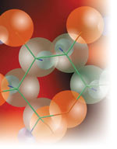
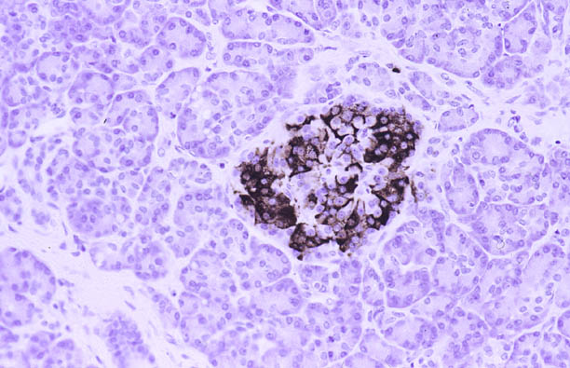
Insulin
Polypeptide hormone
MW. = 5807 Dalton
51 amino acids arranged in
2 polypeptides chains ( A=21 , B=30 )
Produced by B-cells of
islets of Langerhans
Charles Best
Frederick G. Banting
(1891-1941)

Slide 25


Normal Pancreatic Function
Basal: Beta cells secrete small amounts of insulin throughout the day. (40-50%)
Bolus: At mealtime, insulin is rapidly released in response to food. (50-60%)
Bolus Insulin
Basal Insulin
Meal
Meal
Meal
Expected insulin changes during the day for individuals with a healthy pancreas.
*Insulin effect images are theoretical representations and are not derived from clinical trial data.
Notes:
Ensure audience understands normal basal insulin secretion
Discussion points
The ideal insulin regimen should strive to match normal insulin secretion patterns.
This includes;
A basal component that covers basal glucose levels throughout the day.
Bolus components that cover glucose excursions due to meals.

Slide 26
Comparison of Available Insulins
Type | Onset | Peak | Duration
Short-acting Regular insulin (R) | 30–60 min | 2–5 hrs | 5–8 hrs
Rapid-acting Insulin lispro Insulin aspart Insulin glulisine | 15–30 min 10–20 min 20–30 min | 30–90 min 40–50 min 30–90 min | 3–5 hrs 3–5 hrs 1–2.5 hrs
Intermediate-acting NPH | 1–2 hrs | 4–12 hrs | 18–24 hrs
Long-acting Insulin glargine Insulin detemir | 1–1.5 hrs 1–2 hrs | No pronounced peak Relatively flat | 20–24 hrs up to 24 hrs
Premixed Insulins Regular/NPH insulin 70/30 Lispro protamine 75/25, 50/50 Biphasic insulin aspart 70/30 | 30 min 15 min 10–20 min | 2–12 hrs 0.5–2.5 hrs 1–4 hrs | 14–24 hrs 16–20 hrs up to 24 hrs

Slide 27
Insulin preparations
Five different preparations are available
Short-acting insulin: regular
Rapid-acting insulin(analogues): lispro, Aspart, Glulisine
Intermediate –acting insulin: NPH or Lente
Long-acting insulin : Ultralente
Basal insulin(analogues): glargine, detemir,degludec

Slide 28

Action Profiles of Basal Insulins
NPH 12–20 hours
Plasma Insulin Levels
Detemir ~ 6–23 hours (dose-dependent)
Glargine ~ 20–26 hours
Hours
Note: Action curves are approximations for illustrative purposes. Actual patient response will vary.
Adapted from Insulin Therapy for the 21st Century. American Diabetes Association; information from insulin glargine, insulin detemir, and NPH product monographs
Notes:
NPH insulin has an erratic absorption profile and delayed onset of action and peak activity, creating fluctuations in glycemic control and necessitating careful coordination of injections and meals. Analog insulins provide more reliable absorption profiles. The duration of action associated with detemir, a long-acting basal insulin with a relatively flat action profile, varies depending on the dose and ranges from 5.7 hours (0.1 U/kg) to 23.2 hours (1.6 U/kg). Glargine more closely produces a normal basal pattern, with peakless, continuous release over 24 hours.
Figure adapted from the American Diabetes Association’s Clinical Education Program, “Insulin Therapy for the 21st Century.”
Mayfield JA, White RD. Insulin therapy for Type 2 diabetes: Rescue, augmentation, and replacement of beta-cell function. Am Fam Physician 2004;70:489–500.
Plank J, Bodenlenz M, Sinner F, et al. A double-blind, randomized, dose-response study investigating the pharmacodynamic and pharmacokinetic properties of the long-acting insulin analog detemir. Diabetes Care 2005;28:1107–12.

Slide 29
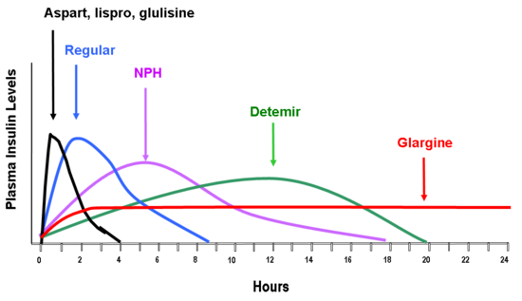
Endotext.com

Slide 30
Insulin dosage
Individuals with type 1 require 0.5 to 1.0 U/kg / day divided into multiple doses.
Initial insulin regimens should be conservative; approximately 40 to 50% of the insulin should be given as basal insulin.
A single daily injection of insulin is not appropriate therapy in type 1 DM.

Slide 31
Physical Activity: Recommendations
Children and adolescents with diabetes or prediabetes:
1-Should engage in:
60 min/day or more
Moderate- or vigorous-intensity
Aerobic activity
2-with vigorous muscle-strengthening and bone-strengthening activities at least 3 days/week.
Notes:
Recommendations for physical activity for people with diabetes are summarized on this slide and the next:
• Children and adolescents with diabetes or prediabetes should engage in 60 min/day or more of moderate- or vigorous-intensity aerobic activity, with vigorous muscle-strengthening and bone-strengthening activities at least 3
days/week. C [Click]
Most adults with type 1 C and type 2 B diabetes should engage in 150 min or more of moderate-to-vigorous intensity aerobic activity per week, spread over at least 3 days/week, with no more than 2 consecutive days without activity. Shorter durations (minimum 75 min/week) of vigorous-intensity or interval training may be sufficient for younger and more physically fit individuals.
[SLIDE]
31
References
American Diabetes Association. Standards of medical care in diabetes—2014. Diabetes Care 2014;37(suppl 1):S31
Knowler WC, Barrett-Connor E, Fowler SE, et al, for the Diabetes Prevention Program Research Group. Reduction in the incidence of type 2 diabetes with lifestyle intervention or metformin. N Engl J Med 2002;346:393–403
Tuomilehto J, Lindström J, Eriksson JG, et al.; Finnish Diabetes Prevention Study Group. Prevention of type 2 diabetes mellitus by changes in lifestyle among subjects with impaired glucose tolerance. N Engl J Med 2001;344:1343–1350
Pan XR, Li GW, Hu YH, et al. Effects of diet and exercise in preventing NIDDM in people with impaired glucose tolerance. The Da Qing IGT and Diabetes Study. Diabetes Care 1997;20:537–544
Colberg SR, Sigal RJ, Fernhall B, et al. Exercise and type 2 diabetes. The American Collegoe of Sports Medicine and the American Diabetes Association: joint position statement. Diabetes Care 2010;33:2692–2696

Slide 32
Physical Activity: Recommendations
Most adults with type 1 and type 2 diabetes:
Should engage in 150 min or more of moderate-to-vigorous intensity aerobic activity per week, spread over at least 3 days/week, with no more than 2 consecutive days without activity.
Notes:
Recommendations for physical activity for people with diabetes are summarized on this slide and the next:
• Children and adolescents with diabetes or prediabetes should engage in 60 min/day or more of moderate- or vigorous-intensity aerobic activity, with vigorous muscle-strengthening and bone-strengthening activities at least 3
days/week. C [Click]
Most adults with type 1 C and type 2 B diabetes should engage in 150 min or more of moderate-to-vigorous intensity aerobic activity per week, spread over at least 3 days/week, with no more than 2 consecutive days without activity. Shorter durations (minimum 75 min/week) of vigorous-intensity or interval training may be sufficient for younger and more physically fit individuals.
[SLIDE]
32
References
American Diabetes Association. Standards of medical care in diabetes—2014. Diabetes Care 2014;37(suppl 1):S31
Knowler WC, Barrett-Connor E, Fowler SE, et al, for the Diabetes Prevention Program Research Group. Reduction in the incidence of type 2 diabetes with lifestyle intervention or metformin. N Engl J Med 2002;346:393–403
Tuomilehto J, Lindström J, Eriksson JG, et al.; Finnish Diabetes Prevention Study Group. Prevention of type 2 diabetes mellitus by changes in lifestyle among subjects with impaired glucose tolerance. N Engl J Med 2001;344:1343–1350
Pan XR, Li GW, Hu YH, et al. Effects of diet and exercise in preventing NIDDM in people with impaired glucose tolerance. The Da Qing IGT and Diabetes Study. Diabetes Care 1997;20:537–544
Colberg SR, Sigal RJ, Fernhall B, et al. Exercise and type 2 diabetes. The American Collegoe of Sports Medicine and the American Diabetes Association: joint position statement. Diabetes Care 2010;33:2692–2696

Slide 33
Exercise
Exercise is an integral component of diabetes care that have multiple positive benefits
Cardiovascular benefits
Reduced blood pressure
Maintenance of muscle mass
Reduction in body fat
Weight loss

Slide 34
Exercise
Individuals with type 1 DM are prone to either hyperglycemia or hypoglycemia during exercise, depending on
Preexercise plasma glucose
Circulating insulin
Exercise-induced catecholamines.

Slide 35
Exercise
To avoid exercise-related hyper- or hypoglycemia, individuals with type 1 DM should:
(1) Monitor blood glucose before, during, and after exercise
(2) Delay exercise if blood glucose is >250 <100 mg/dL, or if ketones are present

Slide 36
Exercise
(3) Eat a meal 1 to 3 h before exercise and take supplemental carbohydrate at least every 30 min during prolonged exercise
(4) Decrease insulin before exercise and inject insulin into a nonexercising area

Slide 37
Physical Activity and Exercise (Type 1)
Families should also receive education on prevention and management of hypoglycemia during and after exercise, including ensuring patients have a pre-exercise glucose level of 90–250 mg/dL (5.0–13.9 mmol/L) and accessible carbohydrates before engaging in activity, individualized according to the type/intensity of the planned physical activity. E

Slide 38
Physical Activity and Exercise (Type 1) (continued)
Children and adolescents
Patients should be educated on strategies to prevent hypoglycemia during exercise, after exercise, and overnight following exercise, which may include reducing prandial insulin dosing for the meal/snack preceding (and, if needed, following) exercise, reducing basal insulin doses, increasing carbohydrate intake, eating bedtime snacks, and/or using continuous glucose monitoring.

Slide 39
Exercise
Formal exercise tolerance testing may be warranted in any of the following:
Age >35 years
Long-standing type 1 DM (>20 to 25 years' duration)
Microvascular complications of DM (retinopathy, microalbuminuria, or nephropathy)
Peripheral vascular disease
Risk factors of coronary artery disease
Autonomic neuropathy

Slide 40
Exercise
Untreated proliferative retinopathy is a relative contraindication to vigorous exercise, since this may lead to vitreous hemorrhage or retinal detachment.

Slide 41
Psychosocial Issues (Type 1)
Children and adolescents
At diagnosis and during routine follow-up care, assess psychosocial issues and family stresses that could impact diabetes management and provide appropriate referrals to trained mental health professionals, preferably experienced in childhood diabetes.

Slide 42
Glycemic Control (Type 1)
Children and adolescents
The majority of children and adolescents with type 1 diabetes should be treated with intensive insulin regimens, either via multiple daily injections or continuous subcutaneous insulin infusion.
All children and adolescents with type 1 diabetes should self-monitor glucose levels multiple times daily (up to 6–10 times/day), including premeal, prebedtime, and as needed for safety in specific situations such as exercise, driving, or the presence of symptoms of hypoglycemia.
Continuous glucose monitoring (CGM) should be considered in all children and adolescents with type 1 diabetes, whether using injections or continuous subcutaneous insulin infusion, as an additional tool to help improve glucose control.

Slide 43
Glycemic Control (Type 1) (continued)
Children and adolescents
Automated insulin delivery systems appear to improve glycemic control and reduce hypoglycemia in children and should be considered in children with type 1 diabetes. B
A1C goals must be individualized and reassessed over time. An A1C of <7% (53 mmol/mol) is appropriate for many children. B
Less-stringent A1C goals (such as <7.5% [58 mmol/mol]) may be appropriate for patients who cannot articulate symptoms of hypoglycemia; have hypoglycemia unawareness; lack access to analog insulins, advanced insulin delivery technology, and/or continuous glucose monitors; cannot check blood glucose regularly;

Slide 44
Glycemic Control (Type 1) (continued)
Children and adolescents
Even less-stringent A1C goals (such as <8% may be appropriate for patients with a history of severe hypoglycemia, limited life expectancy, or extensive comorbid conditions.
Providers may reasonably suggest more-stringent A1C goals (such as <6.5% [48 mmol/ mol]) for selected individual patients if they can be achieved without significant hypoglycemia, negative impacts on well-being. Lower targets may also be appropriate during the honeymoon phase.

Slide 45
Autoimmune Conditions (Type 1)
Assess for additional autoimmune conditions soon after the diagnosis of type 1 diabetes and if symptoms develop.

Slide 46
Thyroid Disease (Type 1)
Children and adolescents
Consider testing children with type 1 diabetes for antithyroid peroxidase and antithyroglobulin antibodies soon after diagnosis.
Measure TSH concentrations at diagnosis when clinically stable or soon after glycemic control has been established. If normal, suggest rechecking every 1–2 years or sooner if the patient has positive thyroid antibodies or develops symptoms or signs suggestive of thyroid dysfunction, thyromegaly, an abnormal growth rate, or unexplained glycemic variability. B

Slide 47
Celiac Disease (Type 1)
Children and adolescents
Screen children with type 1 diabetes for celiac disease by measuring IgA tissue transglutaminase (tTG) antibodies, with documentation of normal total serum IgA levels, soon after the diagnosis of diabetes, or IgG to tTG and deamidated gliadin antibodies if IgA deficient.
Repeat screening within 2 years of diabetes diagnosis and then again after 5 years and consider more frequent screening in children who have symptoms or a first-degree relative with celiac disease. B
Individuals with biopsy-confirmed celiac disease should be placed on a gluten-free diet for treatment and to avoid complications. B

Slide 48
Management of Cardiovascular Risk Factors—Hypertension Screening (Type 1)
Blood pressure should be measured at each routine visit. Children found to have elevated blood pressure (systolic blood pressure or diastolic blood pressure ≥90th percentile for age, sex, and height or, in adolescents ≥13 years, systolic blood pressure 120–129mmHg with diastolic blood pressure ˂80 mmHg) or
hypertension (systolic blood pressure or diastolic blood pressure ≥95th percentile for age, sex, and height or, in adolescents ≥13 years, systolic blood pressure ≥130 mmHg or diastolic blood pressure ≥80 mmHg) should have elevated blood pressure confirmed on three separate days. B

Slide 49
Management of Cardiovascular Risk Factors —Hypertension Treatment (Type 1)
Children and adolescents
Initial treatment of elevated blood pressure includes dietary modification and increased exercise, if appropriate, aimed at weight control. If target blood pressure is not reached within 3–6months of initiating lifestyle intervention, pharmacologic treatment should be considered.
In addition to lifestyle modification, pharmacologic treatment of hypertension should be considered as soon as hypertension is confirmed. E

Slide 50
Management of Cardiovascular Risk Factors—Hypertension Treatment (Type 1) (continued)
ACE inhibitors or angiotensin receptor blockers should be considered for the initial pharmacologic treatment of hypertension
The goal of treatment is blood pressure consistently ˂90th percentile for age, sex, and height or ˂120/˂80 mmHg in children ≥13 years.

Slide 51
Management of Cardiovascular Risk Factors—Dyslipidemia Testing (Type 1)
Initial lipid testing should be performed when initial glycemic control has been achieved and age is ≥2 years.
If initial LDL cholesterol is ≤100 mg/dL (2.6 mmol/L), subsequent testing should be performed at 9-11 years of age.
Initial testing may be done with a non fasting non-HDL cholesterol level with confirmatory testing with a fasting lipid panel.
If LDL cholesterol values are within the accepted risk level
(˂100 mg/dL [2.6 mmol/L]), a lipid profile repeated every 3 years is reasonable.

Slide 52
Management of Cardiovascular Risk Factors—Dyslipidemia Treatment (Type 1)
Children and adolescents
If lipids are abnormal, initial therapy should consist of optimizing glucose control and medical nutrition therapy to limit the amount of calories from fat to 25–30%, saturated fat to <7%, cholesterol <200 mg/day, avoidance of trans fats, and aim for ~10% calories from monounsaturated fats. A
After the age of 10 years, addition of a statin may be considered in patients who, despite medical nutrition therapy and lifestyle changes, continue to have LDL cholesterol >160 mg/dL (4.1 mmol/L) or LDL cholesterol >130 mg/dL (3.4 mmol/L) and one or more cardiovascular disease risk factors, following reproductive counseling because of the potential teratogenic effects of statins. E
The goal of therapy is an LDL cholesterol value <100 mg/dL (2.6 mmol/L). E

Slide 53
Management of Cardiovascular Risk Factors—Smoking (Type 1)
Children and adolescents
Elicit a smoking history at initial and follow-up diabetes visits; discourage smoking in youth who do not smoke and encourage smoking cessation in those who do smoke. A

Slide 54
Microvascular Complications—Nephropathy Screening (Type 1)
Annual screening for albuminuria with a random (morning sample preferred to avoid effects of exercise) spot urine sample for albumin-to-creatinine ratio should be considered at puberty or at age >10 years, whichever is earlier, once the child has had diabetes for 5 years.

Slide 55
Microvascular Complications—Nephropathy Treatment (Type 1)
An ACE inhibitor or an angiotensin receptor blocker, titrated to normalization of albumin excretion, maybe considered when elevated urinary albumin-to-creatinine ratio (>30 mg/g) is documented (two of three urine samples obtained over a 6- month interval following efforts to improve glycemic control and normalize blood pressure). E

Slide 56
Microvascular Complications—Retinopathy Treatment (Type 1)
An initial dilated and comprehensive eye examination is recommended once youth have had type 1 diabetes for 3–5 years, provided they are aged ≥11 years or puberty has started, whichever is earlier. B
Repeat dilated and comprehensive eye examination every 2 years. Less frequent examinations, every 4 years, may be acceptable on the advice of an eye care professional and based on risk factor assessment, including a history of glycemic control with A1C <8%. B

Slide 57
Microvascular Complications—Neuropathy (Type 1)
Consider an annual comprehensive foot exam at the start of puberty or at age ≥10 years, whichever is earlier, once the youth has had type 1 diabetes for 5 years.

Slide 58
Acute complications: DKA

Slide 59
Precipitating factor
1-Infection (30-50%) : most commonly pneumonia, UTI, gastroenteritis/sepsis
2-Stressful settings that increases secretion of catecholamines, cortisol, glucagon.
3-Noncompliance with insulin therapy, Inadequate insulin administration
4-Surgery
5-Trauma
6-Silent MI, Infarction (mesenteric, peripheral)
7-Stroke
8-Pancreatitis
9-Pregnancy
10-Alcohol and drug abuse ,cocaine
11-Drugs: corticosteroid, higher dose thiazide diuretics, Atypical Antipsychotic

Slide 60
DKA is defined as (need all 3 criteria):
(1) Hyperglycemia > 200 (250) mg/dL
AND
(2) Ketonemia (β-OH B > 1 mmol/L)
AND
(3) Venous pH < 7.3 or HCO3 < 15mEq/L.

Slide 61
DKA and HHS Are Life-Threatening Emergencies
Diabetic Ketoacidosis (DKA) | Hyperglycemic Hyperosmolar State (HHS)
Plasma glucose >250 mg/dL | Plasma glucose >600 mg/dL
Arterial pH <7.3 | Arterial pH >7.3
Bicarbonate <15 mEq/L | Bicarbonate >15 mEq/L
Moderate ketonuria or ketonemia | Minimal ketonuria and ketonemia
Anion gap >12 mEq/L | Serum osmolality >320 mosm/L

Slide 62
Diagnostic Criteria for DKA and HHS
 | Mild DKA | Moderate DKA | Severe DKA | HHS
Plasma glucose (mg/dL) | > 250 | > 250 | > 250 | > 600
Arterial pH | 7.25-7.30 | 7.00-7.24 | < 7.00 | > 7.30
Sodium Bicarbonate (mEq/L) | 15 – 18 | 10 - <15 | < 10 | > 15
Urine Ketones | Positive | Positive | Positive | Small
Serum Ketones | Positive | Positive | Positive | Small
Serum Osmolality (mOsm/kg) | Variable | Variable | Variable | > 320
Anion Gap | > 10 | > 12 | > 12 | variable
Mental Status | Alert | Alert/Drowsy | Stupor/Coma | Stupor/Coma

Slide 63
Fluid Therapy in DKA
Normal saline, 1-2 L over 1-2 h
Calculate corrected serum sodium
High or normal serum sodium
Low serum sodium
½ NS at 250-500 mL/h
NS at
250-500 mL/h
Glucose < 250 mg/dl
Change to D5% NS or 1/2NS
ADA. Diabetes Care. 2003;26:S109-S117.

Slide 64
Management of Diabetic Ketoacidosis
If initial K is < 3.5 meq/L, do not administer insulin until K is corrected to > 3.5 meq/L.
Start potassium at same time of initial fluid resuscitation if hypokalemia (K< 3.5 mEq/L) exists at presentation

Slide 65
Intravenous Insulin Therapy in DKA
IV bolus: 0.1 U/kg body weight
IV drip: 0.1 U/kg/h body weight
Glucose < 250 mg/dl
IV drip: 0.05 – 0.1 U/kg/h
until resolution of ketoacidosis
ADA. Diabetes Care. 2003;26:S109-S117.

Slide 66
Management of Diabetic Ketoacidosis
NEVER Give an insulin bolus at the start of therapy (prior to first 10 mL/kg bolus of NS) as it may increase the risk of cerebral edema.
Start regular insulin infusion AFTER completion of first 10 mL/kg bolus of NS that is given over 1 hour
Administer short-acting insulin: IV (0.1 units/kg) bolus
Then 0.1 units/kg/ hour by continuous IV infusion
Increase 2- to 3-fold if no response by 2–4 h.

Slide 67
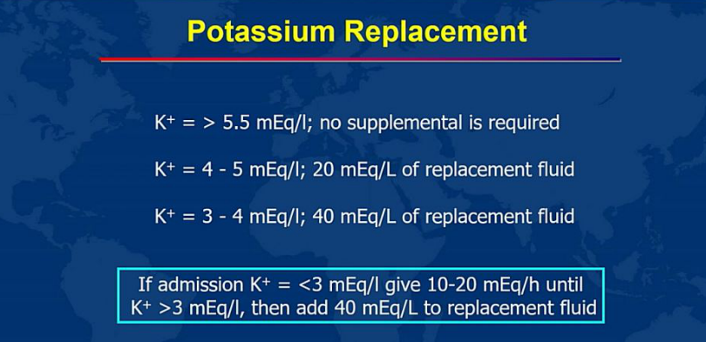

Slide 68
Management of Diabetic Ketoacidosis
In severe acidosis ( pH < 7 after initial hydration)
pH = 6.9–7
Sodium bicarbonate [50 (meq/L) in 200 mL of sterile water with 10 meq/L KCl over 1 h
pH < 6.9
100 mmol/L of sodium bicarbonate in 400 mL of sterile water with 20 meq/L KCl over 2 h

Slide 69
Transition to Subcutaneous Insulin After Resolution of DKA
After Initial IV or SC therapy
(pH>7.3, HCO3 >18, AG < 14)
Give SC basal insulin 2–4 hours before stopping IV insulin
Start multi-dose insulin (basal bolus) regimen
  Insulin analogs are preferred over human insulin
    Basal: glargine or detemir
    Rapid-acting insulin analogs (lispro, aspart, glulisine)
  Analogs result in similar blood glucose control but less hypoglycemia than human insulin (15% vs 41%)
Umpierrez G, Korytkowski M. Nat Rev Endocrinol. 2016;12:222-232.

Slide 70
Hypoglycemia

Slide 71
Epidemiology of Hypoglycemia: Mortality
25-13% of deaths in patients with T1DM are attributable to hypoglycemia
Hypoglycemia may be involved in “dead in bed” syndrome

Slide 72
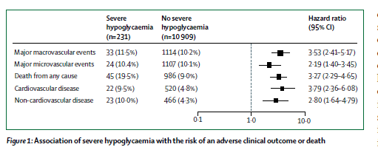
Lancet Diabetes Endocrinol 2019

Slide 73
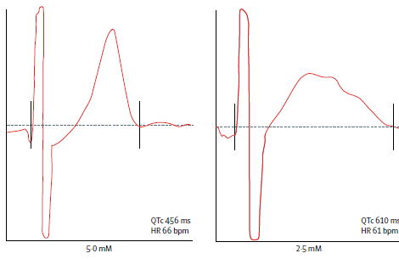
Abnormal cardiac repolarization during hypoglycemia
Lancet Diabetes Endocrinol 2019

Slide 74
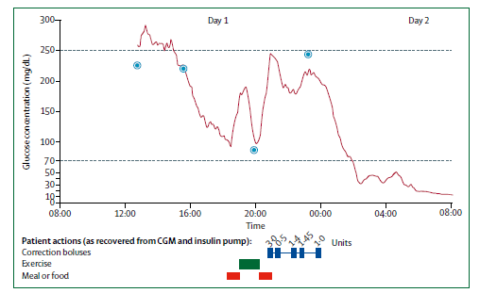
A 23 y/o type1 DM with sudden death during hypoglycemia
Lancet Diabetes Endocrinol2019

Slide 75
Thank you

