Slide 1
American College of Gastroenterology Guideline: Management of Acute Pancreatitis
Dr. Elham Pishgar
Gastroenterologist MD
Firoozgar Hospital
Iran University of Medical Sciences

Slide 2
  The diagnosis of AP is most often established by the presence of two of the three following criteria:
  abdominal pain consistent with the disease
  serum amylase and/or lipase greater than three times the upper limit of normal, and/or
  characteristic findings from abdominal imaging (strong recommendation, moderate quality of evidence).

Slide 3
  The pain: constant with radiation to the back, chest, or flanks
  The intensity of the pain is usually severe, but can be variable.
  The intensity and location of the pain do not correlate with severity.
  Pain described as dull, colicky, or located in the lower abdominal region is not consistent with AP and suggests an alternative etiology.

Slide 4
  Contrast-enhanced computed tomographic (CECT) and/or magnetic resonance imaging (MRI) of the pancreas should be reserved for:
  patients in whom the diagnosis is unclear or who fail to improve clinically within the first 48–72 h after hospital admission (strong recommendation, low quality of evidence)

Slide 5
MRI is helpful in patients with a contrast allergy and renal insufficiency where T2-weighted images without gadolinium contrast can diagnose pancreatic necrosis

Slide 6
  Serum amylase in AP patients :
  rises within a few hours after the onset of symptoms
  returns to normal values within 3–5 days
  Compared with lipase, serum amylase returns more quickly to values below the upper limit of normal

Slide 7
  Serum amylase concentrations may be normal:
  alcohol-induced AP
  hypertriglyceridemia

Slide 8
  Serum amylase concentrations might be high the absence of AP in:
  macroamylasaemia
  decreased glomerular filtration rate
  in diseases of the salivary glands
  acute appendicitis, cholecystitis, intestinal obstruction or ischemia, peptic ulcer, and gynecological diseases

Slide 9
  Serum lipase is more specific and remains elevated longer than amylase
  Lipase is elevated in renal disease, appendicitis, cholecystitis, and so on.
  upper limit of normal greater than 3–5 times is needed in diabetics who appear to have higher median lipase compared with nondiabetic patients for unclear reasons

Slide 10
Etiology
The most common cause of AP is:
Gallstones (40–70%)
Alcohol (25–35%)
Identification of gallstones should prompt cholecystectomy to prevent recurrent attacks and potential biliary sepsis
Gallstone pancreatitis is an acute event and resolves when the stone is removed

Slide 11
Etiology
infectious agents
hypocalcemia
hyperparathyroidism
drugs such as 6-mercaptopurine, azathioprine, and DDI (Dideoxyinosine) hypertriglyceridemia

Slide 12
  Trans abdominal ultrasound should be performed in all patients with acute pancreatitis (strong recommendation, low quality of evidence).

Slide 13
  In the absence of gallstones and/or history of significant history of alcohol use, a serum triglyceride should be obtained and considered the etiology if > 1,000 mg/dl. (conditional recommendation, moderate quality of evidence
  In a patient > 40 years old, a pancreatic tumor should be considered as a possible cause of AP (conditional recommendation, low quality of evidence)

Slide 14
  Endoscopic investigation of an elusive etiology in patients with AP should be limited, as the risks and benefits of investigation in these patients are unclear (conditional recommendation, low quality of evidence

Slide 15
  IDIOPATHIC AP
  defined as pancreatitis with no etiology established after initial laboratory :
  (including lipid and calcium level)
  imaging tests (trans abdominal ultrasound and CT in the appropriate patient)

Slide 16
  IDIOPATHIC AP
  Anatomic and physiologic anomalies of the pancreas occur in 10–15% of the population, including pancreas divisum and sphincter of Oddi dysfunction
  Genetic defects, such as cationic trypsinogen mutations, SPINK, or CFTR mutations
  Individuals with IAP and a family history of pancreatic diseases referred for genetic counseling.

Slide 17
  Severe AP occurs in 15–20% of patients
  Severe AP is defined by the presence of persistent (fails to resolve within 48 h) organ failure and/or death in the absence of organ failure, local complications such as pancreatic necrosis considered severe disease

Slide 18
افتراق پانکراتیتmild و sever

Slide 19
Organ failure previously defined as
Shock (systolic blood pressure < 90 mm Hg),
Pulmonary insufficiency (PaO2
< 60 mm Hg)
Renal failure (creatinine > 2 mg/dl after rehydration)
Gastrointestinal bleeding (> 500 ml of blood loss/24 h)

Slide 20
Table 3. Definitions of severity in acute pancreatitis: comparison of Atlanta and recent revision
Atlanta criteria (1993) | Atlanta Revision (2013)
Mild acute pancreatitis | Mild acute pancreatitis
Absence of organ failure | Absence of organ failure
Absence of local complications | Absence of local complications
Severe acute pancreatitis | Moderately severe acute pancreatitis
1. Local complications AND/OR | 1. Local complications AND/OR
2. Organ failure | 2. Transient organ failure (< 48 h)
GI bleeding (> 500 cc/24 hr) | Severe acute pancreatitis
Shock – SBP < 90 mm Hg | Persistent organ failure > 48 ha
PaO 2 < 60 %
Creatinine > 2 mg/dl
GI, gastrointestinal; SBP, systolic blood pressure. aPersistent organ failure is now defined by a Modified Marshal Score (6,8)

Slide 21
  پیش بینی شدت پانکراتیت در بدو مراجعه

Slide 22
Table 4. Clinical findings associated with a severe course for initial risk assessmenta
Patient characteristics
Age > 55 years (53,57)
Obesity (BMI > 30 kg/m2) (68)
Altered mental status (69)
Comorbid disease (53)
The systemic inflammatory response syndrome (SIRS) (6,53,54,70,71) Presence of > 2 of the following criteria:
– pulse > 90 beats/min
– respirations > 20/min or PaCO2 > 32 mm Hg
– temperature > 38 °C or < 36 °C
–WBC count > 12,000 or < 4,000 cells/mm3 or > 10% immature neutrophils (bands)
Laboratory findings
BUN > 20 mg/dl (63)
Rising BUN (63)
HCT > 44% (62)
Rising HCT (62)
Elevated creatinine (72)
Radiology findings
Pleural effusions (73)
Pulmonary infiltrates (53)
Multiple or extensive extrapancreatic collections (67)
BMI, body mass index; BUN, blood urea nitrogen; HCT, hematocrit; WBC, white blood cell. aThe presence of organ failure and/or pancreatic necrosis defines severe acute pancreatitis.

Slide 23
INITIAL MANAGEMENT

Slide 24
  Aggressive hydration, defined as 250–500 ml per hour of Iso-tonic crystalloid solution should be provided to all patients, unless cardiovascular, renal, or other related comorbid factors exist.
  Early aggressive intravenous hydration is most beneficial during the first 12–24 h, and may have little benefit beyond this time period (strong recommendation, moderate quality of evidence).

Slide 25
  Lactated Ringer’s solution may be the preferred isotonic crystalloid replacement fluid (conditional recommendation, moderate quality of evidence).
  Fluid requirements should be reassessed at frequent intervals within 6 h of admission and for the next 24–48 h. The goal of aggressive hydration should be to decrease the BUN

Slide 26
  Early aggressive intra- venous fluid resuscitation provides micro- and macro circulatory support to prevent pancreatic necrosis
  aggressive hydration require caution for elderly, cardiac and renal disease to avoid volume overload, pulmonary edema, and abdominal compartment syndrome

Slide 27
  Patients with AP and concurrent acute cholangitis should undergo ERCP within 24 h of admission (strong recommendation, moderate quality of evidence).
  ERCP is not needed early in most patients with gallstone pancreatitis who lack laboratory or clinical evidence of ongoing biliary obstruction (strong recommendation, moderate quality of evidence).

Slide 28
  PREVENTING POST-ERCP PANCREATITIS

Slide 29
  AP is the most common complication of ERCP.
  It was seen in 5–10% of cases and in 20–40% of certain high-risk procedures
  interventions to decrease the risk of post-ERCP pancreatitis:
  (i) guide wire cannulation
  (ii) pancreatic duct stents, and
  (iii) rectal NSAIDs

Slide 30
  THE ROLE OF ANTIBIOTICS IN AP

Slide 31
Fever, tachycardia, tachypnea, and leukocytosis associated with SIRS is indistinguishable from sepsis syndrome.
When an infection is suspected:
antibiotics should be given while the source of infection is investigated
once blood and other cultures negative antibiotics should be discontinued

Slide 32
Antibiotics should be given for an extra pancreatic infection, such as:
cholangitis,
catheter-acquired infections, bacteremia,
urinary tract infections,
pneumonia

Slide 33
Routine use of prophylactic antibiotics in patients with severe AP is not recommended.
The use of antibiotics in patients with sterile necrosis to prevent the development of infected necrosis is not recommended

Slide 34
Infected necrosis should be considered in patients with pancreatic or extra pancreatic necrosis who deteriorate or fail to improve after 7–10 days of hospitalization.
initial CT-guided fine-needle aspiration(FNA) for Gram stain and culture to guide use of appropriate antibiotics or empiric use of antibiotics after obtaining necessary cultures for infectious agents, without CT FNA, should be given

Slide 35
  In patients with infected necrosis, antibiotics known to pene- trate pancreatic necrosis, such as:
  carbapenems, quinolones, and metronidazole
  useful in delaying or sometimes totally avoiding intervention
  decreasing morbidity and mortality

Slide 36
  Routine administration of antifungal agents along with prophylactic or therapeutic antibiotics is not recommended

Slide 37
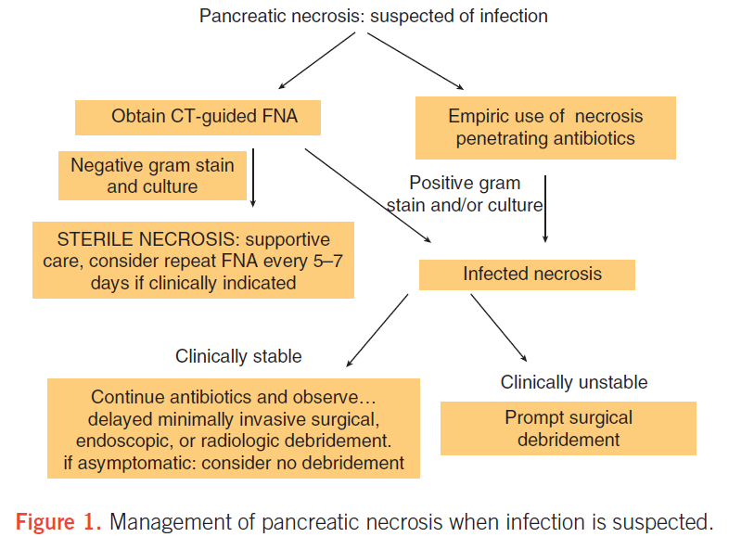

Slide 38
  In mild AP, oral feedings can be started immediately if there is no nausea and vomiting, and the abdominal pain has resolved
  In mild AP, initiation of feeding with a low-fat solid diet appears as safe as a clear liquid diet

Slide 39
In severe AP, enteral nutrition is recommended to prevent infectious complications.
Parenteral nutrition should be avoided, unless the enteral route is not available, not tolerated, or not meeting caloric requirements
Nasogastric delivery and nasojejunal delivery of enteral feeding appear comparable in efficacy and safety

Slide 40
  THE ROLE OF SURGERY IN AP

Slide 41
  In patients with mild AP, found to have gallstones in the gallbladder, a cholecystectomy should be performed before discharge to prevent a recurrence of AP
  In a patient with necrotizing biliary AP, in order to prevent infection, cholecystectomy is to be deferred until active inflammation subsides and fluid collections resolve or stabilize

Slide 42
  Asymptomatic pseudo cysts and pancreatic and/or extra- pancreatic necrosis do not warrant intervention regardless of size, location, and/or extension
  In stable patients with infected necrosis, surgical, radiologic, and/or endoscopic drainage should be delayed preferably for more than 4 weeks to allow the development of a fibrous wall around the necrosis (walled-off necrosis)

Slide 43
  In symptomatic patients with infected necrosis, minimally invasive methods of necrosectomy are preferred to open necrosectomy
  Minimally invasive approaches to pancreatic necrosectomy: laproscopic surgery, percutaneous, radiologic catheter drainage or debridement, video-assisted or small incision-based left retroperitoneal debridement, and endoscopy

Slide 44
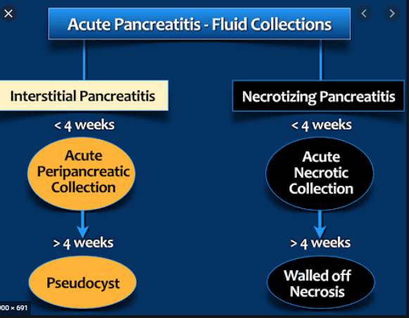

Slide 45
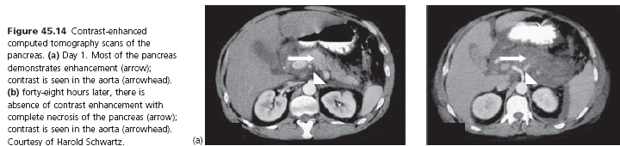

Slide 46

  Questions

Slide 47
1/6) Which of the following can be used in the treatment of acute pancreatitis? Select all that apply.
A. Parenteral fluids
B. Corticosteroids
C. Nasogastric suctioning
D. H2 receptor antagonists
E. Narcotics or Demerol
F. Surgical resection of the pancreas

Slide 48
2/6) A 54-year-old patient admitted with diabetes mellitus, malnutrition, osteomyelitis, and alcohol abuse has a serum amylase level of 280 U/L and a serum lipase level of 310 U/L. To what diagnosis does the nurse attribute these findings?
A. Malnutrition
B. Osteomyelitis
C. Alcohol abuse
D. Diabetes mellitus

Slide 49
3/6) A 36 year old man presents with sudden onset severe epigastric pain following an alcohol binge. Pain is referred to his back. Pain is alleviated when he sits and leans forward. There is also nausea and vomiting. Physical examination revealed upper abdominal tenderness, bluish discoloration around the umbilicus, bowel sounds are absent. What is the most likely diagnosis
A. Acute pancreatitis
B. Acute cholecystitis
C. Acute diverticulitis
D. Acute appendicitis

Slide 50
4/6) In the previous patient All of the following tests should be ordered next except
A. CBC
B. Amylase and lipase
C. Ct scan
D. Metabolic panel
E. ABG

Slide 51
5/6) Which of the radiologic imaging techniques is the most sensitive in diagnosis of acute pancreatitis and pancreatic pseudo cyst?
A. Ultrasonography
B. Ct scan
C. MRCP
D. Plain radiography

Slide 52
6/6) The treatment of this condition must include all of the following except:
A. NPO for 24H
B. Aggressive hydration
C. H2blocker
D. Pain control
E. Calcium supplement

Slide 53

Thank you for your attentions

