Slide 1
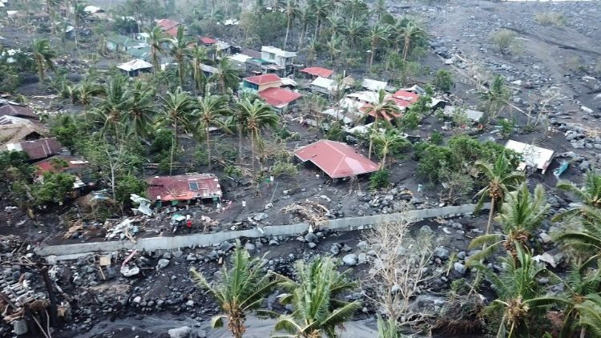
Epilepsy and Seizure
Dr. sma Akbarian

Slide 2
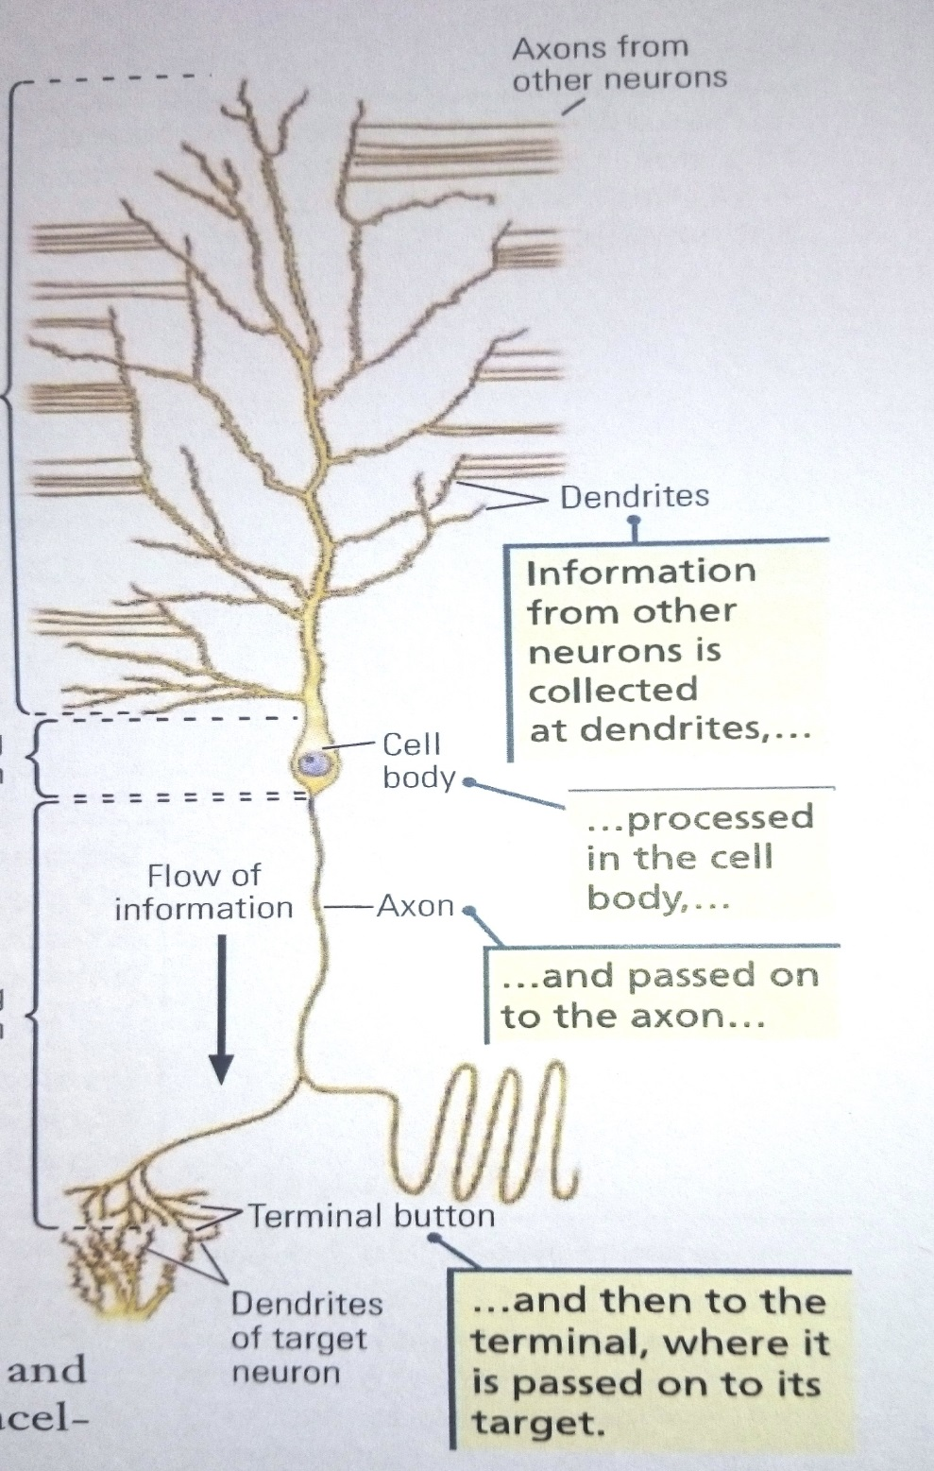

Slide 3
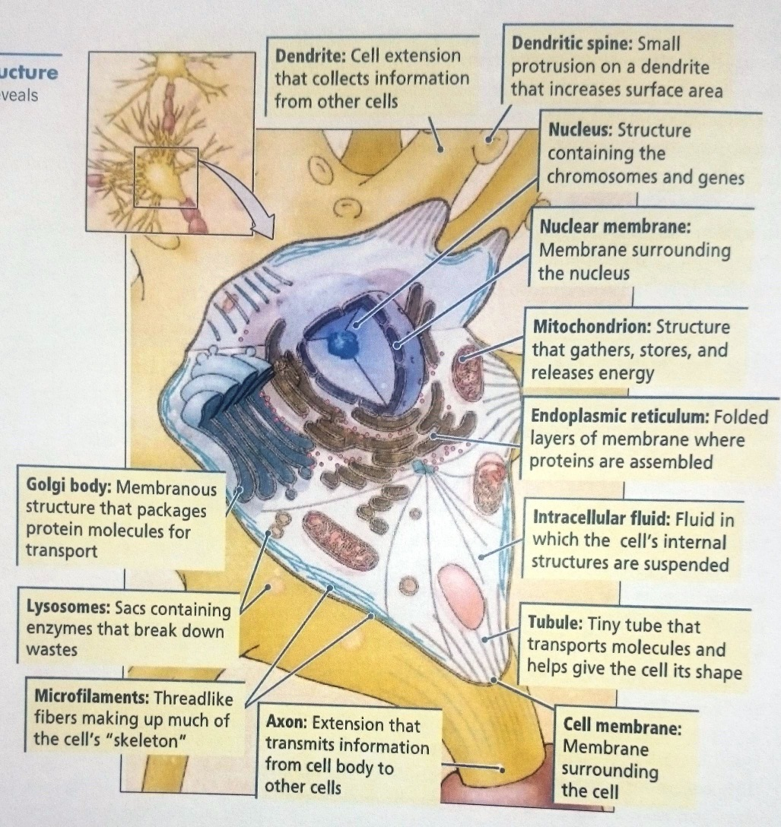

Slide 4
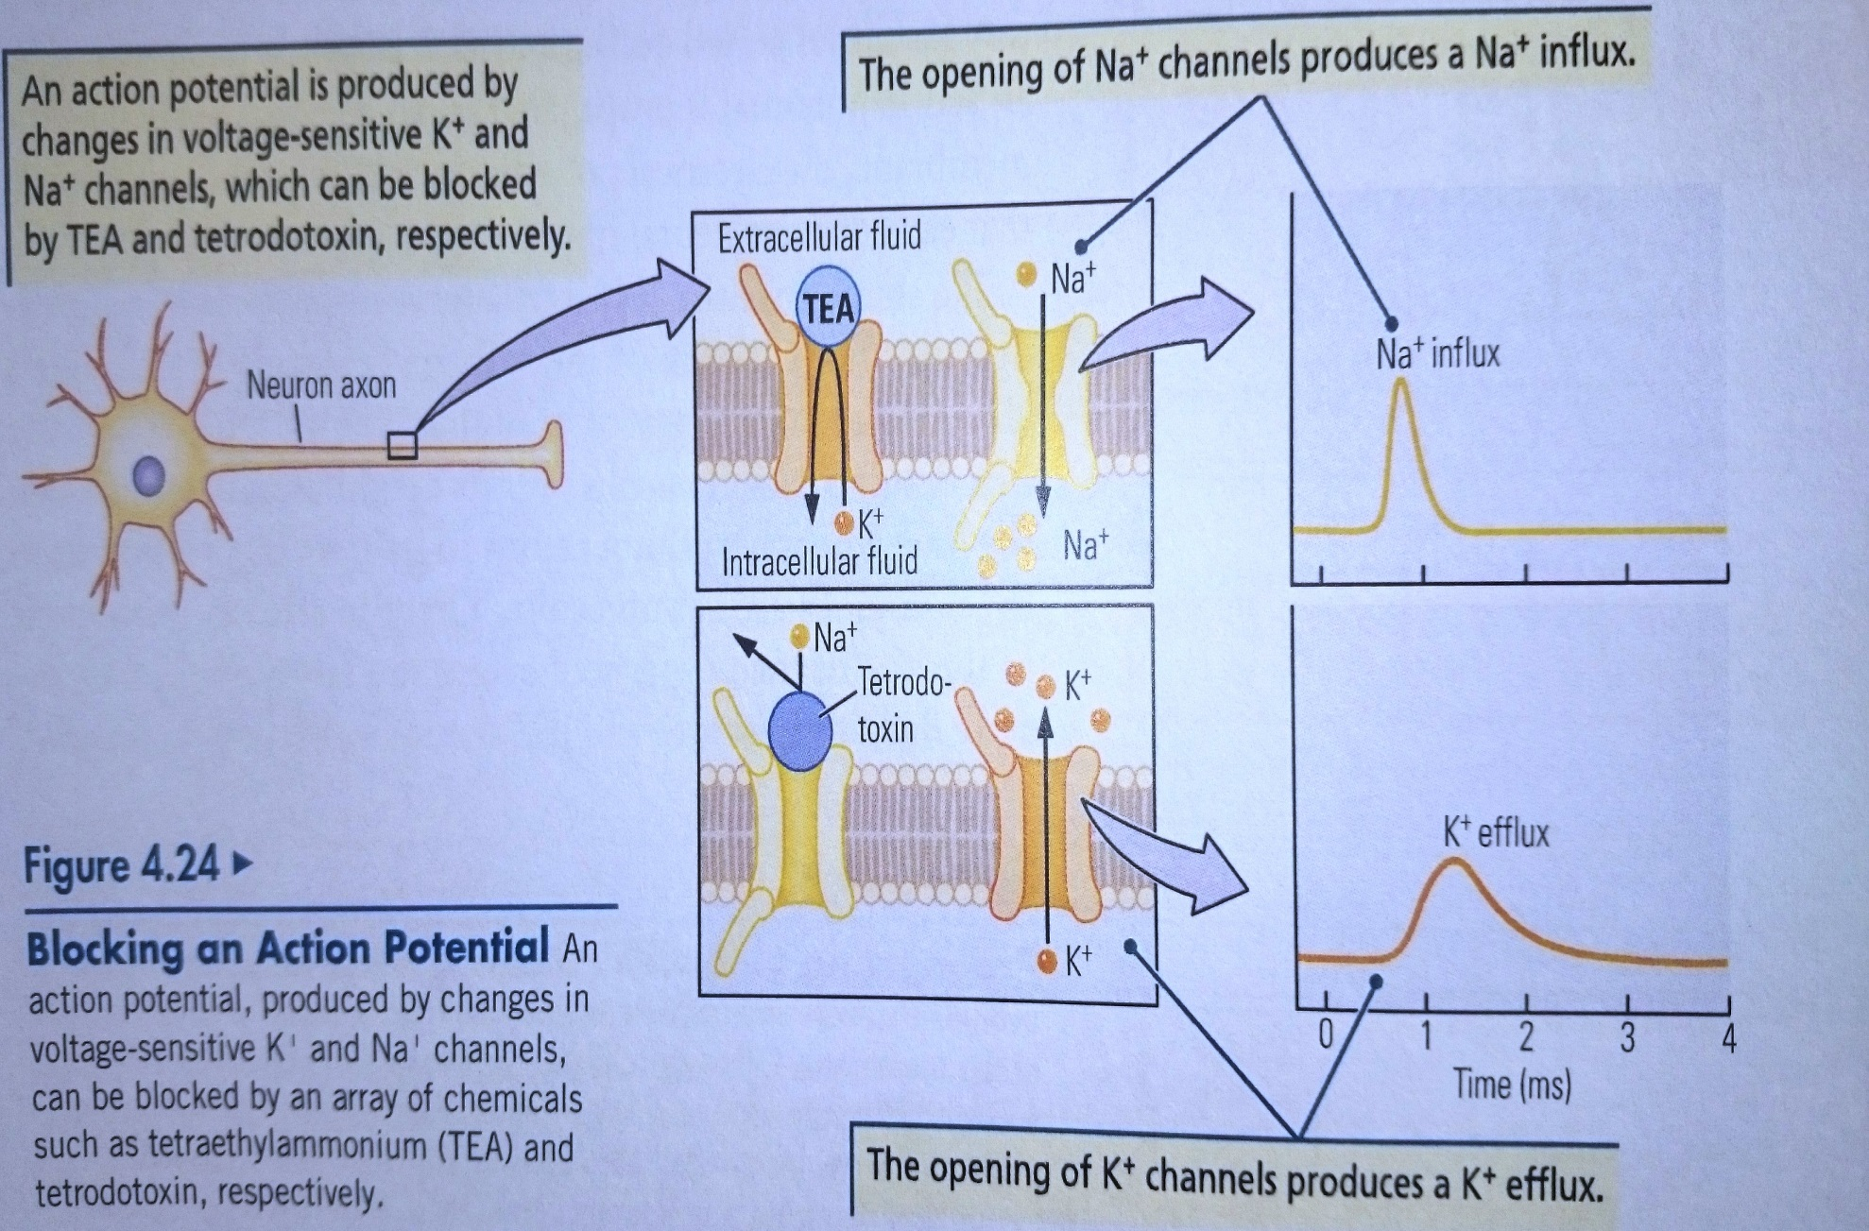

Slide 5
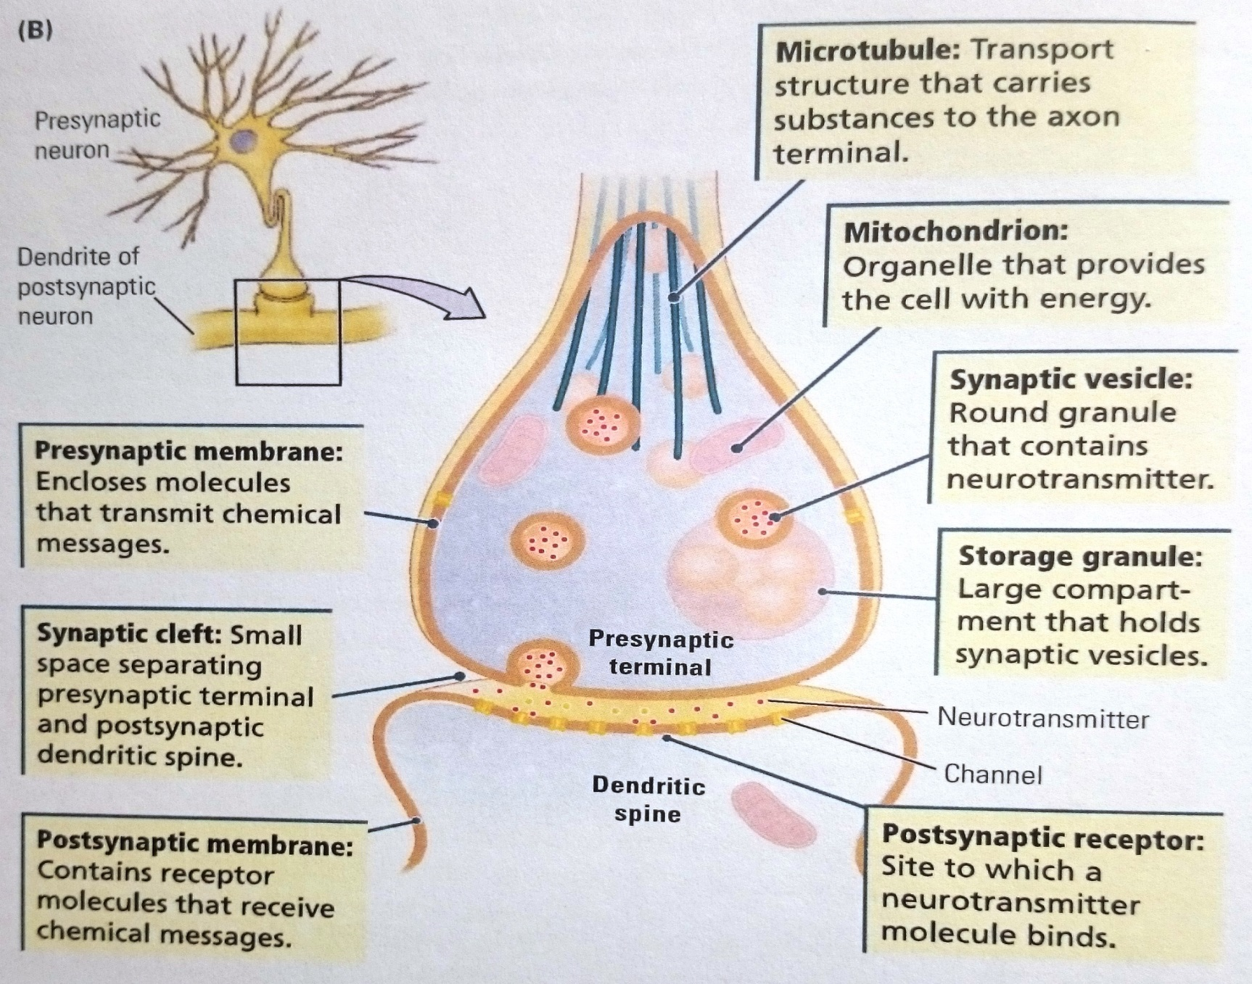

Slide 6
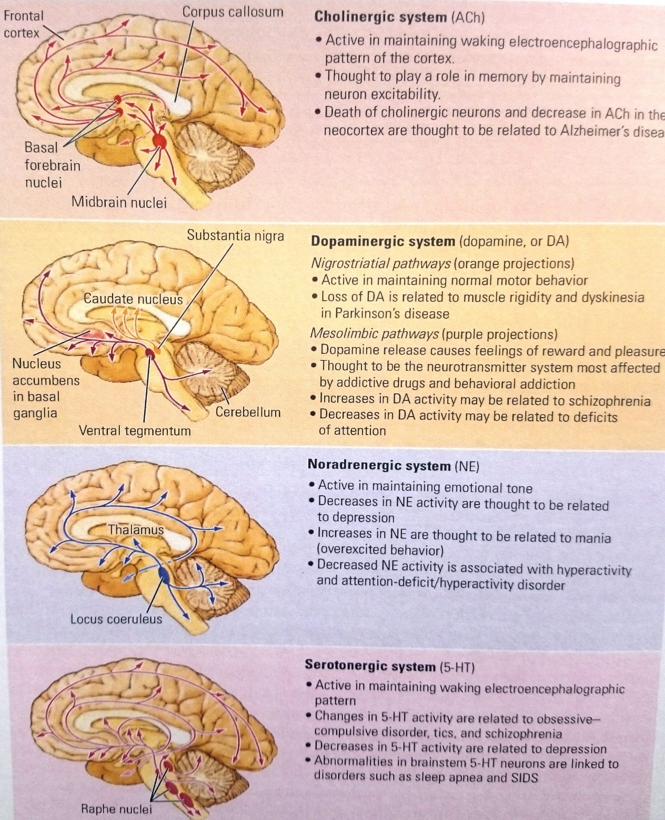

Slide 7
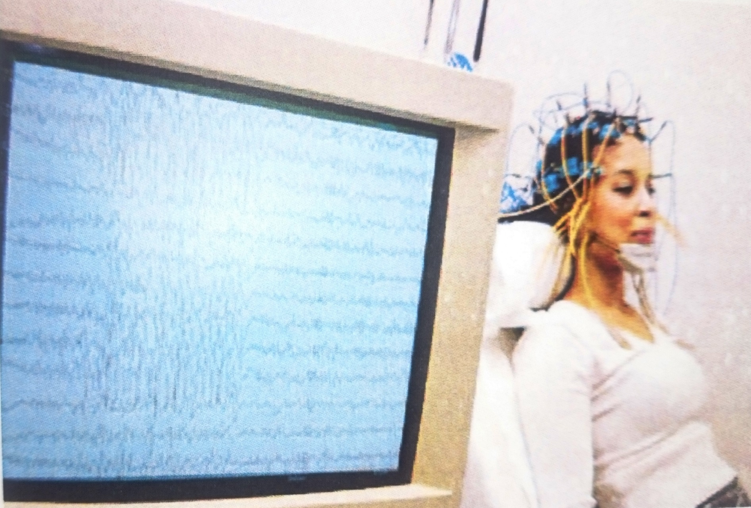

Slide 8
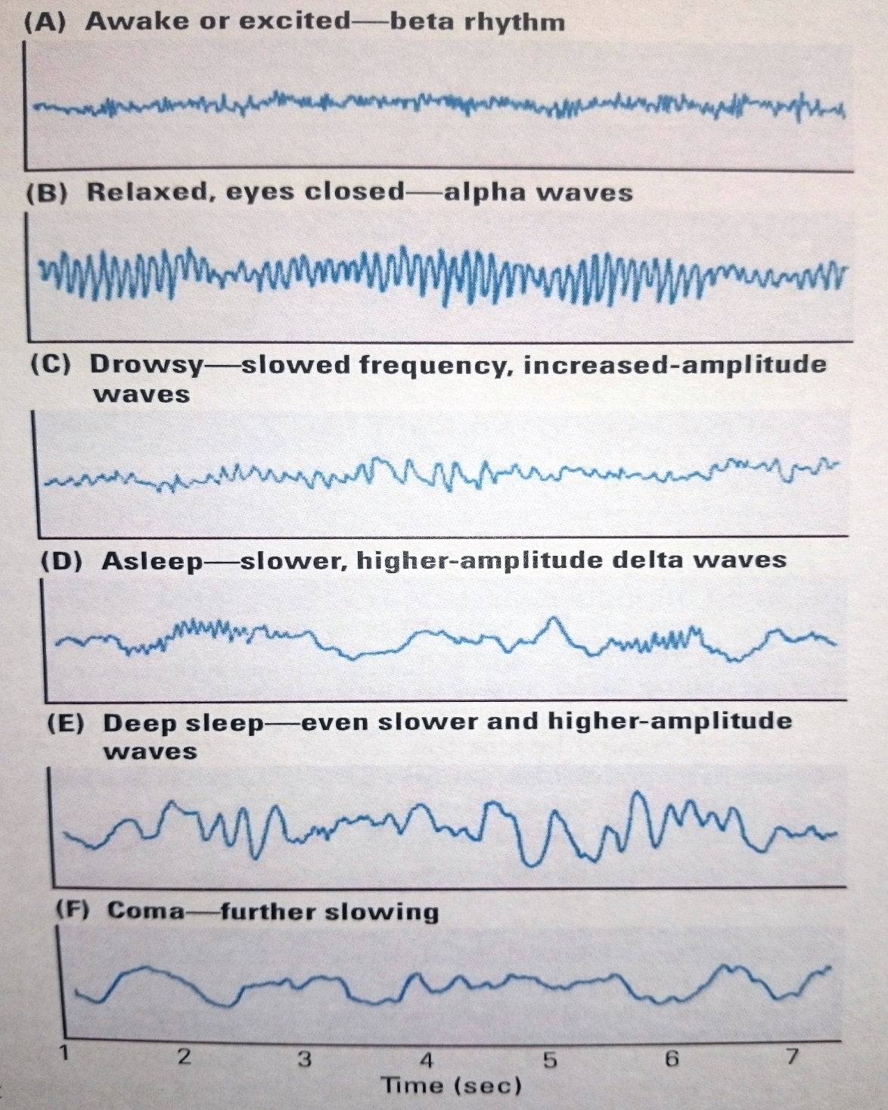

Slide 9
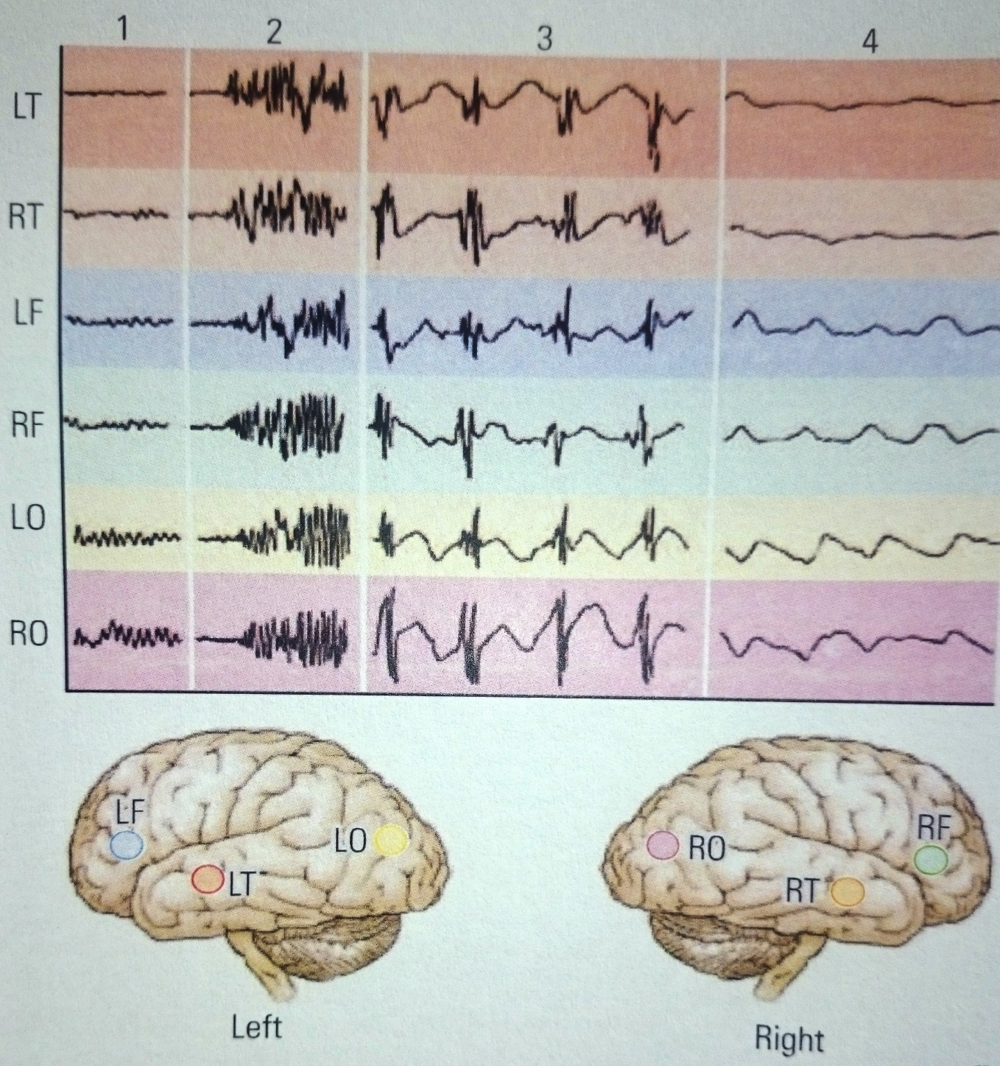

Slide 10
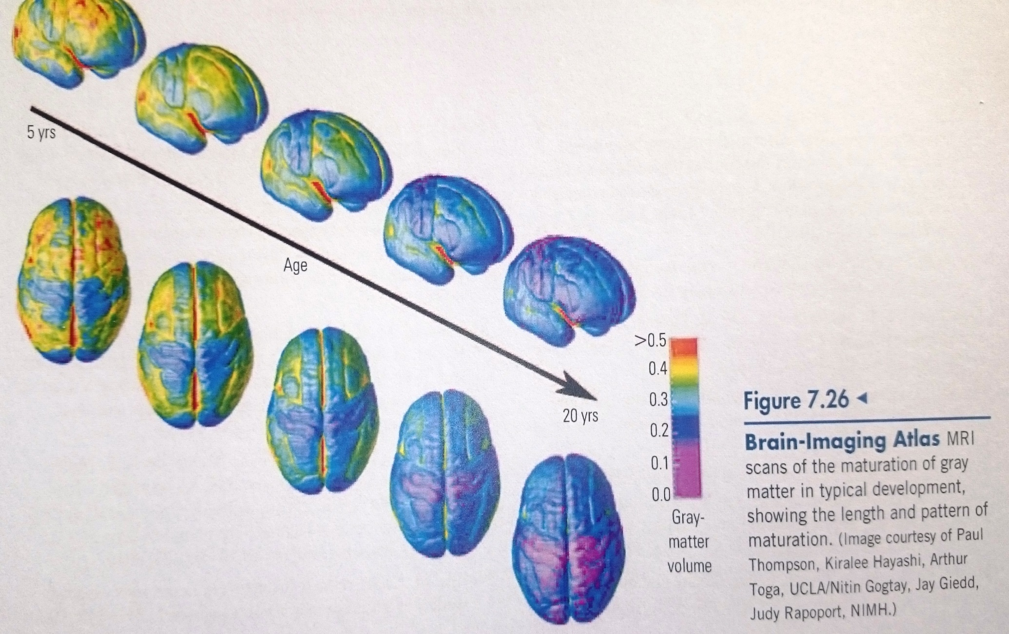

Slide 11
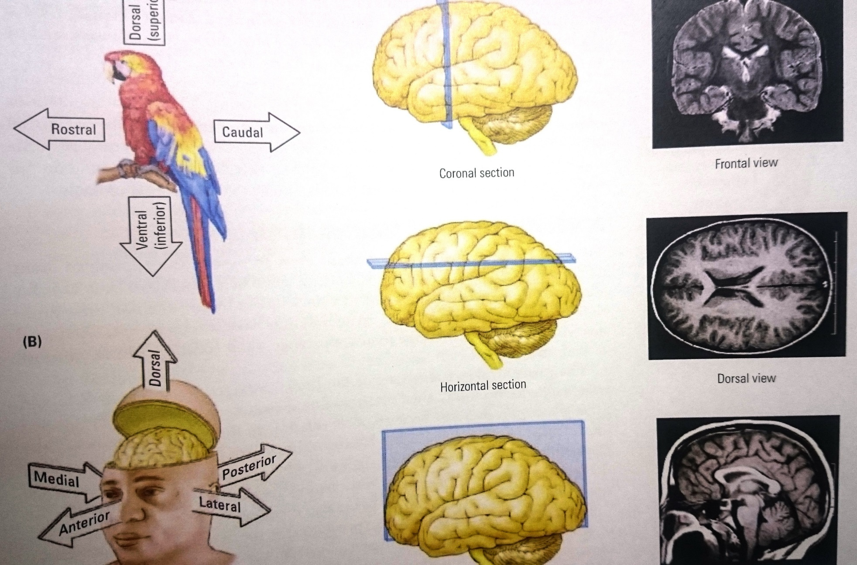

Slide 12
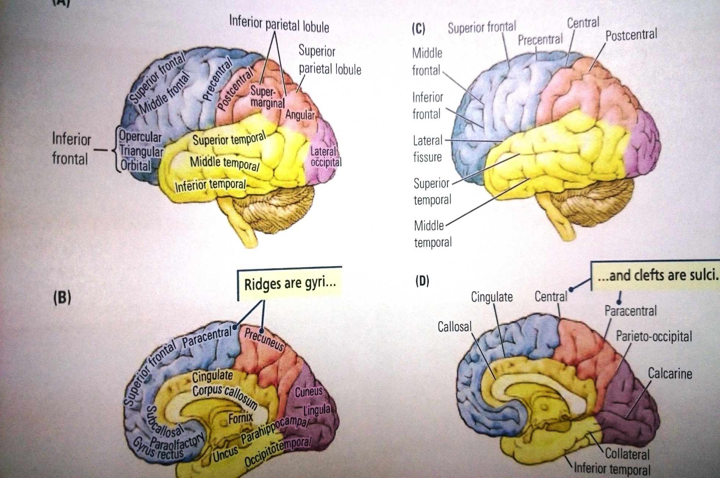

Slide 13
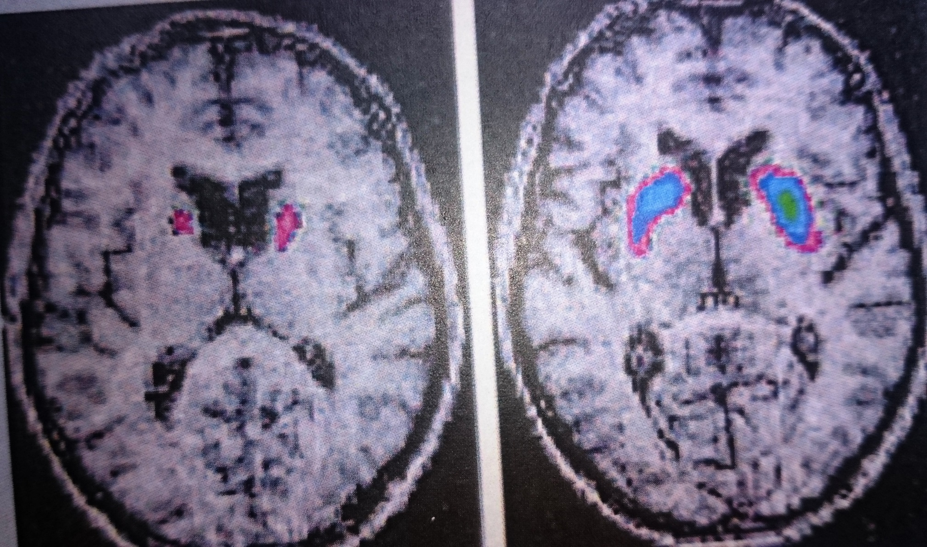

Slide 14
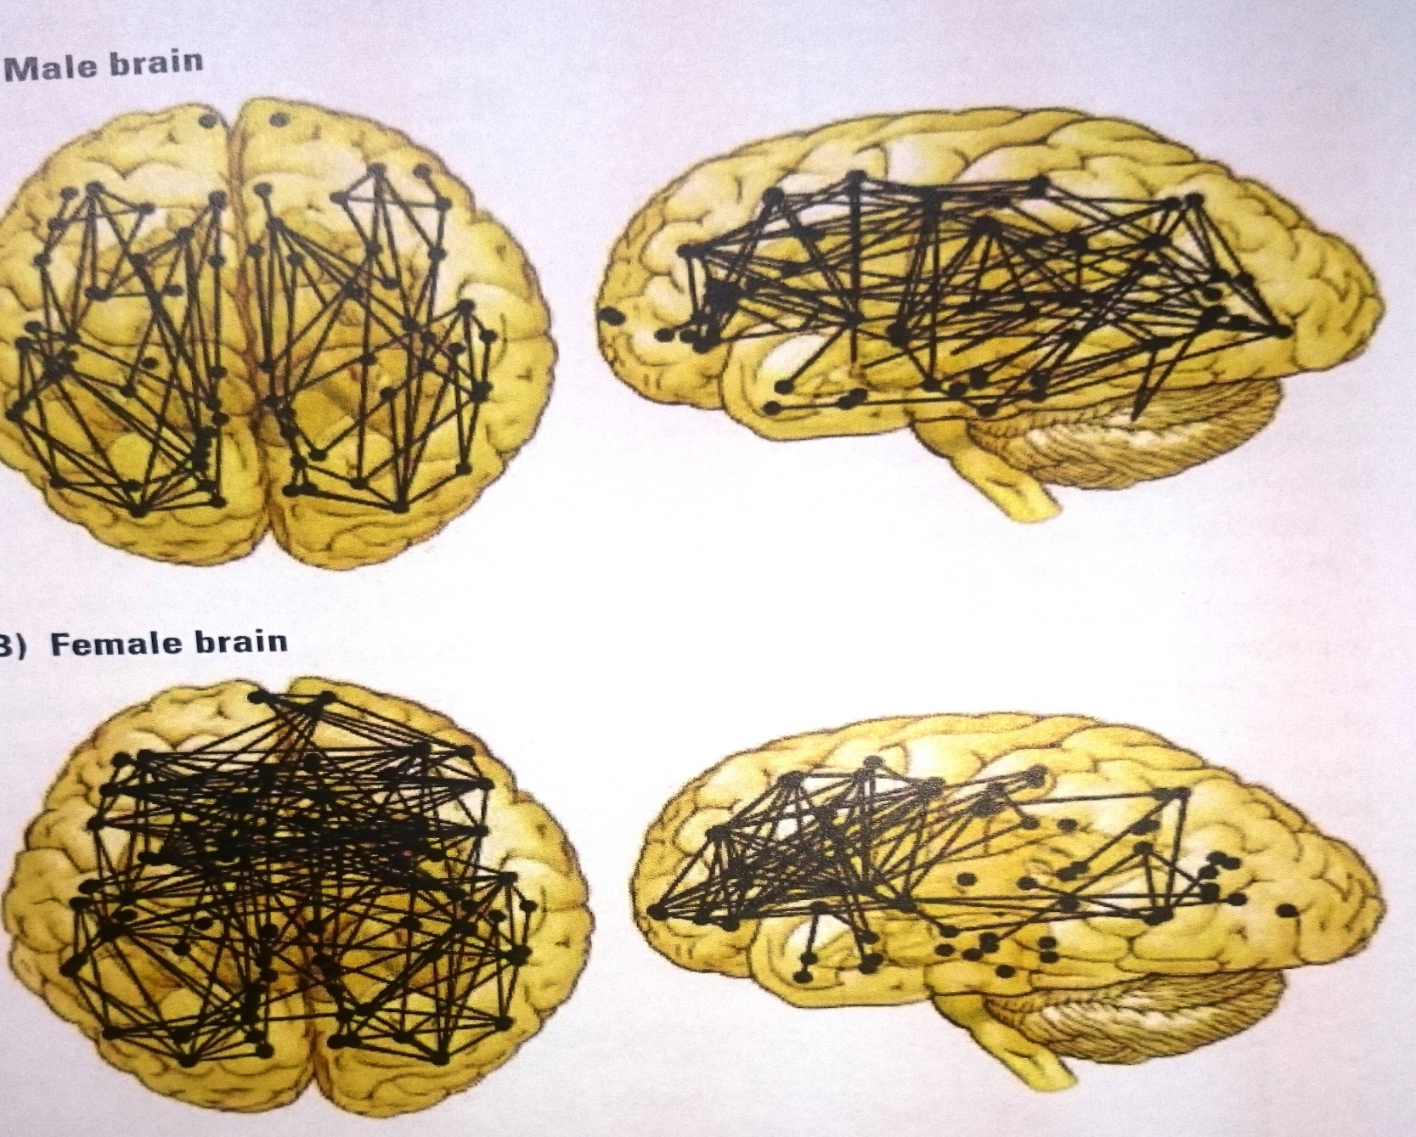

Slide 15
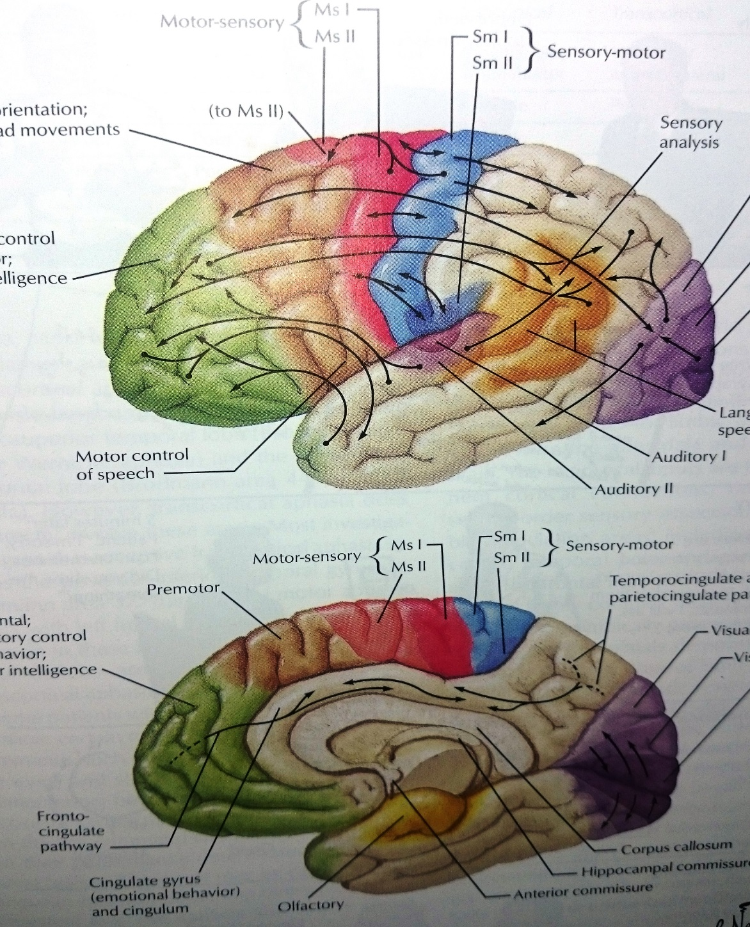

Slide 16
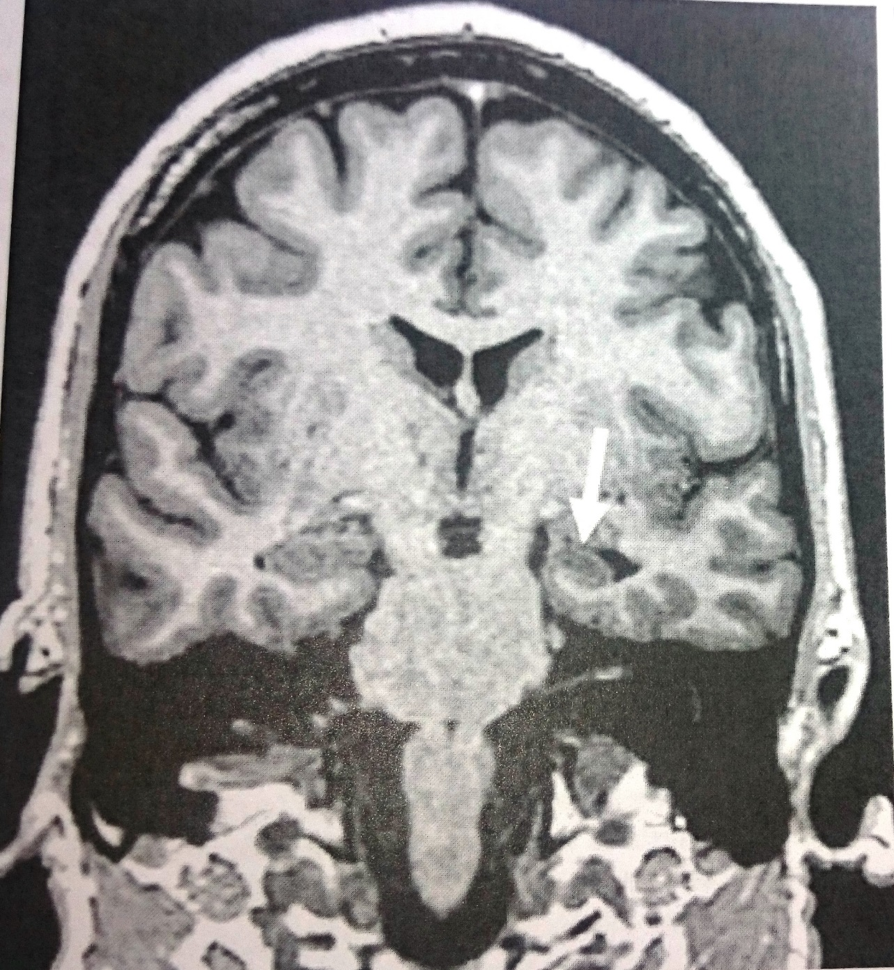

Slide 17
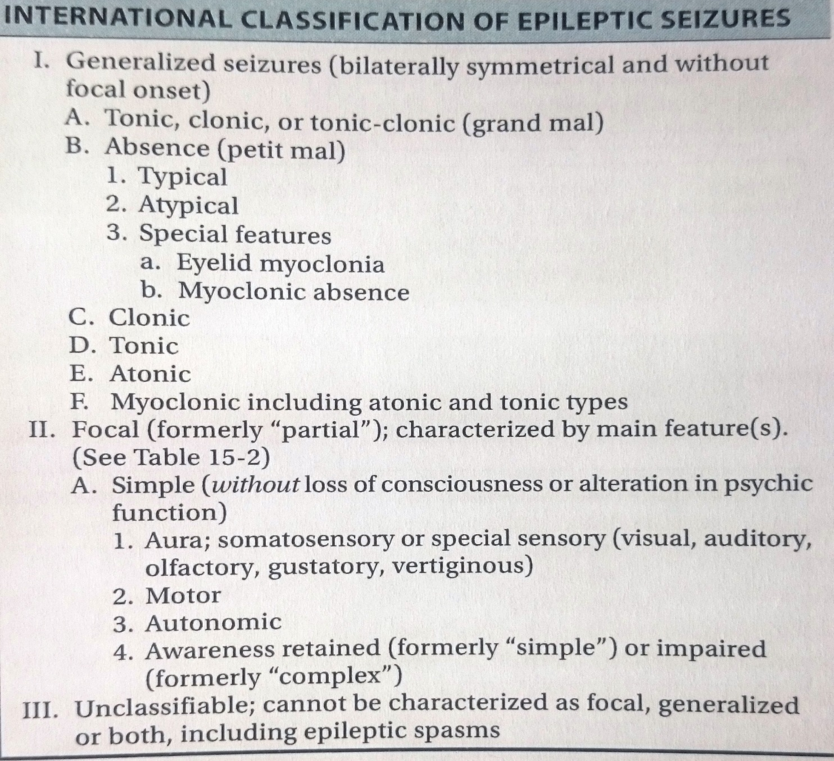

Slide 18
Epilepsy challenges in :
1. Women and Seizure:
genetic causes of seizure
seizure and catamentia
seizure and pregnancy
seizure in menopause
seizure and breast feeding
seizure and hormone contradictions

Slide 19
2. Special types of seizure:
Sexual seizure
Abdominal seizure
Vertiginous seizure
Cerebellar seizure
Tussive- coughing- sneezing seizure
Versive and adversive seizure
Staring seizure
Masticatory, salivation seizure
Head and eye turning seizure
Somatosensory seizure
Uniform images and light patterns
Auditory, olfactory, gustatory, visceral
Hallucination, illusion, discognition (déjà vu, jamaes vu)
Affective ?
Automatism ?
Night terror ?

Slide 20
Is it epilepsy or….?
Syncope vasovagal (SSS-Stocks’ Adams)
Startle
Hysteric (psychogenic)
Hystero-epilepsy
Movement disorder
Myoclonic and Myochymia
Narcolepsy
Cataplexy
Drugs (Hallucinogen,….)
Breath holding
Paroxysmal vertigo

Slide 21
Epilepsy
events with abnormal electrical changes (disruption) in the brain
Non-epileptic seizure
dissociative seizure/organic/psychogenic are look the same epileptic picture but not electrical disruption

Slide 22
* Potential seizure trigger
* Symptoms preceding the event
* What happen during the event
* Independent history from a witness (1,2,3,,,)
* Starting with aura? Objective manifestation
* Urinary incontinency or tongue biting ??
* Post-ictal confusion?
* History of febrile seizure
* Home video segment (familial captured)
* Past medical history; (febrile seizure &CNS infection, head trauma??,,)
* Familial history (afebrile seizure)
* Drug history
* Review of system
* Physical examination
* Neurological examination
* EEG/EEG monitoring (LTM)
* Neuro-imaging (CT scan or and MRI)

Slide 23
Symptoms | Epileptic attacks | Non Epileptic attacks
Prodromal | Rare | Emotional &stress
Onset | Usually short | Several minutes
Aura | Various, Stereotype | Fear, Panic, Alter mental state
Movement | Tonic, Clonic | Voluntary often Unintelligible
Injury | Tongue Biting | Lip?
Consciousness | May Complete loss | Variable
Response to stimuli | Non react | May Proper react
Incontinency | Common | Sometimes
Duration | Few minutes | Prolonged
Recovery | Long | Short

Slide 24
*Syncope
1. LOC for second to minutes
2. May have convulsion specially due to tilt table testing(63%)
3. EEG abnormalities (delta suppression)
4. Prodromal sign
*Hypoglycemia ;
1. Prodromal sign;(hanger/weakness/tremor/malaise?)
2. History of DM/hyperinsulinemia
3. Oral anti diabetic agents
4. Fasting
*Panic attacks; differentiated mesial temporal lobe epilepsy
1. Autonomic &cardiovascular symptoms
2. Palpitation, diaphoresis, shaking, tremor, shortness of
breath
3. Chest discomfort, and sense of impending death

Slide 25
*Drop attacks: Seizure, any cause of loss of consciousness
(Epilepsy, Syncope, Cardiovascular disorder, SSS, Asystol)
*Idiopathic drop attacks
*Vertebrobasilar ischemia(SSS)
*Tonic spasm of multiple sclerosis
*Psychogenic hallucination & delusion
*Non convulsive status epilepticus

Slide 26
Conditions specify to young children:
1. Non-epileptic stairng spells similar to Seizure absence
2. Tics similar to simple partial seizure
3. Shuddering attacks similar to benign proximal space
(sudden flexion of the neck and trunk and adduction of arm)
4. Breath holding (6-60 month) EEG similar to syncope
5. Gastroesophageal reflux→ Laryngospasm
(Opistotonus - Eye deviation- Limb posturing)
6. Benign myoclonus in children
7. Mannerism
8. Spasmus Nutants: Head nodding, Head tilt, Nystagmus

Slide 27
Treatment
Generic name | Mechanism of action | Principle indication | Major limitation
Valporic Acid | Na Channel & GABA | Focal & generalized abs | Hepatic toxicity, teratogenicity
Phenytoin | Sodium channel ↓ | Focal & generalized | Hepatic enzyme inducer
Carbamazepin | Sodium channel ↓ | Focal & generalized | Hepatic enzyme inducer
Oxcarbazeoin | Sodium channel ↓ | Focal seizure | Hepatic enzyme inducer
Eslicarbazepin | Sodium channel ↓ | Focal seizure | Hepatic enzyme inducer
Phenobarbital | GABA potentiation | Focal & generalized | Hepatic enzyme inducer
Lamotrigine | Sodium channel ↓ | Focal & generalized | Hepatic enzyme inducer
Levetiracetam | SV2A modulation | Focal & generalized | Mood disturbance
Topiramat | GABA potentiation Sodium channel ↓ | Focal & generalized | Nephrolythiasis
Lacosamide | Sodium channel ↓ | Focal & generalized | -

Slide 28
Treatment
Generic name | Mechanism of action | Principle indication | Major limitation
Zonizamide | Sodium channel ↓ | Focal & generalized | Nephrolythiasis
Ethosuximide | Calcium channel ↓ | Absence | Insomnia
Clobazam | GABA potentiation | Focal & generalized | Sedation
Gabapentin | Calcium channel ↓ | Focal & generalized | -
Pregabalin | Calcium channel ↓ | Focal & generalized | -
Perampanek | Glutamate ↓ | Focal & generalized | -
Vigabatrin | GABA potentiation | Infantile spasm, Focal & generalized | Retinol toxicity
Clonazepam | GABA potentiation | Adjunctive use only | Sedation
Fosphenytoin | Sodium channel ↓ | Focal & generalized | Skin hypersensitivity
Propofol | Multiple | Adjunctive therapy | Sedation

Slide 29
Treatment of status epilepticus in adults:
Initial assessment: A, B, C, D
Immidiate suppression of convulsion:
Lorazepam or Diazepam 2-4 mg/min IV
total doze 10-15 mg
Initiation or reloading with anticonvulsants:
Phenytoin 15-20 mg/kg IV in normal saline
or fosphenytoin 50-75mg/min
If persistent:
Midazolam 0.2 mg/kg/hr
If persisted after several hours:
Phenobarbital 10mg/min, 20mg/kg with
Carbamazepin or Levetiracetam by NG tube
Inhalational anesthetics (Isoflurane)

Slide 30
چالش های پزشکی قانونی و بیماران صرعی
صرع و ازدواج و طلاق
صرع و بزهکاری
صرع و نابهنجاری های جنسی
صرع و دارو درمانی
صرع و اختلالات روان پریشی
صرع و اعمال جراحی آن در بروز اختلالات روان پریشی
صرع و تحمل کیفری
صرع و اعتیاد و اثرات آن روی یکدیگر

Slide 31
