Slide 1
HEPATOCELLULAR CARCINOMA
Dr miroliaee
gastroentrologist

Slide 2
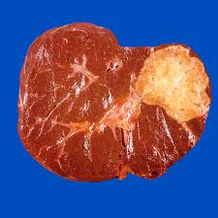

Slide 3
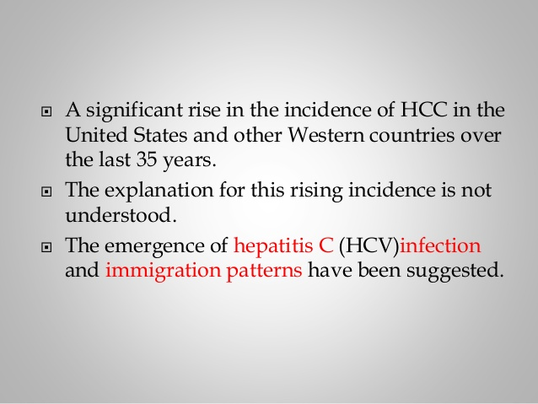

Slide 4
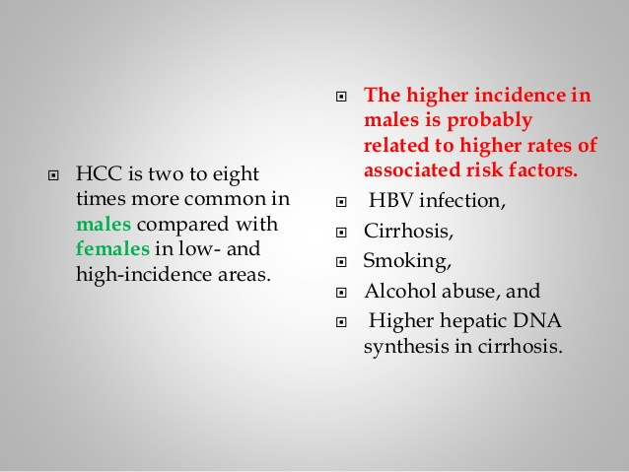

Slide 5
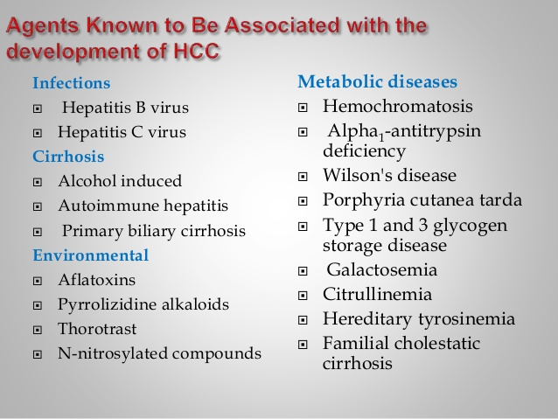

Slide 6
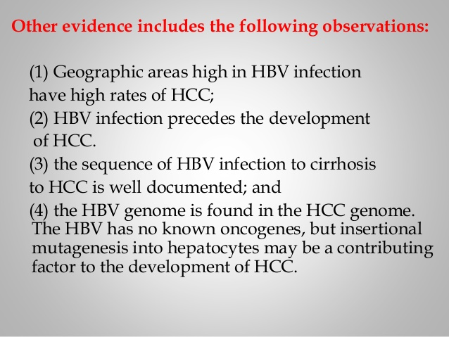

Slide 7
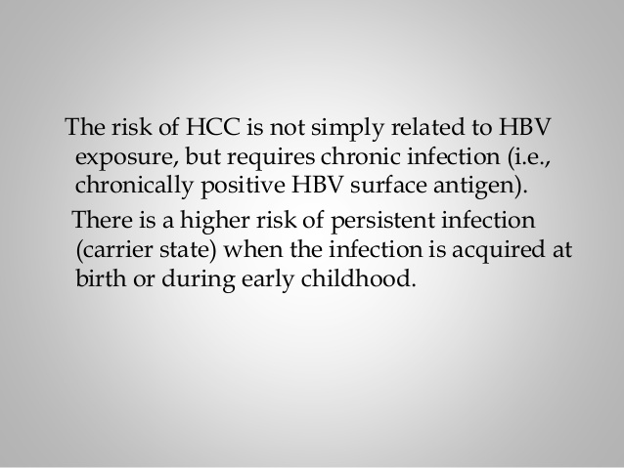

Slide 8
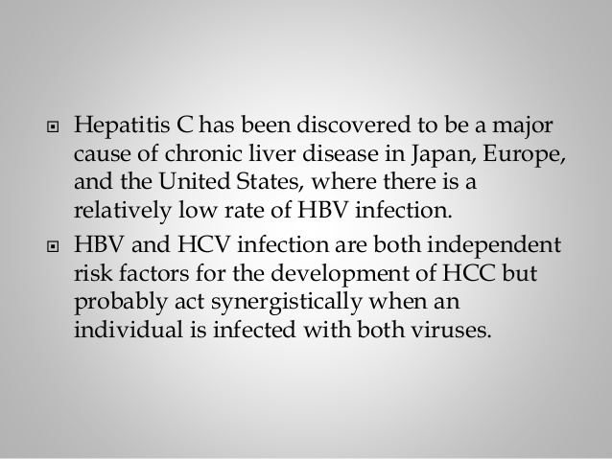

Slide 9
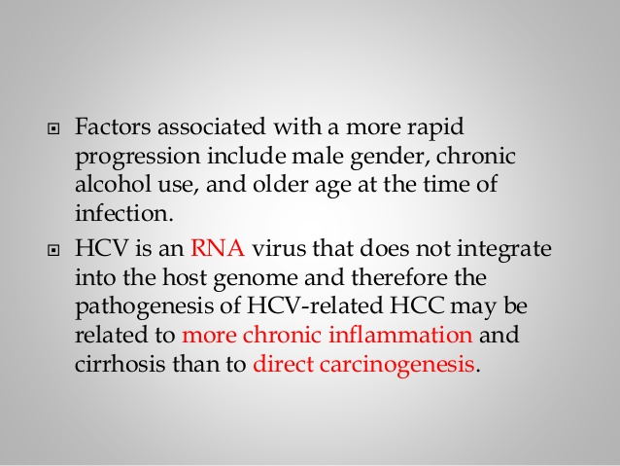

Slide 10
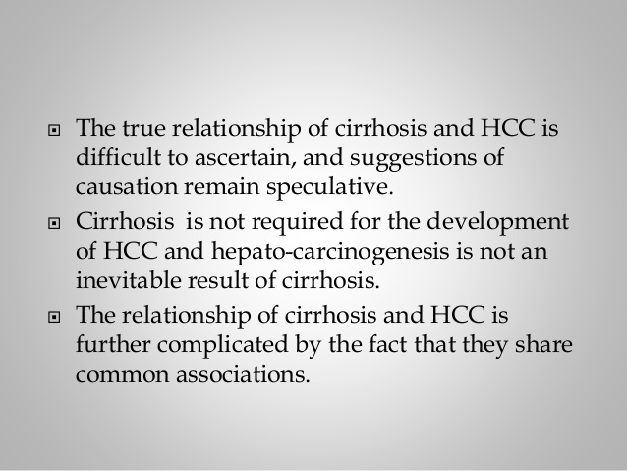

Slide 11
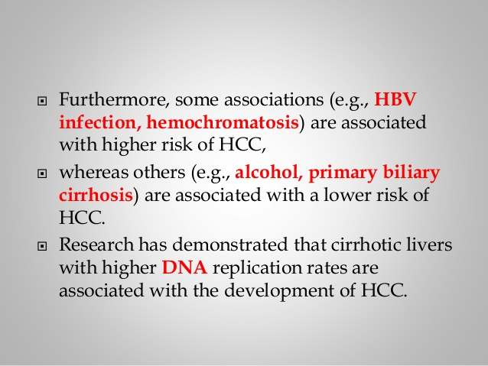

Slide 12
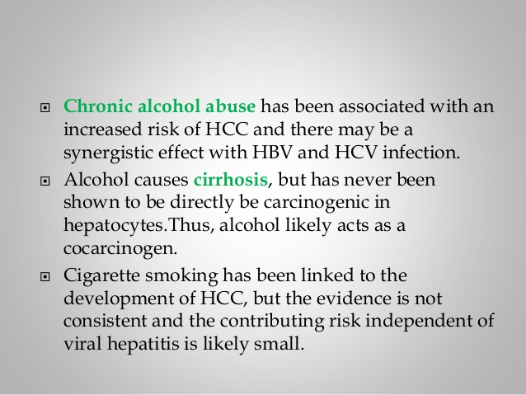

Slide 13
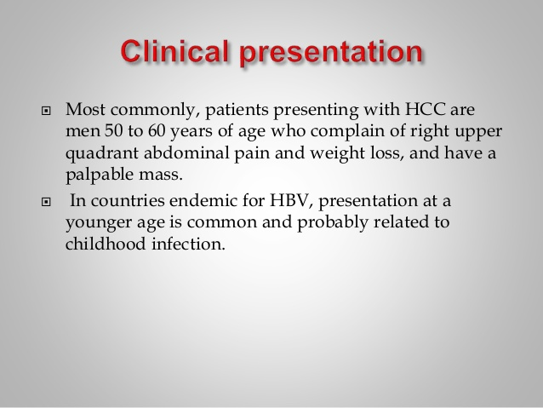

Slide 14
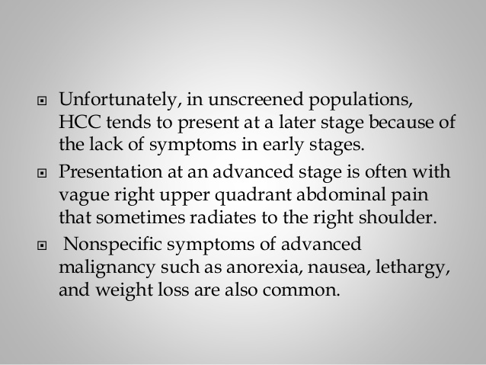

Slide 15
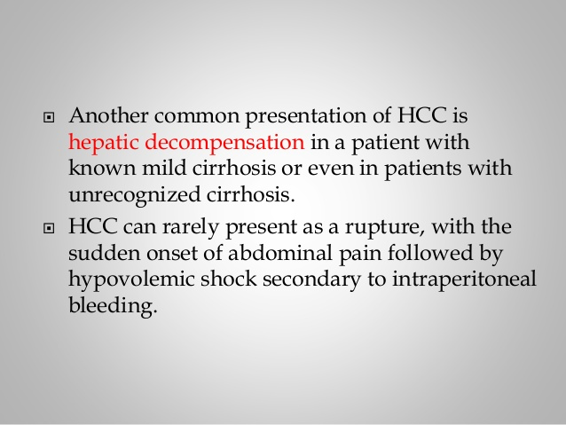

Slide 16
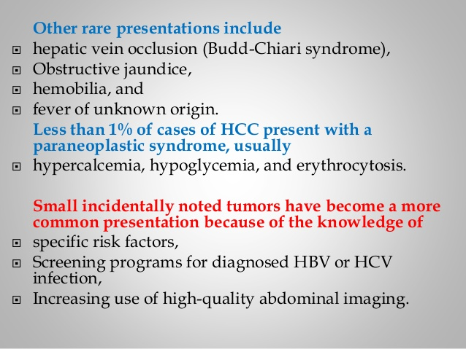

Slide 17
Physical Signs
Hepatomegaly in 50–90% of the patients Abdominal bruits 6–25%, and ascites in 30–60%
Splenomegaly is mainly due to portal hypertension
Weight loss and muscle wasting
Fever is found in 10–50%
jaundice, dilated abdominal veins, palmar erythema, gynecomastia, testicular atrophy, and peripheral edema
Budd-Chiari syndrome due to HCC invasion of the hepatic veins

Slide 18
Paraneoplastic Syndromes
hypoglycemia (also caused by end-stage liver failure), erythrocytosis, hypercalcemia, hypercholesterolemia, dysfibrinogenemia, carcinoid syndrome, increased thyroxin-binding globulin, changes in secondary sex characteristics (gynecomastia, testicular atrophy, and precocious puberty), and porphyria cutanea tarda
thrombocytopenia associated with their fibrosis
normal or high Platele related to elevated interleukin 6 (IL-6) levels

Slide 19
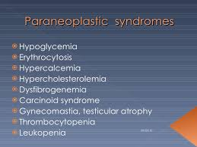

Slide 20
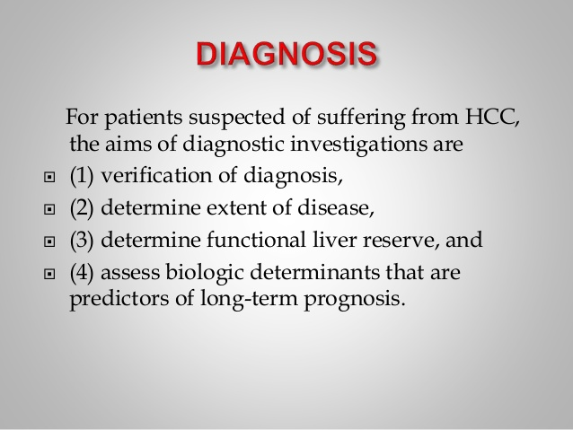

Slide 21
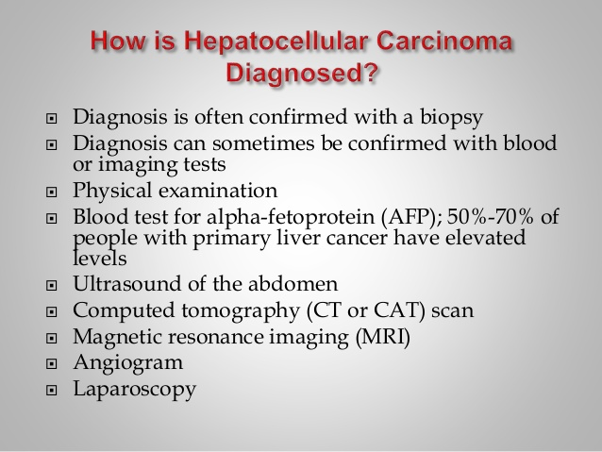

Slide 22
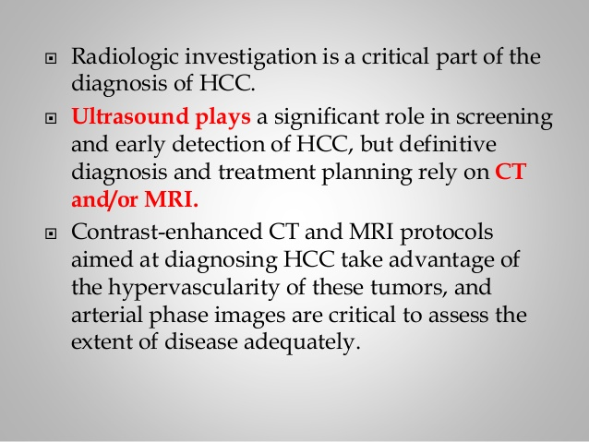

Slide 23
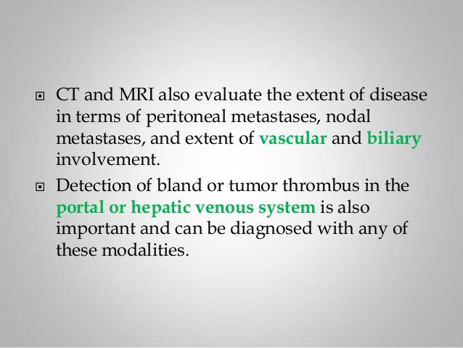

Slide 24
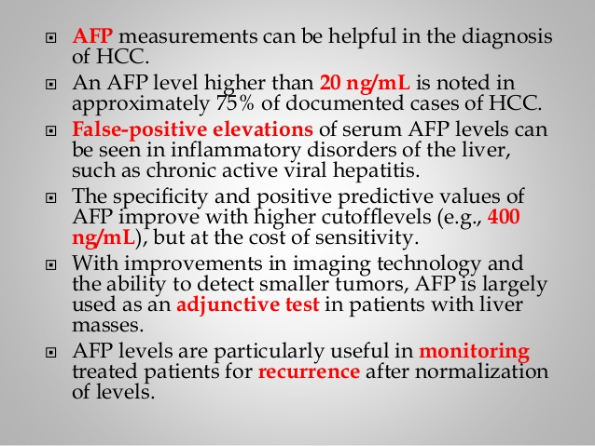

Slide 25
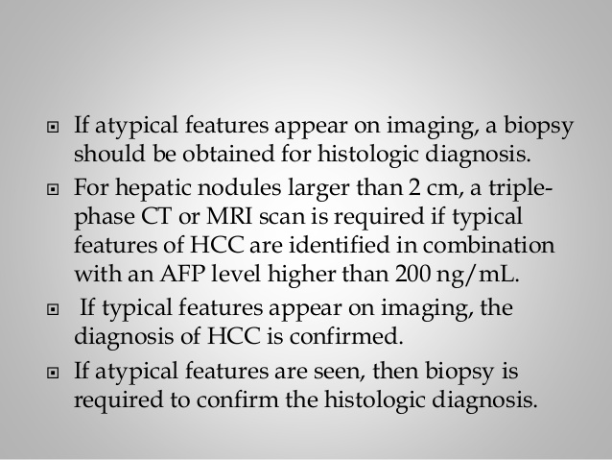

Slide 26
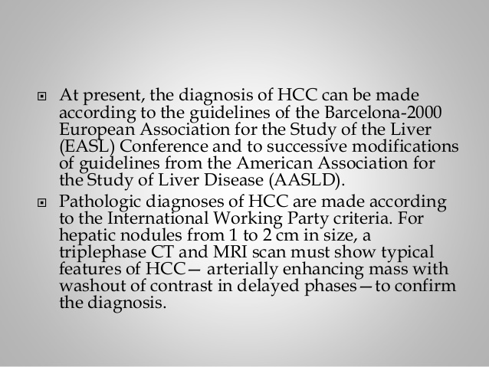

Slide 27
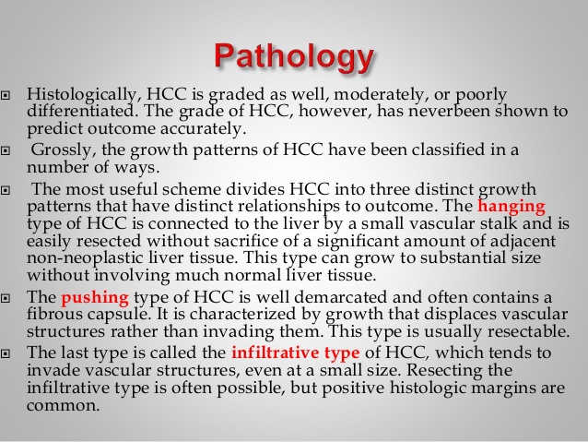

Slide 28
PATHOLOGIC DIAGNOSIS
core liver biopsy of the liver mass under ultrasound guidance
Bleeding risk is increased due to hypervascularity of tumor thrombocytopenia and decreased liverdependent clotting factors and ascites
Tracking of tumor is uncommon
Laparoscopic approaches can also be used
Is usefull prognostically and prediction of recurrent or new HCCs after primary resection(EpCAM, CD44, and CD90 )

Slide 29
SEROLOGIC ASSAYS
AFP is a tumor marker for HCC increased in one-half of U.S. patients
lens culinaris agglutinin-reactive fraction of AFP (AFPL3) more specific
des-γ- carboxy prothrombin (DCP)increased in as many as 80% of HCC and vitamin K deficiency and warfarin use
(CEA), vitamin B , AFP, ferritin, PIVKA- 2, and antimitochondrial antibody should be measured, and standard liver function tests should be performed
Hepatitis A, B, and C serology should be measured

Slide 30
New Directions
Newer biomarkers especially tissue- and serum-based genomics profiling
glypican-3, osteopontin, insulin-like growth factor I, and vascular endothelial growth factor
kits for isolating circulating tumor without the need for further tissue biopsy

Slide 31
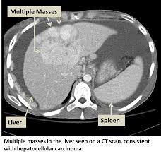

Slide 32
SCREENING HIGH-RISK POPULATIONS
detect smaller tumors that are potentially curable and enhance survival
survival advantage in HBV-positive patients for HCV
ultrasound was more sensitive than AFP elevations alone, But we request both tests at 6-month
Prevention strategies including universal vaccination against hepatitis more effective than screening efforts
CT (more sensitive, especially in overweight patients, but more costly)
high-risk patients (HBV carriers, HCV cirrhosis, family history of HCC)
γ-Glutamyl transpeptidase appears useful for detecting small tumors

Slide 33
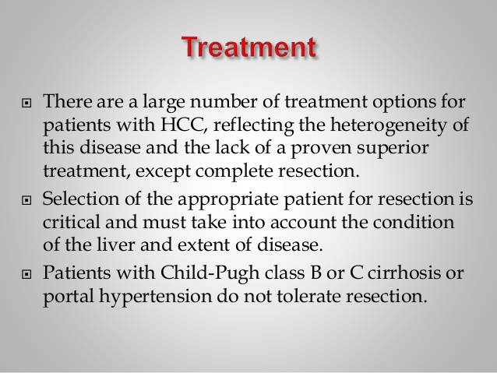

Slide 34
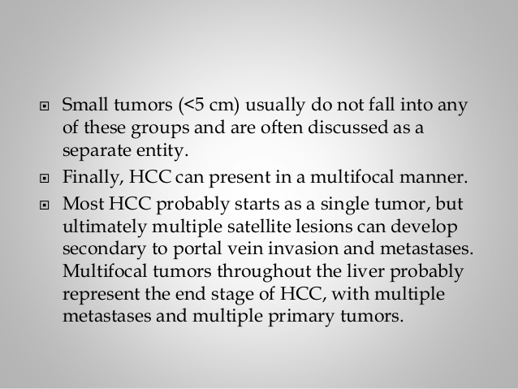

Slide 35
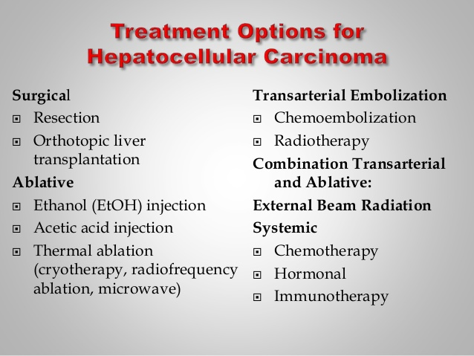

Slide 36
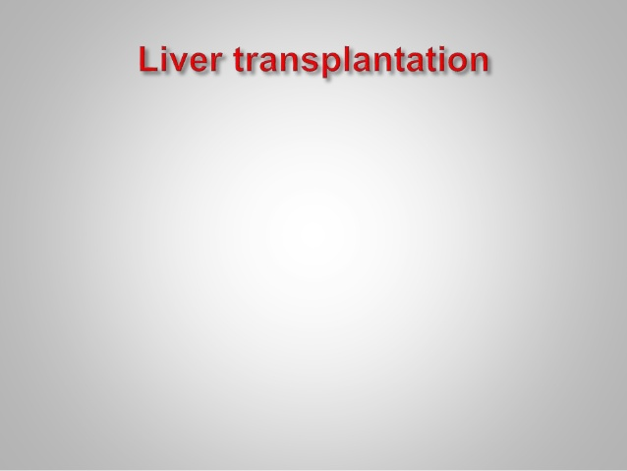

Slide 37
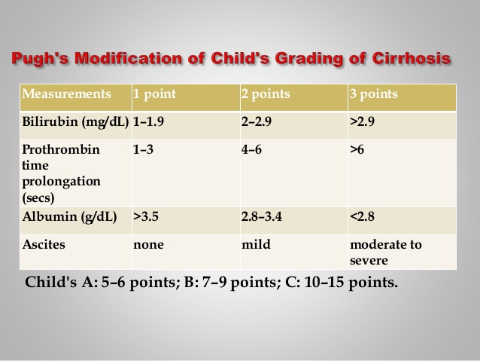

Slide 38
Liver Transplantation (OLTX)
stages I and II tumors in the setting of cirrhosis is OLTX, survival about noncancer cases
single lesion ≤5 cm or three or fewer nodules, each ≤3 cm
“bridge” to OLTX, including RFA, TACE, and hepatic arterial Y-radioembolization
AFP levels >1000 ng/mL have exceptionally high post-OLTX recurrence rates

Slide 39
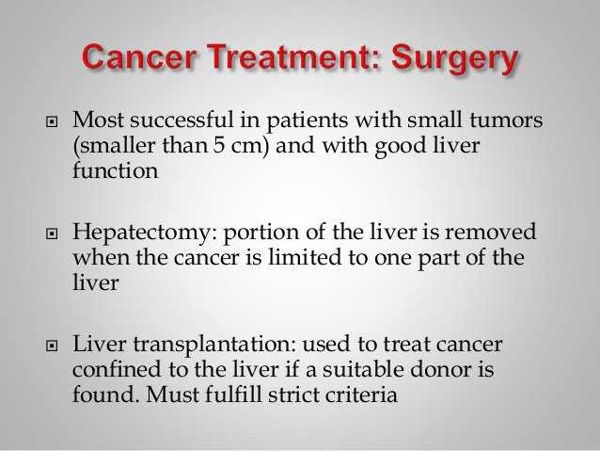

Slide 40
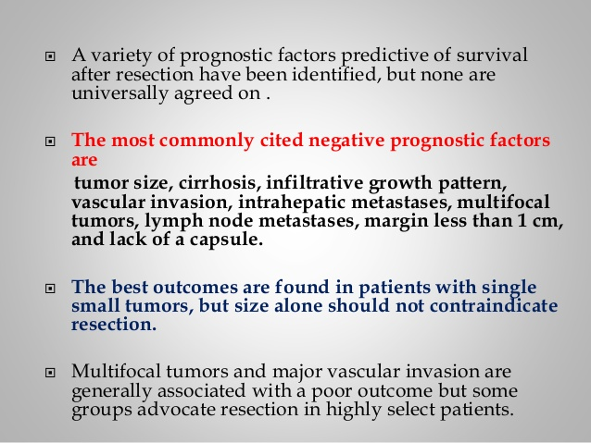

Slide 41
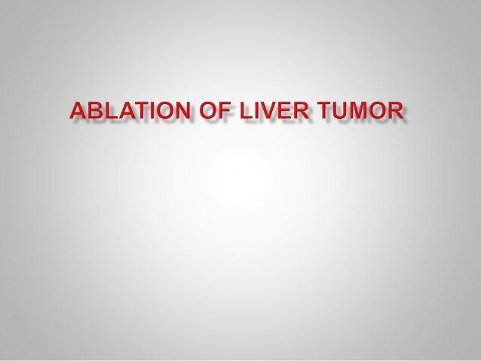

Slide 42
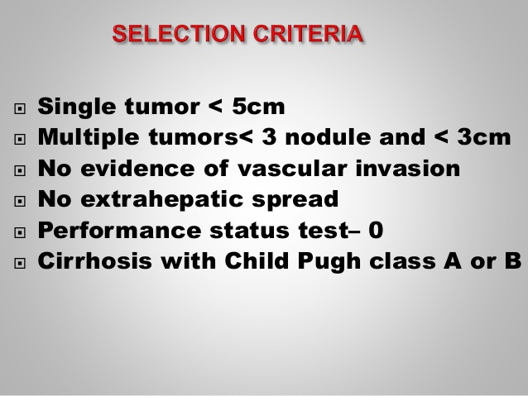

Slide 43
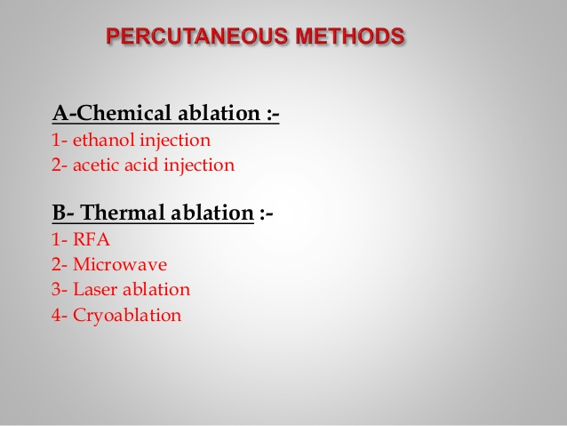

Slide 44
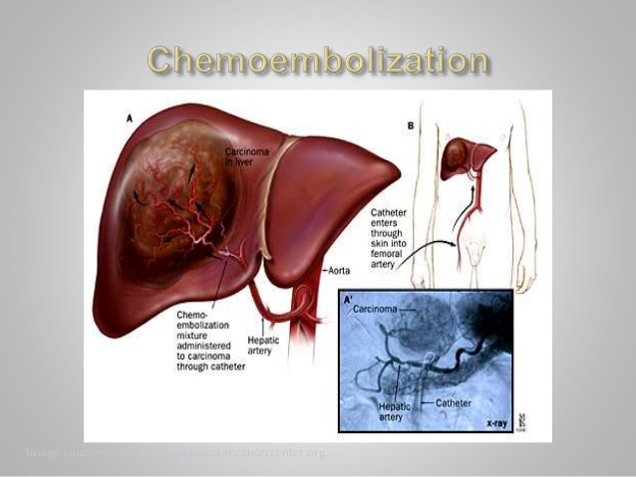

Slide 45
Adjuvant Therapy
adjuvant and neoadjuvant no clear advantage in disease-free or overall survival has been found
Antiviral therapysuccessful in decreasing postresection tumor recurrences

Slide 46
TNM STAGES III AND IV HCC
even successful resection can be followed by rapid recurrence
not considered candidates for transplantation
The prognosis is poor for stage IV tumors, and no surgical treatment is recommended

Slide 47
Systemic Chemotherapy
No single agent or combination of agents given systemically reproducibly leads to even a 25% response rate or has any e?ect on survival

Slide 48
Kinase Inhibitors
oral multikinase inhibitor, sorafenib (Nexavar)
targets both the Raf mitogenic pathway and the vascular endothelial growth factor receptor (VEGFR)
responses were negligible
fatigue, hypertension, diarrhea, mucositis, and skin changes, such as the painful hand-foot syndrome, hair loss, and itching, each in 20–40% of patients
new :sunitinib, brivanib, linifanib, everolimus, and bevacizumab

Slide 49
New Therapies
external-beam radiation and conformal radiation therapy( Radiation hepatitis)
Yttrium attached to either glass (TheraSphere) or resin (SIR-Spheres) microspheres injected into amajor branch hepatic artery
attractiveness of Yttrium therapy is its safety in the presence of major branch portal vein thrombosis
Externalbeam radiation has been reported to be safe and useful in the control of major branch portal or hepatic vein invasion (thrombosis) by tumors
Vitamin K has been assessed in clinical trials at high dosage for its HCCinhibitory actions

