Slide 1
Primary hyperparathyroidism
Alireza Esteghamati,MD
January 2021

Slide 2
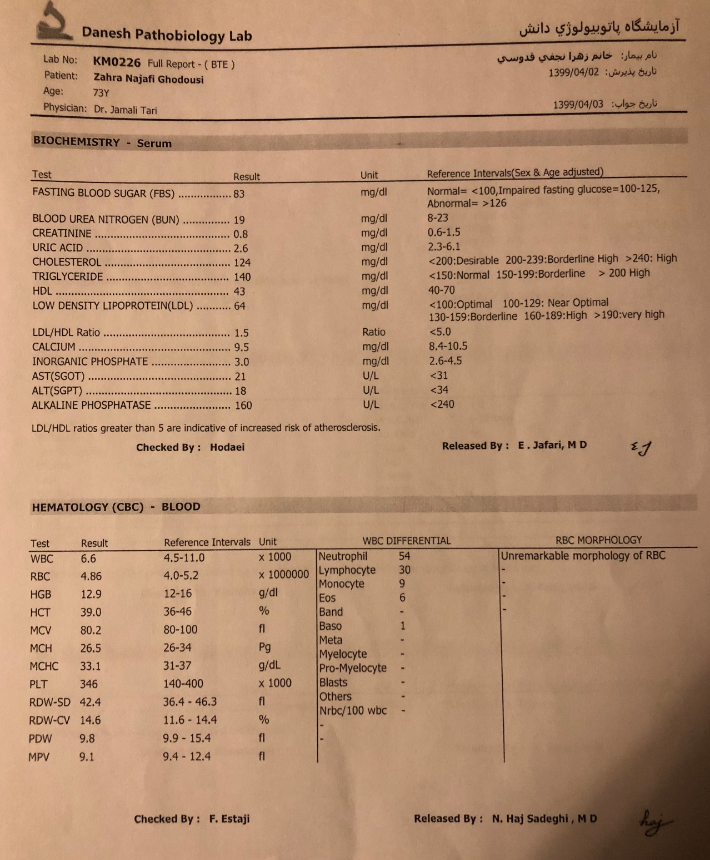
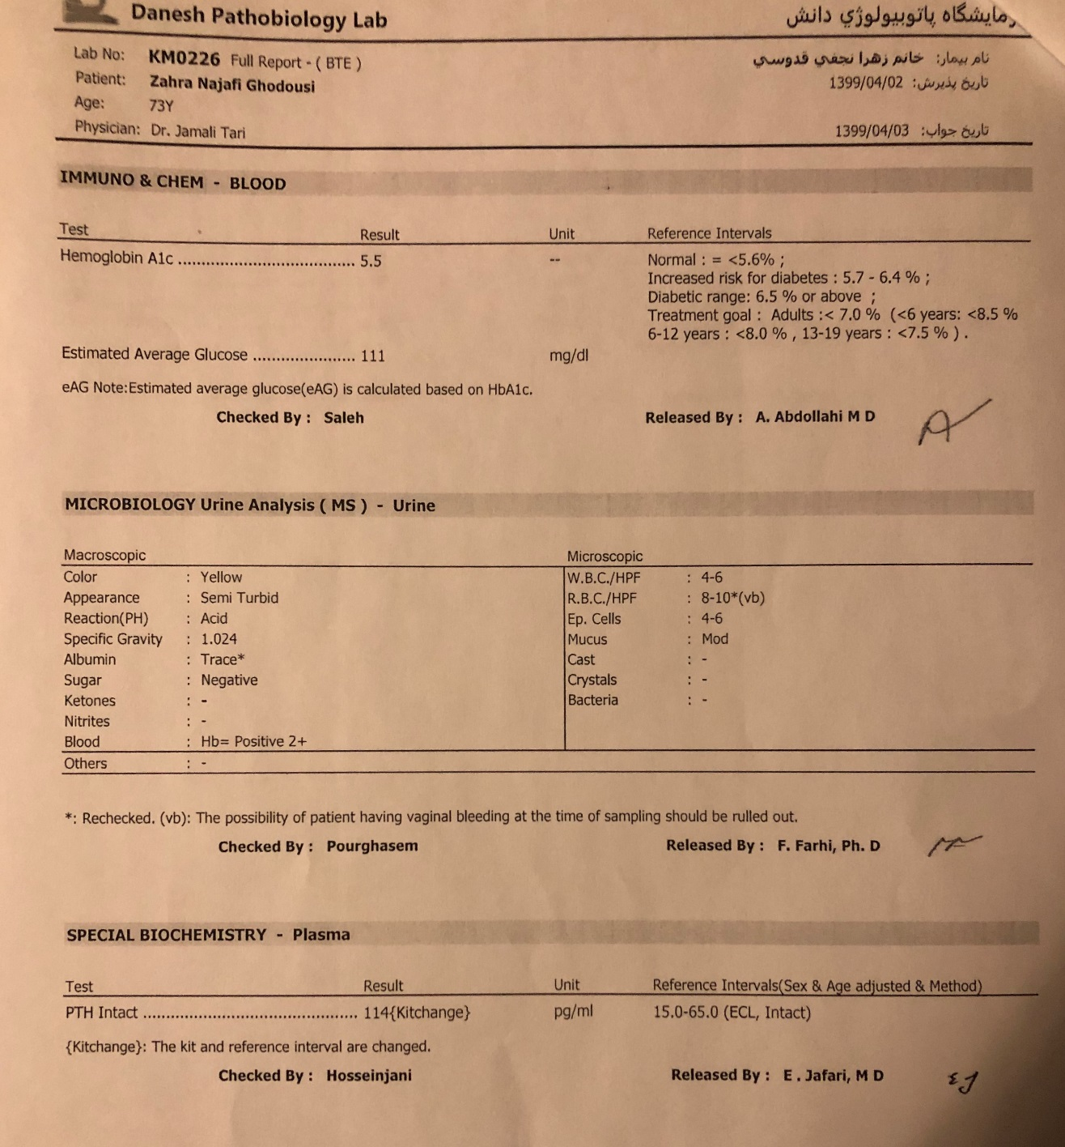
A 73-year- old lady with high PTH and normal serum calcium

Slide 3
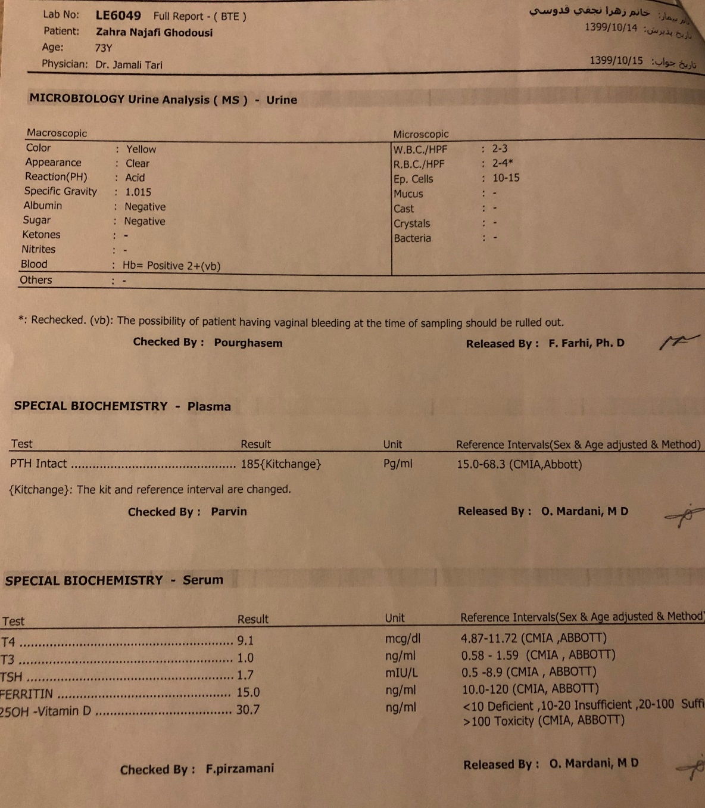
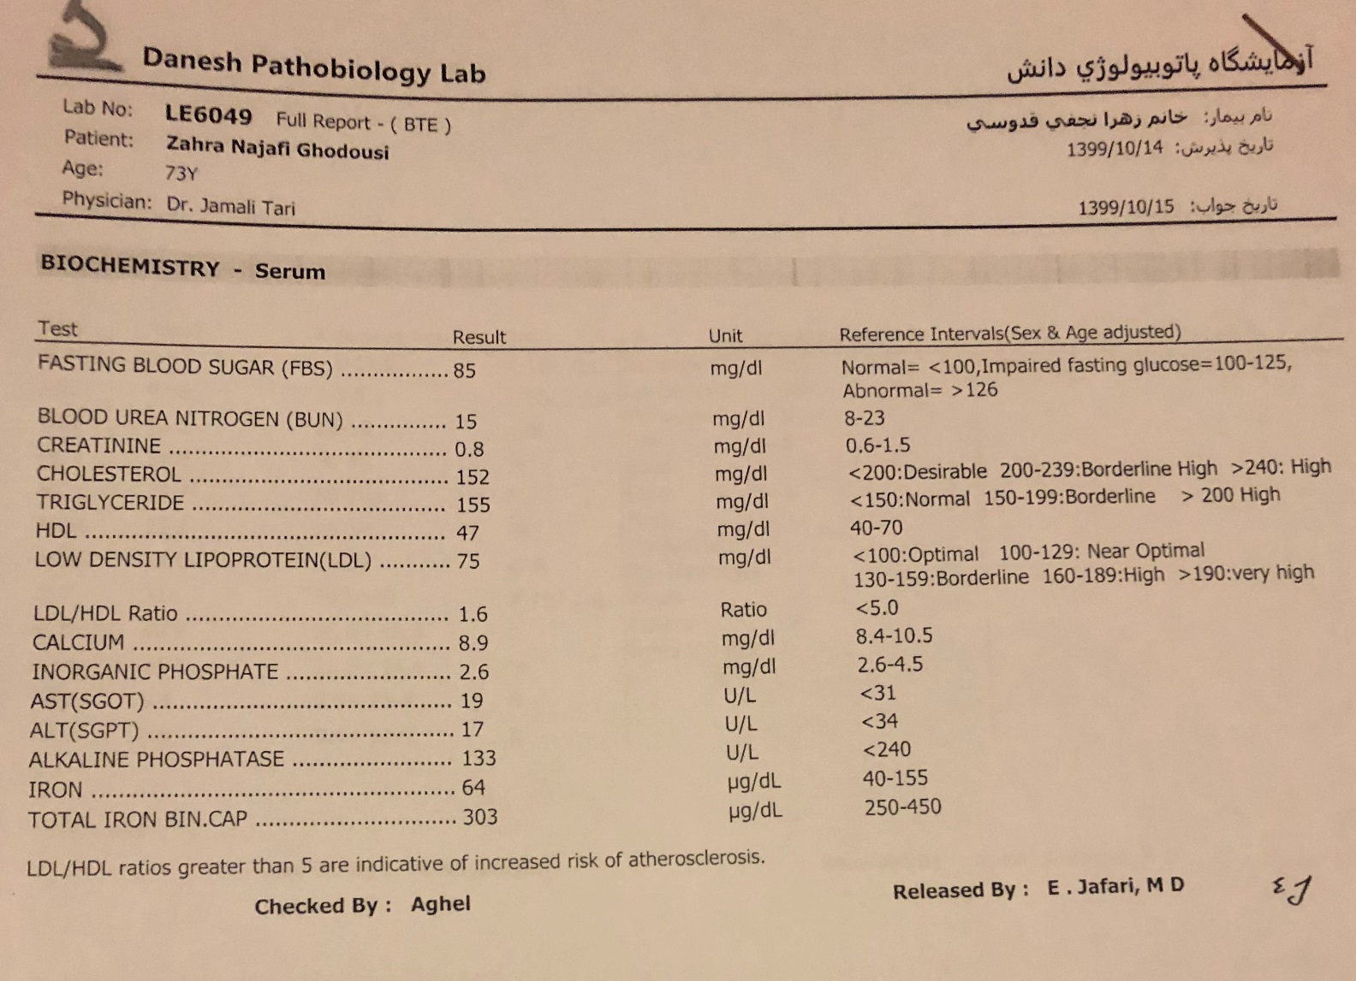
A 73-year- old lady with high PTH and normal serum calcium

Slide 4
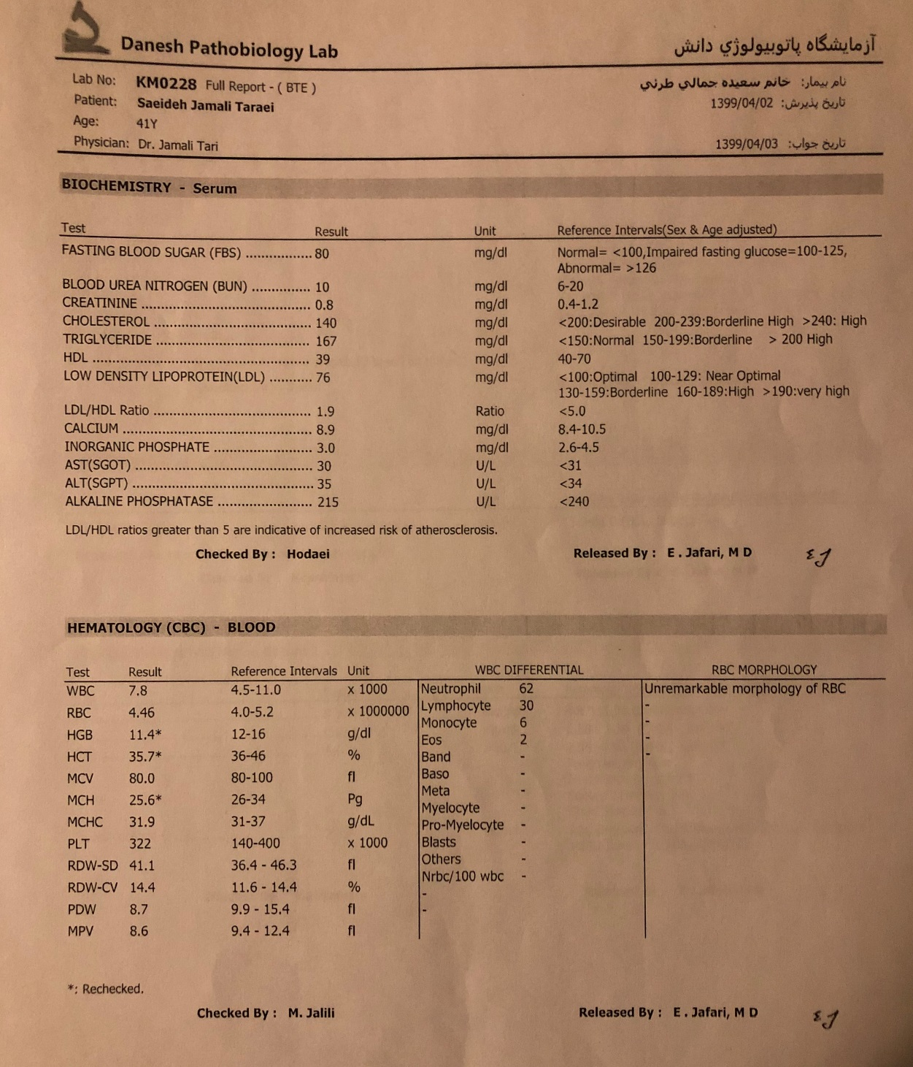
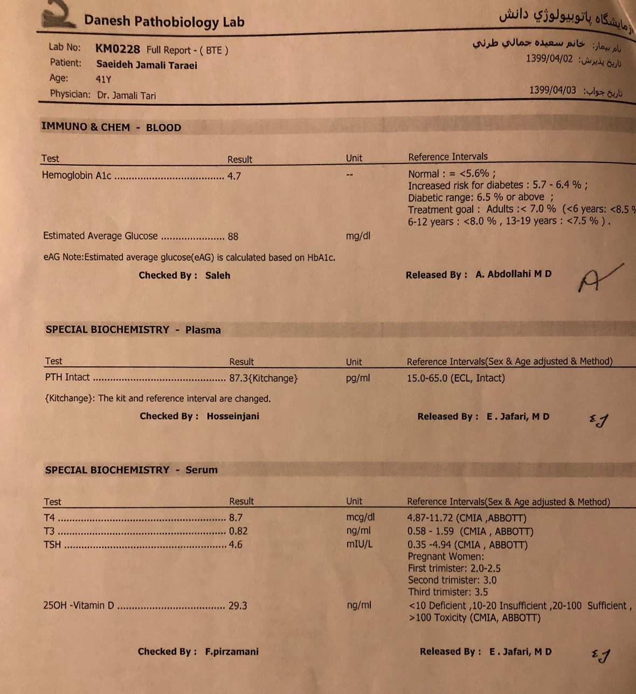
A 41-year- old lady with high PTH and normal serum calcium (her daughter)

Slide 5
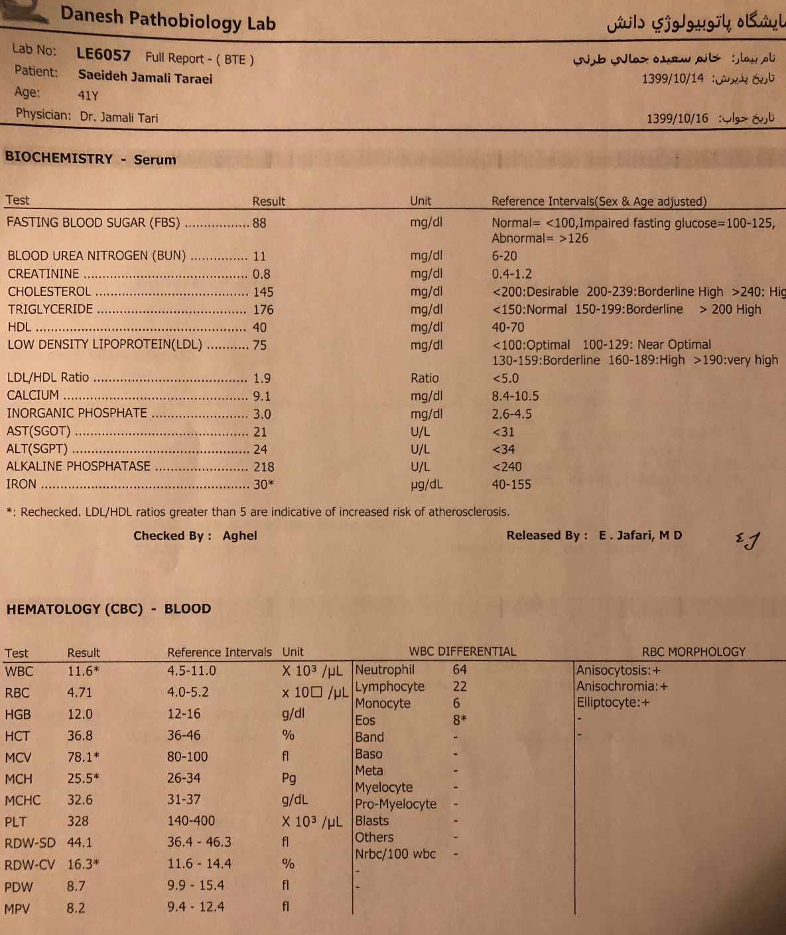
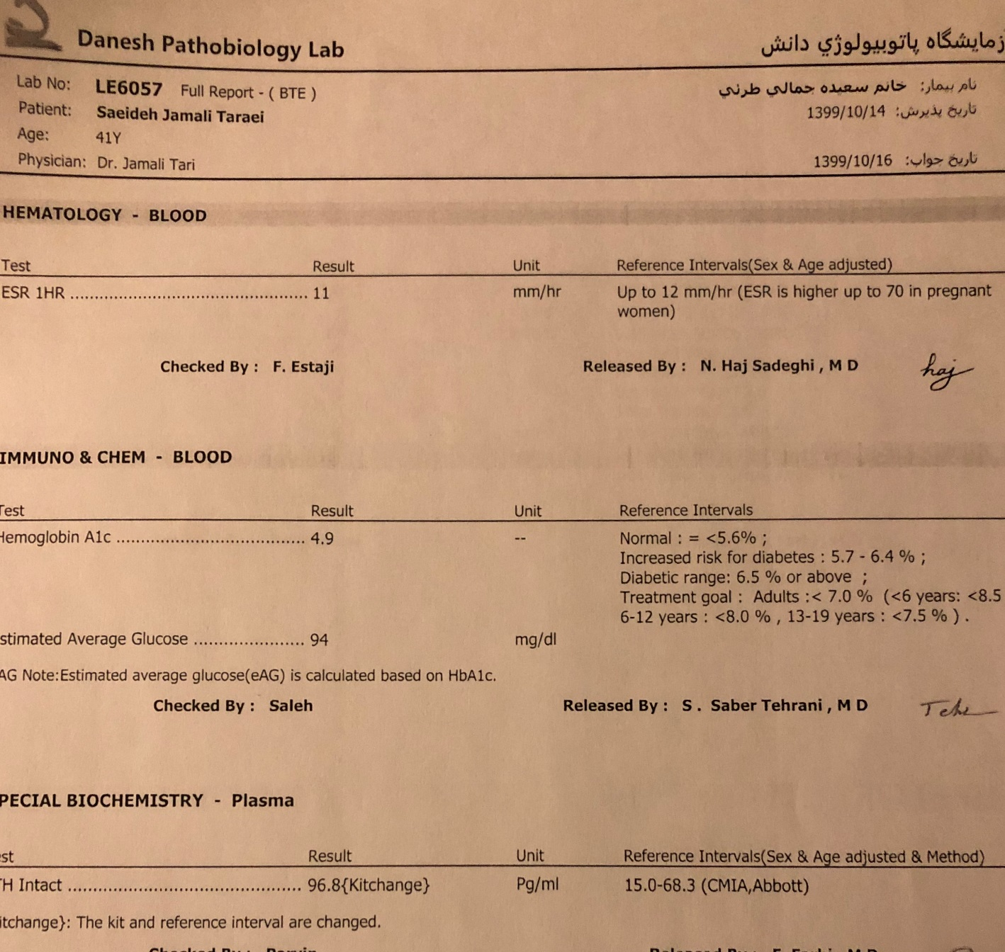
A 41-year- old lady with high PTH and normal serum calcium (her daughter)

Slide 6
Introduction
Primary hyperparathyroidism (PHPT), is the most common cause of hypercalcemia.
Its clinical presentation has changed regarding the involvement of classic and nonclassic target organs.

Slide 7
Classification

Slide 8
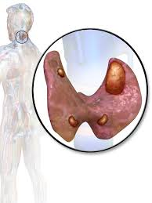
Diagnosis
PHPT is due to abnormal, incompletely-regulated secretion of PTH from one or more of the four parathyroid glands.
The disorder will be benign with either:
A single adenoma (80%)
Multiple gland, generally hyperplastic, disease (20%).

Slide 9
Diagnosis
PHPT is characterized by:
Hypercalcemia and
PTH that are inappropriately high for the hypercalcemic state.
Typically, the PTH level is frankly elevated, but it can also be within the normal range.
In both situations, detectable or elevated levels of PTH are clearly inappropriate when the serum calcium is elevated

Slide 10
Diagnosis
Well documented PHPT has been reported with PTH levels as low as 20 to 25 pg/mL (normal range of ~10 to 65 pg/mL).
In virtually all other etiologies of hypercalcemia, the PTH level will be frankly suppressed.

Slide 11
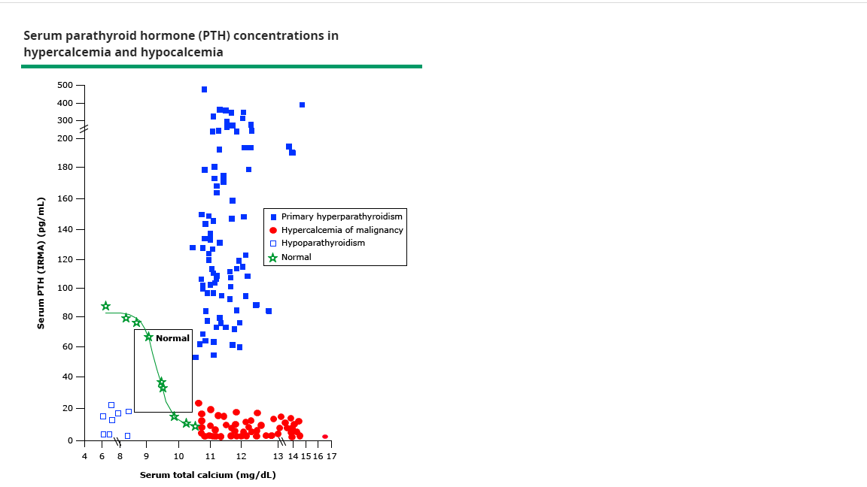

Slide 12
Diagnosis
Unlike classical PHPT, some patients are normocalcemic despite elevated serum PTH and others are hypercalcemic with serum PTH levels in the normal range.
In a 573-patient study of patients with PHPT :
405 patients were classic (70.7%)
96 were normohormonal (16.8%)
72 were normocalcemic (12.5%)
Normocalcemic hyperparathyroidism was associated with multi-gland disease (MGD) in 45% of patients, but only 10% in the normohormonal group and 9% in classic PHPT.
Twelve months after surgery, the biochemistry was normal in >98% in all three groups.

Slide 13
Diagnosis
Interfering substances such as biotin can cause the PTH to read low with certain assays.
When biotin is discontinued, the repeated PTH measurement will be more compatible with the diagnosis of PHPT if the patient has the disease.

Slide 14
Diagnosis
The differential diagnosis of PTH-dependent hypercalcemia includes the use of thiazide diuretics or lithium.
If possible, these medications should be discontinued.
Although the serum calcium will return to normal in some patients, most will demonstrate persistence of the biochemical hallmarks of PHPT, hypercalcemia and elevated levels of PTH.

Slide 15
Diagnosis - FHH
Distinction between familial hypocalciuric hypercalcemia (FHH), a rare disorder of the CASR (calcium-sensing receptor gene) and PHPT is important .
FHH has such high penetrance that virtually all patients will be shown to have hypercalcemia in their young adult years, by the age of 30.
A family history is also usually present

Slide 16
Diagnosis
It is important to distinguish PHPT from FHH, of which there are three subtypes: FHH1, FHH2, and FHH3 .
Generally, these require no treatment.
The diagnosis can be achieved by measuring 24-hour urinary calcium excretion.
A calcium/creatinine level < 0.01 is found in most patients.
Serum PTH are usually normal but may be elevated
Serum magnesium is usually elevated.

Slide 17
Diagnosis
These autosomal dominant disorders are caused by :
Loss-of-function mutation in the calcium-sensing receptor gene (CaSR) in FHH1
Loss of function in G-protein subunit alpha-1 (GNA11) in FHH2
Loss of function in adaptor protein-2 sigma 1 subunit (GNA11) in FHH3.

Slide 18
Diagnosis
The typical postmenopausal woman who develops biochemical signs of PHPT in the first decade after the menopause is highly unlikely statistically to have FHH.
In FHH, the 24-hour urinary calcium excretion will be very low (<100 mg) and the calcium clearance/creatinine clearance ratio will be <0.01.

Slide 19
Diagnosis
Because of PTH’s calcium conserving renal actions, low urinary calcium excretion (i.e., calcium clearance/creatinine clearance ratio <0.01) can also be compatible with PHPT, especially for patients whose dietary calcium has been restricted.
Genetic testing for the most common form of FHH (i.e., mutations in the CaSR), is readily available if FHH is considered to be a plausible diagnosis.

Slide 20
Normocalcemic PHPT
This biochemical phenotype was discovered in 2009 by an international panel of experts
Characterized by:
Elevated PTH
Persistently normal albumin adjusted total and ionized calcium.
Now rather common relates to our proactive approach to the evaluation of osteoporosis or low bone mass syndromes.

Slide 21
Normocalcemic PHPT
In hypercalcemic PHPT, the serum calcium can occasionally be normal
However, in Normocalcemic PHPT (NPHPT), the albumin-adjusted and ionized serum calcium levels will be consistently normal.
The differential diagnosis of NPHPT requires exclusion of secondary causes of increased PTH.

Slide 22
Normocalcemic PHPT
Vitamin D deficiency is one of the most important secondary causes to be ruled out.
Although this point inevitably leads to a discussion of the normal range of 25-OH- D and immediately recalls the Institute of Medicine’s definition of vitamin deficiency as 20 ng/mL (50 nmol/L)
It is important to appreciate that the Institute of Medicine’s Cut point was directed primarily toward a normal population with no known metabolic bone disease.

Slide 23
Normocalcemic PHPT
In the NPHPT, it seems to set the low threshold at 30 ng/mL (75 nmol/L), because some epidemiology studies have associated levels <30 ng/mL with progressive increases in PTH.
It is also reasonable in some situations to aim for an even higher level of 25-OH D (e.g., 40 ng/mL) to see whether the PTH level would become normal.

Slide 24
Normocalcemic PHPT
Other disorders associated with a secondary increase in PTH such as:
Renal insufficiency (estimated GFR <60 mL/min)
Malabsorption syndromes
Medications such as diuretics, lithium, bisphosphonates, and denosumab
should all be ruled out before invoking the diagnosis of NPHPT.

Slide 25
Normocalcemic PHPT
Even after known causes of secondary elevations of PTH have been ruled out, the possibility of some unrecognized secondary stimulus to account for this presentation will remain in some situations.
It is also possible that those whose PTH are minimally elevated represent the outer fringe of the normal distribution curve for PTH.
Approximately 2.5% of the normal population is likely to have PTH levels in this outer, higher fringe zone.

Slide 26
Normocalcemic PHPT
A further consideration of NPHPT:
Serum calcium will have much narrower day-to-day excursions in an individual than the normal population range
It is possible, that some patients with NPHPT actually have hypercalcemia relative to their historically lower serum calcium values
An individual, for example, whose serum calcium was typically ~9.0 mg/dL, can be considered to have become relatively hypercalcemic but still technically normocalcemic if the calcium has increased to 10 mg/dL.

Slide 27
Normocalcemic PHPT
The 1-mg/dL increase in serum calcium would still be within the normal population range but for that given patient decidedly higher.
The patient would present ostensibly with NPHPT.

Slide 28
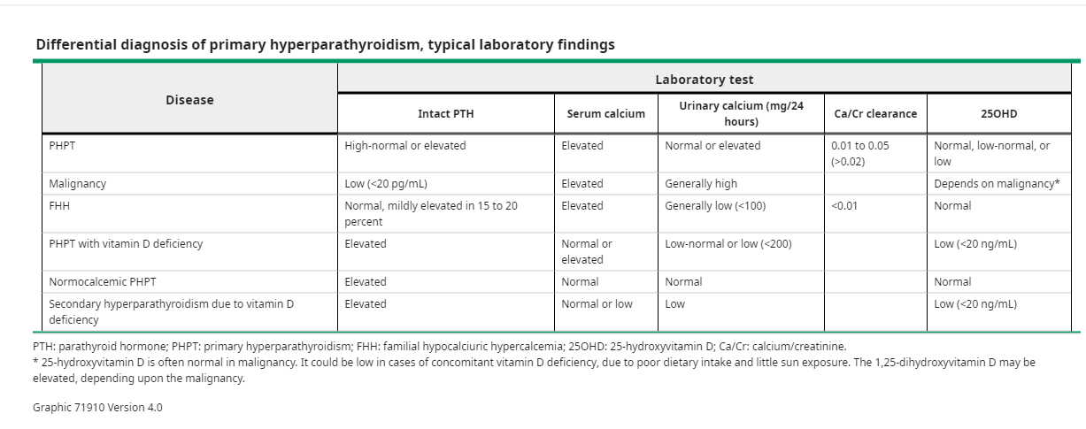

Slide 29
Epidemiology
PHPT predominates among women, usually in their postmenopausal years, with a female/male ratio of 3 to 4:1
In the US, the prevalence of PHPT has been 0.86%
Much wider prevalence estimates have been reported for NPHPT, 0.4% to 11%.

Slide 30
Epidemiology
Overall, the incidence and prevalence of PHPT have increased during the past several decades
In countries where serum calcium has become routinely measured, the incidence of PHPT has increased.

Slide 31
Etiology and Risk Factors
Most patients with PHPT have single adenomatous (80%) or multiply hyperplastic (15% to 20%) parathyroid tissue
Multiglandular disease can also be manifest as two and, very rarely, three adenomas.
Parathyroid carcinoma is rare, accounting for,1% of all cases of PHPT.

Slide 32
Etiology and Risk Factors
Suspicion for parathyroid cancer should be increased when patients, who are typically younger by about one decade
present with much higher serum calcium and PTH levels.
Invariably, renal and skeletal involvement will be readily apparent

Slide 33
Etiology and Risk Factors
Most often, PHPT is a sporadic disease, with no family history and no evidence for other endocrine gland involvement.
Genetic forms of PHPT, constituting no more than 10% of the hyperparathyroid population, can be limited to the parathyroid glands or be part of a multigland endocrine syndrome.
The germline mutations that have been associated with hereditary forms of PHPT are numerous.
At least six somatic mutations have also been described .

Slide 34
Etiology and Risk Factors
Environmental and modifiable risk factors that have been associated with PHPT include:
Chronically low calcium intake
Reduced physical activity
Higher body weight
Furosemide
Hypertension.
External neck radiation and lithium and thiazide therapy are also classic risk factors.
More recent experience with thiazide diuretics has suggested that hypercalcemia in this setting is most likely unmasking the underlying state of PHPT and is not likely to be reversed when the diuretic is stopped.

Slide 35
Sign & Symptoms of PHPT
The signs and symptoms of PHPT can be due to hypercalcemia itself, especially when the serum calcium is >12 mg/dL and/or if it has increased rapidly.
Symptoms include:
Polyuria, polydipsia
Constipation, anorexia, vomiting
Dehydration
Arrhythmias
Altered mental status.

Slide 36
Renal involvement
More likely, the symptoms of PHPT are related not to the hypercalcemia itself but to its key target organs.
Renal involvement can take the forms of hypercalciuria, nephrolithiasis, nephrocalcinosis, and/ or reduced renal function.
Although the incidence of these overt renal manifestations has declined
More recent systematic evaluation of the kidneys among these asymptomatic patients has revealed that stones and/or nephrocalcinosis is actually present in 21% to 55% of patients with asymptomatic PHPT.

Slide 37
Skeletal symptoms
Skeletal symptoms can take the form of any combination of:
Fragility fractures
Skeletal deformities
Bone pain
In the classic setting, osteitis fibrosa cystica describes the radiograph features of this presentation in which brown tumors, lytic lesions, subperiosteal bone resorption of the phalanges, and bone cysts are seen .

Slide 38
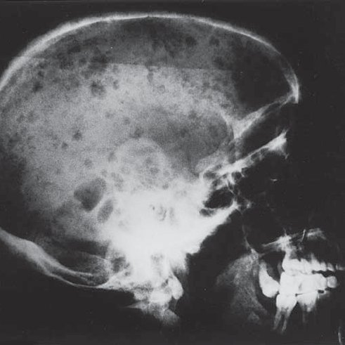
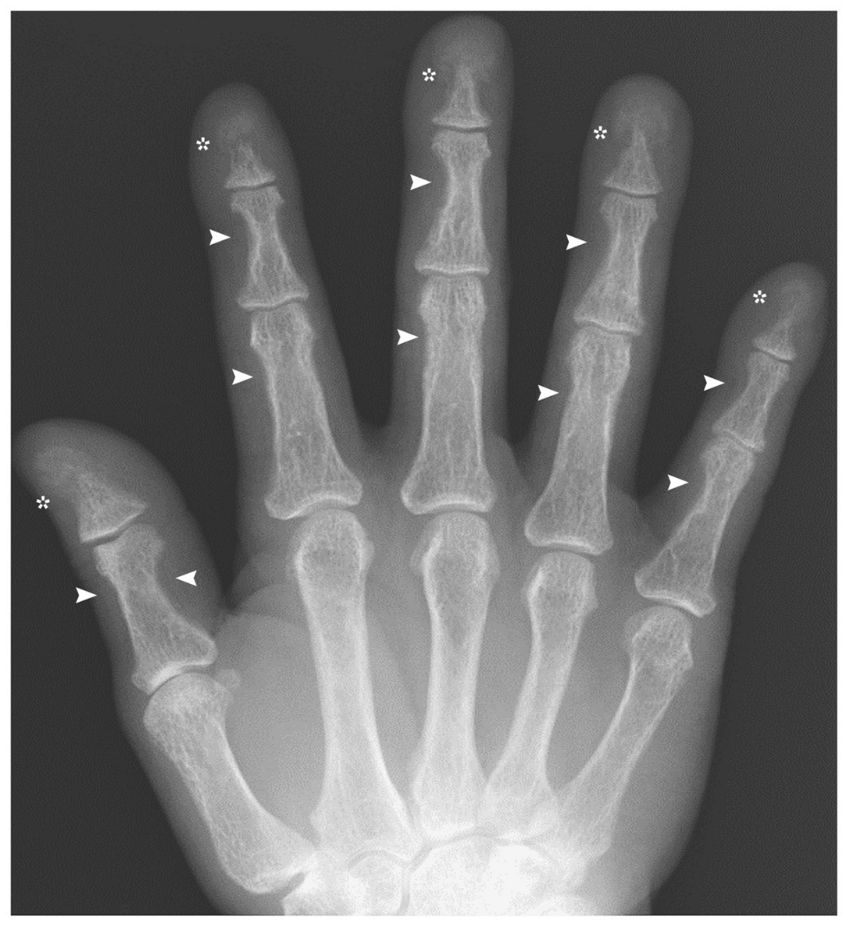
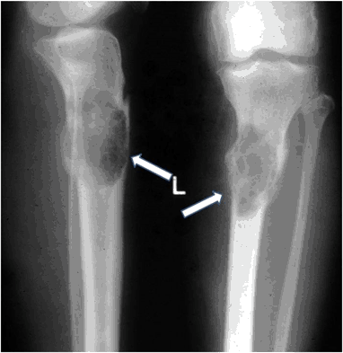

Slide 39
Specific Aspects of PHPT
When patients were first described with asymptomatic PHPT, in the early 1970s, the absence of these radiographic manifestations was assumed to mean that the skeleton was spared or not yet involved.
It took the advent of bone densitometry in the mid-1980s for us to appreciate the extent to which this mild form of the disease did not spare the skeleton.
Using dual energy X-ray absorptiometry (DXA), the distal one third radius, a site of cortical bone, was shown to be low .

Slide 40
Skeletal involvement
The lumbar spine, a skeletal site in which trabecular bone predominates, showed lesser degrees of involvement.
The hip regions, a more even admixture of trabecular and cortical bone, showed densitometric values that were midway between the relatively well-preserved lumbar spine and the affected distal one-third radius sites.
This pattern, first described in the 1980s, is still the most typical densitometric profile and reinforces the need to measure the distal forearm in all patients with PHPT

Slide 41
Skeletal involvement
The opposite pattern, can also be seen in which the lumbar spine is preferentially reduced.
The early effects of estrogen deficiency, before the onset of PHPT in postmenopausal women, can explain the reduced lumbar spine BMD in at least some of these patients.
Any pattern of bone loss can be seen in PHPT, ranging from a uniformly low BMD to a uniformly normal BMD.

Slide 42
Skeletal involvement
The preferential involvement of the distal one-third radius in PHPT was consistent with the notion that the catabolic effects of excessive PTH would be seen first at a cortical site.
Because DXA is a strong predictor of fracture risk, it was thought that in PHPT, fractures would be more often seen in the nonvertebral (i.e., cortical) skeleton.
Two reports by Khosla et al. and Vignali et al., however, showed that vertebral fractures were seen with a significantly greater incidence than in the control populations.

Slide 43
Skeletal involvement
A more incisive imaging technology, with resolving power that permitted direct assessment of the trabecular compartment of bone , was needed to address this apparent paradox
Namely that fracture risk is increased at a site that the DXA results predicted would be relatively protected.
Even histomorphometry of the iliac crest bone biopsy did not help to resolve this issue.

Slide 44
Skeletal involvement
High-resolution peripheral quantitative computed tomography (HRpQCT), showed that both the cortical and the trabecular compartments of bone are adversely affected in PHPT.
In the study by Stein et al. ,trabecular microstructure was further analyzed using individual trabecular segmentation analysis.
The topology of the trabecular indexes favored the vertically oriented rods, a spatial disposition that is suboptimal for bone strength.

Slide 45
Skeletal involvement
HRpQCT is available only in research centers and, thus, not assessable to most clinicians.
The trabecular bone score (TBS), which can identify some aspects of bone quality from the lumbar spine DXA image, is available to anyone whose DXA instrument is installed with TBS software.

Slide 46
Skeletal involvement
The concept of the TBS is a comparative one [the extent to which the textural microstructural patterns of the lumbar spine fit more comfortably as better (homogeneous) or worse (heterogeneous) bone quality].
Using TBS, Silva et al. showed that lower mean TBS scores were much more evident in PHPT than in reduced BMD by DXA.
Similar data were reported by Romagnoli et al.

Slide 47
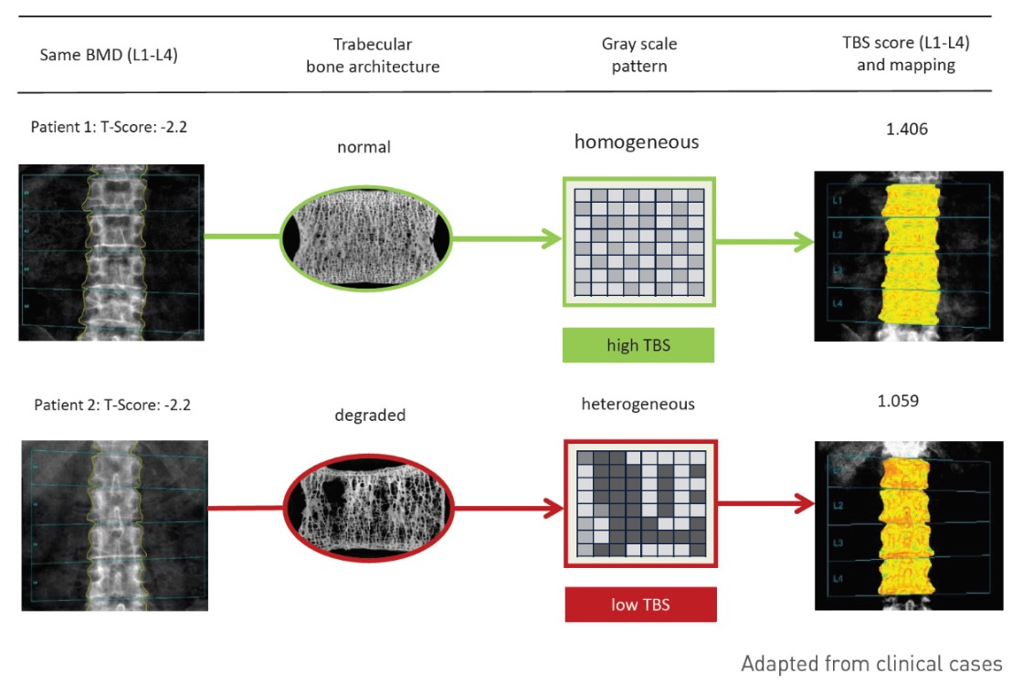
Trabecular bone score

Slide 48
Skeletal involvement
Such studies reinforced the concept, that the trabecular compartment is often involved in PHPT.
By applying these new imaging technologies,in PHPT:
Skeletal microstructure in both cortical and trabecular compartments is compromised
Observations that are now concordant with epidemiology studies that have shown an increased fracture risk at vertebral and nonvertebral sites with this disease.

Slide 49
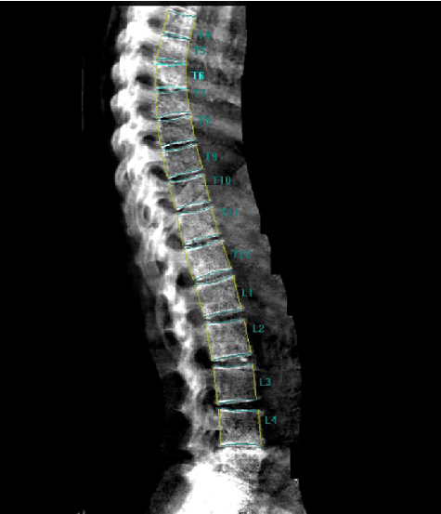
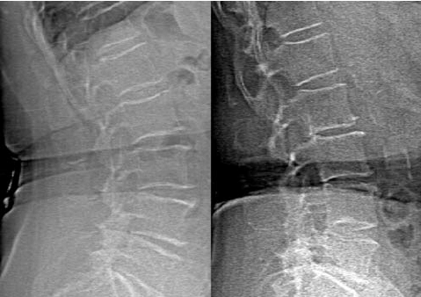
Skeletal involvement
These observations have decision making implications because vertebral fracture assessment( VFA) and TBS are accessible to many clinicians and can supplement the information available from DXA alone.

Slide 50
Neurocognitive features
Neurocognitive features have been well described but not clearly directly attributable to the “modern” form of the disease.
Fatigue, anxiety, poor concentration, cognitive decline, and reduced quality of life have all been reported with varying frequency, leading some to question whether the terminology “asymptomatic” PHPT is an accurate descriptor of these patients

Slide 51
Neurocognitive features
However, the attribution is uncertain.
Each of these features can be seen in any chronic disease, and lack specificity.
Even more problematic, the demonstration of reversibility after successful parathyroid surgery in rigorously conducted clinical trials has been inconclusive.

Slide 52
Other systems
Neuromuscular
Cardiovascular
Rheumatologic
Gl systems are additional putative targets of PHPT.
When the disease was typically symptomatic, all these systems were described as common manifestations of the disease
Now they are not appreciated as a clinical problem, except in “classic” PHPT or in specialized settings.

Slide 53
A Summary of the Variable Clinical Expressions of PHPT

Slide 54
1- The symptomatic disorder
Between 1930 and 1970
PHPT was generally considered a symptomatic disorder with overt skeletal and renal complications.
Radiologically, salt and pepper degranulation of the skull, distal tapering of the clavicles, bone resorption of the phalanges, bone cysts, and brown tumors were common.
Stones and nephrocalcinosis constituted the renal manifestations.
Proximal muscle weakness was due to impaired function of type 2 muscle fibers .

Slide 55
2- The asymptomatic disorder
In the 1970s
Widespread biochemical screening, asymptomatic PHPT emerged as the predominant clinical form.
Because PHPT was being discovered incidentally, the overt radiological features of PHPT essentially disappeared and the incidence of kidney stones plummeted.
Proximal muscle weakness was no longer seen.
Subjects with PHPT are asymptomatic, because they did not have any classic organ signs or symptoms of the disease.

Slide 56
3- The normocalcemic disorder
It took another four decades before the normocalcemic variant of PHPT was described in the first decade of the 21st century .
It was discovered in patients being evaluated for low bone mass or frank osteoporosis.
When NPHPT was first described, it was not asymptomatic but rather associated with overt bone loss
An observation that spoke to the proactive approach to bone loss syndromes in which the PTH became a standard part of the evaluation

Slide 57
3-The normocalcemic disorder
Since the early descriptions of NPHPT, an asymptomatic variant has been described when populations are screened with serum calcium and PTH levels.
Thus, NPHPT can be asymptomatic or symptomatic .

Slide 58
A World View of How PHPT Can Present
These three different presentations of PHPT:
The symptomatic form described first
Followed by asymptomatic PHPT
Most recently, NPHPT
Although this historical perspective is valuable, it is important to recognize that these three forms of PHPT exist concurrently in the world today

Slide 59
A World View of How PHPT Can Present
In Western Europe, North America, and many other parts of the world, asymptomatic PHPT is likely, and it will be appreciated as a rather common disease
The use of the term asymptomatic probably requires some adjustment, because with greater imaging tools applied to this population, it is apparent that such patients can often be shown to have involvement of the skeleton and/or kidneys.
Finally, if PTH is routinely measured when patients with low BMD are being evaluated, even in normocalcemic individuals, NPHPT will emerge as an entity.
Thus, all three forms of PHPT coexist with a relative incidence that is defined by country- and practice-specific variables.

Slide 60
Evaluation
The current recommendations for evaluation of a patient with PHPT are summarized in next Table
In contrast to the approaches for many disorders of bone and mineral metabolism, in which only the lumbar spine and hip regions are measured, DXA measurements should include the distal one-third radius .

Slide 61
Evaluation
In addition to DXA, further evaluation of the skeleton is now recommended because of the recent evidence that many patients with asymptomatic PHPT have vertebral involvement.
In addition to DXA, X-rays, vertebral fracture assessment, or TBS should be part of the skeletal evaluation.
In those centers in which HRpQCT is available, its use also should be seriously considered.
Additional imaging should extend also to the kidneys, because of the recent evidence that stones and/or nephrocalcinosis are often present among those with PHPT discovered incidentally.

Slide 62
Evaluation
The recommendations include abdominal X-ray, ultrasonography, or CT.
The 24-hour test for calcium is also strongly recommended, with guidelines for more complete biochemical urinary stone risk profiling if marked hypercalciuria is present.

Slide 64
Treatment of PHPT

Slide 65
Surgical management
Surgery in PHPT offers the promise of definitive cure and should be recommended to those who meet any one of the criteria for surgery:
hypercalcemia consistently >1mg/dL above normal
Fracture
Renal stones
Hypercalciuria, and other stone risk factors
T-score <2.5 at any site
Age <50 years.
Surgery can also be pursued for those who do not meet any of these indications as long as no medical contraindications are present and unanimity has been reached among the endocrinologist, surgeon, and patient about this course of action.

Slide 67
Preoperative parathyroid localization
It is an axiom in our field that the most important aspect of parathyroid localization is locating the expert parathyroid surgeon
Although this is clearly true, virtually all parathyroid surgeons depend on successful preoperative localization of the abnormal parathyroid tissue.
Ultrasonography and technetium-99m–labeled sestamibi have been the most popular approaches for preoperative localization
More recently, high resolution CT and four-dimensional CT have received positive attention

Slide 68
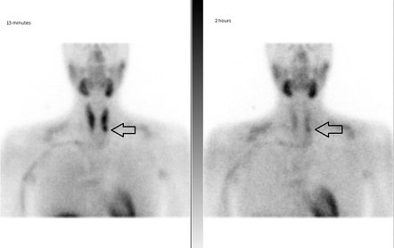
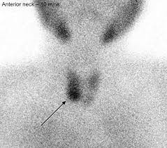
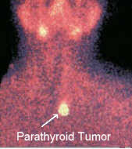
MIBI scan

Slide 69
Preoperative parathyroid localization
The success rates among these surgeons and centers exceed 95%
The use of intraoperative PTH measurements with a rapid throughput assay has given assurance regarding the likelihood of cure after removal of the single or multiply involved parathyroid tissue.
The intraoperative reduction in PTH:
should exceed 50% of the immediate preoperative PTH concentration
should be in the normal range within 15 to 30minutes after the procedure.

Slide 70
Nonsurgical management
Given the surgical guidelines, it is obvious that those who do not meet such guidelines will not necessarily be encouraged to undergo parathyroidectomy.
In these patients who are not to undergo surgery, a reasonable monitoring protocol includes:
semiannual testing of the serum calcium and PTH
Annual or biannual DXA testing (I prefer annual testing)
Annual urinary calcium measurements as clinically indicated
Further skeletal and renal imaging testing as clinically indicated.
If the patient develops a surgical guideline, surgery should be seriously considered.

Slide 72
Nutritional guidelines
Calcium intake
The intrinsic logic among many patients and some physicians is to restrict calcium intake.
Dietary calcium restriction, can be perceived by the abnormal parathyroid tissue, which still maintains some responsiveness to fluctuations in the serum calcium— albeit at a higher level—to further increase PTH levels

Slide 73
Calcium intake
Parathyroid tissue could well perceive a deficient calcium diet and be further stimulated to synthesize and secrete PTH.
For these reasons, a normal calcium intake, in accordance with the Institute of Medicine’s general recommendations for calcium intake should be adopted by patients with PHPT.

Slide 74
Vitamin D
Much evidence has suggested that vitamin D deficiency in PHPT is an inciting factor to further increases in PTH and greater expression of disease activity.
In countries with symptomatic PHPT, severe vitamin D deficiency is common.
In PHPT, vitamin D deficiency is more likely because:
PTH stimulates conversion of 25-(OH) D to 1,25-(OH)2 D.

Slide 75
Vitamin D
Although this might seem paradoxical, namely that vitamin D deficiency is a clinical problem when the 25-hydroxyvitamin D level is low and active vitamin D is normal or high, it is the case.
Early cohorts of patients with PHPT typically described vitamin D deficiency.
Recent observations have shown that 25-hydroxyvitamin D levels are more likely to be normal.
This is undoubtedly because the general population much more commonly uses vitamin D supplements .

Slide 76
Vitamin D
To restore vitamin D adequacy, vitamin D3 or D2 should be used in modest amounts, starting with 1000 IU daily.

Slide 77
Vitamin D
In a randomized clinical trial, Rolighed et al. showed that vitamin D at 2800 IU daily for 6 months led to an increase in 25-hydroxyvitamin D from 20 ng/mL to 38 ng/mL.
The restoration of vitamin D to normal was associated with lower serum PTH and C-telopeptide levels and improved lumbar spine BMD.
Vitamin D supplementation was not associated with any changes in serum or urinary calcium.

Slide 78
Pharmacological guidelines
The reasons for not undergoing parathyroid surgery :
Medical contraindications
Previous and/or multiple previous neck operations
Inability to locate abnormal parathyroid tissue
Patient preference.

Slide 79
Low bone density
The bisphosphonate, alendronate, improves the lumbar spine BMD without any changes in the serum calcium.
Alendronate has also been shown to increase BMD in NPHPT.
Very few data are available for other bisphosphonates in PHPT.

Slide 80
Alendronate
Although an increase in bone density would be welcome in these patients, alendronate was associated with an increase in fracture risk in a large retrospective cohort study using an insurance database.
The comparison was among
those who underwent parathyroidectomy
those who were treated with alendronate
those who were observed without any intervention

Slide 81
Alendronate
The retrospective nature of that nonrandomized survey in which major differences in age, baseline BMD, comorbidities, median T-score, and incidence of osteoporosis were present among these three groups render the conclusion uncertain.
Selection bias could well have predetermined who would receive parathyroid surgery or alendronate, or neither, and, thus, have influenced the results.

Slide 82
Denosumab
Very recently, denosumab has been evaluated in a comparative study of older postmenopausal women with PHPT or osteoporosis.
After 2 years, the group with PHPT showed greater increases in BMD at the lumbar spine, total hip, and femoral neck than did the group with osteoporosis .

Slide 83
Hypercalcemia
In patients who are not going to have parathyroid surgery but in whom the serum calcium is >1 mg/dL above normal or symptomatic hypercalcemia is present, control by pharmacological means could be indicated.
Cinacalcet is a calcimimetic agent that can accomplish this goal by virtue of its property to bind to the calcium-sensing receptor.

Slide 84
Cinacalcet
Its calcimimetic properties lead to an intracellular effect to reduce PTH synthesis and secretion.
The serum calcium level will become normal in 70% of patients
Although the primary effect of cinacalcet is to affect PTH synthesis, circulating PTH will decrease but only modestly.
In a wide range of clinical presentations of PHPT from mild to severe disease, cinacalcet has been shown to be effective as a calcium-lowering agent .
The 5-year data have not shown any change in BMD.

Slide 85
Hypercalcemia and reduced BMD
Because medications in PHPT appear to increase BMD or reduce the serum calcium level, but not both, it seems reasonable to consider combination therapy with alendronate or Denosumab and cinacalcet for these patients.
With the limited experience available to date, this approach has shown promise .

Slide 86
Natural History of PHPT With and Without Surgery
The long-term outcomes of those who do or do not undergo parathyroid surgery are available for #15 years of prospective monitoring .
Among those who do not undergo parathyroid surgery
All relevant biochemical indexes remained stable, with only an upward trend between years 13 and 15 in the serum calcium.
The BMD was stable at all three sites until year 8 when the femoral neck and distal one-third radius began to decline.
These small declines became more evident and were markedly evident between years 10 and 15.

Slide 87
Natural History of PHPT With and Without Surgery
Among those who undergo successful parathyroid surgery
Biochemical indexes will promptly normalize and the BMD will improve at all sites.
BMD increases first in the lumbar spine, followed chronologically by improvements in the hip and distal one-third radius sites.
Parathyroidectomy also leads to improvements in skeletal microstructure and bone strength as determined by HRpQCT and finite element analysis .

Slide 88
Among those who undergo successful parathyroid surgery
within a relatively short follow-up period, during which high-resolution imaging showed improvements, no changes were found in the TBS.
In the setting of a randomized clinical trial, successful parathyroidectomy was associated, not only with improvements in BMD, but also with a reduction in fracture incidence.
Even in NPHPT, when the surgical guidelines are applied, as recommended, parathyroidectomy has been associated often, but not always, with beneficial outcomes such as an increase in BMD.

Slide 89
Natural History of PHPT With and Without Surgery
The renal system appears to be stable over time among those who have not undergone parathyroidectomy, at least regarding serum creatinine and urinary calcium excretion.
Recurrence of kidney stones was common.
Surgery has been associated with a reduction in urinary calcium excretion and kidney stones .
Clinically, the risk of kidney stones appears to be substantially reduced after surgery .

Slide 90
Natural History of PHPT With and Without Surgery
The improvements in skeletal and renal parameters in patients who demonstrate compromise in these two target organs give direct evidence for the guidelines that recommend surgery for these patients.
It has not been possible to show with any consistency that neurocognitive and cardiovascular features, improve with surgery.

Slide 91
Natural History of PHPT With and Without Surgery
Summarizing the experience in this regard, a recent meta-analysis of both randomized clinical trials and observational studies of asymptomatic patients with PHPT did not show any improvements in quality of life, neuropsychiatric symptoms, or cardiovascular events.
The lack of evidence for substantial improvements in these areas after parathyroidectomy helps to substantiate the guidelines that do not include these features among the indications for surgery.

Slide 92
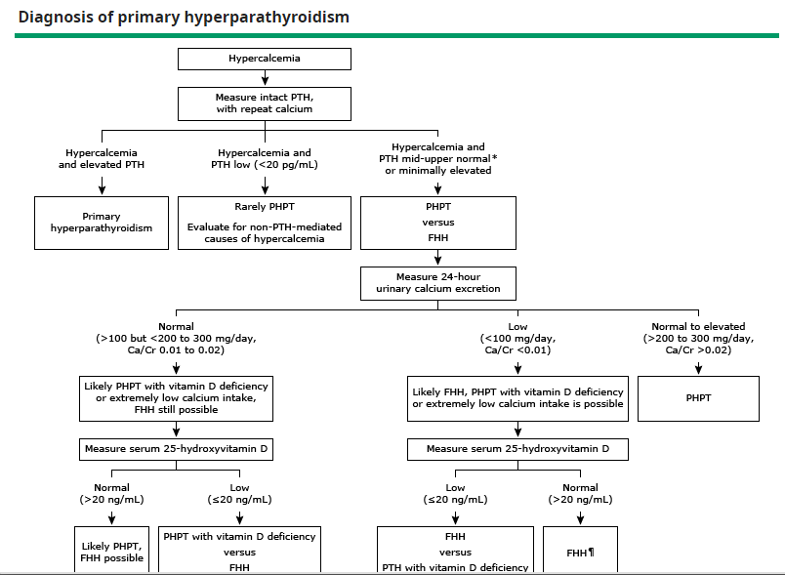

Slide 93
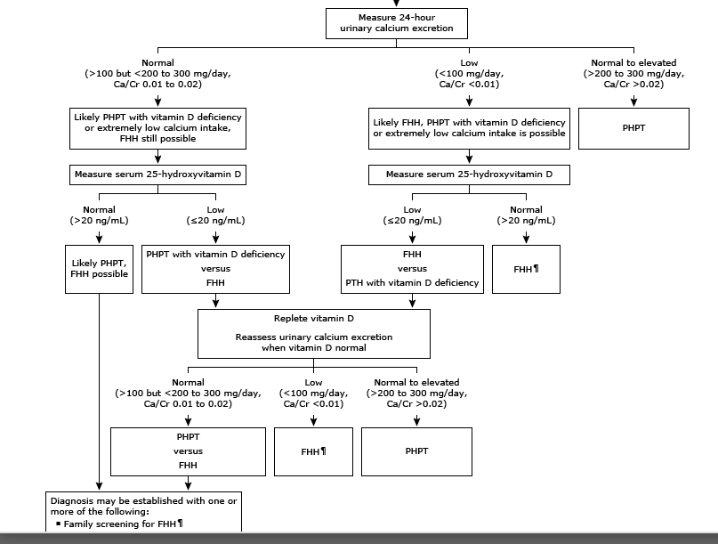

Slide 94
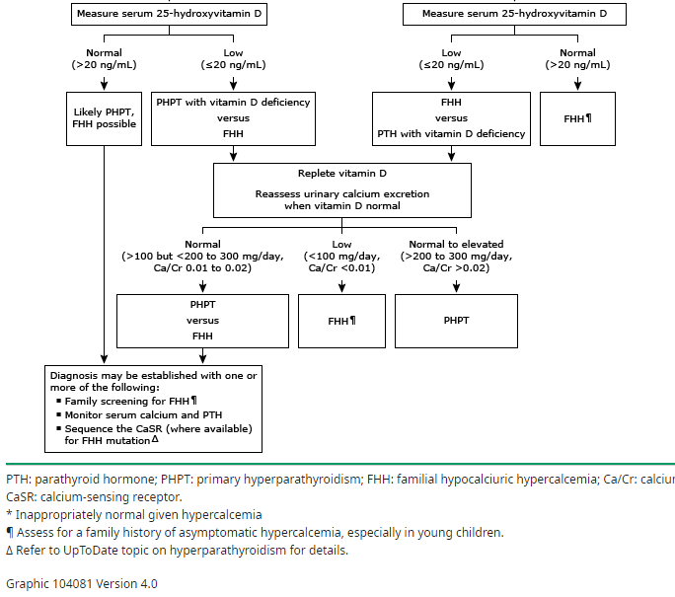

Slide 95
Conclusions
During the past 40 years, we have gained progressively greater insights in presentations, involvement of target organs and the management of PHPT.
New imaging technologies have helped to define involvement among those who are discovered incidentally in the course of biochemical screening.

Slide 96
Conclusions
Among those who present with classic symptoms, the lack of population-based biochemical screening, along with vitamin D deficiency appear to be key determinants.
NPHPT can be discovered among those who are evaluated for a reduced bone mass but can also be discovered incidentally.

Slide 97
Conclusions
Although successful parathyroidectomy cures the disease, the guidelines are useful because of the benign natural history in many who do not meet the criteria for surgery.
In those who do meet the surgical guidelines, but in whom surgery is not to be performed, pharmacological approaches are available to reduce the serum calcium and/or improve the BMD.

Slide 99
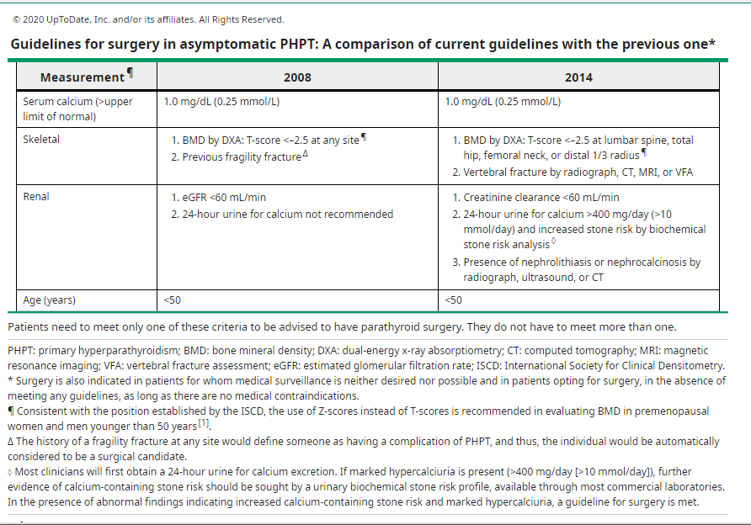

Slide 100
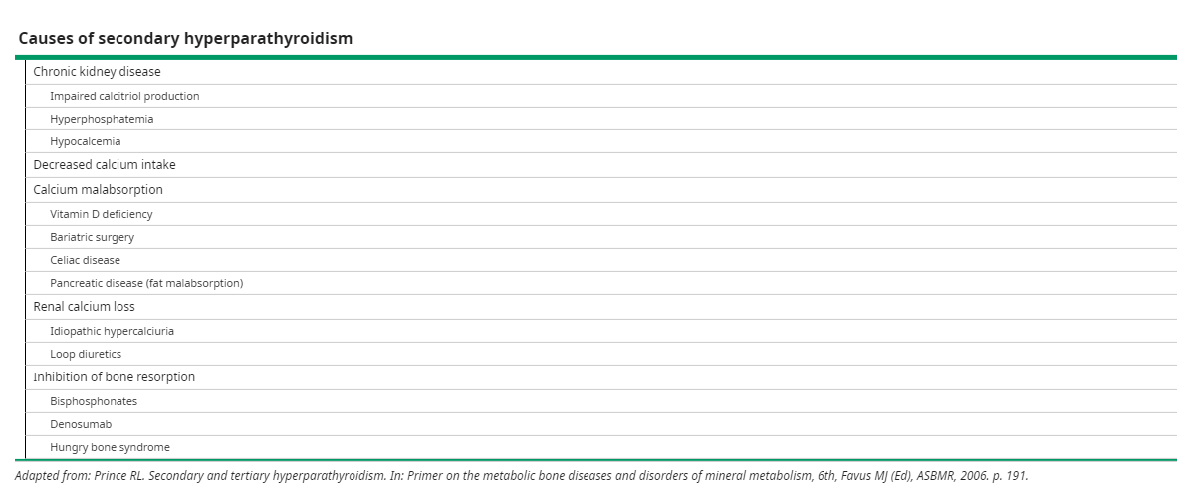

Slide 101


Slide 102
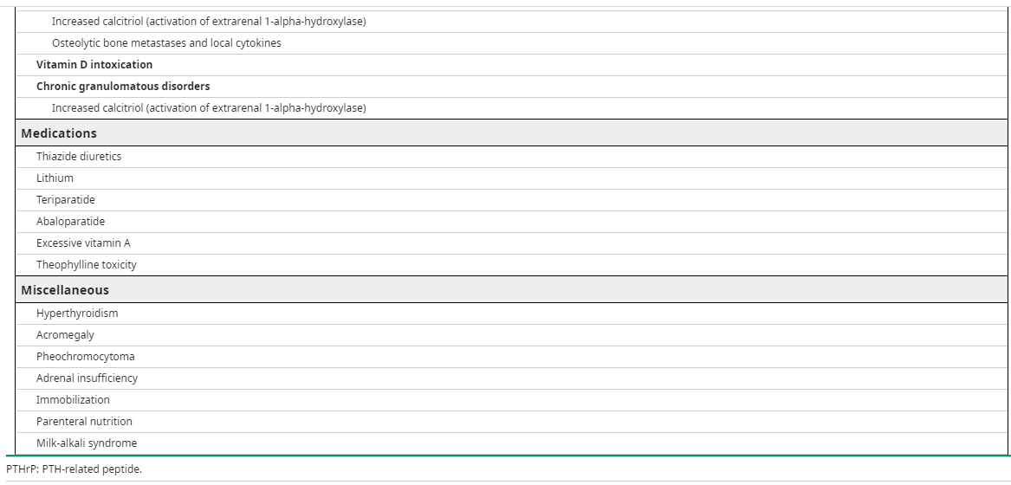

Slide 103
