Slide 1

Covid-19: prevention
Mahshid Talebi-Taher, MD.
Infectious Diseases Specialist,
IUMS

Slide 2
Vaccines:
1-Nonreplicating viral vector(NRVV):
adenoviral based
Considering that SARS-CoV-2 uses S protein to gain entry into cells, all the vaccines currently in trials express either full-length S protein or S protein subunits.
Ad5(China)
rAd5,rAd26: Russia
AstraZeneca
Johnson&Johnson

Slide 3
Cont’
Safe
Immunogenic
All of the aforementioned NRVV candidates induced anti-spike antibodies and induced a measurable cellular immune response.
NRVV vaccines caused small local reactions after injection, such as swelling and redness, and systemic symptoms including malaise, fatigue, fever, and headache, all of which generally resolve within 96 h after vaccination.

Slide 4
2-Messenger RNA vaccine candidates:
Encodes the spike-2 protein antigen
Humoral and cellular immunity
Moderna
Pfizer
the antibody response against the SARS-CoV-2 receptor- binding domain (RBD) of both vaccines showed significantly higher titers compared to patients who have recovered from COVID-19.
Two doses

Slide 5
Cont’
Although these vaccines induced mild adverse symptoms following the initial dose, including mild fatigue, chills, headache, myalgia, and localized pain at the injection site, adverse reactions progressed with an increase in dosage, and booster doses in some patients caused moderate to severe local and systemic reactions.

Slide 6
3-Inactivated whole-virus vaccine
Long production time
Sinopharm/china
Bharat/ India
When compared to other vaccine types, these inactivated viral vaccines appear to have reduced adverse effects.
Most systemic adverse reactions were mild with no severe adverse reactions, while localized injection site redness and pain were common.
All adverse reactions have resolved 72 h after vaccine administration.

Slide 7
Cont’
Similar immunity/Ad5
Several potential disadvantages of inactivated viral vaccines:
the use of aluminum hydroxide as an adjuvant has been previously linked to vaccine-associated enhanced respiratory disease (VAERD),

Slide 8
4-Protein subunit vaccine candidates:
This vaccine candidate consists of a nanoparticle containing the full-length wild-type Spike glycoprotein that was engineered to be resistant to proteolytic cleavage and capable of binding ACE2 receptors with high affinity.
Sanofi Pasteur/GSK
No serious adverse effects have been noted.

Slide 9
واکسن در ایران:
Barkat: Inactivated vaccine/Two doses
Covopars Razi: recombinant protein
Pasteur Institute/Cuba:

Slide 10
Prevent getting sick:
COVID-19 is spread in three main ways:
Inhalation:Breathing in air when close to an infected person who is exhaling small droplets and particles that contain the virus.
Deposition:Having these small droplets and particles that contain virus land on the eyes, nose, or mouth, especially through splashes and sprays like a cough or sneeze.
Touching eyes, nose, or mouth with hands that have the virus on them.

Slide 11
Cont’
Anyone infected with COVID-19 can spread it, even if they do NOT have symptoms.
Get vaccine
Wear a mask
Stay 6 feet apart
Avoid crowds and poorly ventilated spaces(15 minutes).
REINFECTION:rare

Slide 12
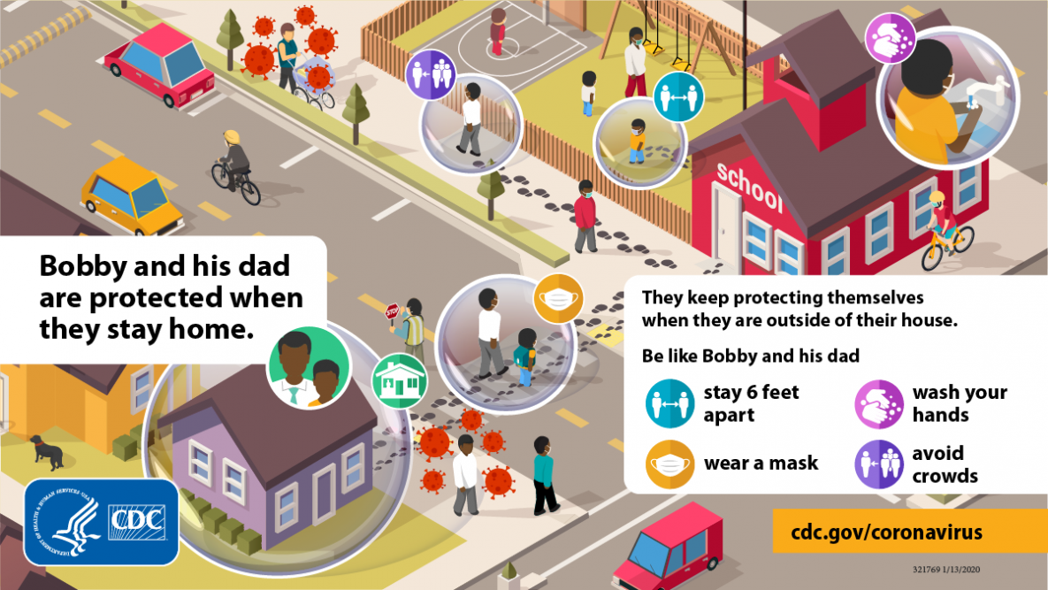

Slide 13
Wear a mask:
Everyone 2 years and older should wear masks in public.
Masks should be worn in addition to staying at least 6 feet apart, especially around people who don’t live with you.
If someone in your household is infected, people in the household should take precaution.
Wash your hand before putting on your mask.
Wear your mask over your nose and mouth and secure it under your chin.

Slide 14
Cont’
Masks are required on planes, buses, trains, and other forms of public transportation.
Avoid close contact with people who are sick.
If possible, maintain 6 feet between the person who is sick and other household members.
Remember that some people without symptoms may be able to spread virus.

Slide 15


Slide 16

How to Store and Wash Masks
Store your cloth mask properly and wash it regularly to keep it clean. Consider having more than one mask on hand so that you can easily replace a dirty mask with a clean one.
If your mask is wet or dirty from sweat, saliva, make-up, or other liquids or substances, keep it in a sealed plastic bag until you can wash it.
Store masks that are not wet or dirty in a paper bag.

Slide 17
Cont’
If you are taking off your mask to eat or drink outside of your home, you can place it somewhere safe to keep it clean, such as your pocket, purse, or paper bag.
Make sure to wash or sanitize your hands after removing your mask.
After eating, put the mask back on with the same side facing out. Be sure to wash or sanitize your hands again after putting your mask back on.

Slide 18
Avoid crowds and poorly ventilated spaces:
Being in crowds like in restaurants, bars, fitness centers, or movie theaters puts you at higher risk for COVID-19.
Avoid indoor spaces that do not offer fresh air from the outdoors as much as possible.
If indoors, bring in fresh air by opening windows and doors, if possible.

Slide 19
Wash your hands often:
With soap and water for at least 20 seconds especially after you have been in a public place, or after blowing your nose, coughing, or sneezing.
Before eating or preparing food
Before touching your face
After using the restroom
After leaving a public place
After blowing your nose, coughing, or sneezing
After handling your mask
After changing a diaper
After caring for someone sick
After touching animals or pets

Slide 20
cont’
If soap and water are not readily available, use a hand sanitizer that contains at least 60% alcohol. Cover all surfaces of your hands and rub them together until they feel dry.
If you are wearing a mask: You can cough or sneeze into your mask. Put on a new, clean mask as soon as possible and wash your hands.
If you are not wearing a mask:
  Always cover your mouth and nose with a tissue when you cough or sneeze, or use the inside of your elbow and do not spit.
  Throw used tissues in the trash.

Slide 21
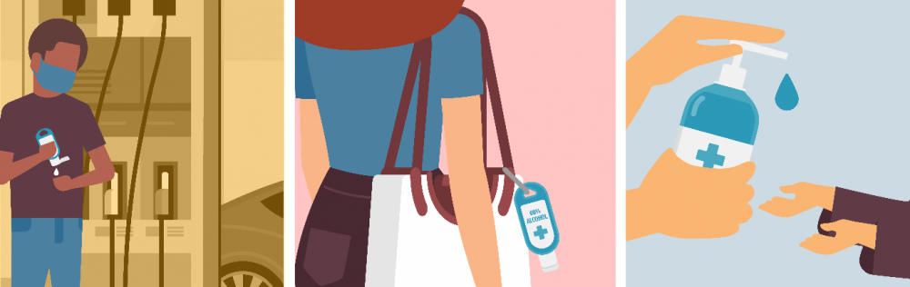
How to Select and Use Hand Sanitizer

Slide 22
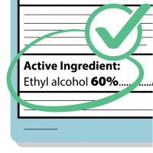
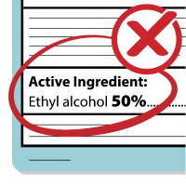

Slide 23
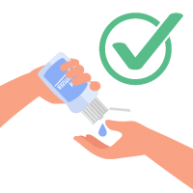

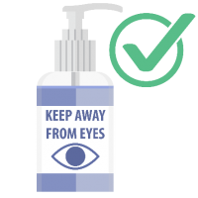
How to use:
Rub the gel over all the surfaces of your hands and fingers until your hands are dry.
Keep alcohol-based hand sanitizer out of your eyes.
Supervise young children when they use alcohol-based hand sanitizer.

Slide 24
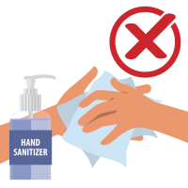
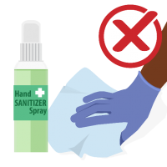
Do not:
Rinse or wipe off the alcohol-based hand sanitizer before it’s dry; it may not work well against germs.
Use alcohol-based hand sanitizer to clean surfaces. Alcohol-based hand sanitizer is not designed to clear or disinfect surfaces.

Slide 25
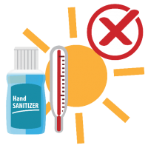
cont’
Store alcohol-based hand sanitizer above 105°F (for example, it should not be stored in a car during the summer months).

Slide 26
Clean and disinfect:
Clean high touch surfaces daily. This includes tables, doorknobs, light switches, countertops, handles, desks, phones, keyboards, toilets, faucets, and sinks.
If surfaces are dirty, clean them using detergent or soap and water prior to disinfection.

Slide 27
Monitor your health daily:
Be alert for symptoms
Take your temperature if symptoms develop.
STAY homes, stay in a specific “sick room” or area.
use a separate bathroom.
Don’t share personal household items like cups.

Slide 28
Cont’
You can be with others after:
1-At least 10 days since symptoms first appeared and
2-At least 24 hours with no fever without fever-reducing medication and
3-Other symptoms of COVID-19 are improving
**Loss of taste and smell may persist for weeks or months after recovery and need not delay the end of isolation​.

Slide 29
cont’
If you had severe illness from COVID-19 (you were admitted to a hospital and needed oxygen), your healthcare provider may recommend that you stay in isolation for longer than 10 days after your symptoms first appeared (possibly up to 20 days) and you may need to finish your period of isolation at home.
Asymptomatic person with POSITIVE PCR: 10 DAYS.
WEAKENED immune system: 20 days.

Slide 30
Getting testing again for COVID-19:
Patients may continue to test positive for three months or more without being contagious to others. For this reason, you should be tested only if you develop new symp.toms of possible COVID-19.

Slide 31

At Increased Risk for Severe Illness:
Older adults
People with medical condition(CKD, cancer,chronic lung disease, dementia and other chronic neurologic dis.,DM, CHF, hypertension,obesity, down synd.,sickle cell, thalassemia, smoking,CVD, Transplant, liver dis.
Pregnant women

Slide 32


