Slide 1

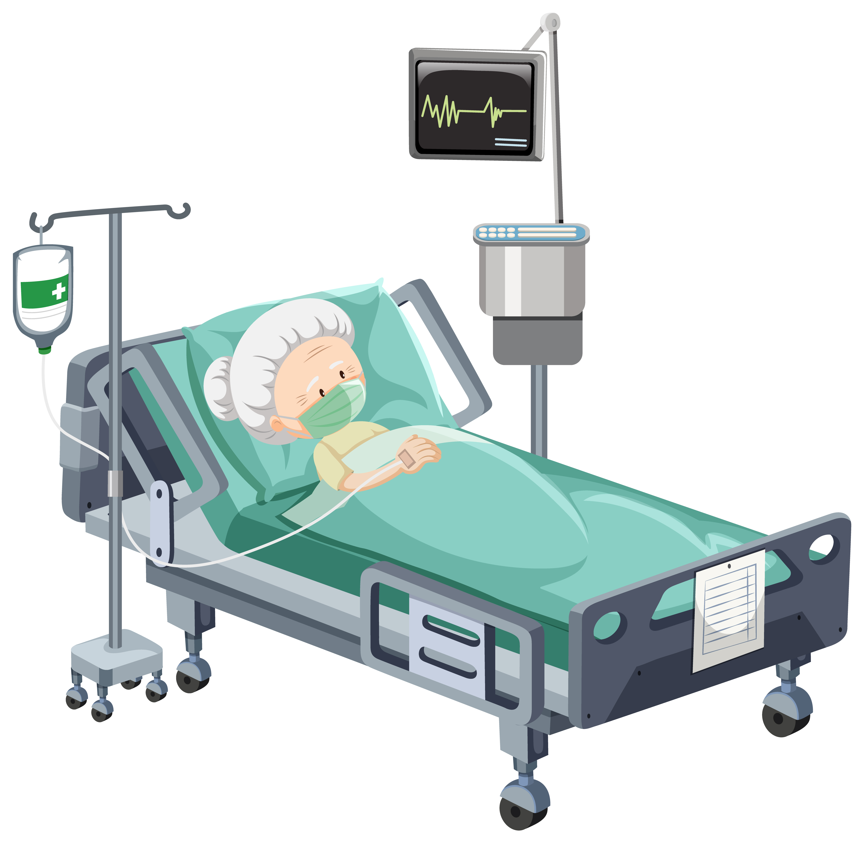
Management of Depression and Anxiety in Patients with COVID-19
Leila Kamalzadeh, M.D.
Geriatric Psychiatrist
Assistant Professor of Psychiatry
Iran University of Medical Sciences

Slide 2

Introduction
COVID-19 pandemic is a major stressor for most of humanity.
The initial focus was necessarily on the physical consequences of the infection per se.
Mental symptoms are very common in patients hospitalized for COVID-19 infection.
Diagnosis and treatment of mental symptoms determine the prognosis of the disease and functional recovery.

Slide 3
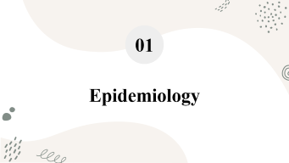



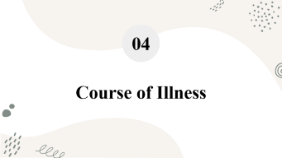
Table of Contents

Slide 4
01
Epidemiology

Slide 5

Epidemiology
During acute infection, 20-60% of inpatients with COVID-19 manifest:
  Insomnia
  Impaired attention or concentration
  Anxiety
  Memory impairment
  Depressed mood
  Confusion
  Altered consciousness

Slide 6

Epidemiology (Cont.)
Patients hospitalized with COVID-19 have a 40% increased risk of being diagnosed with a mental health disorder than outpatients.

Slide 7

Epidemiology (Cont.)
The most common reasons for requesting psychiatric consultation in hospitalized COVID-19 patients:
  Psychomotor agitation/restlessness
  Impairment of sleep
  Evaluation of prior psychiatric treatment
  Anxiety/fear
  Depression/Suicidal ideation

Slide 8

Epidemiology (Cont.)
After the psychiatric evaluations were performed the patients were diagnosed with:
  Delirium (38.2 %)
  Adjustment disorder (27.0 %)
  Depressive disorder (19.1 %)
  Anxiety disorder (11.2 %).

Slide 9
02
Pathogenesis

Slide 10

Pathogenesis
Biological Factors
Psychosocial Factors
Direct effect of CNS infection with COVID-19
Encephalopathy secondary to the massive inflammatory response or medication
Critical illness and resultant ICU stays results to extreme physiological and psychological stressor
Fear of infecting family members

Slide 11
Covid-19 treatment-induced neuropsychiatric adverse effects
Pathogenesis (cont.)
Corticosteroids:
  Depression, emotional lability, euphoria, insomnia, malaise, personality changes, and psychosis
Azithromycin:
  Delirium, mood changes
Lopinavir, ritonavir:
  Depressive symptoms
Chloroquine:
  Mood lability, nervousness, psychosis, suicidal ideation

Slide 12
03
Clinical Features

Slide 13

Clinical Features
Features unique to psychological presentations related to disasters:
The overlapping of psychological problems is common
A vast majority of people with disaster-related psychological disturbances recover spontaneously over time
Presentations do not necessarily amount to a psychiatric diagnosis

Slide 14


Clinical Features (cont.)
Adjustment disorder
    Sadness of mood, anxiety or worry, fear of spreading infection
    Persistent preoccupation with illness worry
    Inability to cope and some degree of dysfunction
    Sleep and Appetite disturbances
    In adolescents, these symptoms might be associated with oppositional behavior or truancy

Slide 15

Clinical Features (cont.)
Depressive disorders
Low mood
Decreased or loss of capacity to enjoy things
Decreased energy
Marked tiredness after even minimum effort (not due to any medical cause including COVID-19)
Reduction in activity or feeling restless
Lowered attention/ concentration- complaints of poor memory
Loss of self-esteem and self-confidence
Ideas that one is worthless, or has done something wrong
Feeling of helplessness (no help will be available), and that there is no hope for the future.
Death wishes, suicidal thoughts or attempts
Sleep and appetite disturbances

Slide 16

Clinical Features (cont.)
Anxiety Disorders
01
Generalized anxiety disorder (GAD)
Excessive worrying and persistent free-floating anxiety
02
Panic disorder
Recurrent unexpected attacks of severe anxiety
03
Phobias
Anxiety symptoms are triggered only in particular
situations

Slide 17

Clinical Features (cont.)
Weaning off mechanical ventilation/supplemental oxygen is at times associated with severe anxiety
Mimic the inherent nature of infection resulting in respiratory distress
Leads to reintubation, prolonging the need for ventilatory support
Anxiety Disorders (cont.)

Slide 18
04
Course of Illness

Slide 19
Course of Illness
Patients who are hospitalized for COVID-19 will manifest persistent psychiatric symptoms.
The point prevalence of psychiatric disorders after 1 year of recovery from COVID-19:
  Anxiety disorders – 35 percent
  Depressive disorders – 30 percent
  Posttraumatic stress disorder (PTSD) – 20 percent

Slide 20
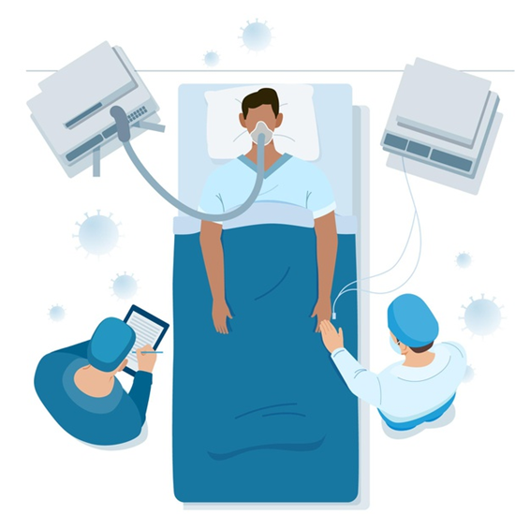
Course of Illness (cont.)
Patients with a psychiatric diagnosis stay in the hospital for a longer period of time compared to other patients
Comorbid medical diseases, need for oxygen treatment and mechanical ventilation are significantly higher in patients with psychiatric disorders
Presence of psychiatric diseases has a negative effect on the course of COVID-19
Oxygen requirement is higher due to the distress triggered by COVID-19 in patients with psychiatric disorders

Slide 21
05
Management

Slide 22

Management
Address the anxiety and depression with direct questions
Use empathic communication
Address the patient and families’ concerns

Slide 23

Management
Provide professional care for psychological distresses
Provide leisure activities in wards
Establish a phone/video line between the patients
and their family

Slide 24

Drug-drug interactions between antidepressant drugs and COVID-19 treatments
Patients with COVID-19 are at high risk for drug-drug interactions because they commonly receive multiple medications.
Drug-drug interactions can lead to serious and potentially lethal adverse events.

Slide 25
Common and Safe to
Use Psychotropics in COVID-19
Common types
  SSRIs (e.g., citalopram, escitalopram, sertraline, fluoxetine)
  SNRIs (e.g., venlafaxine, duloxetine)
  TCAs(e.g., amitriptyline, clomipramine, nortriptyline)
  Mirtazapine, Trazodone
Indications
  Treatment of depression, anxiety disorders, and obsessive-compulsive disorder.
Adverse Effects
  Gastritis, diarrhea, insomnia, and sexual dysfunction, hyponatremia, bleeding tendencies, impaired platelet function, serotonin syndrome
  Tricyclic antidepressants can cause weight gain, anticholinergic side effects, sedation.
Antidepressants

Slide 26
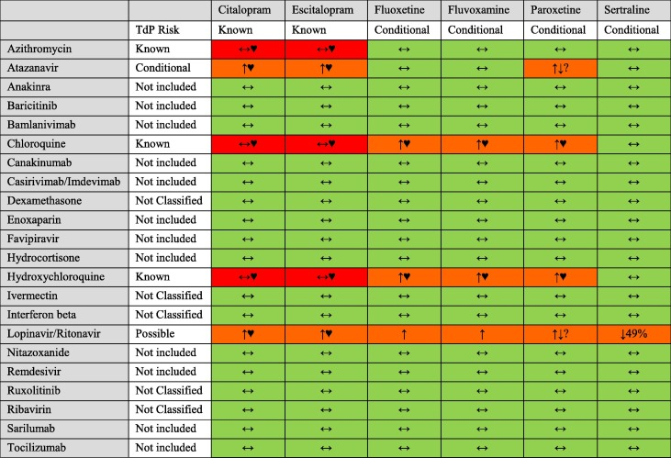









Slide 27

Common and Safe to
Use Psychotropics in COVID-19
Antidepressants
Drug interaction
  Lopinavir/ritonavir can increase the levels of many antidepressants including SSRIs, venlafaxine and TCAs.
  TCAs, citalopram and escitalopram may prolong QTc interval. Hence, they have to be used carefully with azithromycin, hydroxychloroquine and chloroquine.
  Methylprednisolone might decrease levels of TCAs
  SSRI's may increase the risk of bleeding (potential interactions between anticoagulants used for prophylaxis/treatment of hypercoagulability

Slide 28
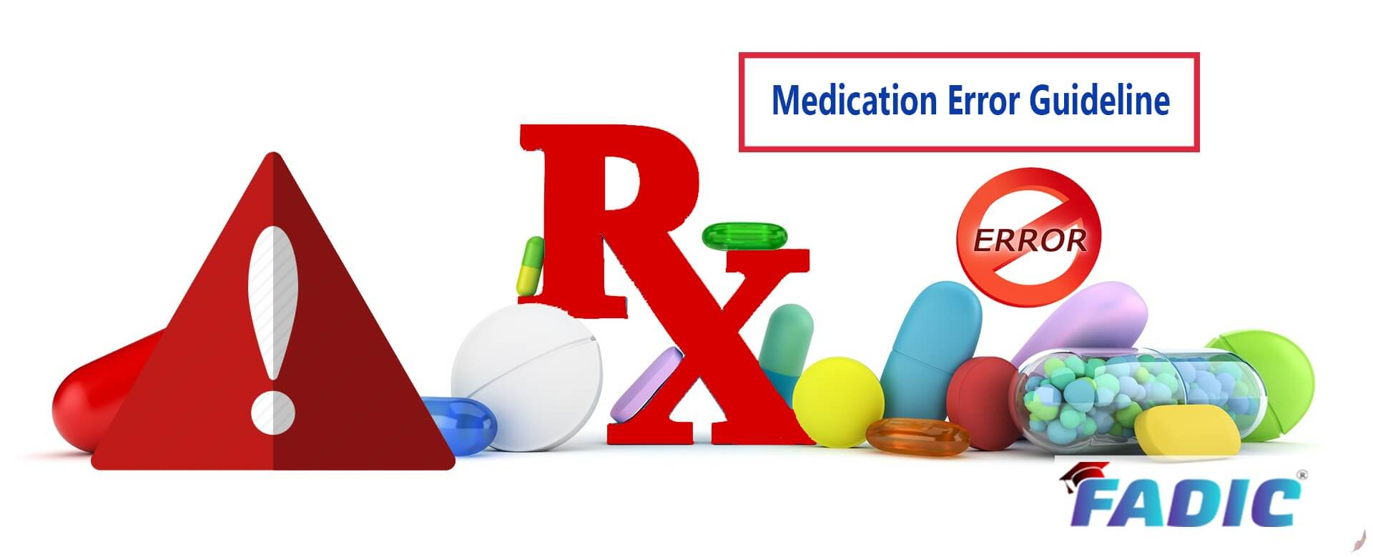

Common and Safe to
Use Psychotropics in COVID-19
Antidepressants
Precautions in COVID-19 patients
  Antidepressants, especially SSRIs, have been found to be safe in those with co-exiting medical conditions including respiratory and cardiovascular disorders.
  Drugs with anticholinergic effects potentially worsen delirium.
  SSRIs, especially sertraline may be the preferred drug due to it safety in comorbid medical conditions and lesser pharmacokinetic interactions.

Slide 29
Common and Safe to
Use Psychotropics in COVID-19
Lithium
Indications
  Treatment of resistant depression, and bipolar disorder
Adverse Effects
  Narrow therapeutic index (levels between 0.6-1.2 mEq/L).
  The risk of lithium toxicity in renal failure, dehydration, hyponatremia, and ingestion of NSAIDs/diuretics.
Precautions in COVID-19 patients
  Lithium is excreted unchanged in the urine and hence is the least likely to have specific drug interactions with antiviral drugs
  Propensity to cause cognitive effects in patients on multiple medications.

Slide 30

Common and Safe to
Use Psychotropics in COVID-19

Slide 31

Electroconvulsive Therapy
Outpatients
Before the 1st ECT session, a negative RT-PCR COVID-19 test, which is not earlier than 5 d, is mandatory
For subsequent sessions, negative rapid antigen COVID-19 test is mandatory once every 2 wks.
If the interval between two tests is more than 2 weeks, then RT-PCR COVID-19 test is repeated.
Inpatients
The admission happened only after the patient and his/her attendant tested negative for RT-PCR COVID-19 test.
During inpatient stay, preventive measures against COVID-19 is followed stringently.
Additional testing is not required unless the patient has high risk contact or develops symptoms suggestive of COVID-19 infection.

Slide 32


