Slide 1
COVID-19
Dr. M. Barati
IUMS
1400

Slide 2
Introduction
past 2 decades: outbreaks in East Asia( SARS, 2002) , Middle East ( MERS, 2012)
Wuhan City, Hubei Province, China, on 12 Dec 2019
WHO declare SARSCo-2 belong Coronaviridae (subfamily Coronavirinae), on 11 Feb 2020
Pandemic on 11 Mar 2020
Until 2020, six CoVs were known to infect humans (HCoV-229E, HCoV-NL63, HCoV-OC43, HCoV-HKU1, SARS-CoV, and MERS-CoV) , SARS-CoV-2 is the seventh
SARS-CoV-2 has 88% similarity to two SARS-like CoVs derived from bat, SARS-CoV (79% similarity) and MERS-CoV (nearly 50%)

Slide 3
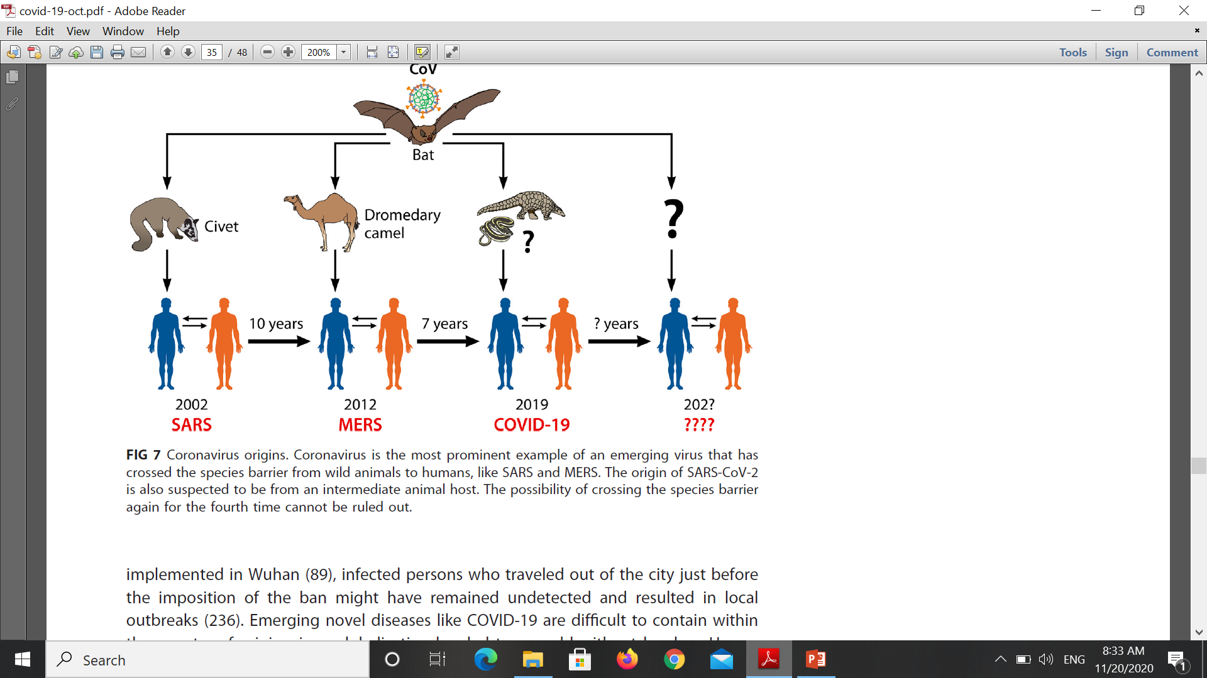

Slide 4
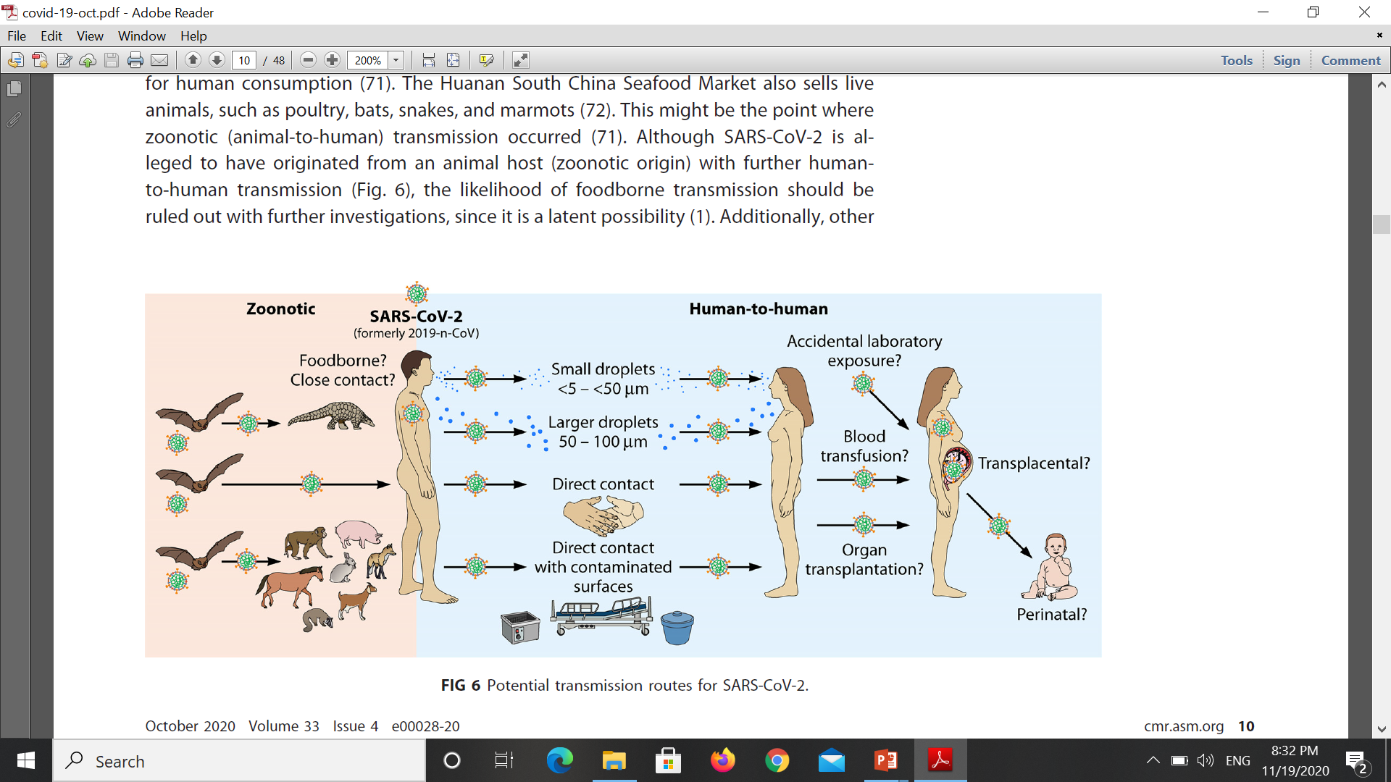

Slide 5
fragile outer lipid envelope
up to 1 day on cloth and wood
up to 2 days on glass
3-4 days on stainless steel and plastic
up to 7 days on the outer layer of a medical mask
4 hours on copper
24 hours on cardboard
survives in a wide range of pH values and ambient temperatures but is susceptible to heat and standard disinfection methods

Slide 6
Definition of a contact
during the 2 days before and the 14 days after the onset of symptoms of a probable or confirmed case:
1. face-to-face contact within 1 meter, at least 15 minutes
2. direct physical contact
3. direct care for a patient without using personal protective equipment
Max infectivity: first 3d
Infective: 1- Asymptomatic, 2- presymptomatic (1-3d), 3- symptomatic ( 14d)

Slide 7
Suspected COVID-19 case
clinical AND epidemiological criteria:
Clinical criteria:
1. Acute onset of fever AND cough; or
2. Acute onset of ANY THREE OR MORE : fever, cough, general weakness/fatigue, headache, myalgia, sore throat, coryza, dyspnoea, anorexia/nausea/vomiting, diarrhoea, altered mental status.
Epidemiological criteria:
1- Residing or working in or travel to an area with high risk of transmission ( within the 14 days)
2. Working in health setting, including within health facilities and within households,
A patient with severe acute respiratory illness, fever, cough, onset within the last 10 days, requires hospitalization

Slide 8
Probable COVID-19 case:
Suspected + contact with probable or confirmed case
suspected + chest imaging
• chest radiography: hazy opacities, often rounded in morphology, with peripheral and lower lung distribution
• chest CT: multiple bilateral ground glass opacities, often rounded in morphology, with peripheral and lower lung distribution
• lung ultrasound: thickened pleural lines, B lines (multifocal, discrete, or confluent), consolidative patterns with or without air bronchograms.
Recent onset of anosmia (loss of smell) or ageusia (loss of taste)
Death, not otherwise explained, in an adult with respiratory distress preceding death AND who was a contact of a probable or confirmed case

Slide 9
Confirmed COVID-19 case:
laboratory confirmation of COVID-19 infection, irrespective of clinical signs and symptoms
Isolation for all

Slide 10
Clinical presentations
Incubation period: 5-6 d ( 14)
Asymptomatic 17%(14-20%)
Severity: Mild: 40%
Moderate: 40%
Severe: 15%
Critical: 5%
fever (83–99%), cough (59–82%), fatigue (44–70%), anorexia (40–84%), shortness of breath (31–40%), myalgias (11–35%), sore throat, nasal congestion, headache, diarrhoea, nausea and vomiting, loss of smell (anosmia) or loss of taste (ageusia), diarrhoea, loss of appetite, delirium

Slide 11
(34%) anxiety, (28%) depression
neurological manifestations : confusion (or delirium), agitation. Delirium, acute cerebrovascular disease ( ischaemic, haemorrhagic stroke, Guillain-Barré meningo-encephalitis
milder in children
pregnant and recently pregnant women: less likely to be symptomatic, if severe at higher risk of ICU, invasive ventilation or extra corporeal membrane oxygenation (ECMO)
risk factors: Older maternal age, high body mass index (BMI), non-white ethnicity, pre-existing comorbidities, chronic hypertension, pre-existing diabetes
long covid

Slide 12
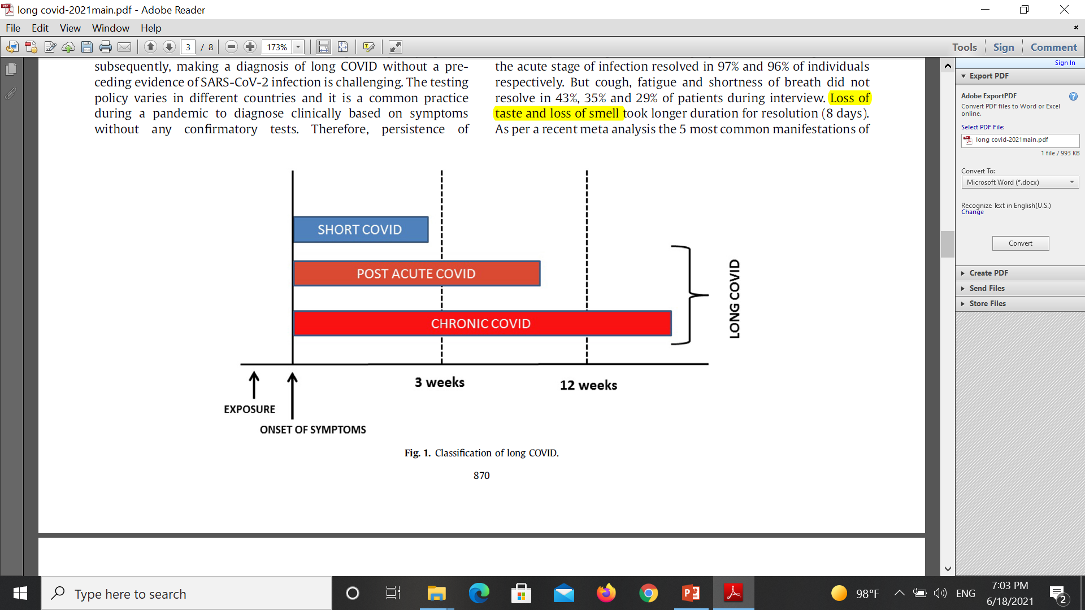
Long COVID= post-COVID syndrome
continuous / relapsing , remitting, new /symptoms of acute, after clinical recovery
Italian survey: 87% ( hospitalized) one symptom , 32% two symptoms, 55% three or more
Most common: fatigue (58%), headache (44%), attention disorder (27%), hair loss (25%), dyspnea (24%)

Slide 13
Risk Factors
twice common in women
Increasing age
more than 5 symptoms in the acute stage Symptoms
Co-morbidities
Obesity (BMI>30
psychiatric conditions (anxiety disorder, depression, posttraumatic stress disorder, paranoia, obsessive-compulsive disorder and schizophrenia)

Slide 14
Pathophysiology
sequelae of organ damage,
persistence of chronic inflammation (convalescent phase)
Immune response/auto antibody generation,
persistence of virus
nonspecific effect of hospitalization,
sequelae of critical illness, post-intensive care syndrome,
adverse effects of medications

Slide 15
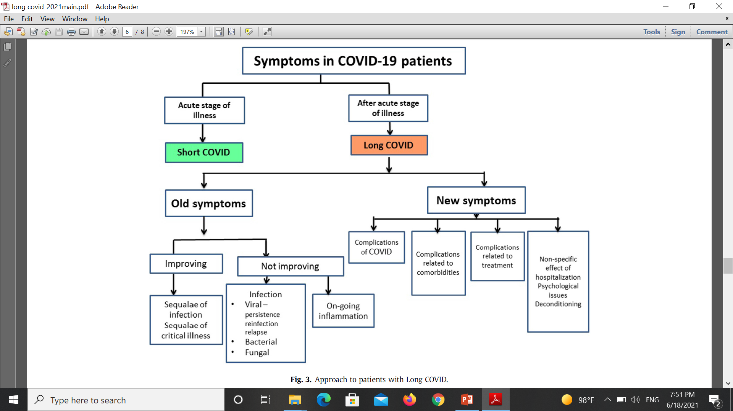

Slide 16
Common symptoms
Profound fatigue: more than 50% , no association between development of fatigue, COVID-19 severity and level of inflammatory markers, Female sex, depression/ anxiety, fatigue persists for 6 months or longer= chronic fatigue syndrome, no objective methods to diagnose it
pulmonary complication: chronic cough, fibrotic lung disease, bronchiectasis, pulmonary vascular disease
Cardiac: labile heart rate and blood pressure responses to activity ,myocarditis , pericarditis, impaired myocardial flow reserve from micro vascular injury, myocardial infarction, cardiac failure, life-threatening arrhythmias, sudden cardiac death , Coronary artery aneurysm, aortic aneurysm, accelerated atherosclerosis, venous and arterial thromboembolic disease, pulmonary embolism
neuro-psychiatric: Headache, tremor, problem with attention and concentration; cognitive blunting (“brain fog”), dysfunction in the peripheral nerves; and mental health problems like anxiety, depression and PTSD , stroke , altered mental status, encephalopathy or encephalitis, agnoses, ICU-acquired weakness, deconditioning, myopathies, neuropathies and delirium
Inflammatory arthralgia
coagulopathy (arterial and venous thrombosis )
Notes:
Post viral fatigues are commonly reported in people with viral infections like EBV, Ebola, influenza, SARS and MERS
Chronic shortness of breath could be the result of residual pulmonary involvement, which is known to clear slowly with time. Unfortunately, many asymptomatic patients with COVD-19 have significant lung involvement, as shown on CT scans. COVID-19 may lead to pulmonary fibrosis, which can result in persistence of dyspnea and need for supplementary oxygen.

Slide 17
Approach to patients with long COVID
history and clinical examination
symptoms suggestive of long COVID (without previous evidence of SARS-CoV-2): antibody positivity
Categorization of symptoms according to the organ system involved will help to identify the etiology

Slide 18
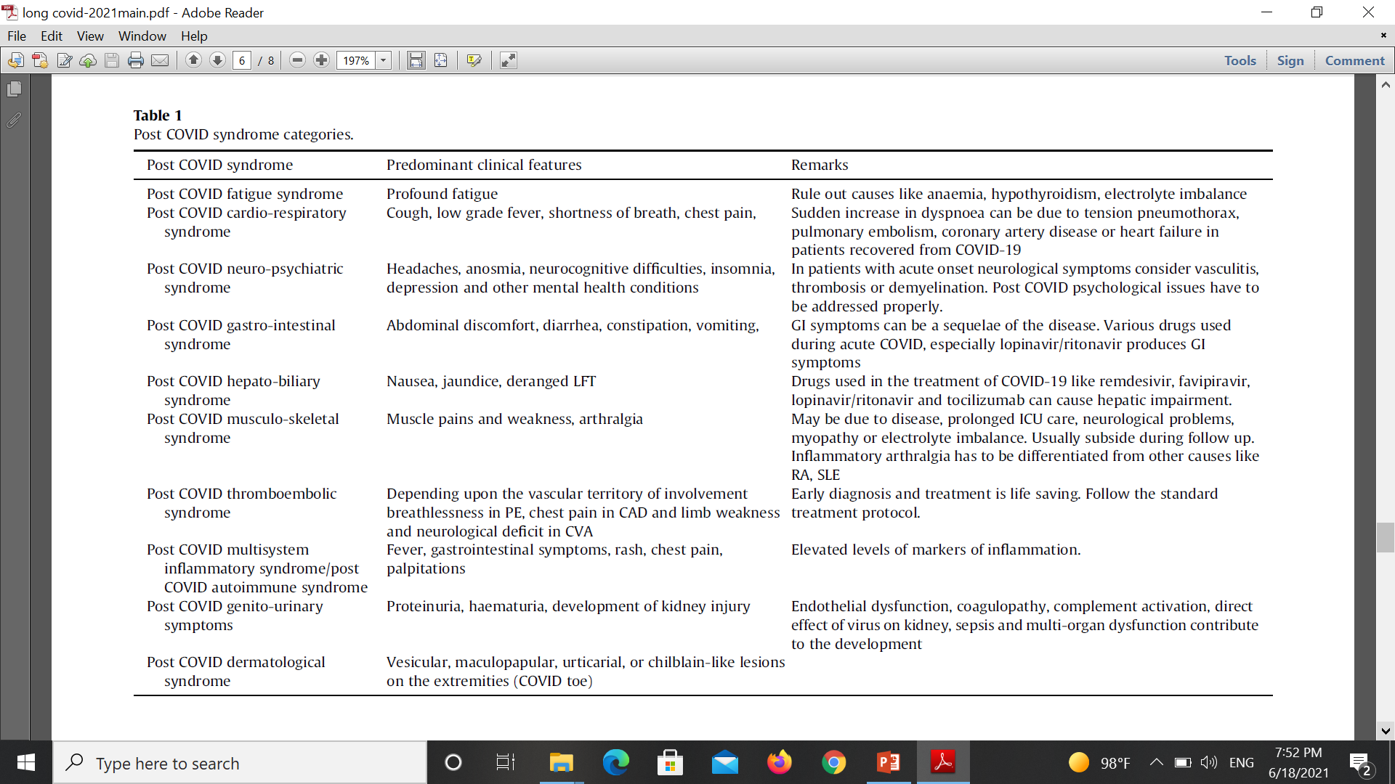

Slide 19
Management
Evaluation
symptomatic treatment
treatment of underlying problems
Physiotherapy
occupational therapy
psychological support

Slide 20
High risk : >65y
Cardiovascular ( heart failure, coronary, cardiomyopathy)
Malignancy
CRF
COPD
BMI≥30
Sickle cell anemia
Solid organ transplantation
Diabetes type 2
Moderate to severe asthma
CVA
Hypertension
Pregnancy
Smoking
GCS ( prednisolone > 20 mg/d for >2 W / 600 mg)
Immunosuppressive therapy
Bone marrow transplantation
HIV
Immunocompromised
Metabolic dis
Liver dis
Neurologic dis
chronic lung dis
Diabetes type 1
Thalassemia
Notes:
Age more than 60 years (increasing with age).
Underlying noncommunicable diseases (NCDs): diabetes, hypertension, cardiac disease, chronic lung disease, cerebrovascular disease, dementia, mental disorders, chronic kidney disease, immunosuppression, obesity and cancer have been associated with higher mortality
In pregnancy, increasing maternal age, high BMI, non-white ethnicity, chronic conditions and pregnancy specific conditions such as gestational diabetes and pre-eclampsia
Smoking

Slide 21
Time course
Zero: Asymptomatic/ presymptomatic
One: Early infection
Two: respiratory phase
1- moderate : respiratory symptom ,SPO2= 90-93%
2- severe: dyspnea, tachypnea ( >30), SpO2<90% , CT involvement >50%
Three: hyper inflammation phase

Slide 23
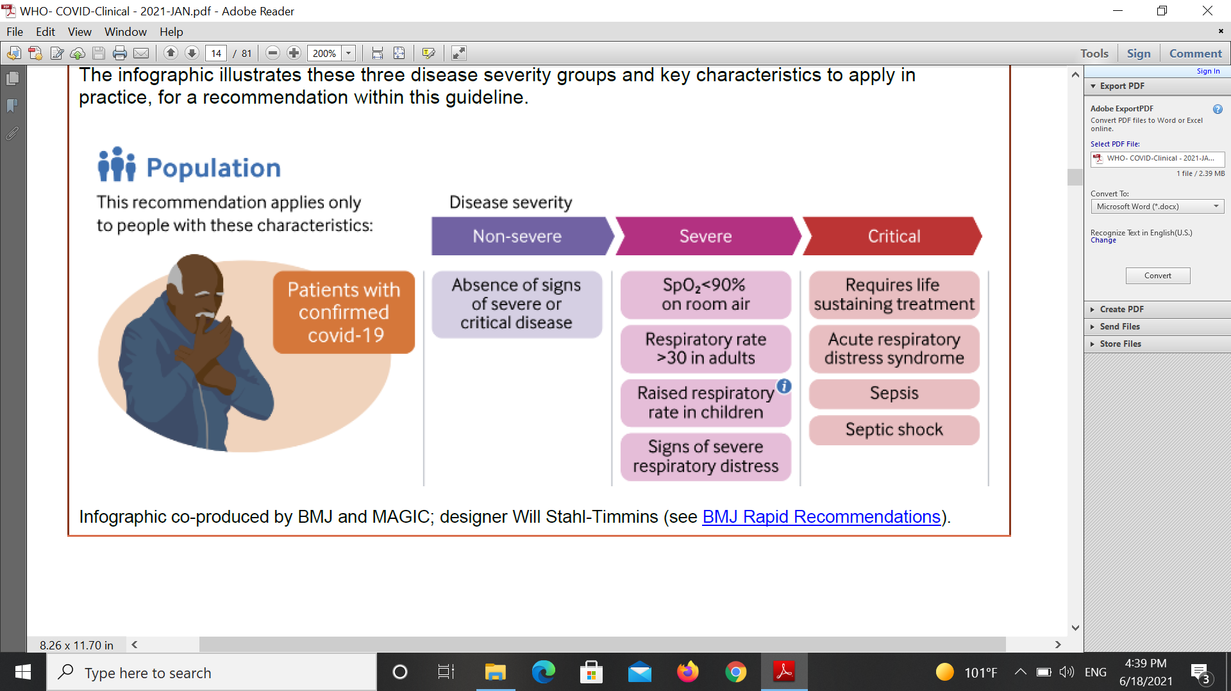

Slide 24
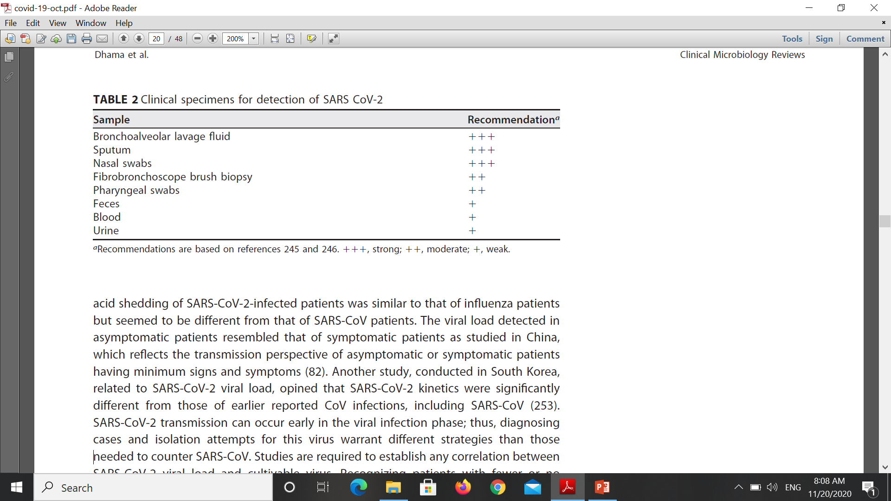
Lab
RT PCR
Serology
CT-SCAN

Slide 25
first week: high viral loads in the upper respiratory tract ( nasopharyngeal and oropharyngeal specimens)
After first week: LRT samples
if URT are negative and clinical suspicion remains, also collect specimens from the LRT
NAAT testing
antigen testing (rapid immunoassays)
serology assays : If repetitive negative NAAT/RT-PCR results are obtained from a patient strongly suspected, a paired serum specimen

Slide 26
Patients
screening all persons at the first point of contact with the health system: Use a simple set of questions
Distance : >1m
cover nose and mouth during coughing or sneezing with tissue or flexed elbow, dispose of tissues safely immediately after use in a closed bin and perform hand hygiene after contact with respiratory secretion
Suspected, probable, confirmed: surgical mask, isolated room

Slide 27
Discontinue isolation
For symptomatic patients: 10 days after symptom onset, plus at least 3 days without symptoms (without fever and respiratory symptoms).
For asymptomatic patients: 10 days after test positive.
Notes:
For example, if patient had symptoms for 2 days, then the patient could be released from isolation after 10 days + 3 = 13 days from date of symptom onset; for a patient with symptoms for 14 days, then the patient can be discharged 14 days + 3 days = 17 days from date of symptom onset; for a patient with symptoms for 30 days, the patient can be discharged 30 days + 3 days = 33 days after symptom onset.
Countries may choose to continue to use testing as part of the release criteria. If so, the initial recommendation of two negative PCR tests at least 24 hours apart can be used

