Slide 1
Physician burnout
مهدی نصراصفهانی
عضو هیات علمی دانشگاه علوم پزشکی ایران
تیر 1400

Slide 2

Physician burnout
Physician burnout, defined as a work-related syndrome involving emotional exhaustion, depersonalization, and a sense of reduced personal accomplishment
Lancet editorial Vol 394 July 13 2019

Slide 3
ICD-11
The 11th Revision of ICD in May, 2019, provided a more detailed definition of burnout, characterizing it as a syndrome of three dimensions
Feelings of energy depletion or exhaustion,
Increased mental distance from one's job or feelings of cynicism or negativism about one's job,
Reduced professional efficacy.
Notably, burnout has been further emphasized in ICD-11 as an occupational phenomenon rather than a medical condition. The need for health system reform in response to physician burnout cannot be delayed.
The 11th Revision of ICD (ICD-11), 2019

Slide 4
COVID-19 is increasing physician burnout
Physician burnout was already a growing problem, and the COVID-19 pandemic has only made it worse, according to a survey by Medscape. The survey queried more than 7,500 doctors from around the world, but the bulk of them - almost 5,000 - practice in the U.S.
Healthcare 2020, 8, 421; doi:10.3390/healthcare8040421

Slide 5
COVID-19 is increasing physician burnout
Almost two-thirds (64%) of the U.S. physicians surveyed said the pandemic had intensified their sense of burnout.
About half said they had personally treated patients with COVID-19.
When asked about the sources of stress caused by the pandemic, some responders cited treating patients who were likely to die, and others cited being exposed to COVID-19 without being given the proper personal protective equipment (PPE).
One-fifth of doctors in Spain and the United Kingdom said they had personally contracted COVID-19, while only 5-6% in the U.S., Germany, and Portugal said they had.
Healthcare 2020, 8, 421; doi:10.3390/healthcare8040421

Slide 6
COVID-19 is increasing physician burnout
When asked about the ways they’re coping with the stress of the pandemic, 29% of U.S. doctors said they were eating more, 19% said they were drinking more alcohol, and 2% said they were taking more prescription stimulants and medications.
Among U.S. physicians, 46% reported increased loneliness; only Portugal and Brazil had higher rates.
Healthcare 2020, 8, 421; doi:10.3390/healthcare8040421

Slide 7
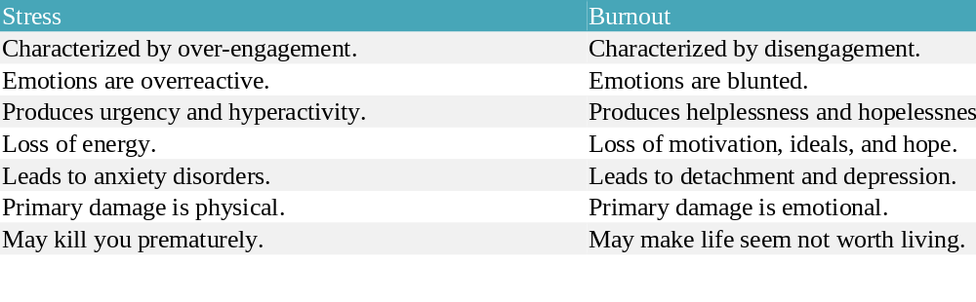
The difference between stress and burnout

Slide 8
Physician burnout contributors
Work factors (excessive workloads and work hours)
Personal characteristics (work-life imbalance, inadequate support, sleep deprivation)
Other factors identified in addition to usual contributors to burnout are lack of control over procedures, infection control measures, the false notion of safety precautions, poor communication and directives, lack of preparedness and emotional support, inadequate personal protective equipment (PPE), and perceived fatality

Slide 9
Other factor
Additionally, workplace ethics and culture vary among different countries, and there is a scarcity of data on physician burnout in low-income and middle-income countries (LMICs). Colin West and colleagues report a systematic review and meta-analysis on interventions to prevent and reduce physician burnout, but most of the included studies of sufficient quality were done in high-income countries. Disturbingly, physician burnout is still a hidden but rapidly growing epidemic in LMICs, given the soaring and large demands for health-care services in these countries
Lancet editorial Vol 394 July 13 2019

Slide 10
Signs and symptoms
Physical
Emotional
behavioral

Slide 11
Physical signs and symptoms of burnout
Feeling tired and drained most of the time
Frequent headache or muscle pain
Change in appetite or sleep habit
Lowered immunity, frequent illnesses

Slide 12
Emotional signs and symptoms of burnout
Sense of failure and self-doubt
Loss of motivation
Feeling helplessness, trapped, and defeated
Increasingly cynical and negative outlook
Detachment, feeling alone in the world
Decreased satisfaction and sense of accomplishment

Slide 13
Behavioral signs and symptoms of burnout
Withdrawing from responsibility
Isolating yourself from others
Procrastinating, taking longer to get things done
Using food, drugs, or alcohol to cope
Taking out your frustration on others
Skipping work or coming in late and leaving early

Slide 14
Causes of burnout
Work-related causes of burnout
Lifestyle causes of burnout
Personality traits can contribute to burnout

Slide 15
Work-related causes of burnout
Feeling like you have little or no control over your work.
Lack of recognition or reward for good work.
Unclear or overly demanding job expectations.
Doing work that’s monotonous or unchallenging.
Working in a chaotic or high-pressure environment

Slide 16
Lifestyle causes of burnout
Working too much, without enough time for socializing or relaxing.
Lack of close, supportive relationships.
Taking on too many responsibilities, without enough help from others.
Not getting enough sleep.

Slide 17
Personality traits can contribute to burnout
Perfectionistic tendencies; nothing is ever good enough.
Pessimistic view of yourself and the world.
The need to be in control; reluctance to delegate to others.
High-achieving, Type A personality.

Slide 18
Burnout intervention strategies
Strategies at the individual level or self-care
Burnout at the work level
Administrative or institutional level strategies

Slide 19
Dealing with burnout
Whether you recognize the warning signs of impending burnout or you’re already past the breaking point, trying to push through the exhaustion and continuing as you have been will only cause further emotional and physical damage. Now is the time to pause and change direction by learning how you can help yourself overcome burnout and feel healthy and positive again.

Slide 20
Dealing with burnout requires the “Three R” approach:
Recognize. Watch for the warning signs of burnout.
Reverse. Undo the damage by seeking support and managing stress.
Resilience. The capacity to recover quickly from difficulties; toughness
(the ability to deal with hardship or to cope in difficult situations.)

Slide 21
Reevaluate your priorities
Take a daily break from technology (Set a time each day when you completely disconnect. Put away your laptop, turn off your phone, and stop checking email or social media.)
Nourish your creative side (Creativity is a powerful antidote to burnout. Try something new, start a fun project, or resume a favorite hobby. Choose activities that have nothing to do with work or whatever is causing your stress.)
Set aside relaxation time: Relaxation techniques such as yoga, meditation, and deep breathing activate the body’s relaxation response, a state of restfulness that is the opposite of the stress response.
Get plenty of sleep: Feeling tired can exacerbate burnout by causing you to think irrationally. Keep your cool in stressful situations by getting a good night’s sleep.
Make exercise a priority

Slide 22
Support your mood and energy levels with a healthy diet
Minimize sugar and refined carbs: You may crave sugary snacks or comfort foods such as pasta or French fries, but these high-carbohydrate foods quickly lead to a crash in mood and energy.
Reduce your high intake of foods that can adversely affect your mood, such as caffeine, unhealthy fats, and foods with chemical preservatives or hormones.
Avoid nicotine. Smoking when you’re feeling stressed may seem calming, but nicotine is a powerful stimulant, leading to higher, not lower, levels of anxiety.
Drink alcohol in moderation. Alcohol temporarily reduces worry, but too much can cause anxiety as it wears off.

Slide 23
Turn to other people
Reach out to those closest to you
Be more sociable with your coworkers
Limit your contact with negative people
Connect with a cause or a community group that is personally meaningful to you

Slide 24
Consult a psychiatrist (seeking professional help)

Slide 25
Burnout intervention strategies
Strategies at the individual level or self-care
Burnout at the work level it is important to clearly define your work-time and your off-time to your colleagues, employers, patients, and most importantly, yourself
Administrative or institutional level strategies

