Slide 1
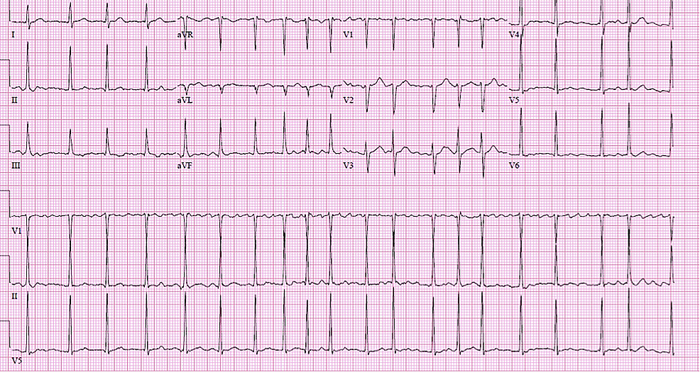
Delirium Cordis
Saeed Oraii MD, Cardiologist
Interventional Electrophysiologist
The Arrhythmia Center
Internal Medicine Symposium 2021
Modified from a presentation at Daily Cardiology Symposium 2021

Slide 2
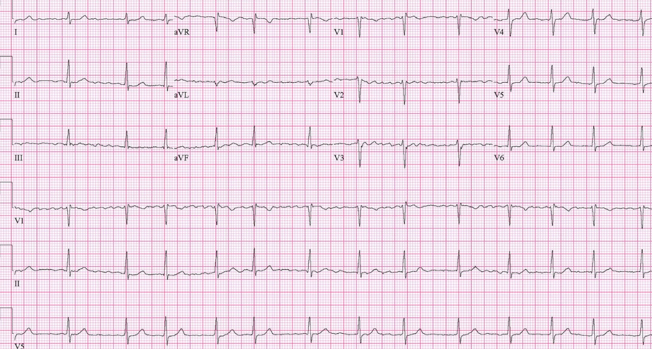
Clinical History
A 67-year-old lady is visited due to a history of recent onset rapid palpitations.

Slide 3
Clinical History
She is now asymptomatic with NSR on ECG.
PMH: HTN (5 years)
Drugs: Amlodipine 5mg daily, Bisoprolol 2.5mg bid
Ph/Ex.: BMI 32 kg/m2, BP 143/85 mmHg, otherwise Unremarkable

Slide 4
Diagnosis of AF
2020 ESC Guidelines for the diagnosis and management of atrial fibrillation

Slide 5
Clinical or Subclinical
2020 ESC Guidelines for the diagnosis and management of atrial fibrillation

Slide 6
What do you recommend as the next step?

Slide 7
4S AF Scheme
2020 ESC Guidelines for the diagnosis and management of atrial fibrillation

Slide 8
Diagnostic Work-up
2020 ESC Guidelines for the diagnosis and management of atrial fibrillation

Slide 9
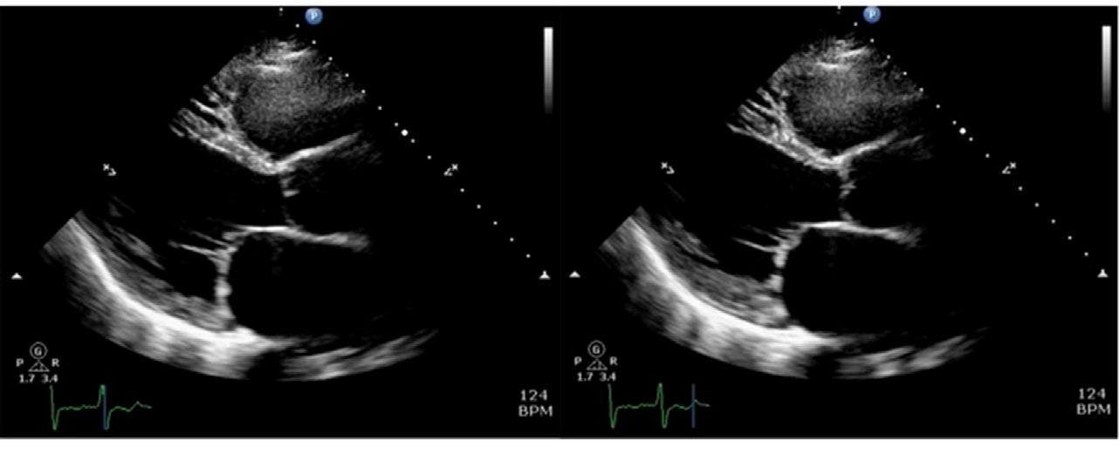
Further work-up
Lab tests normal except for LDL of 140 mg/dl
Echocardiogram: LVEF 60%, mild LVH with IVS 12 mm, LA diameter 42 mm
Holter monitoring: Mean HR 58 bpm, Frequent atrial ectopies

Slide 10
What’s her CHA2DS2-VASc score?
Risk Index | Score
Congestive heart failure | 1
Hypertension | 1
Age >75 | 2
Diabetes mellitus | 1
prior Stroke or TIA | 2
Vascular disease* | 1
Age 65-74 | 1
Sex category (female) | 1
0
1
2
3

Slide 11
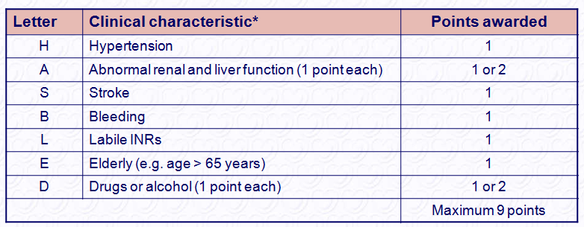
What’s her bleeding risk?
HAS-BLED score
0
1
2
3
*Hypertension is defined as systolic blood pressure > 160 mmHg.
INR = international normalized ratio.

Slide 12
Would you start anticoagulation?
2020 ESC Guidelines for the diagnosis and management of atrial fibrillation

Slide 13
Divergence of opinion in score 1
2020 ESC Guidelines
2019 AHA/ACC/HRS AHA/ACC/HRS Guidelines
COR | LOE | Recommendations
IIb | C- LD | For patients with AF and a CHA₂DS₂-VASc score of 1 in men and 2 in women, prescribing an oral anticoagulant to reduce thromboembolic stroke risk may be considered.

Slide 14
Do not forget about Appropriate Dosing!

Slide 15
What is the role of bleeding scores?!
2020 ESC Guidelines for the diagnosis and management of atrial fibrillation

Slide 16
What would you recommend for symptom management in this patient?
Beta blockers only
Pill in the pocket approach
Long term anti-arrhythmic drug therapy
AF ablation
Pace and ablate

Slide 17
Integrated AF Management
Patient Centered
2020 ESC Guidelines for the diagnosis and management of atrial fibrillation

Slide 18


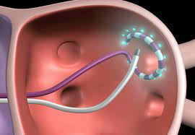
Drugs vs. Catheter Ablation

Slide 19
Factors favoring Catheter Ablation
Younger age
Arrhythmia induced cardiomyopathy
No or few comorbidities/ heart disease
Higher arrhythmia burden
More severe symptoms
No or minimal atrial substrate/ remodeling

Slide 20
What drug would you choose if drug therapy is preferred?
Flecainide
Propafenone
Sotalol
Amiodarone

Slide 21
Choice of AADs
2020 ESC Guidelines for the diagnosis and management of atrial fibrillation

Slide 22
Indications for Catheter Ablation in Paroxysmal AF
2020 ESC Guidelines for the diagnosis and management of atrial fibrillation

Slide 23
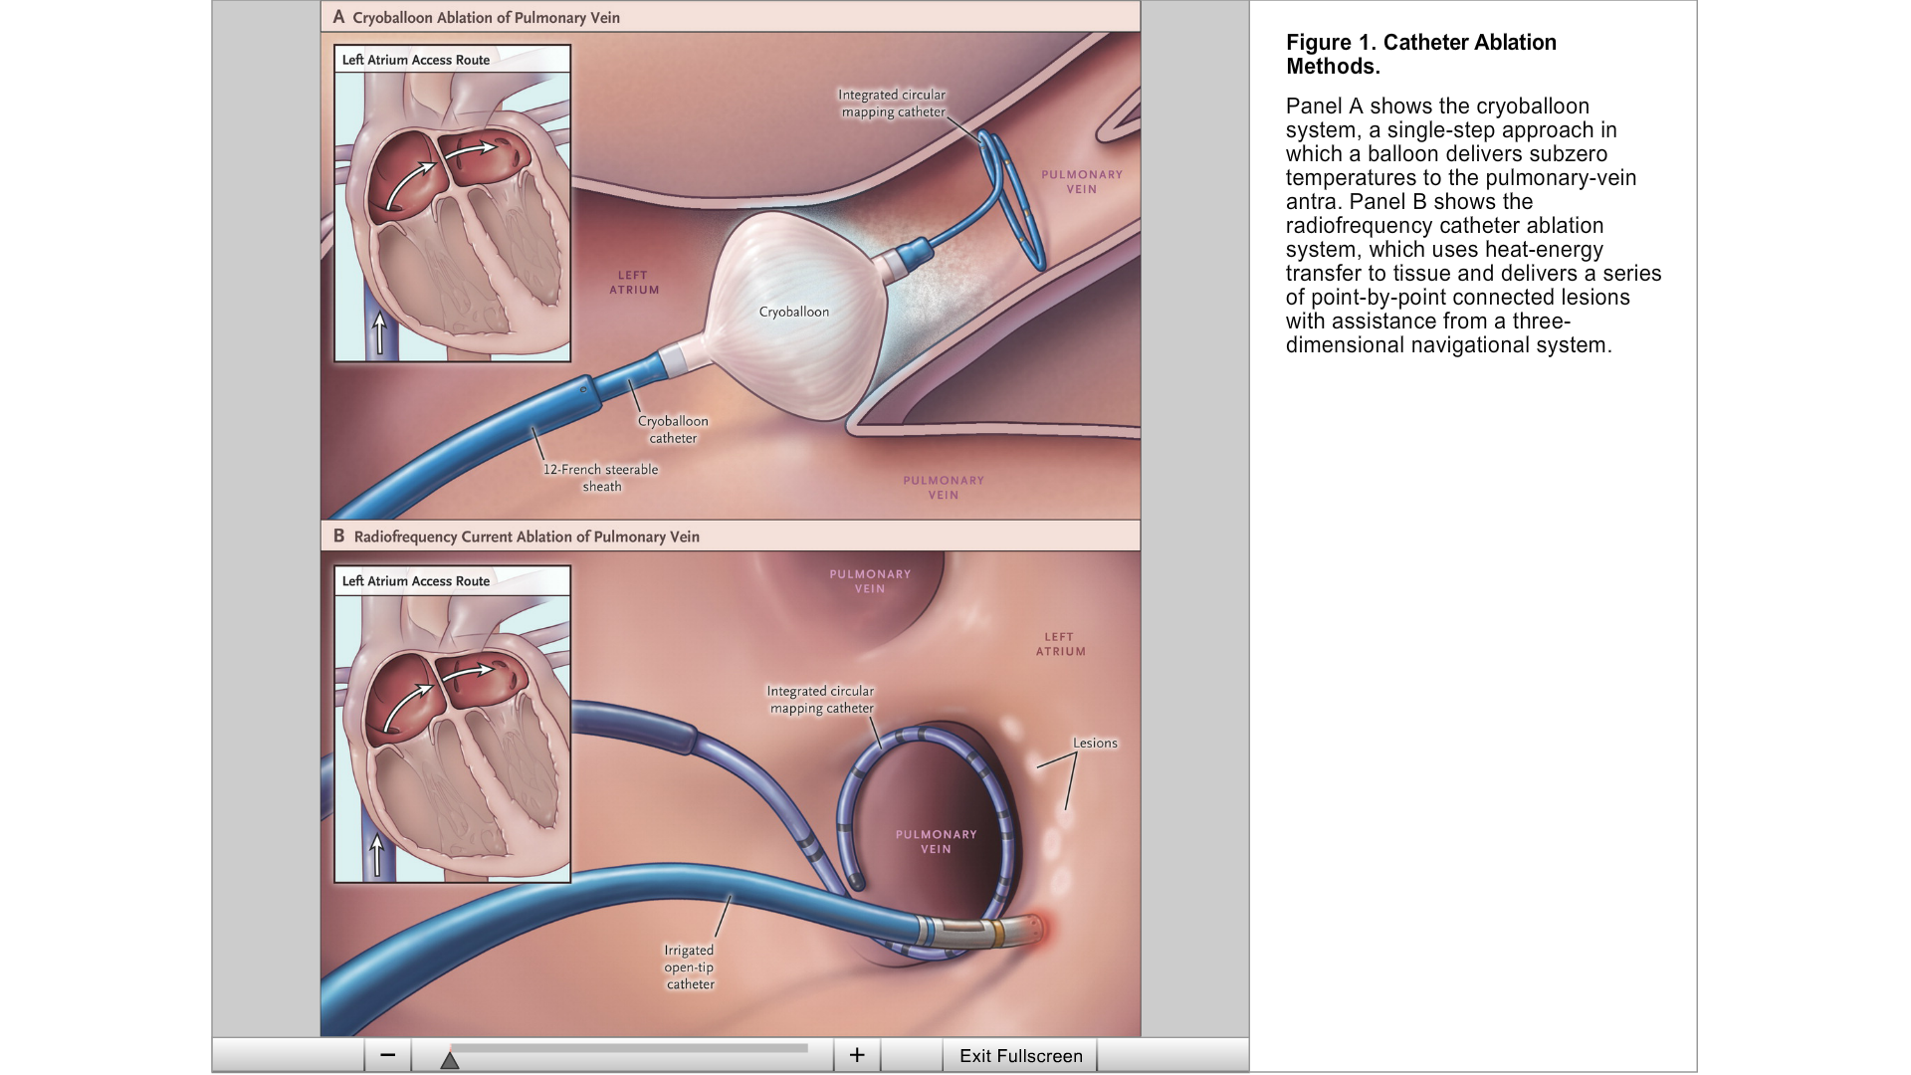
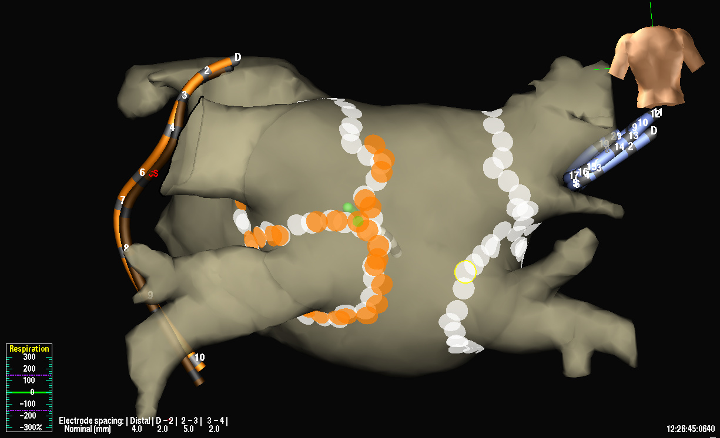
PV Isolation by RF Ablation

Slide 24
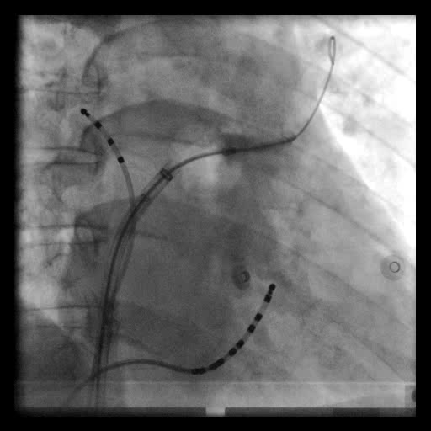
Cryoballoon Ablation

Slide 25
Importance of Risk Factors for AF
2020 ESC Guidelines for the diagnosis and management of atrial fibrillation

Slide 26
Management of
Risk Factors and Comorbidities
2020 ESC Guidelines for the diagnosis and management of atrial fibrillation

Slide 27
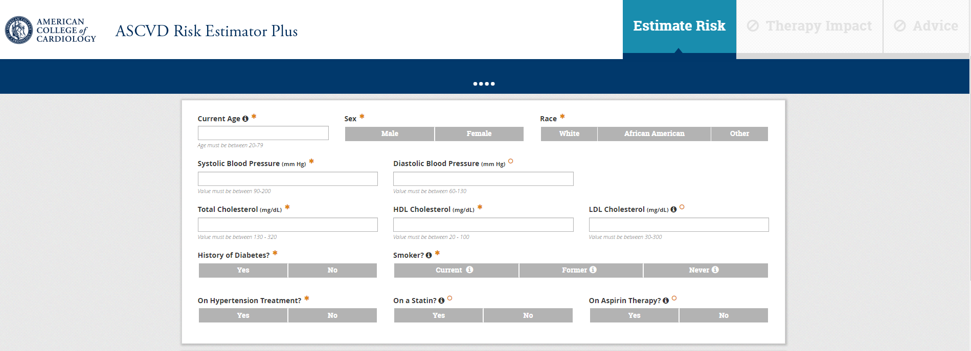
ASCVD Risk Estimation

Slide 28
Our patient’s summary
67-year-old lady with symptomatic clinical paroxysmal AF
Uncontrolled hypertension
Obese (BMI 32)
High LDL with intermediate ASCVD risk
Medications: Amlodipine daily and Bisoprolol 2.5 bid

Slide 29
Treat AF: The ABC Pathway
2020 ESC Guidelines for the diagnosis and management of atrial fibrillation

Slide 30
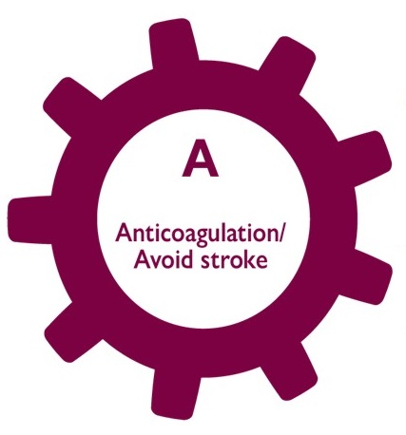
Recommendations:
CHA2DS2-VASc score of 3 with normal GFR
  Full dose NOAC was advised.
  Precautions, compliance, regular Cr measurement were discussed.
HAS-BLED score of 1
  Better hypertension control was emphasized.

Slide 31

Recommendations:
AF management options were fully discussed with the patient.
Despite being a good candidate for AF ablation, anti-arrhythmic drug therapy was chosen for the first step.
Considering the absence of major structural heart disease or comorbidities Flecainide was advised with appropriate precautions and the necessary follow-up routines.
Bisoprolol was continued along with Flecainide pending careful follow-up for HR.

Slide 32

Recommendations:
Lifestyle modifications with regular exercise and weight reduction were advised.
Adjustment of anti-hypertensive medications with combination pills incorporating ACEI/ARB was recommended.
Intermediate risk ASCVD score >> Statin was recommended if a trial of lifestyle modifications prove to be ineffective.

Slide 33


The Arrhythmia Center
WWW.IranEP.Center
info@IranEP.center

