Slide 1

LUNG POCUS
(Point-of-care Ultrasound)

Slide 2

Presented By :
Dr Mahya Naderkhani
M.D/ Emergency Medicine Specialist Assistant Professor of IUMS
Rasool - e - Akram General Hospital

Slide 3
Learning Point!
We propose the use of Lung POCUS in the diagnostic definition and timely treatment of the patient with acute respiratory failure and
hemodynamic instability, before a possible evolution into cardiac arrest.

Slide 4
Lung ultrasound can easily diagnose the following diseases:
Pneumothorax
Pulmonary Edema
Pneumonia
COPD
Asthma
Pleural Effusion
PTE

Slide 5
The Benefit of Lung POCUS
This procedure is simple(Easy-to-perform)
It takes fewer than 3 minutes to complete
Noninvasive
It can be done many times
The ultrasound approach represents the extension of the physical examination and allows the physician to optimise the diagnostic definition and therapeutic management

Slide 6
The limitations of Lung POCUS
Subcutaneous emphysema: ultrasound waves can’t pass through the air in the skin to evaluate the lungs
Obesity : may be difficult to see the lung in severely obese patients

Slide 7
How to perform a Lung Ultrasound Protocol?

Slide 8
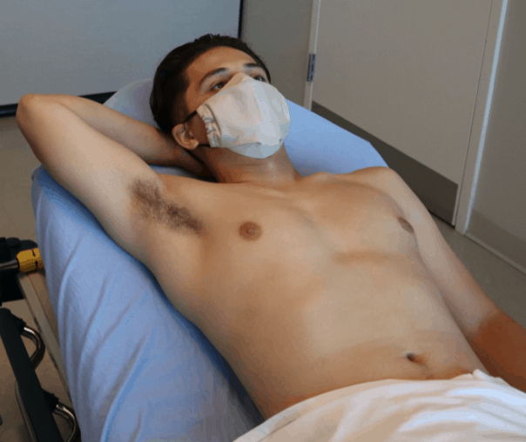
Patient in the supine position
If you’re scanning the right lung, you will ask the patient to lift their right arm and place their hand behind their head, and vice versa for the left lung.

Slide 9
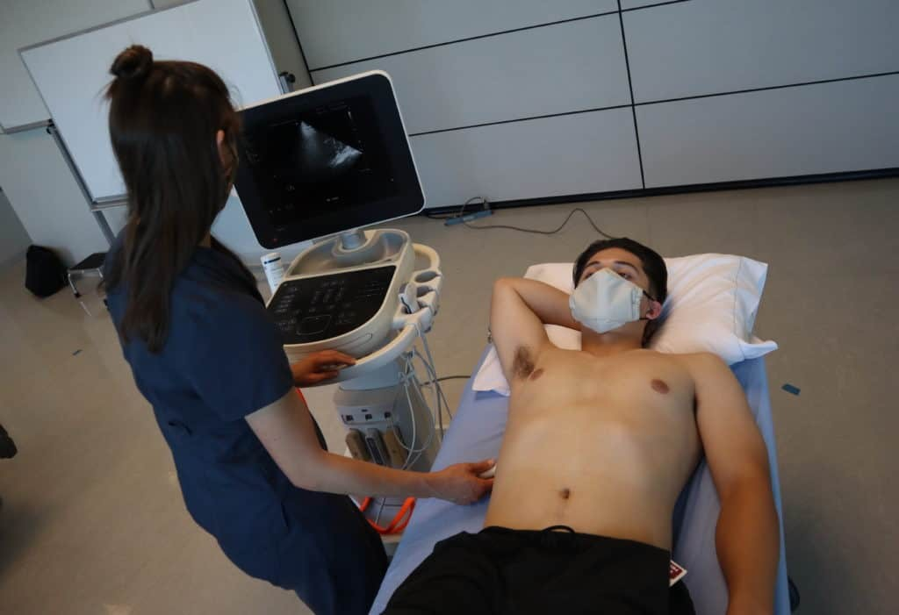
Place the machine on the patient’s right side so you can scan with your right hand and manipulate ultrasound buttons with your left hand.

Slide 10
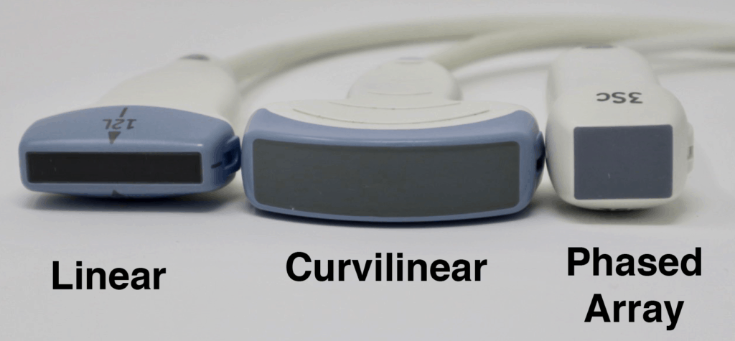
What ultrasound probe is used for lung ultrasound?
Curvilinear Ultrasound Probe or Phased Array Probe.
The linear transducer may be used for shallow imaging to scan the pleura close to the chest wall.

Slide 11
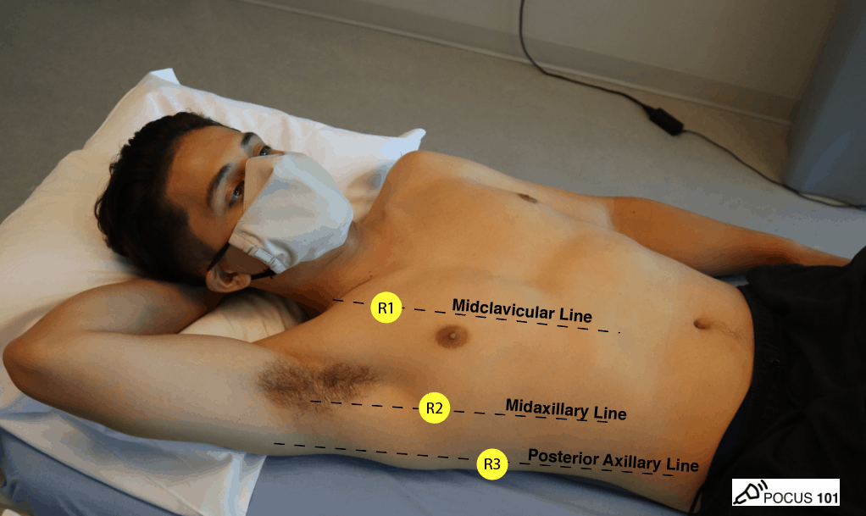
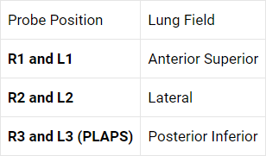
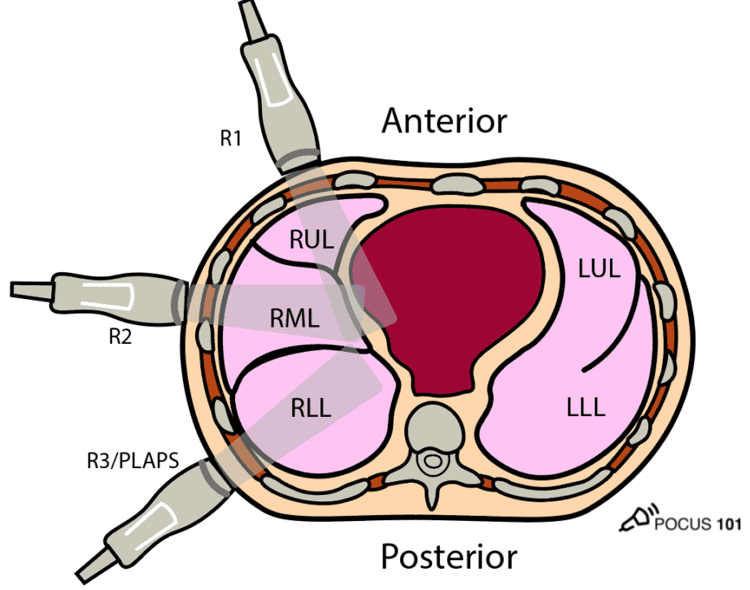
Defining the 6-Point Lung Ultrasound Exam

Slide 12
Lung Ultrasound of ANTERIOR Chest (R1/L1)
Point 1 (R1 and L1) assesses the anterior chest.
This point will be most relevant when assessing for pneumothorax and/or interstitial edema.
Point your indicator towards the patient’s head.
Place your probe at the mid-clavicular line at the 2nd intercostal space of the right (R1) and left (L1) lungs respectively
Anchor your probe in the space between two ribs.

Slide 13
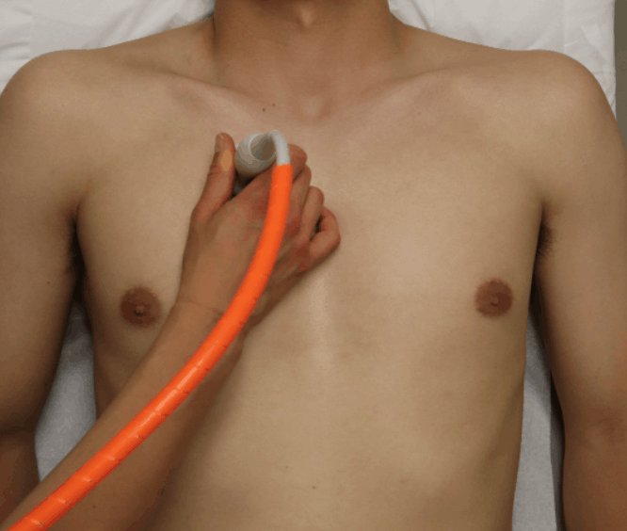

Slide 14
Identify Two Rib Shadows (Batwing Sign)
The first lung ultrasound finding to confirm you are in the correct position is to look for the two rib shadows or the “Batwing Sign.”
This ensures that your probe is in between two ribs.

Slide 15
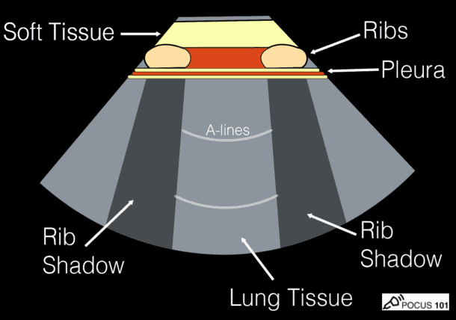
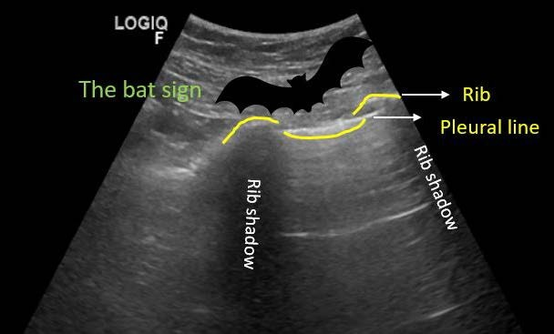

Slide 16
Bedside lung ultrasound in emergency (BLUE)

Slide 17
Bedside lung ultrasound in emergency (BLUE) is a basic point-of-care ultrasound (POCUS) examination performed for undifferentiated respiratory failure at the bedside, immediately after the physical examination
and before echocardiography.

Slide 18
BLUE Protocol
Presence or Absence of:
lung sliding
A lines and B lines
PLAPS
A
noncompressible deep vein

Slide 19
Identify Lung Sliding
The next finding you will want to look for is lung sliding.
Lung sliding is a normal finding where the visceral and parietal pleura slide back and forth on one another as the patient breathes.
This is a simple finding but extremely useful since lung sliding definitely means that the visceral and parietal pleura are next to each other, effectively ruling out pathology such as pneumothorax.
Lung sliding can be seen with the phased array and curvilinear ultrasound probes.

Slide 20
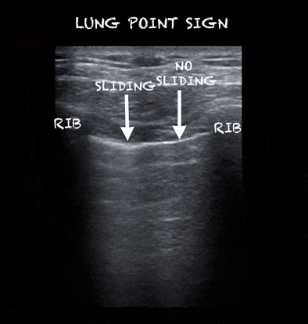
Lung Sliding

Slide 21
A-lines
Horizontal lines
hyperechoic
Arising from the pleural line
Separated by regular intervals that are equal to the distance between the skin and the pleural line

Slide 22
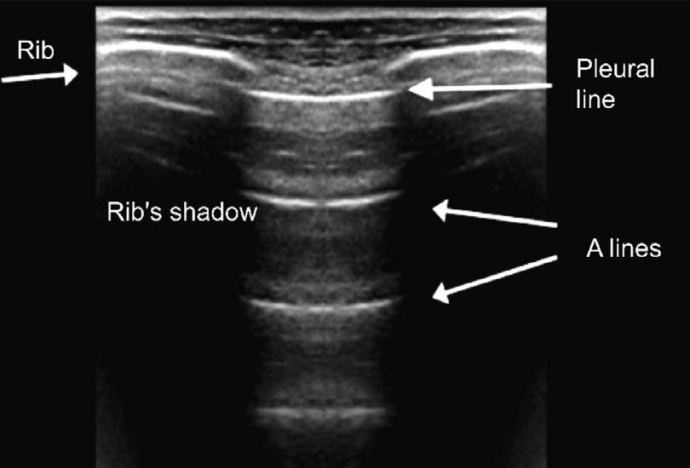
A-lines

Slide 23
A-lines
This can be a normal finding in the healthy patient
A lines may also be prominent in patients with atelectasis, asthma, COPD (positive lung sliding at pleural line), and pneumothorax (negative lung sliding at pleural line)

Slide 24
B-lines
Appear ray-like, hyperechoic, and vertical.
Emanate from the pleural line.
Move with lung sliding
Extend to the periphery of the far-field
A few B-lines (<3/field of view) can often be found under normal circumstances, especially in the elderly, and around the base of the lungs

Slide 25
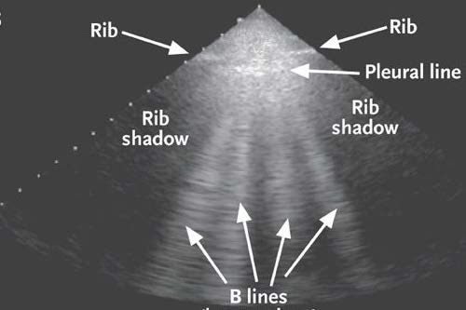
B-lines form when interlobular septa and lung tissue thicken or fill with fluid

Slide 26
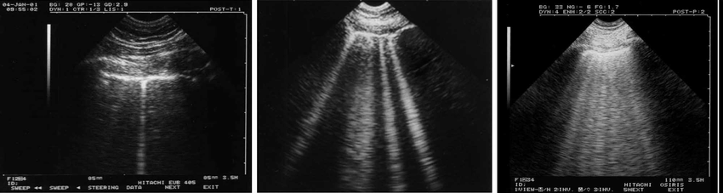
B-lines
Notes:
Presenter
2021-06-19 00:06:31
--------------------------------------------
B-lines. Left: healthy subject. One isolated B-line, labeled " b-line, " without pathologic meaning (possibly minor fissura). Middle and right: pulmonary edema. Several (three or more) B-lines are visible between two ribs, and define interstitial syndrome. This pattern was labeled lung rockets (or B lines). Middle: four or five B-lines are visible. The distance between two B-lines (at the pleural line) is roughly 7 mm in the adult, hence the name " B7-lines. " B7-lines correlate with thickened subpleural interlobular septa. Right: seven or eight B-lines are visible, called B-3 lines (the distance between two B-lines at the pleural line is roughly 3 mm). B3-lines correlate with subpleural ground-glass lesions

Slide 27
B-lines
Focal B lines may suggest pneumonia
Diffuse B lines in 3 or more zones on both sides of the chest suggests a diffuse alveolar interstitial syndrome such as pulmonary edema or ARDS

Slide 28
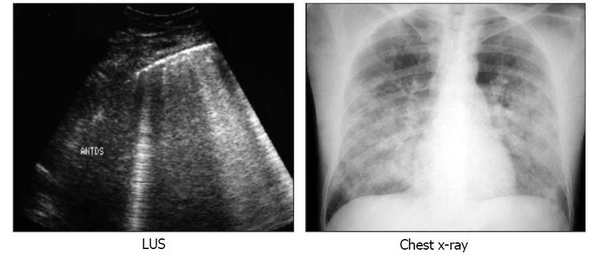
Pulmonary Interstitial Edema is designed by diffuse lung rockets Lung rockets are defined as at least 3 B lines between two ribs

Slide 29
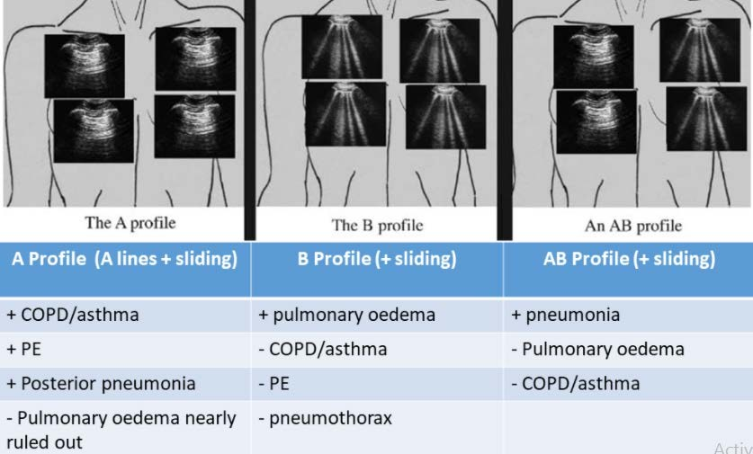
Simplified BLUE Protocol

Slide 30
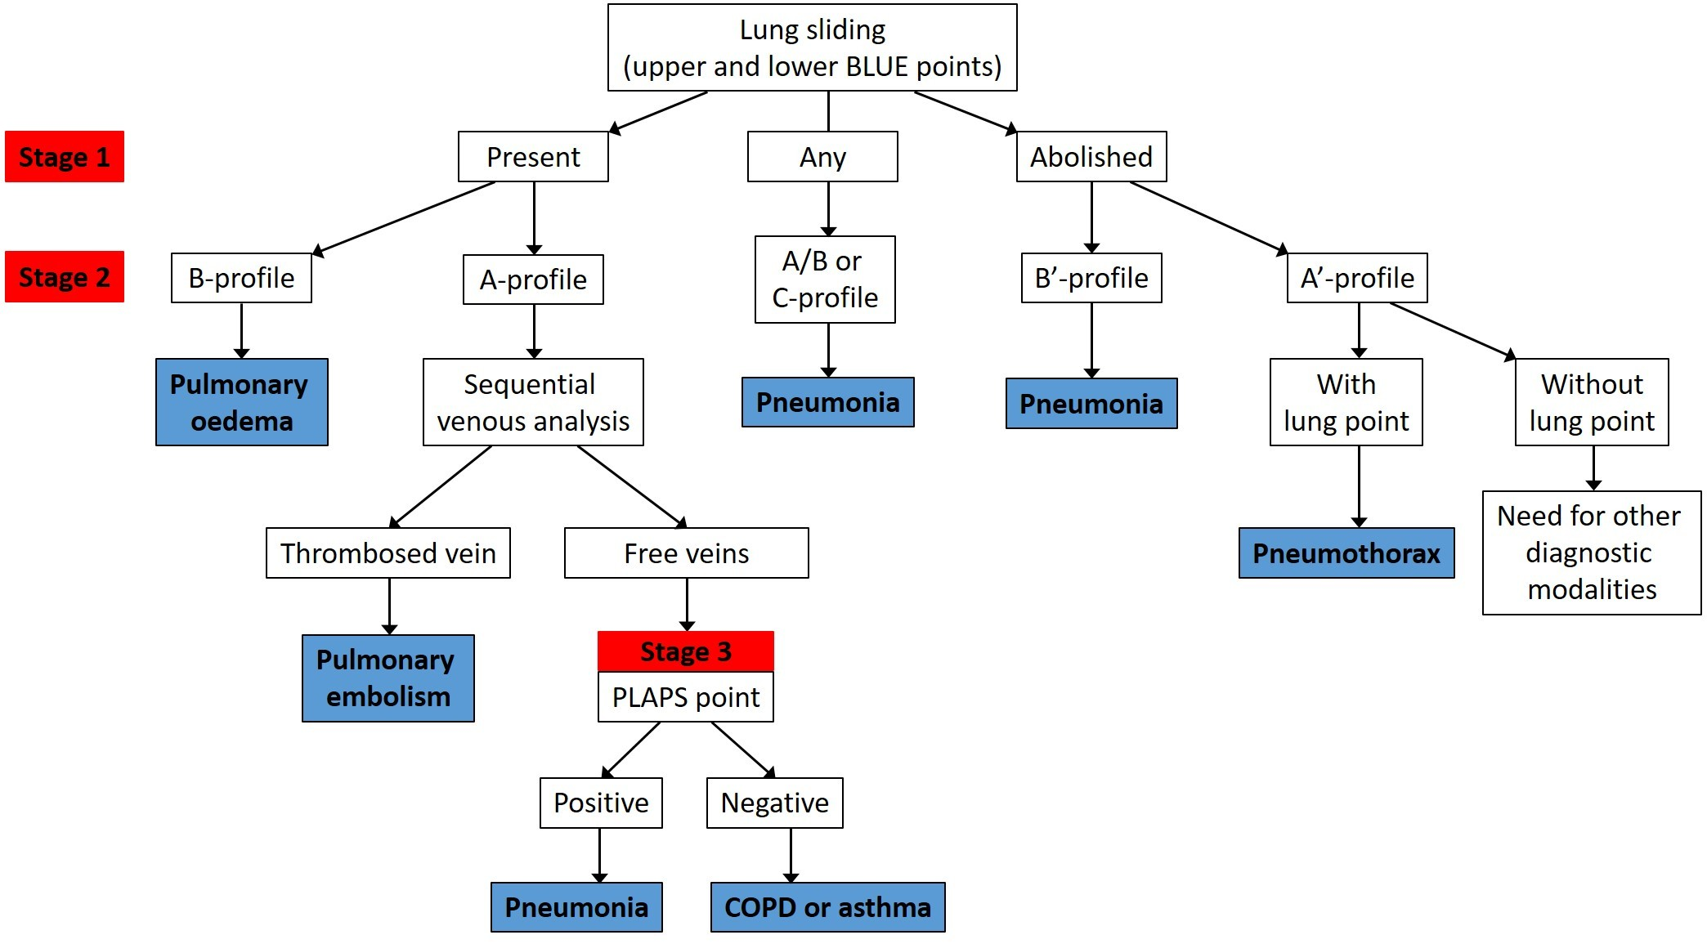
Bedside lung ultrasound in emergency (BLUE)

Slide 31
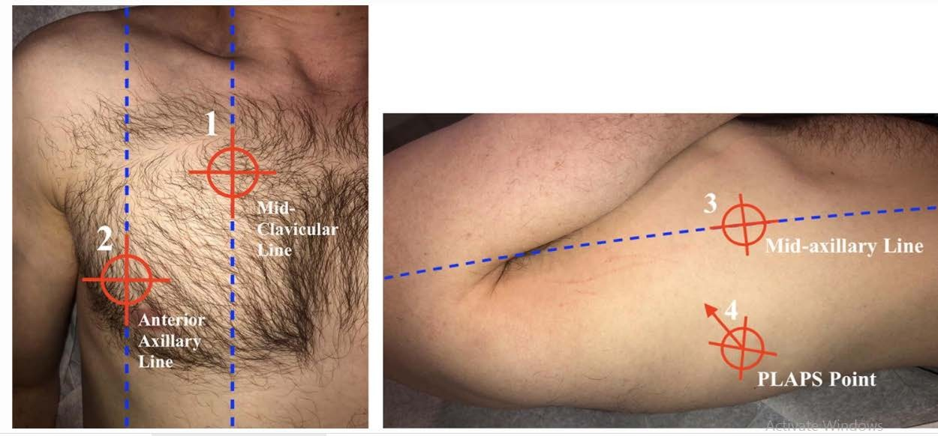
The PLAPS Point

Slide 32
The PLAPS point
It is only if the scan is non-diagnostic to this point that you move to scanning the base of the lungs, where in actual fact the majority of pathology will be found
Posterior and/or Lateral Alveolar and/or Pleural Syndrome (PLAPS)
The presence of consolidation or pleural effusion at the postero-lateral aspect of the lung.

Slide 33
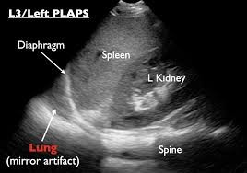
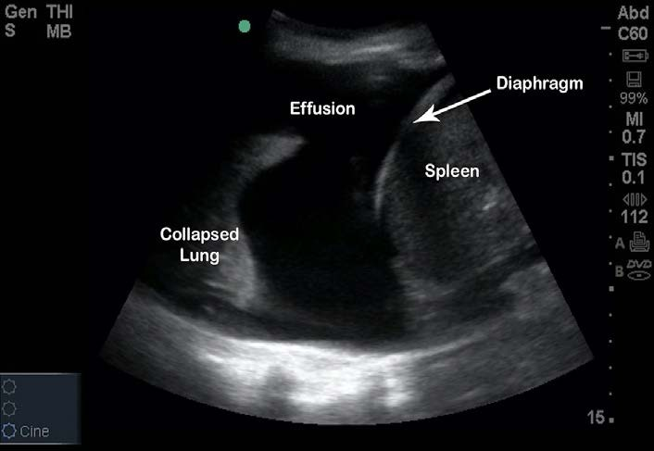
Left sided Pleural Effusion

Slide 34
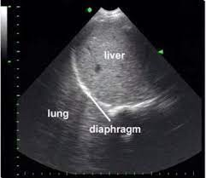
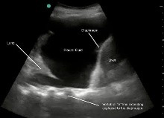
Right sided Pleural Effusion

Slide 35
Thank you for your attention

Slide 36
Case Presentation
The patient was a 75-year-old man with a history of Severe COPD and Corpulmonale, brought to the emergency room complaining of worsening dyspnea. Due to severe respiratory distress and hypoxia he was immediatly intubated upon arrival.
Initial clinical examinations showed BP: 85/p, HR: 130, SPO2:85% and in pulmonary auscultation he has a decrease in sound at the base of the right lung and a decrease in sound in the left lung.

Slide 37
Differential diagnosis
One lung intubation
Pleural effusion
Pneumothorax
Over-inflation of a part of the lungs (emphysema can cause this)
Pneumonia
pulmonary infarction
Atelectasis
low tidal volume

Slide 38
This Case…
There is no lung sliding in the left lung ultrasound and with the diagnosis of tension pneumothorax, a needle thoracostomy was performed.
Immediately after this procedure, the oxygen level reached 94% and the systolic blood pressure reached 110 mm Hg, after which the left chest tube was implanted.

Slide 39
Lung Sliding using M-Mode (Optional)
If lung sliding is not readily apparent, it can be further be evaluated using M-Mode.
M-mode is defined as time motion display of
the ultrasound wave along a chosen ultrasound line
The goal of M-Mode is to see if the patient has a normal
seashore sign.

Slide 40
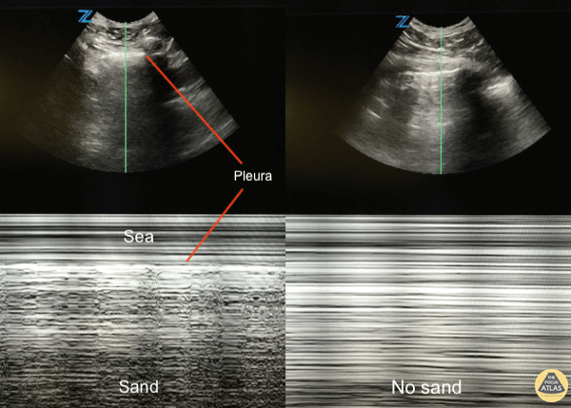
barcode sign in pneumothorax

