Slide 1

4725

Slide 2
DVT & PTE
MANAGEMENT ( CASE BASE )
DR Mehdi Pishgahi
Interventional Cardiologist
Shahid Beheshti University of Medical Sciences

Slide 3
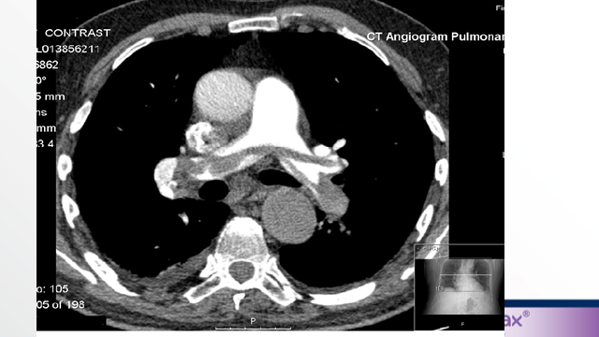

A 61 y/o woman with respiratory distress was referred to our ED. Her blood pressure is 71/55 mmHg with HR of 127 bmp.
Only hx of some episodes of abdominal
pain & mild weakness .
PMH : NEG
RT LOWER LIMB 2 ++ EDEMA
Hb : 9.8 . WBC : 12.500 Cr : 0.9

Slide 4
Emergency medicine specialist has candidate her for thrombolytic therapy .
(t-PA, 100 mg IV infusion for 2 hours).
T-PA will be finished in 10 minutes time.
What will be your preferred anticoagulation regimen following
thrombolytic therapy? ( which & when)
a) NOAC
b)UFH
c)LMWH
d)Warfarin

Slide 5
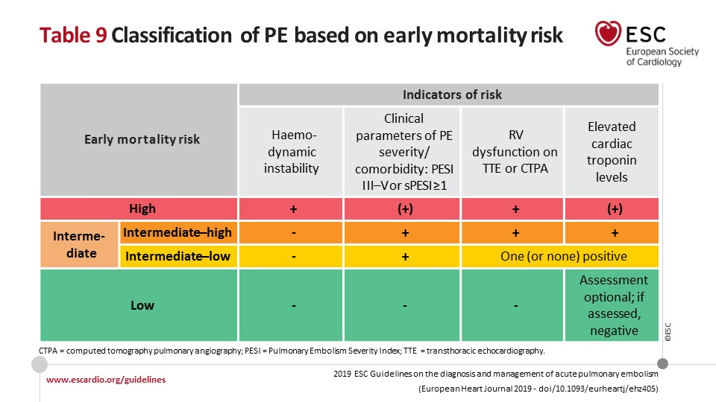

Slide 6
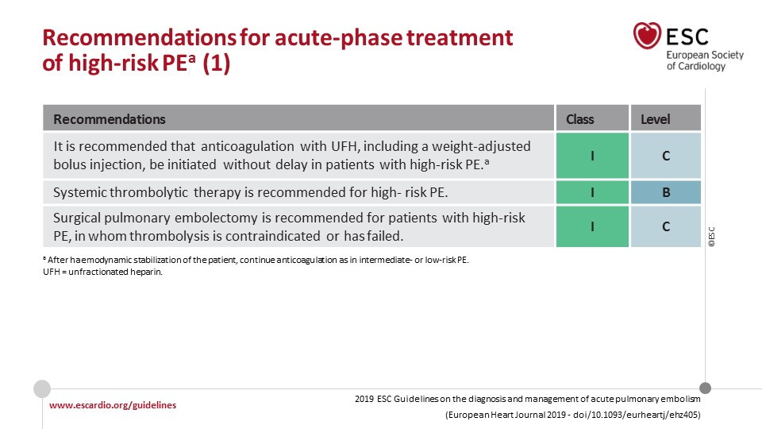

Slide 7
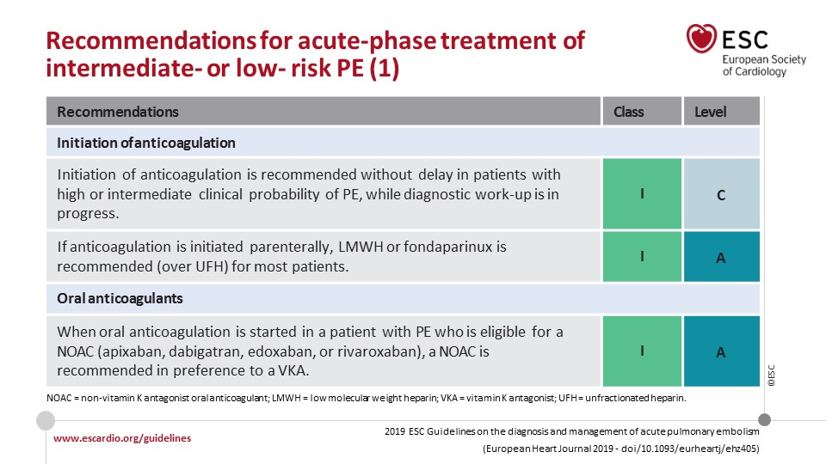

Slide 8
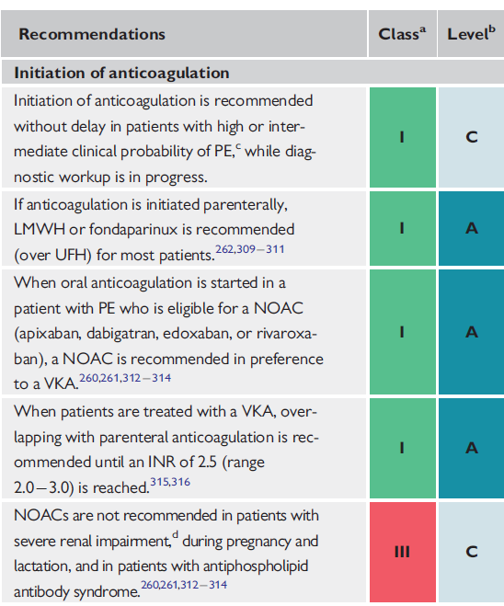



ESC 2019

Slide 9
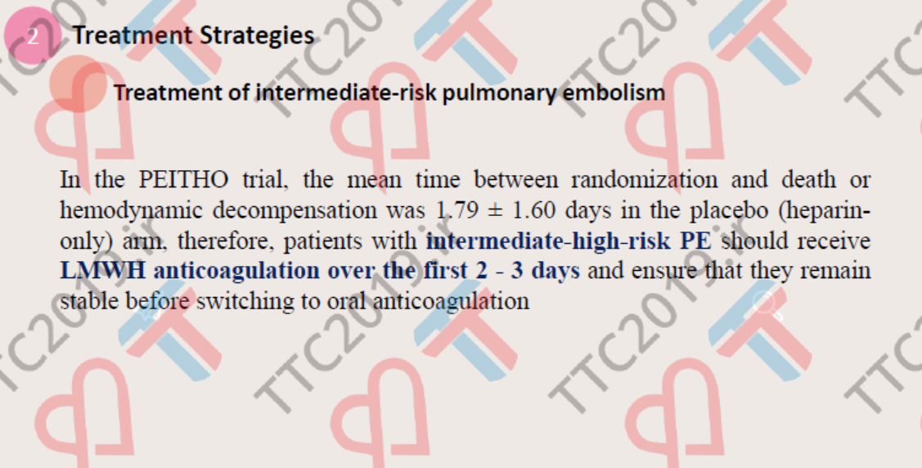
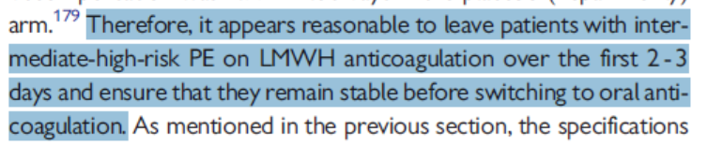

Slide 10

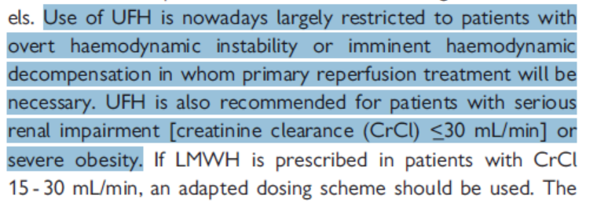
For monitoring of UFH: anti-Xa is preferred over PTT

Slide 11
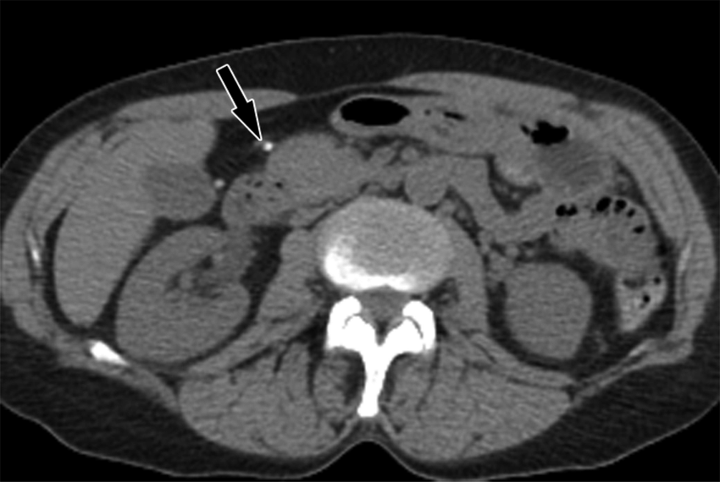
According to some episodes of abdominal pains & weight loss & anemia, abdominopelvic sono & ct reavealed ovarian hetrogen mass which was most compatible with ovarian cancer .

Slide 12
The patient’s condition has been improved during the last 48-72
hours. What will be your anticoagulation regimen?
Apixaban 10 mg/b.i.d for one week then 5 mg. bi.d
Apixaban 5 mg.bi.d
LMWH 1mg.kg b.i.d
Warfarin (overlapping with warfarin)
Other NOACs

Slide 13
Which anticoagulants can be used in cancer patients?

Slide 14

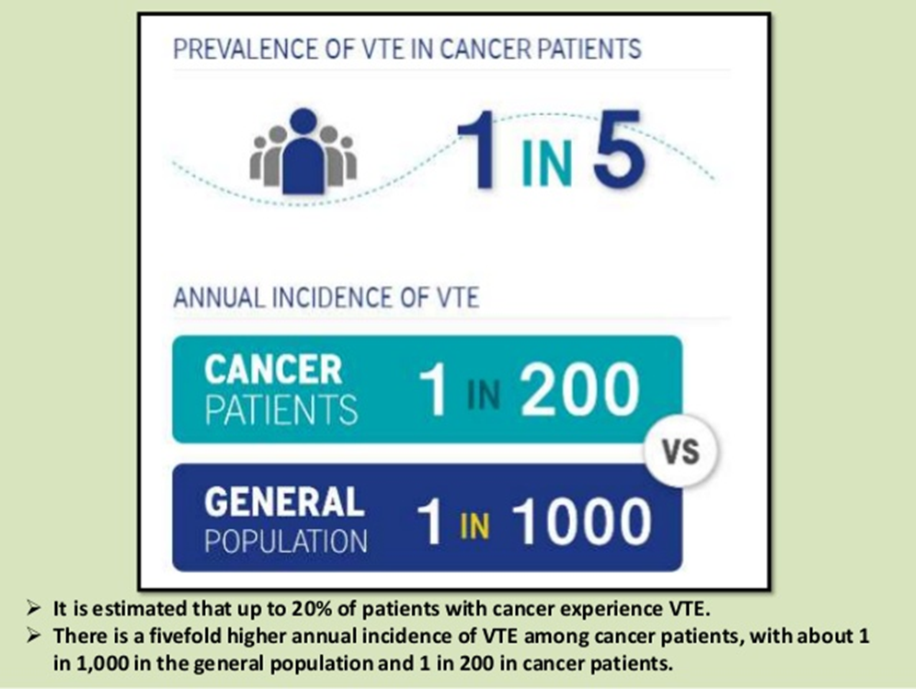

Slide 15
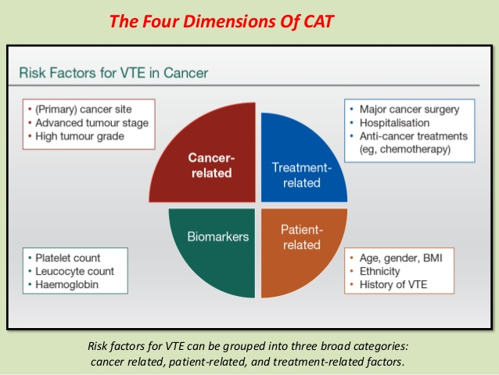
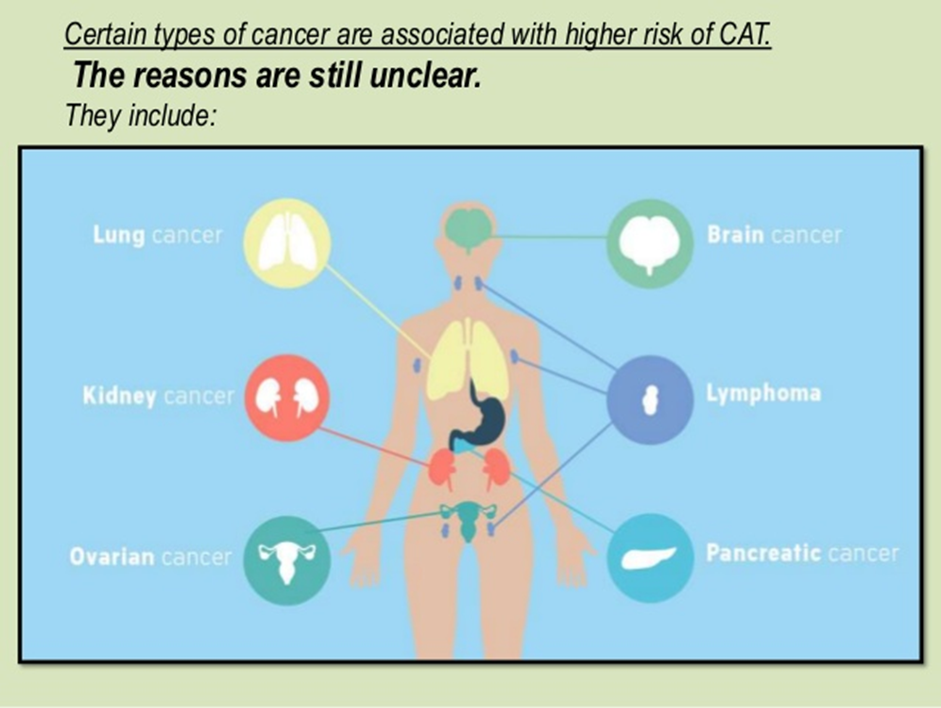

Slide 16
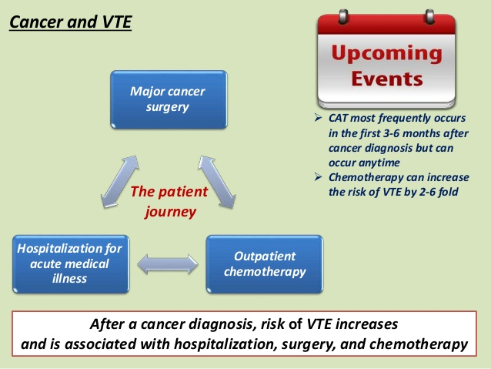

Slide 17
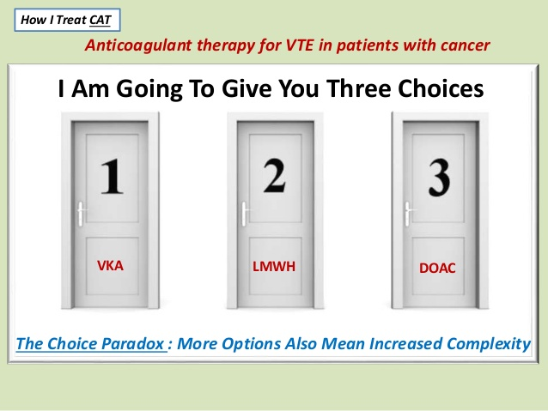
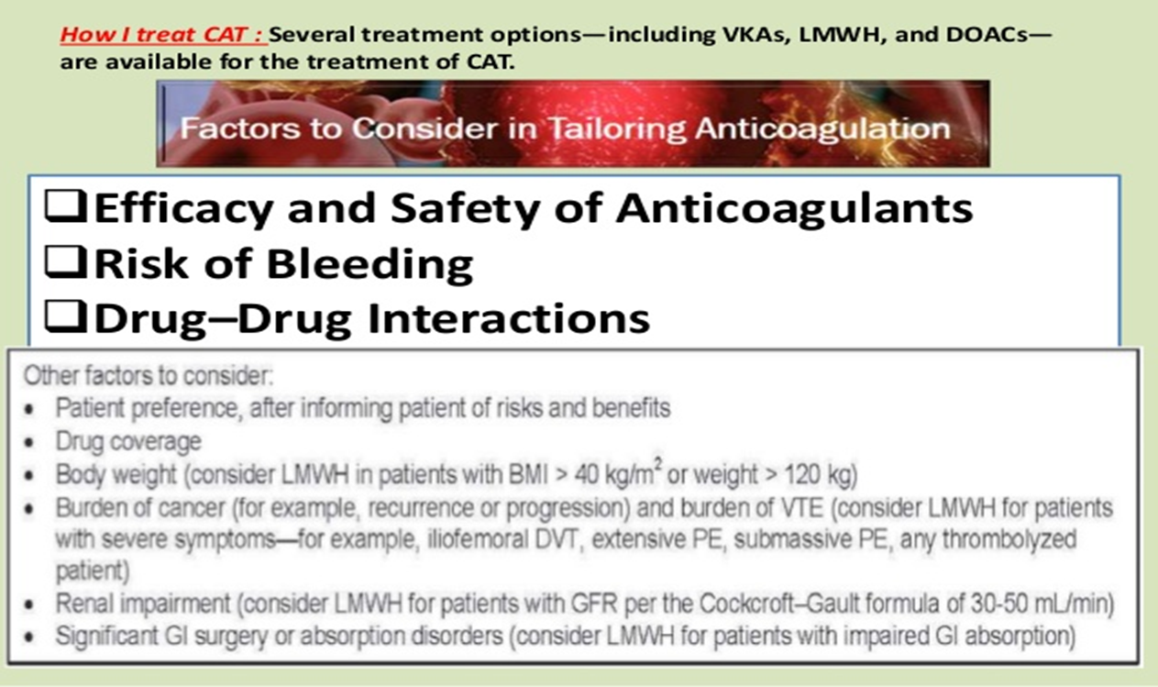

Slide 18
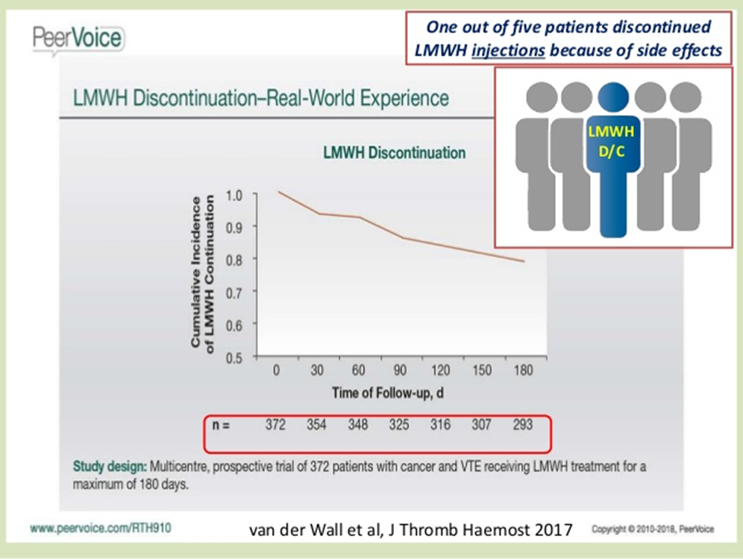
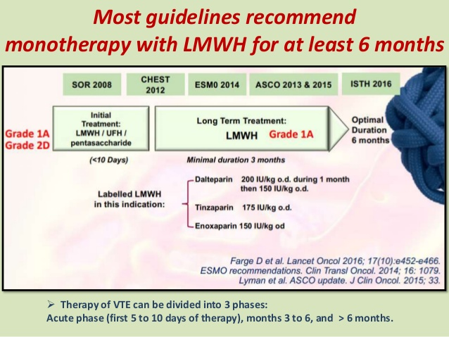

Slide 19
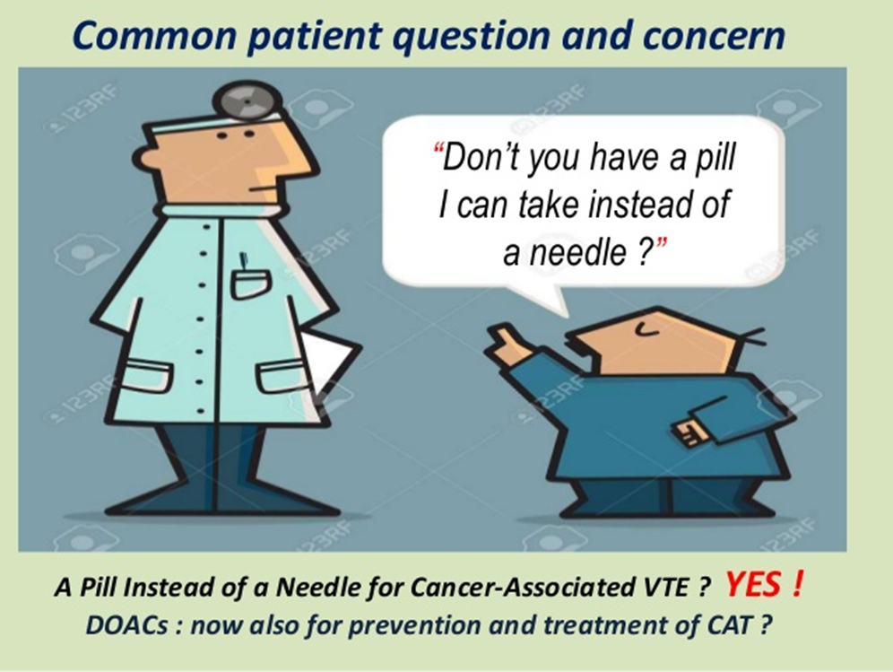
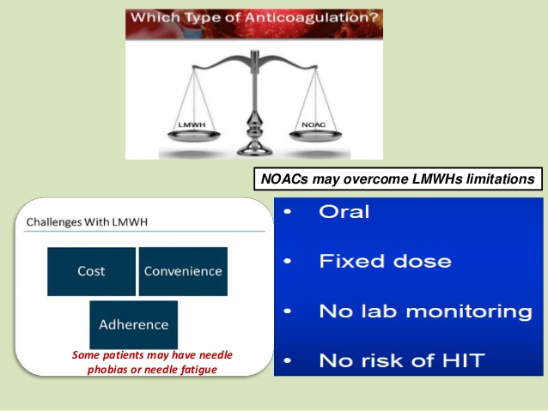

Slide 20
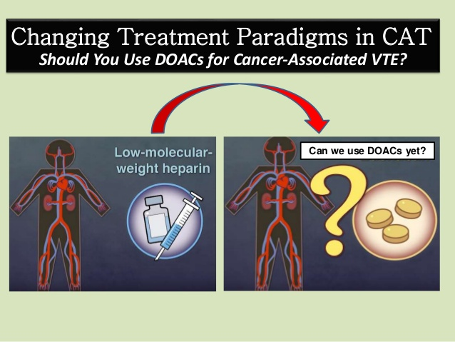
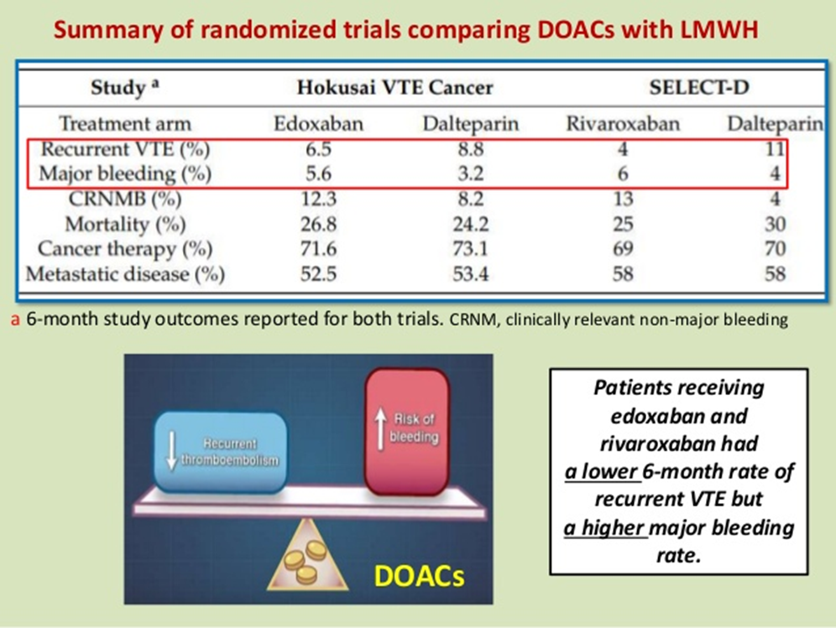

Slide 21

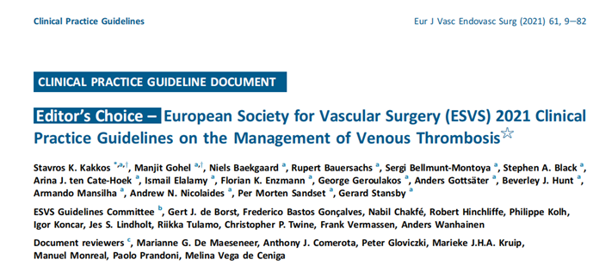
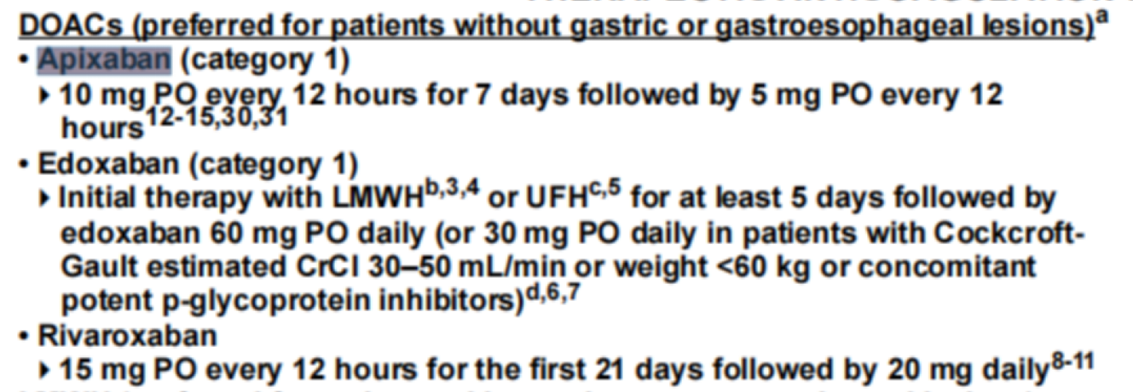
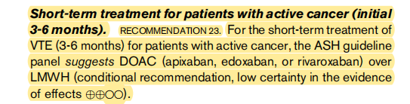
NOAC s are OK , but not in GU & GI ***
ASH GUIDLINE 2020

Slide 22
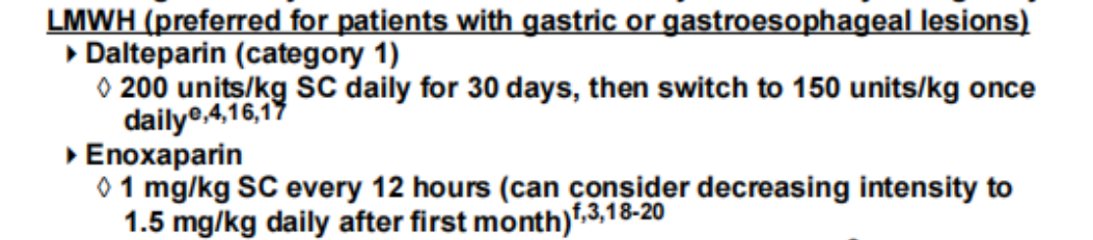
IF SHE HAD GASTRIC CANCER , WHAT WAS THE CHOICE ??

Slide 23

YOU HAVE DECIDED TO START APIXABAN
ACCORDING TO USAGE OF UFH FOR 3 DAYS & FIBRINOLYTIC , HOW DO YOU SWITCH TO APIXABAN ?
APIXABAN 5 mg BID
APIXABAN 10 mg BID FOR 1 W THEN 5 mg BID
OTHER ??

Slide 24
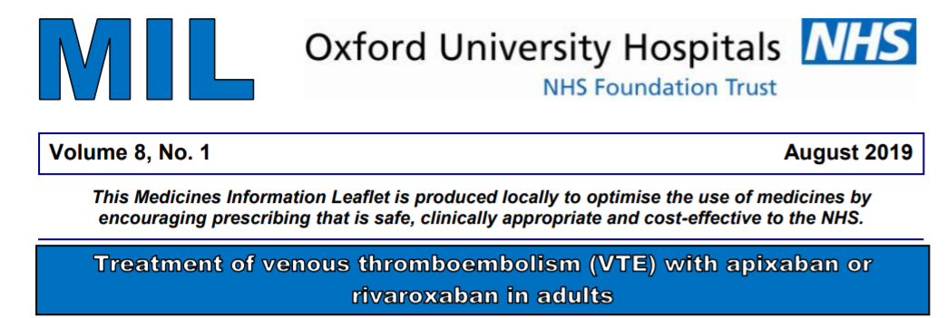
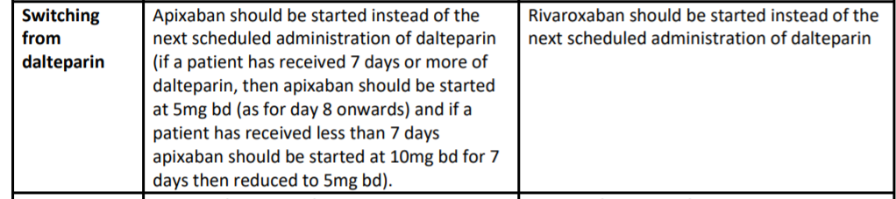
But ;
According to company
Recommendation ( drug PI) :
we can decrease loading days from parentral days
FROM LMWH or UFH to NOAC

Slide 25
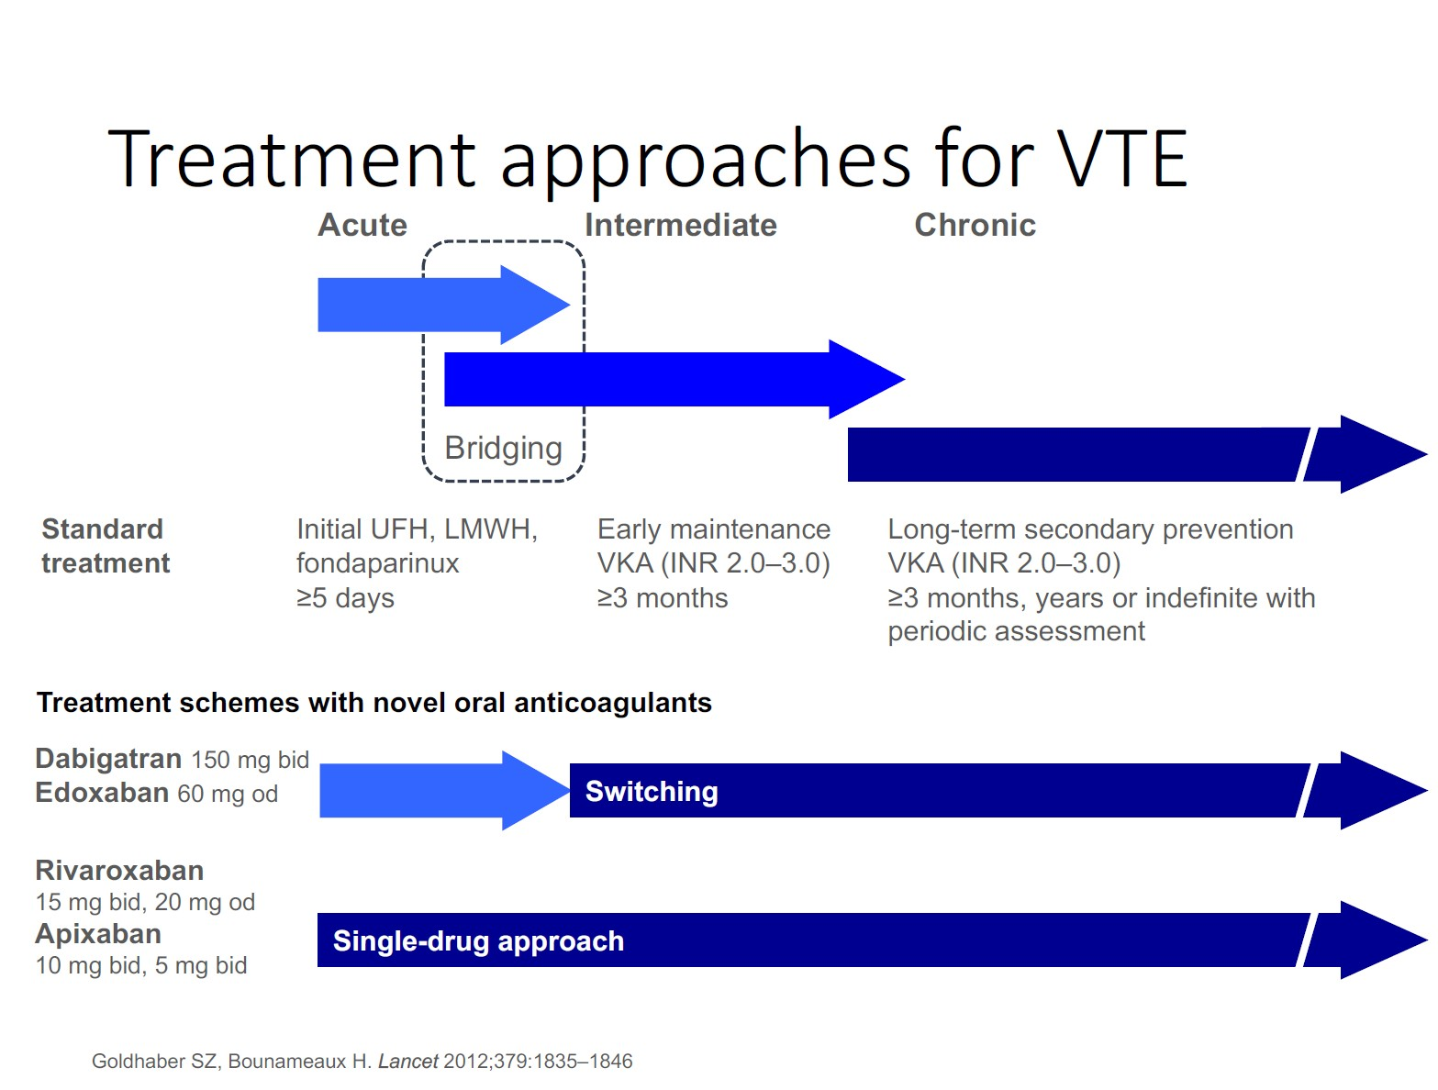

Slide 26
DURATION
&
EXTENTION OF TREATMENT
&
DRUG DOSE IN EXTENTION PHASE

Slide 27
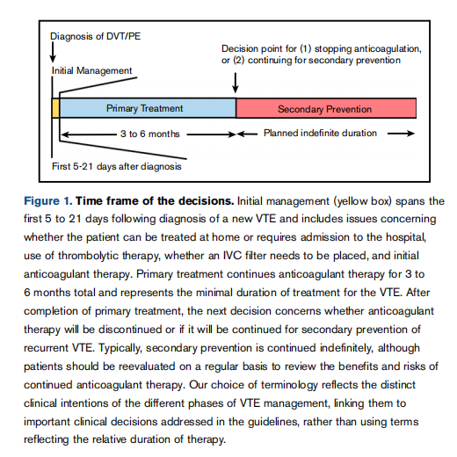
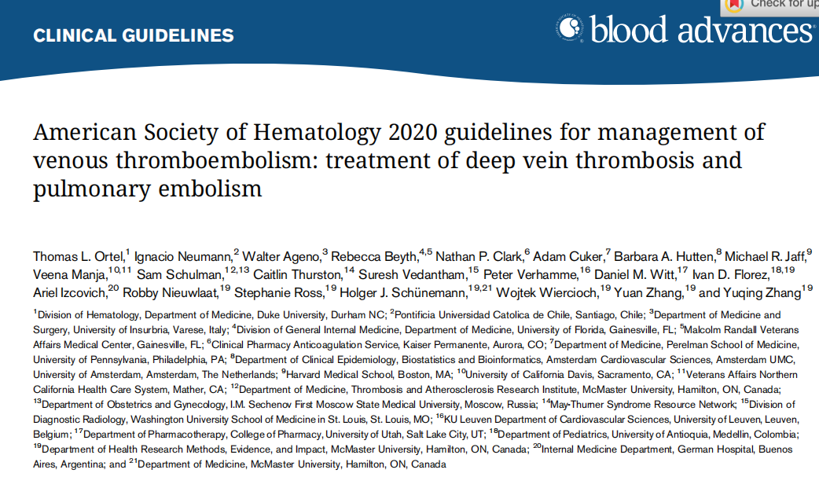

Slide 28

Aetiological classification
DVT
Provoked
Unprovoked
transient
or
persistent
major or minor

Slide 29
Understanding the provoked or unprovoked nature of DVT, as well as the chronicity of any provoking risk factors (transient or persistent), has significant prognostic and treatment implications, as recurrence risk and anticoagulation regimens differ accordingly.
If a DVT is provoked by a major transient risk factor (such as trauma or surgery, oestrogen therapy, pregnancy, or puerperium: very low risk of recurrence when anticoagulation is stopped, provided the risk factor is no longer present.
When DVT is known to be provoked by a persistent and progressive risk factor (such as malignancy), the risk of recurrence is significantly higher in the same conditions.
Patients with unprovoked DVT have an intermediate risk of recurrence.

Slide 30
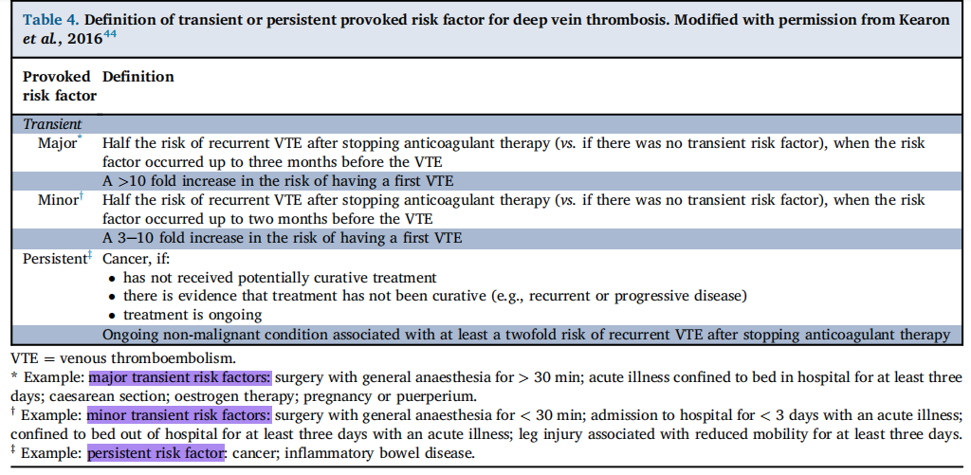

Slide 31
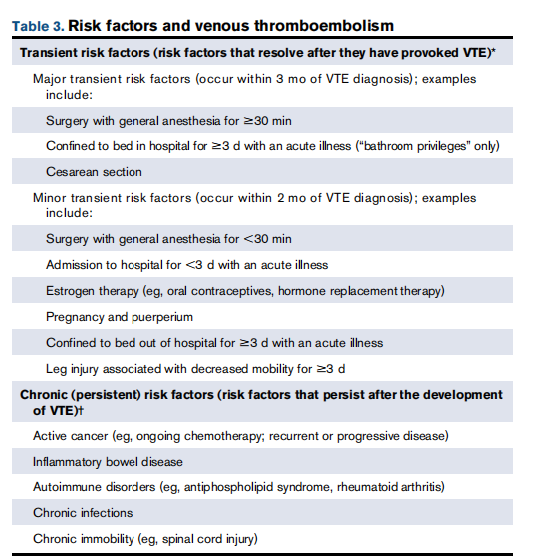
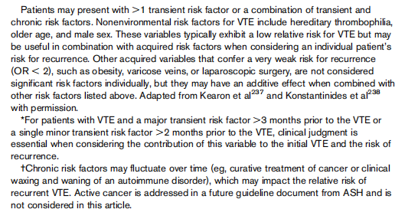

Slide 32
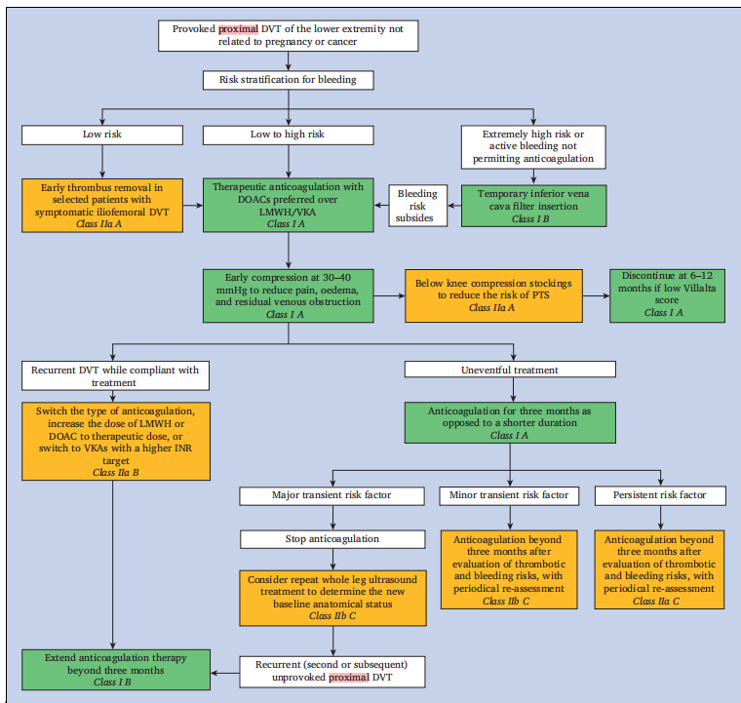
3MONTH
Provoked DVT Treatment

Slide 33
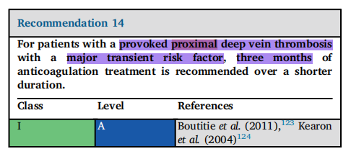
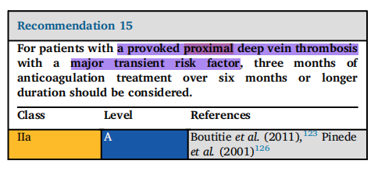
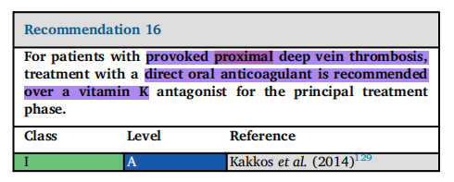
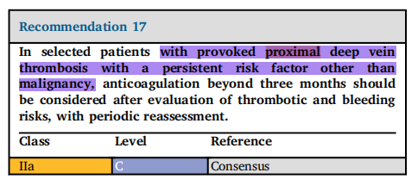
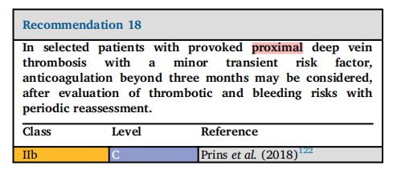
Provoked DVT Treatment

Slide 34
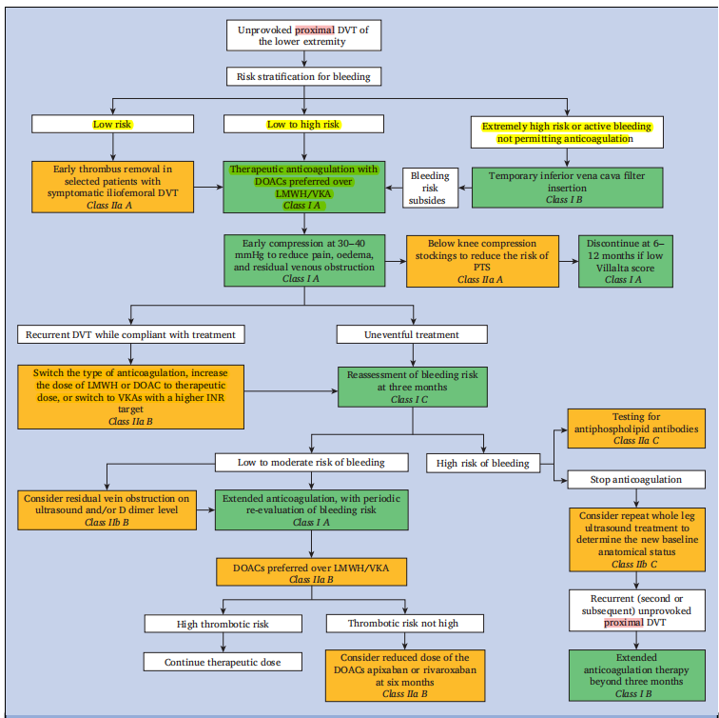
Unprovoked DVT Treatment

Slide 35
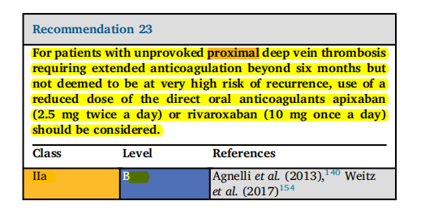
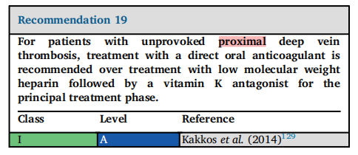
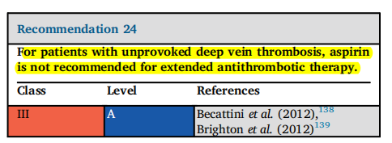
Unprovoked DVT Treatment

Slide 36
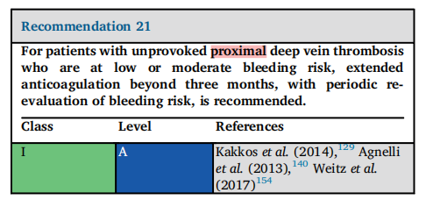
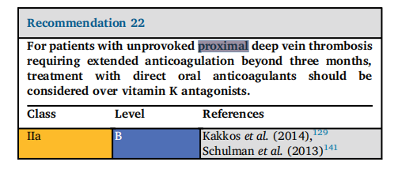
Unprovoked DVT Treatment

Slide 37
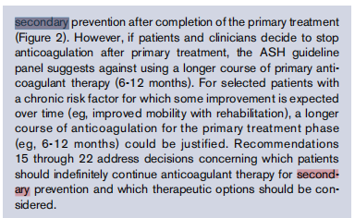
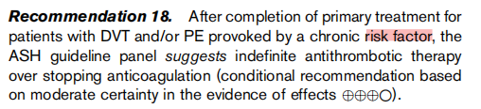
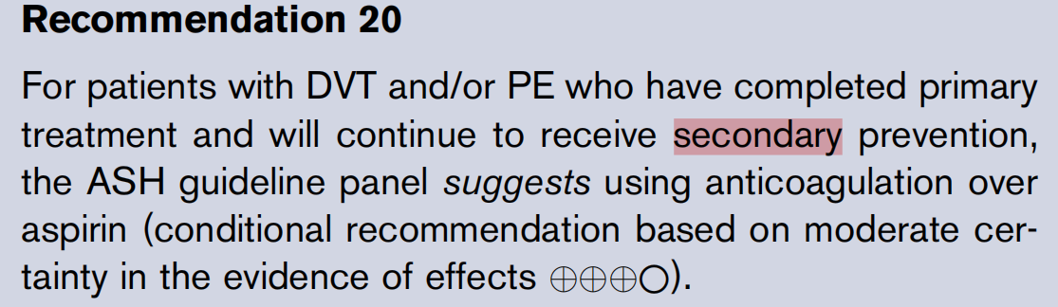
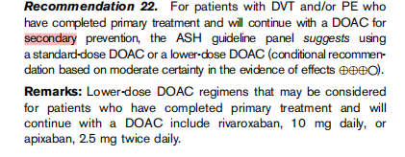

Slide 38
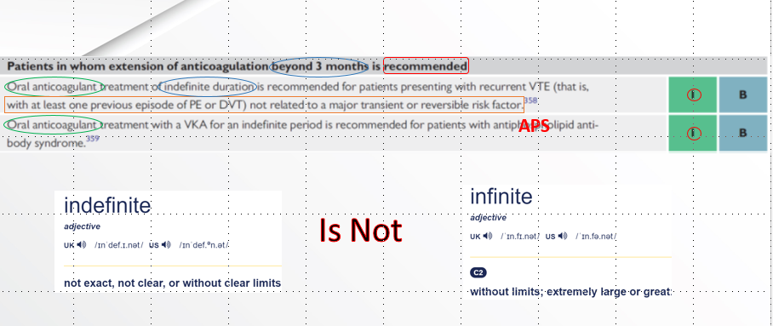


Slide 39



Slide 40


Slide 41


Slide 42



Slide 43
SOME POINTS ABOUT NOAC & CANCER PTs

Slide 44


Slide 45

CAT & CIT ( cancer induced thrombocytopenia)

Slide 46

Primary prevention in cancer pts

Slide 47


Slide 48



Slide 50



