Slide 1
Neurocovid case presentation
Maziar Emamikhah
M.D. Neurologist
Assistant professor at “Rasool-e Akram” hospital,
Iran University of Medical sciences (IUMS),
Tehran, Iran

Slide 2
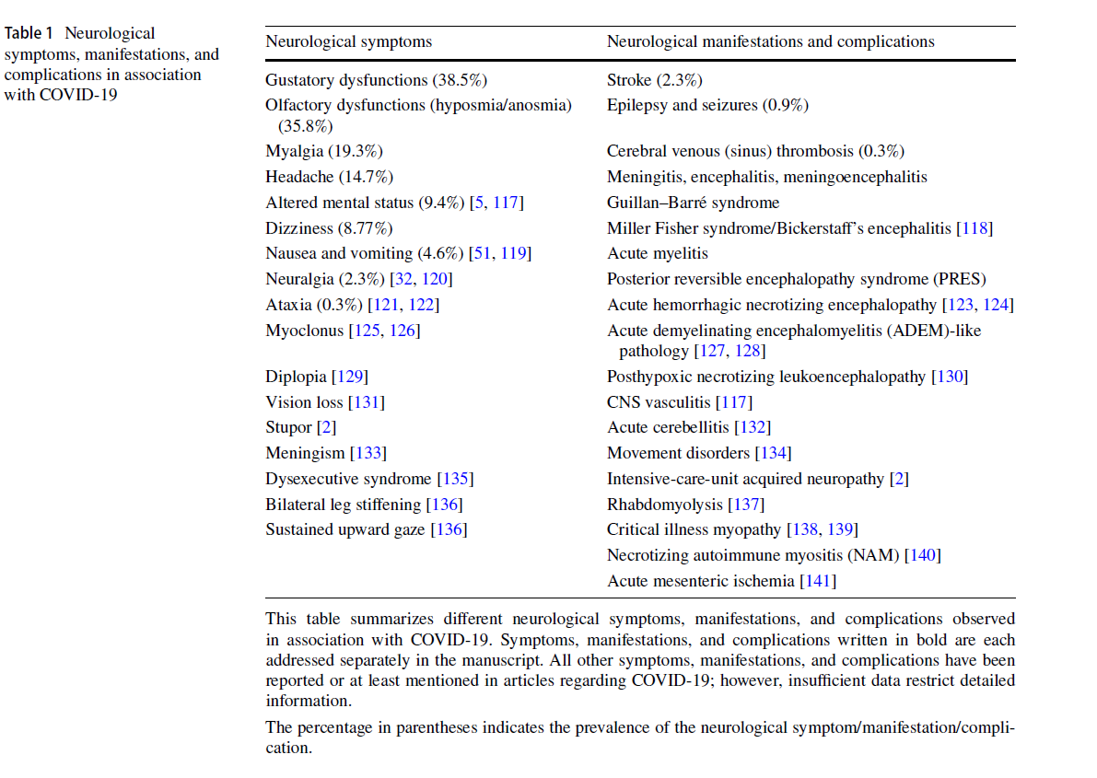

Slide 3
Case 1
Fifty year old male with left hemiplegia and confusion
Hx of HTN, Hx of COVID-19 since one week ago
N/E: Gaze preference to Rt side, Lt hemiplegia, dyarthria and dysphagia, Left hemisensory loss
General P/E: normal regular and symmetrical pulses, No heart murmur
Dx?

Slide 4
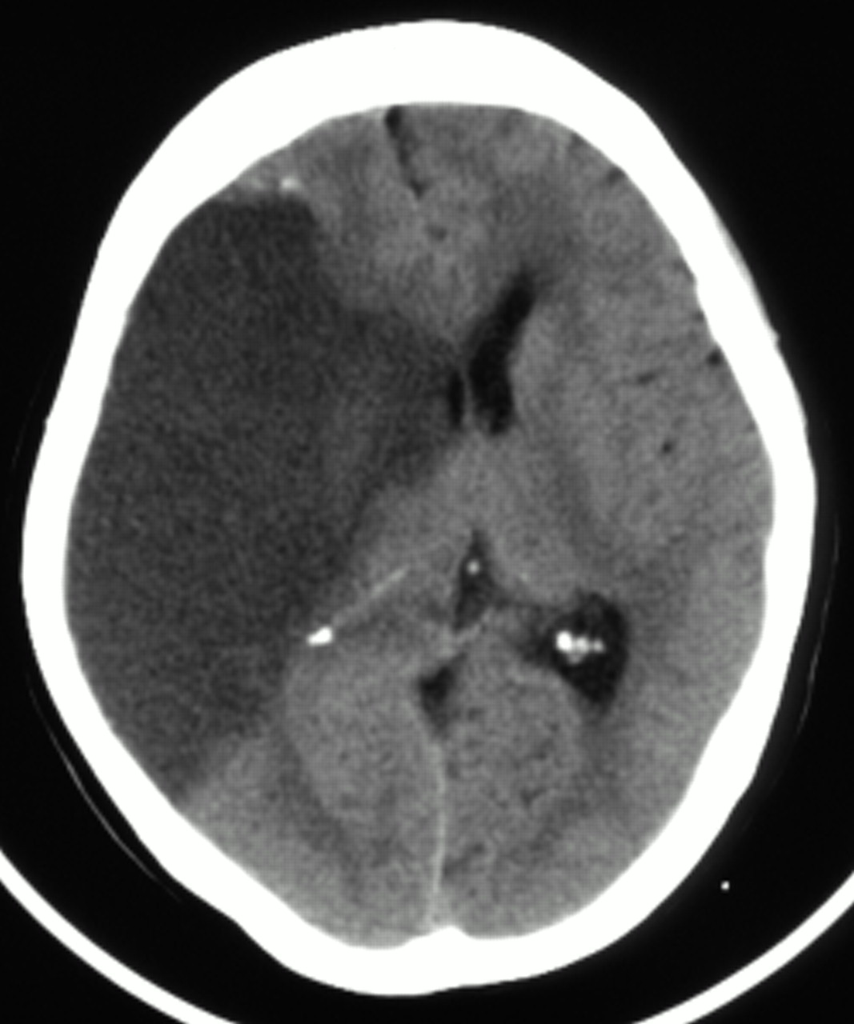
Ischemic stroke

Slide 5
Ischemic stroke
incidence among COVID-19 patients is estimated at 2.3%
with more severe infection reaches 6%
enhanced thrombus formation under conditions of hypoxia
SARS-CoV-2 can infect endothelial cells resulting in endothelial dysfunction
The permeability of blood brain barrier might be increased via inflammatory cells accumulating in the vascular wall
stimulate and initiate a coagulation cascade (hypercoagulability)

Slide 6
Case 2
42 y/o F without hx of prior disease except COVID-19 for the last 10 days came to ER with headaches started 3 days earlier and refractory to analgesics
Hx of fasting during the last two weeks
N/E: mild confusion, Blurred optic disc margins, no FND
Brain CT and MRI without contrast: no paranchymal lesion
Dx?

Slide 7
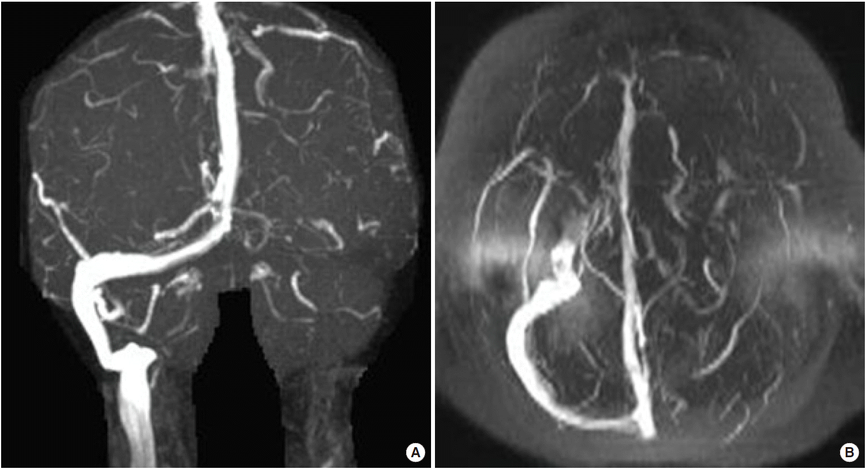
Cerebral venous (sinus) thrombosis

Slide 8
Cerebral venous (sinus) thrombosis
prevalence of 0.3%
prothrombotic state triggered by COVID-19

Slide 9
Case 3
65 y/o M with hx of chronic HTN and COVID-19 since 6 days ago came with Rt hemiplegia, aphasia and drowsiness deteriorating to stupor in hours
Emergent Brain CT
Dx?

Slide 10
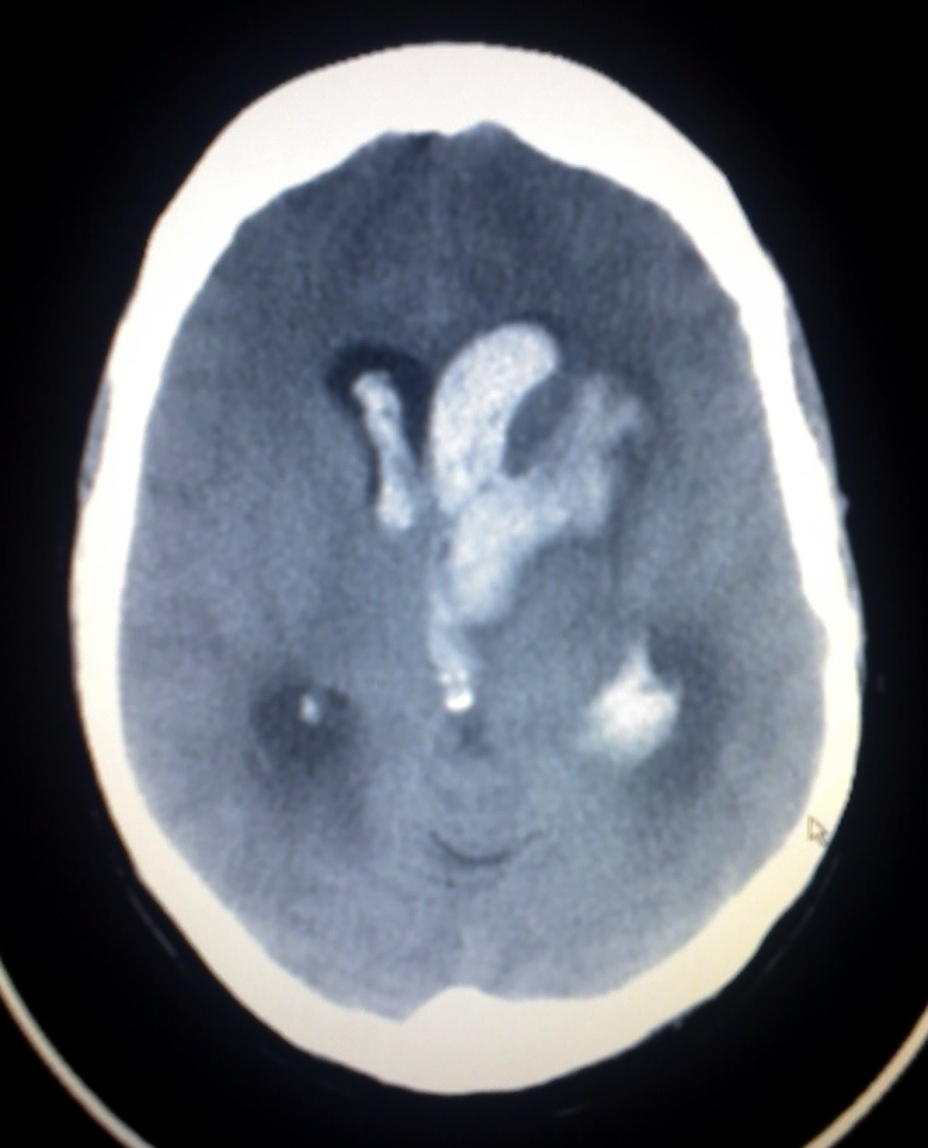
Cerebral hemorrhage

Slide 11
Association with COVID-19?

Slide 12
Case 4
A 56 years old male 10 days after fever and coughs came to ER with drowsiness, blurred visions and headaches
No prior medical hx
N/E: blurred OD margins, normal pupil light reflexes, drowsiness, no FND
Chest CT: typical for COVID-19
Dx?

Slide 13
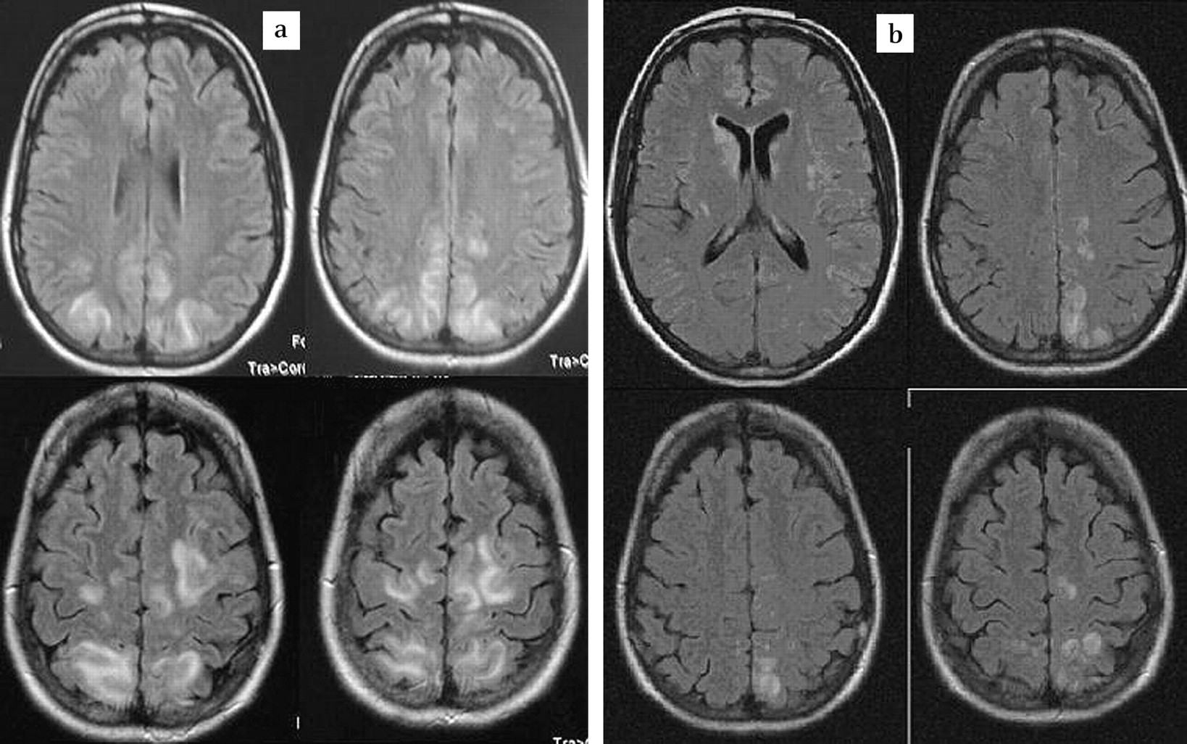
Posterior reversible encephalopathy syndrome (PRES)

Slide 14
Posterior reversible encephalopathy syndrome (PRES)
result from elevated inflammatory markers and cytokines leading to changes in endothelial morphology, impairment of the blood–brain barrier and consecutive increased vascular permeability

Slide 15
Seizure

Slide 16
Case 5
A 32 years old epileptic male, seizure free for one year on medication came to ER because of two episodes of GTCS
Fever and coughs since 3 days ago, COVID-19 in 2 family members
Takes CBZ 200mg regularly
N/E: Normal consciousness and examination one hour after the last seizure
Dx?

Slide 17
COVID-19 can reduce seizure threshold in patients with an existing seizure disorder
can trigger new-onset seizures in patients with no known history of seizures (estimated pooled prevalence 0.9%)
Hypoxia, fever, multi-organ failure, and severe metabolic or electrolyte derangement
secondary to a meningitis/encephalitis associated with SARS-CoV-2 infection
PRESS, Hemorrhage, ischemic stroke, ADEM, …
as a potential COVID-19 presentation in the pediatric age groups, even in children without fever (afebrile seizures)

Slide 18
Case 6
A 8 years old boy with deteriorating consciousness since 1 week ago after 3 days of fever
N/E: stuporous, Rt side limbs are plegic, Lt side is week, bilateral babinski signs, increased DTR in lower limbs
Chest CT: patchy peripheral consolidations
Dx?

Slide 19
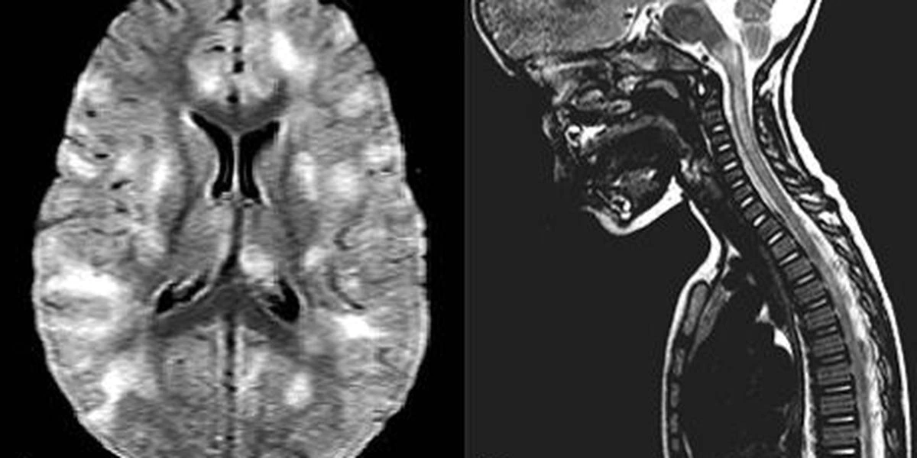
Acute disseminated encephalomyelitis (ADEM)

Slide 20
Case 7
A 40 year old male came to ER because of progressive muscle weakness in lower limbs
Fever since last week and tachypnea since yesterday
N/E: lower limbs MF 2/5, uppers clumsy, DTR 0, gloves and socks pattern hyposthesis, impaired position in lower limbs
Chest CT: Severe lung involvement compatible with COVID-19
Bilateral facial weakness the next day
Dx?

Slide 21
Guillain–Barré syndrome (GBS)
ICU admission and intubation for 1 week
PLEX 12 L led to considerable improvement of weakness
Discharged after 20 days

Slide 22
Case 8
A 38 years old male was admitted to ICU because of severe respiratory distress, fever and stupor with COVID-19 Dx
Received remdesivir, IVIG and ICU care
Chest CT improved after 5 days of admission, consciousness did not
Neurology consult: Deep coma, bilateral babinski sign, brain MRI requested
Dx?

Slide 23
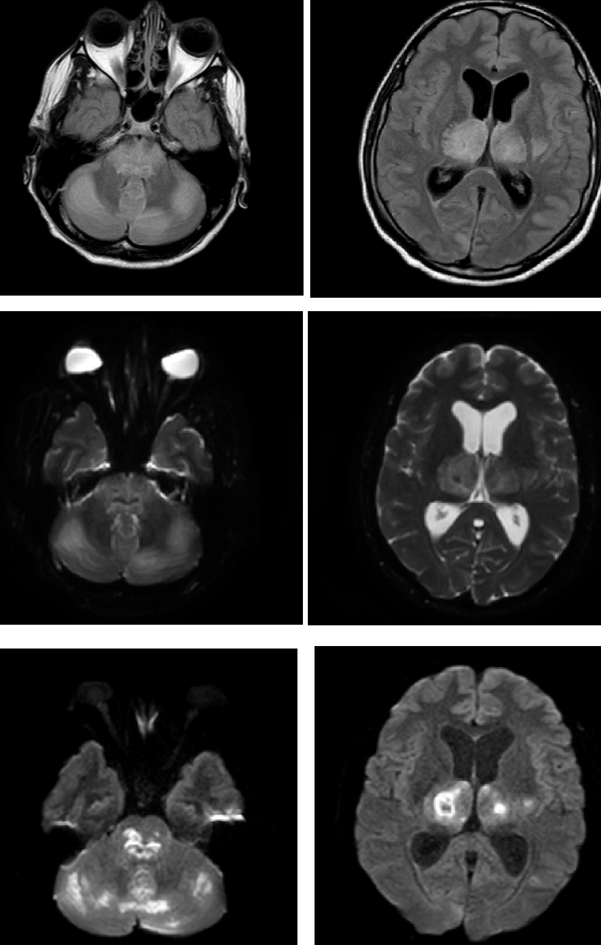
Acute necrotizing encephalitis (ANE)

Slide 24
Improved and discharged after one months of admission
Treated with 2g/kg IVIG+7g methylprednisolon

Slide 25
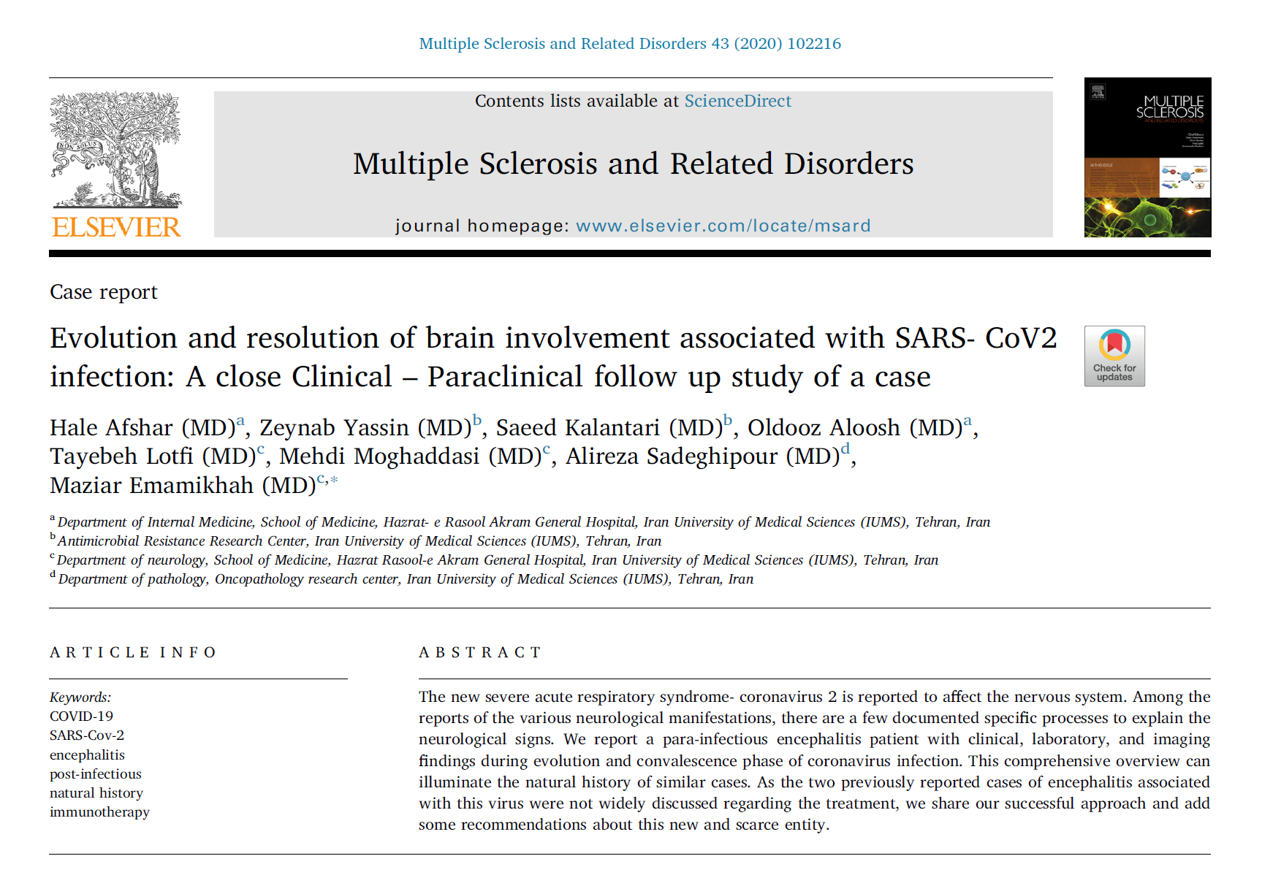

Slide 26
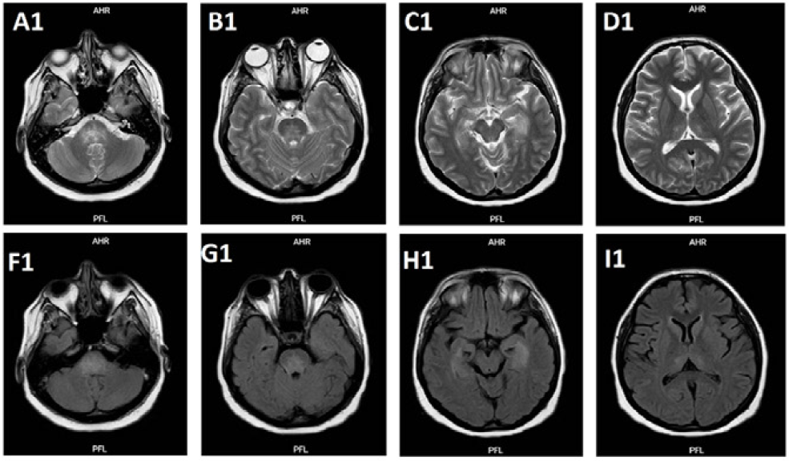

Slide 27
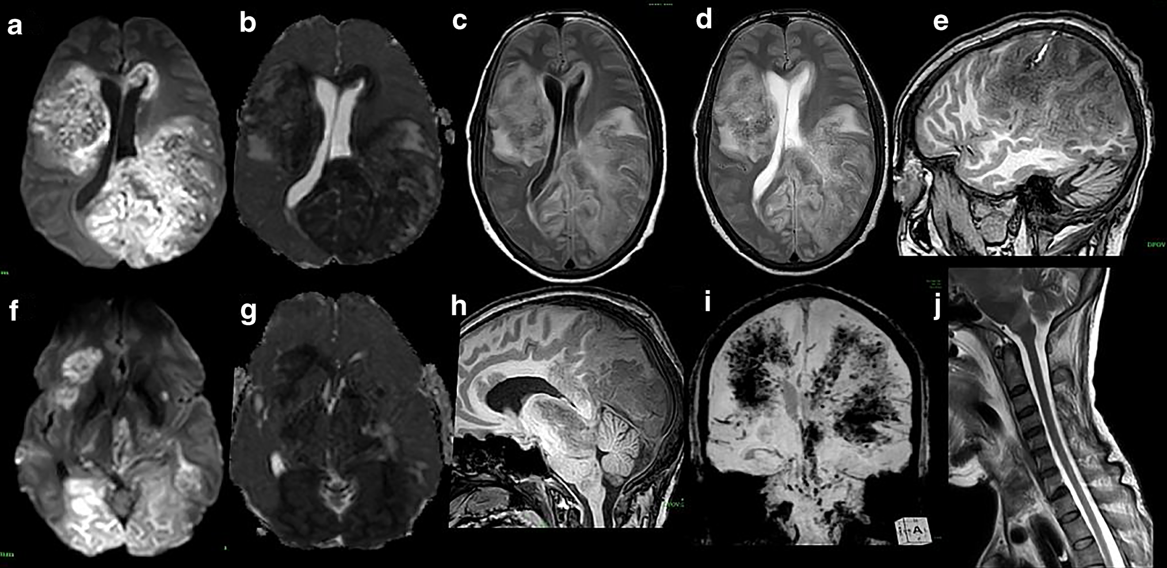
Acute hemorrhagic leukoencephalitis (AHLE)

Slide 28
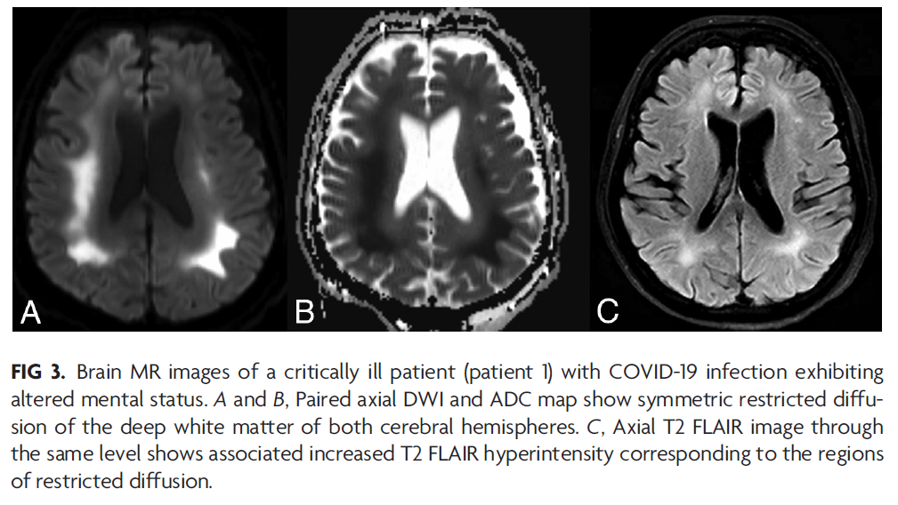
Delayed post-hypoxic leukoencephalopathy (DPHL)

Slide 29
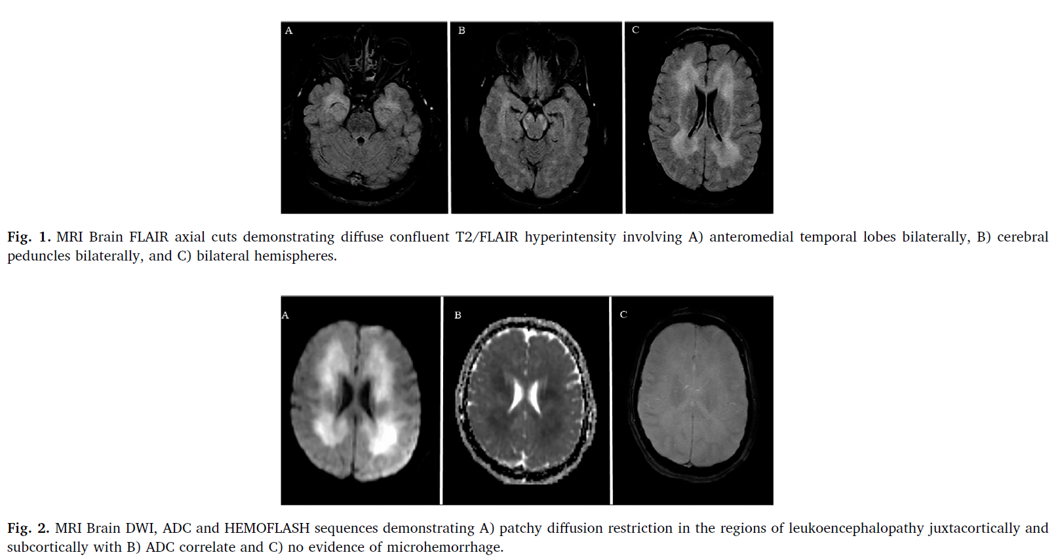
Delayed post-hypoxic leukoencephalopathy (DPHL)

Slide 30
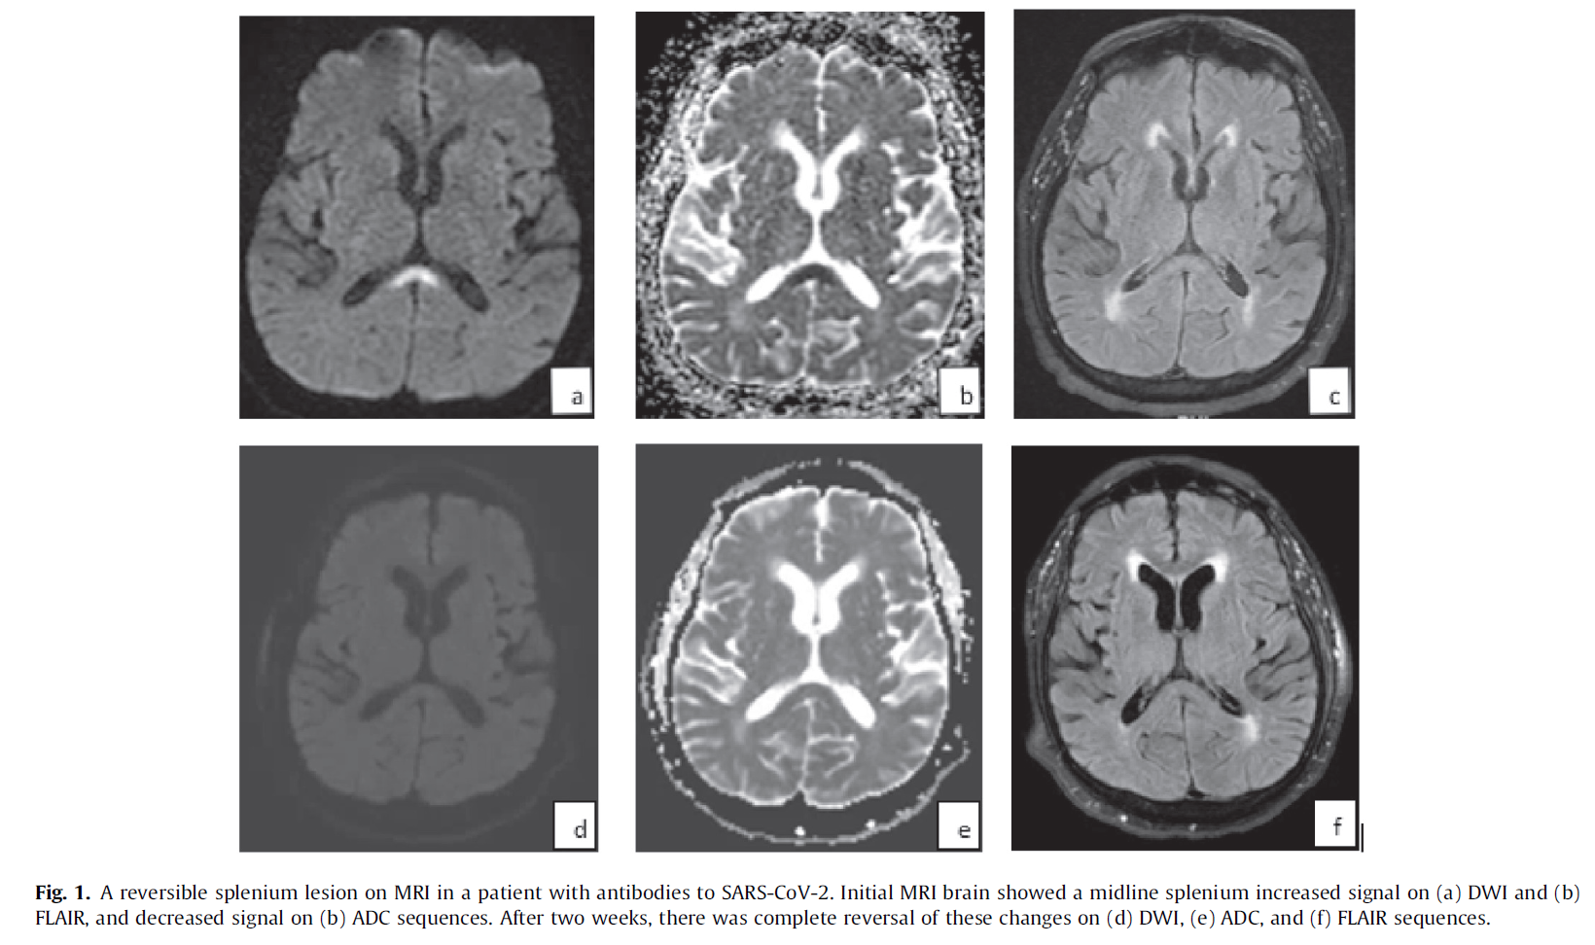
Mild encephalopathy with reversible splenial lesion (MERS) or cytotoxic lesion of corpus callosum (CLOC)

Slide 31
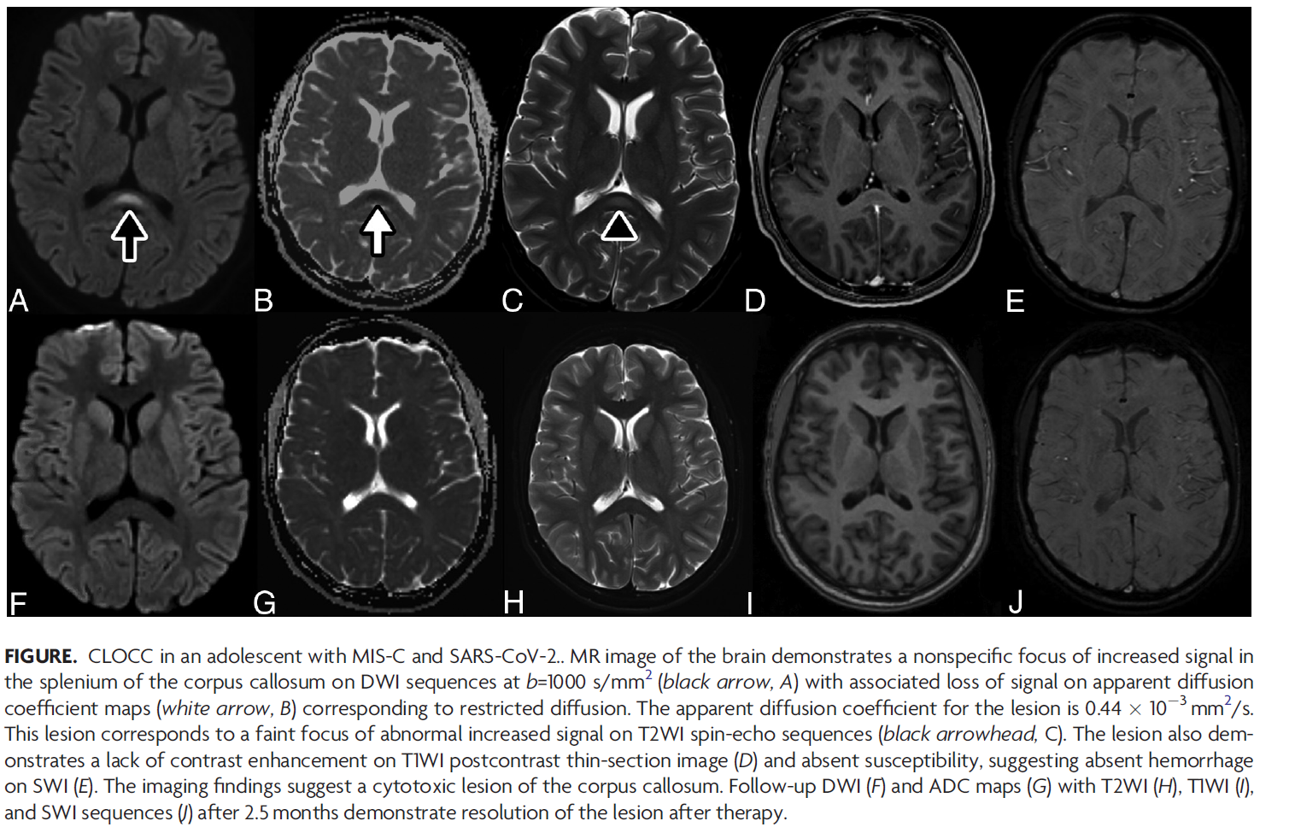
Mild encephalopathy with reversible splenial lesion (MERS) or cytotoxic lesion of corpus callosum (CLOCC)

Slide 32
Eight similar cases

Slide 33
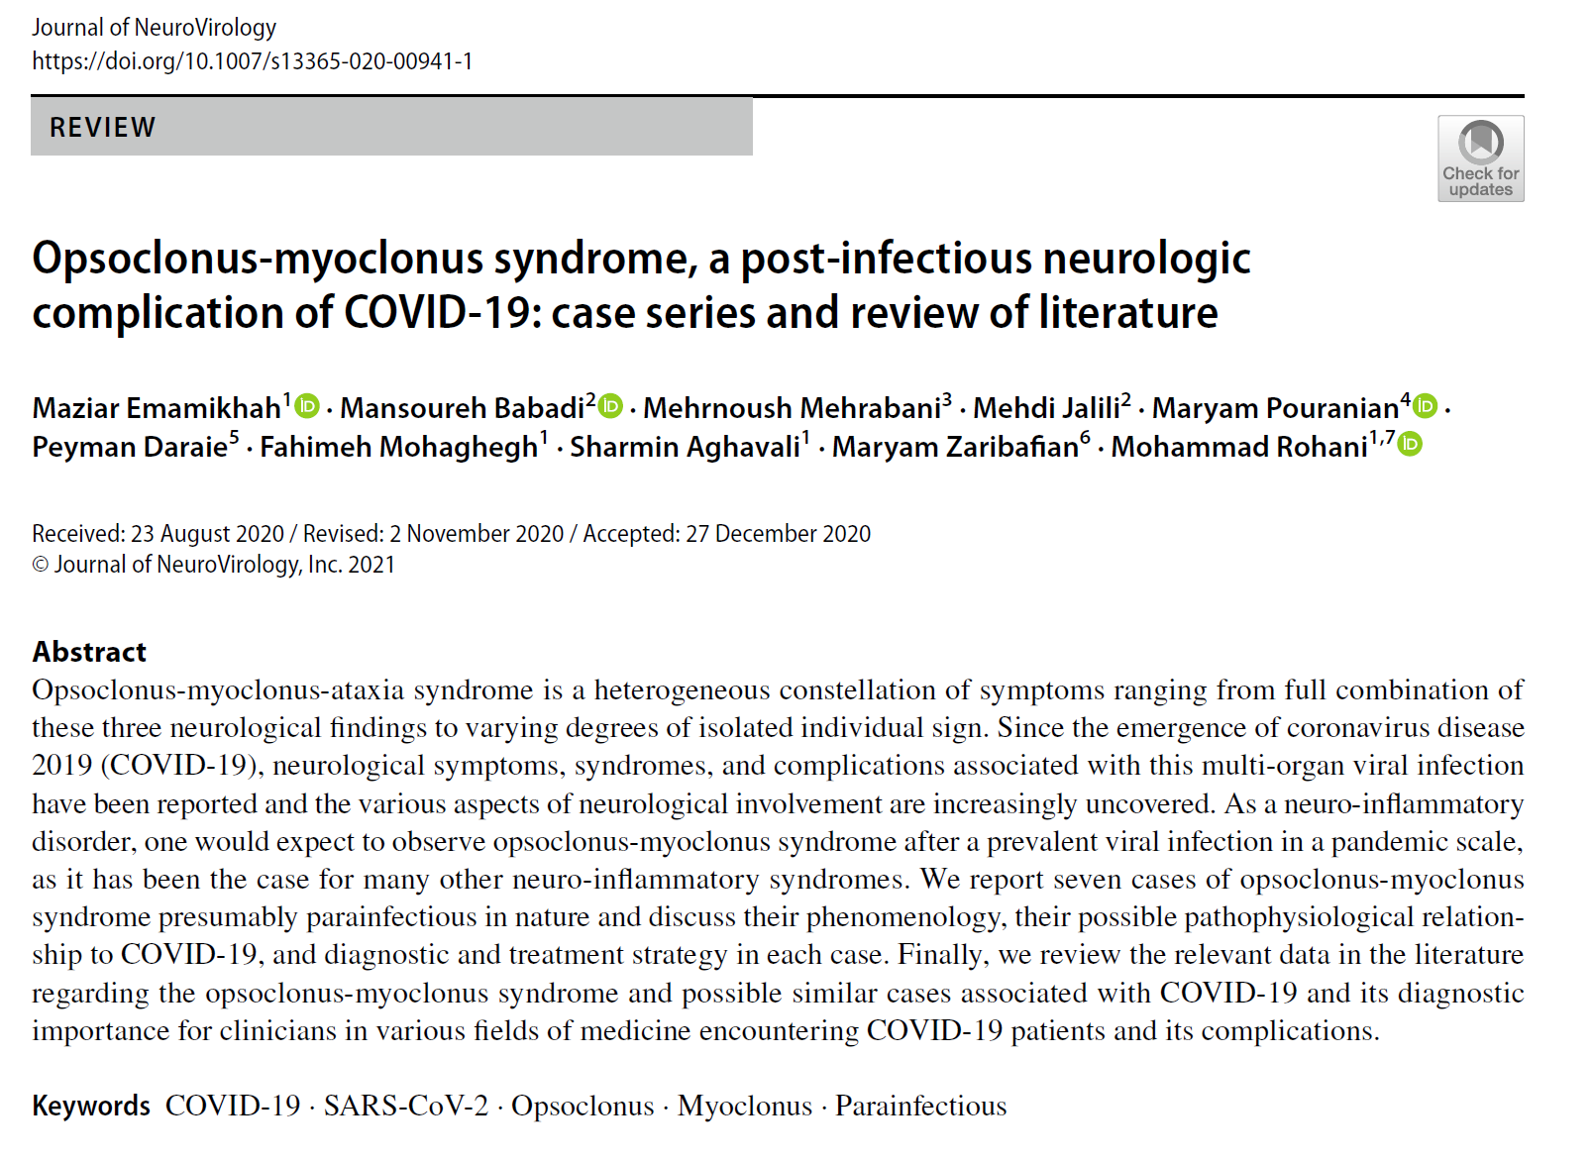
Opsoclonus-myoclonus-ataxia syndrome (OMAS)

Slide 34
Opsoclonus-myoclonus-ataxia syndrome (OMAS)
Video 1

Slide 35
Opsoclonus-myoclonus-ataxia syndrome (OMAS)
Video 2

Slide 36
Opsoclonus-myoclonus-ataxia syndrome (OMAS)
Video 3

Slide 37
Opsoclonus-myoclonus-ataxia syndrome (OMAS)
Video 4

Slide 38
Opsoclonus-myoclonus-ataxia syndrome (OMAS)
Video 5

Slide 39
Opsoclonus-myoclonus-ataxia syndrome (OMAS)
Video 6

Slide 40
Opsoclonus-myoclonus-ataxia syndrome (OMAS)
Video 7

Slide 41
Opsoclonus-myoclonus-ataxia syndrome (OMAS)
Video 8

Slide 42
COVID-19 vaccine, neurological disorders and neurological side effects

Slide 43
Last case
A 73-year old male came to clinic with Lt hemiparesis developed over 24 hours, five days after sinopharm first dose vaccine
N/E: Lt side MF 3/5, Rt hemihyposthesis sparing the face, impaired position in Lt leg, Lt side babinski sign
He had a normal brain MRI
Dx?

Slide 44
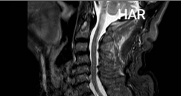

Slide 45
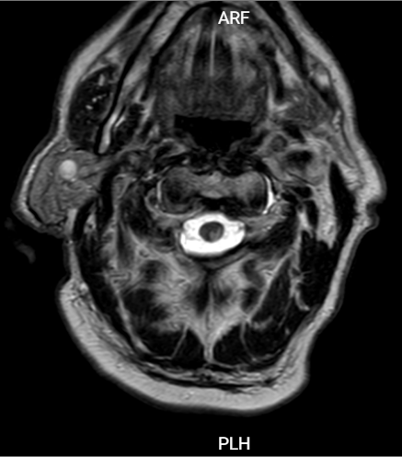

Slide 46
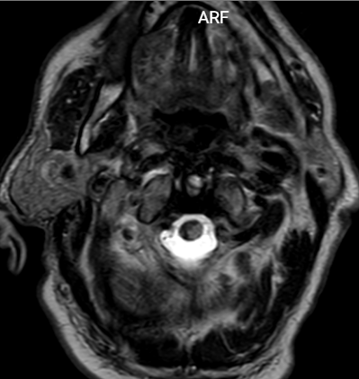

Slide 47
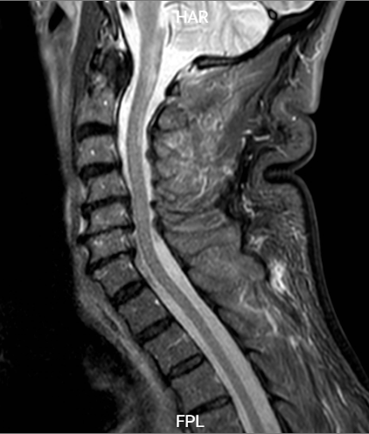

Slide 48
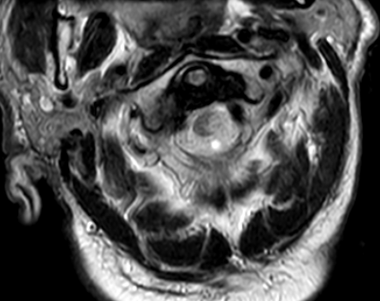

Slide 49
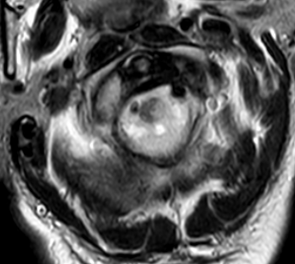

Slide 50
Thanks

