Slide 1
Updates of Asthma Management
2021
A.R.ESLAMINEJAD MD FCCP
SBMU NRITLD

Slide 2
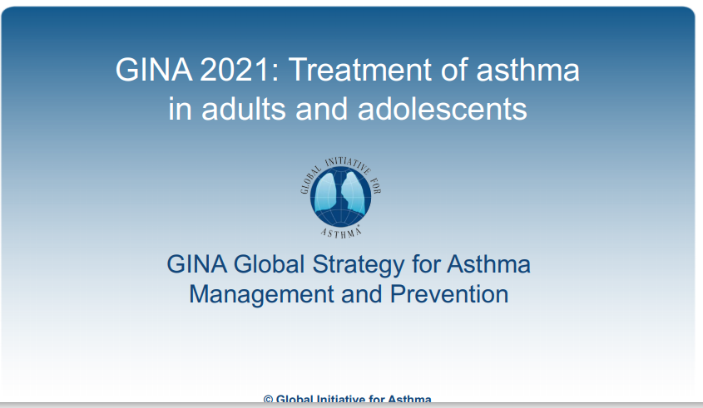

Slide 3
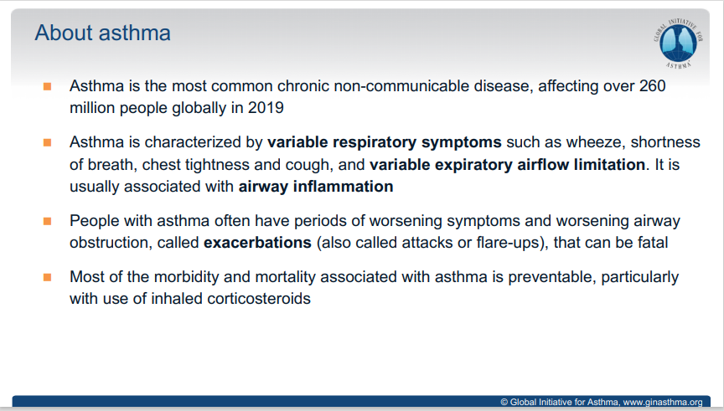

Slide 4
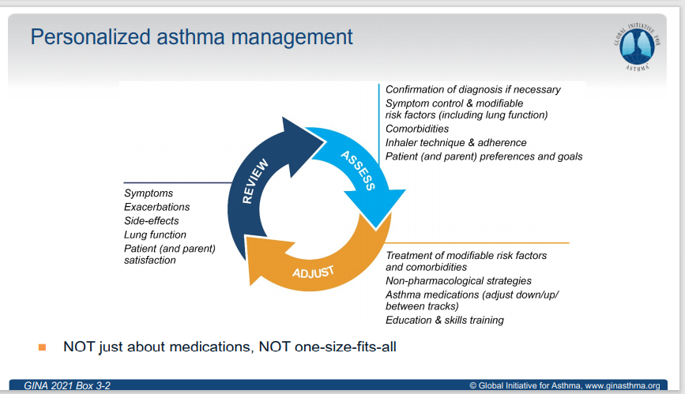

Slide 5
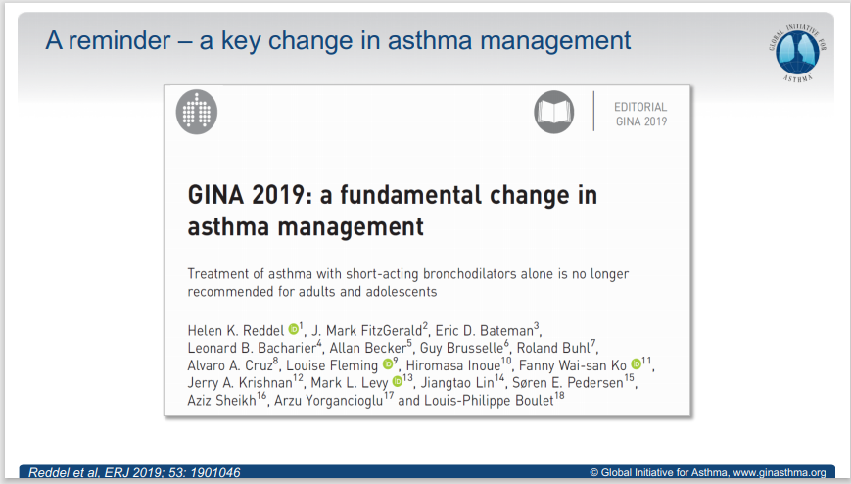

Slide 6
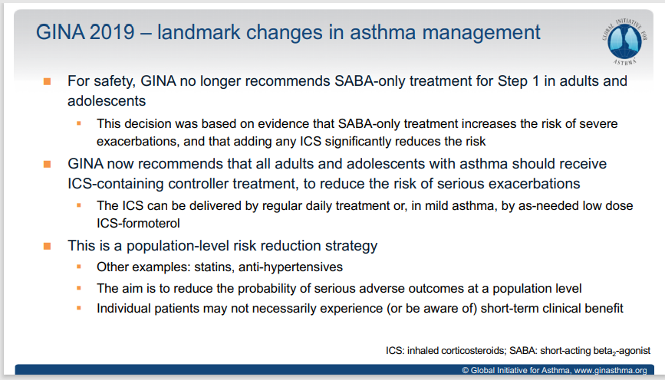

Slide 7
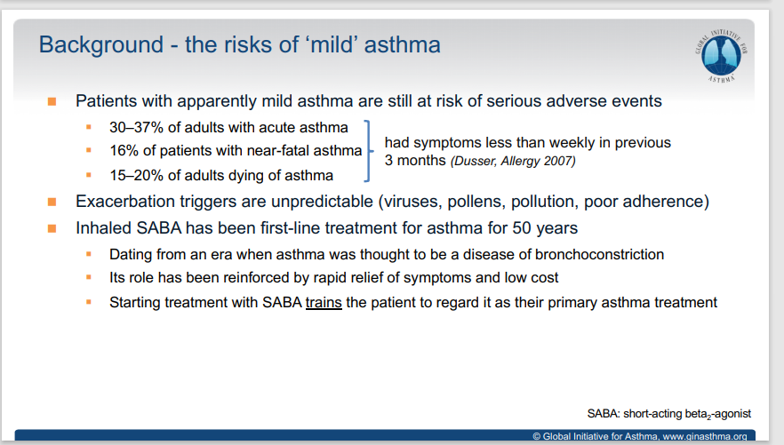

Slide 8
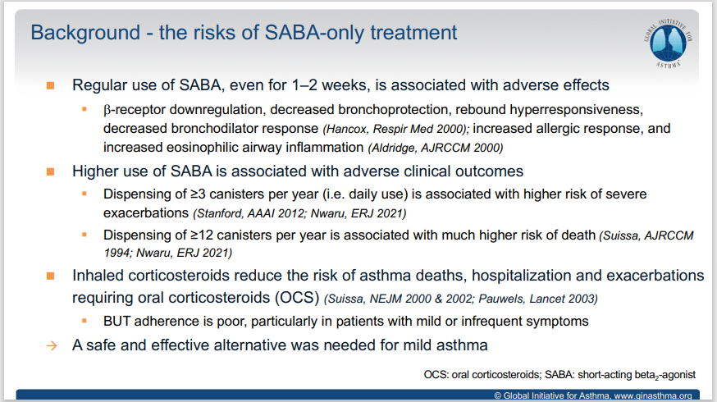

Slide 9
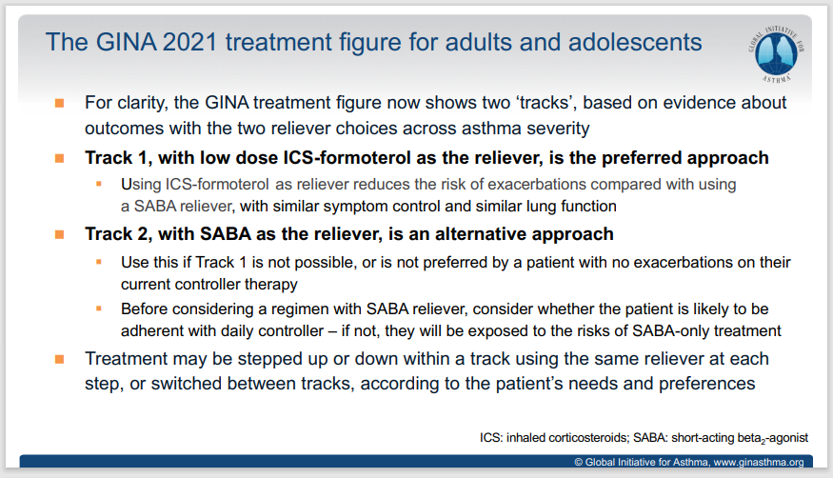

Slide 10
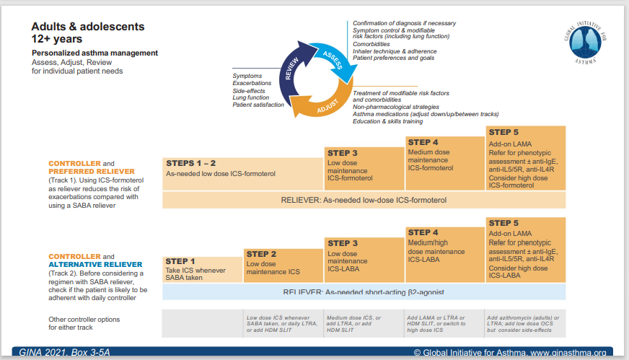

Slide 11
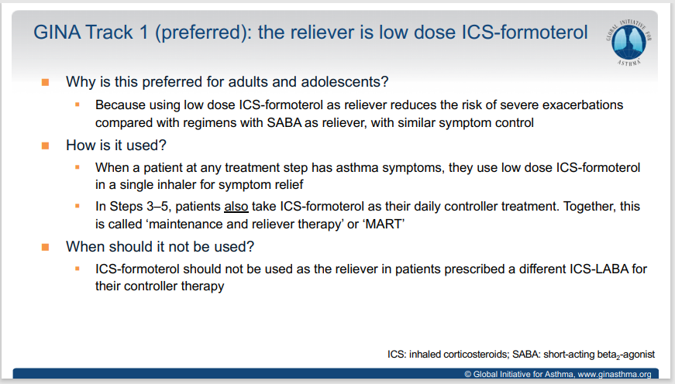

Slide 12
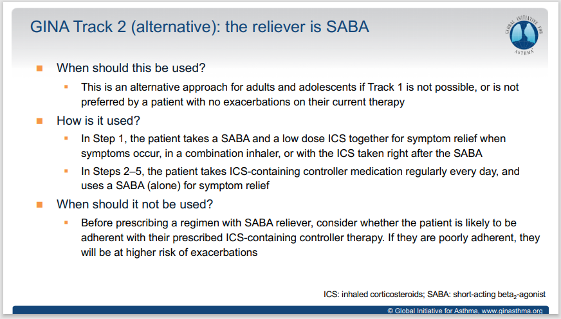

Slide 13
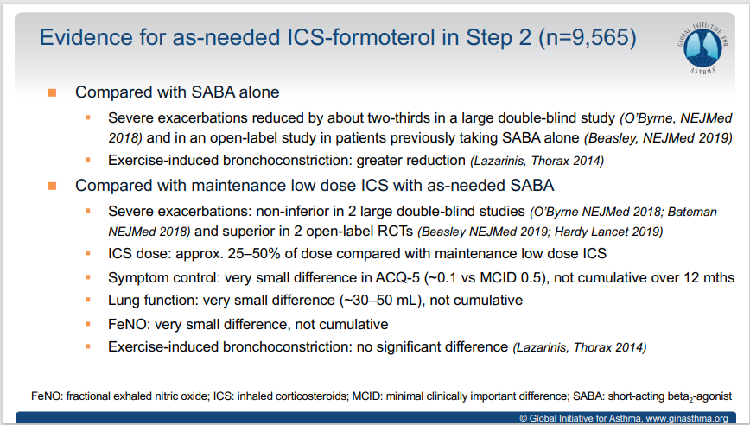

Slide 14
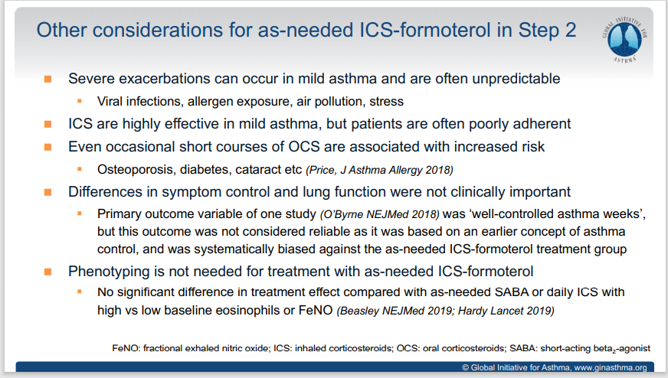

Slide 15
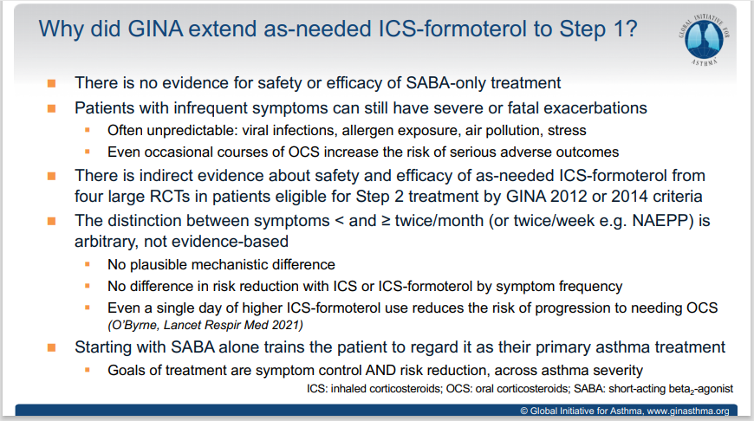

Slide 16
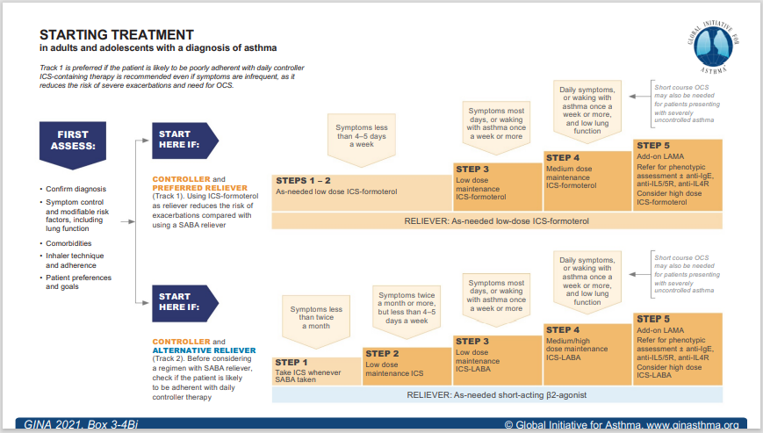

Slide 17
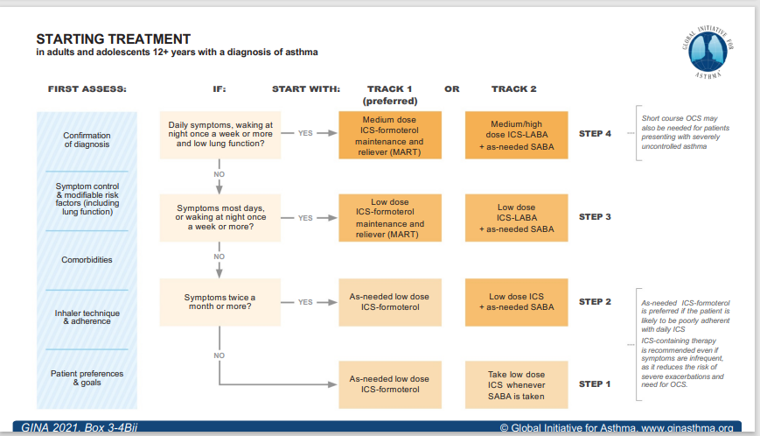

Slide 18
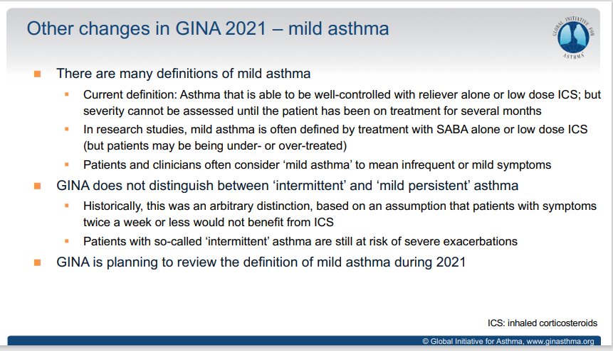

Slide 19
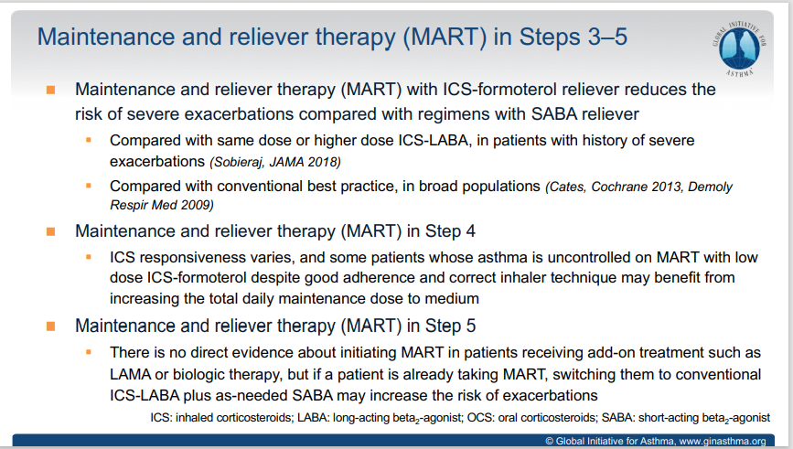

Slide 20
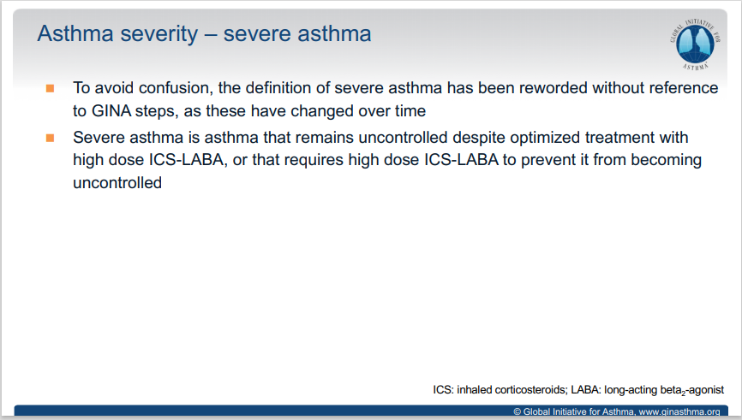

Slide 21
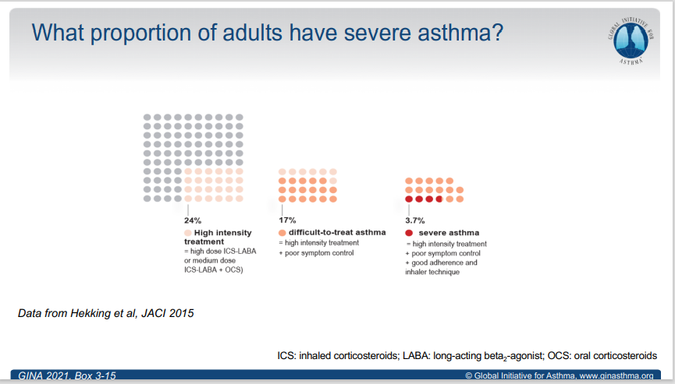

Slide 22
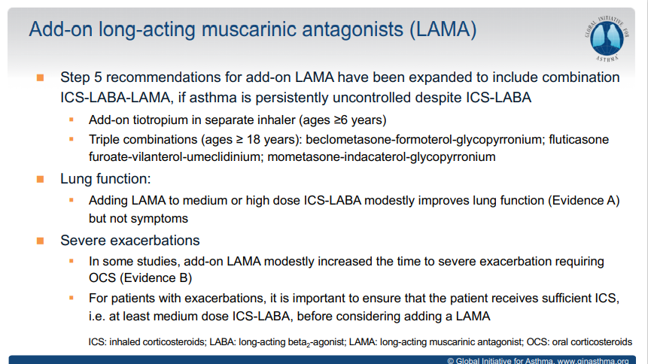

Slide 23
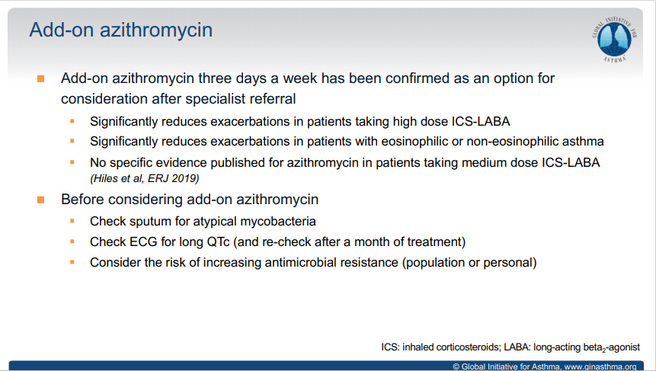

Slide 24
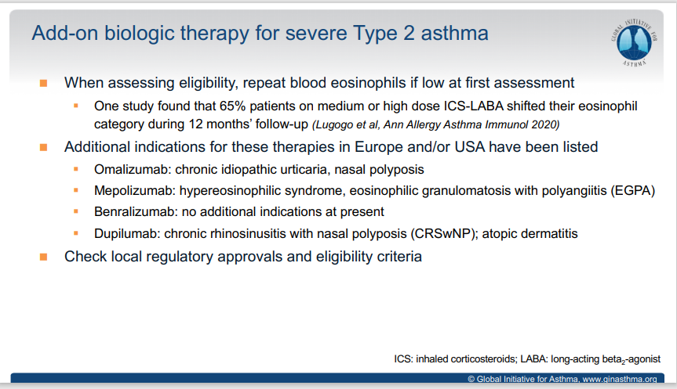

Slide 25
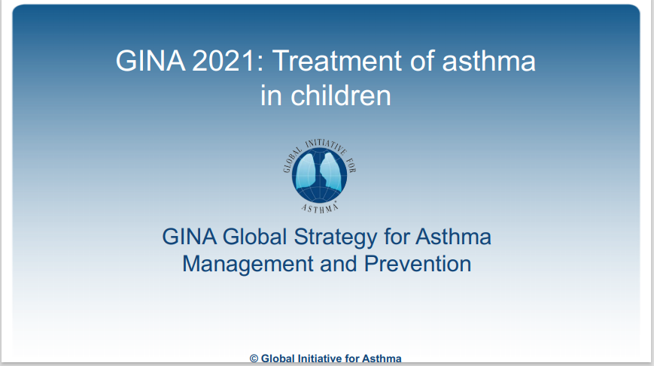

Slide 26
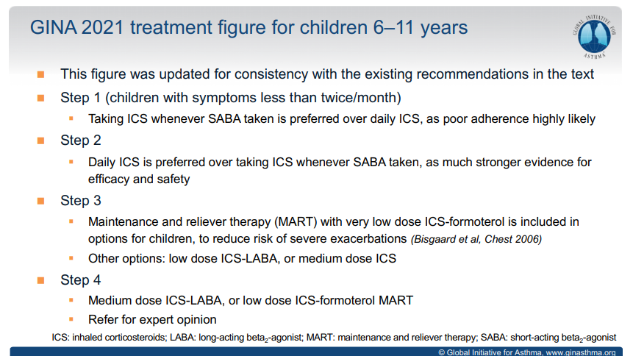

Slide 27
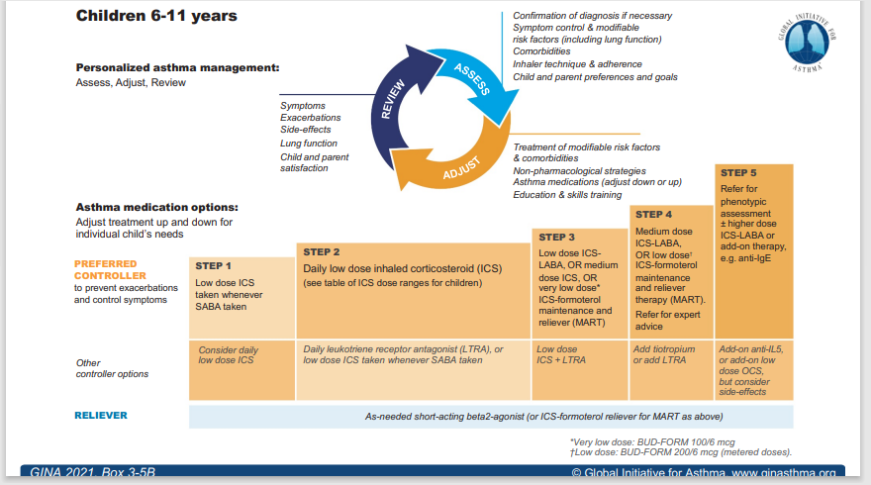

Slide 28
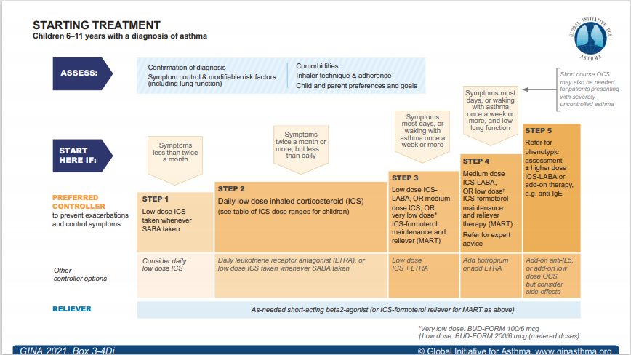

Slide 29
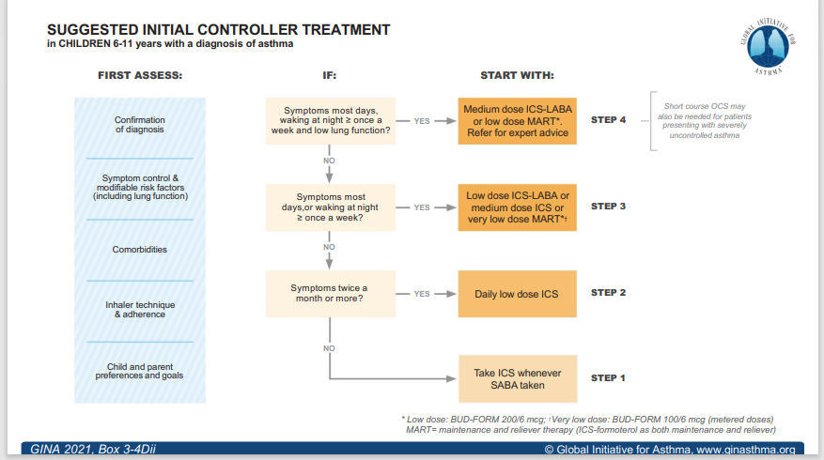

Slide 30
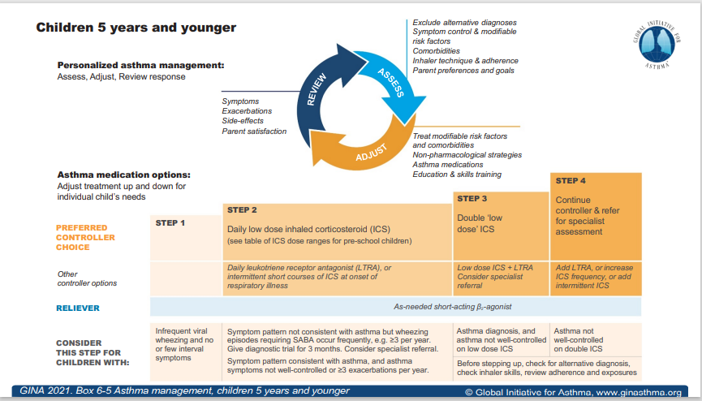

Slide 31
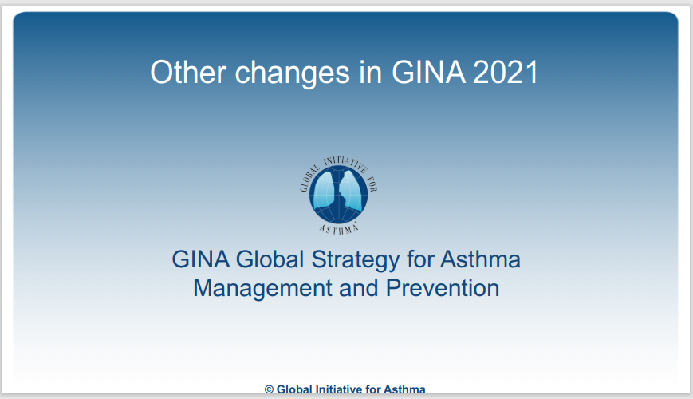

Slide 32
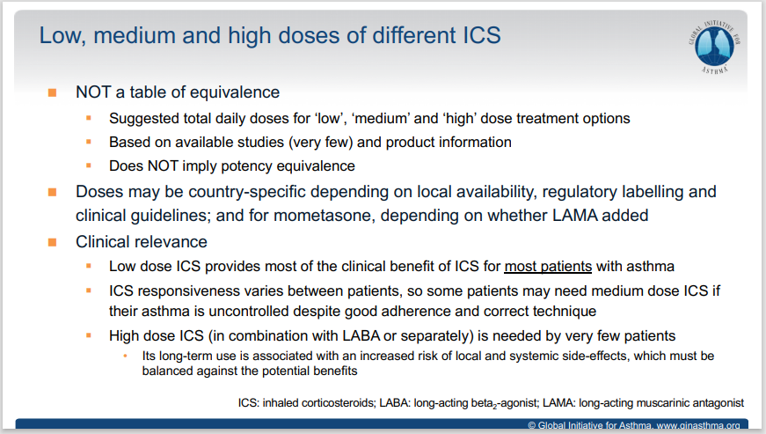

Slide 33
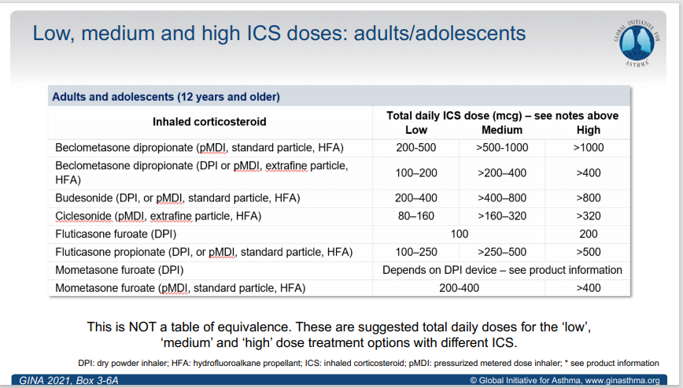

Slide 34
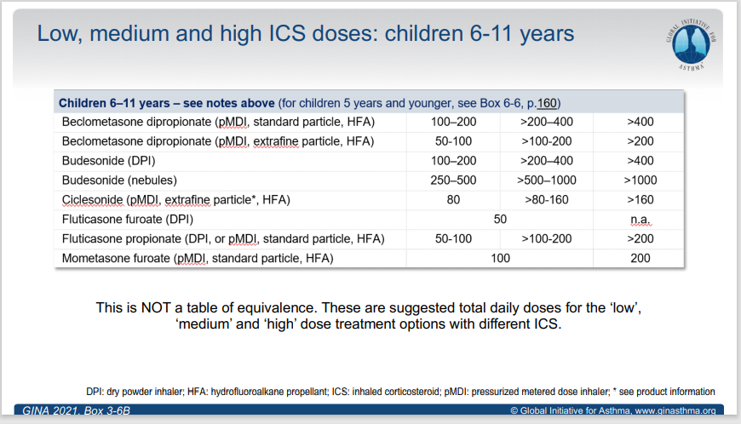

Slide 35
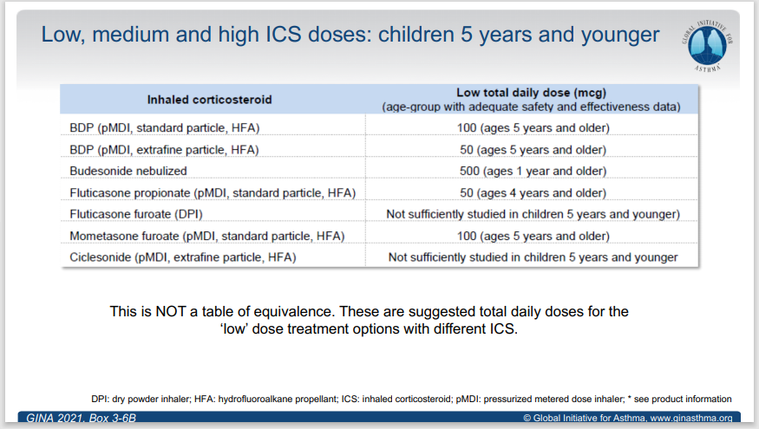

Slide 36
Controller & Reliever Recommended doses for Adults (18 years & older)
According To Symbicort Prescribing Information
The recommended maintenance dose is 2 inhalations per day (160/4.5), given either as one inhalation in the morning or evening. For some patients a maintenance dose of 2 inhalations twice daily may be appropriate.
Patients should take one additional inhalation as needed in response to symptoms. If symptoms persist after a few minutes, an additional inhalation should be taken.
Not more than 6 inhalations should be taken on any single occasion.
A total daily dose of more than 8 inhalations is not normally needed; however, a total daily dose of up to 12 inhalations could be used for a limited period.
Symbicort Prescribing Information, Last Reviewed 2017

Slide 37
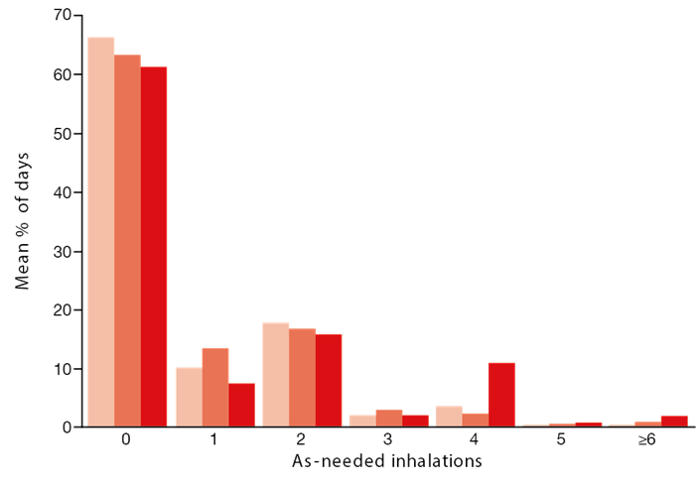
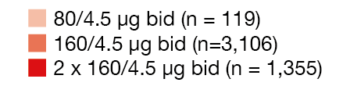
As-needed budesonide/formoterol use in a real-life observational study of budesonide/formoterol as-needed on top of maintenance therapy
As-needed medication was generally low for the majority of the 12-month follow-up
(mean 61–66% of reliever-free days)
High as-needed use (>4 inhalations) was
observed for a mean of 1–3% of days
Budesonide/formoterol as-needed on top
of maintenance therapy provided
appropriate levels of asthma control in
normal clinical practice
Mean percentage of days with
budesonide/formoterol as-needed inhalation use
Figure adapted from Stahlberg et al, 2015.
bid, twice per day.
Ställberg B, Naya I, Ekelund J, Eckerwall G. Real-life use of budesonide/formoterol in clinical practice: a 12-month follow-up assessment in a multi-national study of asthma patients established on single-inhaler maintenance and reliever therapy. International journal of clinical pharmacology and therapeutics. 2015 Jun;53(6):447..

Slide 38
Thanks for your attention
Any question?

