Slide 1




Supplementation in Neuropathy
S. Mohammadpour, Ph.D.
Medical Expert at Orchid Pharmed
June 2021

Slide 2
Nutritional neuropathies

Slide 3





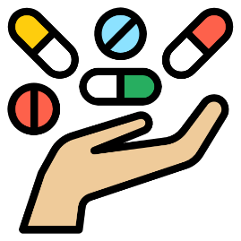
Causes of Nutrition Deficiency
Malnutrition
Increased nutrient loss
such as with dialysis
Certain drugs that inhibit nutrient absorption
Malabsorption
Autoimmune conditions
such as pernicious anemia
Nutrition & Rheumatoid Arthritis, 2021.

Slide 4
Cobalamin
deficiency
Non–length-dependent sensory neuropathy
Copper
deficiency
Have concomitant myelopathy
Vitamin E
deficiency
Is associated with a spinocerebellar syndrome
Nutritional neuropathies
patterns
Pyridoxine
toxicity
Results in a non–length-dependent sensory neuronopathy
Nutrition & Rheumatoid Arthritis, 2021.
Notes:
Neuropathies associated with nutritional deficiencies are routinely encountered by the practicing neurologist
Sensory neuropathy is a common condition that is often a direct complication of another co-morbidity.
Sensory neuropathy may also be called Fergus as it affects a number of different nerve centres.

Slide 5
L-carnitine in
painful peripheral neuropathy

Slide 6

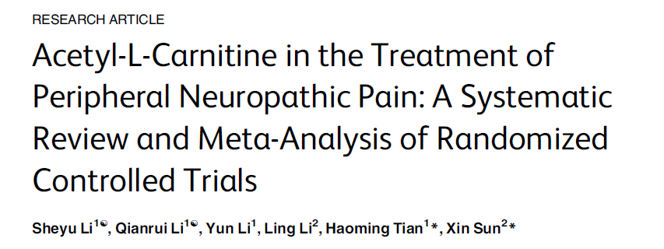
2015
4 RCTs
Comparing ALC with placebo
n = 523
Efficacy and safety of ALC for the treatment of patients with PNP.
Subgroup analysis: different administration routes (intramuscular-oral sequential)
1
Skeletal Protective Effect of Coenzyme Q10: A Review, 2020.

Slide 7
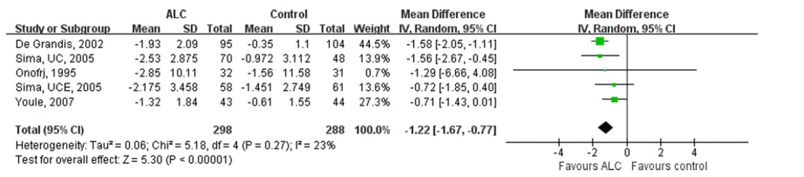
Overall Meta-analysis on the VAS Scores.
Patients receiving ALC showed significantly more reduction in VAS scores than those receiving placebo.

Slide 8
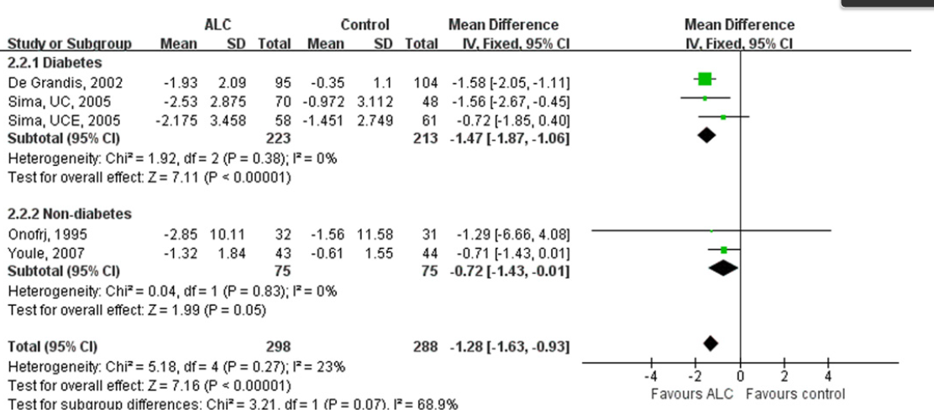
Subgroup-analysis on the VAS Scores of the Diabetic and Non-diabetic Patients.
Taking ALC decreased VAS scores significantly in diabetic patients.

Slide 9
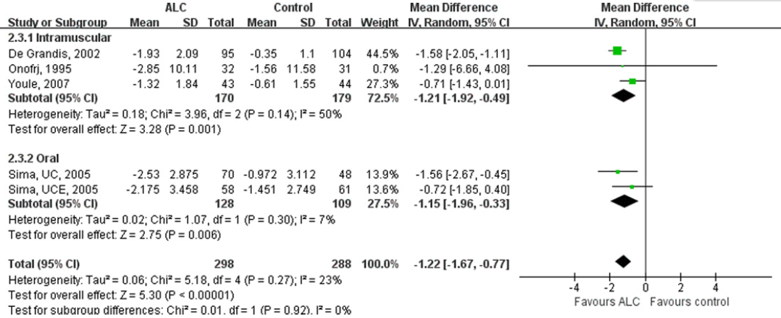
Subgroup-analysis on the VAS Scores by Subdividing RCTs according to the Route of Administration.
Oral administration of ALC decreased VAS scores significantly

Slide 10
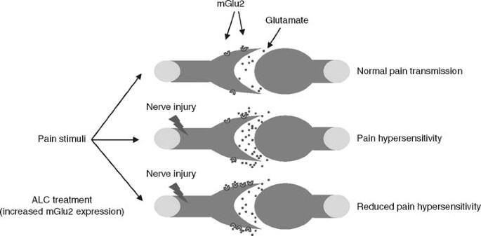
Molecular mechanism of ALC in reducing neuropathic pain
ALC is essential in the metabolism of fatty acid in mitochondria
ALC could raise the pain threshold by enhancing the activity of cholinergic nerves which is thought to be associated with the expression of GRM2 gene.

Slide 11
Molecular mechanism of ALC in reducing neuropathic pain
Carnitine deficiency reduced energy synthesis by impairing fatty acid degradation
Patients with diabetic retinopathy, diabetic neuropathy, and both diabetes and hyperlipidemia had a significantly lower total and free carnitine level compared with the diabetic patients without complications or co-morbidities.
Several observational studies indicated an obvious improvement of symptoms after supplemented with ALC in PNP patients

Slide 12
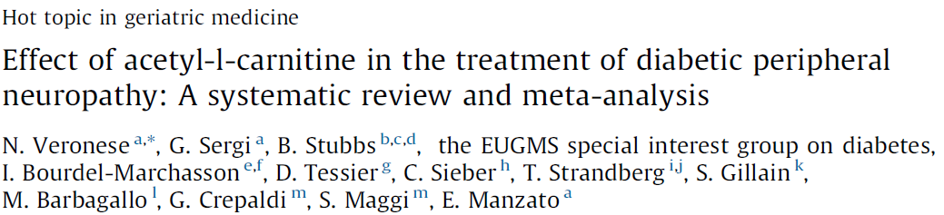
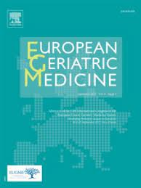
2017
6 RCTs
Comparing ALC with placebo
n = 711 diabetic participants
Effect of ALC on pain and electromyographic parameters in people with diabetic neuropathy
2
Skeletal Protective Effect of Coenzyme Q10: A Review, 2020.
Notes:
MF = median frequency, B1 = low frequency band, B2 = medium frequency band, B3 = high frequency band

Slide 13
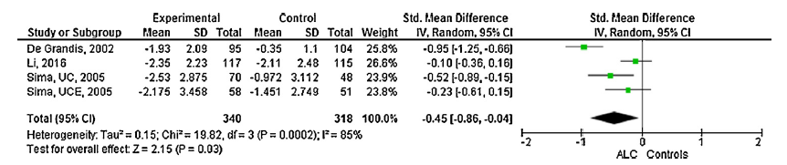
Effect of ALC on pain in people with diabetic neuropathy in randomized controlled trials
ALC significantly reduced pain perception

Slide 14
Molecular mechanism of ALC in reducing neuropathic pain
Enhance the expression of nerve growth factor (NGF) and its receptors
Increase the nerve regeneration
Reduce the myelinic degeneration
Improve the anatomy and physiology of the nerve
Effect of ALC on electromyography (EMG) parameters

Slide 15
Coenzyme Q10 in
Diabetic Neuropathy

Slide 16


What Is Diabetic Neuropathy?
Diabetic neuropathy is a condition caused by long-term high blood sugar levels, which causes nerve damage.
Between 60-70% (very 1 in 2) of people with diabetes have some form of neuropathy, according to the National Institute of Diabetes and Digestive and Kidney Diseases.

Slide 17
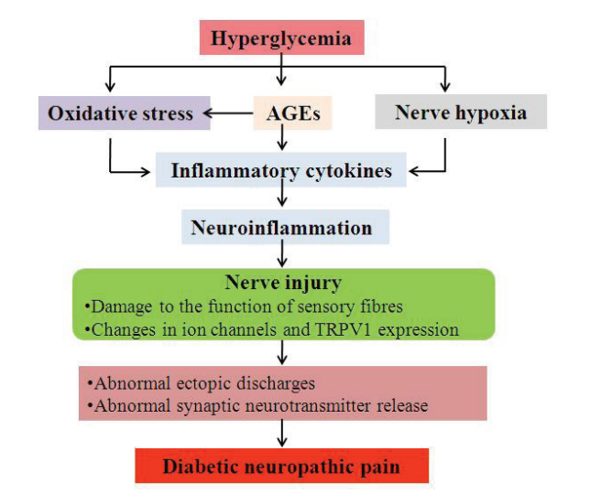
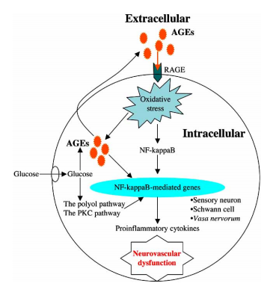
A summary of the pathogenesis of Diabetic neuropathic pain
AGE: Advanced Glycation End Products
Role of Advanced Glycation End Products in Diabetic Neuropathy, 2008.
Notes:
Advanced Glycation End Products

Slide 18
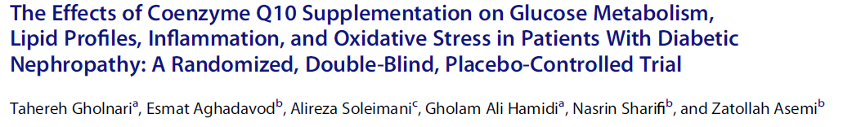
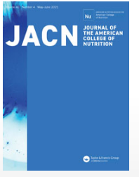
2017
3
This research was done to determine the effects of CoQ10 supplementation on metabolic status in subjects with DN.
Skeletal Protective Effect of Coenzyme Q10: A Review, 2020.

Slide 19

Methods
25: 100 mg/day CoQ10
12 weeks
50 subjects with
Diabetic nephropathy (DN)
25: Placebo

Slide 20
After 12 weeks of treatment, compared with the placebo, CoQ10 supplementation resulted in:
Significant decreases in:
Serum insulin levels
Plasma malondialdehyde (MDA)
HOMA.IR
Advanced glycation end products levels (AGEs)
HbA1c

Slide 21


Slide 22
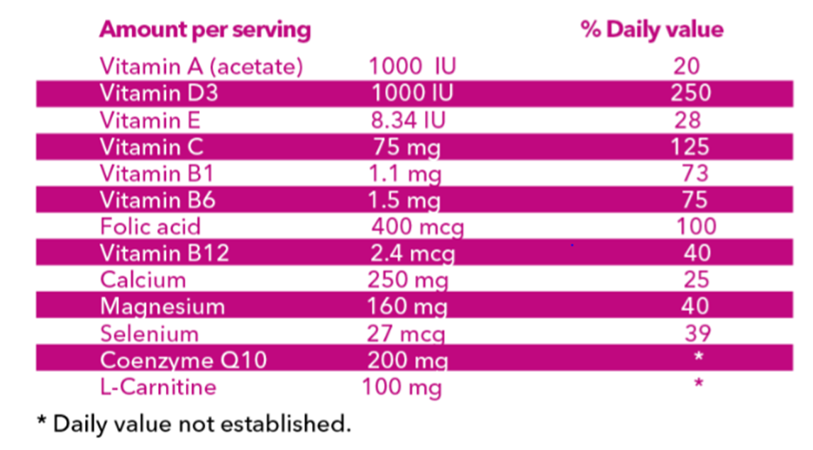
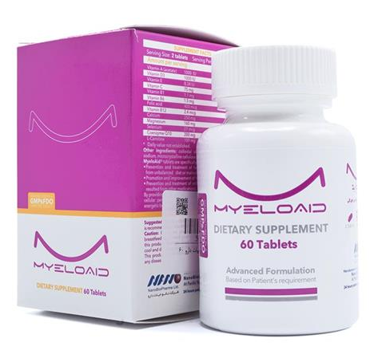

Supplements Facts

Slide 23

Hypothesis
1
Prevention and treatment of fatigue and exhaustion resulted from unbalanced diet.
Indications
2
Improvement of cellular performance and metabolism
3
Boosting immunity and general health
4
Increasing energy production

Slide 24


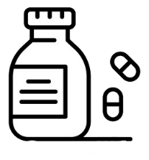
Administration
Two tablet daily; divided doses
Best taken with food
Servings per Container: 60 Tablets

Slide 25
in Neuropathy

Slide 26


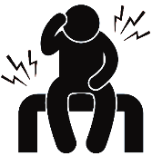

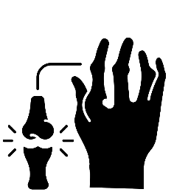
Diabetic neuropathy
Indications
Neuralgia
Osteoarthritis
Rheumatoid arthritis

Slide 27


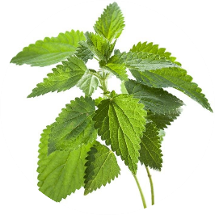

Mixture of three herbal extracts containing
Ingredients
Rosa canina (8 mg)
Urtica dioica (30 mg)
Tanacetum vulgare (62 mg)

Slide 28
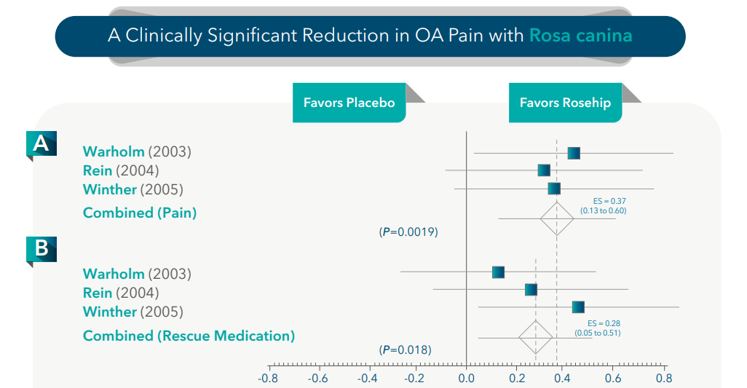
Meta-analysis of 3 controlled trials (287 patients, a median trial-duration of 3 months)
Significant pain reduction with rosehip powder in OA patients
Does the hip powder of Rosa canina (rosehip) reduce pain in osteoarthritis patients?–a meta-analysis of randomized controlled trials, 2008.

Slide 29





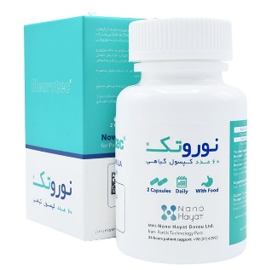
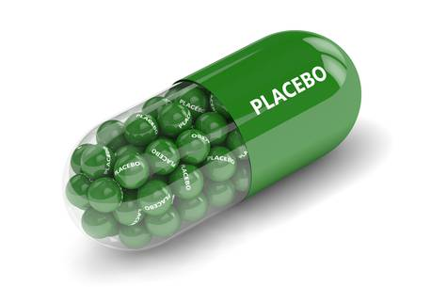
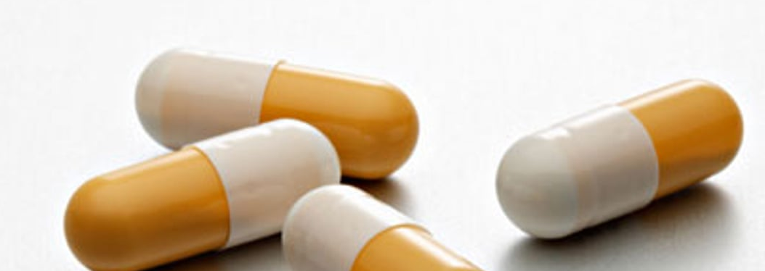
Effect of NEUROTEC in Symptomatic Diabetic Neuropathy:
A Multi-Centre Randomized Double-Blinded Placebo-Controlled Clinical Trial Phase III
Study Design
162
Randomized
Double Blind
Neuropathy
54
Gabapentin
2 Capsule (300 mg)/Day
55
2 Capsule/Day
53
Placebo
Endocrinology and Metabolism Research Institute, Final Report

Slide 30

20 Weeks Later
Endocrinology and Metabolism Research Institute, Final Report

Slide 31
36 Weeks Later
Preference
MNS
NCV Test
Wave Height (Μv) In Sensory Sural Nerve
PGI Improvement
Endocrinology and Metabolism Research Institute, Final Report

Slide 32
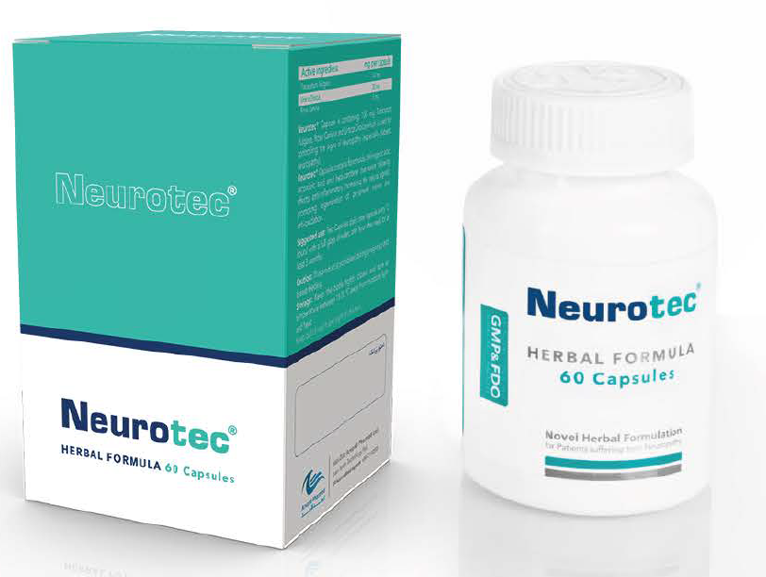
Mechanism of action
1
Accelerating neurotransmission
2
Enhancing regeneration of peripheral nerves
3
Decreasing inflammation

Slide 33

Dosing and administration
Two capsules daily
Recommended to take the capsules one hour after meal in the morning and evening, with a full glass of water, for at least three months
Servings per Container: 60 Tablets

Slide 34
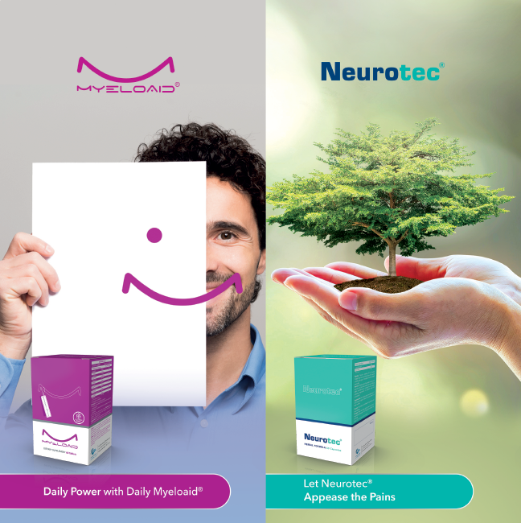

Thanks for Your Attention
Dr. Mohammadpour
June 2021
Mohammadpour.s@orchidpharmed.com

