Slide 1


Slide 2
Dr. Keyvan Elchian
Internist
IUMS

Slide 3
در پارک درحال قدم زدن هستید که متوجه میشوید آقایی حدودا 70 ساله بر روی زمین افتاده است . اولین اقدامی را که مناسب می دانید چیست؟
درخواست کمک یا تماس با اورژانس 115
بررسی ایمنی صحنه
حضور بر بالین فرد و معاینه اولیه
صدا کردن بیمار با صدای بلند

Slide 4
پس از حضور بر بالین فرد متوجه تنفسهای gasping وی می شوید و بیمار با صدا کردن واکنشی نشان نمی دهد.کدام اقدام مناسبتر است؟
چک کردن نبض کاروتید
زدن مشت بر قفسه سینه بیمار
دادن تنفس مصنوعی
خواباندن بیمار به پهلوی چپ

Slide 5
درمعاینه بیمار نبض ندارد.با موبایل خود به اورژانس 115 تماس میگیرید و آدرس محل خود را میدهید. وضعیت بیمار را شرح میدهید.چه اقدامی را انجام میدهید؟
باز کردن راه هوایی با انجام مانور Head tilt – Chin lift
شروع احیای قلبی با 30 ماساژ قلبی و 2 تنفس
فقط ماساژقلبی کافی است چون بیمار تنفس دارد
احیای قلبی با نسبت 15 به 2 به مدت 2 دقیقه

Slide 6
پس از 2 دقیقه از احیای قلبی ، مجددا بیمار ارزیابی شد و متوجه شدید که بیمار همچنان نبض ندارد و تنفس نیز ندارد. چه اقدامی را مناسب می دانید؟
ادامه احیای قلبی با نسبت 15 به 1
انجام ماساژقلبی با سرعت 100 بار و تنفس هر 2 دقیقه
احیای قلبی به مدت 2 دقیقه با نسبت 30 به 2 *****
افزایش سرعت ماساژ قلبی به 150 بار در دقیقه و تنفس 2 بار در دقیقه

Slide 7
5- پس از چند دقیقه از احیای شما همکاران اورژانس 115 در محل حاضر گردیدند.همراه آنها دستگاه AED آماده اتصال به مریض و داروهای احیا است.شما وسط احیا و سیکل 2 دقیقه ای خود هستید.چه افدامی مناسب است؟
ادامه احیا تا پایان سیکل 2 دقیقه ای
ادامه ماساژ قلبی و درخواست از همکار EMS جهت دادن تنفس
توصیه به تزریق اپی نفرین و ادامه ماساژ قلبی
قطع احیا و اتصال دستگاه AED

Slide 8
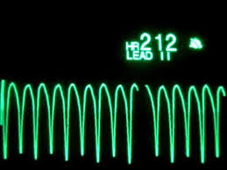
به شما اطلاع میدهند آقای 70 ساله ای را به بخش اورده اند ، در حین ویزیت بیمار مجاور متوجه حرکات لرزشی بیمار و افت هوشیاری وی می شوید ، بلافاصله مانیتور را ملاحظه می کنید ، بر بالین وی حاضر شده و نبض مرکزی را چک می کنید ، بیمار فاقد نبض مرکزی می باشد.
1- اقدام مناسب...
شروع ماساژ قفسه سینه
شوک سینکرونیزه
اینتوباسیون
تجویز اپی نفرین
دادن اکسیژن با ماسک و آمبوبگ
فراخوان تیم احیا

Slide 9
– پس از وصل کردن بیمار به مانیتور و مهیا شدن دستگاه دفیبریلاتور ، ریتم بیمار را ملاحظه می کنید ، اقدام مناسب ....
شوک سینکرونیزه ی 200 ژول
شوک آسینکرونیزه ی 200 ژول
شوک آسینکرونیزه ی 50 ژول
ماساژ قفسه سینه را ادامه داده و اپی نفرین تجویز می کنیم

Slide 10
- بلافاصله پس از دریافت یک نوبت شوک آسینکرونیزه ی 200 ژول مانیتور به شکل زیر است، اقدام بعدی ...
چک نبض بیمار
ادامه ی ماساژ قفسه سینه
تجویز اپی نفرین
شوک الکتریکی مجدد

Slide 11
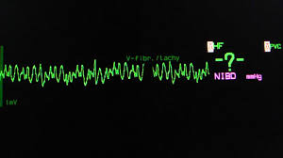
- پس از 5 سیکل کامل 30-2 ماساژ قفسه سینه و تنفس ریتم بیمار به شکل زیر است ، اقدام بعدی ...
چک نبض مرکزی
تجویز آمیودارون
تجویز شوک الکتریکی مجدد
ادامه ی ماساژ قفسه سینه و تنفس 30:2
اقدام به اینتوباسیون
تجویز اپی نفرین

Slide 12
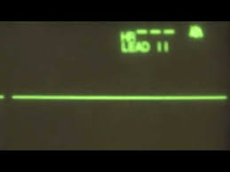
6- پس از شوک الکتریکی دوم و انجام انتوباسیون و ماساژ قفسه سینه به مدت 2 دقیقه و تجویز اپی نفرین ، مانیتور را ملاحظه می فرمایید .اقدام بعدی ..
چک نبض بیمار
شوک الکتریکی مجدد
ادامه ی اپی نفرین هر 10 دقیق
ادامه ی اپی نفرین هر 3-5 دقیقه
قطع ماساژ قفسه سینه
ادامه ی ماساژ قفسه سینه به مدت 2 دقیقه

Slide 13
- پس از 2دقیقه از ادامه ی احیا با اپی نفرین و ماساژ قفسه سینه با کیفیت مناسبت، ریتم بیمار به شکل زیر است و فاقد نبض مرکزی می باشد ،اقدام بعدی ...
ادامه ی ماساژ قفسه سینه
تجویز آمیودارون 300 میلی گرم
تجویز آمیودارون 150 میلی گرم
اقدام به شوک الکتریکی
تجویز آتروپین
ادامه اپی نفرین هر 3-5 دقیقه

Slide 14
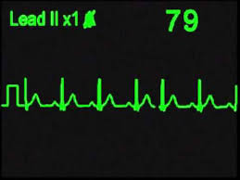
- پس از 2 دقیقه احیای استاندارد ریتم بیمار چک شد که به شکل زیر است، اقدام مناسب بعدی چیست ؟
چک نبض
ادامه ی ماساژ قفسه سینه
شوک الکتریکی سینکرونیزه
شوک الکتریکی آسینکرونیزه
ادامه اپی نفرین هر 3-5 دقیقه
نیاز به اقدام خاصی نیست انتقال بیمار به ccu

Slide 15
- بیمار در حال حاضر نبض دارد ولی هوشیار نمی باشد، اقدام مناسب بعدی چیست ؟
اقدامات حمايتي پس از احیا
مشاوره ی کاردیولوژی
ادامه ی ماساژ قفسه ی سینه

Slide 16
بیمار اماده رفتن به بخش مراقبت های قلبی میشه که متوجه میشوید که ضربان قلب بیمار 30 و تنفس 15 د ردقیقه و فشار بیمتر 100/55 است درجه حرارت بیمار 36.5 اقدام بعدی شماچیست؟
چک قند
چک ریتم
با شک سپس شرو انبی بیوتیک
شروع وازوپرسور
شروع اتروپین
گذتشتن پیس میکر

Slide 17
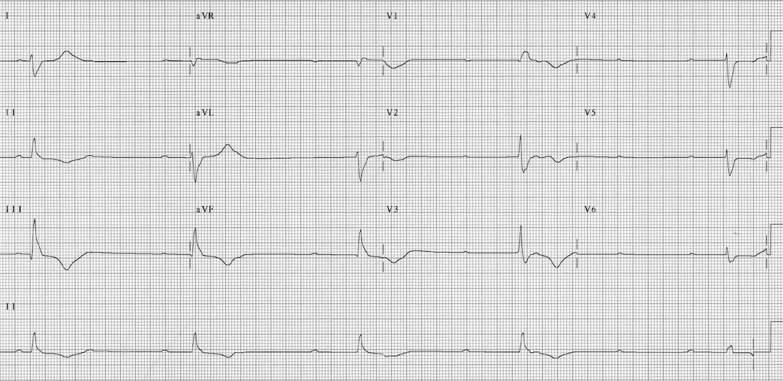

Slide 18
بعد از سیکل های متعدد احیا ریتم بیمارventricular escape bradycardia with hypotension
است
اقدام بعدی چیست؟
انتوباسیون بیمار
کاپنوگرافی
5t$5h را بررسی کنیم
از نظر toxicology بیمار را بررسی میکنیم

Slide 19
Case Presentation
A nurse on the medical ward calls you (rapid response team) because an 80-year-old female patient who was admitted for nausea and vomiting is now experiencing chest discomfort.
What are your initial actions?

Slide 20
Case Presentation:
Physical Findings
You perform the Primary Assessment:
A
B
C
D
E
BP 80/40 mm Hg, HR 110/min, RR 20/min
O₂ sat 90% on RA, temp 37°C (98.6°F), glucose 104 mg/dL
Notes:
Questions and Considerations
A—The airway is patent.
B—Respirations are slightly labored at a rate of 20/min.
C—The patient has a weak radial pulse.
D—Conscious and alert
E—No obvious signs

Slide 21
Perfusion
Intravascular volume
Peripheral vascular resistance
Cardiac contractility
Heart rate
Notes:
Questions and Considerations
Is the patient volume depleted? BP 80/40 mm Hg, HR 110/min
Peripheral vascular resistance: Skin cool, clammy
Cardiac contractility: Could obtain an echocardiogram
HR: 110/min; need to check rhythm

Slide 22
Differential Diagnosis: Secondary Assessment
SAMPLE
S—Signs and symptoms: Nausea/vomiting, chest discomfort, tachycardia, hypotension
A—Allergy: No known drug allergies
M—Medications: Insulin, hydrochlorothiazide, vitamins
P—Past medical history: The patient has a history of diabetes and hypertension.
L—Last meal: NPO last 12 hours
E—Events: No evidence of trauma
What is the likely cause of the patient’s chest discomfort?
Notes:
Questions and Considerations
What is the probable cause of the patient’s chest discomfort?

Slide 23
Differential Diagnosis: Secondary Assessment
H’s
H—Hypovolemia
H—Hypoxia
H—Hydrogen ion (acidosis)
H—Hypo-/hyperkalemia
H—Hypothermia
Notes:
Questions and Considerations
H—Hypovolemia: Does this patient have hypovolemia? It’s possible. The patient was admitted with nausea and vomiting; however, she seems to have been well hydrated by IV fluids. Are there other possible problems? Occult bleeding from GI tract or elsewhere? She may be hydrated but is very anemic.
H—Hypoxia: O₂ sat is 90% on RA. Why is her O₂ sat 90%?
H—Hydrogen ion (acidosis): RR is 20/min.
H—Hypo-/hyperkalemia
H—Hypothermia: Temp is 37°C (98.6°F).

Slide 24
Differential Diagnosis: Secondary Assessment
T’s
T—Tension pneumothorax
T—Tamponade, cardiac
T—Toxins
T—Thrombosis, pulmonary
T—Thrombosis, coronary
Notes:
Questions and Considerations
T—Tension pneumothorax: Lung sounds are equal bilaterally.
T—Tamponade, cardiac
T—Toxins: None noted
T—Thrombosis, pulmonary: Possible
T—Thrombosis, coronary: Need a 12-lead ECG (shows STEMI)
The 12-lead ECG discussion appears on a subsequent slide.

Slide 25
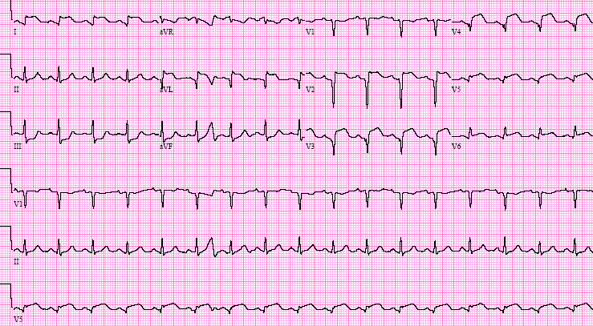
12-Lead ECG
I
II
III
What is the diagnosis?
What is the significance of the ECG changes?
Notes:
Questions and Considerations
The left anterior coronary artery supplies the anterior wall.
Proximal occlusion, particularly before a large diagonal branch, can affect a substantial amount of myocardium in the absence of collateral circulation.
Patients are at risk for CHF and cardiogenic shock.
Ask participants to identify the location of this MI. What complications should they anticipate?
Discussion Points: This ECG demonstrates a large anterior wall MI. Note ST-segment elevation in leads V₂ through V₆. This infarction extends into the lateral wall, indicating occlusion of the proximal LAD coronary artery. There is also significant ST-segment depression in the inferior leads.
This is a large AMI involving the anterior wall.
Patients with a large AMI are at risk for the second most common cause of death and MI: LV failure and congestive heart failure.
Reperfusion and myocardial salvage are critical, and their success is time dependent.

Slide 26
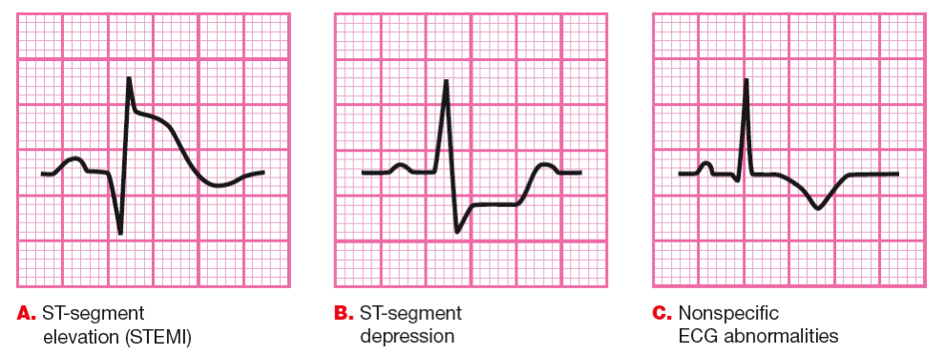
12-Lead ECG Examples
Notes:
Questions and Considerations
The ECG is central to the diagnosis of possible ischemic pain and initial triage and treatment of ACS.
This tracing shows greater than 1 mm ST-segment elevation, measured 0.04 seconds after the J point (STEMI).
This tracing shows 0.5 mm or greater ST-segment depression, measured 0.04 seconds after the J point.
The nonspecific ST-segment and T-wave changes on this tracing are consistent with either NSTEMI or unstable angina.
Cardiac markers could be positive in any of these ECG tracings.

Slide 27
12-Lead ECG Findings
1. ST-segment elevation or new LBBB; strongly suspicious for injury—STEMI | 2. ST-segment depression/dynamic T-wave inversion; strongly suspicious for ischemia— high-risk NSTE-ACS | 3. Normal or nondiagnostic ECG; chest pain strongly suspicious for low/intermediate- risk ACS
What is the treatment strategy indicated by the above initial ECG criteria?
Notes:
Questions and Considerations
Diagnosis: STEMI
Discuss the importance of the 3 ECG categories:
ST-segment elevation or new or presumably new LBBB: Time is of the essence because time is muscle. STEMI drives the reperfusion pathway with a door-to-needle time of 30 minutes (fibrinolytics) and door–to–balloon inflation time of 60 to 90 minutes (PCI) for patients with out-of-hospital STEMI. The same standards or better are expected for patients who are already in the hospital.
ST-segment depression or dynamic T-wave inversion: These patients do not benefit from and may be harmed by administration of fibrinolytic therapy. In high-risk patients, this ECG drives aggressive antiplatelet therapy and early coronary angiography.
Normal or nondiagnostic changes in ST segment or T wave: Perhaps the most challenging group because most patients do not have ischemia, but a significant percentage have CAD and may have unstable syndromes

Slide 28
12-Lead ECG Findings
1. ST-segment elevation or new LBBB; strongly suspicious for injury—STEMI | 2. ST-segment depression/dynamic T-wave inversion; strongly suspicious for ischemia— high-risk NSTE-ACS | 3. Normal or nondiagnostic ECG; chest pain strongly suspicious for low/intermediate- risk ACS
Reperfusion PCI−lytics | Antiplatelet Antithrombin therapy | Risk stratification
Notes:
Questions and Considerations
Briefly review the principle that the 12-lead ECG is the initial and most important triage tool, and it is abnormal in about 50% of patients with ACS.
Stress that the ECG is performed in the prehospital setting or within 10 minutes after the patient’s arrival in the ED, and it is interpreted by the senior healthcare professional charged with initiating reperfusion therapy.
Discuss the importance of the 3 ECG categories:
ST-segment elevation or new or presumably new LBBB: Time is of the essence and time is muscle. STEMI drives the reperfusion pathway with a door–to–balloon inflation time of 60 to 90 minutes (PCI) and door-to-needle time of 30 minutes (fibrinolytics).
ST-segment depression or dynamic T-wave inversion: These patients do not benefit from and may be harmed by administration of fibrinolytic therapy. In high-risk patients, this ECG drives aggressive antiplatelet therapy (aspirin, heparin, glycoprotein IIb/IIIa inhibitor therapy, clopidogrel) and early coronary angiography.
Normal or nondiagnostic changes in ST segment or T wave: This is a challenging group because most patients do not have ischemia, but a significant percentage have CAD and may have unstable syndromes.
Diagnosis: STEMI

Slide 29
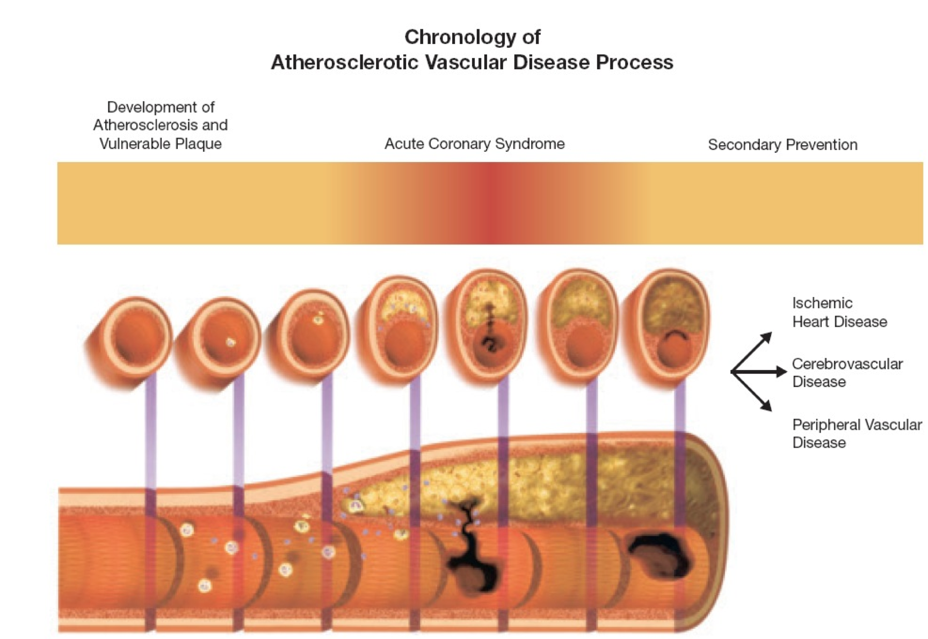
Pathophysiology of ACS
Notes:
Questions and Considerations
From the ACLS for Experienced Providers Manual and Resource Text
What are some syndromes associated with plaque rupture and erosion? STEMI, NSTE-ACS, or UA
Timeline of atherosclerosis and ACS
Slices through coronary artery, each representing a decade of life, depict the development of coronary atherosclerosis.
Gradual narrowing of the artery can cause development of angina when a critical or “significant” narrowing develops, usually 90% cross-sectional narrowing of the artery.
If plaque rupture or erosion occurs, an ACS can develop and result in STEMI, NSTE-ACS, or UA.
Sudden cardiac death can complicate any of these syndromes and can be the first, last, and only symptom.
When this process occurs in other vascular beds, stroke or peripheral vacular disease may occur.
Image adapted with permission from Libby P. Current concepts of the pathogenesis of the acute coronary syndromes. Circulation. 2001;104(3);365-372. © 2001 American Heart Association.

Slide 30
Diagnosis
What is your diagnosis?
Anterolateral STEMI
Notes:
Diagnosis: Anterolateral STEMI

Slide 31
Treatment
What treatments and dosages would you recommend?
Provide your reasoning.
Notes:
Treatments
O₂ (nasal cannula at 2 L/min): Maintain O₂ sat at 90% to 99%. Although all patients received O₂ in the past, there is some evidence that hyperoxia may reduce cardiac contractility and lead to additional damage from oxygen free radicals on reperfusion. Oxygen is recommended to keep Spo₂ at 90% or greater when the patient is in respiratory distress or if Spo₂ is unknown.
Aspirin: 160 to 325 mg (chewable, nonenteric coated) if not contraindicated
Nitrates: Nitroglycerin (0.4 mg) every 5 minutes up to 3 times
Nitroglycerin ointment 0.5 to 1 inch
Nitroglycerin infusion (for longer transports or critical care)
Should not be used if patient is hypotensive as in this case
IV fluids: How much? IV fluids can be titrated if hypotension is believed to be due to hypovolemia. In practice, this can sometimes be hard to determine. Some advocate careful titration of small (approximately 250 mL) fluid boluses if the patient’s volume status is uncertain.
Morphine 2 to 4 mg IVP; titrate for pain alleviation (if discomfort is not relieved by nitroglycerin). Caution must be taken for patients who are hypotensive because morphine may further decrease BP, worsening cardiac perfusion.
What measures must be taken? Notify the catheterization lab of an emergency. What if you are in a hospital that does not have this capability? Consider urgent transfer or fibrinolytic therapy.
Other options? Pressors/inotropes; intra-aortic balloon pump
What are the pros/cons of these interventions?

Slide 32
Case Progression
After STEMI is diagnosed on the 12-lead ECG and initial treatment is started, the patient becomes unresponsive.
What would you do now?
Notes:
Additional Information/Discussion Points
You conduct the BLS Assessment and do not detect a pulse.
The monitor indicates VF.
Call for additional help if needed.
High-quality CPR should be started immediately.
Prepare for defibrillation.

Slide 33
Case Progression
You conduct the BLS assessment; no pulse is found and VF is present on the monitor.
What would you do next?
What additional actions do you want to take?
Notes:
Additional Information/Discussion Points
The patient needs good BLS/ACLS.
High-quality CPR is being performed.
The team is following the Adult Cardiac Arrest Algorithm.
Defibrillation is performed, compressions are resumed, and a vasopressor is given (only after the second shock).
Is the timing of pressor vs antiarrhythmic important in this setting? The key interventions for VF arrest are chest compressions and defibrillation. There is evidence that a pressor is more useful for achieving ROSC and that this should be given priority over an antiarrhythmic. The optimal timing of amiodarone is not known. In the past, this medication was mixed in a solution that often caused vasodilation; this is no longer the case.
What about intubation? If the patient can be adequately ventilated with a mask, it is reasonable to continue doing so at least until initial CPR and defibrillation can be performed. An advanced airway may be helpful, but this should be placed with minimum interruptions in chest compressions (less than 10 seconds). Use of a supraglottic airway may achieve this more readily than intubation with an endotracheal tube.
Should fibrinolytics be administered during the code? ROSC will only be achieved in this specific case if the patient is given fibrinolytics.

Slide 34
Case Progression
ROSC is achieved.
What are your next actions?
Notes:
ROSC is achieved after the patient is given fibrinolytics.

Slide 35
Treatment
The patient is intubated.
After an IV fluid bolus is given and dopamine is started at 5 mcg/kg per minute, the patient’s BP is up to 120/80 mm Hg and HR is 80/min.
You initiate targeted temperature management (TTM) and transfer the patient to the catheterization lab.
Notes:
Targeted temperature management can be safely combined with primary PCI after cardiac arrest caused by AMI.
2015 American Heart Association (AHA) Guidelines Update for Cardiopulmonary Resuscitation (CPR) and Emergency Cardiovascular Care (ECC), Part 9: Acute Coronary Syndromes
In adult patients presenting with STEMI in the ED of a non–PCI-capable hospital, immediate transfer without fibrinolysis from the initial facility to a PCI center instead of immediate fibrinolysis at the initial hospital with transfer only for ischemia-driven PCI is recommended (Class I, LOE B-R). When STEMI patients cannot be transferred to a PCI-capable hospital in a timely manner, fibrinolytic therapy with routine transfer for angiography may be an acceptable alternative to immediate transfer to PPCI (Class IIb, LOE C-LD).
When fibrinolytic therapy is administered to a STEMI patient in a non–PCI-capable hospital, it may be reasonable to transport all postfibrinolysis patients for early routine angiography in the first 3 to 6 hours and up to 24 hours rather than transport postfibrinolysis patients only when they require ischemia-guided angiography (Class IIb, LOE B-R).

Slide 36
Case Summary
After PCI, the patient is transferred to the ICU.
Notes:
Major Teaching Points
Healthcare providers should ensure an adequate airway and support breathing immediately after ROSC.
After ROSC is achieved, the clinician should assess vital signs and monitor for recurrent cardiac arrhythmias.
If the patient is hypotensive (systolic BP less than 90 mm Hg), consider administration of fluid boluses.
Because TTM is the only intervention demonstrated to improve neurologic recovery, it should be considered for any patient who is unable to follow verbal commands after ROSC.

Slide 37
Case Summary
An inpatient is admitted for vomiting and then develops chest discomfort representing a STEMI.
An ECG reveals the diagnosis, and the patient will go into cardiac arrest shortly after the ECG is read.
ROSC is achieved when the patient is given tPA during the arrest.
An alternative in some systems could be to bring the patient to the catheterization lab, but this would be an unlikely scenario in most systems.
Notes:
Major Teaching Points
If fibrinolytics are given, the patient will achieve ROSC in this specific case.
Major Discussion Points
An ECG will reveal the diagnosis, and the patient will go into cardiac arrest shortly after the ECG is read.
No ROSC will be achieved unless the patient is given fibrinolytics during the arrest.
An alternative in some systems could be to bring the patient to the catheterization lab, but this would be an unlikely scenario in most systems.
From the 2015 AHA Guidelines for CPR and ECC
Because aspirin should be administered as soon as possible after symptom onset in patients with suspected ACS, it is reasonable for EMS dispatchers to instruct patients with no history of aspirin allergy and without signs of active or recent GI bleeding to chew an aspirin (160 to 325 mg) while awaiting the arrival of EMS providers (Class IIa, LOE C).
If the patient is dyspneic or hypoxemic or has obvious signs of heart failure, providers should titrate therapy, based on monitoring of oxyhemoglobin saturation, to 94% or greater (Class I, LOE C).
Morphine is indicated in STEMI when chest discomfort is unresponsive to nitrates (Class I, LOE C); morphine should be used with caution in UA/NSTE-ACS because of an association with increased mortality in a large registry (Class IIa, LOE C).
Advance notification should be provided to the receiving hospital for patients identified as having STEMI (Class I, LOE B).
It is strongly recommended that systems that administer fibrinolytics in the prehospital setting include the following: protocols using fibrinolytic checklists, 12-lead ECG acquisition and interpretation, experience in advanced life support, communication with the receiving institution, medical director with training and experience in management of STEMI, and continuous quality improvement (Class I, LOE C).
In these circumstances, fibrinolytic therapy has equivalent or improved outcomes compared with PCI, especially when the benefit to bleeding risk is favorable (eg, young age, anterior location of MI) (Class I, LOE B).
Hospital and ED protocols should clearly identify criteria for expeditious transfer of patients to PCI facilities.
These include patients who are ineligible for fibrinolytic therapy or who are in cardiogenic shock (Class I, LOE C).
A door-to-departure time of less than 30 minutes is recommended by the American College of Cardiology Foundation/American Heart Association Guidelines.
Transfer of high-risk patients who have received primary reperfusion with fibrinolytic therapy is reasonable (Class IIa, LOE B).
From the 2015 AHA Guidelines Update for CPR and ECC, Part 9: Acute Coronary Syndromes
In the treatment of patients with suspected STEMI, the combined application of fibrinolytic therapy followed by immediate PCI (as contrasted with immediate PCI alone) is not recommended (Class III: Harm, LOE B-R).
Potential Case Debriefing Questions
What were the most important findings from the systematic approach?
What were the key physiologic and pathologic processes in this case?
What were your differential and final diagnoses?

Slide 38
Localizing Ischemia or Injury
I lateral
aVR
V₁ septal
V₄ anterior
II inferior
aVL lateral
V₂ septal
V₅ lateral
III inferior
aVF inferior
V₃ anterior
V₆ lateral
Notes:
Questions and Considerations
Experienced providers should be proficient in ECG identification of the major ECG presentations of ACS. Use this slide and the following to review and assess their skills. Ask which coronary arteries supply the above distributions, ie, LAD coronary artery is anterior; generally, circumflex coronary artery is lateral (although a high large diagonal or intermediate ramus may supply this area); right coronary artery is inferior wall.
Teaching Point: The circumflex coronary artery may be electrically silent in 60% or greater of patients with ACS. If you are convinced a patient is experiencing an ACS with persistent ischemic-type pain but there are no ECG indications of ischemia, you can use other techniques to establish the diagnosis.
Ask participants if there is anything else they can do.
Waiting for cardiac markers is not an option. Markers may not elevate for 4 to 6 hours after onset of infarction: this is too late to save most myocardium in the infarct zone. Extension of the anterior leads, ie, V₇, V₈, and V₉, may be helpful, but echocardiography will demonstrate a wall motion abnormality if significant ischemia/infarction is present. This noninvasive technique is also useful in assessing other acute cardiovascular problems, eg, pericardial effusion, and aortic dissection involving the proximal aorta. Order bedside urgent cardiac ultrasound when in doubt. Hemodynamically unstable patients benefit from immediate diagnostic angiography.

Slide 39
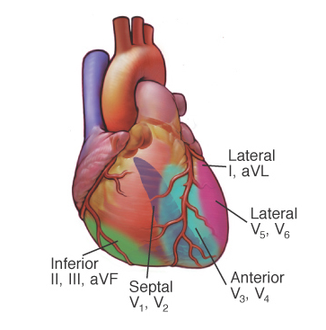
Cardiac Anatomy in Relation to the Coronary Artery
Notes:
Now, review the anatomy discussed in the previous table. Note that the LAD supplies the largest amount of myocardium. The more proximal the occlusion, the greater the change of a large infarct and cardiogenic shock and CHF.
Ask what might be expected from an inferior wall MI. Emphasize the SA and AV nodal supply, and discuss the potential for bradyarrhythmias.

Slide 40
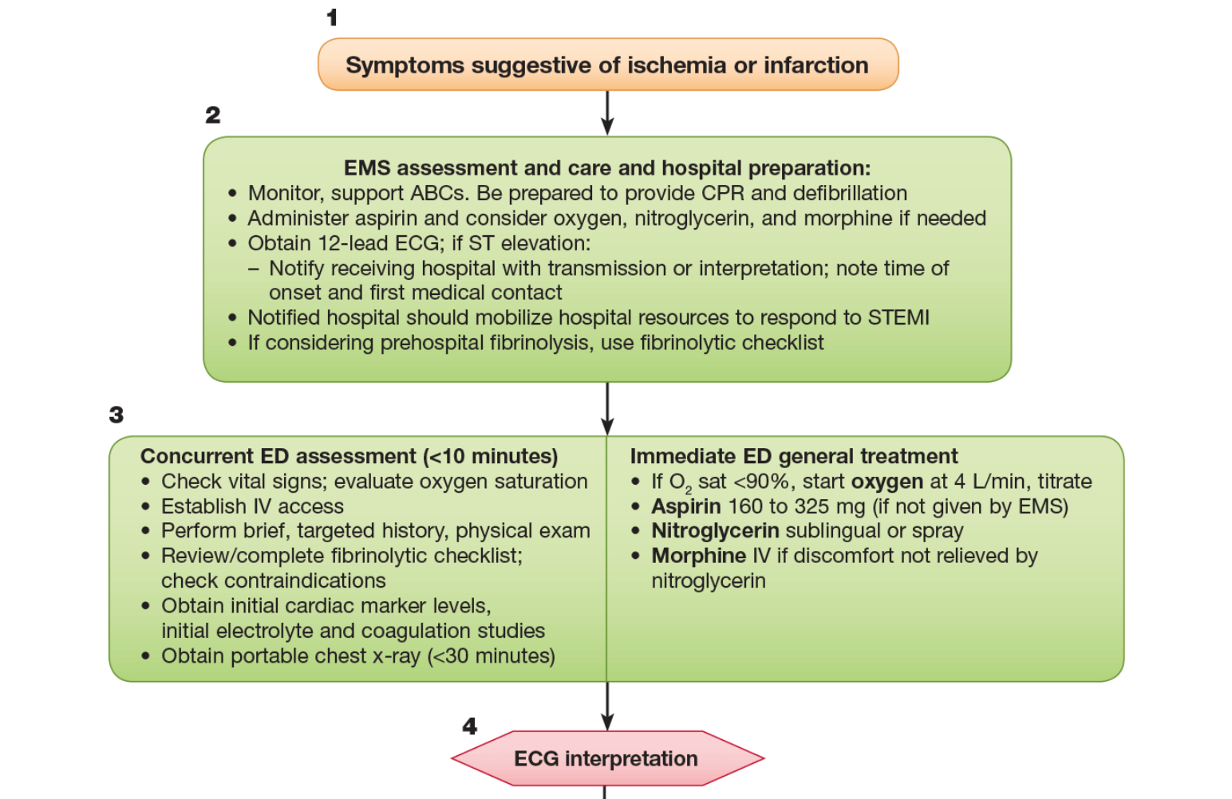
Acute Coronary Syndromes
Notes:
Additional Discussion
From the 2015 AHA Guidelines Update for CPR and ECC, Part 9: Acute Coronary Syndromes
This figure shows the section of the ACS algorithm that pertains to all acute coronary syndromes.
Prompt diagnosis and treatment offers the greatest potential benefit for myocardial salvage in the first hours of STEMI; early, focused management of unstable angina and NSTE-ACS reduces adverse events and improves outcome.
Thus, it is imperative that healthcare providers recognize patients with potential ACS to initiate the evaluation, appropriate triage, and management as expeditiously as possible; in the case of STEMI, this recognition also allows for prompt notification of the receiving hospital and preparation for emergent reperfusion therapy.
Potential delays to therapy occur during 3 intervals: from onset of symptoms to patient recognition, during prehospital transport, and during emergency department (ED) evaluation.
Half the patients who die of ACS do so before reaching the hospital. VF or pulseless VT is the precipitating cardiac arrest rhythm in most of these deaths, and it is most likely to develop in the early phase of ACS evolution.

Slide 41
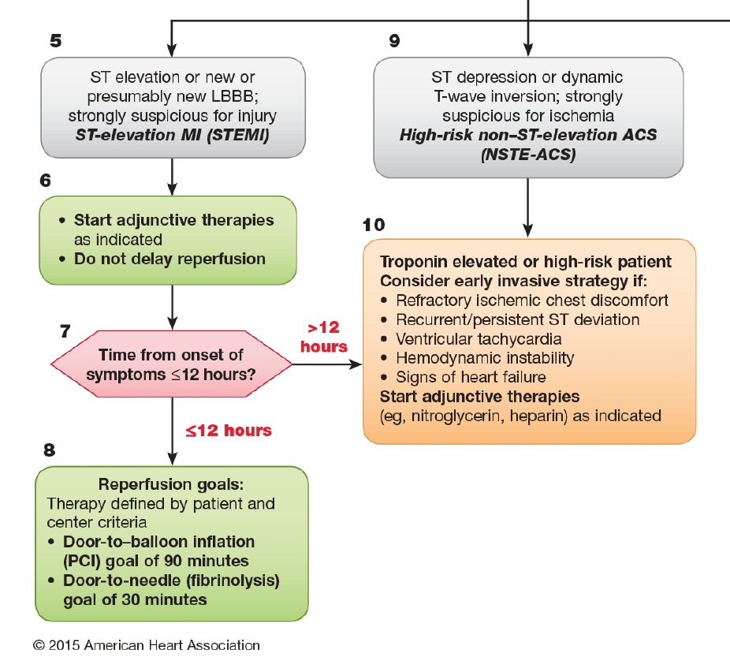
Acute Coronary Syndromes: STEMI
Notes:
Additional Discussion
From the 2015 AHA Guidelines Update for CPR and ECC, Part 9: Acute Coronary Syndromes
This figure shows the section of the ACS algorithm that pertains to the treatment of STEMI.
Patients with STEMI usually have complete occlusion of an epicardial coronary artery.
Discuss that the primary goal of initial treatment is early reperfusion therapy through PCI or administration of fibrinolytics.
Providers should rapidly identify patients with STEMI and quickly screen them for indications and contraindications to fibrinolytic therapy and PCI.
Patients who are not eligible for fibrinolytic therapy should be considered for transfer to a PCI facility regardless of delay.
Within a STEMI system of care, the first physician who encounters a patient with STEMI determines the need and strategy (fibrinolytic or PPCI) for reperfusion therapy (see Table 1 on the next slide).

Slide 42
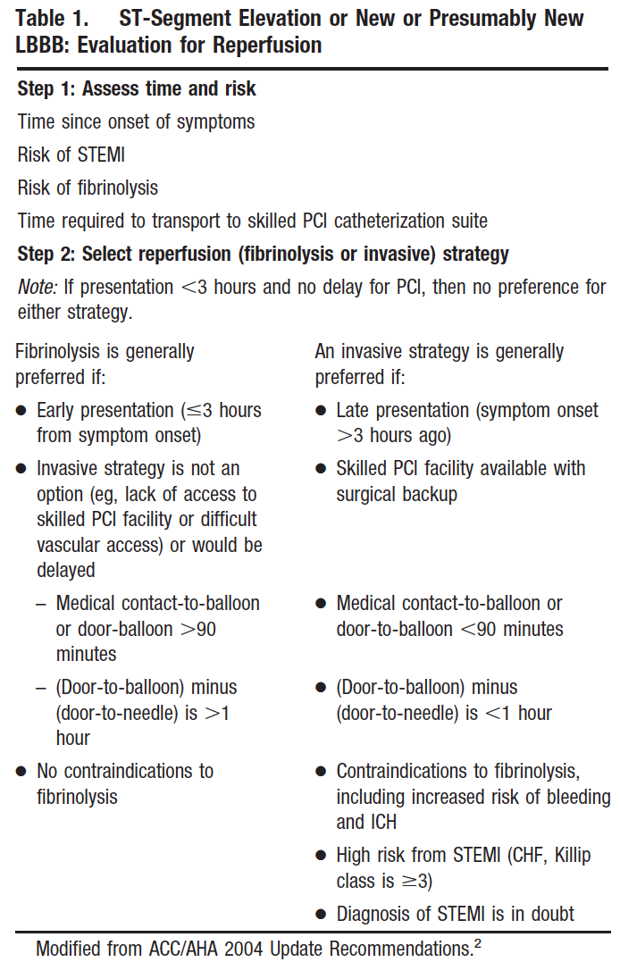
Notes:
Questions and Considerations
From the 2015 AHA Guidelines Update for CPR and ECC
Discuss whether it is advisable to take the time for a consultation in this case.
If the patient meets the criteria for fibrinolytic therapy, a door-to-needle time (initiation of fibrinolytic agent) of 30 minutes is recommended—the earlier the better (Class I, LOE A).
Routine consultation with a cardiologist or another physician is not recommended except in equivocal or uncertain cases.
Consultation delays therapy and is associated with increased hospital mortality rates (Class III, LOE B).

