Slide 1


Slide 2
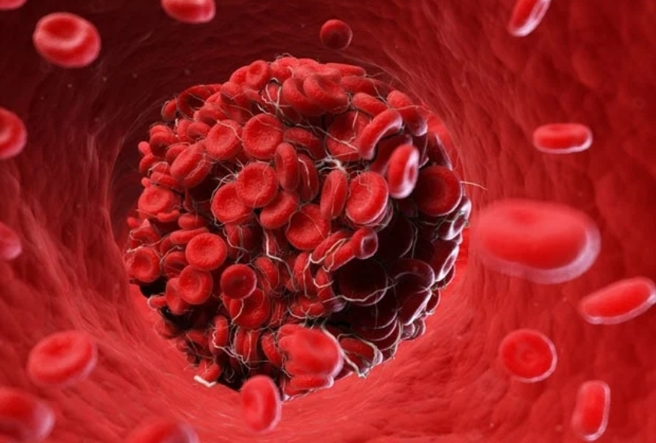
Thrombophilia and Pregnancy
Dr. Marziyeh Ghalamkari
Assistant professor of hematology and medical oncology
Iran University Of Medical Science

Slide 3
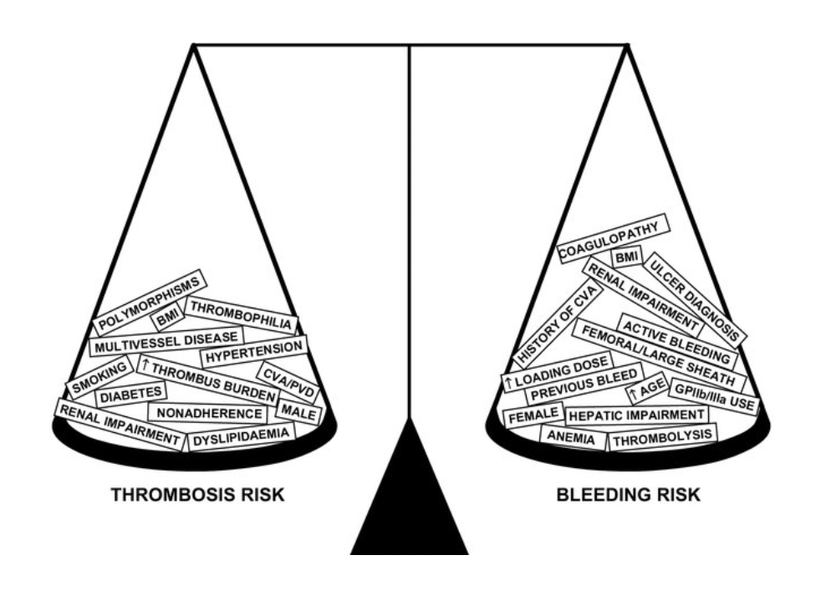

Slide 4
Coagulation changes in pregnancy
During pregnancy, normal changes occur in the coagulation system:
- Increase in coagulation factors : Vc, VIIIc, Xc, and von-Willebrand factor antigen and Platelet derived inhibitor of type2 plasminogen activation (PAI-2)
- Reduction in: total and free S protein
- Coagulation activation markers are increased particularly in the third trimester of pregnancy.
- There is no significant change in plasma levels of protein C or antithrombin III throughout pregnancy
These physiological changes during pregnancy develop a relative thrombotic tendency.
cesarean section, previous thromboembolic event, high BMI, multiple pregnancies, infections, preeclampsia, immobility, and maternal age are additional risk factors for venous thromboembolic events

Slide 5
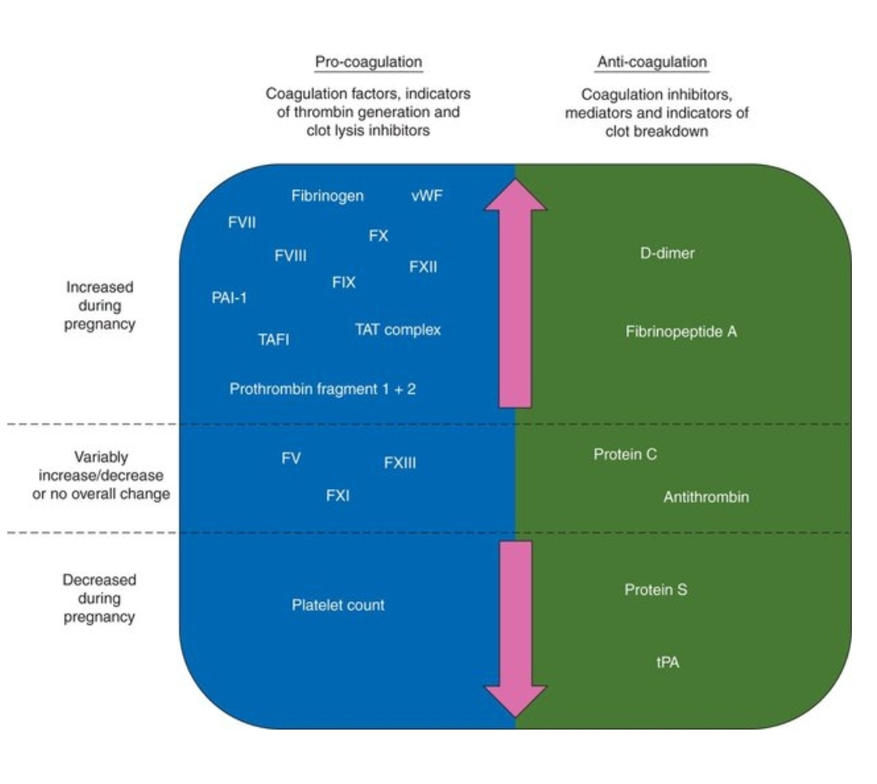

Slide 6
Known and possible pregnancy complications
Inherited thrombophilias increase the risk of maternal venous thromboembolism (VTE).
It has been hypothesized that they also increase the risk of thrombosis at the low flow maternal-placental interface, resulting in placenta-mediated complications, such as pregnancy loss, preeclampsia, fetal growth impairment, and abruption.

Slide 7
Pregnancy complications
many clinical types of hereditary thrombophilia are associated with pregnancy complications such as
recurrent miscarriage
Preeclampsia
endometrial growth retardation
HELLP syndrome

Slide 8
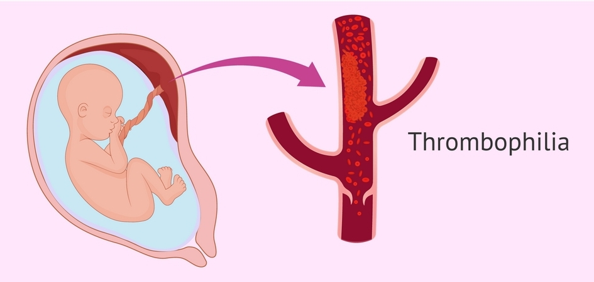

Slide 9
Thrombophilia
Thrombophilia : a series of conditions with increased risk of blood clot formation in vessels. It may be congenital or acquired, and all the symptoms depend on the location as well as the extent of thrombosis
Patients with thrombophilia form clots very easily, either because they produce in excess certain proteins called coagulation factors or because they produce less anticoagulants
1.Congenital/inherited thrombophilia: It is used for inborn and more often hereditary abnormalities.
2. acquired thrombophilia : all cases that present later in life.

Slide 10
Completely inherited thrombophilia causes:
Antithrombin (AT) deficiency.
Protein C deficiency.
Protein S deficiency.
Mutation in factor V.
Prothrombin gene mutation.

Slide 11
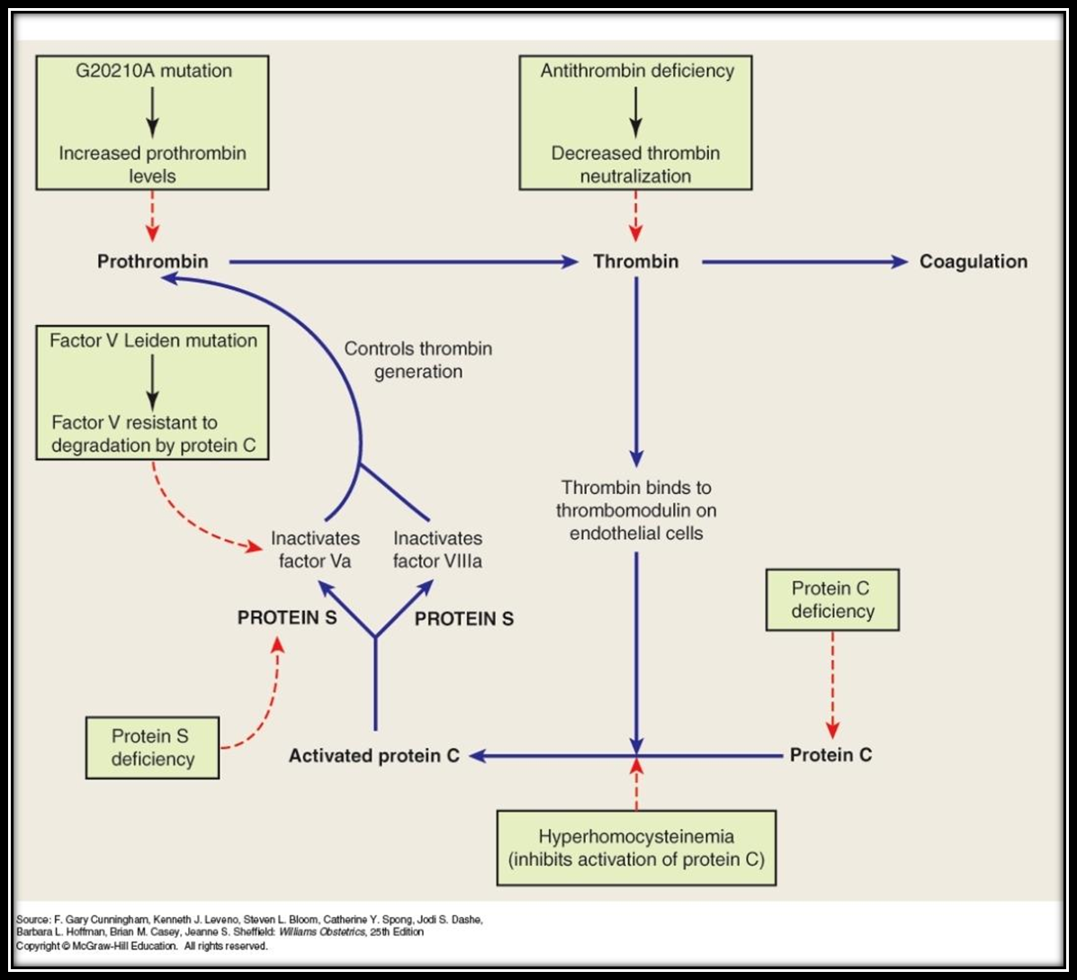

Slide 12
Other gene variants and procoagulants
variants in the factor V gene other than FVL
promoter variants in the PAI-1 gene
variants in the gene for protein Z
variants that affect expression or enhance activity of other clotting factor genes

Slide 13
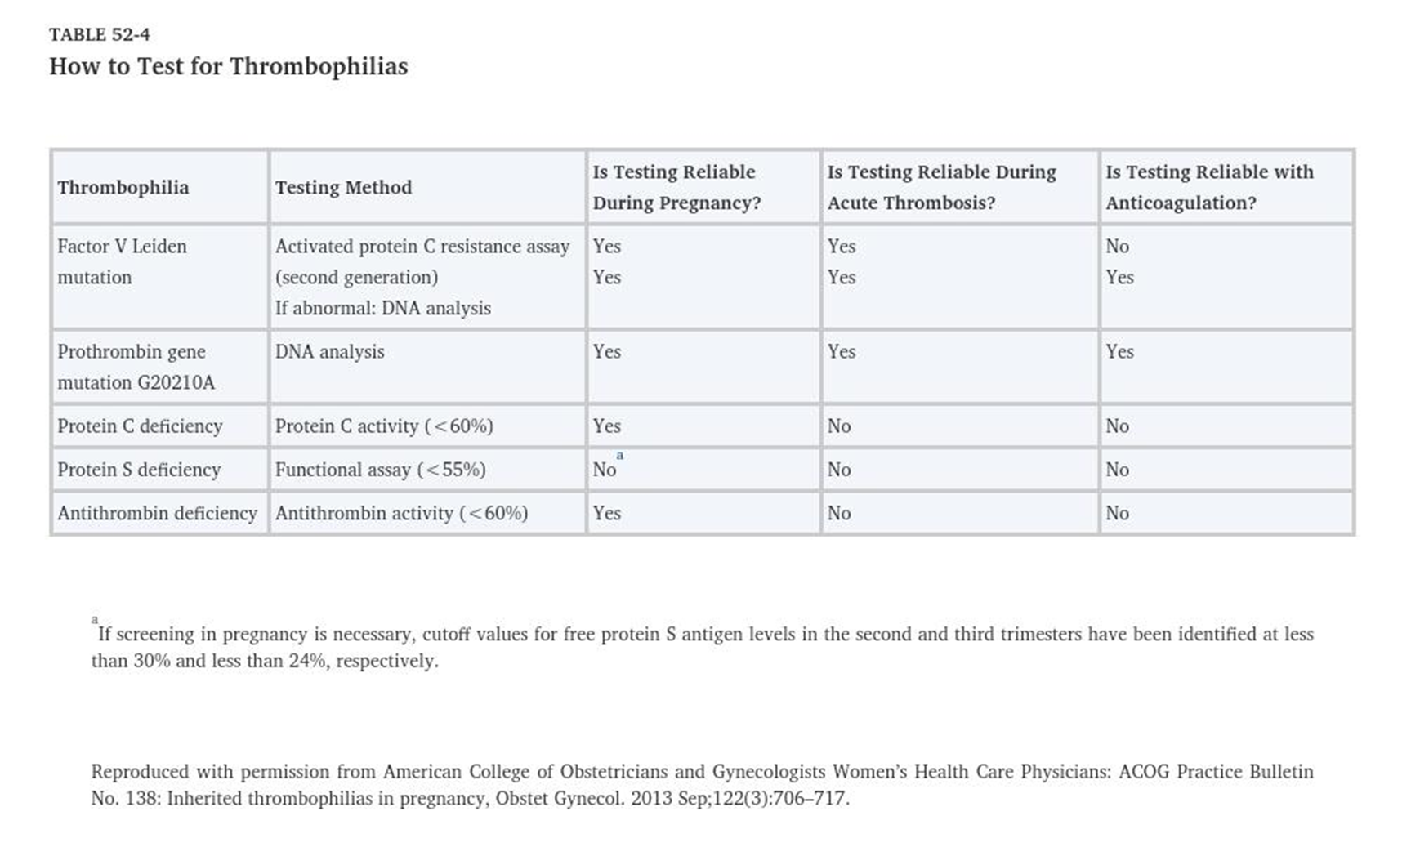

Slide 14
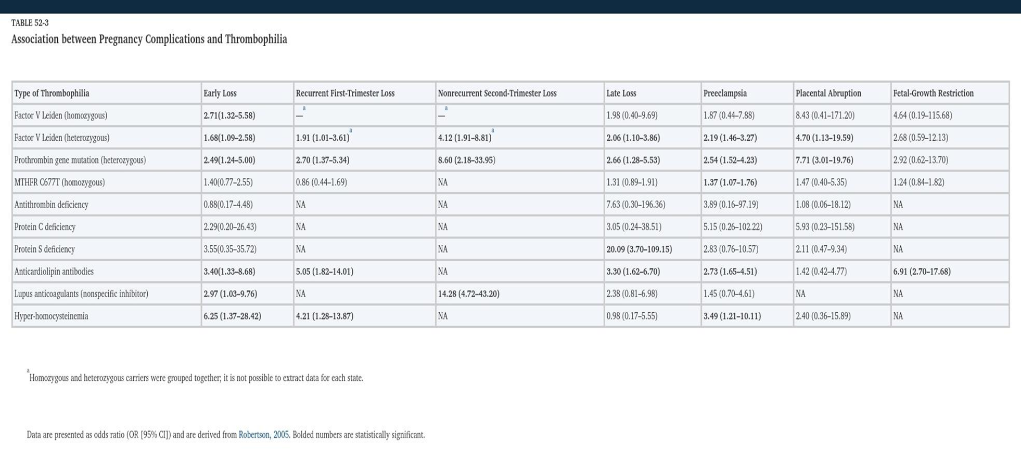

Slide 15
Selection of patients for screening
Routinely screening for inherited thrombophilias in unselected populations is not recommended because of the low frequency of the condition becoming symptomatic and the lack of a safe, cost-effective, long-term method of prophylaxis against thromboembolism
The American College of Obstetricians and Gynecologists suggests screening for thrombophilia when the results will affect pregnancy/postpartum management

Slide 16
Thrombophilia test: is it necessary and when?
1.History of VTE associated with a transient risk factor:
those with no hereditary thrombophilic defect are at low risk for recurrent thrombosis and do not require antepartum thromboprophylaxis
2. History of idiopathic (unprovoked) VTE, recurrent VTE, or VTE in association with estrogen-progestin contraceptive use or pregnancy:
women are at relatively high risk of recurrent thrombosis and should receive prophylactic anticoagulation antepartum regardless of thrombophilia status. However, screening is still useful in this population because the presence and type of thrombophilia affect the anticoagulant dose.
3. No prior VTE but a first degree relative with a history of a high-risk thrombophilia:
Testing is reasonable in asymptomatic (no prior VTE) women planning a pregnancy who have a first degree relative with a history of a high-risk thrombophilia.
The rationale for such testing is that antepartum and postpartum prophylaxis are indicated if the asymptomatic patient is found to be a carrier of one of the more highly thrombogenic defects
If the asymptomatic patient is heterozygous for one of the less thrombogenic defects (eg, heterozygous FVL), thromboprophylaxis may be indicated in the presence of other risk factors for VTE (eg, cesarean delivery, prolonged immobilization, severe obesity, or a first-degree relative with VTE before age 50 years)

Slide 17
When thrombophilia test not recommended?
Women with a history of recurrent or nonrecurrent early fetal loss, abruption, fetal growth restriction, or preeclampsia
Couples with IVF failure

Slide 18
Laboratory testing
Laboratory testing is performed:
at least six weeks from the thrombotic event
while the patient is not pregnant
not taking an anticoagulant or hormonal therapy
Ideally, hemostasis is not evaluated by functional assays earlier than three months following delivery and after terminating breastfeeding to exclude pregnancy-related effects

Slide 19
Thrombophilia tests recommendations
AT deficiency
APC resistance and FVL
Protein S deficiency
Protein C deficiency
Prothrombin G20210A : also called prothrombin gene mutation [PGM]
Antiphospholipid antibodies: immunoassays for IgG and IgM antibodies to cardiolipin and beta2-glycoprotein (GP) I and a functional assay for the lupus anticoagulant (LA) phenomenon.

Slide 20
Thrombophilia tests not recommend
Homocysteine level
MTHFR polymorphisms (C677T, A1298C)
PAI-1 polymorphism: The prevalence of the PAI-1 polymorphism (4G/5G) is very high (approximately 50 percent) in the general population and 20 to 25 percent of these individuals are homozygous for the purported 4G/4G "thrombogenic" genotype.

Slide 21
Prevention of VTE
In pregnant women with inherited thrombophilias the goal of treatment is prevention of maternal venous thromboembolism (VTE).
Anticoagulant therapy is based on:
-prior VTE
-Thrombophilia risk
-

Slide 22
High-risk thrombophilias
antithrombin [AT] deficiency, homozygotes for factor V Leiden [FVL], homozygotes for prothrombin G20210A (prothrombin gene mutation, PGM) , double heterozygotes for FVL and PGM
low risk thrombophilias : heterozygotes for FVL or PGM, deficiencies of protein C or protein S

Slide 23
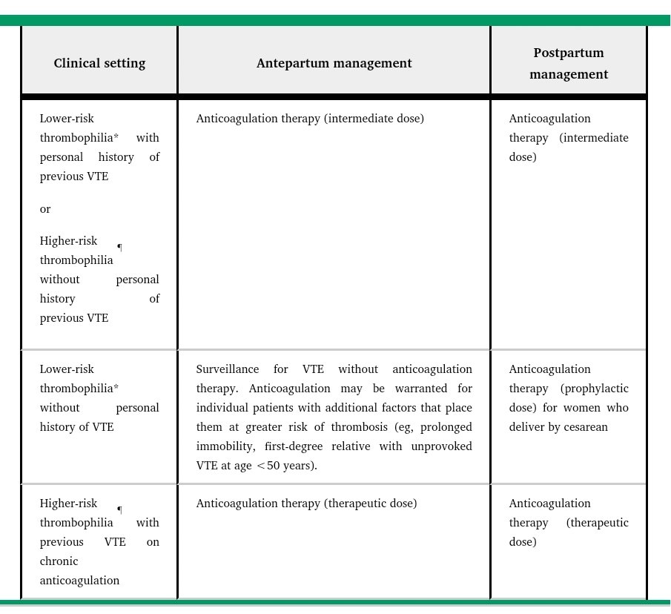

Slide 24
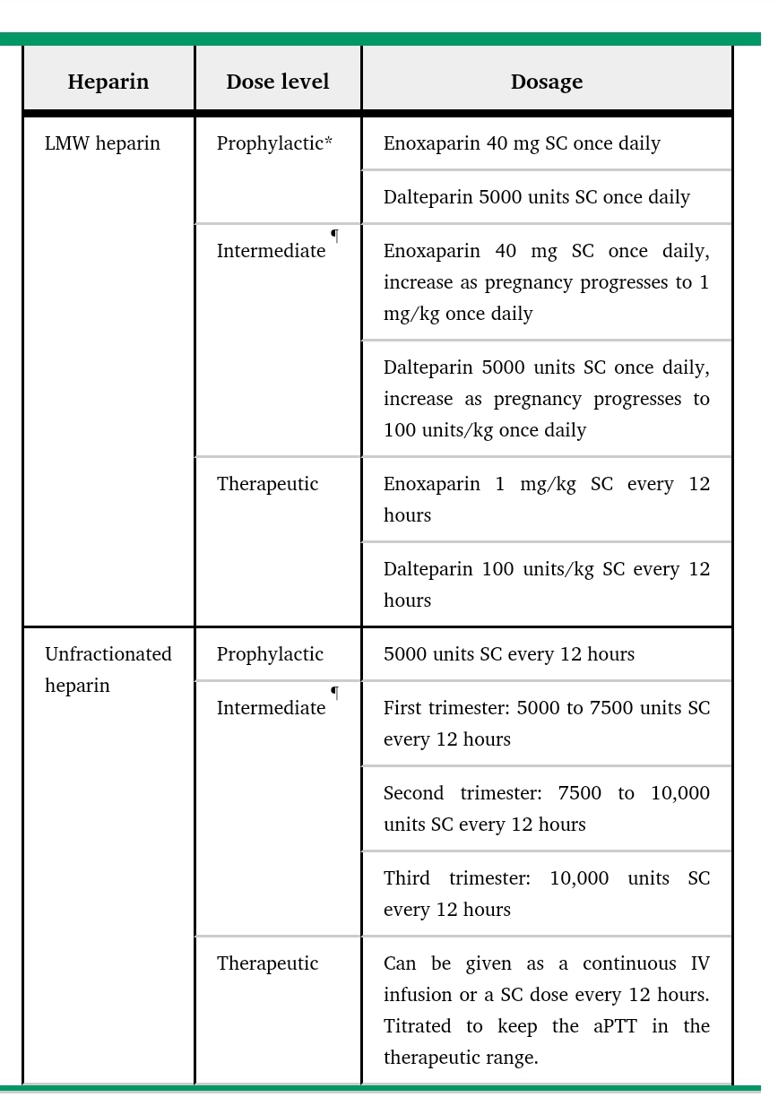

Slide 25
Prevention of pregnancy complications
most available evidence does not support an association between inherited thrombophilia and preeclampsia, fetal growth restriction, or abruption
There is some evidence of an association between inherited thrombophilia and late fetal loss.
we consider anticoagulation on a case-by-case basis after taking into account the patient's medical and obstetric history, placental histopathology, and other potential causes of the adverse pregnancy outcome.
we may offer treatment with an intermediate or therapeutic dose of LMWH to a patient with an inherited thrombophilia and a third-trimester fetal loss associated with decidual vasculopathy and thrombi and multifocal maternal-side placental infarction, but no history of preeclampsia or VTE

Slide 26
Antepartum/intrapartum:
-Anticoagulation should be initiated in the first trimester since the risk of VTE increases early in pregnancy.
-Anticoagulation should be discontinued at onset of labor or before scheduled induction or cesarean delivery to minimize risk of hemorrhagic complications
Postpartum :
Postpartum risk of VTE is as high or higher than antepartum risk
Postpartum treatment is sometimes indicated for women who did not receive antepartum anticoagulation.
Postpartum heparin can generally be started 4 to 6 hours after a vaginal delivery or 6 to 12 hours after a cesarean delivery in patients with normal postpartum bleeding
warfarin therapy can begin immediately after delivery since it takes a few days to achieve anticoagulation.

Slide 27
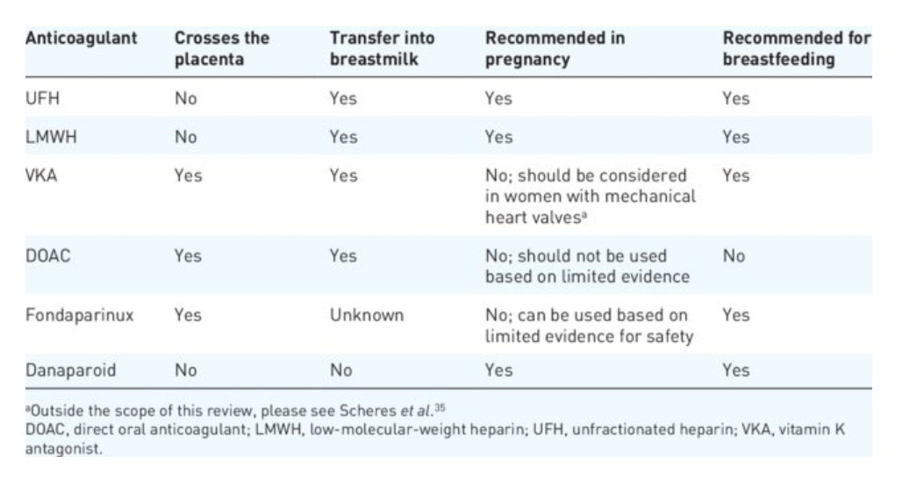

Slide 28

Thanks for attention

