Slide 1
Anticoagulation in patients with thrombocytopenia
Mohsen Esfanbdod MD
Hemotolgist & medical oncololgist
Hemostasis and Thrombosis Research Center
TUMS

Slide 2
Thrombocytopenia may increase bleeding risk, but it does not protect against venous thromboembolism (VTE) or stroke

Slide 3
Thus, caring for patients with both thrombocytopenia and an indication for anticoagulation (eg, VTE prophylaxis or treatment, stroke prophylaxis or treatment) can be challenging

Slide 4
Balance the risks of thrombosis and thrombosis progression with the risks of bleeding

Slide 5
There is no simple formula for calculating which risk (thrombosis or bleeding) is greater
There is no anticoagulant that can reduce thrombotic risk without also increasing bleeding risk

Slide 6
Estimating bleeding risk
Recent major bleeding
Platelet count <50,000/microL
Hematopoietic stem cell transplant
Coagulation abnormalities(liver disease ,DIC)
Platelet function defects :Uremia from renal failure or certain medications (eg, tyrosine kinase inhibitors such as ibrutinib)
Older age Especially >75 years

Slide 7
For individuals with VTE or atrial fibrillation who do not have one of these increased bleeding risk factors, anticoagulation can generally be given if the platelet count is ≥50,000/microL

Slide 8
Increased risk of bleeding
Use of lower-dose anticoagulation (either prophylactic dose or reducing the dose by half)
Temporarily holding the anticoagulant (especially if bleeding risk factors are transient
Placement of an inferior vena cava (IVC) filter

Slide 9
High risk for VTE progression/recurrence/embolization
VTE within the prior 30 days
Proximal lower extremity deep vein thrombosis (DVT)
Segmental or larger pulmonary embolus (PE)
Poor performance status (eg, bedridden for most or all of the day)
Active cancer and/or receiving chemotherapy
Strongly prothrombotic syndrome such as APS, PNH, or HIT
High-risk thrombophilia such as homozygous factor V Leiden mutation or antithrombin deficiency

Slide 10
Low risk for VTE progression/recurrence/embolization
VTE that occurred more than 30 days prior
Isolated distal DVT
Isolated subsegmental PE (with negative bilateral ultrasound)
DVT associated with a transient risk factor that has been eliminated

Slide 11
Use anticoagulation in those at high risk for VTE progression or recurrence(platelet>25000)
low risk for VTE or VTE progression: anticoagulation if the platelet count is >50,000/microL and there are no other major bleeding risk factors

Slide 12
Platelet transfusions
Thrombopoietin receptor agonists (TPO-RAs)
Correction of underlying coagulation disorder

Slide 13
CANCER-ASSOCIATED VTE
Primary VTE prophylaxis (platelet counts above 50,000/micro)(full dose anticoagulation)
Platelet count is below the 20,000 to 30,000/microL(No anticoagulation)

Slide 14
VTE treatment
Platelet counts ≥50,000/microL full-dose anticoagulation
Certain exceptions
Age >75 years
A recent severe bleeding episode
Hematopoietic stem cell transplant (HCT)
Renal or hepatic failure
Concomitant coagulation disorder or platelet function defect

Slide 15
Prophylaxis
For individuals with platelet counts of 50,000/microL or above, anticoagulation for VTE prophylaxis can be done according to established protocols

Slide 16
For those with counts between 25,000 and 50,000/microL, VTE prophylaxis is individualized
Plateletvcounts below 25,000/microL, prophylactic anticoagulation generally is not used.

Slide 17
Treatment
For individuals with platelet counts of 50,000/microL or above, anticoagulation for VTE treatment can be administered according to established protocols

Slide 18
For most individuals with cancer-associated VTE and platelet counts between 25,000 and 50,000/microL :
Full (therapeutic)-dose anticoagulation with platelet support (eg, platelet transfusions to raise the platelet count above 50,000/microL)
Half-dose anticoagulation (eg, enoxaparin 0.5 mg/kg twice daily rather than 1 mg/kg twice daily), prophylactic-dose anticoagulation

Slide 19
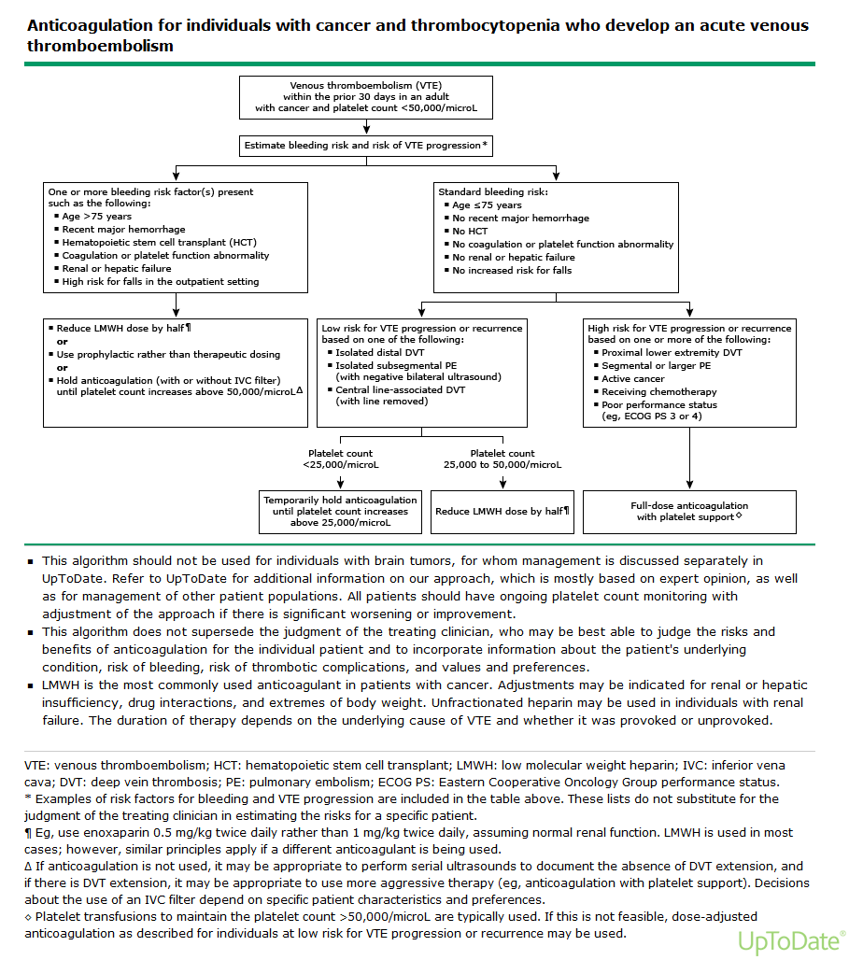

Slide 20

Thanks for your patient attention

