Slide 1
New antithrombotic agents
Dr Zahra Jahangard Rafsanjani
Clinical pharmacist
Tehran university of medical sciences

Slide 2
introduction
Antithrombotic agents include both antiplatelet agents as well as anticoagulants
Anticoagulants
  Agents that inhibit one or more steps in the coagulation cascade
    Direct enzymatic inhibition
      Direct thrombin inhibitors, direct factor Xa inhibitors
    Indirect inhibition by binding to antithrombin
      Unfractionated heparin, low molecular weight heparins, fondaparinux
    Antagonism of vitamin K-dependent factors by preventing their synthesis in the liver and/or modification of their calcium-binding properties
      Vitamin K antagonists such as warfarin

Slide 3
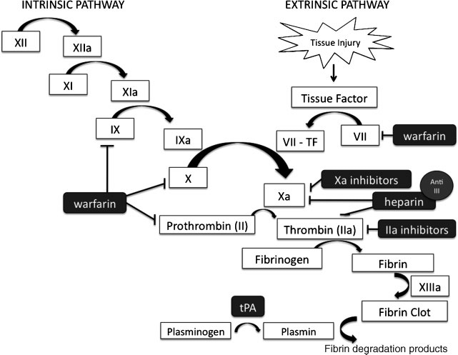
Notes:
Thrombin – Thrombin (factor IIa) is the final enzyme of the clotting cascade that produces fibrin; it is formed by the proteolytic cleavage of prothrombin by factor Xa. Thrombin has a central role in coagulation: it cleaves fibrinogen to fibrin; activates other procoagulant factors including factors V, VIII, XI, and XIII; and activates platelets

Slide 4
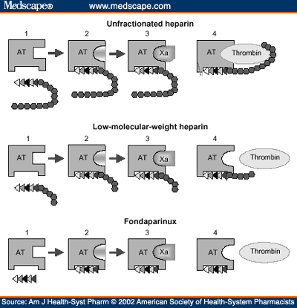
Indirect inhibition
UFH:
  Inhibition at Xa and IIa in a 1:1 ratio
LMWH products:
  Inhibition at Xa and IIa in a 3:1 ratio
Pentasaccharides:
  Inhibits directly FXa

Slide 5
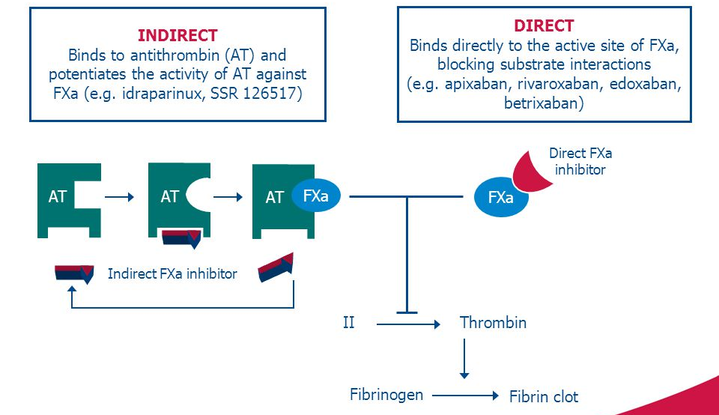

Slide 6
Direct thrombin inhibitors
  Parenteral DTIs
    Bivalirudin
    Argatroban
    Desirudin
  Oral DTI
    Dabigatran etexilate (Pradaxa)

Slide 7
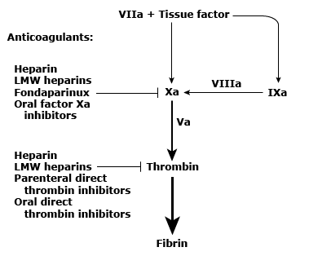

Slide 8
Oral Direct Thrombin Inhibitor & Oral Direct Factor Xa Inhibitors
Direct oral anticoagulants
DOACs
Novel oral anticoagulants or non-vitamin K antagonist oral anticoagulants
NOACs

Slide 9
Anticoagulant differences
Efficacy depending on the clinical setting
Dosing
Monitoring
Cost
Risks

Slide 10
INDICATIONS
Post operative VTE prophylaxis (non-orthopedic & orthopedic)
VTE treatment (initial & long-term anticoagulation)
Atrial fibrillation
Acute coronary syndromes
Heparin-induced thrombocytopenia

Slide 11
Inappropriate prescribing
DOACs are marketed for:
  Having fixed dosing as compared to warfarin
  Due to a wider therapeutic index
  More predictable pharmacokinetic and pharmacodynamic properties
  The lack of routine monitoring
When determining the appropriate dose for a patient, factors such as the indication, physiological properties and clinical parameters (age, weight, renal insufficiency, interacting drugs) of the patient should be taken into consideration
Notes:
According to a subgroup analysis regarding off label dosing of non-VKA oral anticoagulants of the Outcomes Registry for Better Informed Treatment of Atrial Fibrillation phase III (ORBIT-AF III) trial, almost one in eight of US patients in the community received a DOAC dose inconsistent with labeling
Two prospective studies conducted to evaluate the appropriateness of prescribing dabigatran and rivaroxaban in patients with non-valvular atrial fibrillation (NVAF) in the clinic setting found that the choice of drug and dosage were the most frequent inappropriate criterion among patients
Although the clinical impact of adverse events associated with inappropriate prescribing has not been well established among various clinical studies, some have identified thrombotic and bleeding risks associated with suboptimal prescribing

Slide 13
Anticoagulant | Potential for pharmacokinetic drug interactions*¶
Dabigatran (Pradaxa) | P-gp inhibitors can increase dabigatran effect P-gp inducers can decrease dabigatran effect Avoidance of some combinations or dose adjustment may be needed
Apixaban (Eliquis) | Strong CYP3A4 inhibitors and/or strong P-gp inhibitors can increase apixaban effect Strong CYP3A4 inducers and/or strong P-gp inducers can decrease apixaban effect Avoidance of some combinations or dose adjustment may be needed
Edoxaban (Savaysa, Lixiana) | P-gp inhibitors can increase edoxaban effect P-gp inducers can decrease edoxaban effect Avoidance of some combinations or dose adjustment may be needed
Rivaroxaban (Xarelto) | Strong CYP3A4 inhibitors and/or strong P-gp inhibitors can increase rivaroxaban effect Strong CYP3A4 inducers and/or strong P-gp inducers can decrease rivaroxaban effect Avoidance of some combinations or dose adjustment may be needed
Notes:
* Examples of P-gp inhibitors that reduce metabolism of DOACs, leading to increased DOAC levels, include clarithromycin, ombitasvir- or ritonavir-containing combinations, and verapamil. Examples of P-gp inducers that increase DOAC metabolism, leading to lower DOAC levels, include phenytoin, rifampin, and St. John's wort.
¶ Examples of strong CYP3A4 inhibitors that reduce metabolism of some DOACs, leading to increased DOAC levels, include clarithromycin and ombitasvir- or ritonavir-containing combinations. Examples of strong CYP3A4 inducers that increase metabolism of some DOACs, leading to lower DOAC levels, include carbamazepine, phenytoin, and rifampin.

Slide 15
Settings in which a heparin or vitamin K antagonist may be preferable
Prosthetic heart valves
Pregnancy
Chronic kidney disease
Severe liver disease
Antiphospholipid syndrome
Compliance
Gastrointestinal disease
Altered gastrointestinal anatomy
Dosing convenience
Cost
Inability to titrate the dose
Notes:
Prosthetic heart valves – The direct thrombin inhibitors and direct factor Xa inhibitors are not used in patients with prosthetic heart valves, due to greater risk of valve thrombosis, which may be fatal. (See "Antithrombotic therapy for surgical prosthetic heart valves and surgical valve repair: Indications", section on 'Direct oral anticoagulants'.)
●Pregnancy – Direct thrombin inhibitors and direct factor Xa inhibitors are not used during pregnancy, due to lack of clinical experience in this setting; LMW heparin is preferred in most pregnant women who require an anticoagulant. If a patient taking one of these agents becomes pregnant, she should be switched to LMW heparin immediately. This issue is discussed in detail separately. (See "Use of anticoagulants during pregnancy and postpartum".)
●Chronic kidney disease – DOACs are metabolized mostly in the kidney, with apixaban least dependent on clearance by the kidney (approximately 25 percent). Creatinine clearance (CrCl) can be estimated from the patient's sex, age, weight, and serum creatinine (calculator 1 and calculator 2). Concerns have existed with the use of DOACs in individuals with CrCl less than 30 mL/minute. However, data continue to accumulate, especially in individuals with atrial fibrillation, suggesting that DOACs, especially apixaban, have better to equal efficacy and safety, similar to effects in individuals with normal CrCl. (See 'Chronic kidney disease' above and "Atrial fibrillation: Anticoagulant therapy to prevent thromboembolism", section on 'Chronic kidney disease'.)
●Severe liver disease – DOACs are hepatically metabolized to varying degrees, and most clinicians do not use DOACs in individuals with severe hepatic impairment, as shown in the table (table 3).
●Antiphospholipid syndrome – In patients with the antiphospholipid syndrome (APS) who require anticoagulation, heparin followed by warfarin is the preferred therapy, especially for those with a history of arterial thrombosis or other high-risk features. (See "Treatment of antiphospholipid syndrome".)
●Compliance – Use of DOACs may be challenging in patients who are unable to take their medication as prescribed. The lack of routine monitoring and short half-lives of these agents make it more difficult to determine if a patient is taking them appropriately. In addition, missing one or two doses can leave the patient inadequately anticoagulated; in contrast, missing a couple of doses of warfarin is unlikely to substantially increase the time outside the therapeutic range.
●Gastrointestinal disease – Patients with gastrointestinal diseases, especially those with a history of bleeding, may prefer to avoid the direct factor Xa inhibitors because of an increased bleeding risk. Individuals with severe dyspepsia may not tolerate dabigatran. (See 'Risks (dabigatran)' below.)
●Altered gastrointestinal anatomy – Individuals who have undergone gastrectomy or weight reduction surgeries such as gastric bypass may have altered absorption of the DOACs. Some experts consider this a reason to avoid DOAC and would use a different anticoagulant such as heparin or warfarin, for which therapeutic drug monitoring is available. Another alternative if a DOAC is used is to measure drug levels to confirm absorption.
●Dosing convenience – Dabigatran and apixaban require twice daily dosing, which may cause an increased burden for patients who place a higher value on taking a single daily dose of an anticoagulant. European labeling for dabigatran includes once daily dosing. Rivaroxaban and edoxaban have a once daily dosing schedule, as does warfarin.
●Cost – Vitamin K antagonists are typically much less expensive than DOACs.
●Inability to titrate the dose – Individuals with an aggressive hypercoagulable state may have recurrent thrombosis despite adequate anticoagulation. For individuals with warfarin, one approach is to target a higher INR. This type of dose titration is not validated for DOACs.

Slide 16
Advantages over heparin and warfarin
Lower bleeding risk
Possible lower risk of fractures
Less laboratory monitoring
Preferable pharmacokinetics
Notes:
Lower bleeding risk – Overall, all-cause mortality from DOACs appears to be lower than that from warfarin, driven primarily by a decrease in fatal intracranial bleeding risks [26]. However, direct comparison of bleeding risk with different agents is challenging because risks appear to vary in different patient populations and clinical settings, and meta-analysis often combines different doses of the same anticoagulant [27]. This issue is discussed in detail separately. (See "Risks and prevention of bleeding with oral anticoagulants", section on 'Risk factors related to the anticoagulant'.)
●Possible lower risk of fractures – The risk of fractures has not been evaluated in a randomized trial, but a series of observational studies suggest that DOACs are associated with lower risk of fractures than warfarin. One retrospective series of nearly 170,000 individuals with atrial fibrillation who were started on a new anticoagulant found a lower fracture risk of the ensuing 13 months with DOACs over warfarin (hazard ratio [HR], 0.78; 95% CI 0.79-0.96) [28]. The finding was most impressive for people with preexisting osteoporosis and with apixaban versus warfarin. A second retrospective series of nearly 20,000 individuals followed for 2.4 years reported remarkably similar findings supporting a lower risk with DOACs (HR 0.84; 95% CI 0.77-0.93) with the greatest decrease seen with apixaban [29]. An earlier study observed a lower risk of fractures with dabigatran compared with warfarin [30-32].
The reason for this difference in fracture risk, if real, is unknown. Nor is it clear whether it represents an increase over baseline risk with warfarin or a decrease from baseline risk with DOACs. Suggested mechanisms range from a difference in risk of falls to alterations in bone biology. (See "Pathogenesis of osteoporosis".)
●Less laboratory monitoring – Heparin and warfarin both have a relatively narrow therapeutic window and more variable dose-response relationship that depends on a variety of factors; these features lead to a requirement for frequent monitoring of clotting times to optimize the therapeutic dose range and prevent bleeding [33,34]. Dose may be affected by differing bioavailability, diet, and acute medical illnesses. In contrast, the DOACs are generally used without a requirement for monitoring of drug levels or coagulation (clotting) times. This may be an advantage for patients for whom frequent monitoring is a greater burden. It remains to be determined whether laboratory monitoring of any of the DOACs can further improve their efficacy or safety. (See 'Laboratory testing and monitoring (dabigatran)' below.)
●Preferable pharmacokinetics – Warfarin pharmacokinetics is affected by the level of vitamin K intake and production in the gastrointestinal tract, as well as induction of hepatic cytochromes. Thus, warfarin effect can be altered by changes in diet, administration of other medications, gastrointestinal disorders, and reduced oral intake. Patients with difficulty controlling the prothrombin time/international normalized ratio (PT/INR) may benefit from a DOAC because these agents have less variability in drug effect for a given dose than vitamin K antagonists. Affected patients may include those with unavoidable drug-drug interactions (such as frequent need for antibiotics or a large number of concomitant and variable medications) or unexplained poor warfarin control. However, it is important to determine that the INR instability with a vitamin K antagonist is not due to poor compliance, which may be easier to monitor for vitamin K antagonists than for the target-specific agents.

Slide 17
ORAL DIRECT THROMBIN INHIBITORS

Slide 18
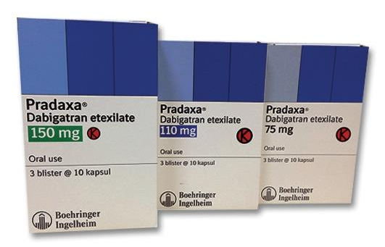
Dabigatran
Dabigatran etexilate a prodrug converted in the liver to dabigatran
Should only be dispensed and stored in the original bottle (with desiccant) or blister package
Once the bottle is opened, the pills inside must be used within four months
Capsule must be taken intact and requires gastric acidity for absorption
Unaffected by food
Is used in the prevention and management VTE disease, in stroke prevention in patients with AF, and in ischemic heart disease
Notes:
should only be dispensed and stored in the original bottle (with desiccant) or blister package in which they came, due to the potential for product breakdown from moisture and resulting loss of potency

Slide 19
Dabigatran
Given at a fixed dose without monitoring
VTE primary prophylaxis in surgical patients:
  110 mg one to four hours after surgery, followed by 220 mg once daily for 28 to 35 days (hip replacement) or 10 days (knee replacement).
Treatment and secondary prevention of VTE:
  150 mg orally twice daily after 5 to 10 days of parenteral anticoagulation (CrCl >30 mL/minute).
Stroke prevention in AF:
  110 mg orally twice daily or 150 mg orally twice daily (CrCl >30 mL/minute).
  European labeling suggests dose reduction in patients older than 75 years (eg, 150 mg orally once per day or 110 mg orally twice per day)

Slide 20
dose modification or drug avoidance
Avoidance in CrCl <15 mL/minute or in those who are hemodialysis dependent (US labeling)
Avoidance in CrCl <30 mL/minute(Canadian, United Kingdom, and European Medicines Agency labeling)
Nonvalvular atrial fibrillation & CrCl 15-30: 75 mg twice daily
A substrate for P-glycoprotein
  P-glycoprotein inhibitors or inducers
Avoidance in individuals with a BMI >40 kg/m2, or weight ≥120 kg

Slide 21
Bleeding risk
Overall bleeding rates are similar with dabigatran compared with warfarin
A slightly lower rate of intracranial hemorrhage and death, and a slightly higher risk of gastrointestinal bleeding at the 150 mg twice daily dose
An antidote has been developed
  Idarucizumab

Slide 22
DIRECT FACTOR Xa INHIBITORS

Slide 23
Administered at a fixed dose without monitoring
Anti-factor Xa activity can be measured in unusual circumstances
  Individual with altered gastrointestinal anatomy for whom there is concern about drug absorption
  Individual who must take an interacting drug along with a direct factor Xa inhibitor
  Individual with an extremely high body mass index [BMI]).
Partially excreted by the kidney (approximately 25 to 35 percent) and metabolized in the liver
Avoidance of these agents in individuals with a body mass index (BMI) >40 kg/m2, or weight ≥120 kg

Slide 24
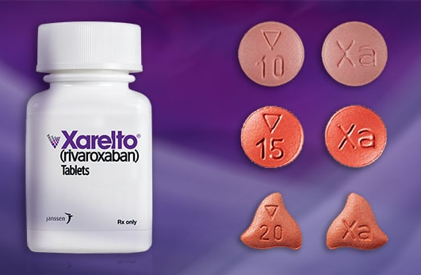
Rivaroxaban
A half-life of 5 to 9 hours
Is used in the prevention and treatment of VTE disease, in stroke prevention in patients with AF, and in ischemic heart disease.
10 mg dose:
  80 to 100% bioavailable, Unaffected by food
20 mg dose:
  66% bioavailable if taken when fasting; increased if taken with food

Slide 25
dosing
VTE prophylaxis in surgical patients:
  10 mg daily; duration (12 days versus extended to 35 days) depends on the type of surgery
Treatment and secondary prevention of VTE:
  15 mg twice daily (with food) for 21 days, followed by 20 mg once daily (with food).
  If therapy is continued after six months, the dose can be reduced to 10 mg once daily for selected individuals.
  For those with an increased risk for VTE beyond six months of anticoagulation (eg, two or more episodes of VTE), the 20 mg once-daily dose should be used

Slide 26
dosing
Stroke prevention in AF:
  20 mg once daily with the evening meal (creatinine clearance [CrCl] >50 mL/minute); or 15 mg once daily with the evening meal (CrCl ≤50 mL/minute)
Secondary prevention in individuals with stable cardiovascular disease:
  2.5 mg twice daily in combination with aspirin
Is not recommended for VTE prophylaxis, treatment, or secondary prevention in individuals with a CrCl <30 mL/minute.
Should not be used in individuals with a CrCl <15 mL/minute, as well as in those with significant hepatic impairment (Child-Pugh Class B and C with coagulopathy)

Slide 27
Drug interactions
Contrandicated with drugs that are potent dual inhibitors of CYP-3A4 and P-glycoprotein
  Systemic ketoconazole, itraconazole, voriconazole, posaconazole or ritonavir
Drugs that inhibit either CYP-3A4 or P-glycoprotein, as opposed to both, do not seem to significantly alter rivaroxaban
Potent inducers of CYP-3A4 (eg, rifamycins, carbamazepine, St. John's wort) may reduce rivaroxaban's effects

Slide 28
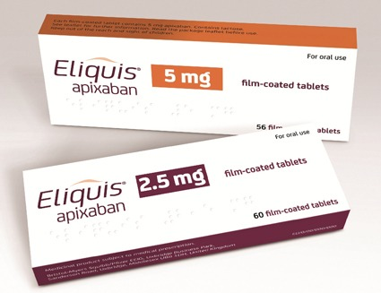
Apixaban
A half-life of approximately 12 hours.
50% bioavailable, Unaffected by food
Is used in the prevention and treatment of VTE and in stroke prevention in patients with AF
The dosing of apixaban differs according to the clinical indication and the patient's age, weight, and kidney function

Slide 29
dosing
VTE prophylaxis in surgical patients:
  2.5 mg twice daily; duration (12 days versus extended to 35 days) depends on the type of surgery
Treatment and secondary prevention of VTE:
  10 mg twice daily for seven days, followed by 5 mg twice daily. If therapy continues beyond six months, the dose is reduced to 2.5 mg twice daily
Stroke prevention in AF:
  5 mg twice daily (CrCl >50 mL/minute)
  or 2.5 mg twice daily for those with any two of the following: age ≥80 years, body weight ≤60 kg, or serum creatinine ≥1.5 mg/dL.

Slide 30
dose reduction is recommended for patients who are also receiving strong dual inhibitors of CYP-3A4 and P-glycoprotein
Has the least dependence on clearance by the kidney
Canadian product information states that apixaban is not recommended in individuals with CrCl <15 mL/minute
United States product information recommends dose adjustments based on CrCl, body weight, and age

Slide 31
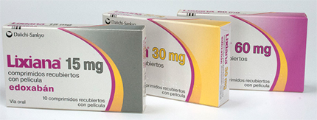
Edoxaban
A half-life in the range of 10 to 14 hours
62% bioavailable, Unaffected by food
Is excreted by the kidney and is a substrate for P-glycoprotein
Used in treatment of VTE and in stroke prevention in patients with AF

Slide 32
dosing
VTE treatment:
  Is given after 5 to 10 days of parenteral anticoagulation
  Typical dosing is 30(weight <60 kg) or 60 mg (weight >60 kg)orally once daily
Nonvalvular AF - stroke prophylaxis:
  60 mg once daily
  Reduced efficacy in patients with CrCl >95 mL/minute so Do not use

Slide 33
Standard dosing of direct oral anticoagulants
Anticoagulant | Nonvalvular AF - stroke prophylaxis* | VTE treatment¶ | VTE primary prophylaxis^{Δ}
Dabigatran (Pradaxa) | 150 mg twice daily | Parenteral anticoagulation for 5 to 10 days; then dabigatran 150 mg twice daily | 110 mg for the first day, then 220 mg once daily
Apixaban (Eliquis) | 5 mg twice daily | 10 mg twice daily for one week, then 5 mg twice daily | 2.5 mg twice daily
Edoxaban (Lixiana) | 60 mg once daily | Parenteral anticoagulation for 5 to 10 days; then edoxaban 60 mg once daily
Rivaroxaban (Xarelto) | 20 mg once daily with the evening meal | 15 mg twice daily with food for three weeks; then 20 mg once daily with food | 10 mg once daily, with or without food

Slide 34
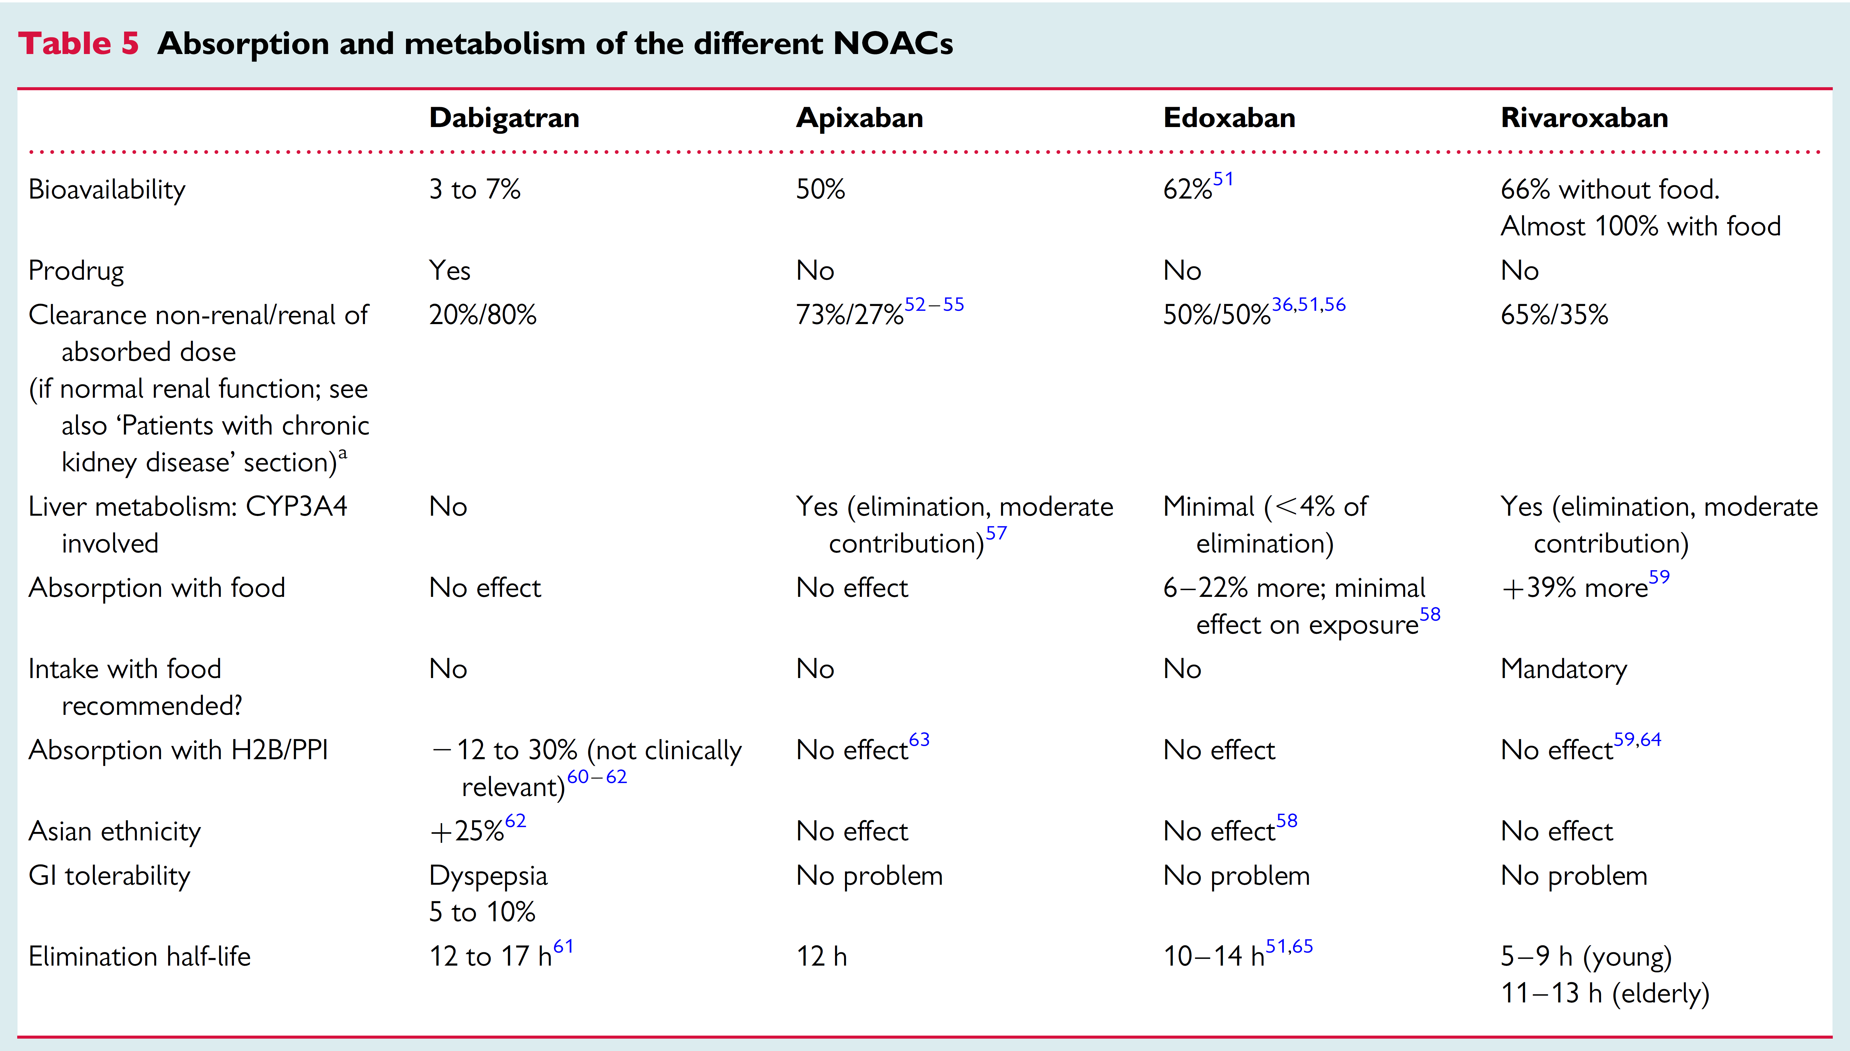

Slide 35
TRANSITIONING BETWEEN ANTICOAGULANTS
Notes:
The goal when transitioning between anticoagulants is to maintain stable anticoagulation. Thus, when transitioning from a DOAC to a vitamin K antagonist (VKA), it is important to keep in mind that the full effect of the VKA does not occur for the first few days, despite prolongation of the prothrombin time/international normalized ratio (PT/INR) [113,114] (see "Warfarin and other VKAs: Dosing and adverse effects", section on 'Initial dosing'). Likewise, when transitioning from warfarin to a DOAC, the resolution of warfarin effect may take several days.

Slide 36
Switching from a DOAC to warfarin
Dabigatran | Overlap warfarin with dabigatran for 3 days (normal renal function); 2 days (CrCl 30 to 50 mL/min); or 1 day (CrCl 15 to 30 mL/min); note that dabigatran can contribute to INR elevation. -or- Overlap warfarin with dabigatran until the INR is therapeutic on warfarin (ASH).*
Apixaban | If continuous anticoagulation is needed, discontinue apixaban and start a parenteral anticoagulant with warfarin; continue the parenteral agent until the INR is therapeutic on warfarin (PI). Note that apixaban can contribute to INR elevation. -or- Overlap warfarin with apixaban until the INR is therapeutic on warfarin, testing right before the next apixaban dose to minimize the effect of apixaban on INR elevation (ASH).*
Edoxaban | Reduce dose by half (eg, from 60 to 30 mg daily or from 30 to 15 mg daily) and begin warfarin concurrently (PI). Discontinue edoxaban when the INR is ≥2; note that edoxaban can contribute to INR elevation. -or- Discontinue edoxaban and start a parenteral anticoagulant with warfarin; continue the parenteral agent until the INR is therapeutic on warfarin (PI). -or- Overlap warfarin with edoxaban until the INR is therapeutic on warfarin, testing right before the next edoxaban dose to minimize the effect of edoxaban on INR elevation (ASH).*
Rivaroxaban | Discontinue rivaroxaban and start a parenteral anticoagulant with warfarin; continue the parenteral agent until the INR is therapeutic on warfarin (PI). Note that rivaroxaban can contribute to INR elevation. -or- Overlap warfarin with rivaroxaban until the INR is therapeutic on warfarin, testing right before the next rivaroxaban dose to minimize the effect of rivaroxaban on INR elevation (ASH).*

Slide 37
Switching from warfarin to a DOAC
Dabigatran | Stop warfarin, monitor the PT/INR, and start dabigatran when the INR is <2 (PI).
Apixaban | Stop warfarin, monitor the PT/INR, and start apixaban when the INR is <2 (PI).
Edoxaban | Stop warfarin, monitor the PT/INR, and start edoxaban when the INR is ≤2.5 (PI).
Rivaroxaban | Stop warfarin, monitor the PT/INR, and start rivaroxaban when the INR is <3 (PI).
Switching from one DOAC to a different DOAC
Any DOAC | Start the second DOAC when the next dose of the first DOAC would have been due; do not overlap.

Slide 38
Conclusion & Important points
Are generally administered at fixed doses without laboratory monitoring
Age, weight, renal function is important for dosing
Use is not appropriate in patients with severely reduced kidney function, severe liver disease, pregnancy, antiphospholipid syndrome (APS), or prosthetic heart valves
These agents generally should be avoided in individuals with a body mass index (BMI) >40 kg/m2 or weight >120 kg.
Drug adherence
Drug-Drug Interactions
Notes:
In addition, missing one or two doses can leave the patient inadequately anticoagulated; in contrast, missing a couple of doses of warfarin is unlikely to substantially increase the time outside the therapeutic range
CYP3A4 is an important metabolizer for apixaban (20-25%) and rivaroxaban (50%) but not the other DOACs. P-gp is an important mediator for apixaban, betrixaban, dabigatran, and rivaroxaban.

Slide 39

Thanks for your attention

