Slide 1
Casting a new lights on Next Generation of Insulin Glargine
Amouzegar A, MD
Endocrine Research Center, Research Institute for Endocrine Sciences, Shahid Beheshti University

Slide 2
Section 1
Burdens and barriers
Section 2
Gla-300 character-istics
Section 4
Impact in real life
Section 3
Gla-300 clinical profile

Slide 3
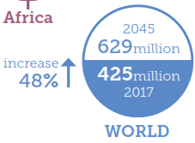
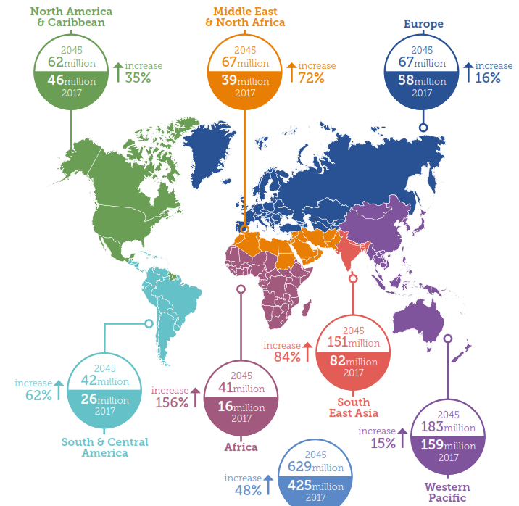
Diabetes is an increasing global epidemic
~425 million people worldwide had diabetes in 2017
~629 million will have diabetes by 2045
~4.0 million people died from diabetes and its complications in 2017
Total health expenditure on diabetes is estimated at USD 727 billion
Diabetes complications can be prevented by good glycemic control
Data from 20–79 years olds
2017 8th Edition. International Diabetes Federation Atlas
Notes:
Diabetes is an increasing global epidemic
Slide taken from Gla-300 value deck – slide 2

Slide 4
HbA_{1c} target achievement
Results
  Attainment of HbA_{1c} target (<7 %) was low in people with T1D or T2D
Proportion of people attaining HbA_{1c} <7 %, ≥7–≤8 % or >8 % (%)
OGLD, oral glucose-lowering drugs
Ashner P, et al. Diabetes 2018;67(Suppl 1):1026-P.

Slide 5
Reasons for insulin discontinuation: T1D and T2D
Results
T1D
T2D
OGLD, oral glucose-lowering drugs
Ashner P, et al. Diabetes 2018;67(Suppl 1):1026-P.
Participants, %
Notes:
The most frequent reasons for discontinuing therapy in people with T1D were the impact of insulin injection on social life, cost of medications, fear of hypoglycaemia and lack of support.
Reasons for discontinuation in people with T2D were similar to those with T1D
Additionally, lack of experience in insulin dosing was a further highly referenced reason for discontinuation in people with T2D

Slide 6
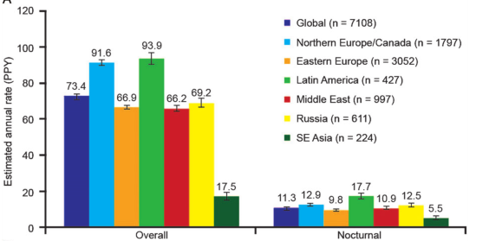
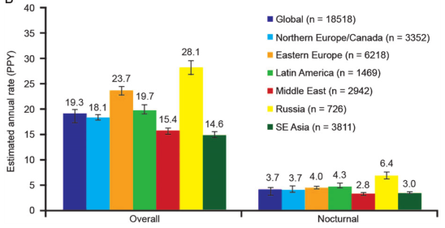
High hypoglycemia rates with insulin therapy and adverse impact
T1DM*
T2DM*
Overall: 73.4 events/patient-year
14.4% reported a severe event
Overall: 19.3 events/patient-year
8.9% reported a severe event
Hypoglycemia incurs morbidity and increased health care utilization
Hypoglycemia is a limiting factor in achieving good glycemic control
Non-interventional 6-month retrospective and 4-week prospective global HAT study of 27,585 patients with T1DM or T2DM treated with insulin for <12 months from 24 countries
*During the prospective period
Khunti K et al. Diabetes Obes Metab. 2016;18:907-15
Notes:
Rates of hypoglycemia are high
Slide taken from Gla-300 value deck – slide 2

Slide 7
The possibility of hypoglycemia may limit treatment intensification
Primary care physicians
I would treat my patients more aggressively if there was no concern about hypoglycemia
Specialists
Proportion of healthcare professionals, %
Insulin regimens with lower risk of hypoglycemia may potentially lead to improvements in glycemic control
International Global Attitudes of Patients and Physicians in Insulin Therapy internet survey: 1,250 physicians who treat patients with T1DM and T2DM
Adapted from Peyrot M et al. Diabet Med. 2012;29:682-689
Notes:
70-80% of physicians would consider the target of their patients tightly if there was no concern about hypoglycemia
Slide taken from Gla-300 value deck – slide 2

Slide 8
Evolution of basal insulin development: Overcoming limitations
Insulin glargine 100 U/mL (Gla-100) and insulin detemir were developed to overcome some limitations of early basal insulins such as NPH insulin, with less variable absorption and longer duration of action^{1,2}
Longer-acting basal insulins,
insulin glargine 300 U/mL (Gla-300) and insulin degludec, have since been developed with less variability and more prolonged durations of action (>24 h)^{1,2}
NPH insulin
Relative insulin effect
Relative insulin effect
Insulin detemir
Gla-100
Gla-100
0
12
24
0
12
24
Time, h
Time, h
Relative insulin effect
Relative insulin effect
Gla-100
Gla-100
Insulin degludec
Gla-300
0
12
24
0
12
24
Time, h
Time, h
Comparison of action after a single dose for NPH and Gla-100 and for Gla-100 and insulin detemir;
comparison at steady state for Gla-100 and Gla-300 and for Gla-100 and insulin degludec
NPH, neutral protamine Hagedorn
1. Eliaschewitz FG, Barreto T. Diabetol Metab Syndr. 2016;8:2; 2. Adapted from Pettus J et al. Diabetes Metab Res Rev. 2016;32:478-96
Notes:
Overcoming limitations in basal insulins
Clinical benefits of an ideal PK/PD profile
Slide taken from Gla-300 value deck – slide 2

Slide 9
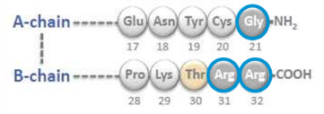
Compact depot formation results in more gradual insulin release
More compact SC depot with smaller surface area^{1,2}
More gradual and slower release from depot surface¹⁻⁴
Insulin glargine
For illustrative purposes only
1. Pettus J et al. Diabetes Metab Res Rev. 2016;32:478-96; 2. Adapted from Sutton G et al. Expert Opin Biol Ther. 2014;14:1849-60;
3. Steinstraesser A et al. Diabetes Obes Metab. 2014;16:873-6; 4. Becker RH et al. Diabetes Care. 2015;38:637-43

Slide 10
Low within-day and between-day fluctuation with Gla-300
Gla-300: Low within-day distribution of GIR-AUC as 6- and 12-hour fractions of total AUC
3
53%
47%
Clamp 1
2
Clamp 2
GIR, mg/kg/min
Average GIR
1
24%
23%
29%
23%
0
0–6 h
6–12 h
12–18 h
18–24 h
Gla-300: Low between-day fluctuation
Clamp 1
20
Clamp 2
10
INS, μU/ml
0
<LLOQ
0
6
12
18
24
Time, h
AUC, area under the curve; INS, serum insulin concentration; LLOQ, lower limit of quantification
Adapted from Becker RH et al. Diabetes Obes Metab. 2015;17:261-7 (main article and Supplementary Table 1)

Slide 11
Case 1
A 56 year- old man with type 2 diabetes who presents to discuss diabetes control.
He notes that his work schedule has become erratic, some days construction is slow, other days he has to skip meals to keep up with work demands.
His A1C in the past year has gone from 7.4% to 8.9 % but most recently 9.5%.
Medical history
Type 2 diabetes x 8 years, mild microalbuminuria, and hypercholesterolemia
Family history
His father and older brother have Diabetes.
Medications
Metformin 1000 mg bid and Gliclazide 80 mg BD
Other meds: Losartan 50 mg daily, Atorvastatin 20 mg daily
One year ago he started Liraglutide but could not tolerate the treatment after 2 months due to GI complications.

Slide 12
Case1
Physical exam
BMI 27 Kg/m², BP 130/75 mg/dl, sensation on microfilament exam fully intact, no retinopathy
Labs
A1C :9.5 %
Lipids: LDL cholesterol 74 mg/dL, HDL cholesterol 35 mg/dL,
Triglycerides: 150 mg/dl
You review his glucose meter log and note he is checking frequently. As you review his glucose patterns with him, he admits that keeping up with his medication regimen is challenging. He often falls asleep after dinner, due to workday fatigue.

Slide 13
Case1:
What is your recommendation for this patient?
(More than one answer may be correct. Please select the approach you are most likely to take.)
A) Add the third OAD
B) Start Toujeo (insulin glargine U300) and give it about the same time as he would at home
C) other actions

Slide 14
Case1 discussion
Start Toujeo and give it about the same time as you would at home
– Data supports safety and efficacy up to a ±3 hour window for administration
Add OAD:
is a not good option, since HBA1C is 9.5% .
Add GLP1RA:
is not a good option since HBA1C is 9.5% and he could not tolerate the complications.

Slide 15
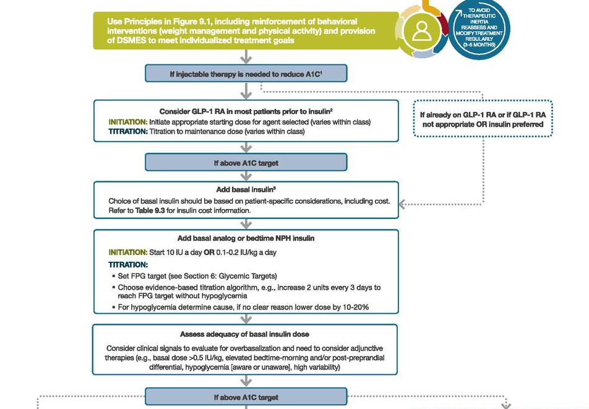

Slide 16
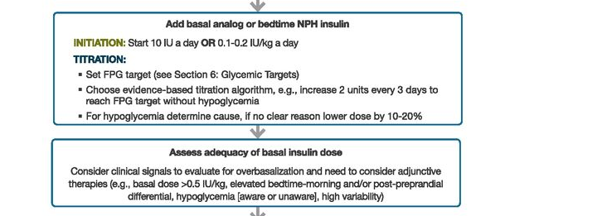
Initiation

Slide 17
Glargine-300 vs other Basal Insulins

Slide 18
EDITION program
Testing Gla-300 vs Gla-100 in several populations
T2DM
EDITION 1*
N=807
BB
Basal insulin plus mealtime bolus insulin (fast-acting analogue)
EDITION 2*
N=811
BOT
Basal insulin plus OAD (excl. SU)
EDITION 3
N=878
BOT
Insulin naïve +OAD (excl. SU) and/or GLP-1 receptor agonists
EDITION JP 2
N=241
BOT
Basal insulin plus OAD
All Phase 3, age of participants ≥18 years, randomization ratio 1:1
BB, basal-bolus therapy; BOT, basal only therapy; GLP-1, glucagon-like peptide-1; OAD, oral antihyperglycemic drug; SU, sulfonylurea
T2DM – type 2 diabetes mellitus, T1DM – type 1 diabetes mellitus, * in EDITION 1 and EDITION 2, people being treated with basal insulin ≥42U/day were recruited
Riddle MC et al. Diabetes Care. 2014;37:2755-62; Yki-Järvinen H et al. Diabetes Care. 2014;37:3235-43;
Bolli GB et al. Diabetes Obes Metab. 2015;17:386-94; Terauchi Y et al. Poster presentation at EASD 2014; Abstract 976;
Home PD et al. Oral presentation at EASD 2014; Abstract 148; Matsuhisa M et al. Poster presentation at EASD 2014; Abstract 975

Slide 19
Consistently effective glycemic control
Non-inferior change in HbA_{1C} for Gla-300 vs Gla-100 at Month 6 in the EDITION program
T2DM
T1DM
EDITION 1¹
BB
EDITION 2²
BOT switch
EDITION 3³
Insulin naïve: BOT start
EDITION JP 2⁴
BOT switch
EDITION 4^{5,6}
BB
EDITION JP 1⁷
BB
LSM difference
(95% CI)
0.00%
(-0.11 to 0.11)
-0.01%
(-0.14 to 0.12)
0.04%
(-0.09 to 0.17)
0.10%
(-0.08 to 0.27)
0.04%
(-0.10 to 0.19)
0.13%
(-0.03 to 0.29)
LSM HbA_{1C} change from baseline to Month 6, %
Gla-300
Gla-100
Modified intention-to-treat population; BB, basal-bolus therapy; BOT, basal-oral therapy; CI, confidence interval; LSM, least squares mean
1. Riddle MC et al. Diabetes Care. 2014;37:2755-62; 2. Yki-Järvinen H et al. Diabetes Care. 2014;37:3235-43; 3. Bolli GB et al. Diabetes Obes Metab. 2015;17:386-94;
4. Terauchi Y et al. Diabetes Obes Metab. 2016;18:366-74 (main article and Supplementary Table 2); 5. Home PD et al. Diabetes Care. 2015;38:2217-25;
6. Data on file, EDITION 4 CSR (6 months) pg 88; 7. Matsuhisa M et al. Diabetes Obes Metab. 2016;18:375-83 (main article and Supplementary Table 1)

Slide 20
Similar HbA_{1C} reduction with lower incidence of hypoglycemia Gla-300 vs Gla-100 in EDITION T2DM studies* to Month 6
Mean (SE) HbA_{1C}, %
Participants with ≥1 confirmed (≤70 mg/dL
[≤3.9 mmol/L]) or severe hypoglycemia event at Month 6
8.4
    LS mean difference at Month 6: 0.00%
    95% CI –0.08 to 0.07%
8.2
Favors Gla-300 | Favors Gla-100
← | →
8.0
Nocturnal (00:00 h–05:59 h)
Any time of day (24 h)
7.8
0.75 (0.68 to 0.83)
7.6
7.4
0.91 (0.87 to 0.96)
7.2
Gla-300 n=1247
Gla-100 n=1249
0.5
1
1.5
7.0
Relative risk (95% CI)
Baseline
Week 12
Month 6
*Patient-level meta-analysis of EDITION 1 (BB), EDITION 2 (BOT switch) and EDITION 3 (BOT start) studies in a broad population of patients with T2DM
SE, standard error
Adapted from Ritzel R et al. Diabetes Obes Metab. 2015;17:859-67

Slide 21
EDITION 2
6-Month, Multicenter, Randomized, Open-label, Parallel-group Study Comparing the Efficacy and Safety of Gla-300 and Gla-100 both in Combination With Oral Antihyperglycemic Drug(s) in Patients With T2DM With a 6-Month Safety Extension Period
Yki-Järvinen H et al. Diabetes Care. 2014;37:3235-43; Yki-Järvinen H et al. Diabetes Obes Metab. 2015;17:1142-9

Slide 22
Trial design
EDITION 2
Inclusion criteria
Males and females
Aged ≥18 years
T2DM (as defined by the WHO)
HbA_{1C} 7.0–10.0%
Established treatment with high-dose (≥42 U daily) basal insulin (Gla-100 or NPH) together with OADs (excl. SU) and without mealtime insulin
Participants
N=811
Randomized
1:1
Once-daily evening insulin dose titrated to FPG
80–100 mg/dL (4.4–5.6 mmol/L)
Basal dose unchanged unless on 2 NPH injections
(dose ↓ 20%)
Pre-study OADs continued (excl. SUs)
Gla-300
n=404
Gla-100
n=407
Week 0 to Week 8
Week 9 to Month 6
Primary efficacy endpoint:
HbA_{1C} change from baseline to Month 6
Adapted from Yki-Järvinen H et al. Diabetes Care. 2014;37:3235-43

Slide 23
Objectives and endpoints
EDITION 2
Primary efficacy endpoint
HbA_{1C} change from baseline to Month 6 (endpoint)
Main secondary endpoints
Percentage of participants with at least one confirmed (≤70 mg/dL ) or severe nocturnal (00:00–05:59 h) hypoglycemic event from Week 9 to Month 6
Change in pre-injection SMPG
Change in variability of pre-injection SMPG
Other secondary endpoints
Change in FPG (from baseline to Month 6)
Change in 8-point SMPG profiles per time-point including change in nocturnal SMPG
Change in and variability of the mean 24-h plasma glucose values
Proportion (%) of participants with HbA_{1C} <7% and ≤6.5%, and FPG <5.6 mmol/L and
<6.7 mmol/L
Hypoglycemic events
  Hypoglycemia according to definitions (severe, documented symptomatic, asymptomatic, probably symptomatic, relative)
  Hypoglycemia according to the time (nocturnal, any time)
Safety and tolerability
Yki-Järvinen H et al. Diabetes Care. 2014;37:3235-43; Data on file, EDITION 2 CSR (6 months) pg 34-40

Slide 24
EDITION 2, M6
    Gla-300 met the primary endpoint of non-inferiority to Gla-100 for reduction in HbA_{1C} at Month 6
% of participants with
HbA_{1c} <7.0%
Mean (SE) HbA_{1C,} mmol/mol
Mean (SE) HbA_{1C,} %
70
8.5
Gla-300
Gla-100
65
8.0
Gla-300
60
7.5
Gla-100
LS mean difference at Month 6:
–0.01 (95% CI –0.14 to 0.12) %
55
7.0
Baseline
Week 12
Month 6
LOCF
mITT population
Adapted from Yki-Järvinen H et al. Diabetes Care. 2014;37:3235-43

Slide 25
Comparable FPG reductions for Gla-300 and Gla-100 at Month 6
Mean (SE) FPG, mmol/L
EDITION 2, M6
Mean (SE) FPG, mg/dL
9.5
LS mean difference at Month 6:
0.19 (95% CI –0.15 to 0.52) mmol/L
160
8.5
140
7.5
Gla-300
120
6.5
Gla-100
5.5
Baseline
Week 12
Month 6
LOCF
mITT population
Adapted from Yki-Järvinen H et al. Diabetes Care. 2014;37:3235-43 (Supplementary Figure 2 and Table 1)

Slide 26
EDITION 2, M6
Gla-300 and Gla-100 demonstrated comparable 8-point SMPG profiles at Month 6
Mean (SE) SMPG, mmol/L
Mean (SE) SMPG, mg/dL
12.5
Gla-300
Gla-100
Baseline
Month 6
(LOCF)
220
11.5
200
10.5
180
9.5
160
8.5
140
7.5
120
6.5
5.5
100
0300 h
Post-breakfast
Post-Lunch
Post-Dinner
Pre-breakfast
Pre-Lunch
Pre-Dinner
Bedtime
mITT population
Adapted from Yki-Järvinen H et al. Diabetes Care. 2014;37:3235-43

Slide 27
Gla-300 vs Gla-100 lowered the rate of confirmed (≤70 mg/dL ) or severe hypoglycemia at any time of day (24 h) and during the predefined nocturnal period
EDITION 2, M6
At any time of day (24 h)
Cumulative mean numbers of confirmed
(≤70 mg/dL ) or severe events
Nocturnal (00:00–05:59 h)
Cumulative mean numbers of confirmed
(≤70 mg/dL) or severe events
12
2.5
10
2.0
Gla-100
Gla-100
8
1.5
6
Gla-300
1.0
4
Gla-300
2
0.5
Rate ratio 0.77 (0.63 to 0.96)
Rate ratio 0.52 (0.35 to 0.77)
0
0.0
0
4
8
12
16
20
24
28
0
4
8
12
16
20
24
28
Time, weeks
Time, weeks
Adapted from Yki-Järvinen H et al. Diabetes Care. 2014;37:3235-43 (main article and Supplementary Table 3)

Slide 28
Incidence of hypoglycemia at any time of day (24 h) by ADA definitions
Relative risk based on percentage with ≥1 event at Month 6
EDITION 2, M6
Gla-300 % | Gla-100 % | Relative risk (95% Cl)
70.0 | 77.3 | 0.90 (0.83-0.98)
47.1 | 60.1 | 0.78 (0.69-0.89)
59.3 | 65.0 | 0.91 (0.82-1.02)
27.3 | 35.2 | 0.78 (0.63-0.95)
12.9 | 19.5 | 0.66 (0.48-0.91)
20.3 | 26.4 | 0.77 (0.60-0.99)
49.6 | 57.4 | 0.86 (0.76-0.98)
29.5 | 38.9 | 0.76 (0.63-0.92)
40.4 | 44.3 | 0.91 (0.78-1.07)
20.6 | 26.8 | 0.77 (0.60-0.98)
8.7 | 13.5 | 0.64 (0.43-0.96)
15.9 | 20.0 | 0.80 (0.59-1.07)
1.0 | 1.5 | 0.67 (0.19-2.37)
0.2 | 0.5 | 0.61 (0.08-4.56)
0.7 | 1.2 | 0.60 (0.15-2.51)
Confirmed (≤70 mg/dL [≤3.9 mmol/L]) or severe
Baseline to Month 6
Baseline to Week 8
Week 9 to Month 6
Confirmed (<54 mg/dL [<3.0 mmol/L]) or severe
Baseline to Month 6
Baseline to Week 8
Week 9 to Month 6
Documented symptomatic ≤70 mg/dL (≤3.9 mmol/L)
Baseline to Month 6
Baseline to Week 8
Week 9 to Month 6
Documented symptomatic <54 mg/dL (<3.0 mmol/L)
Baseline to Month 6
Baseline to Week 8
Week 9 to Month 6
Severe
Baseline to Month 6
Baseline to Week 8
Week 9 to Month 6
0.1
0.3
1
3.0
10.0
Favors Gla-300
Favors Gla-100
Relative risk (95% CI)
Safety population
Adapted from Yki-Järvinen H et al. Diabetes Care. 2014;37:3235-43 (Supplementary Table 2)
Data on file – MA dossier Module 5 – Integrated Safety Summary (6 months), appendix saf_hypo_ph2_3 pg 185-280

Slide 29
Incidence of nocturnal hypoglycemia by ADA definitions
Relative risk based on percentage with ≥1 event (00:00–05:59 h) at Month 6
EDITION 2, M6
Gla-300 % | Gla-100 % | Relative risk (95% Cl)
28.3 | 39.9 | 0.71 (0.58-0.86)
13.2 | 24.6 | 0.53 (0.39-0.72)
22.1 | 28.8 | 0.77 (0.60-0.97)
9.9 | 13.3 | 0.75 (0.51-1.10)
4.0 | 7.1 | 0.56 (0.31-1.01)
7.2 | 9.6 | 0.75 (0.47-1.19)
22.6 | 31.0 | 0.73 (0.58-0.92)
8.4 | 19.5 | 0.43 (0.30-0.63)
19.1 | 22.2 | 0.86 (0.66-1.13)
8.2 | 11.6 | 0.71 (0.46-1.08)
2.5 | 6.4 | 0.39 (0.19-0.79)
6.7 | 8.6 | 0.78 (0.48-1.26)
0 | 0.5 | Not estimated
0 | 0
0 | 0.5
Confirmed (≤70 mg/dL [≤3.9 mmol/L]) or severe
Baseline to Month 6
Baseline to Week 8
Week 9 to Month 6
Confirmed (<54 mg/dL [<3.0 mmol/L]) or severe
Baseline to Month 6
Baseline to Week 8
Week 9 to Month 6
Documented symptomatic ≤70 mg/dL (≤3.9 mmol/L)
Baseline to Month 6
Baseline to Week 8
Week 9 to Month 6
Documented symptomatic <54 mg/dL (<3.0 mmol/L)
Baseline to Month 6
Baseline to Week 8
Week 9 to Month 6
Severe
Baseline to Month 6
Baseline to Week 8
Week 9 to Month 6
0.1
0.3
1
3.0
10.0
Favors Gla-300
Favors Gla-100
Relative risk (95% CI)
Safety population
Adapted from Yki-Järvinen H et al. Diabetes Care. 2014;37:3235-43 (Supplementary Table 2)
Data on file – MA dossier Module 5 – Integrated Safety Summary (6 months), appendix saf_hypo_ph2_3 pg 185-280

Slide 30
Insulin dose from baseline to Month 6
Mean (SE) insulin dose, U/kg/day (LOCF)¹
EDITION 2, M6
Mean basal insulin dose, U/day (OC)²
 | BL | M6
Gla-300 | 62.1 | 92.7
Gla-100 | 63.9 | 82.8
1.2
1.0
0.8
Relative difference for
Gla-300 vs Gla-100 at
Month 6 (based on U/kg/day)²: +10.44%
0.6
0.4
0.2
0.0
LOCF
BL
W12
M6
mITT population
LOCF, last observation carried forward
1. Adapted from Yki-Järvinen H et al. Diabetes Care. 2014;37:3235-43;
2. Data on file, Sanofi response to D80 CHMP List of Questions (post-hoc analysis): E19_Insulin dose_Absolute and Relative differences_M12_2014-09-03. doc pg 11, 12

Slide 31
Less weight gain with Gla-300 vs Gla-100 at Month 6
EDITION 2, M6
Mean weight change, kg
P=0.015
1.0
Gla-300
Gla-100
0.5
0.0
–0.5
BL
W12
M6
LOV
LOV, last on-treatment value
Safety population
Adapted from Yki-Järvinen H et al. Diabetes Care. 2014;37:3235-43 (Supplementary Figure 3)

Slide 32
The Real-World LIGHTNING Study
Rates of Hypoglycemia Predicted in Patients with Type 2 Diabetes on Insulin Glargine 300 U/ml Versus First and Second-Generation Basal Insulin Analogs
Petttus, J., et al .Diabetes Ther 2019

Slide 33
LIGHTNING: Assessing hypoglycemia rates in T2DM patients using 1st or 2nd generation BI analogs
Retrospective observational study designed to assess hypoglycemia rates in patients with T2DM
prescribed first- (Gla-100, IDet) or second-generation (Gla-300, IDeg) BI analogs
Patient selection:
Confirmed diagnosis of T2DM (presence of ≥1 ICD- 9 or 10 diagnosis codes [ICD-9: 250.x0; 250.x2; ICD-10: E11] or ≥1 prescriptions for an antidiabetic drug anytime during study window
Age ≥18 years at the time of first known prescription of a BI in EHR database
Individuals with >10 BI switches within the study window were excluded as they likely represent unusual clinical behavior
First generation BI analogs (Gla-100 or IDet)
Second generation BI analogs (Gla-300 or IDeg)
Basal insulin switch
  Analysis:
  Severe hypoglycemia was defined as hypoglycemic events (ICD 9/10 code identified or plasma glucose ≤70 mg/dL) related to inpatient or emergency department encounter
  HbA1c change was defined as change from baseline to 76–180 day follow-up, for the subgroup of patients with HbA1c in both time windows
  PSM was used to match cohorts for potentially confounding characteristics, allowing for between-treatment comparison
PSM, propensity score matching
Meneghini L et al. Poster presented at ATTD 2018

Slide 34
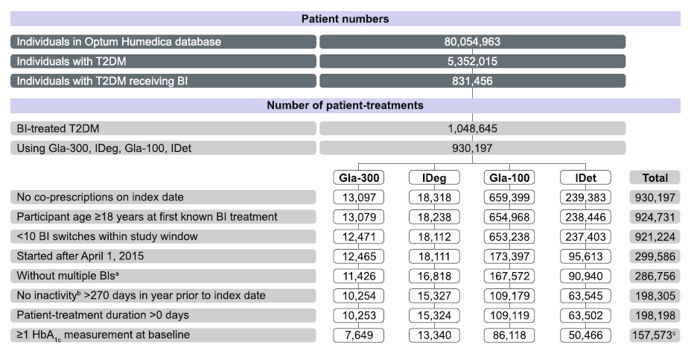
LIGHTNING: Study population
Patient numbers
Individuals in Optum Humedica database
74,389,932
Individuals with T2DM
4,978,173
Individuals with T2DM receiving BI
779,813
Number of patient treatments
BI-treated T2DM
1,050,697
Using Gla-100, IDet, Gla-300 or IDeg
930,869
Gla-100
IDet
Gla-300
IDeg
Total
No co-prescriptions on index date
12,070
628, 733
215,005
11,454
867,262
Participant age ≥18 years at first known BI treatment
12,061
624, 871
214, 198
11,421
862,551
<10 BI switches within study window
11,582
613, 523
210,886
11,359
847,350
Started after April 1, 2015
11,577
145,344
76,005
11,358
244,284
Without multiple BIs
10,687
140,292
71,573
10,560
232,112
No inactivity >270 days in year prior to index date
9,680
95,761
52,388
9,756
167,585
With baseline Hba1c value
7,053
73,997
40,700
8,405
130,155
ªMultiple treatments defined as those that have another treatment start within 1 week (before or after) specified basal insulin start; ^{b}Inactivity defined as the lack of any time-stamped data
Meneghini L et al. Poster presented at ATTD 2018

Slide 35
Propensity score matching results – BI naive
Similar glycemic control and less or similar hypoglycemia after initiating BI therapy with Gla-300 versus other BI
Comparable HbA_{1c} reductions after initiating Gla-300 or comparator BI
Rates of severe hypoglycemia after initiating
Gla-300 or comparator BI
Gla-300 vs 1st generation BIs
Gla-300 vs
2nd generation BI
PSM-matched cohorts
Gla-300
n=666
Gla-100
n=548
Gla-300
n=669
IDet
n=580
Gla-300
n=347
IDeg
n=354
NS
p=0.0222
p=0.0027
p=0.1523
Mean (SD) HbA_{1c} reduction (%)
Mean ± SE event rate (event/patient-years)
(0.04)
(0.04)
(2.16)
(2.15)
(2.15)
(0.03)
(2.26)
(2.27)
(0.03)
(0.02)
(0.03)
(2.22)
NS
p=0.2600
NS
p=0.8547
NS
p=0.6170
PSM-matched cohorts
Gla-300
n=2615
Gla-100
n=2717
Gla-300
n=2602
IDet
n=2647
Gla-300
n=1517
IDeg
n=1458
Gla-300 vs 1st generation BIs
Gla-300 vs
2nd generation BI
BI, basal insulin; Gla-100, insulin glargine 100 U/mL; Gla-300, insulin glargine 300 U/mL; IDeg, insulin degludec; IDet, insulin detemir; NS, not significant; PSM, propensity score matching; SD, standard deviation; SE, standard error
CONFIDENTIAL PLEASE DO NOT COPY OR DISTRIBUTE

Slide 36
Propensity score matching results – BI switchers
RWE – EMR study
Similar glycemic control and less or similar hypoglycemia after switching to Gla-300 vs other BI
Comparable HbA_{1c} reductions following a switch to Gla-300 or comparator BI
Rates of severe hypoglycemia following a switch to
Gla-300 or comparator BI
Gla-300 vs 1st generation BIs
Gla-300 vs
2nd generation BI
PSM-matched cohorts
Gla-300
n=1070
Gla-100
n=930
Gla-300
n=1066
IDet
n=894
Gla-300
n=549
IDeg
n=591
p=0.0155
NS
p=0.1406
p=0.0450
(1.83)
(2.06)
(0.08)
(0.20)
Mean (SD) HbA_{1c} reduction (%)
(0.10)
(1.84)
(1.84)
(1.82)
(1.74)
Mean (SE) event rate
(events/patient-years)
NS
p=0.4125
NS
p=0.3090
NS
p=0.5711
(0.06)
(0.06)
(0.07)
PSM-matched cohorts
Gla-300
n=3166
Gla-100
n=3166
Gla-300
n=3101
IDet
n=3101
Gla-300
n=2226
IDeg
n=2226
Gla-300 vs 1st generation BIs
Gla-300 vs
2nd generation BI
BI, basal insulin; Gla-100, insulin glargine 100 U/mL; Gla-300, insulin glargine 300 U/mL; IDeg, insulin degludec;
IDet, insulin detemir; NS, not significant; PSM, propensity score matching; SD, standard deviation; SE, standard error
CONFIDENTIAL PLEASE DO NOT COPY OR DISTRIBUTE

Slide 37
LIGHTNING: Conclusions
LIGHTNING indicates significantly lower rates of severe hypoglycemia for Gla-300 vs first-generation BIs and comparable rates vs IDeg, without compromising HbA1c reduction, in patients with T2DM switching from any previous BI
RCT, randomized controlled trial; RWE, real-world evidence
Meneghini L et al. Poster presented at ATTD 2018

Slide 38
In conclusion:
Gla-300(Toujeo)
  Comparable HbA_{1C} reduction vs other 1st and 2nd generation basal insulins
  Lower rates of severe, Nocturnal, Any time hypoglycemia vs 1st generation basal insulins
  Less glycemic variability with Gla-300 when administered in the morning or evening
  Flexibility to select the timing of injections to either am or pm dosing and within a ± 3 hours window when needed
  Lower Weight gain in comparison Gla-100
  Convenient administration with the easy-to-use TOUJEO™ SoloSTAR® pen
BI, basal insulin; RCT, randomized controlled trial; RWE, real-world evidence
1. Zhou LF et al. Diabetes Obes Metab. 2017 Dec 22. doi: 10.1111/dom.13199. [Epub ahead of print]; 2. Zhou LF et al. Poster presented at ADA 2017, Poster 986-P;
3. Blonde L et al. Poster presented at WCIRDC 2017; 4. Meneghini L et al. Poster presented at WCIRDCR 2017

Slide 39
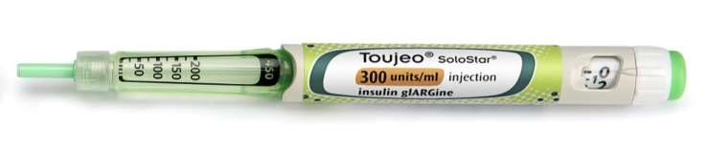
DOSAGE & ADMINISTRATION
General Instructions:
Basal Insulin
Once a Day
SC injection at any time of the day
  When needed, patients can administer Toujeo up to 3 hours before or after their usual time of administration
Dosage ranges from 1 to 80 U / one injection
Toujeo should not be administered intravenously.
Toujeo must not be mixed with any other insulin or diluted. Mixing or diluting can change its time/action profile and mixing can cause precipitation

Slide 40
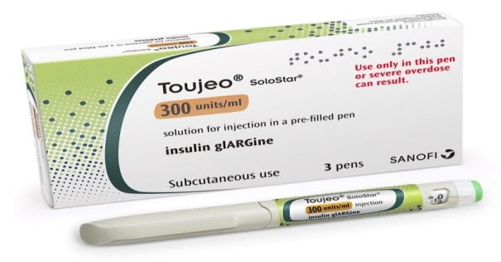
DOSAGE FORMS & STRENGTHS
Injection:
300 units per mL of insulin glargine.
Clear, Colorless solution
1.5 mL SoloStar disposable prefilled pen (450 Units/1.5 mL)

Slide 41
Case2:
A 68-year-old patient, retired teacher with a 15-year history of type 2 diabetes.
He presents to your office as a new patient. He is concerned about recent nighttime sweats and mild tremors.
He checks his blood sugar about 2-3 days per week but only before breakfast. His average fasting
Glucose is about 136 mg/dL.
• His current A1C is 7.4%.
• His diet consists of three meals a day but with no standardization.
• He walks most days for about 30 minutes.

Slide 42
Case2
• Medical history
Hyperlipidemia, hypertension
• Medications
  Metformin -Sitagliptine 50mg/1000 mg BD
  Insulin glargine U100 38 units at bedtime
  Lisinopril 20 mg qd ,Atorvastatin 80 mg qd
  ASA 80 mg daily
• Physical exam
  BP = 135/80 mg/dl P = 68 BMI = 30.2
  evidence of early background retinopathy
  Legs with 1+ edema
  Reduced sensation in feet without lesions

Slide 43
Case2:
Labs
A1C = 7.4 %
Albumin Creatinine ratio = 45 mcg/mg
Sodium = 141
Potassium = 4.3
Creatinine = 1.23 eGFR = 58 cc/min
LDL = 66 mg/dL ,HDL = 38 mg/dl, Triglycerides = 198 mg/dL

Slide 44
Case2
The patients tests his glucose for a week as noted below:
Day | Night 2-4 AM | FBS | Bedtime | Symptom
Saturday |  | 145 mg/dl | 174mg/dl | 59mg/dl
Sunday | 82 mg/dl | 105 mg/dl | 159 mg/dl
Monday |  | 172 mg/dl | 147 mg/dl | 62 mg/dl At 2:30 am
Tuesday | 89 mg/dl | 137 mg/dl | 133 mg/dl
Wednesday | 78 mg/dl | 126 mg/dl | 172 mg/dl
Thursday |  | 139 mg/dl | 126 mg/dl
Friday | 102 mg/dl | 143 mg/dl | 179 mg/dl

Slide 45
Case2(Discussion)
His morning glucose values are not low.
Average = 138 mg/dL
• He requires relatively intensive therapy to maintain his A1C near a modified 7-7.5% goal.
• Basal insulin serves a good purpose in this patient.

Slide 46
Case2:
What is your recommendation for this patient?
(More than one answer may be correct. Please select the approach you are most likely to take.)
A)Decrease the glargine U100 to avoid nocturnal hypoglycemia
B) Discontinue glargine U100 and add an OAD
C)Change glargine U100 to Toujeo(glargine U300 )
D) Add or increase snack at bedtime
E) other actions

Slide 47
Case2(Discussion)
Add or increase snack at bedtime
– In an obese individual you don’t want to add unnecessary calories
– We prefer not to create iatrogenic hypoglycemia and then add an intervention to prevent it
• Back to OAD such as SGLT2 inhibitor
-substituting a SGLT2 inhibitor for basal insulin generally will lead to less glucose reduction.
-Not a good option since the patients is on 38 units of insulin
Change glargine U100 to Toujeo
Toujeo is associated with a significantly lower risk of nocturnal hypoglycemia and will maintain the same
efficacy

Slide 48
DELIVER-2: Evaluating clinical outcomes in T2DM patients switching BI
Retrospective cohort study designed to evaluate clinical outcomes and health care utilization of T2DM patients
using BI who switched to either Gla-300 or another BI in real-world clinical practice settings
Patient selection:
Adult patients with T2DM (at least 1 diagnosis record in the database at any time)
Basal insulin switch to Gla-300 U/mL / other BI (Gla-100, insulin detemir, insulin degludec); index date is the date of switching: March 1, 2015, through May 31, 2016
HbA1c level measurements available in the <6-month baseline and >90 day follow-up periods
Gla-300
(n=2,196)
Other BI (Gla-100, IDet or IDeg)
(n=3,837)
12-month pre-switch baseline period
Basal insulin switch
6-month post-switch follow-up
Analysis: 1:1 propensity score matching based on baseline demographics and clinical characteristics
Demographics: age, gender, race, insurance, region, physician specialty; Clinical characteristics: HbA1c, BMI, baseline antidiabetic agent use, comorbidities and diabetic complications (including Charlson comorbidity index), % hypoglycemia at 12-month and 6-month baseline, baseline basal insulin and concomitant medication use
BMI, body mass index; IDet, insulin detemir
T2DM, type 2 diabetes mellitus
Zhou FL et al. Diabetes Obes Metab. 2017 Dec 22. doi: 10.1111/dom.13199 [Epub ahead of print]

Slide 49
DELIVER-2: Similar glycemic control with less hypoglycemia after switching to Gla-300 vs other basal insulins in real life
Comparable HbA_{1C} reductions at 6 months
Adjusted* mean hypoglycemia event rate during 6 months of follow up
P=0.928 for change Gla-300 vs other BI
Δ=-0.51% P<0.001
Δ=-0.51% P<0.001
LSM difference -0.15 events/PPPY
P=0.041
19%
0.79
0.64
Events/per patient per year
Switch
Following on from the DELIVER 1 pilot study, DELIVER 2 was a retrospective observational analysis of matched cohorts (matched at a 1:1 ratio on a propensity score based on baseline demographics and clinical characteristics) of patients with T2DM on prior basal insulin who were switched to either Gla-300 or another basal insulin (Gla-100, insulin detemir or IDeg), US PHIE EMR database (March 2015 to March 2016) (n=1,819 per cohort)
*adjusted for baseline hypoglycemia incidence
BI, basal insulin; EMR, electronic medical records; PHIE, Predictive Health Intelligence Environment
Zhou FL et al. Diabetes Obes Metab. 2017 Dec 22. doi: 10.1111/dom.13199. [Epub ahead of print]
Notes:
Study Results:
F. Liz Zhou, L. Xie, et al, AACE 2017 (DELIVER 2)
Objective: To evaluate clinical outcomes and health care utilization of patients with T2D using basal insulin who switched to either Gla-300 or other basal insulins in real-world clinical practice.
Methods:
Study Design
The Differentiate Gla-300 clinical and Economic in real-world Via EMR data study (DELIVER 2) is a retrospective cohort study.
Data were collected from the Predictive Health Intelligence Environment database of electronic medical records (EMRs) representing 37 integrated health delivery networks
Patient Selection
Patients with ≥ 1 T2D diagnosis record in the database at any time were identified by ICD-9-CM/ICD-10-CM codes.¹
Included patients in the study were adults with T2D using basal insulin, with data for 12 months prior to (baseline)
and 6 months after (follow-up) switching to either Gla-300 or other basal insulins (Gla-100, insulin detemir, insulin
degludec) (index date: first basal insulin switch from March 1, 2015 through May 31, 2016).
All patients had glycated hemoglobin A1c (A1C) levels measured < 6 months pre- and > 90 days post-index date.
Patients using more than 1 basal insulin on the index date were excluded.
Outcomes Assessment
The study endpoints included:
A1C change: reduction in A1C from baseline to follow-up (latest available value during follow-up period)
A1C goal attainment measured as number of patients who reached A1C goal of < 7.0% and < 8.0%
incidence and event rate (adjusted for baseline hypoglycemia events) of hypoglycemia (identified by ICD-9-CM/ICD-10-CM and/or plasma glucose level ≤ 70 mg/dl) during the 6-month follow-up
health care utilization: proportion of patients requiring inpatient, emergency department (ED), and outpatient services during the 6-month follow-up (all-cause, diabetes- [defined as encounters with a recorded diagnosis of T2D at different care settings], and hypoglycemia-related [defined as encounters with a recorded diagnosis of T2D and hypoglycemia at different care settings]); 6-month health care resource utilization rates (events/per patient per year [PPPY]) (adjusted for baseline health care utilization)
health care cost and cost-saving: cost was estimated by applying cost per event (unit cost) to adjusted mean health care events/PPPY; cost-saving related to Gla-300 was calculated similarly based on adjusted mean difference in events/PPPY between the 2 cohorts. All unit cost values were inflated to 2016 USD using the medical care component of the Consumer Price Index.
Propensity Score
Patients switching to Gla-300 and to other basal insulins were matched at a 1:1 ratio on a propensity score based on baseline demographics and clinical characteristics.²
Baseline patient characteristics used in the matching were demographic characteristics (age, gender, race, insurance type, geographic region), clinical characteristics (A1C, body-mass index [BMI]), Charlson comorbidity index (CCI) score, prevalence of comorbidities, concomitant medication, hypoglycemia incidence within 6 months and 12 months prior to baseline, baseline basal insulin, and baseline all-cause heath care utilization.
To assess any imbalance before and after matching in individual baseline characteristics, the statistical test (χ2 test/2-sample Student t-test) was performed, and standardized mean difference (SMD) was calculated as well.
Statistical Analysis
Differences between baseline and follow-up A1C were tested by paired Student t-test within each cohort, and A1C changes from baseline to follow-up were compared between Gla-300 and other basal insulin cohorts by 2-sample Student t-test.
Adjusted odds ratios (aOR) (adjusted for baseline hypoglycemia incidence) were calculated for incidence of hypoglycemia to compare risks between the 2 cohorts; adjusted mean and least-squares means (LSM) difference were calculated for event rates of hypoglycemia in the 2 cohorts controlled for baseline hypoglycemia event.
aORs (adjusted for baseline healthcare resource use) were calculated to compare risk of requiring health care utilizations between the two cohorts; adjusted mean and LSM difference were calculated for health care event rates in the 2 cohorts controlled for baseline health care event.
Results:
Patient Selection and Matching
The final cohort consisted of 2,185 patients who switched to Gla-300 and 3,921 who switched to other basal insulins. After matching, each cohort comprised 1,827 patients.
After matching, all baseline characteristics (except the percentages of commercial- and Medicaid-insured patients) had an SMD < 0.1, demonstrating that the matching resulted in improved balance in baseline values between the treatment groups.
Patient Baseline Characteristics
• In the matched cohorts, 48.9% and 47.8% of patients were men in the Gla-300 and other basal insulin cohort, respectively, and mean age was 59 years.
• Gla-100 was the baseline basal insulin in 72.5% and 71.6% of patients in the cohorts switching to Gla-300 and other basal insulin, respectively. The remainder of patients in each cohort switched from insulin detemir. In the other basal insulin cohort, 24.1%, 65.7%, and 10.2% of patients switched to Gla-100, insulin detemir, and insulin degludec, respectively.
• The mean number of oral antidiabetes medications was 1.1 in both cohorts.
• Hypoglycemia prevalence within 6 months prior to baseline was 15.9% in the Gla-300 cohort and 14.1% in the other basal insulin cohort. Annual hypoglycemia prevalence within 12 months prior to baseline was 22.1% in the Gla-300 cohort and 20.8% in the other basal insulin cohort.
A1C Change
• Mean baseline A1C was 8.95% in the Gla-300 cohort and 8.93% in the other basal insulin cohort, and A1C levels significantly decreased to 8.40% and 8.46%, respectively, during the 6-month follow-up period (P < 0.01 for both). A1C reductions were comparable in both cohorts (−0.55% for Gla-300 vs −0.47% for other basal insulin; P = 0.14).
A1C Goal Attainment
• After the 6-month follow-up, patients on Gla-300 and those on other basal insulins were equally likely to reach A1C < 7.0% (16.9% vs 18.7%, respectively; P = 0.35) and A1C < 8.0% (45.0% vs 42.0%, respectively; P = 0.31)
Hypoglycemia
• During the 6-month follow-up period, significantly fewer patients on Gla-300 experienced hypoglycemia versus those on other basal insulins (incidence: 15.9% vs 18.2%, respectively, P = 0.01; aOR 0.78, 95% confidence interval [CI] [0.65, 0.94]) controlled for baseline hypoglycemia incidence. Adjusting for baseline hypoglycemia, switching to Gla-300 was associated with a significantly lower hypoglycemia event rate at the 6-month follow-up (adjusted mean: Gla-300: 0.677 events/PPPY, other basal insulin: 0.902 events/PPPY; LSM difference: −0.225 events/PPPY, 95%CI[−0.379,−0.072], P < 0.01).
• A similar trend was observed for hypoglycemia associated with inpatient or ED encounters.
Health Care Utilization Incidences
• Patients on Gla-300 had a lower risk of requiring all-cause inpatient or ED services compared to other basal insulins at follow-up (aOR: inpatient 0.76, 95% CI [0.63, 0.93], P = 0.01; ED 0.77, 95%CI [0.66, 0.91], P < 0.01). Similarly, the outcomes of diabetes- and hypoglycemia-related health care utilization were significantly favorable for Gla-300.
Health Care Utilization Events and Costs
• Patients switching to Gla-300 experienced significantly fewer days in hospital due to all-cause, diabetes- and hypoglycemia-related causes during 6 months follow-up compared to patients switching to other basal insulins, translating to savings of $1,800, $1,148 and $1,359 PPPY, respectively.
• There were significantly fewer all-cause ED and outpatient events during follow-up in patients treated with Gla-300 (LSM difference: ED −0.177 events/PPPY, 95%CI [−0.319, −0.036], P = 0.01; outpatient −0.985 events/PPPY, 95%CI [−1.610, −0.359], P < 0.01) resulting in savings of $199 and $72 PPPY for the two outcomes, respectively.
• The number of diabetes-related outpatient visits was also lower in patients switching to Gla-300 (LSM difference in events/PPPY: −0.298, 95%CI [−0.584, −0.013], P = 0.04), resulting in a saving of $43 PPPY.
Strengths and Limitations:
• To our knowledge, this is the first study to evaluate the novel second-generation basal insulin Gla-300 with matched cohorts and large sample size in a real-world setting.
• While the findings represent actual treatment-use patterns and outcomes outside the confines of clinical trials, several limitations should be noted:
–– hypoglycemia may have been underreported in the study, as only the more marked events were likely to be captured (i.e. no self-monitoring blood glucose or continuous blood glucose monitoring data)
–– EMR data may not reveal the reason why patients switched basal insulins
–– EMR data capture the prescription of medication, not the dispensing or consumption of medication. The prescription information may not reflect the actual drug use in real life
–– dosage data were missing in a high percentage of the EMRs; thus the dose information could not be addressed in this study
–– unit cost may differ based on integrated delivery network size, feature, geographic location, etc.
Conclusions:
• In T2D patients with elevated A1C levels in clinical settings, switching basal insulins to Gla-300 versus other basal insulins is associated with similarly improved glycemic control but with significantly lower risk of hypoglycemia.
• The lower hypoglycemia risk is associated with lower health care resource utilization, including inpatient and ED visits as well as the associated costs.
• Given the prevailing significant personal and economic burden of T2D, these results demonstrate that basal insulin therapy that delivers improved control with lower hypoglycemia risk and lower health care resource utilization and costs, may have important relevance and implications for patients, providers, and payers.
References:
1. The American Association of Clinical Endocrinologists. Diabetes ICD-9-CM crosswalk to ICD-10-CM. Available from: https://www.aace.com/files/
socioeconomics/crosswalk/icd9-icd10-crosswalk-for-dm-2015.pdf. Accessed February 28, 2017.
2. Rosenbaum PR, Rubin DB. Biometrika. 1983;70:41-55
Slide taken from Gla-300 value deck – slide 2

Slide 50
DELIVER-2: Conclusions
DELIVER 2 provided the first comparative real-world evidence for the benefits of switching
from other basal insulins (BI) to Gla-300 in patients with T2DM
Change in HbA1c from baseline was comparable between the Gla-300 and other BI matched cohorts
The Gla-300 cohort exhibited a lower hypoglycemia incidence and adjusted event rate compared to the patients who switched to another BI.
ER, emergency room
Zhou FL et al. Diabetes Obes Metab. 2017 Dec 22. doi: 10.1111/dom.13199 [Epub ahead of print]

Slide 51
DELIVER-3: Similar glycemic control with less hypoglycemia after switching to Gla-300 vs other basal insulins in real life (in Elderly)
Comparable HbA_{1C} reductions at 6 months
Adjusted* mean hypoglycemia event rate during 6 months of follow up
Adjusted LS mean difference -0.09
P=0.24 for change Gla-300 vs other BI
P=0.0002
Δ = 0.33% P<0.01
Δ = 0.34% P<0.01
48%
Events/100 patients/month
% relative to other BI
DELIVER 3 retrospective observational analysis of patients aged ≥65 years with T2DM on prior basal insulin who were switched to either Gla-300 or another basal insulin
(Gla-100, insulin detemir or IDeg) from US PHIE EMR database (March 2015 to March 2016). Logistic regression analysis adjusted for baseline confounders
*adjusted for baseline hypoglycemia incidence; BI, basal insulin; EMR, electronic medical records; PHIE, Predictive Health Intelligence Environment
Zhou LF et al. Poster presented at ADA 2017, Poster 986-P and unpublished data
Notes:
Slide taken from Gla-300 value deck – slide 2

Slide 52
Administration
Switch between Lantus to Toujeo :
Switching from insulin Lantus to Toujeo, can be done on a unit-to-unit basis.
Switch from other basal insulins to Toujeo:
Switching from once-daily basal insulins to once-daily Toujeo can be done unit-to-unit based on the previous basal insulin dose.
Switching from twice-daily basal insulins to once-daily Toujeo, the recommended initial Toujeo dose is 80% of the total daily dose of basal insulin that is being discontinued.

Slide 53
Case2 Follow up:
The patient was switched to Toujeo( glargine U300) at 38 units(Same dose) at bedtime and then titrated till FBS would be at target.
• He returns to see you after 3 months and he is currently on glargine U300 ,44 units at bedtime along with his Sitagliptin- metformin. His A1C is 7.3 % and he tells you that he has not had any episodes of night sweats like before.

Slide 54
Thank you

