Slide 1

NeuroCOVID
Abdorreza Naser Moghadasi
MS Research Center

Slide 2


A 45 years old woman
Working as a nurse in COVID ward
She has had RA since 10 years ago receiving CinnoRA

Slide 3

She has developed right hemiparesis since 2 weeks ago.
The patient had no cough or fever.
In N/E the patients had hyperreflexia and right side babinski sign.

Slide 4

What is your diagnosis?
NMOSD
Neurological complication of COVID
MS
Neurological complication of RA
Side effect of CinnoRA

Slide 5
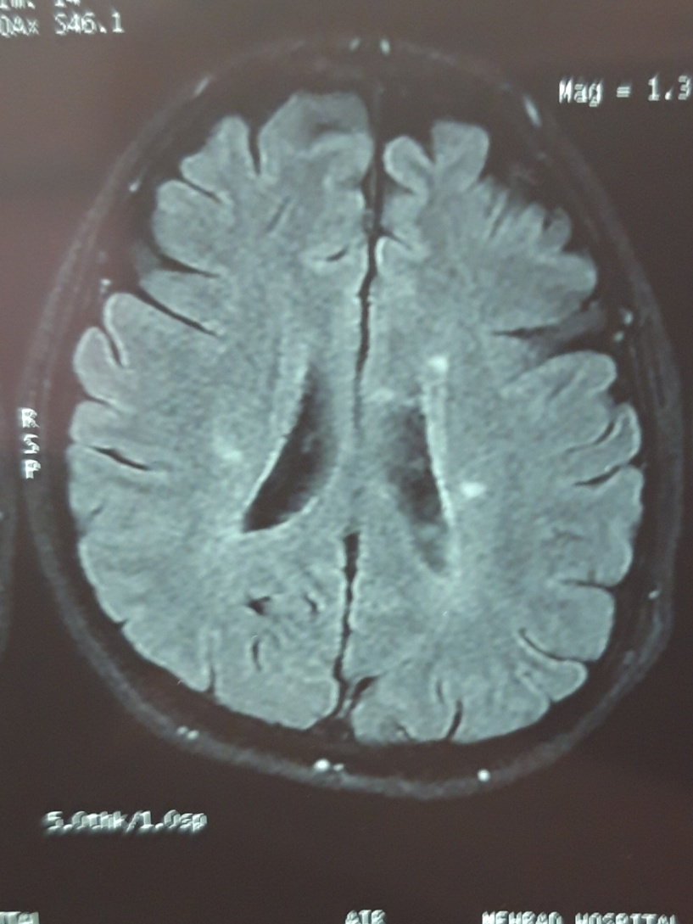

Slide 6
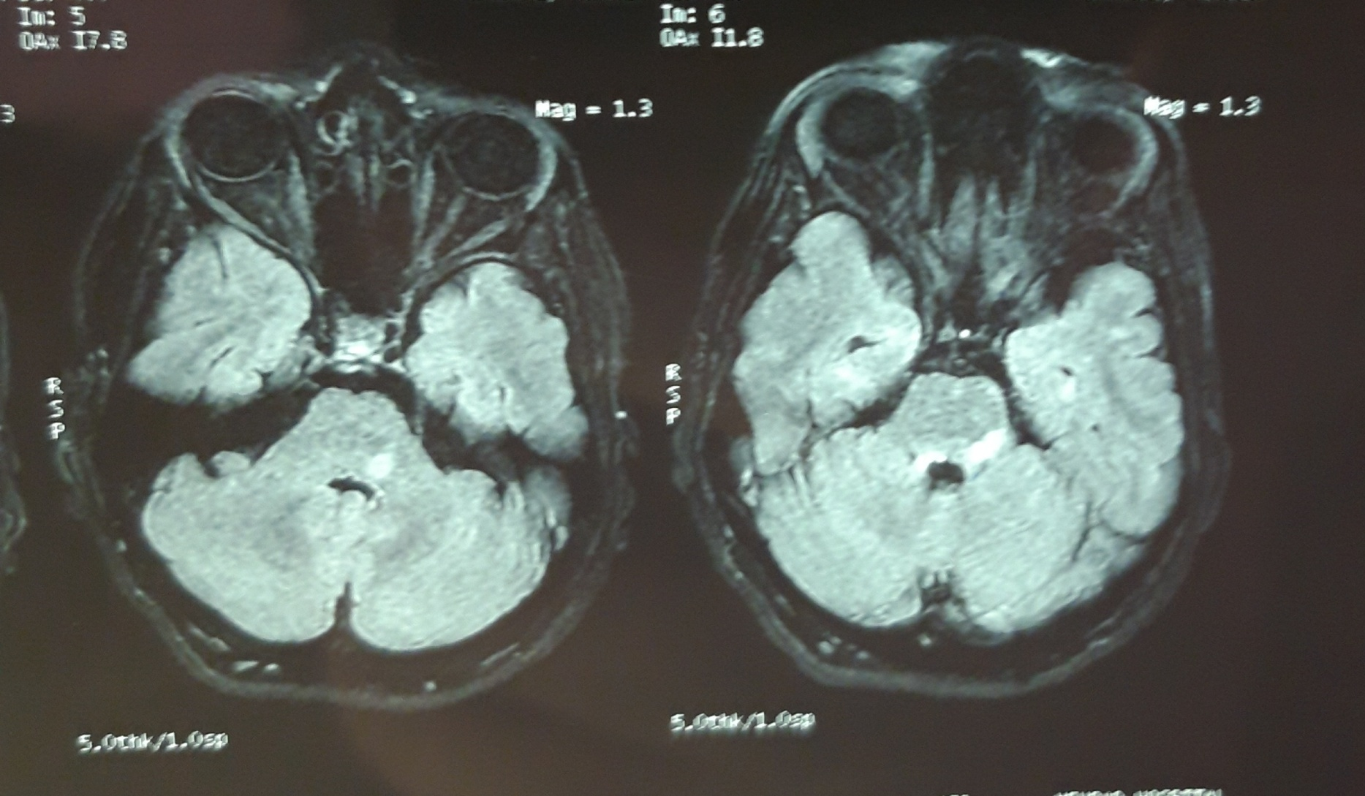

Slide 7
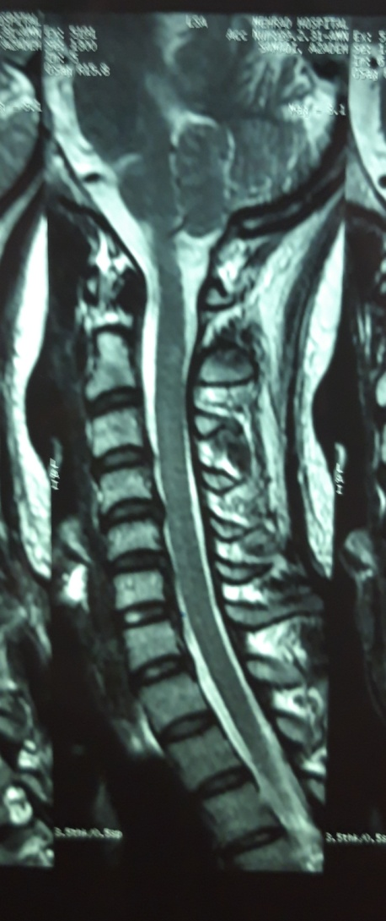

Slide 8
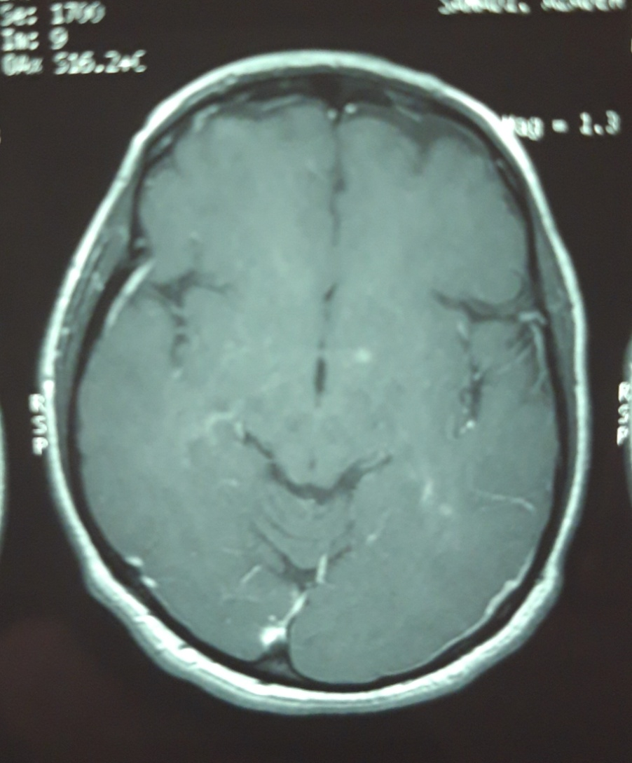

Slide 9

Which tests do you want for better diagnosis?
NMO
MOG
PCR-COVID in CSF
OCB
Routine PCR-COVID

Slide 10

NMO and MOG (-)
PCR-COVID (-)
OCB (+)
CHEST CT: NL

Slide 11

What is your diagnosis?
NMOSD
Neurological complication of COVID
MS
Neurological complication of RA
Side effect of CinnoRA

Slide 12
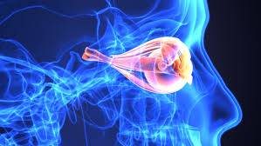
NMOSD
NMO (-)
Cervical MRI revealed short segment involvement
The most common autoimmune disease accompanied by NMOSD are SLE, Sjogren and MG

Slide 13
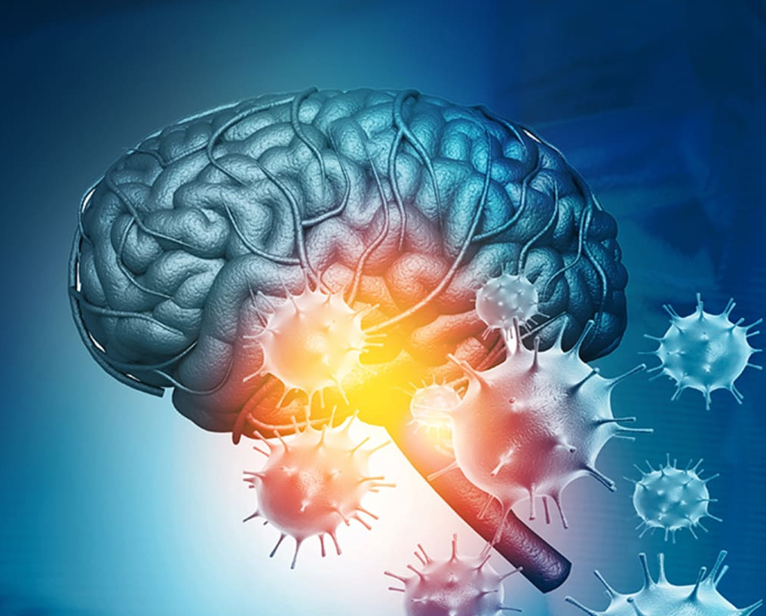
Neurological complication of COVID
Multifaceted mechanisms including:
Direct damage to specific receptors
Cytokine-related injury
Secondary hypoxia
Retrograde travel along nerve fibers

Slide 14

Much like its expression on lung epithelial cells, the expression of ACE2 on endothelial cells of the blood-brain barrier can allow viral binding at this important site, facilitating viral entry into the central nervous system by attacking the vasculature

Slide 15
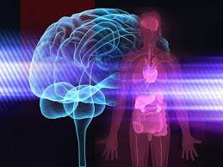
The binding of SARS-CoV-2 at the pulmonary epithelial cells also generates a global systemic inflammatory response (SIRS), producing increased levels of interleukin (IL)-6, IL-12, IL-15, and tumor necrosis factor alpha (TNF-α); activating glial cells; and producing a massive pro-inflammatory central nervous system state

Slide 16
These systemic effects combined with localized lung alveolar damage result in severe hypoxia, which can lead to cerebral vasodilation and may decompensate into cerebral edema and ischemia

Slide 17
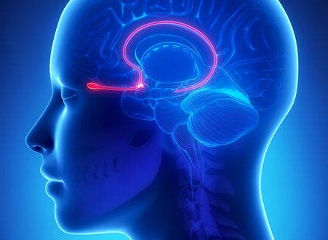
Finally, SARS-CoV-2 travels retrograde along the olfactory nerve and bulb, which provides an avenue between the nasal epithelium and the central nervous system and may also explain the common complaint of anosmia

Slide 18
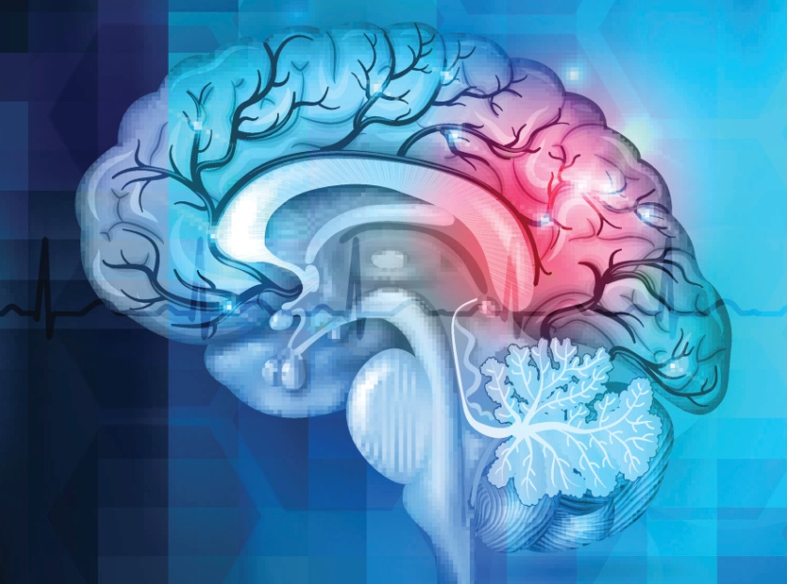
Acute cerebrovascular disease
One of the more common and serious neurologic complications seen in COVID-19 populations
COVID-19 has led to younger patients presenting with ischemic stroke, including large vessel occlusions

Slide 19
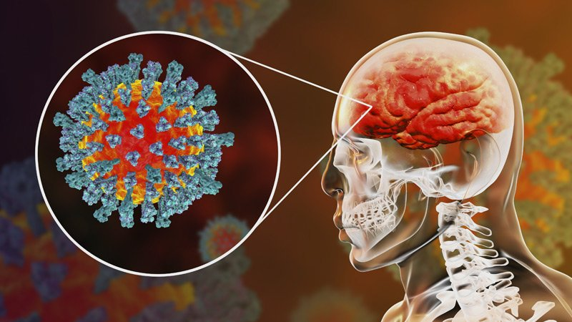
Encephalitis and encephalopathy
While rare, SARS-CoV-2 encephalitis has been reported in several cases, though this was based on clinical and imaging findings as there has been no CSF evidence of SARS-CoV-2 to date

Slide 20
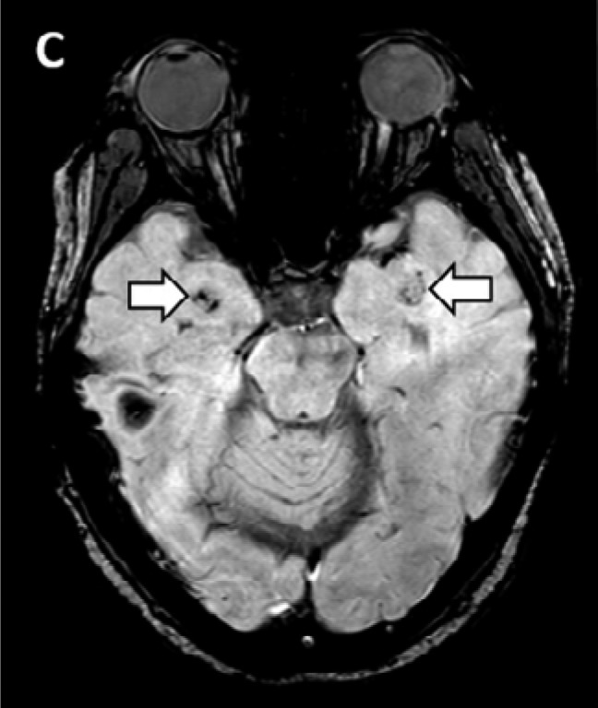
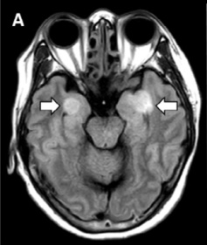
Acute necrotizing encephalopathy (ANE) : A rare neurologic complication caused by cytokine storm and damage to the blood-brain barrier
Demyelination is not present in ANE
Pathogenesis is poorly understood, but with the hyper-inflammatory state, treatment with IVIG and steroids can be attempted

Slide 21
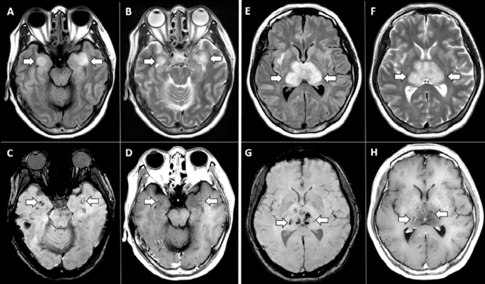

Slide 22
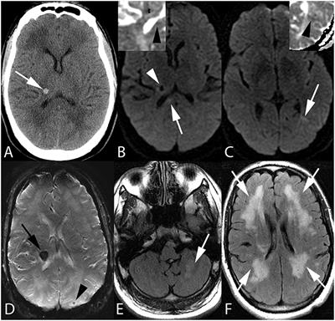

Slide 23
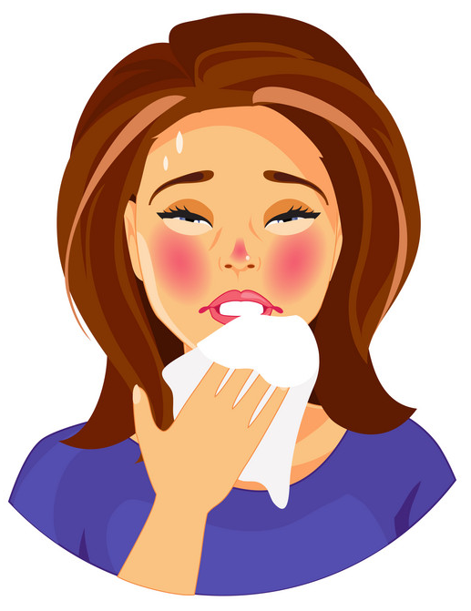
COVID-19-associated acute disseminated encephalomyelitis (ADEM)
51-year-old woman
Dyspnea, fever, and Vomiting
Tachycardia and Hypoxia
Chest X-ray :extensive patchy airspace opacification
Positive SARS-CoV-2 PCR from a nasopharyngeal swab

Slide 24
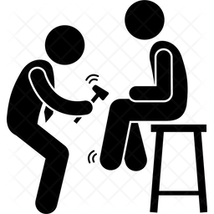
Pupils: equal and reactive
Corneal responses: intact
Oculocephalic response: impaired to the left
Muscle tone: flaccid , extremities did not move spontaneously or to noxious stimuli
DTR: depressed
Plantar responses: mute

Slide 25
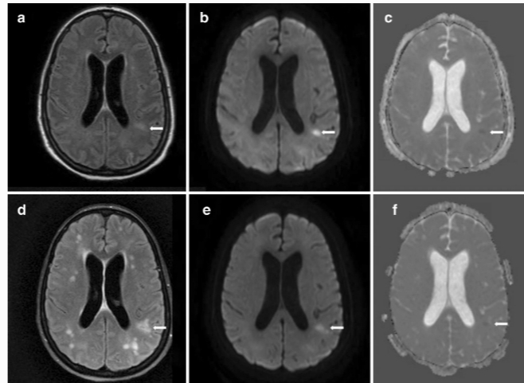

Slide 26
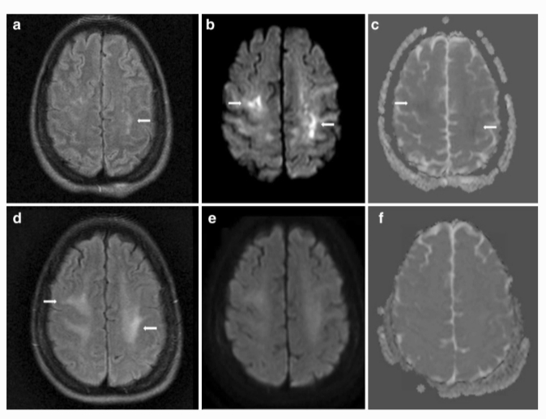

Slide 27
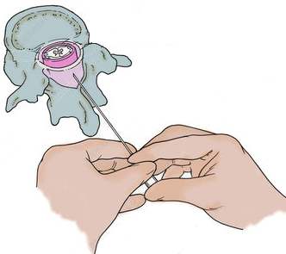
Lumbar puncture was atraumatic
CSF analysis:
  1 white blood cell
  2095 red blood cells with xanthochromia
  62 mg/dl protein
  56 mg/dl glucose
Bacterial culture, fungal culture, and a PCR panel (including HSV, VZV, EBV, and CMV) were negative
Four oligoclonal bands, present in both serum and CSF
SARS-CoV-2 was not detected by qualitative PCR

Slide 28
Methylprednisolone 1 g IV daily for 5 days
(for presumed ADEM)
Exams with sedation held, grossly unchanged
IVIG
0.4 g/kg daily for 5 days
starting on hospital day 31

Slide 29
Alertness improved gradually:
Day 36
Patient started to follow simple commands
Left hemiparesis became evident
Day 39
Patient was extubated
Day 59
Patient was fully oriented
Was able to begin speaking

Slide 30
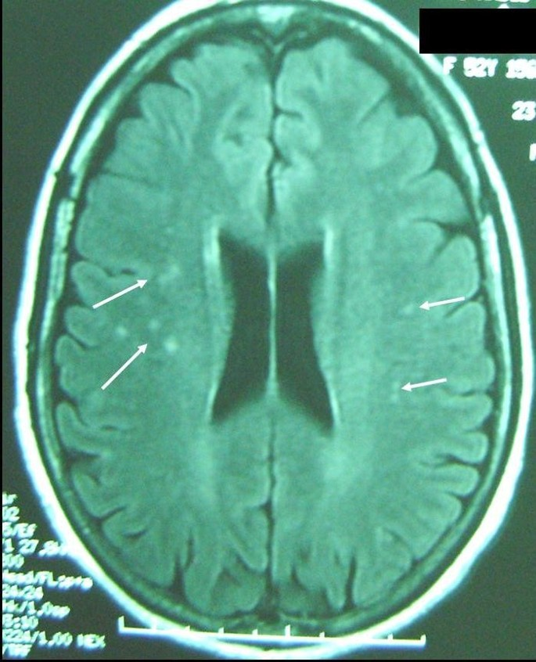
Neurological complication of RA

Slide 31
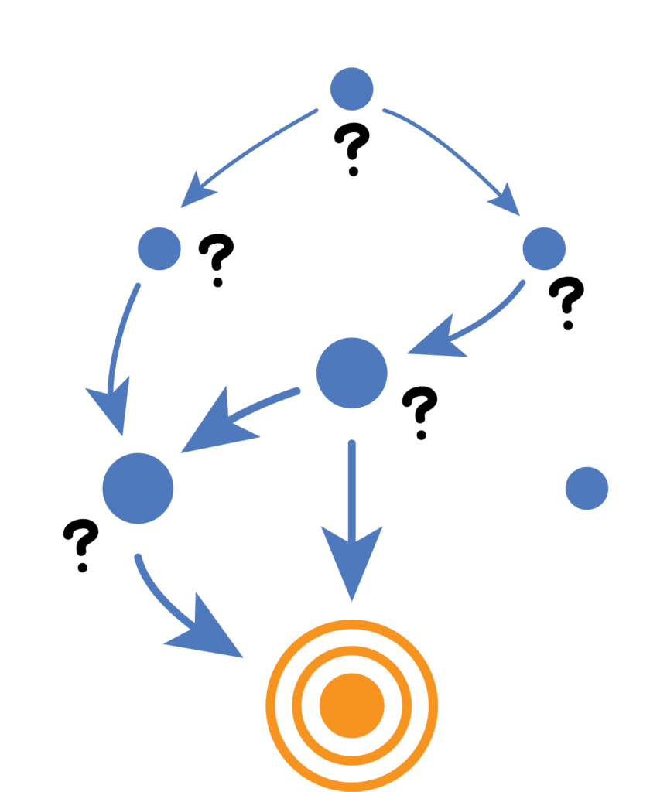
Side effect of CinnoRA
The previous study raised the question whether the demyelinating events in patients who had previously received TNF-α blockers were the result of uncovering latent MS, onset of a novel demyelinating event (MS or MS-like syndrome), or were merely an accidental coexistence of the 2 disorders.

Slide 32
Long-term follow-up of these patients is required to properly diagnose, determine the clinical course, and point out the potential differences from typical MS.
Complete symptom remission after therapy withdrawal or a positive rechallenge phenomenon could prove causality, although the nature of MS, with relapses and remissions of symptoms, argues against such a relationship.

Slide 33
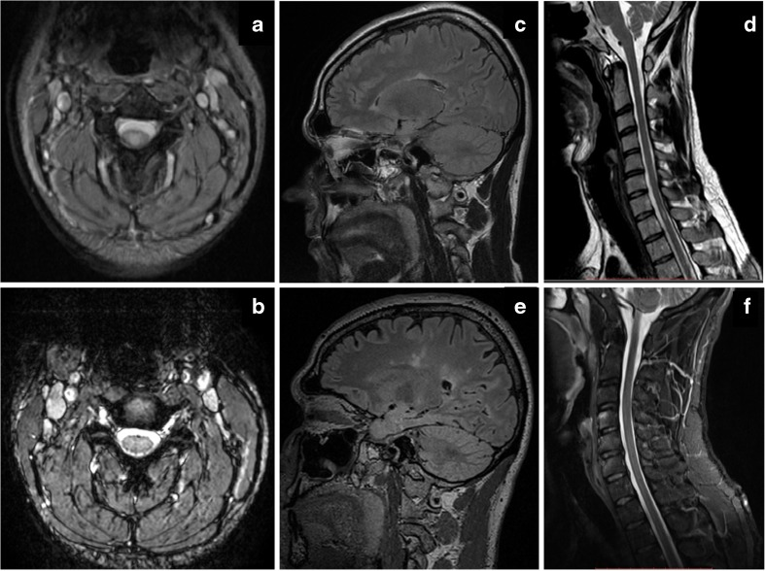

Slide 34

What is your treatment?
CinnoRA + Glatiramer
Rituximab
Glatiramer + Azathioprin
Prednisolone

