Slide 1

New Paradigms of Extended
Thromboprophylaxis in Medically Ill Patients
Farzad Masoudkabir, MD, MPH
Assistant Professor of Cardiology
Tehran Heart Center
Tehran University of Medical Sciences

Slide 2

Burden of VTE in Acute Medically Ill Patients
Among acute medically ill patients:
Approximately 2.5% of high risk medical patients will have symptomatic VTE or VTE-related death
More than 150,000 of the 20,000,000 acute medically ill patients each year survive their medical condition but die of VTE
VTE Prophylaxis During Hospitalization
Chest. 2011; 10: 1378; 10: 194
N Engl J Med. 2011; 365: 2167
J Thrombolysis. 2011; 4: 407.

Slide 3






VTE Prophylaxis GUIDELINES era: 1986-present

Slide 4
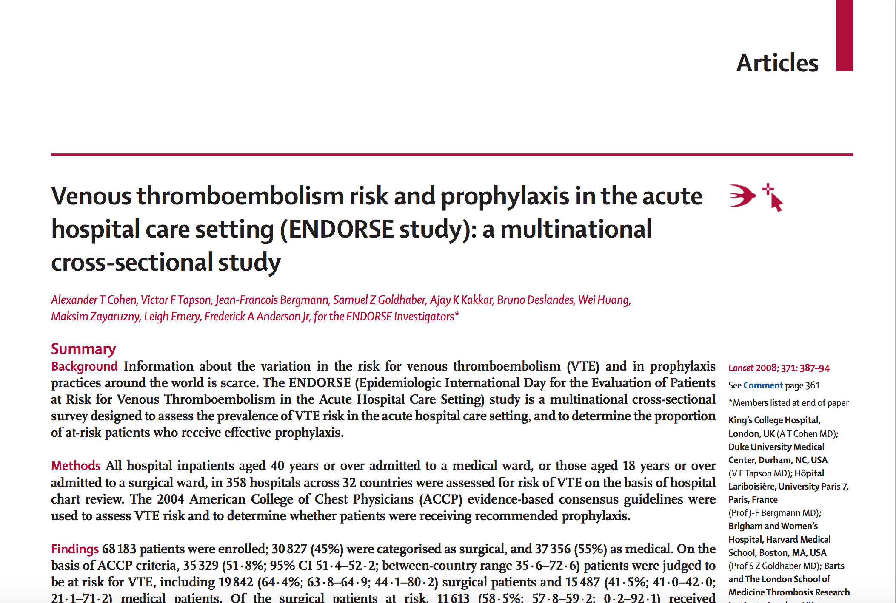
ENDORSE endorsed the underuse & misuse!
>68000 patients from 358 hospitals across 32 countries
Lancet 2008; 371: 387-394

Slide 5
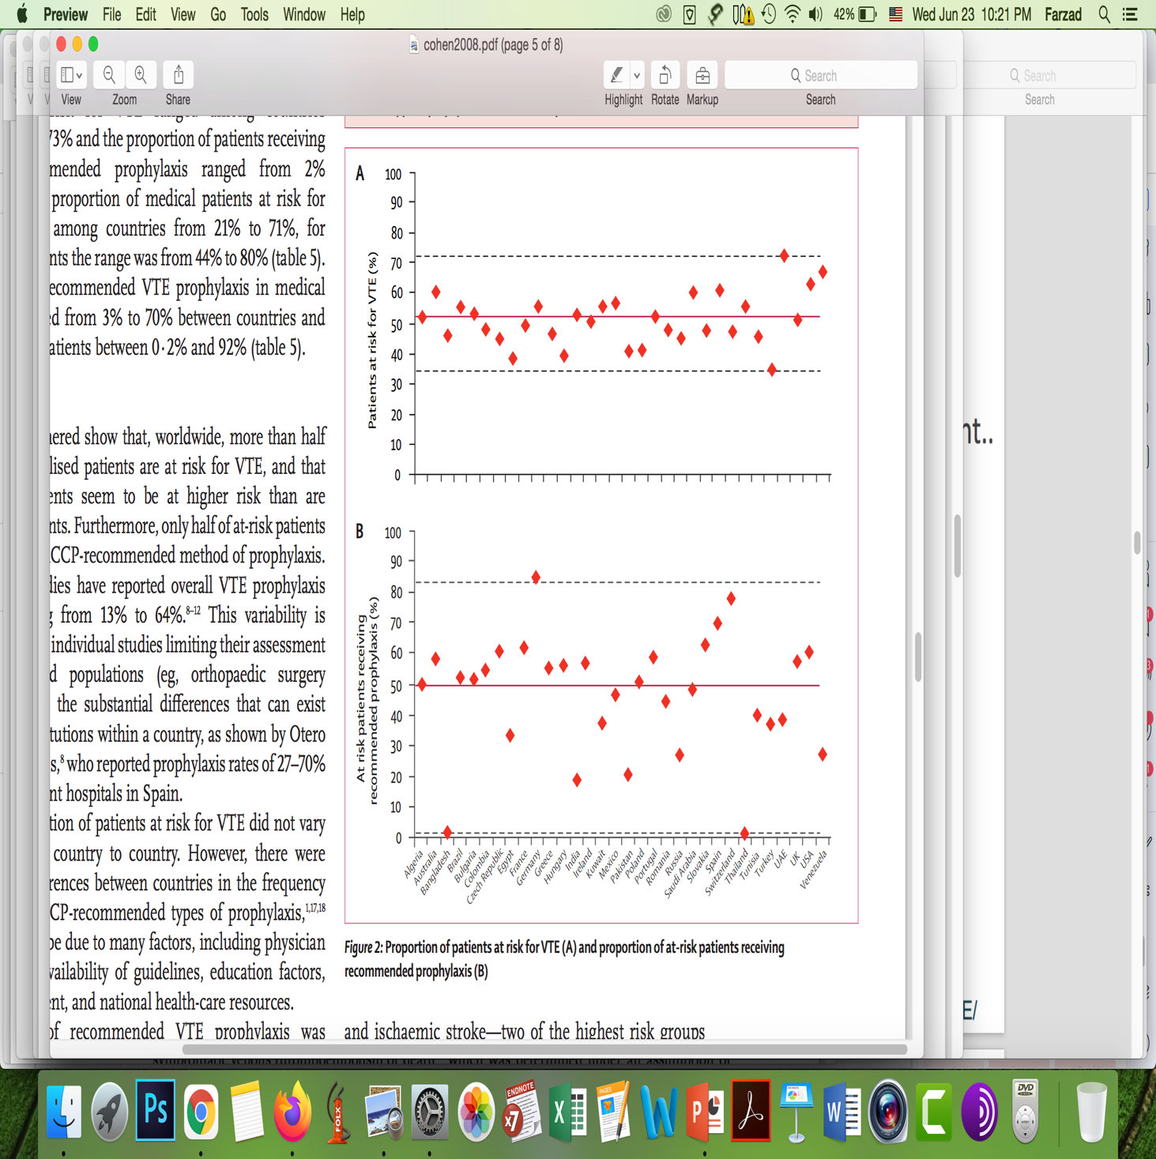
ENDORSE endorsed the underuse & misuse!
Spurred accreditation metrics, hospital protocol changes, and new research
to improve VTE prophylaxis in HOSPITALIZED patients
Lancet 2008; 371: 387-394

Slide 6
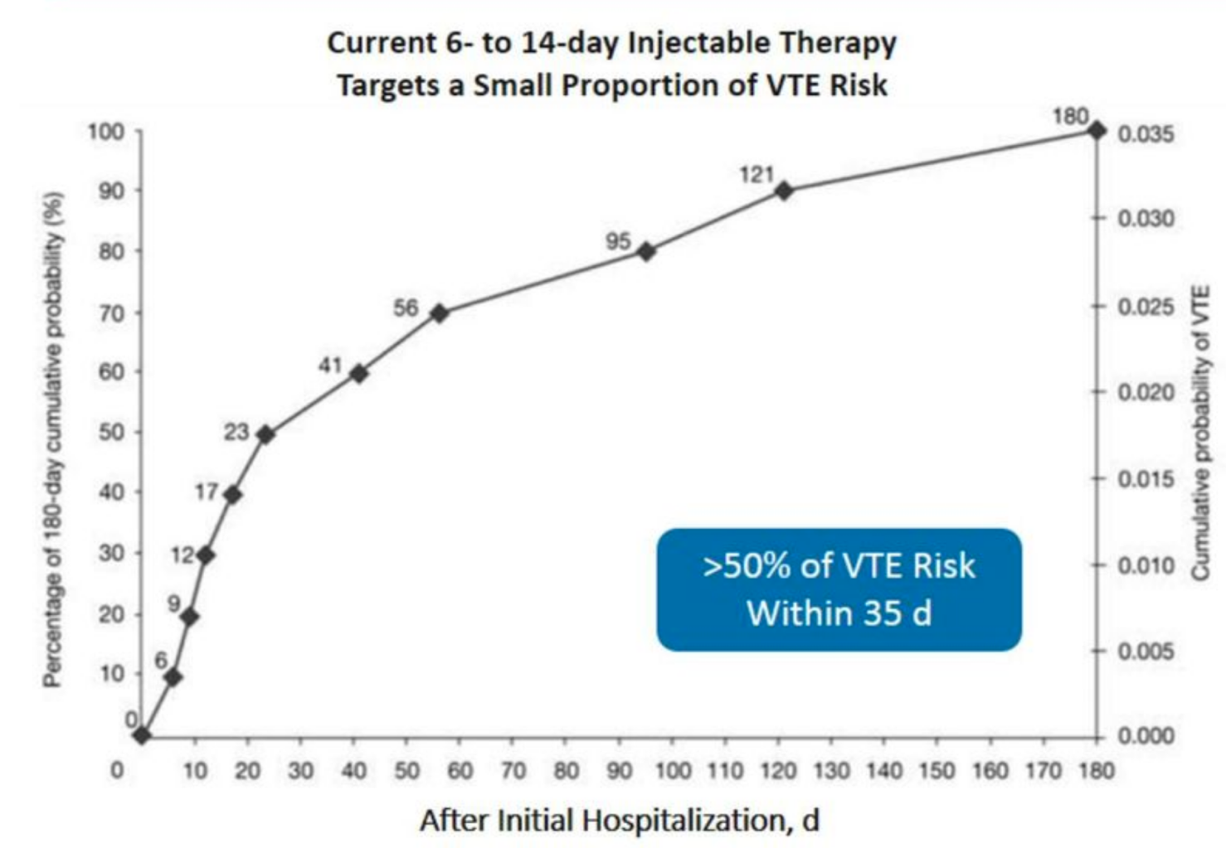
VTE Risk Persists Post-Discharge in Acute Medically III Patients
Current 6- to 14-day injectable therapy targets a small proportion of VTE risk
CUMULATIVE 180 DAY PROBABILITY (%)
Mean Hospital Stay
5.3 DAYS
DAYS AFTER ADMISSION
J Hosp Med, 2012; 7: 231-238

Slide 7
VTE Burden Extends Beyond Hospitalization
  Majority of VTEs occur after discharge and standard prophylaxis!
  More than 60% of all VTEs occur during post-hospital discharge period and that the majority of VTE events (approximately 80%) occur within 6 weeks after discharge
Chest. 2011; 10: 1378; 10: 194
N Engl J Med. 2011; 365: 2167
J Thrombolysis. 2011; 4: 407.

Slide 8
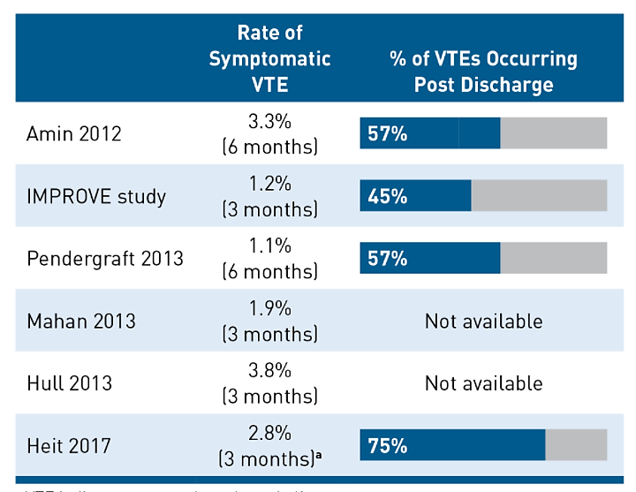
Majority of Symptomatic VTEs occur after discharge
However, Less than 10% of patients receive VTE prophylaxis at discharge!
Am J Manag Care. 2018;24:-S0

Slide 9
Extended VTE Prophylaxis
Which drug? How long?!

Slide 10
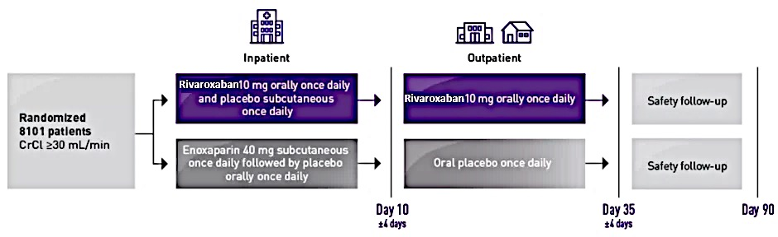
EXCLAIM Trial: Enoxaparin vs. Placebo
5963 patients with acute medical illness
Age >40y
Reduced mobility for ≥3 days before and after randomization
All patients received Enoxaparin 40mg s.c Daily
Enoxaparin 40mg s.c Daily
Placebo
Day 10 ± 4 days
Day 38
± 4 days
37% reduction (-1.5%) of asymptomatic/symptomatic proximal DVT or symptomatic /fatal PTE
Significant increase in major bleeding (0.8% vs 0.3%)
Ann Intern Med. 2010;153:8-18.

Slide 11
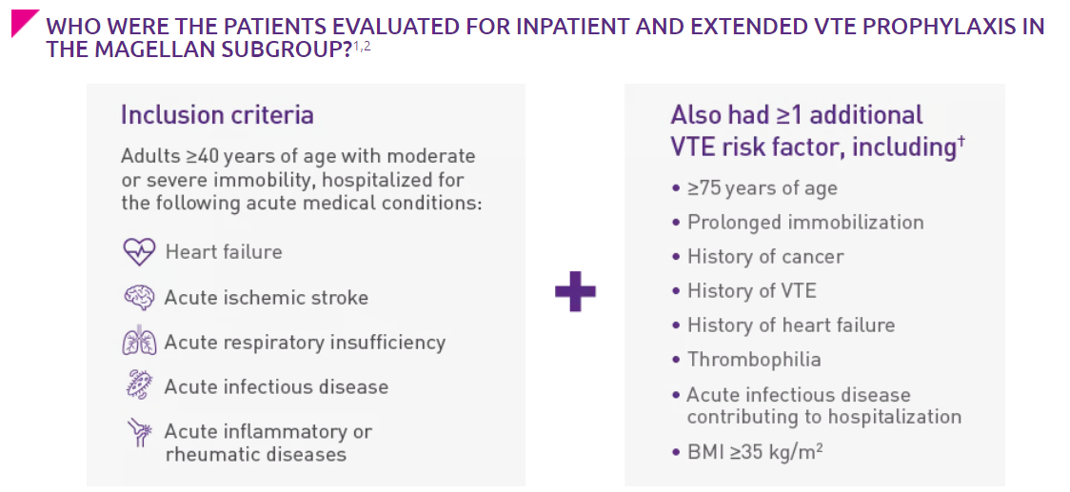
MAGELLAN Trial: Rivaroxaban vs Enoxaparin
8101 patients
Moderate or severe immobility
Hospitalization at least for 4 days
Admitted for following indications
Have at least 1 additional VTE risk factor
Rivaroxaban 10mg Daily
Rivaroxaban 10mg Daily
Safety Follow up
Enoxaparin 40mg s.c Daily
Placebo
Safety Follow up
Day 10 ± 4 days
Day 35
± 4 days
Day 90
23% reduction (4.4% vs 5.7%) of asymptomatic/symptomatic proximal DVT or symptomatic/fatal PTE at 35 days
2.9-fold increase in major bleeding
N Engl J Med 2013; 368:513-523

Slide 12
EXCLAIM
Enoxaparin
MAGELLAN
Rivaroxaban
VTE Events
RRR = 22.8%
RRR = 38.0%
p = 0.02
p <0.042
The significant benefit from VTE reduction is largely offset by significant increase in major bleeding!
Net clinical benefit is negligible!
EXCLAIM demonstrated a net clinical benefit just in level 1 immobility, women, age > 75
Incidence
Major Bleeding
p=0.04
p<0.001
Enoxaparin Pacebo Rivaroxaban Enoxaparin
Hull RD, et al. Ann Intern Med. 2010;153(1):8-18
Cohen AT, et al. N Engl J Med. 2013;368(6):513-23

Slide 13
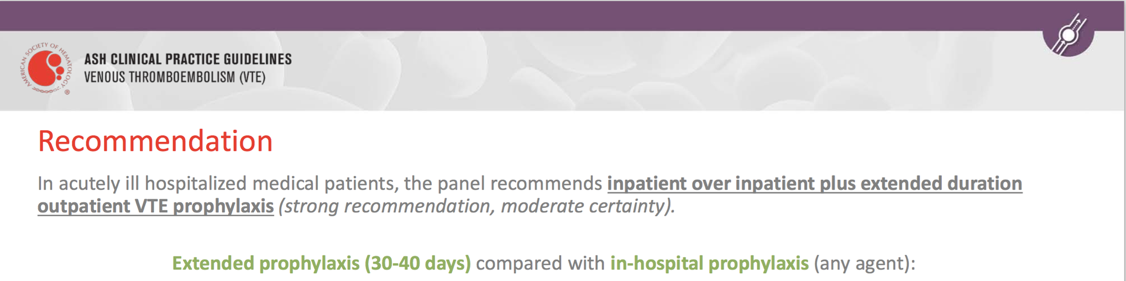
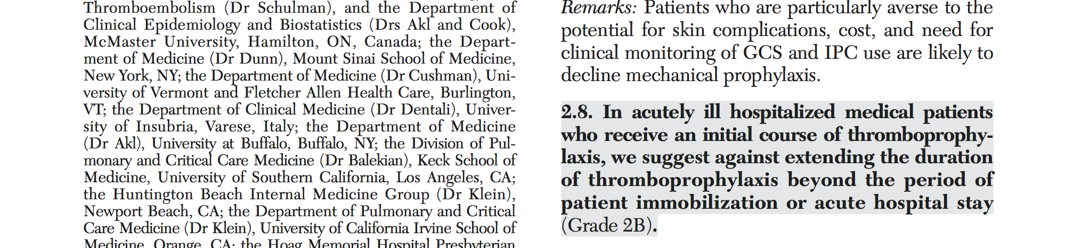
ASH 2018 Guideline
ACCP 2012 Guideline

Slide 14
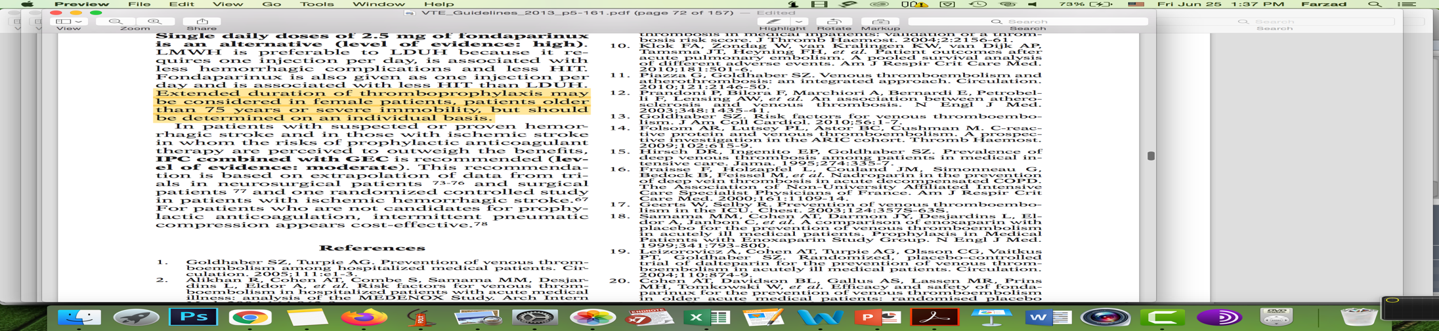
International Union of Angiology 2013 Guideline

Slide 15
Increased risk for VTE
&
Low risk for bleeding

Slide 16
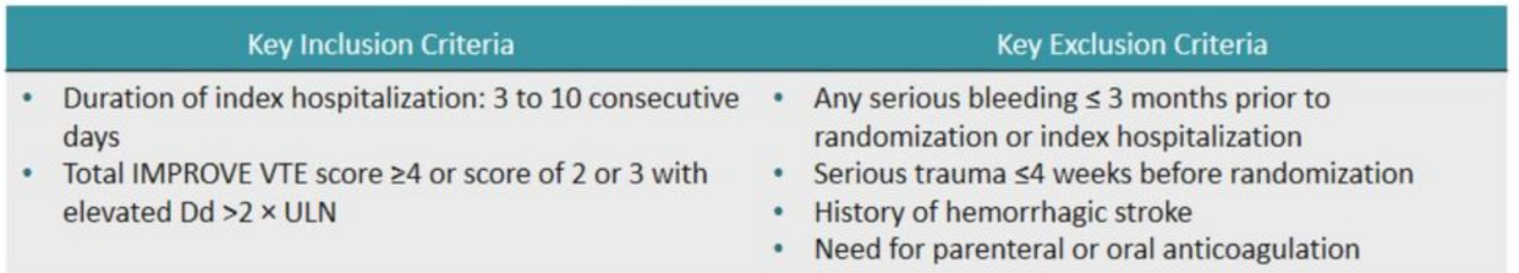
MARINER Trial: Rivaroxaban vs Placebo
12,019 patients
Age >40y
Reduced mobility
Hospitalization for 3-10d
Admitted for HF, Acute stroke, respiratory insufficiency, infectious or rheumatologic disease
All patients received Enoxaparin or UFH during hospitalization
Rivaroxaban 10 mg Daily (CrCl ≥50) or Rivaroxaban 7.5mg Daily (CrCl =30-49 ml/min)
Placebo
Day 0
Day 45
± 4 days
N Engl J Med 2018; 379:1118-1127

Slide 17
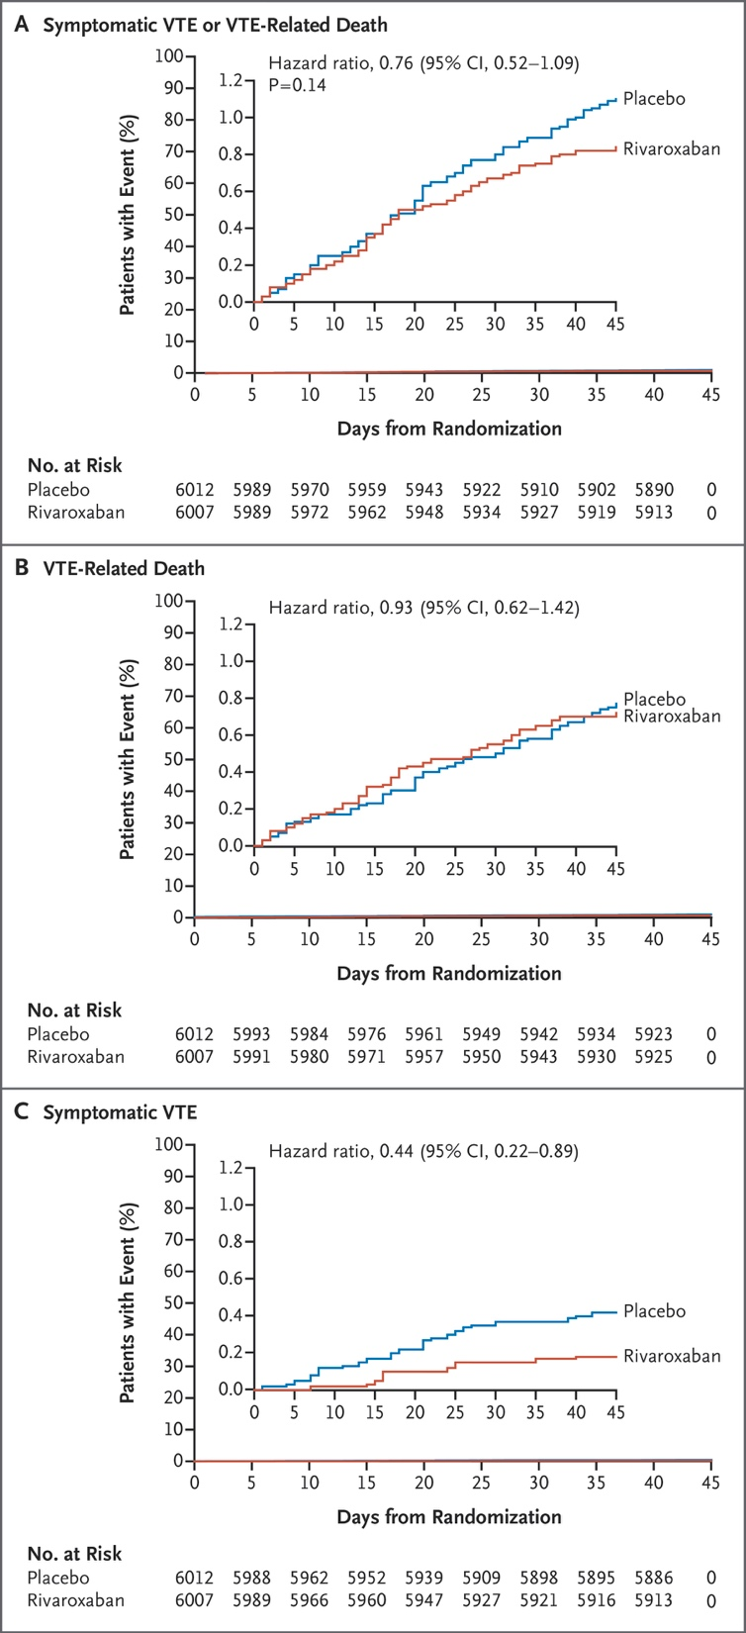
MARINER Study
Notes:
the implementation of extended thromboprophylaxis with appropriate selection of medically ill patients may reduce the health burden of nonfatal venous thromboembolism in this population.

Slide 18
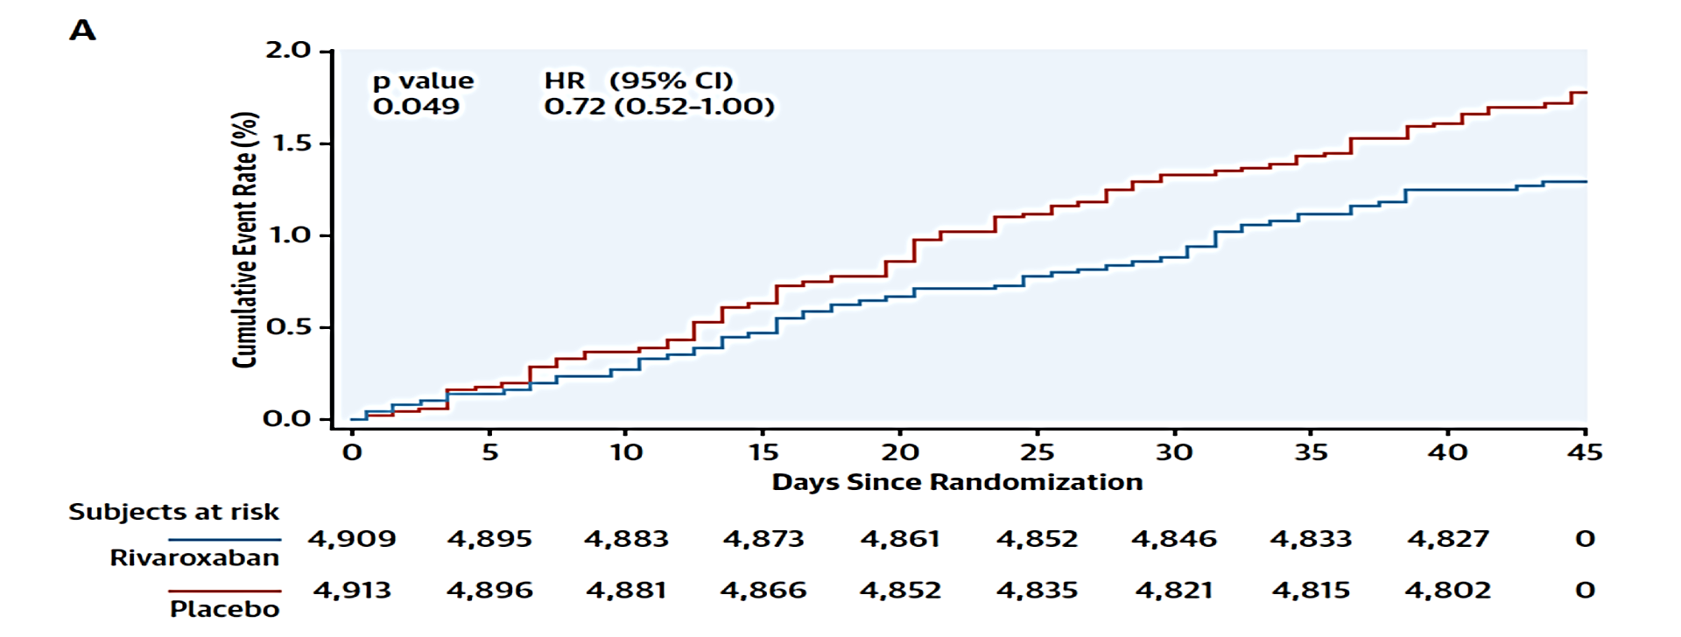
MARINER Study
Composite endpoint: VTE, MI, nonhemorrhagic stroke, and cardiovascular death
J Am Coll Cardiol. 2020;75(25):3140–3147.
Notes:
Time to first occurrence of composite: venous thromboembolism, myocardial infarction, nonhemorrhagic stroke, and cardiovascular death up to day 45 (rivaroxaban 10 mg daily vs. placebo; intention to treat). Includes all data from randomization to day 45 (inclusive). Patients who do not have events are censored on the minimum of last visit before or on death or day 45.

Slide 19
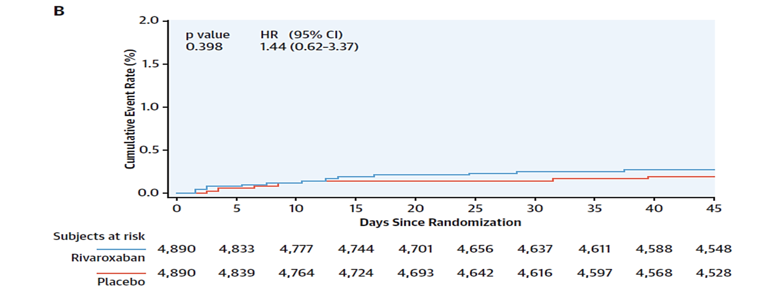
MARINER Study
Low incidence of major bleeding (0.28% vs 0.15%)
J Am Coll Cardiol. 2020;75(25):3140–3147.
Notes:
Time to first occurrence of major bleeding on-treatment (rivaroxaban 10 mg daily vs. placebo; safety population). On-treatment includes all data from randomization to 2 days after the last dose of the study drug (inclusive). Subjects who do not have events are censored on the minimum of last visit before or on death, or last dose +2 days.

Slide 20
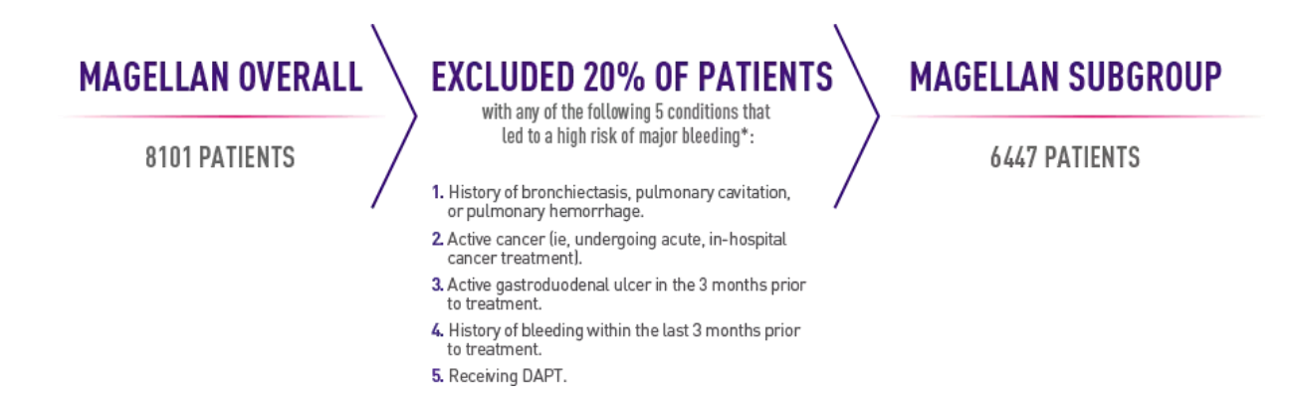
Improved Benefit Risk Profile of Rivaroxaban in a Subpopulation of the MAGELLAN Study
Major and fatal bleeding rates in the subpopulation compared to the original population in the MAGELLAN trial were significantly reduced, while anticoagulant efficacy was maintained.
Clin Appl Thromb Hemost 2019;25:1076029619886022

Slide 21
Pooled analysis of MAGELLAN & MARINER for extended use of Rivaroxaban as VTE prophylaxis
22% reduced risk of major VTE or death
Circulation. 2019;140:A12863

Slide 22
These data suggest that in properly selected patients at risk for VTE and at low risk for bleeding, that extended-duration rivaroxaban at 10 mg has a favorable benefit risk profile.
J Am Coll Cardiol. 2020;75(25):3140–3147.

Slide 23

Based on the results from the MAGELLAN and MARINER studies, the Food and Drug Administration (FDA) gave Rivaroxaban a new indication for VTE prophylaxis in 2019.
The approval was granted for prevention of VTE and VTE-related death in acute medically ill patients who were hospitalized and at risk for VTE complications but not at high risk of bleeding. Rivaroxaban can now be initiated in these patients during hospitalization and after discharge for a total recommended duration of 31-39 days.

Slide 24
Should We Await a Change in Practice Guidelines?!
Evidence suggests that approximately 25% (and up to 40%) of the 7.2 million medically ill patients in the US would benefit from extended thromboprophylaxis.
Data based on the MAGELLAN subgroup suggests that in the EU and USA health systems, a strategy of extended thromboprophylaxis with rivaroxaban has the potential to prevent symptomatic VTE and VTE-related death in approximately 24,000 patients annually at the cost of approximately 6000 to 12,000 increase in MB or fatal bleeding events.
There is an urgent need to update antithrombotic guidelines based on the best available evidence
Clin. Appl. Thromb. Hemost. 2019, 25.

Slide 25
Increased risk for VTE
&
Low risk for bleeding

Slide 26
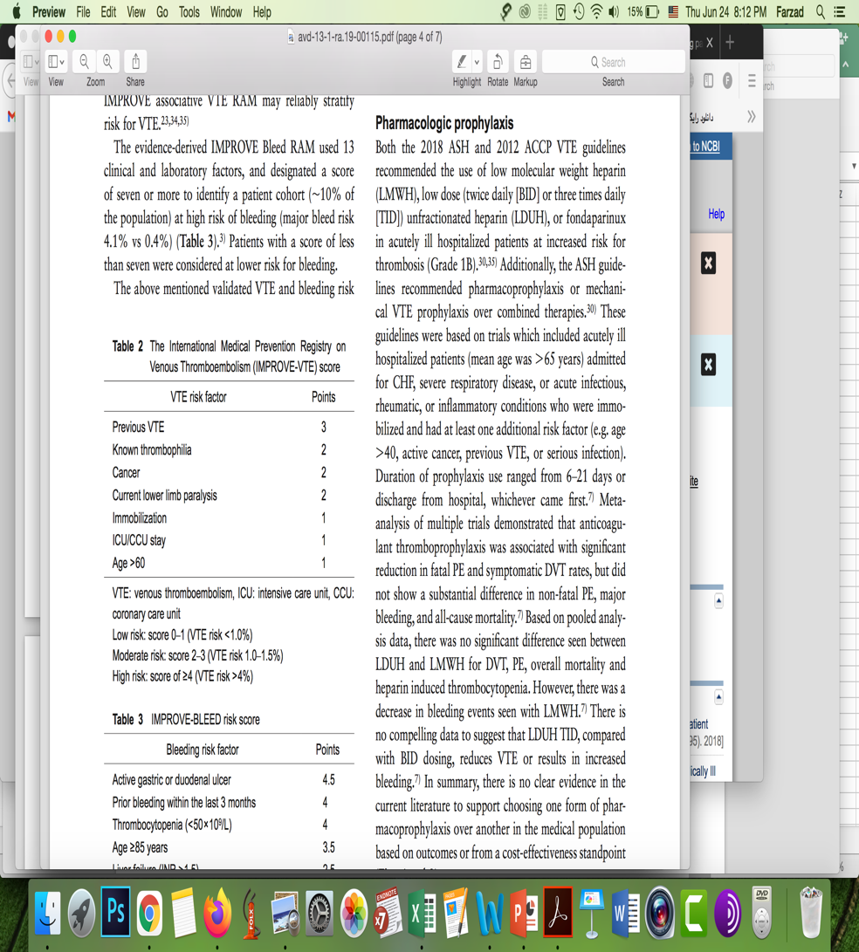
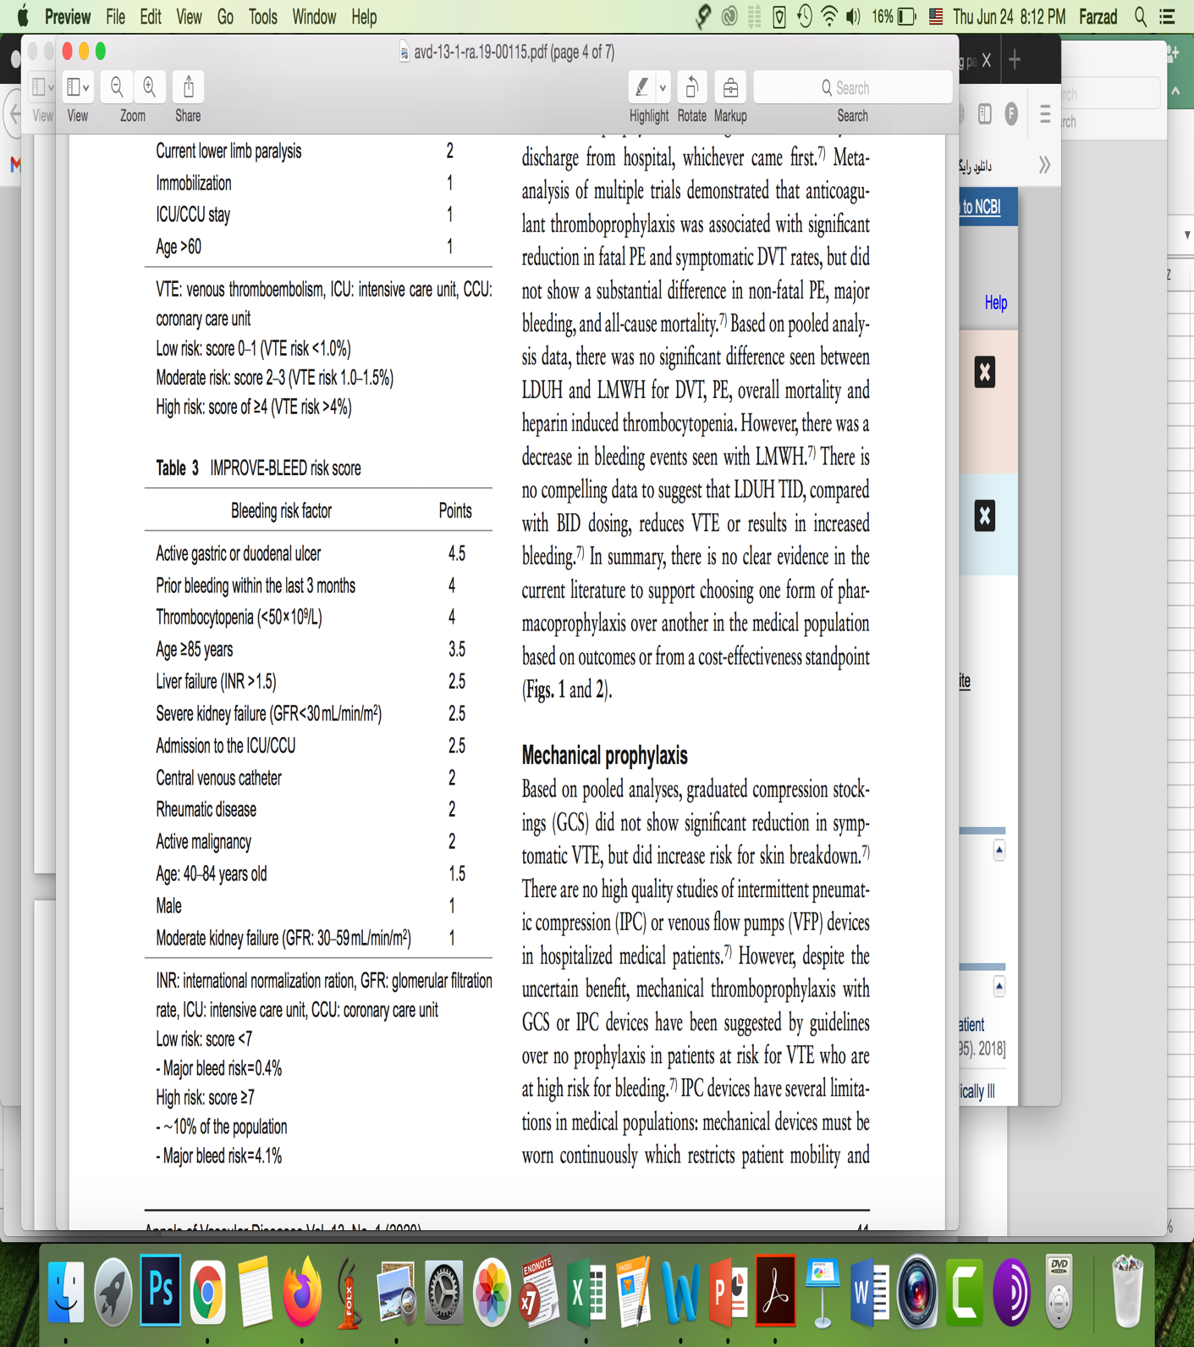
IMPROVE-VTE and IMPROVE-BLEED Risk Scoring System
Notes:
15,156 patients were enrolled from 52 hospitals in 12 countries

Slide 27
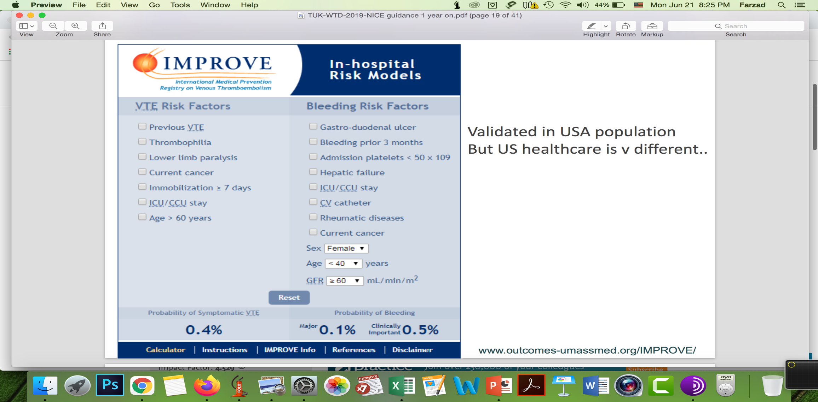
https://www.outcomes-umassmed.org/IMPROVE/

Slide 28
VTE Risk Assessment and Prophylaxis Strategies
for Hospitalized Medically Ill Patients Prior to Discharge
Does hospitalized medically ill patient has any of the following bleeding risk factors?
- Active gastroduodenal ulcer
- Hx of bleeding within 3 months
- Dual antiplatelet treatment
- Bronchiectasis/Pulmonary cavitation
- Active cancer
- IMPROVE–BLEED score ≥ 7
No
Yes
High VTE risk?
IMPROVE –VTE score ≥ 4
IMPROVE –VTE score = 2-3 & D-dimer > 2* ULN
High VTE risk?
IMPROVE –VTE score ≥ 4
IMPROVE –VTE score = 2-3 & D-dimer > 2* ULN
No
Yes
No
Yes
No post-discharge prophylaxis required
Rivaroxaban 10mg Daily for a total of 31-39 days
No post-discharge prophylaxis required
Mechanical prophylaxis
J Clin Med. 2020 ; 9(4): 1002.
Ann Vasc Dis. 2020 Mar 25; 13(1): 38–44.

Slide 29


Slide 30
Venous thromboembolism and COVID-19
IR-0222-ELQ-6389-SP

Slide 31
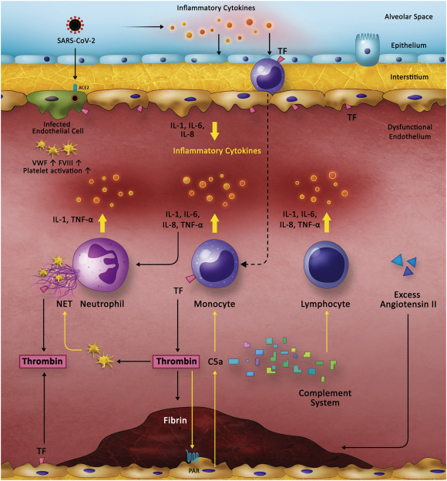
Pathophysiology of Thromboembolism in COVID-19
Critical illness is known to cause hypercoagulable state due to immobilization, CV line, and mechanical ventilation, but . . .
A pathophysiology unique to COVID-19
Bi-directional relationship between inflammation and thrombosis is well established
COVID-19 causes a profoundly pro- inflammatory state
IL-6 and fibrinogen levels are shown to correlate with each other in COVID-19 patients, providing credence to the idea of inflammatory thrombosis
IR-0222-ELQ-6389-SP
Thrombosis Research 194 (2020) 101–115

Slide 32
Association Between COVID-19 and Thromboembolism
VTE is emerging as one of the most severe sequels of the COVID-19.
COVID-19 Patients
Hospitalized patients VTE
21 %
ICU VTE
31%
Outpatients VTE
1%
Ward VTE
5%
EClinicalMedicine 2020;29:100639
Circulation 2020 14;142(2):114-128.
PLoS One. 2020; 15(7): e0235653.
IR-0222-ELQ-6389-SP

Slide 33
Association Between COVID-19 and Thromboembolism
VTE is associated with poorer outcomes in COVID-19
The pooled odds of mortality were 74% higher among patients who developed VTE compared to those who did not
Pooled Mortality Rate in COVID-19 Patients
23% with VTE
13% without VTE
EClinicalMedicine 2020;29:100639
Circulation 2020 14;142(2):114-128.
PLoS One. 2020; 15(7): e0235653.
IR-0222-ELQ-6389-SP

Slide 34
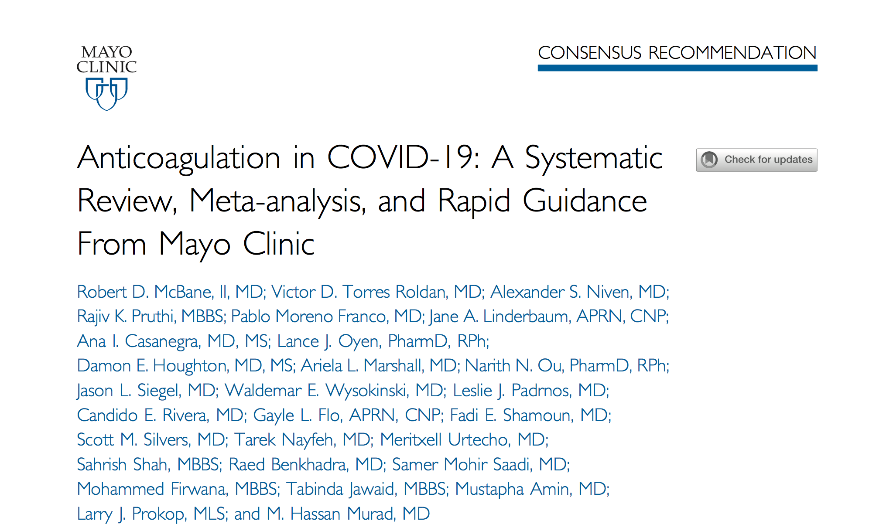
Mayo Clin Proc. November 2020;95(11):2467-2486
IR-0222-ELQ-6389-SP

Slide 35
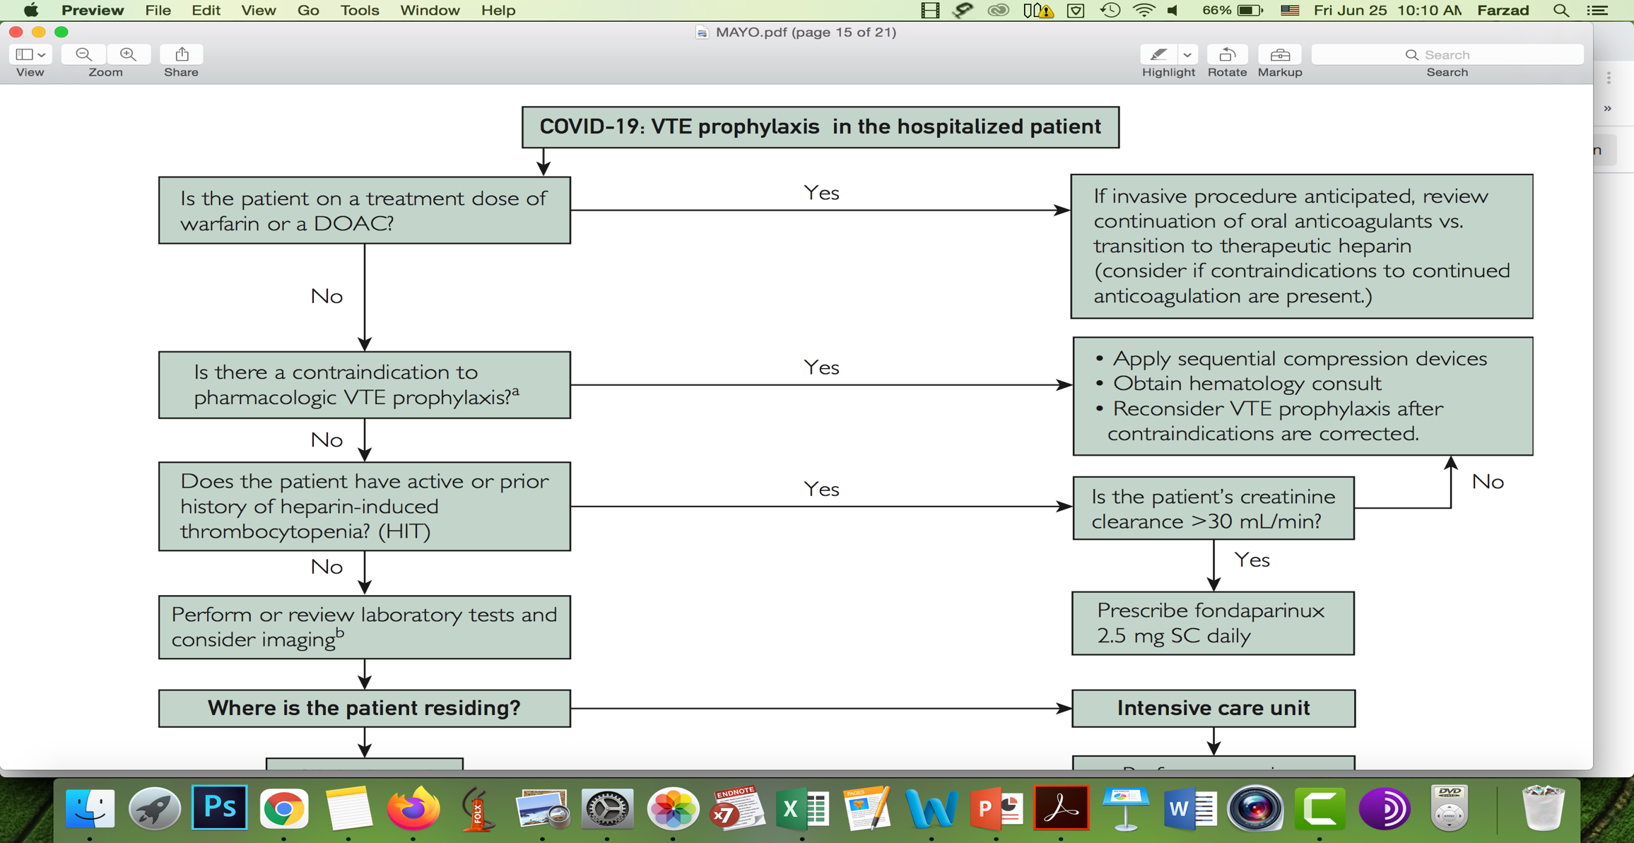
Active bleeding
Platelet <30000
Congenital bleeding disorder including vWD or hemophilia
CBC, PT, aPTT, fibrinogen, D-dimer
Lower extremity Doppler US
Mayo Clin Proc. November 2020;95(11):2467-2486
IR-0222-ELQ-6389-SP

Slide 36
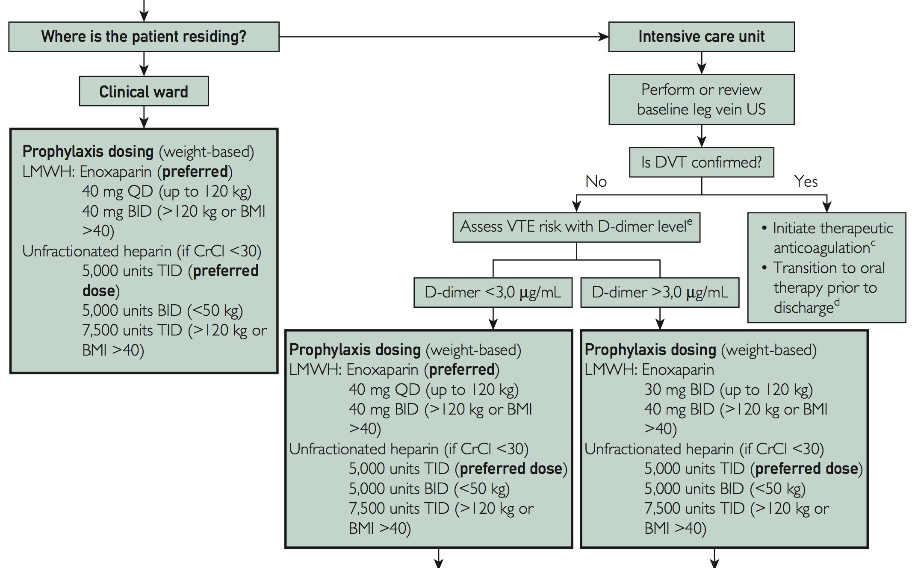
UFH infusion is preferred
Continue for at least 3 months
A DOAC is preferred unless the patient has another indication for the use of a VKA or LMWH.
Mayo Clin Proc. November 2020;95(11):2467-2486
IR-0222-ELQ-6389-SP

Slide 37
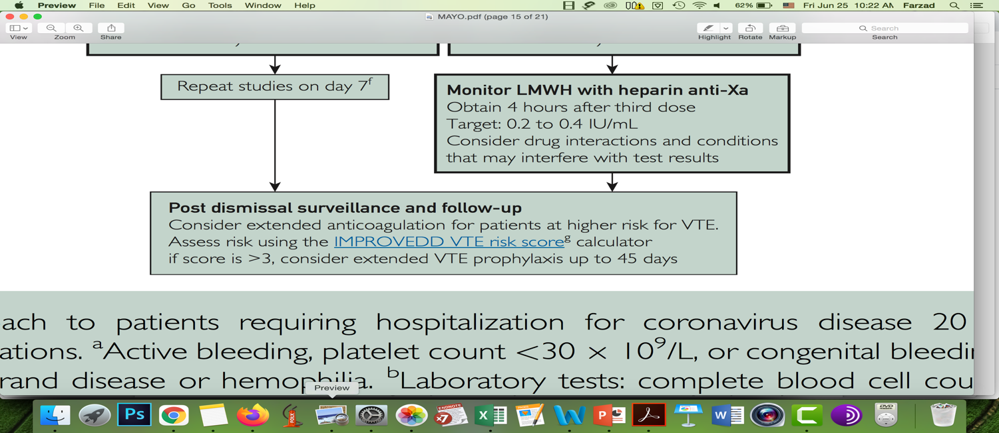

Daily clinical assessment for VTE
A low threshold for imaging any new clinical findings
Weekly US surveillance for leg DVT while in the ICU
Mayo Clin Proc. November 2020;95(11):2467-2486
IR-0222-ELQ-6389-SP

Slide 38
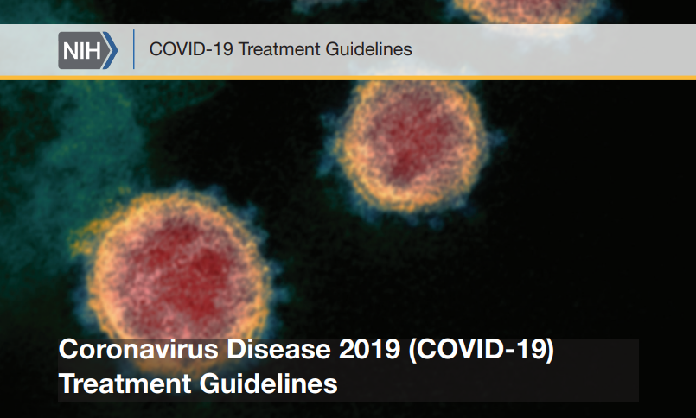
IR-0222-ELQ-6389-SP

Slide 39

Patients who are receiving anticoagulant or antiplatelet therapies for underlying conditions should continue these medications if they receive a diagnosis of COVID-19.
For non-hospitalized patients with COVID-19, anticoagulants and antiplatelet therapy should not be initiated for the prevention of VTE or arterial thrombosis unless the patient has other indications for the therapy or is participating in a clinical trial. COVID-19 outpatients receiving warfarin who are in isolation and thus unable to get international normalized ratio monitoring may be candidates for switching to direct oral anticoagulant therapy. Patients with mechanical heart valves, ventricular assist devices, valvular atrial fibrillation, or antiphospholipid antibody syndrome or patients who are lactating should continue treatment with warfarin.
COVID-19 Treatment Guidelines Panel. Coronavirus Disease 2019 (COVID-19) Treatment Guidelines. National Institutes of Health. Available at https://www.covid19treatmentguidelines.nih.gov/. Accessed [2020-12-24].
IR-0222-ELQ-6389-SP

Slide 40
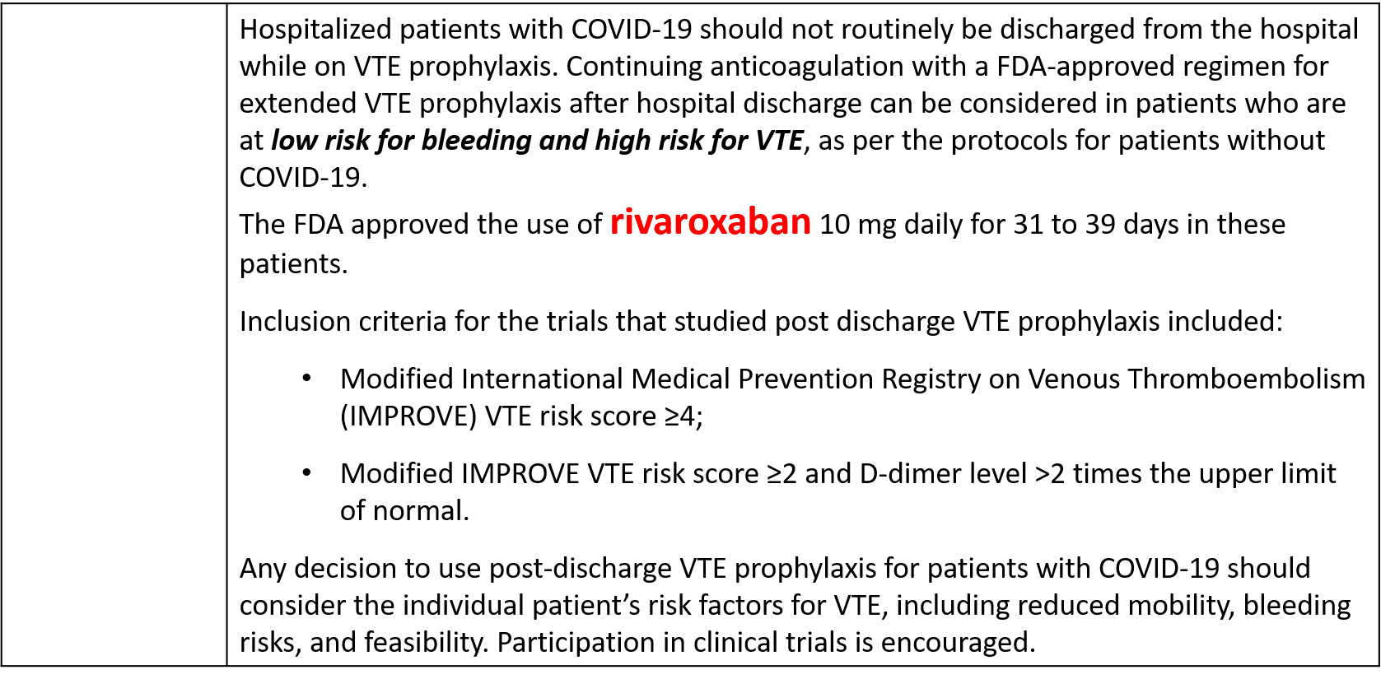

COVID-19 Treatment Guidelines Panel. Coronavirus Disease 2019 (COVID-19) Treatment Guidelines. National Institutes of Health. Available at https://www.covid19treatmentguidelines.nih.gov/. Accessed [2020-12-24].
IR-0222-ELQ-6389-SP
Hospitalized patients with COVID-19 should not routinely be discharged from the hospital while on VTE prophylaxis. Continuing anticoagulation with a FDA-approved regimen for extended VTE prophylaxis after hospital discharge can be considered in patients who are at low risk for bleeding and high risk for VTE, as per the protocols for patients without COVID-19. The FDA approved the use of rivaroxaban 10 mg daily for 31 to 39 days in these patients. Inclusion criteria for the trials that studied post discharge VTE prophylaxis included: Modified International Medical Prevention Registry on Venous Thromboembolism (IMPROVE) VTE risk score ≥4; Modified IMPROVE VTE risk score ≥2 and D-dimer level >2 times the upper limit of normal. Any decision to use post-discharge VTE prophylaxis for patients with COVID-19 should consider the individual patient’s risk factors for VTE, including reduced mobility, bleeding risks, and feasibility. Participation in clinical trials is encouraged.

Slide 41
Thank You for Your Attention

