Slide 1
Hypertension Management in Adults With Diabetes
Amir Ziaee.MD
Professor of Endocrinoloy
IUMS

Slide 2
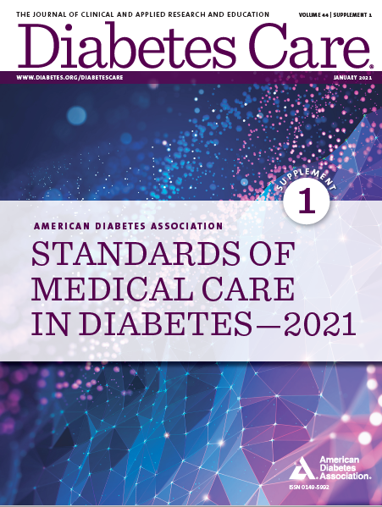
Standards of Medical Care in Diabetes—2021

Slide 3
Scope of The problem
Approximately73% have concomitant hypertension (HTN)
At the time of diagnosis of diabetes, HTN is present in 50% of diabetic patients
HTN among diabetic patients accelerates progression to renal and cardiovascular disease(CVD)
less than 30% of diabetic patients have their blood pressure (BP) controlled at less than 130/80 mm Hg
As many as 8 million diabetics have undiagnosed HTN

Slide 4
Hypertension and Diabetes Mellitus
Early aggressive BP management was shown to decrease CVD mortality in
diabetic patients when combined with optimization of the other components of
the metabolic syndrome and insulin resistance, such as dyslipidemia, obesity,
and hyperglycemia.

Slide 5
Screening and Diagnosis
Cardiovascular Disease and Risk Management
10.1 Blood pressure should be measured at every routine clinical visit. Patients found to have elevated blood pressure (≥140/90 mmHg) should have blood pressure confirmed using multiple readings, including measurements on a separate day, to diagnose hypertension. B
10.2 All hypertensive patients with diabetes should monitor their blood pressure at home. B

Slide 6
Treatment Goals
Cardiovascular Disease and Risk Management
10.3 For patients with diabetes and hypertension, blood pressure targets should be individualized through a shared decision-making process that addresses cardiovascular risk, potential adverse effects of antihypertensive medications, and patient preferences. C
10.4 For individuals with diabetes and hypertension at higher cardiovascular risk (existing atherosclerotic cardiovascular disease [ASCVD] or 10-year ASCVD risk ≥15%), a blood pressure target of, 130/80 mmHg may be appropriate, if it can be safely attained. C
10.5 For individuals with diabetes and hypertension at lower risk for cardiovascular disease (10-year atherosclerotic cardiovascular disease risk <15%), treat to a blood pressure target of <140/90 mmHg. A

Slide 7
Treatment Goals (continued)
Cardiovascular Disease and Risk Management
10.6 In pregnant patients with diabetes and preexisting hypertension, a blood pressure target of 110–135/85mmHgis suggested in the interest of reducing the risk for accelerated maternal hypertension A and minimizing impaired fetal growth. E

Slide 8
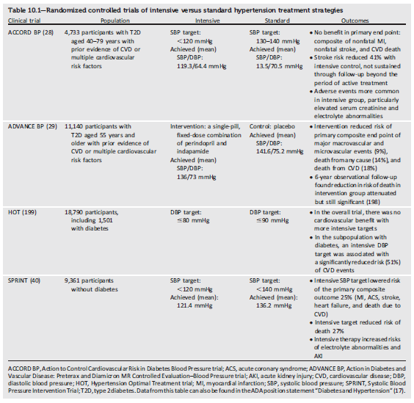
Cardiovascular Disease and Risk Management
Randomized controlled trials of intensive versus standard hypertension treatment strategies
Cardiovascular Disease and Risk Management:
Standards of Medical Care in Diabetes - 2021. Diabetes Care 2021;44(Suppl. 1):S111-S150

Slide 9
Treatment Strategies—Lifestyle Intervention
Cardiovascular Disease and Risk Management
10.7 For patients with blood pressure >20/80 mmHg, lifestyle intervention consists of weight loss when indicated, a Dietary Approaches to Stop Hypertension (DASH)-style eating pattern including reducing sodium and increasing potassium intake, moderation of alcohol intake, and increased physical activity. A

Slide 10
Treatment Strategies—Pharmacologic Interventions
Cardiovascular Disease and Risk Management
10.8 Patients with confirmed office-based blood pressure ≥140/90 mmHg should, in addition to lifestyle therapy, have prompt initiation and timely titration of pharmacologic therapy to achieve blood pressure goals. A
10.9 Patients with confirmed office based blood pressure ≥160/100 mmHg should, in addition to lifestyle therapy, have prompt initiation and timely titration of two drugs or a single-pill combination of drugs demonstrated to reduce cardiovascular events in patients with diabetes. A
10.10 Treatment for hypertension should include drug classes demonstrated to reduce cardiovascular events in patients with diabetes. A ACE inhibitors or angiotensin receptor blockers are recommended first-line therapy for hypertension in people with diabetes and coronary artery disease. A

Slide 11
Treatment Strategies—Pharmacologic Interventions (continued)
Cardiovascular Disease and Risk Management
10.11 Multiple-drug therapy is generally required to achieve blood pressure targets. However, combinations of ACE inhibitors and angiotensin receptor blockers and combinations of ACE inhibitors or angiotensin receptor blockers with direct renin inhibitors should not be used. A
10.12 An ACE inhibitor or angiotensin receptor blocker, at the maximum tolerated dose indicated for blood pressure treatment, is the recommended first-line treatment for hypertension in patients with diabetes and urinary albumin- to-creatinine ratio ≥300 mg/g creatinine A or 30–299 mg/g creatinine. B If one class is not tolerated, the other should be substituted. B
10.13 For patients treated with an ACE inhibitor, angiotensin receptor blocker, or diuretic, serum creatinine/estimated glomerular filtration rate and serum potassium levels should be monitored at least annually. B

Slide 12
Treatment Strategies—Resistant Hypertension
Cardiovascular Disease and Risk Management
10.14 Patients with hypertension who are not meeting blood pressure targets on three classes of antihypertensive medications (including a diuretic) should be considered for mineralocorticoid receptor antagonist therapy. B

Slide 13
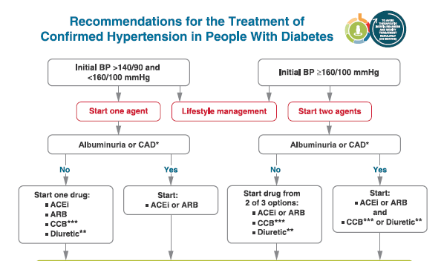
Cardiovascular Disease and Risk Management
Recommendations for the Treatment of Confirmed Hypertension in People with Diabetes (1 of 2)
Cardiovascular Disease and Risk Management:
Standards of Medical Care in Diabetes - 2021. Diabetes Care 2021;44(Suppl. 1):S111-S150

Slide 14
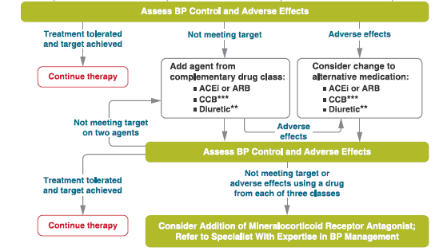
Cardiovascular Disease and Risk Management
Recommendations for the Treatment of Confirmed Hypertension in People with Diabetes (2 of 2)
Cardiovascular Disease and Risk Management:
Standards of Medical Care in Diabetes - 2021. Diabetes Care 2021;44(Suppl. 1):S111-S150

Slide 15
THANK YOU

