Slide 1
Lipid management in patients with diabetes
Soghra Rabizadeh, MD. Endocrinologist,
Imam Khomeini Medical Complex,
Tehran University of Medical Sciences

Slide 2
Significance of the Clinical Problem
Given the well-established strong link between
lipids and cardiovascular disease
it is essential that clinicians develop a strategy to decide who they will treat and which drugs they will use.

Slide 3
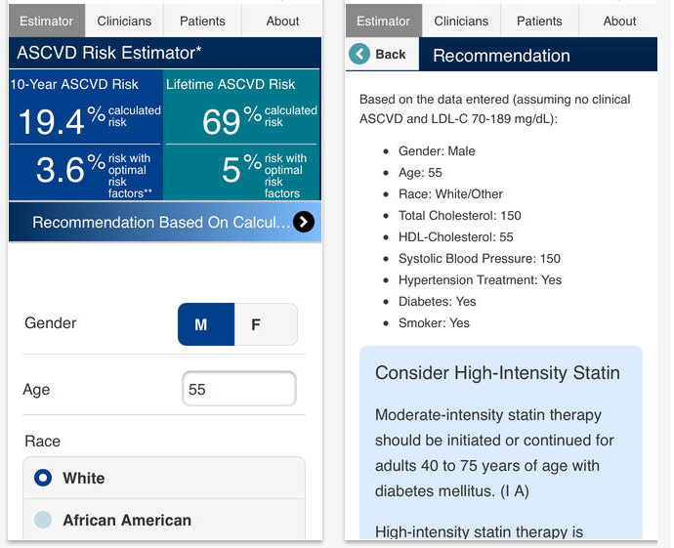
ASCVD Risk Estimator

Slide 4
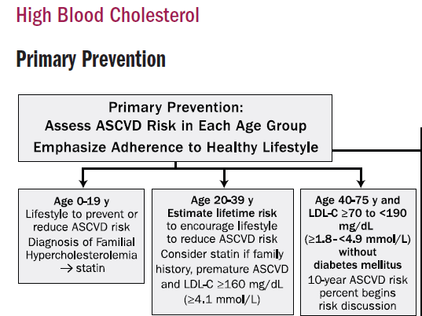
2019 ACC/AHA Guideline on the Primary Prevention o f Cardiovascular Disease

Slide 5
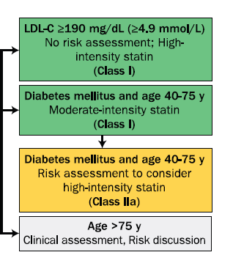

2019 ACC/AHA Guideline on the
Primary Prevention of Cardiovascular Disease

Slide 6
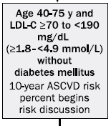
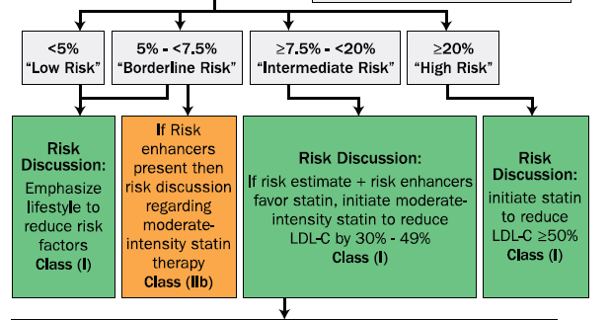
Primary Prevention: Assess ASCVD Risk in Each Age Group
Emphasize Adherence to Healthy lifestyle

Slide 7

Long duration
Albuminuria
eGFR <60 mL/min/1.73 m2
Retinopathy
Neuropathy
ABI <0.9

Slide 8
Atherosclerotic Cardiovascular Disease Risk Categories and LDL-C Treatment Goals
Risk Category
Extreme risk LDL-C goal <55 mg/dl | Progressive ASCVD including unstable angina in patients after achieving an LDL-C <70 mg/dL Established clinical cardiovascular disease in patients with DM, CKD 3/4 HeFH– History of premature ASCVD (<55 male, <65 female)
Very high risk LDL-C goal <75 mg/dl | – Established or recent hospitalization for ACS, coronary, carotid or peripheral vascular disease, 10-year risk >20% – Diabetes or CKD 3/4 with 1 or more risk factor(s) – HeFH
High risk LDL-C goal <100 mg/dl | – ≥2 risk factors and 10-year risk 10-20% – Diabetes or CKD 3/4 with no other risk factors

Slide 9
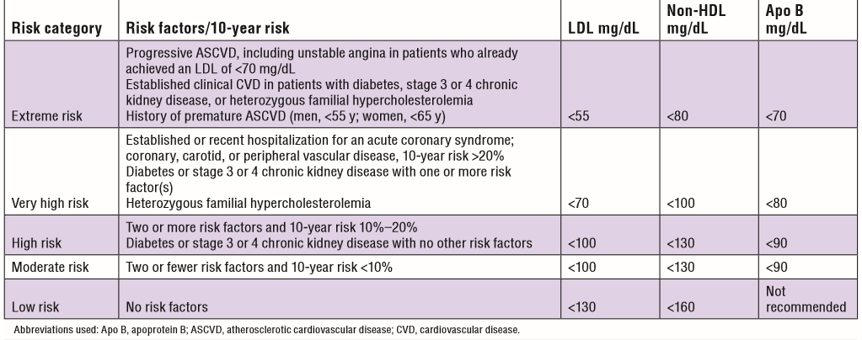
New lipid guidelines shift focus back to LDL goals Risk categories and treatment goals

Slide 10
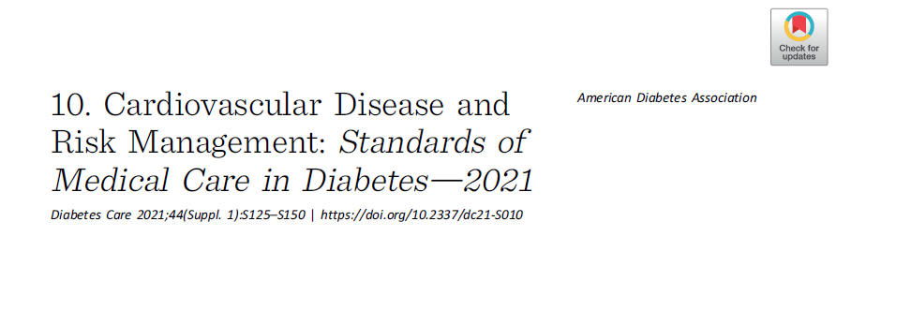

Slide 11
1.Primary Prevention in Diabetes
Lifestyle modification :
Weight loss
Mediterranean style or Dietary Approaches to Stop Hypertension (DASH)
Reduction of saturated and trans fat
Increase of dietary n-3 fatty acids
Viscous fiber, and plant stanols/sterols intake
Increased physical activity

Slide 12
1.2. Primary Prevention in Diabetes
For patients with diabetes aged 40–75 years without ASCVD, use moderate-intensity statin therapy in addition to lifestyle therapy. A

Slide 13
1.3.Primary Prevention in Diabetes
For patients with diabetes aged 20–39 years with additional ASCVD risk factors, it may be reasonable to initiate statin therapy in addition to lifestyle therapy. C

Slide 14
1.4.Primary Prevention in Diabetes
In patients with diabetes at higher risk, especially those with multiple ASCVD risk factors or aged 50–70 years, it is reasonable to use high-intensity statin therapy. B

Slide 15
1.5.Primary Prevention in Diabetes
In adults with diabetes and 10-year ASCVD risk of 20% or higher, it may be reasonable to add ezetimibe to maximally tolerated statin therapy to reduce LDL- cholesterol levels by 50% or more. C

Slide 16
Secondary Prevention
For patients of all ages with diabetes and atherosclerotic cardiovascular disease, highintensity statin therapy should be added to lifestyle therapy. A

Slide 17
For patients with diabetes and ASCVD considered very high risk, if LDL cholesterol is
>70 mg/dL on maximally tolerated statin dose, consider adding additional LDL-lowering therapy (such as ezetimibe or PCSK9 inhibitor). A
Ezetimibe may be preferred due to lower cost.
For patients who do not tolerate the intended intensity, the maximally tolerated statin dose should be used

Slide 18
In adults with diabetes aged >75 years already on statin therapy, it is reasonable to continue statin treatment. B

Slide 19
In adults with diabetes aged >75 years, it may be reasonable to initiate statin therapy after discussion of potential benefits and risks. C

Slide 20
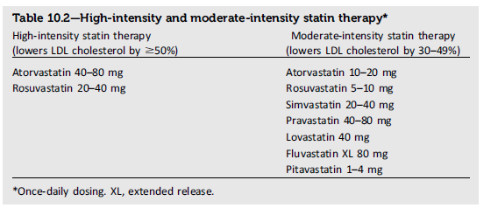

Slide 21
Treatment of Other Lipoprotein Fractions or Targets
For patients with fasting triglyceride levels ≥500 mg/dL (5.7 mmol/L), evaluate for secondary causes of hypertriglyceridemia and consider medical therapy to reduce the risk of pancreatitis. C

Slide 22
Treatment of Other Lipoprotein Fractions or Targets
In adults with moderate hyperTG (fasting or nonfasting triglycerides 175–499 mg/dL), clinicians should address and treat lifestyle factors (obesity and metabolic syndrome),
secondary factors (diabetes, chronic liver or kidney disease and/or nephrotic syndrome, hypothyroidism), and medications that raise triglycerides. C

Slide 23
In patients with ASCVD or other cardiovascular risk factors on a statin with controlled LDL cholesterol but elevated triglycerides (135–499 mg/dL), the addition of icosapent ethyl can be considered to reduce cardiovascular risk. A

Slide 24
Other Combination Therapy
Statin plus fibrate combination therapy has not been shown to improve ASCVD outcomes and is generally not recommended. A

Slide 25
Statin plus niacin combination therapy has not been shown to provide additional cardiovascular benefit above statin therapy alone.
May increase the risk of stroke with additional side effects, and is generally not recommended. A

Slide 26
Monitoring Lipid Panel
Obtain a lipid profile at:
Initiation of statins or other lipid- lowering therapy,
4–12 weeks after initiation or a change in dose, and
Annually thereafter as it may help to monitor the response to therapy and inform medication adherence. E

Slide 27
Monitoring Lipid Panel
In adults not taking statins or other lipid-lowering therapy, it is reasonable to obtain a lipid profile:
At the time of diabetes diagnosis,
At an initial medical evaluation,
And every 5 years thereafter if under the age of 40 years, or more frequently if indicated. E

Slide 28
Statin Intolerance

Slide 29
Serious muscle injury is rare (<1 in 1,000 patients)
Muscle aches and pains are common background symptoms in middle-aged and older people not taking statins and are rarely caused by the statin (<1 in 50 to 100 patients)

Slide 30
Risk factors for statin associated muscle symptoms
Advance age
Female
Physical disability
Lower BMI
Hypothyroidism
Colchicin , Alcohol (toxic muscle effect)
Exercise

Slide 31
Approach to symptomatic
Statin Related muscle problems

Slide 32
Step1
History and Ph/E to determine potential causes
Check CK level & review other labs.( cr,TSH, 25 vitD,
NL CK (myalgia)
CK < 10 × ULN
CK> 10 × ULN
(R/O rhabdomyolysis)
(check Cr , urine myoglobin)
Saxon DR, Eckel RH. Progress in Cardiovascular Diseases.2016

Slide 33
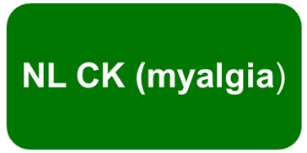

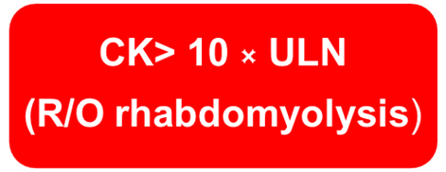


Step2
Lower statin dose OR discontinue depending severity of symptoms
Discontinue statin, intensive management
Moderate to severe symptoms, weekly contact
If symptoms resolve:
Rechallenge with statin
If symptoms persists: appropriate referral
Severe muscle injury:
rechallenge is not appropriate
Saxon DR, Eckel RH. Progress in Cardiovascular Diseases.2016

Slide 34

Step2
If statin rechallenge : use different statin or alternative dose
Rosuvastatin 5 mg or atorvastatin 10 mg QWK,
fluva-1mg or pravastatin 10mg QOD or QD
Reassess patients within 6 weeks.
Clarify patients LDL goal based on ASCVD risk
Saxon DR, Eckel RH. Progress in Cardiovascular Diseases.2016

Slide 35
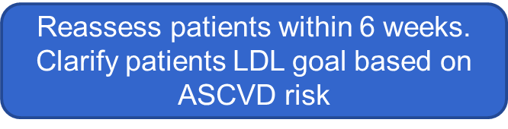



Step3
Not tolerate low dose statin
Tolerate statin, not reaching LDL goal
Tolerate statin ,reaching LDL goal:
Continue drug & follow up
Non statin agents
Ezetimibe, bile acid sequestrantsPCSK9 inhibitors, niacin and fibrate
Saxon DR, Eckel RH. Progress in Cardiovascular Diseases.2016

Slide 36
The interaction between statins and exercise
The combined use of statins and exercise training (ET) can result in health gains and decreased CVD risk
Some of the events: decreased athletic performance, muscle injury, myalgia, joint problems, decreased muscle strength, and fatigue

Slide 37
Strategies to Decrease the Risk of Adverse
Interactions Between Statin and Exercise Training (ET)
Reassess the need for statin.
Decrease the dose of statin.
Change to a hydrophilic statin.(pravastatin , rosuvastatin)
Prescribe a statin holiday followed by a rechallenge.
Decrease the intensity and duration of ET.
Prescribe vitamin D replacement.
Prescribe coenzyme Q10 supplementation.
Prescribe L-carnitine supplementation.
Avoid drug interactions that increase toxicity
Richard E. Deichmann, et al. The Ochsner Journal.2015

Slide 38
Statin liver safety

Slide 39
Statin and liver
Reversible , dose dependent and asymptomatic elevation of liver enzymes
Persistent elevation in ALT or AST> 3× ULN in about 3% of patients receiving high dose statins
Liver enzymes elevation alone without increases in bilirubin don’t indicate severe hepatic injury
FDA .2012

Slide 40
2014 NLA Statin Safety Task Force Questions

Slide 41
Question1
Have any unexpected safety concerns arisen since the regulatory recommendation that liver enzymes need not be measured after initiating statin therapy?
NO
Irreversible liver damage with statins is exceptionally rare and is idiosyncratic.

Slide 42
Question 2
Should baseline liver enzymes be obtained before initiating statin therapy?
Yes
Liver enzymes tests should be performed before starting statin and as clinically indicated thereafter

Slide 43
Question 3
Are statins safe to use in patients with nonalcoholic fatty liver disease?
Yes
chronic liver diseases and compensated cirrhosis were not contraindications
for statin use.

Slide 44
Question 4
Do statins have drug interactions with medications used to treat infections (eg, hepatitis B, C) that require change
in statin, change in statin dosing, or change in antiviral regimen dosing?
Yes

Slide 45
Question 5
Can statins safely be used in liver transplant recipients?
Yes
Cardiovascular events are
common among liver transplant patients

Slide 46
Question 6
Can statins safe in patients with autoimmune hepatitis?
Yes

Slide 47

Patients wit elevated liver enzymes
ALT or AST < 3 × ULN
History & Ph/E for other causes
Review prior liver enzymes tests
Repeat tests to confirm elevation
Total bilirubin normal
CK normal
Total bilirubin elevated
CK normal

Slide 48
Total bilirubin normal
CK normal
Total bilirubin elevated
CK normal
Prior bilirubin↑ (Gilbert)
If the most diagnosis is NAFLD
OK to start statin
Lifestyle change
Asymptomatic
Prior bili is periodically elevated
Indirect bili elevated
Continue statin
Repeat liver tests

Slide 49
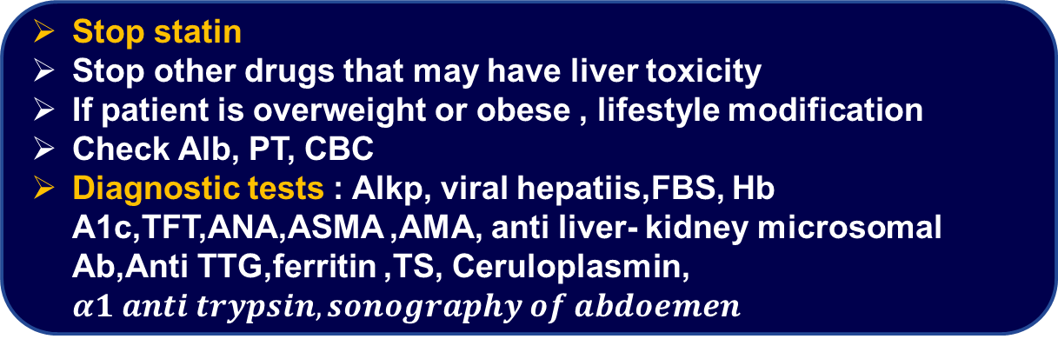
Prior bili NL
Now bili ↑ (specially direct)
liver biopsy or imaging if liver enzymes don’t improve with discontinuing statin and lifestyle change

Slide 50

Patient with ALT or AST > 3 × ULN
History & PH/E
Review prior liver enzyme tests
Repeat tests immediately
ALT or AST >3 × ULN
CK NL

Slide 51
ALT or AST >3 × ULN
CK NL
Stop statin
Stop other drugs that may have liver toxicity
If patient is overweight or obese , lifestyle modification
Check Albumin, PT, CBC
Diagnostic tests :
Alkp, viral hepatiis,FBS, Hb A1c,TFT,ANA,ASMA ,AMA, anti liver- kidney microsomal ab, Anti TTG, ferritin ,TS, Ceruloplasmin, 𝜶𝟏 𝒂𝒏𝒕𝒊 𝒕𝒓𝒚𝒑𝒔𝒊𝒏, 𝒔𝒐𝒏𝒐𝒈𝒓𝒂𝒑𝒉𝒚 𝒐𝒇 𝒂𝒃𝒅𝒐𝒆𝒎𝒆𝒏
liver biopsy or imaging if liver enzymes don’t improve with discontinuing statin and lifestyle change

Slide 52
Thank you

