Slide 1
Diabetes Therapeutics
Manouchehr Nakhjavani, MD
Endocrinology & Diabetes

Slide 2
Drug –specific and patients factors when selecting
antihyperglycemic treatments in adults with T2D
 | Efficacy | Hypoglycemia | Cost | Weight change | Oral/SC
Metformin | High | No | Low | Neutral | Oral
SGLT-2 I | Intermediate | No | High | Loss | Oral
GLP-1 RAs | High | No | High | Loss | SQ (oral)
DPP-4 I | Intermediate | No | High | Neutral | Oral
TZDs | High | No | Low | Gain | Oral
SUs | High | Yes | Low | Gain | Oral

Slide 3
Drug –specific and patients factors when selecting
antihyperglycemic treatments in adults with T2D
 | ASCVD | Heart Failure |  | Progression of CKD | Renal dose adjustment
Metformin | High | Neutral |  | Neutral | +
SGLT-2 I | Benefit | Benefit |  | Benefit | +/-
GLP-1 RAs | Benefit or Neutral | Neutral |  | Benefit | +/- Liraglutide safe
DPP-4 I | Intermediate | Risk: saxagliptin |  | Neutral | +/-
TZDs | Potential benefit: pioglitazone | Neutral |  | Neutral | - Fluid retention
Sus: 2nd generation | Neutral | Yes |  | Neutral | Not recommended

Slide 4
Personalized Choices of Therapy
Minimizing Cardiovascular Risks
Minimizing Hypoglycemia
Minimizing Weight Gain
Minimizing Costs

Slide 5
Case Study
ID/CC: 56 years old man with T2DM _ 6 years on Metformin.
A1c increasing to 7.8% over the past year.
Add’l Hx: Further attempts at lifestyle change unsuccessful.
PMH: HTN on enalpril, receives rosuvastatin.
Father had CAD
Highly compliant/adherent.
Declines injectables.

Slide 6
Case study
PE: Obese, BMI= 36.5, BP= 142/84,
Acanthosis nigricans.
Data: A1c 7.8%, FPG 147,
Cr 1.1 (eGFR =60),
LDL 84, HDL 38, TG 256,
ECG: normal.
Your recommendation?

Slide 7
Your recommendation?
Metformin-based combination therapies
Discuss Advantages' and disadvantages
1- Sulfonylurea
2- Thiazolidindione
3- DPP-4 Inhibitor
4- SGLT2 Inhibitor

Slide 8

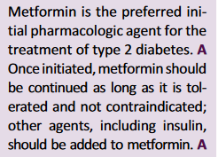

Slide 9


Slide 10
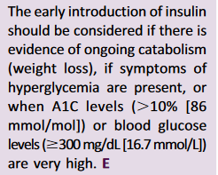

Slide 11
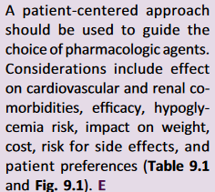

Slide 12
Case 2
ID/CC: 64 years old female with T2DM _ 14 years on Metformin/Sitagliptin.
A1c now at 8.4%.
Prior A1c’s have been stable at 7 to 7.5%.
Add’l Hx: Recently hospitalized for ACS/stent. Diastolic
dysfunction by echo.
Cardiologist told her to seek your counsel about
Improving metabolic control.

Slide 13
Case 2
PMH: CAD s/p MI; HTN, HLD, hypothyroid, breast ca.
On Atorvastatin, losartan, levothyroxine, tamoxifen, ASA.
Grade school teacher. Well insured.
Questionable adherence. Open to injections.
PE: Obese, BMI 32.1, BP 118/76.
Data: A1c 8.4%, FPG 188.
Cr 1.4 (eGFR 44),
LDL 67, HDL54, TG 123,
ECG: old IWMI
Your recommendation?

Slide 14
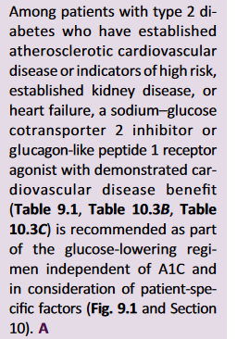

Slide 15
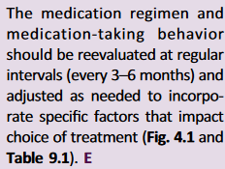

Slide 16
Case 3
ID/CC: 56 years old man with recent diagnosis of T2DM _ Unable to tolerate Metformin.
A1c 8.5 and 9% on two occasions.
Add’l Hx: Further attempts at lifestyle change unsuccessful.
PMH: HTN on valsartan.
Highly compliant/adherent.
Declines injectables.

Slide 17
Case 3
PE: Obese, BMI= 31, BP= 135/85,
Data: A1c 9%, FPG 157,
Cr 1.1 (eGFR =60),
LDL 94, HDL 38, TG 240,
ECG: normal.
Your recommendation?

Slide 18
Case 3: Your recommendation?
Non-metformin-based combination therapies
Discuss Advantages' and disadvantages
1- Thiazolidindiones (TZDs) plus sulfonylureas
2- TZDs plus DPP-4 inhibitors
3- SGLT2 inhibitors plus DPP-4 Inhibitors
4- SGLT2 Inhibitor plus sulfonylureas
5- SGLT2 Inhibitor plus TZDs

Slide 19


Slide 20
Case 4
ID/CC: 77 years old man T2DM _ 21 years on Metformin,Linagliptin, Gliclazide.
A1c never well controlled (8–9%
range). Recent A1c climb to 9.6% after hospitalization for PNA and stay at rehab facility.
Add’l Hx: PMH: COPD, CHF, CML, BPH,

Slide 21
Case 4
On simvastatin, furosemide, carvedilol, lisinopril, amlodipine, imatinib, leuprolide.
Good adherence and visit attendance (family accompanies). Not opposed to injections.

Slide 22
Case 4
PE: BMI 29.6, BP 112/68,
Cervical lymphadenopathy, pulmonary rales.
Data: A1c 9.6%, FPG 223,
Cr 2.3, (eGFR 29), UAE 231mcg/mg Cr,
LDL 78, HDL 43, TG 117.
ECG: RBBB.
Your recommendation?

Slide 23
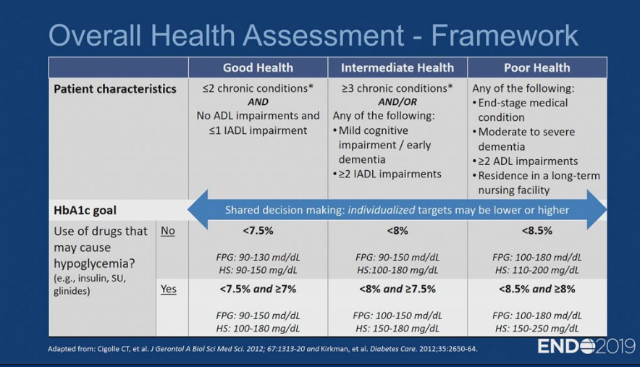

Slide 24


Slide 25
Drug –specific and patients factors when selecting
antihyperglycemic treatments in adults with T2D
 | Efficacy | Hypoglycemia | Cost | Weight change | Oral/SC
Insulin | Highest | Yes |  | Gain | SC
Human |  |  | Low
Analogue |  |  | High

Slide 26
Drug –specific and patients factors when selecting
antihyperglycemic treatments in adults with T2D
 | ASCVD | Heart Failure |  | Progression of CKD | Renal dose adjustment
Insulin | Neutral | Neutral |  | Neutral | +
Human |  |  |  |  | +/-
Analogue

Slide 27
Case 5
ID/CC: 72 years old woman with T2DM _ 16 years on glargine 78 U QHS. Over past year, glargine dose increased to combat progressive fasting hyperglycemia.
Two hypo reactions, one at home and one at outside both occurring in the mid-afternoon.
Add’l Hx: SMBG log shows FBG 110–140 mg/dl, predinner 70–90 mg/dl.

Slide 28
Case 5
PMH: HTN, HLD, diastolic HF, osteoporosis,
RA, DJD (R TKR), visually impaired due to retinopathy.
Widow; lives alone. Home health aid.
Agreeable to up to 2 injections/day, but no more.
PE: Obese, BMI 36.5, BP 152/96, _ PDR.
Data: A1c 7.8%, FPG 147,
LDL 84, HDL 38, TG 256,
ECG: Nonspecific ST-segment and T-wave changes

Slide 29
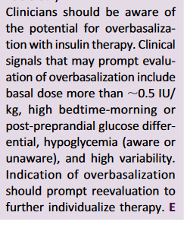

Slide 30
Diabetes in Older Adults
Cases: Medication Selection to Minimize Hypoglycemia
She is 77-year-old female with a 20+ year history of
T2DM. In general she has been well controlled with an A1c of 6.8-7.5%. She eats carefully, takes her medications and walks 5 times per week. She was started on oral agents initially but for the past 10 years she has been on basal insulin and premeal rapid acting insulin. She uses a correction scale before meals. Recently she has noted a decrease in her appetite.

Slide 31
Diabetes in Older Adults
Cases: Medication Selection to Minimize Hypoglycemia
She fell and fractured her right wrist and this has made management of her diabetes more difficult. She lives with her daughter and son-in-law, but they work, so she is alone most of the day. She has had episodes of mild hypoglycemia several times per week lately. There is no particular pattern as to timing of these episodes. Her eGFR has fallen from 60 to 30 over the past two years. Her is BMI=24.5 kg/m².

Slide 32
Diabetes in Older Adults
Cases: Medication Selection to Minimize Hypoglycemia
Question: Which approach would most safely and effectively reduce her risk of hypoglycemia?
Attempting to taper off prandial insulin onto a regimen of basal insulin plus a DPPIV-Inhibitor
B. Changing her rapid acting insulin to after-eating rather than before meals.
Attempting to taper off prandial insulin onto a regimen of basal insulin plus metformin
Adding a GLP-1 RA

