Slide 1
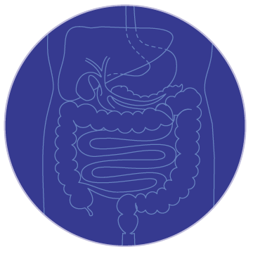
Medical management of mild (low risk) Crohn disease in adults
Masoodi M. MD
IUMS - CRRC

Slide 2
Epidemiology of IBD in Iran
Incidence?
Prevalence?

Slide 3
Epidemiology of IBD in Iran
 | IBD 1990 | UC 1990 | CD 1999 | IBD 2012 | UC 2012 | CD 2012
Incidence | 0.62 | 0.42 | 0.19 | 3.11 | 2.7-3.25 | 0.41
prevalence | 4.69 | 3.62 | 1.06 | 40.67 | 15 - 35.52 | 5.03

Slide 4
Case
40 year old male with diarrhea 2 time per day and mild abdominal pain from 3 mon ago and normal abdominal exam.
CRP :normal
Calprotectin mild increased
Few superficial small ulceration in colon and terminal ileum on colonoscopy
Pathology suggestive of IBD
Choice of therapy?

Slide 5

The choice of therapy varies depending upon
The anatomic location of disease
The severity of disease
Induce remission or maintain remission
Treatment history
Patient comorbidities

Slide 6
Crohn Disease Activity?

Slide 7

Crohn Disease Activity Index
Crohn's Disease Activity Index (CDAI)
Harvey-Bradshaw Index (HBI)
These CDAI systems rely on subjective symptoms
A drop in the CDAI of 100 points corresponds to a 3-point drop in the HBI.
A CDAI of <150 (ie, clinical remission) corresponds to an HBI of <4.

Slide 8
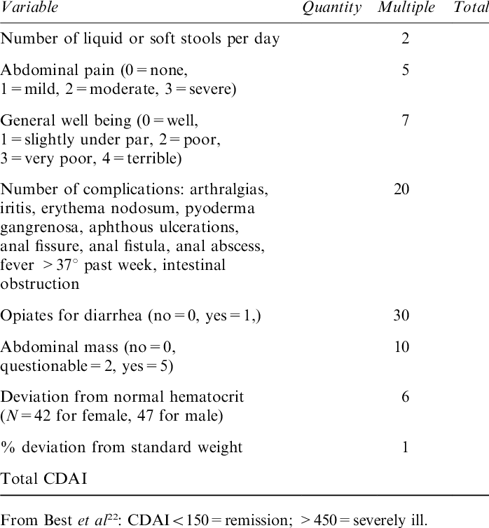
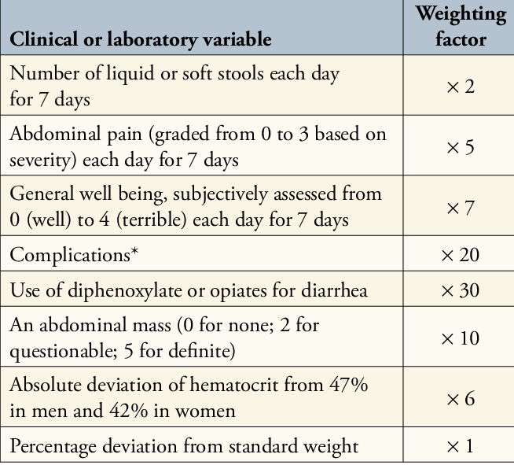
Crohn's Disease Activity Index (CDAI)
Clinical remission (<150)
Mild Crohn disease (150-220)
Moderate to severe ( 220-450)
Severe-fulminant disease ( >450)

Slide 9
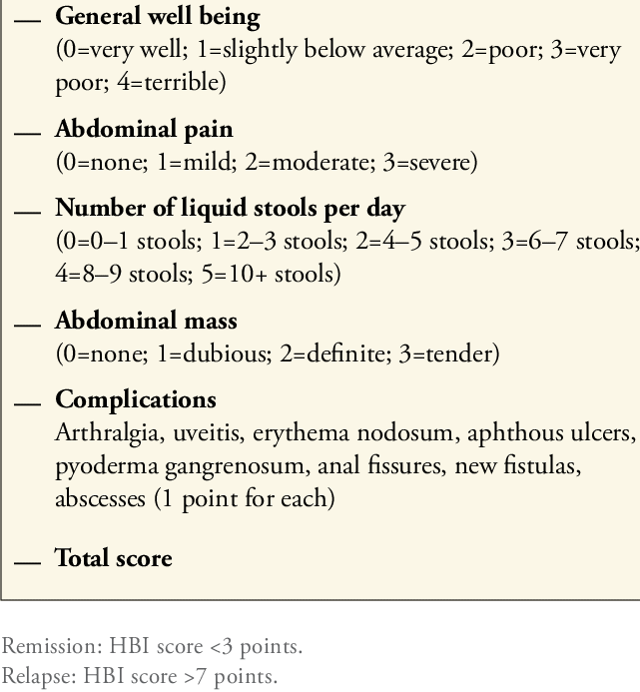
Harvey-Bradshaw Index (HBI)
< 5 clinical remission
5 - 7 mild disease
8 - 16 moderate disease
> 16 severe disease.

Slide 10
Low- versus moderate/high-risk patients
In addition to the clinical parameters, the American Gastroenterological Association (AGA) stratifies patients into either a low or moderate/high risk category by assessing inflammatory status with the following tests :
Endoscopic evaluation
  mucosal ulcerations
  stricture
  disease extent
Laboratory parameters: CRP and/or fecal calprotectin
Presence or absence of upper gastrointestinal involvement

Slide 11
Other prognostic factors associated with a more complicated disease course include :
Bowel damage as measured by cross sectional imaging
Extra-intestinal manifestations of disease
Number of flares
Need for glucocorticoids
Resultant hospitalizations

Slide 12
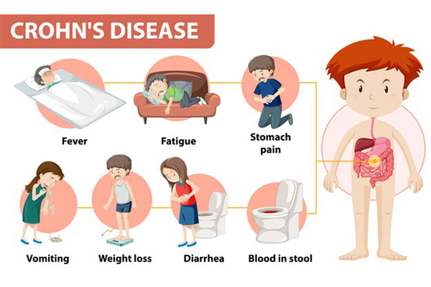
Definition of mild Crohn disease?

Slide 13
Low-risk patients with mild Crohn disease have the following features:
No or mild symptoms
Normal or mild elevation in CRP and/or fecal calprotectin levels
Diagnosis at age >30 years
Limited distribution of bowel inflammation
Superficial or no ulceration on colonoscopy
Lack of perianal complications
No prior intestinal resections
Absence of penetrating or stricturing disease

Slide 14
In clinical practice, working definitions may be more useful
Clinical remission (CDAI <150) – These patients are asymptomatic and without symptomatic inflammatory sequelae. This status is achieved either spontaneously or after medical or surgical intervention. Patients requiring glucocorticoids to remain asymptomatic are not considered to be in remission but are referred to as being "steroid-dependent".
Mild Crohn disease (CDAI 150-220) – These patients are typically ambulatory and tolerating an oral diet. They have <10 percent weight loss and no symptoms of systemic disease such as fever, tachycardia, abdominal tenderness, and no signs or symptoms of obstruction.
Moderate to severe Crohn disease (CDAI 220-450) – This group comprises patients who have failed treatment for mild to moderate disease or those patients with prominent symptoms such as fever, weight loss, abdominal pain and tenderness, intermittent nausea or vomiting, or anemia.
Severe-fulminant disease (CDAI >450) – Patients with persistent symptoms despite glucocorticoids or biologic agents as outpatients, or individuals presenting with high fever, persistent vomiting, intestinal obstruction, peritoneal signs, cachexia, or evidence of an abscess.

Slide 15
Medical therapies that are used for CD
Oral 5-aminosalicylates
  Sulfasalazine,masalamine
Glucocorticoids
  Prednisolone, budesonide
Immunomodulators
  Azathioprine, methotrexate,6-mrcaptopurine
Biologic therapies
  anti–TNF-α class
    Infliximab, adalimumab, and certolizumab
  Anti–IL-12/23 monoclonal therapy
    Ustekinumab
  Gut-specific anti–integrin α4β7 monoclonal therapy.
    Vedolizumab and Natalizumab

Slide 16
INDUCTION OF REMISSION?

Slide 17
Two general approaches to the treatment of CD
Step-up therapy – Step-up therapy typically starts with less potent medications that are often associated with fewer side effects. More potent and potentially more toxic medications are used only if the initial therapies are ineffective.
Top-down therapy – Top-down therapy starts with more potent therapies, such as biologic therapy and/or immunomodulator therapy, relatively early in the course of the disease before patients become glucocorticoid dependent, and possibly even before they receive glucocorticoids

Slide 18
There are two general approaches to the treatment of Crohn disease:
When treating patients with mild Crohn disease who are low-risk, we favor step-up therapy
In contrast, high-risk patients with moderate to severe Crohn disease should be initiated on biologic or immunomodulator therapy in a top-down approach
In addition:
  cost of therapy
  patient compliance
  individual susceptibility to drug toxicity
  patient preferences
are equally relevant factors for making patient-specific decisions.

Slide 19
INDUCTION OF REMISSION for mild Crohn disease
Outpatient therapy with oral medications is appropriate
Choice of treatment will in part depend upon the distribution of disease.
Treatment goals — The treatment goal for patients with Crohn disease is to achieve remission (endoscopic, histologic, and clinical remission) by demonstrating complete mucosal healing.

Slide 20
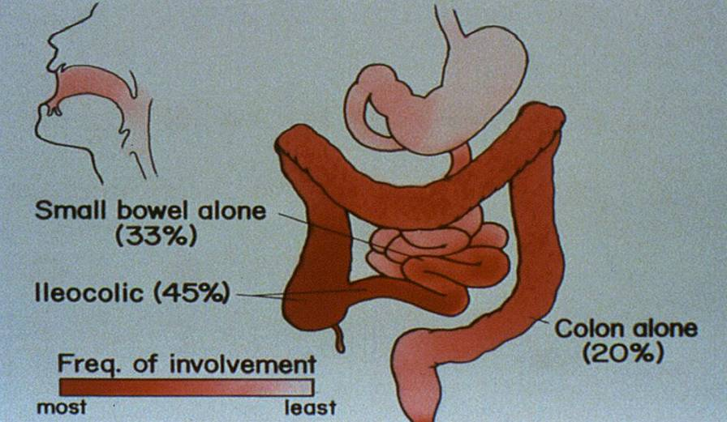

Slide 21
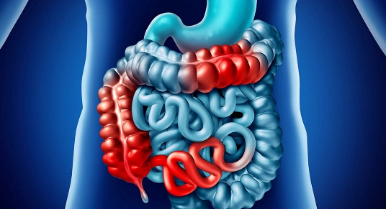
Ileum and/or proximal colon involvement
Enteric-coated budesonide is the first line treatment
  Budesonide is started at 9 mg per day for at least 4 weeks, but not more than 8 weeks.
  Budesonide is then tapered by 3 mg increments every 2-4 weeks for a total of 8-12 weeks of therapy.
  We do not recommend using budesonide for longer than 12 weeks per course
In patients who cannot successfully taper budesonide by 3-6 months, treatment escalation with either a thiopurine or biologic is indicated

Slide 22
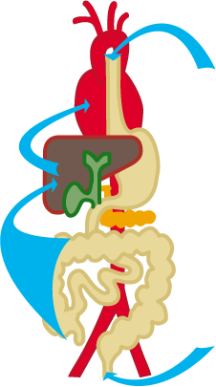


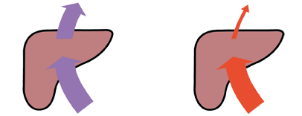
Systemic glucocorticoids vs. budesonide
Systemic Local glucocorticoid
glucocorticoid treatment with
treatment budesonide
Distribution
of active agent
First pass
effect ca. 20% ca. 90%

Slide 23
Oral budesonide formulations used in treatment of inflammatory bowel disease
Brand names | Type | Description | pH release | Delivery | Uses
Entocort EC (Canada, US) Entocort CR, Entocir (EU, UK) Ortikos (US) NOTE: Generic equivalents may be available | Controlled ileal release (CIR) formulation, pH- and time-dependent | Entocort EC, Entocort CR, Entocir: 3 mg gelatin capsule filled with enteric-coated granules Ortikos: 6 mg gelatin capsule filled with pellets 9 mg gelatin capsule filled with pellets | ≥5.5 | Terminal ileum and/or ascending colon | Mild to moderately active Crohn of ileum and/or ascending colon
Budenofalk (EU, UK) NOTE: Not available in US or Canada | pH-dependent release | 3 mg gelatin capsule filled with enteric-coated granules 9 mg sachet filled with enteric-coated granules | >6.4 | Terminal ileum and/or ascending colon | Mild to moderately active Crohn of ileum and/or ascending colon
Uceris (US) Cortiment (Canada, EU, UK) | Multi-matrix (MMX) structure with gastric acid-resistant coating | 9 mg delayed- and extended-release tablet | ≥7.0 | Controlled delivery to ascending, transverse, and descending colon | Mild to moderately active ulcerative colitis

Slide 24
Ileum and/or proximal colon involvement
Alternative agents
Prednisone can be given to low-risk patients who do not respond to budesonide;
  The initial dose of prednisone is 40 mg per day for one week, and many patients will respond to this dose.
  At that point, a gradual tapering by 5 -10 mg per week should be started with the goal of discontinuing the prednisone over 1-2 months
Patients who initially respond to oral glucocorticoids but cannot tolerate gradual tapering of prednisone are no longer regarded as low-risk and should be reassigned to the moderate/high risk category

Slide 25
Ileum and/or proximal colon involvement
Alternative agents
The use of 5-ASA for Crohn disease is controversial
We limit its use to patients with mild CD with limited ileocolonic involvement who prefer to avoid glucocorticoids.
For patients with limited ileitis and mild symptoms, a slow release, oral 5-ASA agent is suitable, such as mesalamine (eg, Pentasa or Asacol)
Studies evaluating the efficacy of 5-ASA in Crohn disease have had mixed results; some suggest that higher doses of mesalamine
  Dose above 2.4 g per day were more likely to achieve remission

Slide 26
Diffuse colitis or left colonic involvement
Oral prednisone 40 mg per day for one week. At that point, a gradual tapering by 5 to 10 mg per week should be started with the goal of discontinuing the prednisone over 1-2 months
Sulfasalazine (3 to 6 g per day over a course of 16 weeks) may be an alternative option
Sulfasalazine was inferior to glucocorticoids for inducing remission

Slide 27
Asymptomatic patients diagnosed incidentally?

Slide 28
Asymptomatic patients diagnosed incidentally
For asymptomatic patients who undergo a routine, screening colonoscopy and are incidentally found to have very small, shallow aphthous ulcers, a repeat ileocolonoscopy is performed in 6-12 months in addition to clinical monitoring
An alternative approach for asymptomatic, low-risk patients with mild endoscopic disease is maintenance therapy with an oral 5-aminosalicylate (5-ASA) agent, especially if the erosions are primarily affecting the colon, although there are little data to support either approach

Slide 29
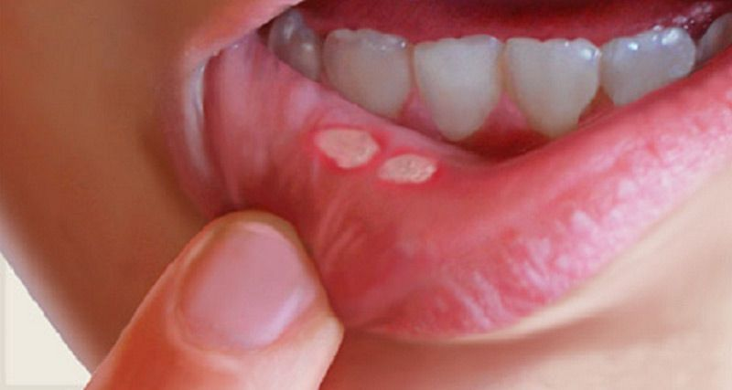
Oral lesions
Aphthous ulcerations, the most common oral lesions, occur in 20 -30% of adult patients with Crohn disease
Other oral lesions
  buccal swelling
  granulomatous masses
  cheilitis
  granulomatous sialadenitis
Oral lesions usually coexist with intestinal disease and respond to treatment directed at the intestinal disease.
Topical medications, such as triamcinolone acetonide, can provide local symptom relief.

Slide 30
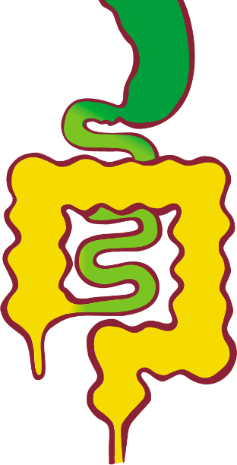
Gastroduodenal disease
Distal antrum of the stomach and duodenum are most commonly affected.
The management of patients with gastroduodenal Crohn disease is managed as high-risk patients

Slide 31
Perianal disease
Patients with perianal abscess and fistula and their associated symptoms (eg, pain, fever, fistula drainage) are assigned to a moderate- to high-risk category

Slide 32
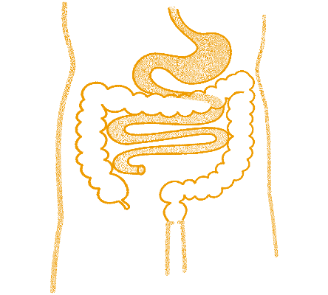
MAINTENANCE OF REMISSION?
In mild Crohn disease

Slide 33

MAINTENANCE OF REMISSION
For low-risk patients with mild CD who achieved remission with a glucocorticoid (eg, budesonide or prednisone), we recommend tapering and then discontinuing the glucocorticoid, followed by clinical observation and ileocolonoscopy in 6-12 months
For low-risk patients with mild CD who achieved remission with a 5-ASA agent , we continue the same agent for long-term maintenance therapy and perform an ileocolonoscopy in 6 -12 months (although some societies advise against 5-ASA)
For patients with Crohn colitis, some data suggest that long-term use of 5-ASA agents may decrease the risk of colon cancer.

Slide 34
Alternative approaches to preventing relapse of Crohn disease include the following:
However, in some patients who have difficulty tapering budesonide, we continue budesonide at a dose of 6 mg daily for no longer than 3-6 months.
In patients who require glucocorticoids to maintain remission, we also initiate a thiopurine.

Slide 35
Monitoring during remission
In addition to assessing patients clinically and with ileocolonoscopy in 6-12 months after achieving clinical remission, noninvasive markers of inflammation can be useful.
We obtain noninvasive markers of inflammation including CRP and fecal calprotectin at the time of colonoscopy and correlate these tests with the degree of mucosal healing.
  In some patients with Crohn disease, CRP does not correlate with endoscopic findings, and we do not rely solely on noninvasive markers for monitoring patients in remission.
  Use of biomarkers, compared with clinical management alone, was associated with improved rates of mucosal healing

Slide 36
MANAGING RELAPSE
In patients who have clinical recurrence after achieving remission following glucocorticoid therapy, we begin a second course of a glucocorticoid.
Initiation of a thiopurine and/or biologic therapy is also recommended
If they fail to respond to the second course of glucocorticoids, they are regarded as high-risk

Slide 37
Antidiarrheal medications
Symptomatic treatment with antidiarrheal drugs is an option for patients not responding completely to first-line therapy who have mild Crohn disease without complications such as strictures.
  Lperamide as needed in small doses (2 -4 mg after an episode of loose stool)
  Cholestyramine or other bile sequestrants are other options for patients with non-stricturing ileal disease who have chronic watery diarrhea.
Patients with moderate or severe CD or those at risk for bowel obstruction should not receive antidiarrheal agents.

Slide 38
Probiotics
The available data do not support clinical effectiveness of probiotic therapy for either induction or maintenance of remission in patients with Crohn disease

Slide 39
Antibiotics
We generally do not use antibiotics for patients with mild Crohn disease
It is unclear if the efficacy of antimicrobial therapy is due to treatment of an undetected pathogen, bacterial overgrowth, or an unsuspected microperforation.
The most frequently utilized antibiotics include metronidazole or ciprofloxacin, which also carry potential side effects

Slide 40
Colorectal cancer screening
Patients with Crohn disease with involvement of more than one third of the colon have an increased risk of colon cancer after 8 years of disease,and regular colonoscopic surveillance with biopsies is recommended every 1 to 3 years beginning at year 8, with adjustments based on family history, prior dysplasia, disease extent, disease duration, and primary sclerosing cholangitis.
Patients with a concurrent diagnosis of primary sclerosing cholangitis are at higher risk for colorectal neoplasia and should undergo annual colorectal cancer surveillance.

Slide 41
Quality measures are for outpatients
Many of these quality measures are for outpatients and can be co- managed by gastroenterology and primary care, such as:
  Screening for tobacco abuse and counseling patients to quit if they are smokingis strongly recommended.
  Assessment for bone loss with a bone density scan in patients exposed to systemic steroids for 3 months or more of the equivalent of 7.5 mg per day of prednisone.
  Yearly inactivated influenza vaccination, pneumococcal vaccination
  Live vaccinations should not be given to patients currently receiving immunosuppression therapy. Killed or recombinant vaccination alternatives are available for influenza, zoster, polio, and typhoid

Slide 42
Quality measures are for outpatients
Patients receiving thiopurines, methotrexate, or anti-TNF medications should have regular skin checks for skin cancer
Women receiving thiopurines, a yearly pap smear is recommended given the increased risk of cervical dysplasia.

Slide 43
Dietary interventions?

Slide 44
Dietary interventions
For most patients with Crohn disease, a diverse diet is to be encouraged and food avoidance should be limited
Nutritional deficiencies are uncommon in patients with mild disease.
Patients with Crohn disease, particularly those with ileal disease, have an increased frequency of acquired lactase deficiency and symptomatic lactose intolerance
The most common deficiencies are iron, vitamin D, and B12
    B12 deficiencie particularly in patients with extensive ileal disease
It is recommended that testing for levels should be done before supplementation with goal-directed therapy.
Many patients with moderate ileal disease have adequate absorption of oral B12.

Slide 45
Dietary interventions
Patients who have had severe flares or have undergone surgical procedures should ensure adequate protein intake to support healing of the intestine and surgical wounds.
A strictures for whom a low residue diet is encouraged to limit obstructive symptoms.
For patients with significant bloating, abdominal distention, and abdominal pain without significant detectable inflammation, a low-FODMAP (fermentable oligosaccharides, disaccharides, monosaccharides, and polyols) diet can prove benefit in reducing these symptoms

Slide 46
Emotional Care
The emotional aspects of Crohn disease are often under recognized and undertreated.
Anxiety (18%-35%) and depression (20%-34%) are quite common in patients with Crohn disease
Patients adjust to lost opportunities and restrict their life opportunities because of concerns about future disease flares.
The prevalence of these disorders is much higher during active disease.
Many patients choose to be childless due to medication related concerns or misinformation, including the perception that there is a high risk of genetic transmission.
In a study that posttraumatic stress disorder occurred in 38.2%, most frequently in those with difficult hospitalizations, severe symptoms, and ileostomy surgery for Crohn disease.
Increasing evidence suggests that cognitive behavioral therapy and antidepressant therapy can be beneficial for symptomatic patients with Crohn disease.

