Slide 1

Asthma Management
What's New in GINA 2021?
Dr. Alireza Eslaminejad, Pulmonologist
Associate Professor of Respiratory Disease
Masih Daneshvari Hospital, Shahid Beheshti university of Medical Sciences
Oct.2021

Slide 2
Agenda
Asthma prevalence worldwide
Asthma Management During COVID-19 Pandemic
What’s Wrong With SABA !
GINA 2021 Updates

Slide 3
Asthma prevalence in Iran & Worldwide
Asthma prevalence in Iran
Asthma prevalence worldwide
8.9% of Iranian adults suffer from Asthma¹
262 million people
Fazlollahi, et al. Clin Respir J.2018
who

Slide 4
Interim Guidance on Asthma Management During the COVID-19 Pandemic
According to GINA 2021 added information ,people with asthma in general do not seem to have an increased risk of:
Accquiring Covid -19
Severe Covid-19 disease
Covid-19 related death

Slide 5
COVID-19 & Asthma - Medications
Advise patients with asthma to continue taking their prescribed asthma medications, particularly inhaled corticosteroid (ICS) medications, and oral corticosteroids (OCS) if prescribed

Slide 6
Are ICS protective in COVID-19?
In one study of hospitalized patients aged ≥50 years with COVID-19, ICS use in those with asthma was associated with lower mortality than in patients without an underlying respiratory condition (Bloom, Lancet RM 2021)

Slide 7
Make sure that all patients have a written asthma action plan
An action plan tells the patient how to recognize worsening asthma
How to increase their reliever and controller medications (MART) maintenance and reliever therapy
How to seek medical help
A short course of OCS may be needed during severe asthma flare-ups (exacerbations)

Slide 8
Avoid nebulizer when possible to reduce the risk of spreading virus
Pressurized metered dose inhaler via a spacer is preferred except for life threatening exacerbations
Add a mouthpiece or mask to the spacer if required

Slide 9
Avoid Spirometry in patients with confirmed/suspected
COVID-19
Postpone spirometry and peak flow measurement within health care facilities unless there is an urgent need.
If spirometry is needed urgently for clinical management, follow infection control recommendations.

Slide 10
COVID-19 Vaccines & Asthma
At present, based on the risks & benefits ,and with the above caution, GINA recommends COVID-19 vaccination for people with asthma
Ask if patient has a history of allergy to any components of the vaccine
If the patient has a fever or another infection ,delay vaccination until they are well
We suggest that biologic therapy and COVID-19 vaccine should not be given on the same day, so that adverse effects of either can be more easily distinguished

Slide 11
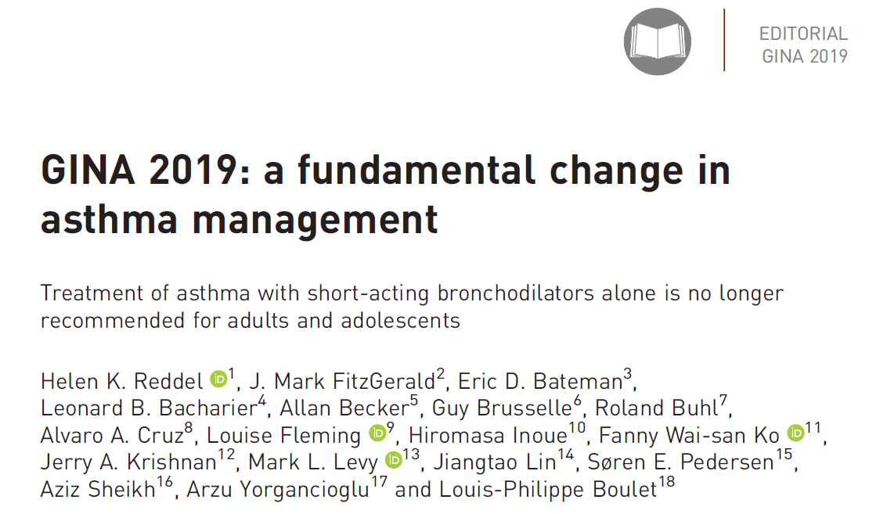

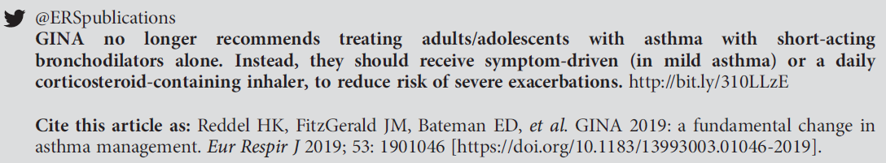
A reminder – the key change in GINA 2019

Slide 12
Background to changes in 2019 - the risks of ‘mild’ asthma
Patients with apparently mild asthma are at risk of serious adverse events:
  30–37% of adults with acute asthma
  16% of patients with near-fatal asthma
  15–20% of adults dying of asthma
Exacerbation triggers are variable (viruses, pollens, pollution, poor adherence)
had symptoms less than weekly in previous 3 months (Dusser, Allergy 2007)
Notes:
Dusser D, Montani D, Chanez P, de Blic J, Delacourt C, Deschildre A, Devillier P, et al. Mild asthma: an expert review on epidemiology, clinical characteristics and treatment recommendations. Allergy 2007;62:591-604.
Reddel HK, Ampon RD, Sawyer SM, Peters MJ. Risks associated with managing asthma without a preventer: urgent healthcare, poor asthma control and over-the-counter reliever use in a cross-sectional population survey. BMJ open 2017;7:e016688.
Hancox RJ, Cowan JO, Flannery EM, Herbison GP, McLachlan CR, Taylor DR. Bronchodilator tolerance and rebound bronchoconstriction during regular inhaled beta-agonist treatment. Respir Med 2000;94:767-71.
Aldridge RE, Hancox RJ, Robin Taylor D, Cowan JO, Winn MC, Frampton CM, Town GI. Effects of terbutaline and budesonide on sputum cells and bronchial hyperresponsiveness in asthma. Am J Respir Crit Care Med 2000;161:1459-64.
Stanford RH, Shah MB, D’Souza AO, Dhamane AD, Schatz M. Short-acting β-agonist use and its ability to predict future asthma-related outcomes. Annals of Allergy, Asthma & Immunology 2012;109:403-7.
Suissa S, Ernst P, Boivin JF, Horwitz RI, Habbick B, Cockroft D, Blais L, et al. A cohort analysis of excess mortality in asthma and the use of inhaled beta-agonists. Am J Respir Crit Care Med 1994;149:604-10.

Slide 13
Beta adrenergic drugs are the most potent bronchodilators currently approved for clinical use in asthma and obstructive lung disease
Beta agonists were developed through modifications of the epinephrine
Beta-2 agonists also interact with beta adrenergic receptors on the surface of a variety of other cells that play a role in asthma pathogenesis.
Decrease mast cell mediator release
Inhibit neutrophil, eosinophil, and lymphocyte functional responses
Increase mucociliary transport, and affect vascular tone and edema formation

Slide 14
Background to changes in 2019 - the risks of SABA-only treatment
Regular or frequent use of SABA is associated with adverse effects:
Increased allergic response, and increased eosinophilic airway inflammation (Aldridge, AJRCCM 2000)
  β-receptor downregulation, decreased bronchoprotection, rebound hyperresponsiveness, decreased bronchodilator response (Hancox, Respir Med 2000)
Notes:
Reddel HK, Ampon RD, Sawyer SM, Peters MJ. Risks associated with managing asthma without a preventer: urgent healthcare, poor asthma control and over-the-counter reliever use in a cross-sectional population survey. BMJ open 2017;7:e016688.
Hancox RJ, Cowan JO, Flannery EM, Herbison GP, McLachlan CR, Taylor DR. Bronchodilator tolerance and rebound bronchoconstriction during regular inhaled beta-agonist treatment. Respir Med 2000;94:767-71.
Aldridge RE, Hancox RJ, Robin Taylor D, Cowan JO, Winn MC, Frampton CM, Town GI. Effects of terbutaline and budesonide on sputum cells and bronchial hyperresponsiveness in asthma. Am J Respir Crit Care Med 2000;161:1459-64.
Stanford RH, Shah MB, D’Souza AO, Dhamane AD, Schatz M. Short-acting β-agonist use and its ability to predict future asthma-related outcomes. Annals of Allergy, Asthma & Immunology 2012;109:403-7.
Suissa S, Ernst P, Boivin JF, Horwitz RI, Habbick B, Cockroft D, Blais L, et al. A cohort analysis of excess mortality in asthma and the use of inhaled beta-agonists. Am J Respir Crit Care Med 1994;149:604-10.

Slide 15
Background to changes in 2019 - the risks of SABA-only treatment
Dispensing of ≥3 canisters per year (average 1.7 puffs/day) is associated with higher risk of emergency department presentations (Stanford, AAAI 2012)
Dispensing of ≥12 canisters per year is associated with higher risk of death (Suissa, AJRCCM 1994)
Higher use of SABA is associated with adverse clinical outcomes:

Slide 16
GINA 2019 – landmark changes in asthma management
For safety, GINA no longer recommends SABA-only treatment for Step 1
  This decision was based on evidence that SABA-only treatment increases the risk of severe exacerbations, and that adding any ICS significantly reduces the risk
GINA now recommends that all adults and adolescents with asthma should receive ICS-containing controller treatment, to reduce the risk of serious exacerbations
  The ICS can be delivered by regular daily treatment or, in mild asthma, by as-needed low dose ICS-formoterol

Slide 17

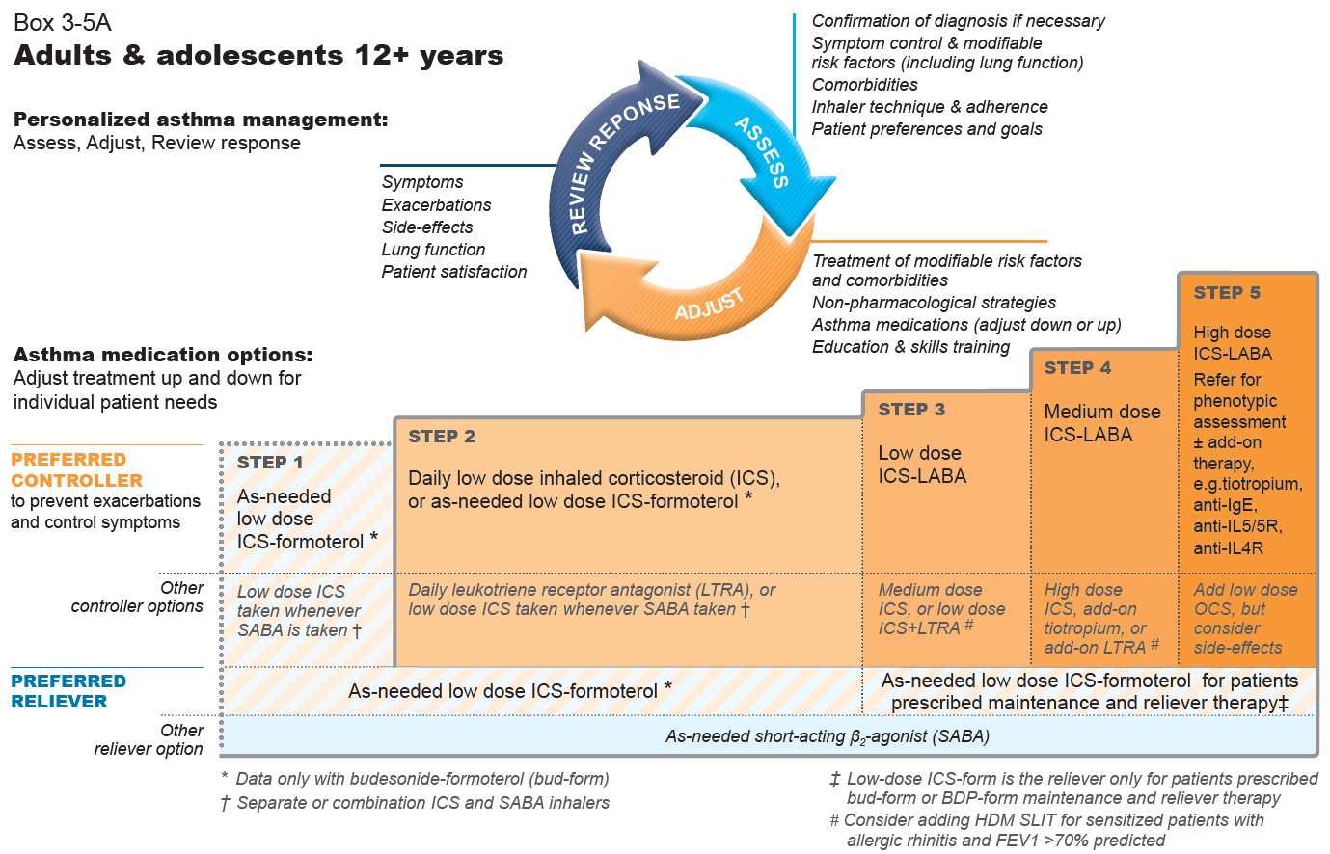
GINA 2020
GINA 2020, Box 3-5A
@ Global Initiative for asthma ,www.ginasthma.org
Notes:
The only changes in this figure from the 2019 report are (in the arrowed circle) addition of patient preferences in the Assess section and addition of “adjust down or up” in the “Adjust” section, and removal of “off-label”. There are also some formatting changes to improve readability

Slide 18
The GINA 2021 treatment figure for adults and adolescents
Track 2
(the alternative approach)
with SABA as the reliever
Track 1
(the preferred approach)
low dose ICS-formoterol as reliver
For clarity, the GINA treatment figure now shows two ‘tracks’, based on evidence about outcomes with the two reliever choices across asthma severity

Slide 19
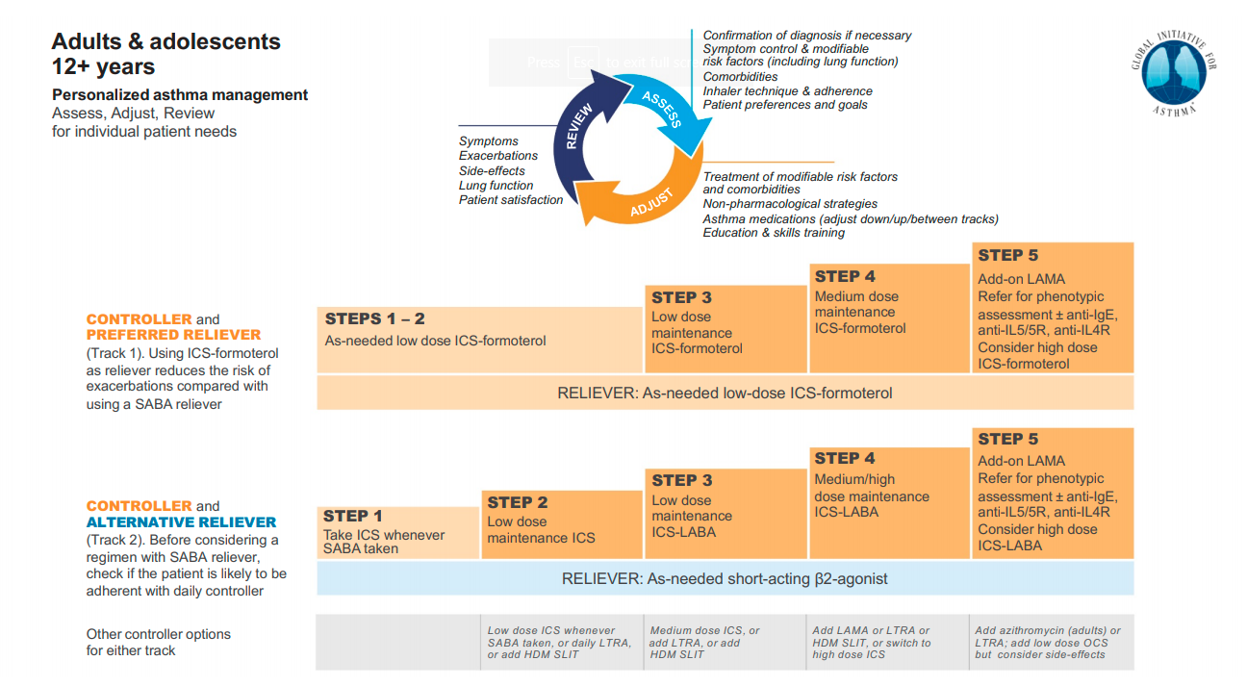
GINA 2021

Slide 20
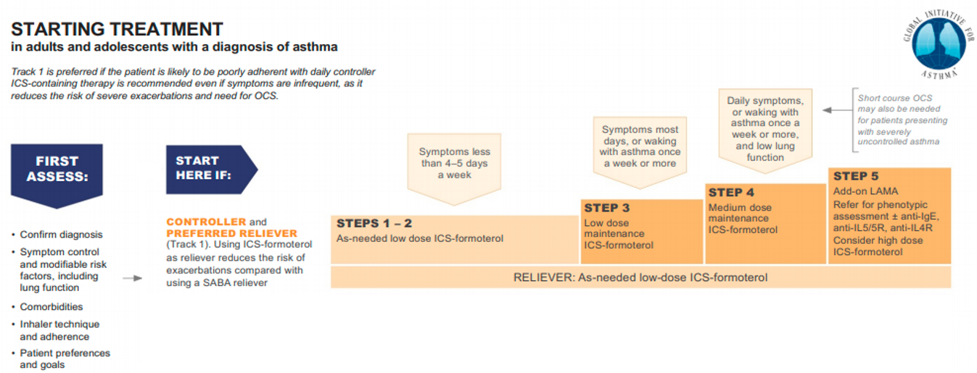
Track 1: preferred, To reduce the risk of exacerbations
Using ICS-formoterol as reliever reduces the risk of exacerbations compared with using a SABA reliever, with similar symptom control and similar lung function

Slide 21
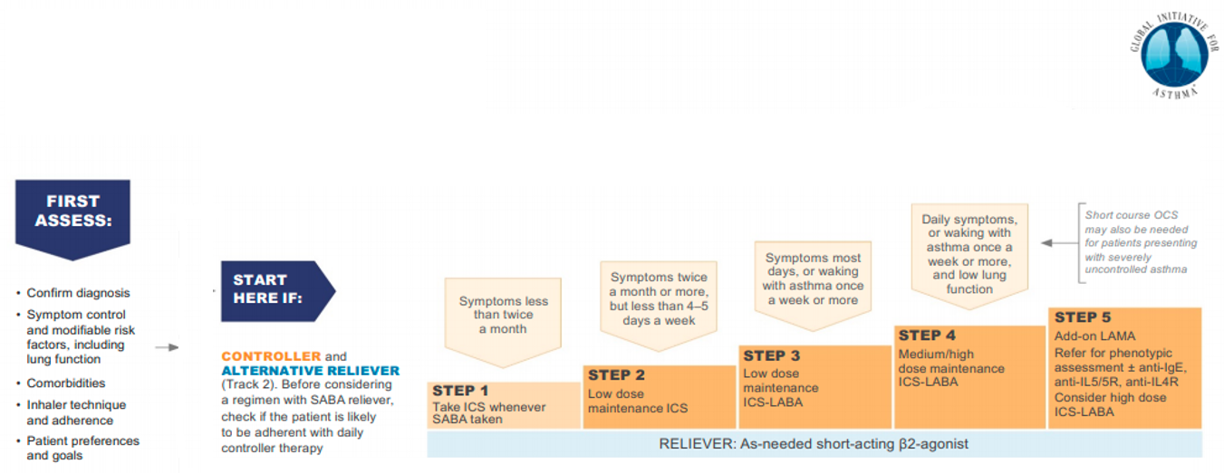
Track 2: The alternative Track
if Track 1 is not possible, or is not preferred by a patient with no exacerbations on their current controller therapy
First ,consider whether the patient is likely to be adherent with daily controller – if not, they will be exposed to the risks of SABA-only treatment

Slide 22
As needed low dose ICS-Formoterol
So far all evidence for as-needed ICS-formoterol in mild asthma is with low dose Budesonide-Formoterol but Beclometasone-Formoterol may also be suitable.
Both of these medications are well established for as-needed use within maintenance and reliever therapy(MART) in GINA step 3-5

Slide 23
Why did GINA extend as-needed ICS-formoterol to Step 1?
  There is no evidence for safety or efficacy of SABA-only treatment
  Patients with infrequent symptoms can still have severe or fatal exacerbations
  There is indirect evidence about safety and efficacy of as-needed ICS-formoterol from four large RCTs in patients eligible for Step 2 treatment by GINA 2012 or 2014 criteria
  The distinction between symptoms < and ≥ twice/month (or twice/week e.g. NAEPP) is arbitrary, not evidence based.
  Starting with SABA alone trains the patient to regard it as their primary asthma treatment
Notes:
Beasley R, Holliday M, Reddel HK et al. Controlled trial of budesonide-formoterol as needed for mild asthma. N Engl J Med 2019; 380: 2020-2030
Hardy J et al, and Reddel HK et al. Budesonide-formoterol reliever therapy vs maintenance budesonide plus terbutaline reliever therapy in adults with mild to moderate asthma: the PRACTICAL study, an independent open-label randomised controlled trial. Lancet 2019; 394: 919-928.
Sumino K, Bacharier LB, Taylor J, Chadwick-Mansker K, Curtis V, Nash A, et al. A pragmatic trial of symptom-based inhaled corticosteroid use in African-American children with mild asthma. JACI in Practice. 2019. DOI 10.1016/j.jaip.2019.06.030

Slide 24
Other changes in GINA 2021 – mild asthma
Patients and clinicians often consider ‘mild asthma’ to mean infrequent or mild symptoms
GINA does not distinguish between ‘intermittent’ and ‘mild persistent’ asthma
GINA is planning to review the definition of mild asthma during 2021

Slide 25
Maintenance and reliever therapy (MART) in Steps 5
There is no direct evidence about initiating MART in patients receiving add-on treatment such as LAMA or biologic therapy, but if a patient is already taking MART, switching them to conventional ICS-LABA plus as-needed SABA may increase the risk of exacerbations

Slide 26
ICS-formoterol – maximum daily dose in MART approach
Beclometasone-formoterol :
The maximum recommended total dose in a single day is 48 mcg formoterol for beclomethasone-formoterol formulation
From product information, the maximum recommended total in one day is 48 mcg formoterol
(6 inhalations of Beclometasone-formoterol pMDI100/6 mcg)
Budesonide-formoterol:
From product information, the maximum recommended total in one day is 72 mcg formoterol

Slide 27
Asthma severity – severe asthma
To avoid confusion, the definition of severe asthma has been reworded without reference to GINA steps, as these have changed over time
Severe asthma is asthma that remains uncontrolled despite optimized treatment with high dose ICS-LABA, or that requires high dose ICS-LABA to prevent it from becoming uncontrolled

Slide 28
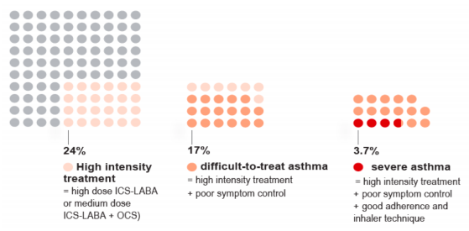
What proportion of adults have severe asthma?
Data from Hekking et al, JACI 2015

Slide 29
Add-on long-acting muscarinic antagonists (LAMA)
Step 5 recommendations for add-on LAMA have been expanded to include combination ICS-LABA-LAMA, if asthma is persistently uncontrolled despite ICS-LABA
Adding LAMA to medium or high dose ICS-LABA modestly improves lung function (Evidence A) but not symptoms & increased the time to severe exacerbation requiring OCS (Evidence B)
For patients with exacerbations, it is important to ensure that the patient receives sufficient ICS, i.e. at least medium dose ICS-LABA, before considering adding a LAMA

Slide 30
Add-on azithromycin
Add-on azithromycin three days a week has been confirmed as an option for consideration after specialist referral
Significantly reduces exacerbations in patients taking high dose ICS-LABA
Significantly reduces exacerbations in patients with eosinophilic or non-eosinophilic asthma
No specific evidence published for azithromycin in patients taking medium dose ICS-LABA (Hiles et al, ERJ 2019)\
Before considering add-on azithromycin ,Check sputum for atypical mycobacteria , Check ECG for long QTc (and re-check after a month of treatment) ,Consider the risk of increasing antimicrobial resistance (population or personal)

Slide 31
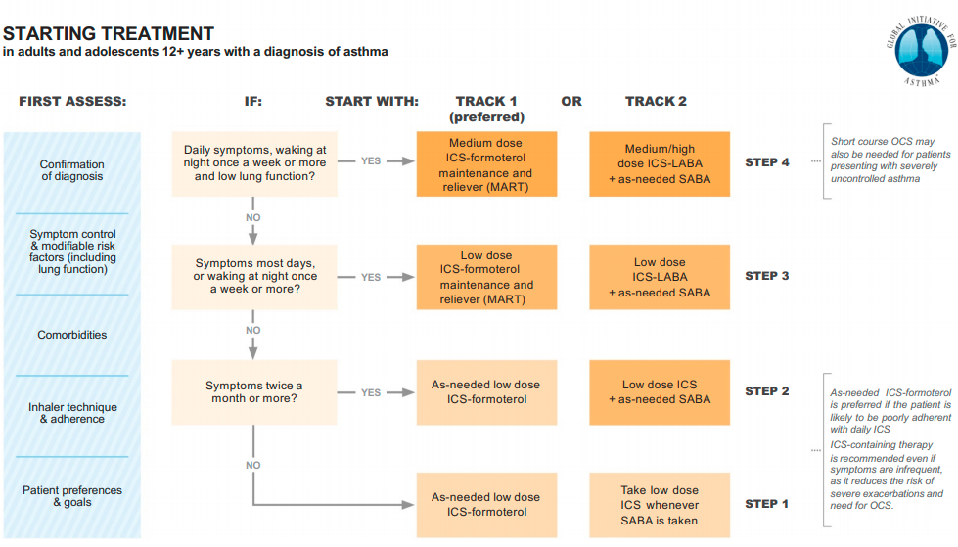
@ Global Initiative for asthma ,www.ginasthma.org
Notes:
An alternative figure to Box 3-4A for teaching purposes, if audiences are not familiar with the GINA treatment figure

Slide 32
Low, medium and high doses of different ICS
NOT a table of equivalence
  Suggested total daily doses for ‘low’, ‘medium’ and ‘high’ dose treatment options
  Based on available studies (very few) and product information
  Does NOT imply potency equivalence
Clinical relevance
  Low dose ICS provides most of the clinical benefit of ICS for most patients with asthma
  However, ICS responsiveness varies between patients, so some patients may need medium dose ICS if their asthma is uncontrolled despite good adherence and correct technique
  High dose ICS (in combination with LABA or separately) is needed by very few patients
    Its long-term use is associated with an increased risk of local and systemic side-effects, which must be balanced against the potential benefits

Slide 33
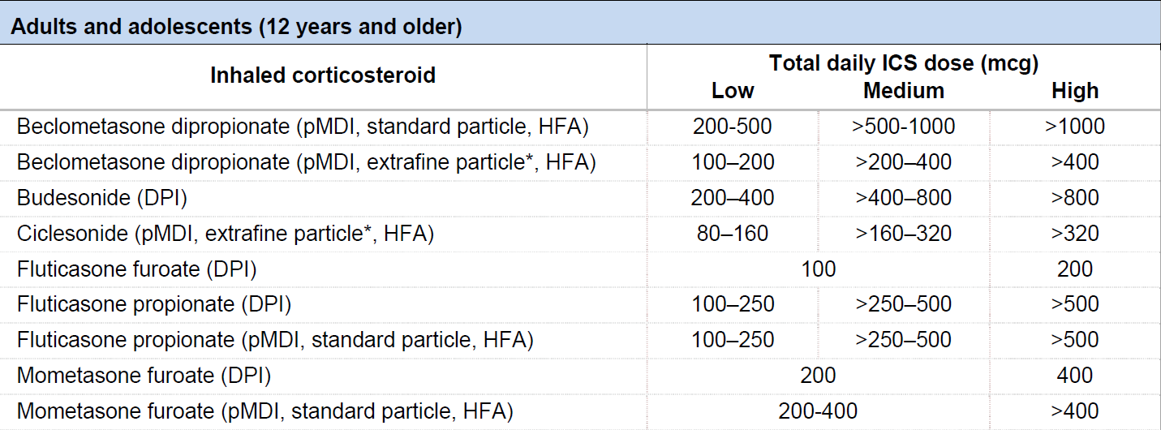
Low, medium and high ICS doses: adults/adolescents
This is NOT a table of equivalence. These are suggested total daily doses for the ‘low’, ‘medium’ and ‘high’ dose treatment options with different ICS.
GINA 2020, Box 3-6A
DPI: dry powder inhaler; HFA: hydrofluoroalkane propellant; pMDI: pressurized metered dose inhaler (non-CFC); * see product information

Slide 34
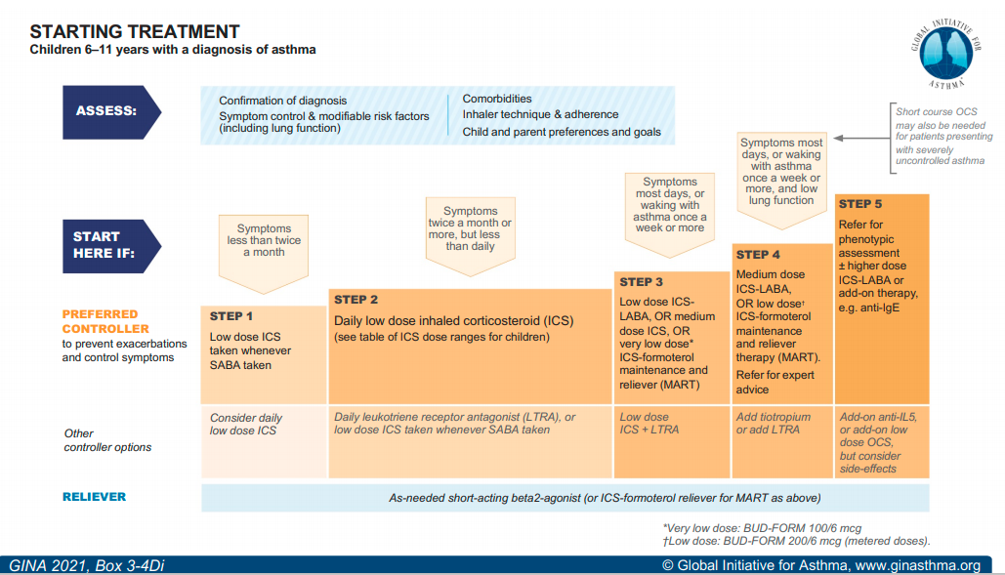

Slide 35
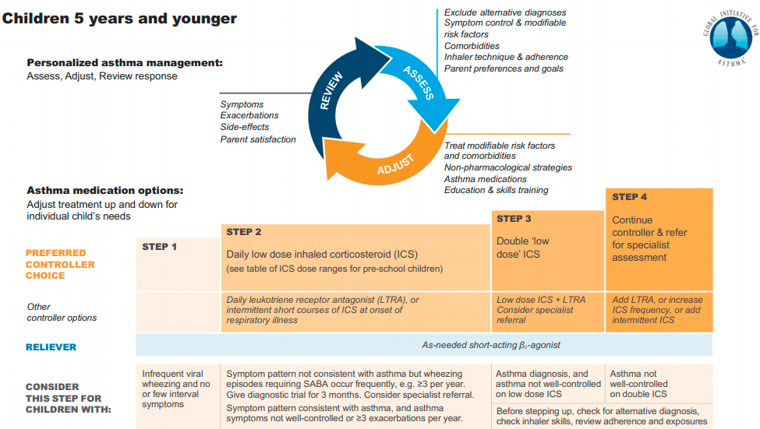

Slide 36

Thank you

