Slide 1
Extra-fine formulations Benefits
Dr. Shahideh Amini
Clinical Pharmacist, Fellowship of Pharmacotherapy in Critical Care
TUMS
July. 2021

Slide 2
Objective
Define delivery factors
Extrafine Formulation
Extrafine Formulations: The clinical relevance

Slide 3
Drug delivery factors
Patients Factors
Disease status
Inhaler Factors
Aerosol properties
Particle properties
Inhalation Technique
Physicochemical properties
Lung properties
Device
Mass median aerodynamic diameter
Geometric standard deviation
Fine particle fraction
Air/particle velocity
Volume diameter
Bulk density
Tap density
Shape
Charge
Geometry of respiratory tree (airway structure and diameter of airways)
Influence of disease state on airway structure
Breathing pattern – mouth or nasal breathing
Ibrahim, M., Verma, R., & Garcia-Contreras, L. (2015). Inhalation drug delivery devices: technology update. Medical devices (Auckland, N.Z.), 8, 131–139. https://doi.org/10.2147/MDER.S48888

Slide 4
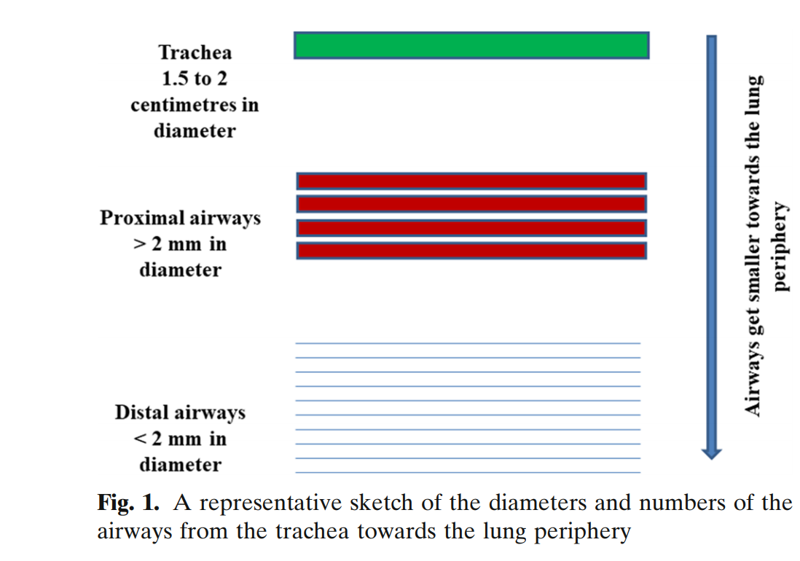
Respiratory Tract: Structure and Attractions for Drug Delivery
It is well recognized that, of aerosol characteristics, drug particle size is the major determinant governing the site of airway deposition of inhaled medication
AAPS PharmSciTech (2020) 21: 238
Notes:
Particles >5 microns (μm) are most likely to be deposited in the oropharynx.
For drug delivery to the lower respiratory tract and lungs, particle size (mass-median aerodynamic diameter) can be fine (2–5 μm) or extra-fine (<2 μm), which influences the total respirable fraction (particles <5 μm) and the amount and site of drug deposition (more peripheral deposition with extra-fine particles).
The particle size distribution of an aerosol is
usually expressed in terms of its mass median aerodynamic
diameter (MMAD). Particles deposit in the respiratory tract by
inertial impaction (3-6 mm), sedimentation (1-3 mm), and
diffusion (<1 mm). To reach the lower respiratory tract past the
carina, the MMAD of inhaled particles should be less than 5 mm
in diameter; specifically, the particle size with the most efficient
deposition in the small airways, so-called extrafine particle
fraction, is said to be less than 2 mm

Slide 5
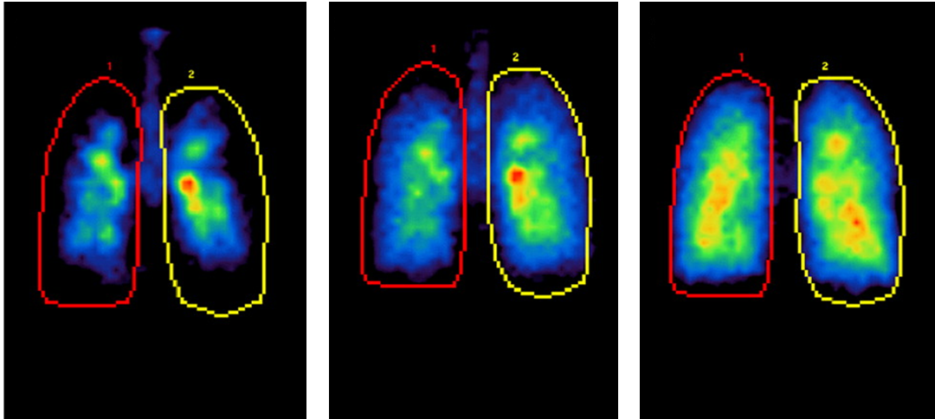
Effect of MMAD on lung deposition
MMAD 6 μm
MMAD 3 μm
MMAD 1.5 μm
12 subjects with asthma (FEV₁, 76.8±11.4% predicted) inhaled technetium-99m–labelled monodisperse salbutamol aerosols (30 mcg dose) of 1.5-, 3-, and 6-mcm MMAD, at slow (30–60 L/min) and fast (60 L/min) inspiratory flows. Lung and extrathoracic radioaerosol deposition were quantified using planar- γ-scintigraphy
MMAD: median mass aerodynamic diameter
Adapted from Usmani et al. Am J Respir Crit Care Med 2005; 172: 1497–504
Notes:
A: Regions of interest, where a 5X8 matrix was closely fitted to the krypton ventilation-scan lung boundary and superimposed on the posterior thorax aerosol deposition images, which was partitioned into a central zone (blue and orange), 2X3matrix centred on the lung hilum; an intermediate zone (green and beige), 3X5matrix excluding the central zone; and a peripheral zone defined as the remaining lung field within the lung outline (red and yellow). B-D: MMAD posterior thorax images of technetium-99m–labelled salbutamol aerosol deposition in the lungs. Red areas indicate regions of highest radioactivity, and black of least radioactivity.
Results: Smaller particles achieved greater total lung deposition (1.5 m [56%], 3 m [50%], and 6 m [46%]), farther distal airways penetration (0.79, 0.60, and 0.36, respective penetration index), and more peripheral lung deposition (25, 17, and 10%, respectively). However, larger particles (30-g dose) were more efficacious and achieved greater bronchodilation than 200 g MDI albuterol (FEV1[ml]: 6 m [551], 3 m [457], 1.5 m [347], MDI [494]). Small particles were exhaled more (1.5 m [22%], 3 m [8%], 6 m [2%]), whereas greater oropharyngeal deposition occurred with large particles (15, 31, and 43%, respectively). Faster inspiratory flows decreased total lung deposition and increased oropharyngeal deposition for the larger particles, with less bronchodilation. A shift in aerosol distribution to the proximal airways was observed for all particles. Conclusions: Regional targeting of inhaled 2-agonist to the proximal airways is more important than distal alveolar deposition for bronchodilation. Altering intrapulmonary deposition through aerosol particle size can appreciably enhance inhaled drug therapy and may have implications for developing future inhaled treatments.

Slide 6
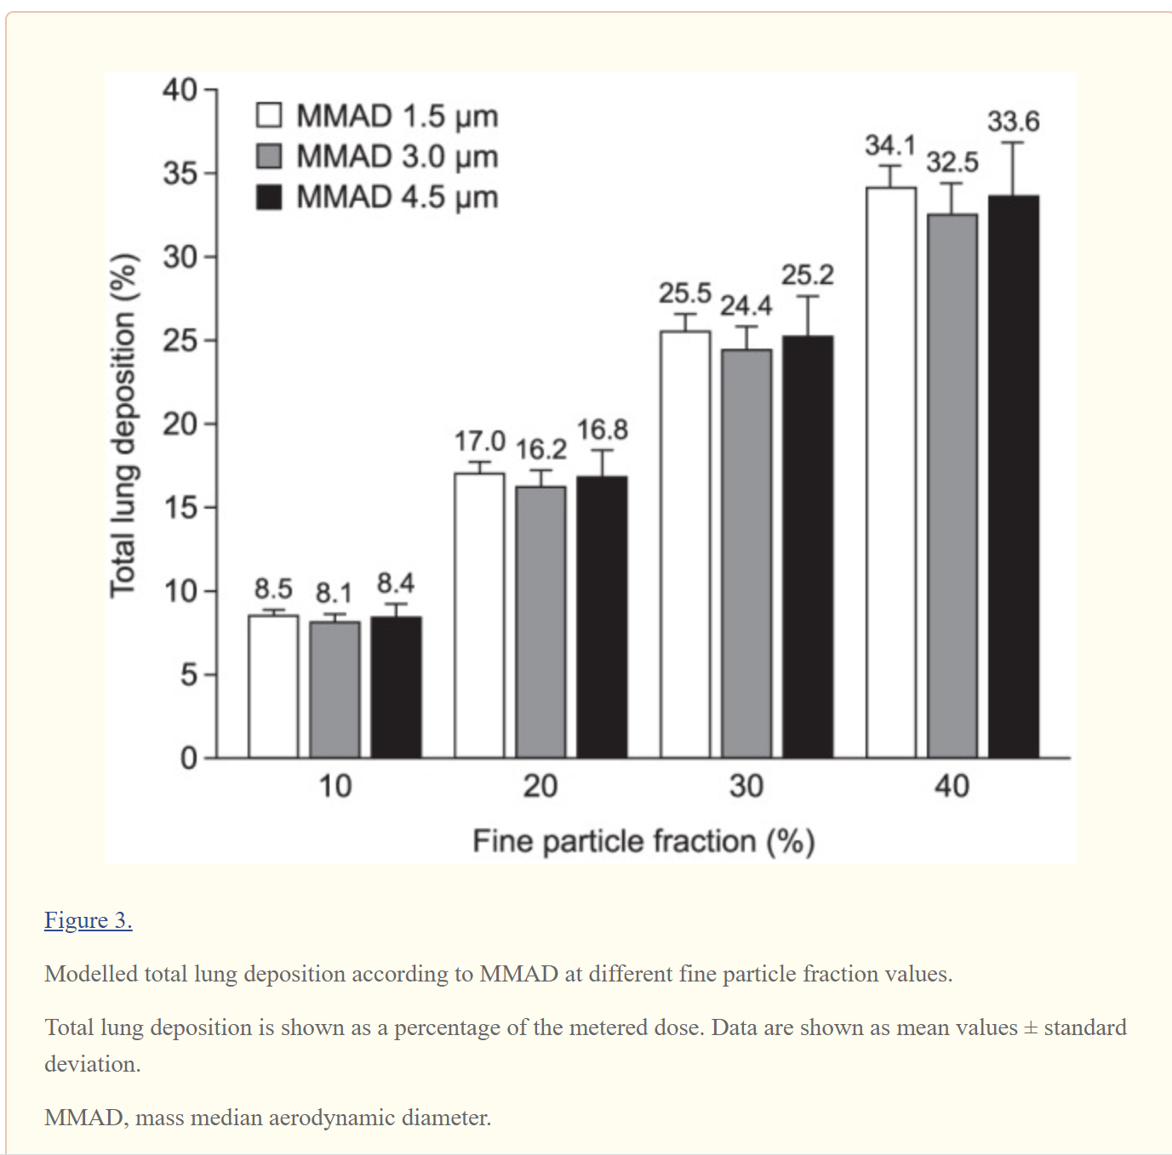
Influence of MMAD and FPF on lung deposition
Van Holsbeke C, De Backer J, Vos W, Marshall J. Use of functional respiratory imaging to characterize the effect of inhalation profile and particle size on lung deposition of inhaled corticosteroid/long-acting β2-agonists delivered via a pressurized metered-dose inhaler. Ther Adv Respir Dis. 2018;12:1753466618760948.
Notes:
Three-dimensional models of the lungs of six patients with asthma (mean forced expiratory volume in 1 s, 83%), treated with an ICS/LABA, were included. FRI modelling was used to simulate (1) the effects on lung deposition of inhalation duration and particle size [fine particle fraction (FPF), proportion of particles <5 µm; and mass median aerodynamic diameter (MMAD), average size of inhalable particles]; (2) deposition of fluticasone propionate/formoterol (FP/FORM) 125/5 µg; and (3) how inhalation profiles and flow rates affected FP/FORM deposition.
FPF is the fraction of the total drug dose <5.0μm; MMAD is the average size of particles constituting the dose which reach the impactor, excluding those that deposit in the 'throat’.
In the simulations performed in this study, TLD improved with increasing FPF values, whereas changes in MMAD had little effect on TLD. At each FPF value, TLD was similar for all three MMADs; for example, at an FPF of 10%, mean ± SD TLD was 8.5% ± 0.34, 8.1% ± 0.48 and 8.4% ± 0.81 for MMADs of 1.5, 3.0 and 4.5 μm, respectively, and at an FPF of 40%, mean ± SD TLD was 34.4% ± 1.37, 32.5% ± 1.93 and 33.6 ± 3.25, respectively (Figure 3). By contrast, mean ± SD TLD was greater at higher FPFs, increasing from 8.1% ± 0.48 of the metered dose at an FPF of 10%, to 16.2 ± 0.97 at an FPF of 20%, 24.4% ± 1.45 at an FPF of 30% and 32.5% ± 1.93 at an FPF of 40% for an MMAD of 3.0 μm (Figure 3). These trends were confirmed when using a mixed-effects model to assess the influence of FPF or MMAD on TLD; increasing FPF was found to be significantly associated with increasing TLD (p < 0.001), whereas MMAD was found to have no effect on TLD (p = 0.30). When averaged over the 1.5, 3.0 and 4.5 μm MMAD values, the total linear model (R2 = 0.97; p < 0.001) resulted in mean (95% CI) values of 8.3% (7.2%, 9.3%), 16.7% (15.5%, 17.6%), 25.0% (23.8%, 26.0%) and 33.4% (32.2%, 34.4%) for FPF values of 10, 20, 30 and 40%, respectively.

Slide 7

Rationale for developing extrafine drug formulations
New extrafine formulations can incresae the deposition to small airways
Can we achieve additional clinical benefits by targeting small airways?
Small airways are a potential target for treatment

Slide 8
Target small airway
Small airways has been recognized as the major site of airfow limitation in both asthma and COPD.
Small airways dysfunction (sad) cannot be detected through standard spirometry, and so may go unnoticed (the so called “quiet zone” ).
The persistence of uncontrolled inflammation in the peripheral small airways emerged as a strong contributors of asthma control.
There is a clear correlation between the presence of sad and increased decline in forced expiratory volume in 1 second (FEV1) in patients with COPD
Cottini et al. Clin Mol Allergy (2021)- 19:7
Usmani OS et al. Int J Chron Obstruct Pulmon Dis. (2020) 7;15:2433-2440.
Notes:
Te small airways are defned as airways with an internal diameter ≤2 mm that do not contain cartilage in their
walls and extend from the 8th generation airways to the
periphery of the lung [40]. Under normal circumstances,
small airways contribute only minimally to airway resistance, and for this reason they are known as the lung’s
“quiet zone” [41]. In contrast, in COPD and asthma, small
airways are likely the key area that determines the transition from physiologic to pathophysiologic behavior of the
bronchial tree [38]. Many studies and systematic reviews
suggested that SAD is associated with more severe bronchial hyper-responsiveness, worse asthma control and a
higher number of exacerbation Overall, the prevalence of SAD in patients with asthma is around 50–60% [43], but it seems to vary with the physiological measure used to assess it

Slide 9
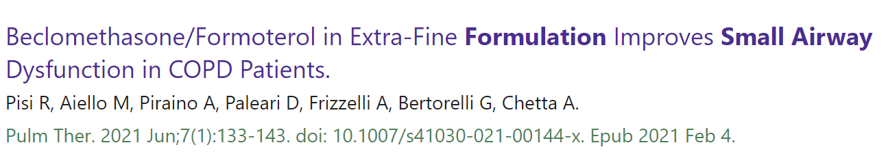
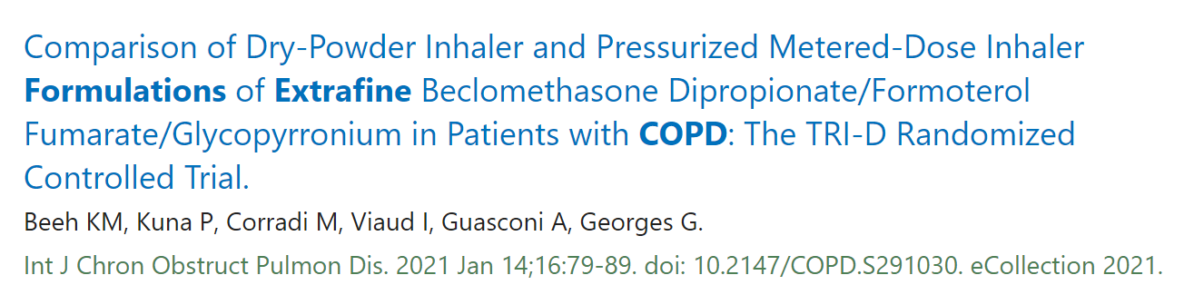
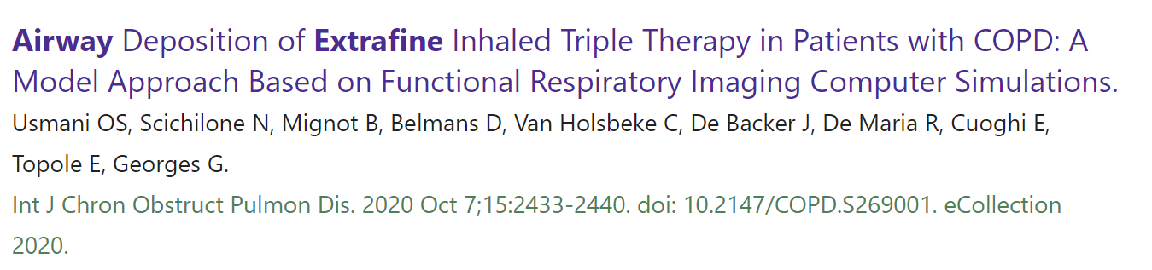
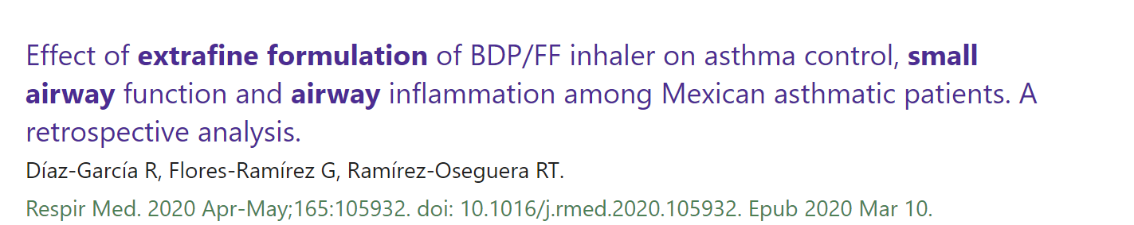
Notes:
We enrolled COPD patients with
severe airflow obstruction and at least one
moderate exacerbation in the previous year,
having started treatment with BDP/FF NEXThaler for no more than 1 week. Patients
underwent three visits: at the start of the treatment (V1), 6 weeks (V2), and 12 weeks later
(V3). At each visit, we evaluated the fall in
resistance from 5 to 20 Hz (R5–R20) and residual
volume/total lung capacity (RV/TLC) ratio by
impulse oscillometry, spirometry, and plethysmography. The COPD Assessment Test (CAT)
and the modified Medical Research Council
(mMRC) questionnaire were also administered
to assess the disease’s impact on quality of life

Slide 10
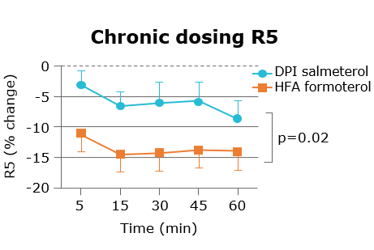
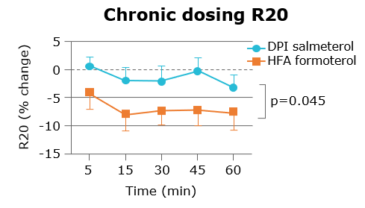
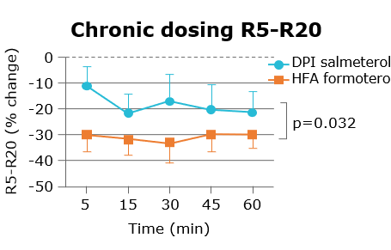
Small-particles LABA vs large-particles LABA: Effects in IOS
Randomised open-label cross-over study. Impulse oscillometry (IOS) to compare single and repeated dosing effects (over 1-2 weeks) of small- and large-particle
long-acting –β₂-agonists in 16 patients with persistent asthma. Effects on IOS outcomes with either small-particle formoterol or large-particle salmeterol over a 60-minute period after inhaling the last dose shown as percentage change from baseline. Data are depicted as means and SEMs. For all IOS outcomes, there were significant differences between treatments, which were sustained over the 60-minute period.
HFA: hydrofluoroalkane; LABA: long-acting beta agonists; DPI: dry powder inhaler
Adapted from Manoharan et al. J Allergy Clin Immunol 2016; 137: 727–33 e1
Notes:
Effects on IOS outcomes with either small-particle formoterol or large-particle salmeterol over a
60-minute period after inhaling the last dose shown as percentage change from baseline. Data are depicted
as means and SEMs. For all IOS outcomes, there were signiﬁcant differences between treatments, which
were sustained over the 60-minute period.
The results of the present study showed signiﬁcantly greater improvements in all IOS outcomes conferred by small-particle formoterol in terms of total (R5), central (R20), and peripheral airway resistance (R5-20) and AX and X5, as well as RF. These changes in IOS outcomes occurred after repeated dosing with 12 μg of twice-daily formoterol compared with 50 $μ$g of twice-daily salmeterol when used as add-on to ICSs in controlled
patients with mild-to-moderate persistent asthma. Moreover, the differences between formulations for all of the IOS outcomes were sustained over the entire 60-minute period after inhaling the last dose. The greater reduction in central and peripheral resistance might reﬂect enhanced distribution of formoterol throughout the lung, including the small airways, which is in keeping with its ﬁner particle size. No such differences were seen
for FEV 1 , FEF 25-75 , or domiciliary PEF after repeated dosing.
The apparent disconnect in IOS outcomes between single and chronic dosing might be explained by the cumulative effects of extraﬁne particles on the smaller airways on repeated exposure, resulting in subtle changes in airway geometry. In other words, it is possible that equilibration was achieved at steady state for regional bronchodilator effects, which improved the overall signal/noise ratio seen with IOS after repeated but not single dosing.

Slide 11
PRISMA study
Lower Mean daily ICS dose in patients treated with ICS/LABA combinations
p<0.0001
The mean daily dose of BDP/F was significantly lower compared with BUD/F or FP/S
Mean daily ICS dose (mcg)
BDP/F
BUD/F
FP/S
n=437
n=423
n=454
To estimate the prevalence of partly controlled and uncontrolled asthmatic patients, to evaluate quality of life and healthcare resource consumption. Cross sectional phase followed by a 12-month prospective phase. Asthma Control Test™ and the EQ-5D were used. 2853 adult patients recruited in 56 Hospital Respiratory Units in Italy were evaluated.
BDP: beclometasone dipropionate; BUD: budesonide; F: formoterol; FP: fluticasone propionate; ICS: inhaled corticosteroids; pMDI: pressurised metered dose inhaler
LABA: long-acting beta agonists; S: salmeterol
Adapted from Allegra et al. Respir Med 2012; 106: 205–14
Notes:
, the cross-sectional phase of the observational PRISMA study indicated that asthma control can be achieved in a good proportion of patients and is associated with better quality of life and reduced health care resource consumption. ICS/LABA combination is the most common therapy and differences both in asthma control and in quality of life may be seen in a real-life setting showing better clinical outcomes in favor of extraﬁne BDP/F combination with the advantage of a more efﬁcient ICS dose.
ross-sectional phase followed by a 12-month prospective phase. Asthma Control Test and the EQ-5D were used.
Results: 2853 adult patients recruited in 56 Hospital Respiratory Units in Italy were evaluated: 64.4% had controlled asthma, 15.8% partly controlled asthma and 19.8% were uncontrolled. The mean (SD) EQ-5D score was 0.86 (0.17) in controlled, 0.75 (0.20) in partly controlled and 0.69 (0.23) in uncontrolled patients (p<0.001 between groups). The number of patients requiring hospitalization or emergency room visits was lower in controlled (1.8% and 1.6%, respectively) than in partly controlled (5.1% and 11.5%) and uncontrolled (6.4% and 18.6%). A combination of an inhaled corticosteroid and a long-acting beta-2 agonist was the reported therapy by 56.0% of patients, with the rate of controlled asthma and improved quality of life being higher in patients on extrafine beclomethasone/formoterol compared to budesonide/formoterol (p<0.05) and fluticasone/salmeterol (p<0.05 for quality of life).
Conclusions: Asthma control is achieved in a good proportion of Italian patients. Differences may be detected in a real-life setting in favor of extrafine beclomethasone/formoterol combination.

Slide 12
Extrafine BDP/F and asthma control real life studies : higher proportion of patients with fully controlled asthma
patients
Müller et al. BMC Pulmonary Medicine 2011
Allegra L et al PRISMA Study. Respir Med. 2012
Notes:
Extrafine BDP/F combination achieved better a sthma control according to ACT score vs large particle combinations despite lower ICS use
the cross-sectional phase of the observational PRISMA study indicated that asthma control can be achieved in a good proportion of patients and is associated with better quality of life and reduced health care resource consumption. ICS/LABA combination is the most common therapy and differences both in asthma control and in quality of life may be seen in a real-life setting showing better clinical outcomes in favor of extraﬁne BDP/F combination with the advantage of a more efﬁcient ICS dose.
ross-sectional phase followed by a 12-month prospective phase. Asthma Control Test and the EQ-5D were used.
Results: 2853 adult patients recruited in 56 Hospital Respiratory Units in Italy were evaluated: 64.4% had controlled asthma, 15.8% partly controlled asthma and 19.8% were uncontrolled. The mean (SD) EQ-5D score was 0.86 (0.17) in controlled, 0.75 (0.20) in partly controlled and 0.69 (0.23) in uncontrolled patients (p<0.001 between groups). The number of patients requiring hospitalization or emergency room visits was lower in controlled (1.8% and 1.6%, respectively) than in partly controlled (5.1% and 11.5%) and uncontrolled (6.4% and 18.6%). A combination of an inhaled corticosteroid and a long-acting beta-2 agonist was the reported therapy by 56.0% of patients, with the rate of controlled asthma and improved quality of life being higher in patients on extrafine beclomethasone/formoterol compared to budesonide/formoterol (p<0.05) and fluticasone/salmeterol (p<0.05 for quality of life).
Conclusions: Asthma control is achieved in a good proportion of Italian patients. Differences may be detected in a real-life setting in favor of extrafine beclomethasone/formoterol combination.

Slide 13
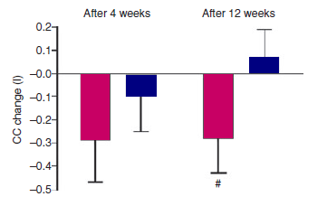
Extrafine BDP/F effects on air trapping
The reduction in closing capacity in patients treated with Foster is consistent with a reduction in air trapping
  A positive trend for improvement in closing capacity at the end of treatment period was observed only inBDP/F extrafine group
BDP/F
100/6µg, two puffs b.i.d.
FP/SALM 125/25µg, two puffs b.i.d.
# p<0.08 vs. baseline
CC: closing capacity
Scichilone et al. Allergy 2010
Notes:
Effects of extra-fine inhaled beclomethasone/formoterol
on both large and small airways in asthma
single breath nitrogen test (SBN2)
After a 1- to 4-week run-in period, patients with asthma were randomized to a double blind, double dummy, 12-week treatment with either extra-fine beclomethasone/formoterol (BDP/F) 400/24 lg daily or fluticasone propionate/ salmeterol (FP/S) 500/100 lg daily. Methacholine (Mch) bronchoprovocation challenge and single breath nitrogen (sbN2) test were performed. Results: Thirty patients with asthma (15 men), mean age 43, mean forced expiratory volume in the first second (FEV1) 71.4% of predicted, were included. A significant increase (P < 0.01) versus baseline was observed in predose FEV1 in both BDP/F and FP/S groups (0.37 ± 0.13 l and 0.36 ± 0.12 l, respectively). PD20FEV1 Mch improved significantly from 90.42 (±30.08) lg to 432.41 (±122.71) lg in the BDP/ F group (P = 0.01) but not in the FP/S group. A trend toward improvement vs baseline was observed for BDP/F in closing capacity (CC), whereas no differences were recorded in other sbN2 test parameters. Conclusion: The findings of this pilot study suggest that an extra-fine inhaled combination for the treatment of asthma has beneficial effects on both large and small airways function as expressed by Mch and sbN2 tests

Slide 14
Maintenance and Reliever Therapy (MART)
Significant reduction in severe exacerbations with MART: chronic & as needed Extrafine BDP-FF formulation
Patients with severe exacerbations (%)
1714 patients with asthma and history of exacerbation
p=0,0003
Time since randomization (days)
Papi et al, The Lancet Respir Med 2013
Notes:
MART 2 STUDY
Maintenance and Reliever Therapy (MART)
A 48-week, multicentre, multinational, randomized, double-blind, 2-arm parallel group study, comparing the efficacy of FOSTER MART® [FOSTER 100/6 µg, (one inhalation bid) plus additional inhalations as needed] versus fixed-dose FOSTER for maintenance + salbutamol as reliever [FOSTER 100/6 µg, (one inhalation bid) plus salbutamol (200 µg/inhalation as needed)] in asthmatics ≥ 18 years of age
Primary outcome: time to first severe exacerbation (defined as deterioration in asthma resulting in hospitalization or emergency room treatment, and/or the need for systemic steroids for ≥ 3 days)
Background According to international treatment guidelines, inhaled rapid-acting β2 agonists should be used for the control of symptoms in patients with asthma. We compared the effi cacy and safety of an extrafi ne combination inhaler containing a corticosteroid (beclometasone) plus a rapid-onset, long-acting β2 agonist (formoterol) with a short-acting β2 agonist (salbutamol) as reliever strategies in patients taking beclometasone–formoterol combination as maintenance treatment. Methods In a double-blind trial undertaken in 183 centres in 14 European countries over 48 weeks, patients (aged ≥18 years) with asthma that was not fully controlled, with a forced expiratory volume in 1 s (FEV1) of at least 60% predicted, had a 2-week run in. During this period, patients were treated with a combination of beclometasone 100 μg and formoterol 6 μg per one inhalation twice daily plus salbutamol 100 μg as required delivered by use of a pressurised metered-dose inhaler. They were then randomly assigned in a 1:1 ratio with a computer-generated randomisation list to receive beclometasone 100 μg plus formoterol 6 μg or salbutamol 100 μg as reliever in addition to maintenance with beclometasone 100 μg plus formoterol 6 μg twice daily. Primary outcome was the time to fi rst severe exacerbation (admission to hospital or visit to emergency department, or use of systemic steroids for ≥3 consecutive days). Secondary outcomes were number of severe exacerbations (events per 100 patients per year), time to and number of mild exacerbations, additional exacerbation variables, lung function, symptom scores, and asthma control. Analysis was by intention to treat. The study is registered with ClinicalTrials.gov, number NCT00861926. Findings 1714 patients were randomly assigned to the as-needed beclometasone–formoterol (n=857) and as-needed salbutamol groups (n=857), and 1701 were analysed (852 and 849, respectively). 326 severe exacerbations were reported by 251 patients during the study, and 99 versus 152 patients had at least one exacerbation during the 48 weeks, respectively. Compared with beclometasone–formoterol plus salbutamol as needed, beclometasone– formoterol for both maintenance and reliever treatment significantly increased the time to fi rst exacerbation (209 days vs 134 days) by 75 days, with a 36% reduction in risk (hazard ratio 0·64 [95% CI 0·49 to 0·82]; p=0·0005), and the estimated probability was 12% and 18%, respectively (p=0·0003). The number of days with mild asthma exacerbations was also lower with as-needed beclometasone–formoterol than with as-needed salbutamol (56·04 days per patient per year vs 65·11 days per patient per year; 0·86 [0·76 to 0·98]; p=0·021). From the run-in period to week 48, both treatments improved symptoms (mean change –1·59 [–1·94 to –1·25] in the as-needed beclometasone– formoterol group vs –1·44 [–1·78 to –1·10] in the as-needed salbutamol group, diff erence –0·15 [–0·60 to 0·30]; p=0·507), percentage of asthma control days (9·5% [7·3 to 11·8] vs 10·9% [8·7 to 13·1], respectively, –1·4 [–4·3 to 1·6]; p=0·359), use of reliever (–0·29 [–0·38 to –0·20] vs –0·27 [–0·36 to –0·19], respectively, –0·02 [–0·13 to 0·10]; p=0·794), and lung function (FEV1, 0·090 [0·060 to 0·120] vs 0·090 [0·060–0·120], respectively, 0·001 [–0·040 to 0·040]; p=0·969), and were well tolerated (patients with serious adverse events, 32 [4%] and 41 [5%], respectively). Interpretation Our results lend support to the use of the combination of a single inhaled corticosteroid plus a rapidonset, long-acting β2 agonist for maintenance and relief in patients with moderate to severe asthma and provide encouraging data for the formulation of beclometasone–formoterol for this use.

Slide 15
The FORWARD study:
Extrafine BDP/F provides significant improvement of quality of life vs baseline in COPD
Ef BDP/F
Formoterol
0
-1.0
SGRQ total score, change from baseline
-2.0
-3.0
#
*
#p<0.001 vs baseline
*p=0.002 Foster vs formoterol
-4.0
Wedzicha et al, Respir Med 2014; 108:1153-62
Notes:
The FORWARD study is a randomised, double-blind trial that compares the efficacy and safety of 48 weeks treatment with extrafine beclomethasone dipropionate/formoterol fumarate (BDP/FOR), 100/6 μg pMDI, 2 inhalations BID, vs. FOR 12 μg pMDI, 1 inhalation BID, in severe COPD patients with a history of exacerbations. Co-primary endpoints were exacerbation rate over 48 weeks and pre-dose morning FEV(1) at 12 weeks. The ITT population included 1186 patients (69% males, mean age 64 years) with severe airflow limitation (mean post-bronchodilator FEV(1) 42% predicted). Salbutamol as rescue therapy, theophylline and tiotropium (if stable regimen prior to screening) were allowed. Compared to FOR, BDP/FOR: (1) reduced the exacerbation rate (rate ratio: 0.72 [95% confidence interval 0.62-0.84], p < 0.001); (2) improved pre-dose morning FEV(1) (mean difference: 0.069 L [0.043-0.095] p < 0.001); (3) prolonged the time to first exacerbation; (4) improved the SGRQ total score. The percentage of patients with adverse events was similar (52.1% with BDP/FOR and 49.2% with FOR). Pneumonia incidence was low, slightly higher with BDP/FOR (3.8%) than with FOR (1.8%). No difference for laboratory values, ECG or vital signs. Extrafine BDP/FOR significantly reduces the exacerbation rate and improves lung function of patients with severe COPD and history of exacerbations as compared to FOR alone.

Slide 16
The FORWARD study:
Extrafine BDP/F significantly reduces exacerbations compared to large particle formoterol
1.2
1.0
-28%
*
0.8
RR Ef BDP/F vs formoterol
0.719 (0.619; 0.837)
*p<0.001
0.6
Exacerbation rate per patient per year
0.4
0.2
0
Ef BDP/F
Formoterol
Wedzicha et al, Respir Med 2014; 108:1153-62

Slide 17
The FORWARD study:
Extrafine BDP/F significantly improves lung function compared to large particle formoterol
90
*
*p<0.001 Foster vs formoterol
60
Mean change in FEV₁ from baseline (mL)
30
0
Foster
Formoterol
Wedzicha et al, Respir Med 2014; 108:1153-62

Slide 18
Extra fine BDP/F provides significant improvement in FVC in severe stable COPD
The improvement in pre-dose FVC was statistically significant for Ef BDP/F but not for BUD/F or formoterol and it is consistent with a more efficient peripheral deposition
100
*
LUNG VOLUMES
80
* p<0.005 vs baseline
NORMAL
AIR TRAPPING
60
FVC
FVC
FVC
Change from baseline (ml)
40
RV
RV
20
0
Ef BDP/F
400/24 mg
BUD/F
800/ 24 mg
Formoterol
24 mg
Calverley P et al: Resp Med 2010
Notes:
A double-blind, double-dummy, randomised, active-controlled, parallel-group study. After 4 weeks run-in with ipratropium/salbutamol (40/200 μg, three times daily) patients were randomised to receive beclomethasone/formoterol (200/12 μg pressurised metered dose inhaler), budesonide/formoterol (400/12 μg dry powder inhaler) or formoterol (12 μg dry powder inhaler) twice daily for 48 weeks. Co-primary efficacy variables were change from baseline to 48 weeks in pre-dose morning forced expiratory volume in 1 s (FEV(1)) and mean rate of COPD exacerbations.
Results: Of 718 patients randomised, 703 (232 beclomethasone/formoterol, 238 budesonide/formoterol, 233 formoterol) were in the ITT analysis. Improvement in pre-dose morning FEV(1) was 0.077 L, 0.080 L and 0.026 L for beclomethasone/formoterol, budesonide/formoterol and formoterol respectively (LS mean from the ANCOVA model). Beclomethasone/formoterol was not inferior to budesonide/formoterol (95% CI of the difference -0.052, 0.048) and superior to formoterol (p = 0.046). The overall rate of COPD exacerbations/patient/year was similar and not statistically significantly different among treatments (beclomethasone/formoterol 0.414, budesonide/formoterol 0.423 and formoterol 0.431). Quality of life and COPD symptoms improved in all groups and use of rescue medication decreased. Safety profiles were as expected and treatments well-tolerated.
Conclusions: Beclomethasone/formoterol (400/24 μg) treatment for 48 weeks improved pulmonary function, reduced symptoms compared to formoterol, was safe and well-tolerated in patients with severe stable COPD. Neither of the long-acting β2-agonist/inhaled corticosteroid combinations affected the low exacerbation rate seen in this population.

Slide 19
Extrafine BDP VS large particle FP/SAL Therapy in COPD: Only BDP/F provides clinically meaningful improvement of quality of life
Overall population
(FEV₁<60%)
Patients with FEV₁<50%
0
Foster 400/24 mg
Seretide 1000/100 mg
-2.0
SGRQ total score, change from baseline
*
-4.0
*
Threshold for clinical relevance
**
-6.0
**
*p=0.010 vs baseline
**p<0.001 vs baseline
No significant difference between treatments
Singh et al, BMC Pulm Med 2014; 14:43
Notes:
xtrafine Beclomethasone/formoterol compared to Fluticasone/salmeterol Combination Therapy in COPD

Slide 20
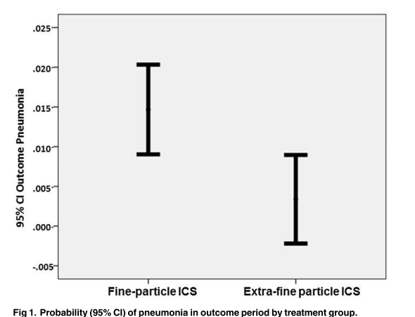
A real-life study comparing extra-fine and fine-particle ICS: Probability of pneumonia by treatment group
Patients with obstructive lung disease on extra-fine particle ICS have a lower risk of pneumonia than those on fine-particle ICS, with those receiving higher ICS doses being at a greater risk.
Sonnappa S et al. (2017) PLoS ONE 12(6): e0178112.
Notes:
Regular use of inhaled corticosteroids (ICS) in patients with obstructive lung diseases has been associated with a higher risk of pneumonia, particularly in COPD. The risk of pneumonia has not been previously evaluated in relation to ICS particle size and dose used.
Methods
Historical cohort, UK database study of 23,013 patients with obstructive lung disease aged 12–80 years prescribed extra-fine or fine-particle ICS. The endpoints assessed during the outcome year were diagnosis of pneumonia, acute exacerbations and acute respiratory events in relation to ICS dose. To determine the association between ICS particle size, dose and risk of pneumonia in unmatched and matched treatment groups, logistic and conditional logistic regression models were used.
Results
14788 patients were stepped-up to fine-particle ICS and 8225 to extra-fine ICS. On unmatched analysis, patients stepping-up to extra-fine ICS were significantly less likely to be coded for pneumonia (adjusted odds ratio [aOR] 0.60; 95% CI 0.37, 0.97]); experience acute exacerbations (adjusted risk ratio [aRR] 0.91; 95%CI 0.85, 0.97); and acute respiratory events (aRR 0.90; 95%CI 0.86, 0.94) compared with patients stepping-up to fine-particle ICS. Patients prescribed daily ICS doses in excess of 700 mcg (fluticasone propionate equivalent) had a significantly higher risk of pneumonia (OR [95%CI] 2.38 [1.17, 4.83]) compared with patients prescribed lower doses, irrespective of particle size.
Conclusions
These findings suggest that patients with obstructive lung disease on extra-fine particle ICS have a lower risk of pneumonia than those on fine-particle ICS, with those receiving higher ICS doses being at a greater risk.

Slide 21
Take Home Message
Clinical outcome
Higher ability of extra fine formulation to reach smaller airways achieved a better efficacy profile in terms of lung function, asthma symptoms, use of rescue medication and quality of life
Since the extra fine size yields a high lung deposition, the nominal dose of BDP per actuation in BDP/FF fixed combination resulted in 2.5-fold dose reduction, as compared with the conventional BDP CFC, thus lowering the amount of ICS absorbed into the systemic circulation by extrathoracic pathways
Lower deposition in the oropharynx reduces typical adverse effects such as hoarseness, dysphonia and candidiasis resulting in higher tolerability
Notes:
ERS/ISAM guidelines, which recommend a long, slow inhalation because this clearly improves both TLD and peripheral deposition.
FPF can have a major effect on TLD, with deposition increasing as FPF increases, whereas MMAD only influenced regional deposition at the same FPF.

Slide 22


Slide 23

Agenda
Foster® Introduction
Foster® Indication & Dosage
Foster® Clinical Evidence
In Asthma
In COPD
MART
Summary®

Slide 24
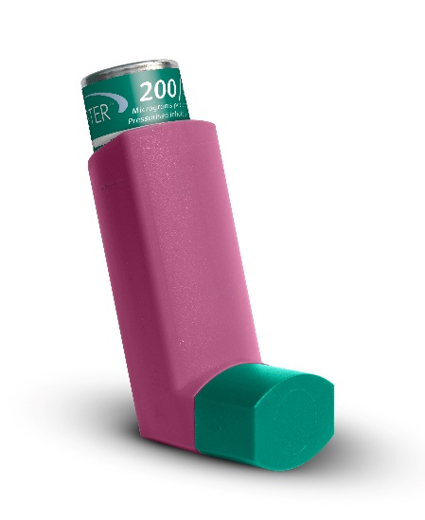
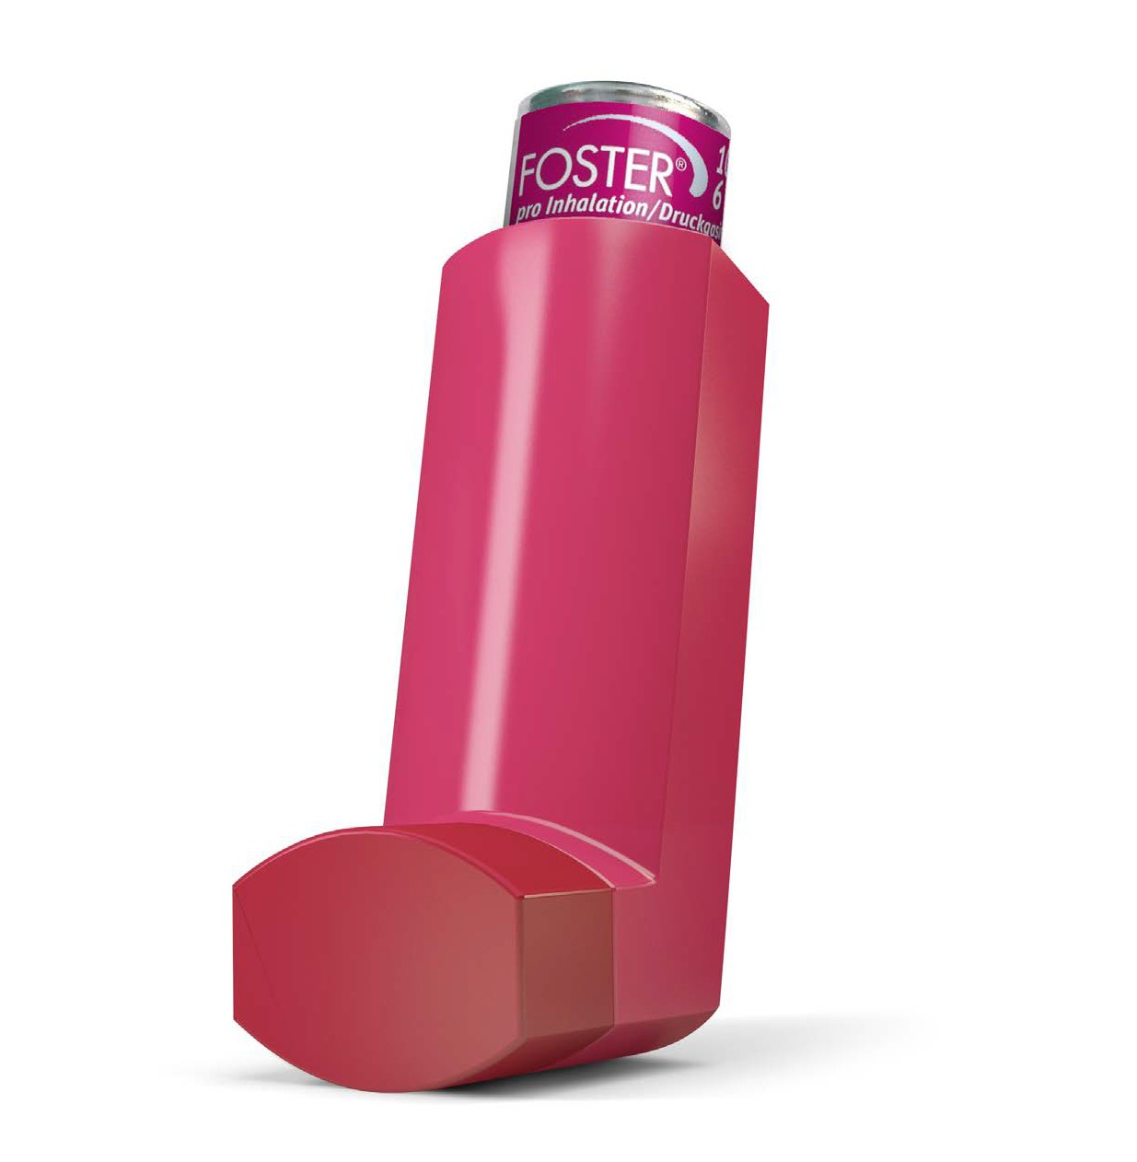
The Only Extrafine ICS-LABA
Approved in Asthma & COPD¹
1- Foster 200/6 is not approved in COPD

Slide 25

Qualitative and quantitative composition
Each metered dose contains:
100 μg and 200 μg of beclometasone dipropionate
6 μg of formoterol fumarate
pMDI (SOLUTION)
Ref :1-Chisholm A., Horizons in Respiratory Medicine, Issue 5 November 2008
2- Foster 100/6 & 200/6 pMDI SmPC

Slide 26
Foster® unique features:
Extrafine formulation
UNIQUE MODULITE Technology
Better hand-breath coordination
Solution: No need for shaking
MART Indication

Slide 27
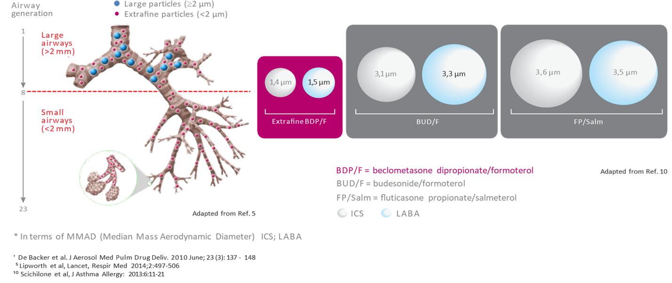
Foster® is the only ICS/LABA with an extrafine formulation which can reach small airways

Slide 28
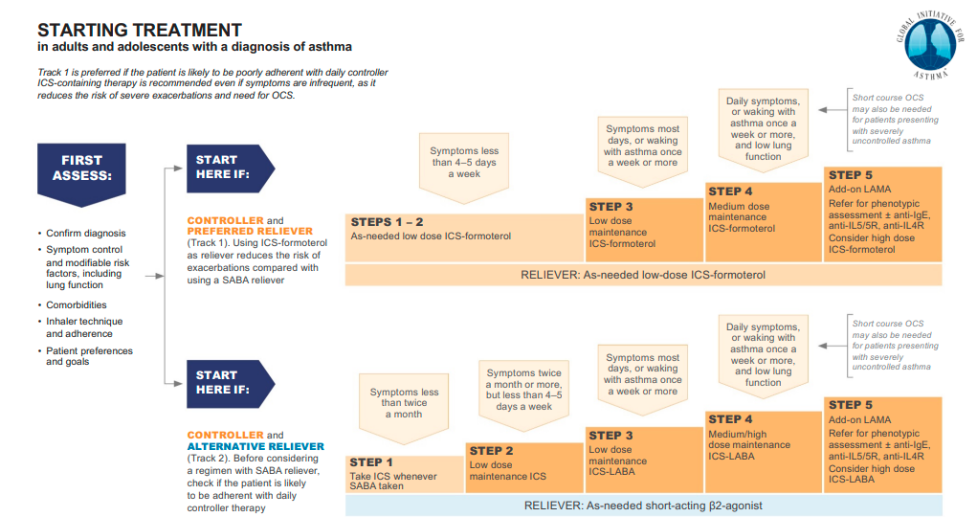
GINA 2021: ICS-Formoterol is the preffered Reliver

Slide 29
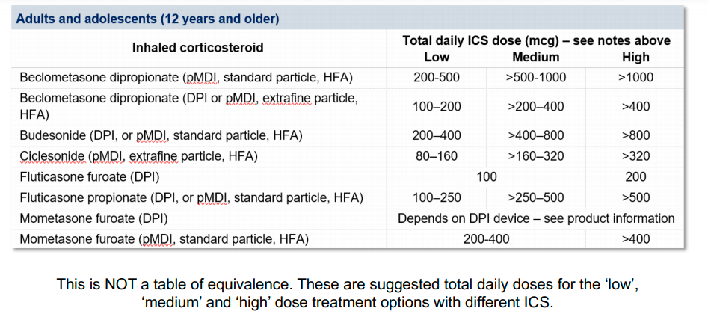
GINA 2021 ICS dose

Slide 30
GINA 2021: ICS doses
Low dose:
Foster 100/6 1 puff twice daily →
EF BDP 200 mcg daily dose = 500 mcg of non EF BDP
Medium dose:
Foster 100/6 2 puffs twice daily
EF BDP 400 mcg daily dose = 1000 mcg of non EF BDP
High dose:
Foster 200/6 2 puffs twice daily
EF BDP 800 mcg daily dose = 2000 mcg of non EF BDP
Adapted from GINA 2021

Slide 31
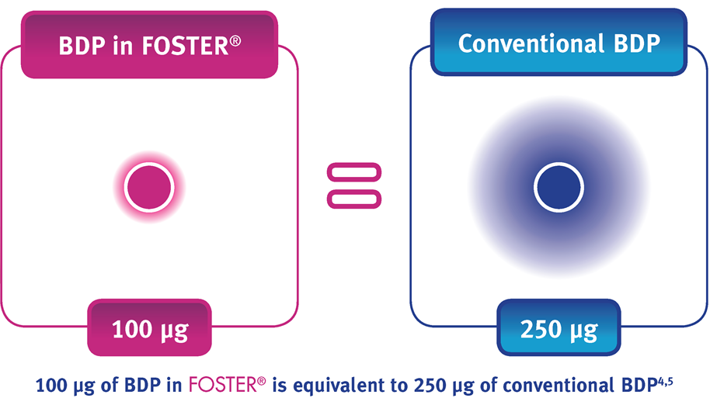
The respirable dose (FPD^) of extrafine BDP 100 μg in Foster is comparable to that of BDP CFC 250 μg

Slide 32
Indications & Prescription
Foster® 100/6 μg
Asthma
A. Maintenance therapy
As regular maintenance treatment + separate as needed SABA
1-2 inhalations twice daily. The maximum daily dose is 4 inhalations in this approach
B. Maintenance & Reliever therapy(MART)
As regular maintenance treatment + as needed in response to asthma symptoms.
one additional inhalation in response to symptoms. If symptoms persist after a few minutes , an
additional inhalation should be taken.The maximum daily dose is 8 inhalation in this approach
Ref: Foster 100/6 SmPC

Slide 33
Indications & prescription
Foster® 100/6 μg
COPD:
Symptomatic treatment of patients with severe COPD and a history of repeated
exacerbations, who have significant symptoms despite regular therapy with LABA
2 inhalations twice daily.
The maximum daily dose is 4 inhalations in this approach
Ref: Foster 100/6 SmPC

Slide 34
Indications & prescription
Foster® 200/6 μg
Asthma
Regular treatment of asthma where use of a combination product (ICS/LABA) is appropriate.
The dose should be titrated to the lowest dose at which effective control of symptoms is
maintained
Foster® 200/6 μg should be used as maintenance therapy only.
Foster® 100/6 μg is available for maintenance and reliever therapy.
Posology: 2 inhalations twice daily. The maximum daily dose is 4 inhalations
Foster® 200/6 μg is not indicated in COPD
Ref: Foster 200/6 SmPC

Slide 35
EVIDENCE IN ASTHMA

Slide 36
Summary
With a lower dosage of ICS, Asthma and COPD patients can be controlled
Patients can benefit from one device for two indication (MART)
Using the pMDI device with Modulite® technology can lead a better hand-breath coordinating
In a long term period using Foster® can lead a decrease in hospitalization cost for patients

Slide 37

Thank you

