Slide 1
Electrolyte Imbalance
M.Rezai
EM Physician

Slide 2
Case senario
Patient C is a woman, 32 years of age, with a history of hypertension and asthma. Her current medications include albuterol (as needed via inhaler), atenolol 25 mg twice daily, and 25 mg hydrochlorothiazide. She is admitted to the hospital with a diagnosis of exacerbation of asthma secondary to bronchitis. She is treated with albuterol treatments every three hours, a cephalosporin antibiotic, and a prednisone taper. Her atenolol is stopped due to fears it is exacerbating her asthma. After 24 hours, Patient C complains of severe muscle cramps...

Slide 3
Case senario
Despite the fact that her admission potassium level was 3.9 mEq/L, within normal limits. A basic metabolic profile is requested, which reveals normal renal function and a potassium level of 2.9 mEq/L. She is given 40 mEq of potassium immediately, and prescribed 40 mEq twice daily with close monitoring of her level.

Slide 4
Hypokalemia causes…
Decreased Potassium Intake
Increased entry into cells
An elevation in extracellular pH
Increased availability of insulin
Elevated beta-adrenergic activity
Hypokalemic periodic paralysis
Marked Increased in blood cell production
Hypothermia
Chloroquine intoxication

Slide 5
Hypokalemia causes…
Increased gastrointestinal losses
Vomiting
Diarrhea
Tube drainage
Laxative abuse

Slide 6
Hypokalemia
causes…
Increased urinary losses
Diuretics
Primary mineralocorticoid excess
Loss of gastric secretions
Non absorbable anion
Renal tubular acidosis
Hypomagnesaemia
Amphotericin B
Nephrophathy (Bartter or Gitelman)
Polyuria
Increased sweet losses
Dialysis
Plasmopheresis

Slide 7

Clinical Manifestation
Serum potassium <3 mEq/L
Severe muscle weakness
Respiratory failure
Ileus, vomiting, nausea, distension
Ogilvie’s syndrome
Muscle cramp
Myoglobinuria and Rhabdomyolysis
Cardiac arrhythmia
Kidney Abnormality

Slide 8
Treatment
1
Potasium Replacement
Attention: Digoxin
Treat the underlying
Hypomagnesaemia
Rebound hyperkalemia

Slide 9
Treatment
2
Estimation of potassium deficit
Uncontrolled diabetes
Potassium preparations

Slide 10
Treatment
3
Intravenous therapy
Ongoing losses and the steady state
Potassium sparing diuretics

Slide 11
Treatment
4
Mild to Moderate hypokalemia (10 to 20 mEq BID to QID)
Severe or symptomatic hypokalemia (20to 40 mEq Q2-3h)
Intravenous potassium repletion
Potassium rich foods

Slide 12
Case scenario
Patient R is a man, 56 years of age, with diabetes and hypertension. He is currently being treated with metformin 1 g twice per day, lisinopril 40 mg/day, and amlodipine 10 mg/day. His blood pressure is 146/83 mm Hg, and lab work reveals the following abnormalities: BUN 83 mg/dL, serum creatinine 4.1 mg/dL, and potassium 7.3 mEq/L.

Slide 13
Case scenario
He is rushed urgently via emergency medical services to the local hospital, where an ECG is obtained immediately. Blood gases are sent to rule out lactic acidosis due to use of metformin in acute renal failure. The ECG shows widening of the QRS wave, and Patient R is showing signs of muscle weakness.

Slide 14
Case scenario
He is treated emergently with calcium gluconate 10% 10 mL infusion while his ECG is monitored. An infusion of 10% dextrose and insulin is started, and potassium levels are sent every 15 minutes.

Slide 15
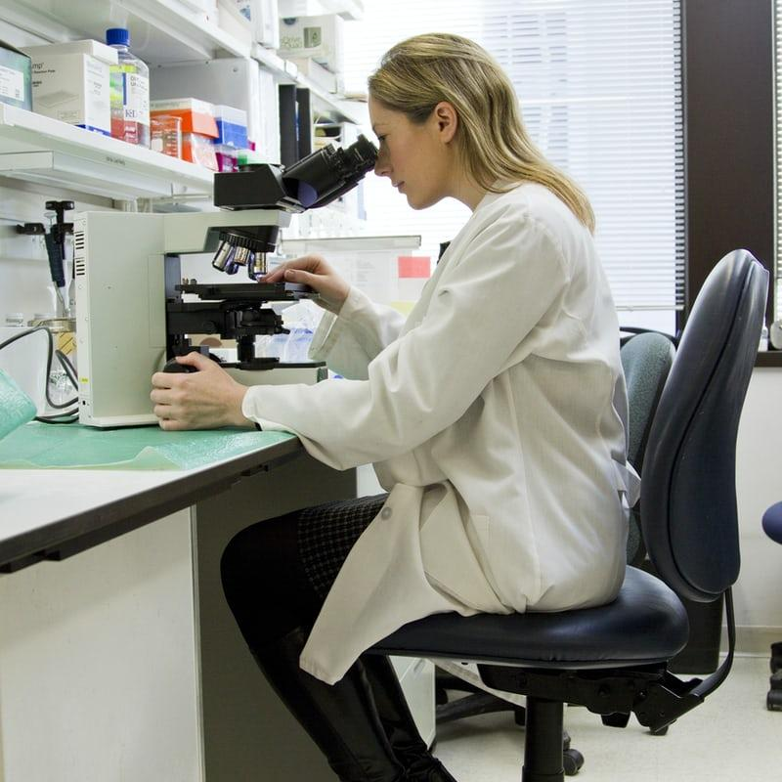
Hyperkalemia
Potassium physiology
Increased potassium release from cells
metabolic acidosis
hyperglycemia & hyperosmolarity
beta blockers
exercise
increased tissue catabolism
digitalis, succinylcholine

Slide 16
Hyperkalemia
Potassium physiology
Reduced urinary potassium excretion
reduced aldosterone secretion
reduced distal sodium and water delivery
exercise
acute and chronic kidney disease

Slide 17
Evaluation
Carefull history, physical exam, muscle weakness, EKG, lab tests

Slide 18
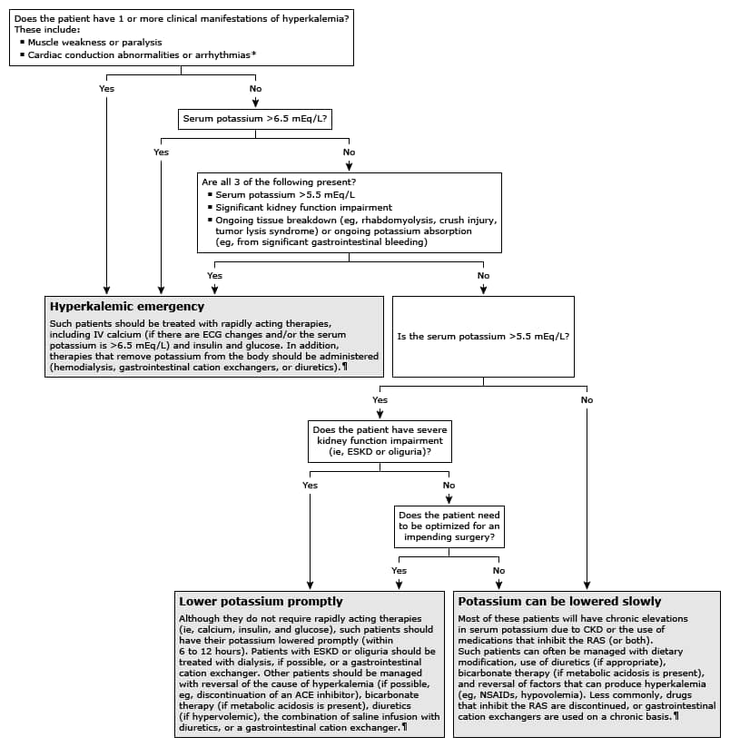
Black
Is the color of ebony and of outer space. It has been the symbolic color of elegance, solemnity and authority.

Slide 19
Clinical manifestation
Muscle weakness
Paralysis
Cardiac conduction
arrythmia

Slide 20

Treatment

Slide 21
Hyperkalemic emergencies
Cell membrane satabalize
Calcium gluconate
Shifting
remover
Insulin
Glucose
Hemodialysis
Diuretics

Slide 22
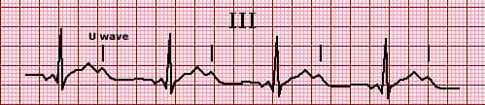
ECGs

Slide 23
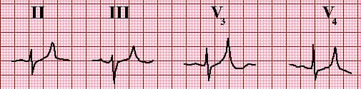

Slide 24
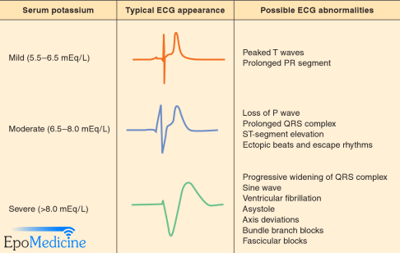

Slide 25
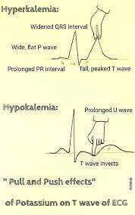

Slide 26
THANKS!
You can find me at:
Rezaei.m@iums.ac.ir
09121381048
Hazrat Rasool Hospital
Mah_re@yahoo.com
IUMS
Health Research Institute

