Slide 1
Colonoscopy
Good expertise in UGI endo
Good training
Up to date equipment
Variable stiffness scope
Dependent on anatomy
Full of maneuvers

Slide 2
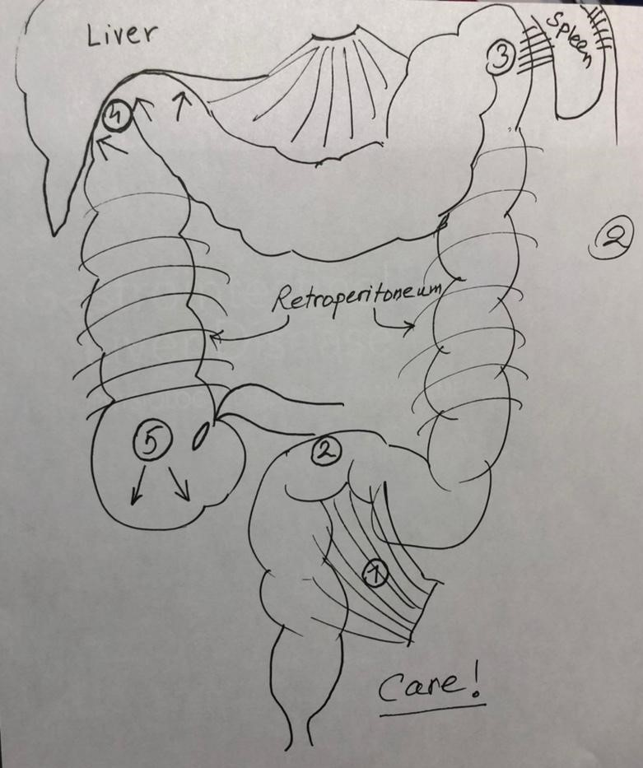

Slide 3
‍Colonoscopy Goals
Polyps
Cancer and Precancer
Colitis
Diarrhea
Diverticula Care! Everted!
Strictures
Rare Lesions

Slide 4
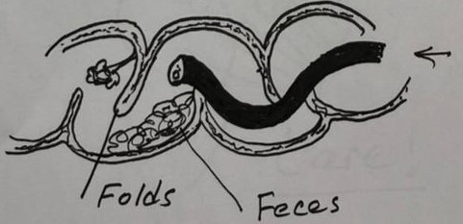
Colonoscopy
95% reaches cecum .
Is not a “Push” procedure
Is a push-pull procedure maneuvers
Section is a great help .
If difficult for you consult or end the procedure
Finding of no lesion does not mean that it does not exist !

Slide 5
Colonoscopy Complications
Risk (Trained) 0.28%
Risk factors :
Age Polypectomy
Comorbid
Cardiovascular – Pulmonary
Perforation
Bleeding
Ligament ovulsion
Post polypect . Electrcoag . Synd .
Sedation and anesthesia

Slide 6
