Slide 1
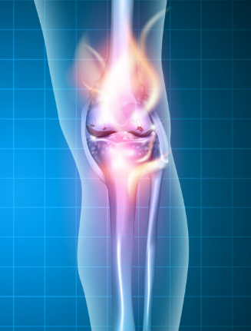
Chronic TB Arthritis
Case Report
Dr. Anahita Amirpour
Rheumatologist Sbmu member
Taleghani Hospital

Slide 2
Case Report
We present a 37 y/o male patient:
With longstanding right Knee pain (3 years)
Which was treated conservatively with NSAIDs.
Pain increased in the last 5 months (10/10)
It was gradual
Aggravated on weight-bearing & walking
Extended to the right lower extremity

Slide 3
Case Report
No fever, weight loss or loss of appetite
No history of trauma
No any medical illnesses
No Contact history with TB patients

Slide 4
Case Report
P/E:
Swelling
Tenderness
Warmness
Knee not be flexed under 110◦C& extended −30◦
Other P/ E :NL

Slide 5
Which work up needs to evaluation?
Infectious Process
Collagen Vascular Disease
Malignancy
Internal Derangments

Slide 6
The pt. admitted in University Hospital
CBC | NL | Widal | Neg
ESR | 96 | Wright | Neg
CRP | 40 | HBS Ag | Neg
Cr | 0.9 | HCV Ab | Neg
LFT | NL | HIV | Neg
ANA | NL | RF | Neg
Anti-CCP | Neg | TST | Neg

Slide 7
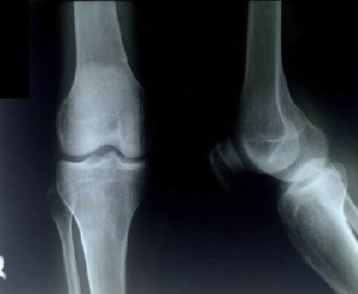
X-Ray
Radiograph examinations In 1397:
There was only a narrowing of the joint space

Slide 8
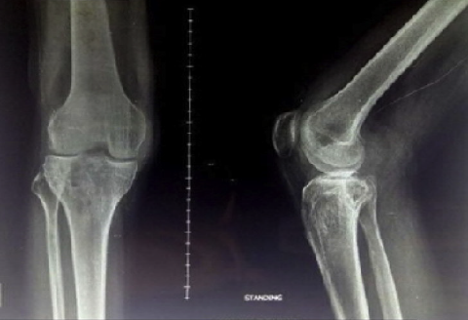
Evaluation of sequence radiograph examinations:
Progressive knee destruction
After 3 years:
Bone destruction
Lytic lesion in both fibula and tibia

Slide 9
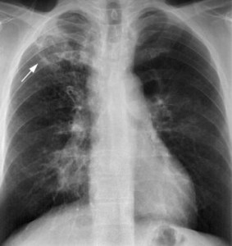
Next Step?
CXR:
Infiltration in upper lobe

Slide 10
What is your further W/U?
Joint Fluid Aspiration:
Color | Not Clear | LYM | 55%
Viscosity | Decreased | RBC | Neg
Pro | 5.7 | Gram Stain | Neg
WBC | 40000 | Culture | Neg

Slide 11
EPIDEMIOLOGY
Skeletal TB :10 - 35 % of extrapulmonary TB
Pott disease(50%)
TB Arthritis
Extraspinal TB osteomyelitis

Slide 12
EPIDEMIOLOGY
In highly endemic regions:
M.S TB usually manifests in the year following
primary lung infection (young pt)
Outside highly endemic areas:
M.S TB associated with late reactivation ( adults)

Slide 13
Pathogenesis : Reactivation of hematogenous foci or paravertebral LN
Weight-bearing Joints
TB of the bones / joints : 10% of extrapulmonary (In USA)
Spine ( 40% ) Hips ( 13%) Knees (10%)

Slide 14
Peripheral
Joints
Hip :head of femur\ Pain
Diagnosis
Synovial fluid: Thick, High protein ,Variable cell count
Knee : Pain & Swelling
Synovial fluid culture
Synovial BX & Tissue culture

Slide 15
Differential DX
Bacterial Arthritis
Rapid Destraction
Differential DX
Tumors
Other Infections
Pyogenic Bacterial
Rapid Sclerosis
Osteomyelitis

Slide 16
TB Arthritis
Caseous Exudative Type
Bone Destruction, Local Swelling, Abscess & Sinus Formation
TB Arthritis
Granular Type
More insidious & less destructive, Less Abscess formation
Host-Parasite interactions : Dynamic
Mixed Patterns
TB Arthritis
Constitutional Symptoms
Most in adults
Most in children

Slide 17
TB Arthritis
Monoarticular
Hip & Knee
HIP
Most common
10-15%
Any Joint Involvement
Multifocal
In developing countries

Slide 18
TB Arthritis
Cold Joint
Most difficult to DX
TB Arthritis
Clinical manifestations
Swelling, Pain, loss of function
TB Arthritis
Complication
Joint Destruction Deformity & Restricted ROM
Constitutional Symptoms: 30 %
Draining Sinuses Erosion of Cartilage
Most Debilitating

Slide 19
Radiography
Soft Tissue Swelling Osteopenia
Bone Destruction
Spare of Cartilage Space
Structural Collapse Sclerotic Changes
Soft Tissue Calcification
Cystic Changes

Slide 20
Radiography
Phemister Triad :
Juxta-Articular Osteopenia
Peripherally Osseous Erosions
Narrowing of the Joint Space

Slide 21
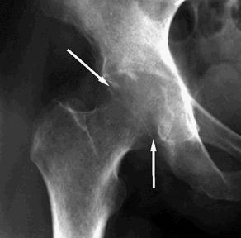
Complete loss of the joint space / destruction of the cartilage and adjacent joint surfaces/ Severe periarticular bony demineralization

Slide 22
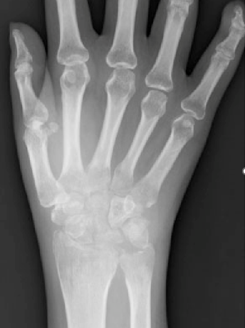

Slide 23
Diagnosis of TB Arthritis
AFB Staining
Synovial Fluid:
Nonspecific
WBC or
PMN or LYN
Xpert MTB/RIF assay :
an Automated Nucleic Acid Amplification
(M.TB & rifampin resistance)
Xpert: 79 %sensitivity
Xpert Ultra:91% sensitivity

Slide 24
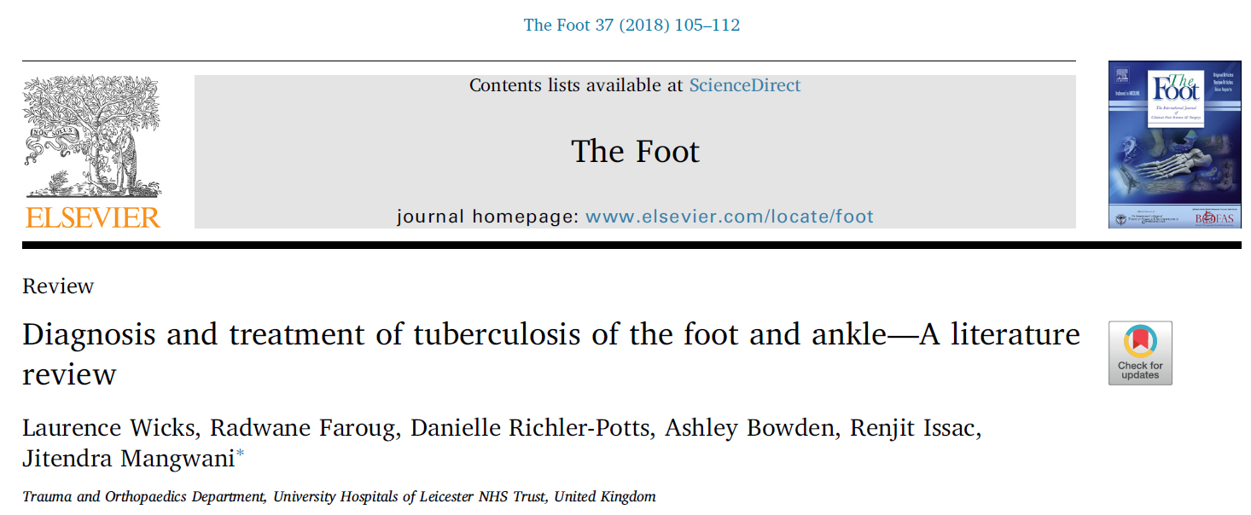

Slide 25
Biopsy, Culture and Microscopy
The TST : Sensitivity (59%), Specificity (95%)
Cultures from a discharging sinus :usually contaminated with variable microorganisms .
Fine needle aspiration of synovial fluid can produce false results .
Synovial biopsy & culture has demonstrating theTB bacillus.
(Open biopsy or CT guided biopsy)
The Foot 37 (2018)

Slide 26
Polymerase chain reaction (PMR) assay of nucleic acid amplification
(NAA) from sputum smears
The only weakness tests is their low specificity and sensitivity of NAA for EPTB & need to sputum culture
The Foot 37 (2018)

Slide 27
Measurement of Interferon-γ released by T-cells after stimulated by MTB antigens:
(greater specificity than the TST)
T-SPOT TB (number of anti-M effector T cells in the blood)
QuantiFERON-TB (amount of IFN- γ released from lym incubated overnight with PPD)
The Foot 37 (2018)

Slide 28
CT demonstrates:
Calcified lesions
Margins of the lesion
Guide for bone biopsy
Fragmentation type or Lytic type
Sensitivity (67% ) Specificity (50%)
The Foot 37 (2018)

Slide 29
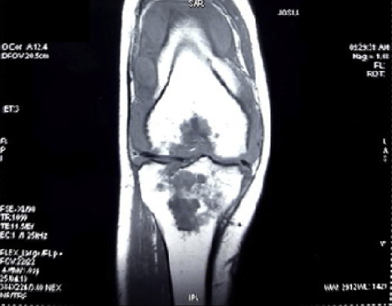
Next Step?
MRI:
On coronal view :
Well-defined iso-Hyperintense mass
Free fluid collection
Synovitis

Slide 30
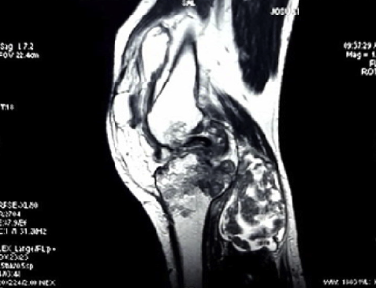
MRI
In sagittal :
An iso-hyperintense mass
(half of musculus gastrocnemius mediolateral,plantaris, popliteal

Slide 31
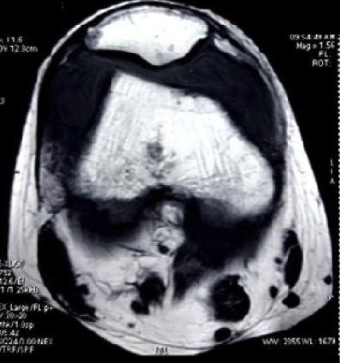
MRI
Axial view:
Free fluid collection
(in suprapatella / minimal infrapatella )

Slide 32
MRI demonstrate:
Spread of disease into soft tissues
BM edema
Pre-destructive phase
Cortical reaction
Sensitivity (100%) specificity(80%)
The Foot 37 (2018)

Slide 33
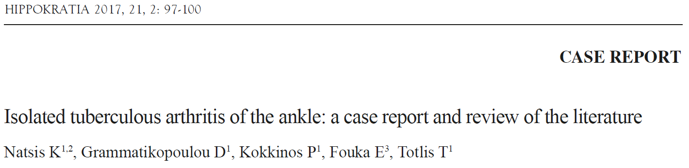
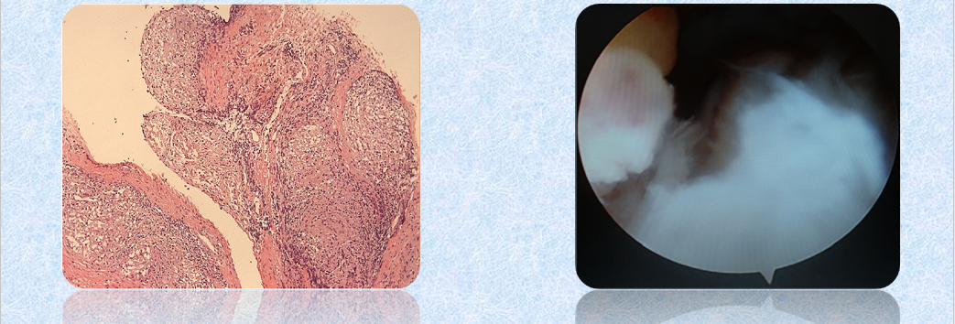

Slide 34
Synovial biopsy is the standard diagnostic technique
No specific clinical or radiologic findings exist
DX may be confirmed by PCR and QFT-GIT
( higher sensitivity & higher predictive value)
1/3 of osteoarticular TB had active TB in the lungs
Isolated tuberculous arthritis of the ankle: a case report and review of the literature HIPPOKRATIA 2017

Slide 35
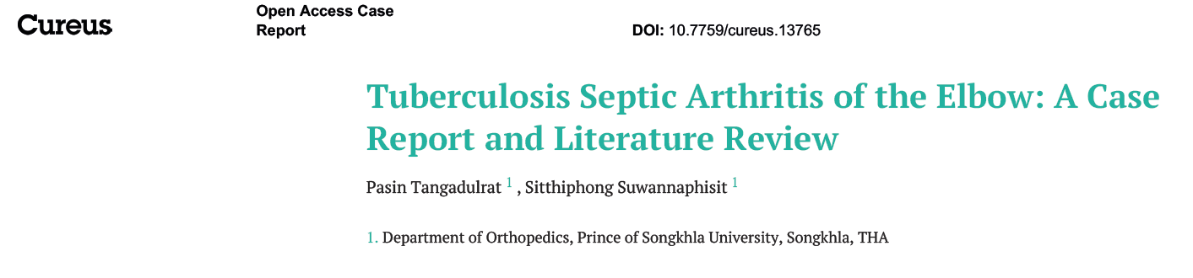
Half of all EPTB cases occurred concurrently with PTB.
Isolated EPTB occurs in 1/3 of all TB patients.
The imaging modality of choice is an MRI.
Joint aspiration should be done and sent for AFB staining, PCR and TB culture.
2021 Tangadulrat et al. Cureus

Slide 36
Next Step?
The patient was performed synovectomy 3 mo later.
Debridement & Arthrotomy, followed by total synovectomy

Slide 37
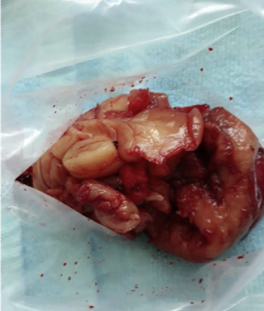
Synevectomy
The macroscopic finding:
Synovium Destruction
Cold Abscess

Slide 38
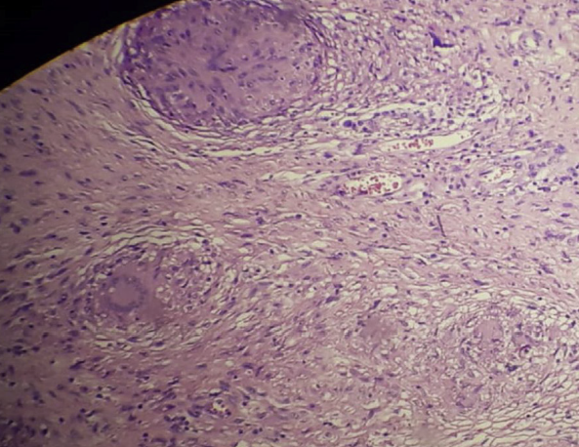
Synevectomy
The microscopic finding: Epitheloid Proliferation
Granuloma
Necrotic
Lymphocyte Infiltration Localized Fibrosis

Slide 39
Surgical intervention
Failure of therapy
Severe joint destruction
Surgical Procedure:
Debridement of the joint
Surgical Procedure;
Resection of destroyed bone
Spread of the disease
Curettage
Synovectomy
Arthrodesis
Isolated tuberculous arthritis of the ankle: a case report and review of the literature HIPPOKRATIA 2017

Slide 40
Patient was prescribed with :
Isoniazid (10 mg/kg/day)
Pyrazinamide (30 mg/kg/day)
Rifampicin (15 mg/kg/day)
Ethambutol (15mg/kg/day)
for 2 months followed synovectomy
Treatment was then continued for 7 months with:
INH & RIF

Slide 41
Clinical improvement was observed after 6 mo.
Improvements on flexed and extended ability to 130 &−10◦
After 1 year, the patient has only:
Mild LOM
Secondary Osteoarthritis

Slide 42
According to the guideline of tuberculosis:
Standard TB treatments of extra-pulmonary TB
Divided into two phases;
Intensive phase :Combination of R, H, Z, E
Continued phase : R and H for more than 1 year
International Journal of Surgery Case Reports 71 (2020)

Slide 43
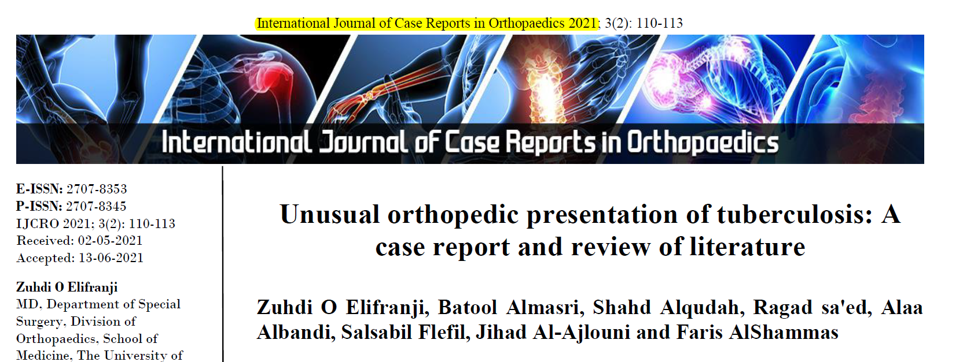

Slide 44
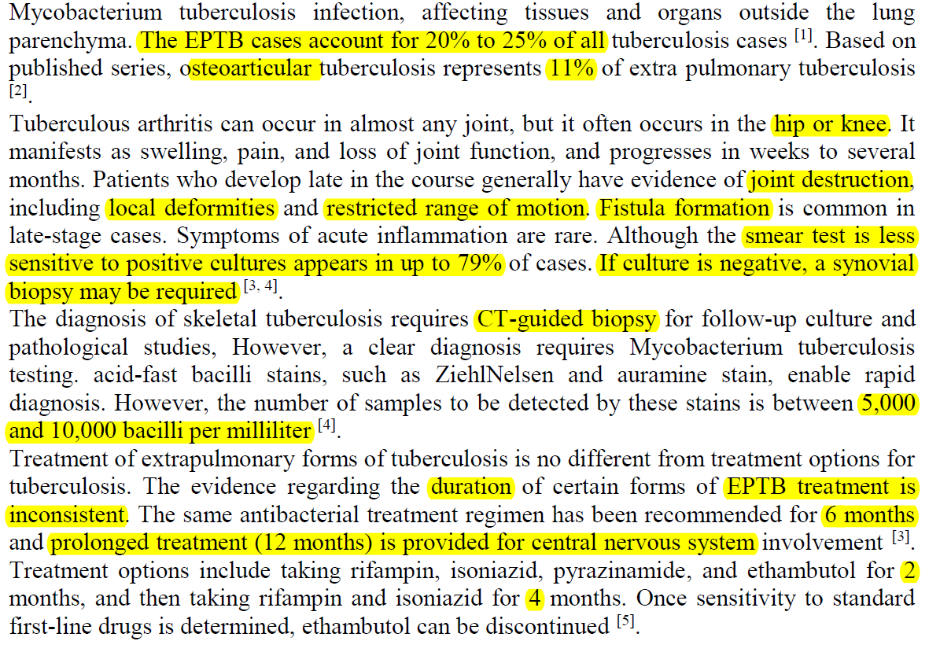

Slide 45
Antimicrobial Therapy
Same as pulmonary TB
Optimal duration of therapy : Uncertain
6-9 months duration of therapy :
For most patients receiving first-line agents

Slide 46
Antimicrobial Therapy
9 to 12 months for patients:
On regimens without Rifampin
Extensive or Advanced disease
Difficult to assess the response to therapy

Slide 47

Thanks for Your Attention

