Slide 1
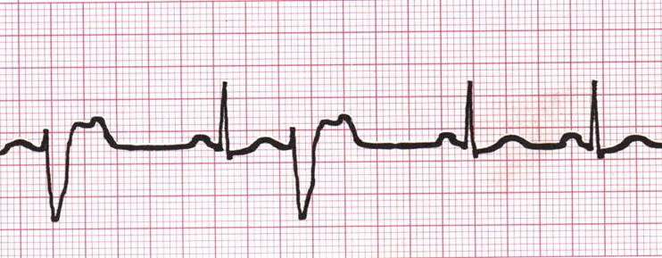
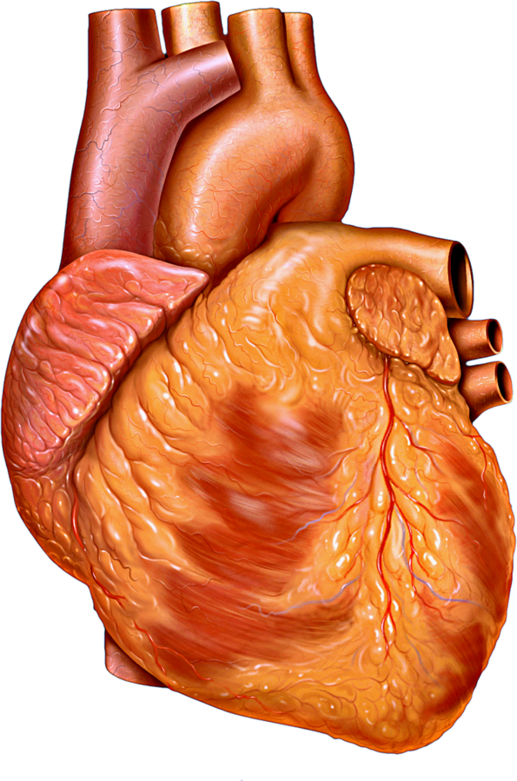
Arrhythmias
Post Myocardial Infarction
Saeed Oraii MD, Cardiologist
Interventional Electrophysiologist
The Arrhythmia Center
June 2022
Internal Medicine Congress

Slide 2
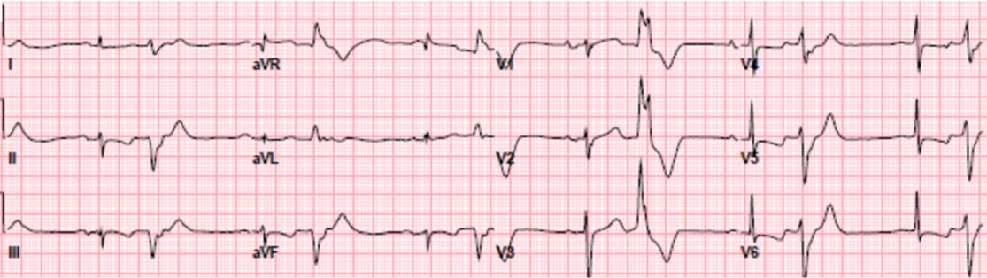
A patient admitted with
Acute Coronary Syndrome
What is the prognostic impact of Ventricular premature beats (PVCs)?
How would you treat the PVCs?

Slide 3
How frequent are ventricular arrhythmias?
The incidence of ventricular arrhythmias has declined in the hospital phase of acute coronary syndromes (ACS), mainly due to prompt revascularization and optimal medical therapy.
Still up to 6% patients with ACS develop ventricular tachycardia and/or ventricular fibrillation within the first hours of ACS symptoms.
Early VAs are associated with up to six-fold increased in-hospital mortality, whereas long-term prognosis seems not to be significantly affected by VAs occurring within 48 h of AMI.
The risk of cardiac arrest and sudden cardiac death (SCD) remains increased after MI and it is highest in the first 30 days (1.2–2.3%).
EHRA CONSENSUS DOCUMENT. Europace (2019) 21, 1603–1604

Slide 4
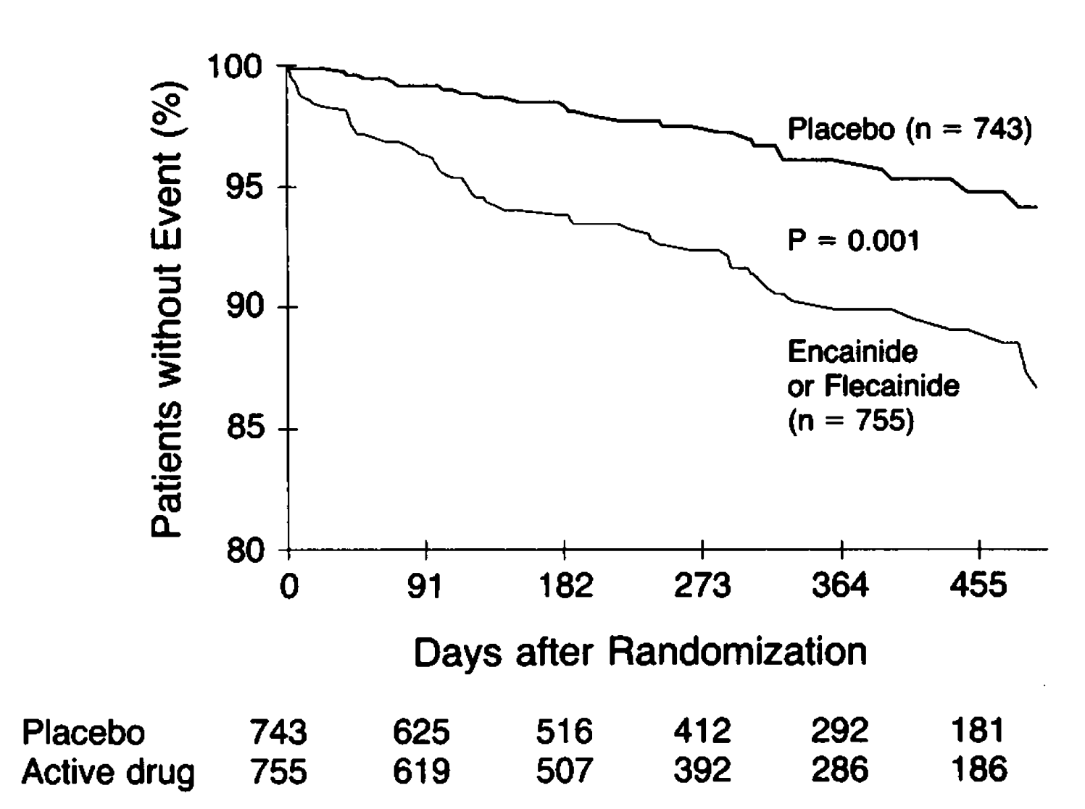
Prognostic Impact of PVCs
PVCs, which are typically asymptomatic, are common during acute MI with a reported incidence as high as 93%.
Frequent and/or multiform PVCs that persist more than 48–72 h after a MI may be associated with an increased long-term arrhythmic risk.
As there is potential drug toxicity of
anti-arrhythmic drugs, suppression of PVCs
using anti-arrhythmic drugs is not
recommended in this setting.
Cardiac Arrhythmia Suppression Trial 1989

Slide 5
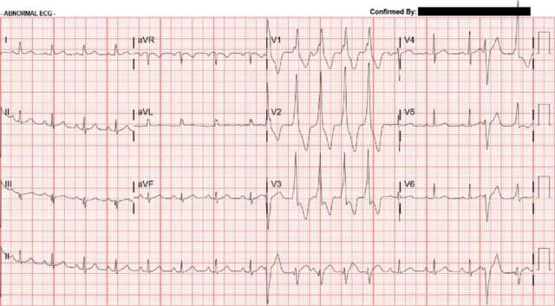
What about NSVT?
Monomorphic
non-sustained VT (NSVT)
The frequency ranges from
1% to 7%.
In patients with
asymptomatic NSVT,
suppression with
anti-arrhythmic drugs has not been shown to improve outcomes.

Slide 6
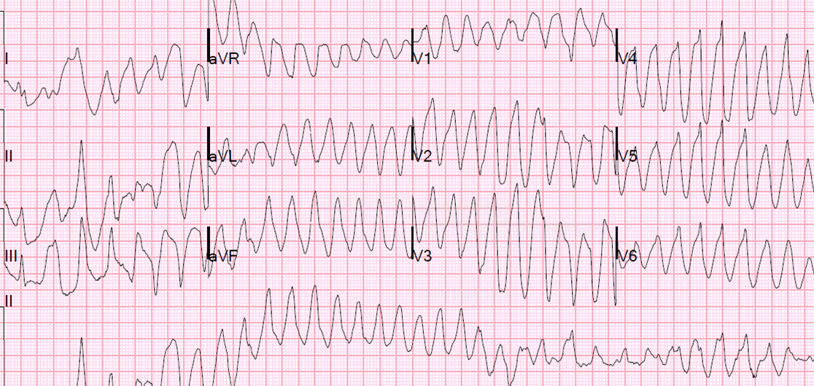
PMVT/VF
Polymorphic ventricular tachycardia and ventricular fibrillation are the most frequent mechanisms of prehospital SCD.
About 6–10% of STEMI patients develop significant arrhythmias, mainly polymorphic VT, often degenerating into VF.
The occurrence of VF among patients with an acute MI, if occurring within the first 48 h, is associated with an increase in early mortality, but little or no increase in mortality at 1–2 years.

Slide 7
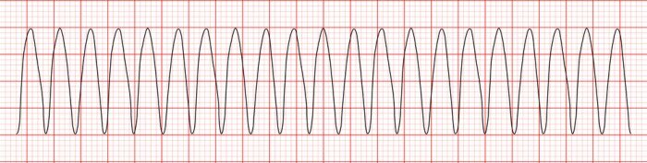
Sustained Monomorphic VT
Sustained monomorphic VT
(SMVT) occurs in
approximately 2%-3% of
patients with STEMI and less
than 1% with a non-ST elevation myocardial infarction (NSTEMI) or unstable
angina.
It is associated with larger MI size and may also be related to previous scar.
Early SMVT is usually associated with higher in-hospital mortality due to cardiac arrest and possibly to exacerbation of ischemia and extension of the infarct.
Whether early SMVT is associated with an increased long-term mortality risk among patients who survive to hospital discharge is unclear.

Slide 8
How to treat the sustained VT?
Repetitive electrical cardioversion/defibrillation may be necessary.
Urgent reperfusion is the most important therapy, as acute ischemia usually triggers these arrhythmias.
Intravenous beta-blockers and/or amiodarone are useful if no contraindications exist.
If there is insufficient control, lidocaine may be considered.
Transvenous overdrive pacing can be considered (as second choice) for recurrent VAs with hemodynamic intolerance not controlled by amiodarone, beta-blockers or repetitive electrical cardioversions.

Slide 9
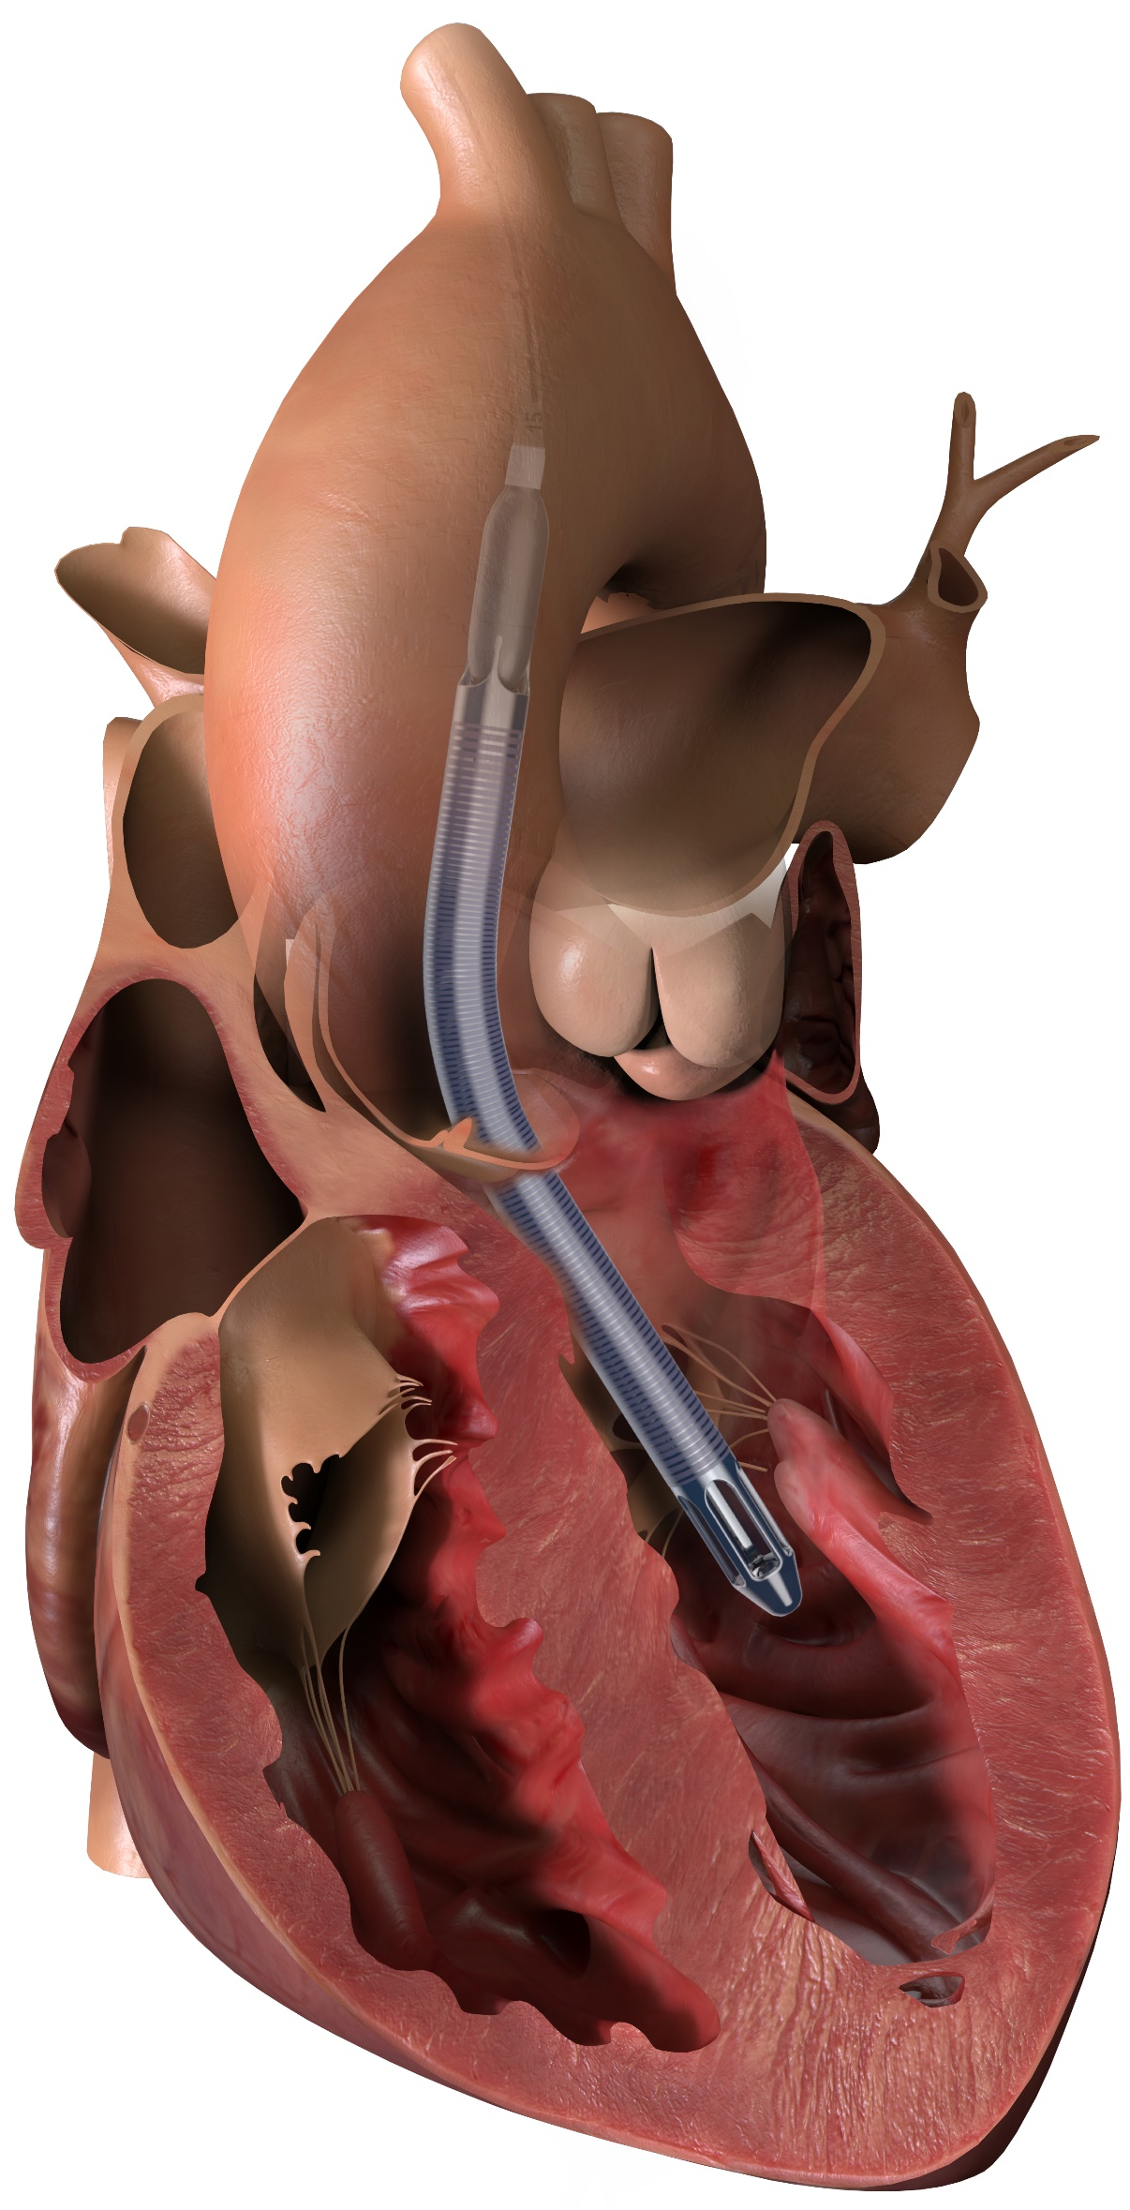
Other measures
In hemodynamically unstable patients with refractory VAs a percutaneous LVAD (Impella, TandemHeart, or extracorporeal life support) may be considered.
In patients with recurrent life-threatening VAs sedation (preferably with benzodiazepines) or general anesthesia to reduce sympathetic drive should be considered.
Correction of electrolyte imbalances is strongly recommended.

Slide 10
Longer term treatments for early VT/VF
Ventricular arrhythmias that occur within 48 h of acute MI (predominantly VF or polymorphic VT) are perceived to be related to electric instability triggered by acute ischemia, reperfusion, necrosis, and autonomic changes.
Thus, prompt revascularization along with optimal medical therapy are key anti-arrhythmic therapies.
Treatment with angiotensin-converting-enzyme inhibitors (ACE-I)/angiotensin II receptor blockers (ARBs) and statins should be started within the first 24 h.
Implantation of Implantable Cardioverter Defibrillators (ICD) is not recommended for these patients.

Slide 11
Late Ventricular Arrhythmias
The incidence of late VAs, defined as arrhythmias occurring >48 h from hospital admission after MI, has declined in recent decades as the consequence of early revascularization and progress in pharmacological and non-pharmacological therapies.
Late VAs are associated with a higher risk of death than early VAs.
Identifying patients at risk of late VAs is crucially important.

Slide 12
ESC Guideline Recommendations
Monitoring for >24 h in patients should be considered for patients with MI at intermediate-to-high risk for cardiac arrhythmias:
  Hemodynamically unstable
  Major VAs <24 h
  LVEF <40%
  Failed reperfusion
  Additional critical coronary stenoses of major vessels or complications related to percutaneous revascularization.
EHRA CONSENSUS DOCUMENT. Europace (2019) 21, 1603–1604

Slide 13
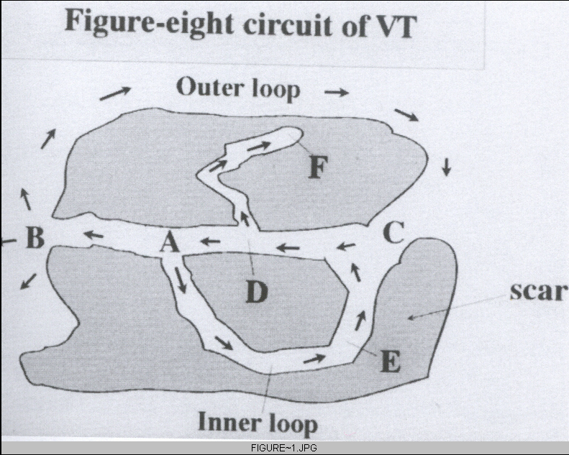
Post-discharge Ventricular arrhythmias
These VAs may be caused by scar or recurrent ischemia.
Ventricular arrhythmias in the setting of ischemia are more often polymorphic VT or VF than monomorphic VT.
In structural heart diseases, re-entry mechanism is responsible for most sustained VAs.
Scar with fibrosis after MI creates conduction
block and the excitation wavefront might
circulate along the border of the scar or through
a path within the scar region.

Slide 14
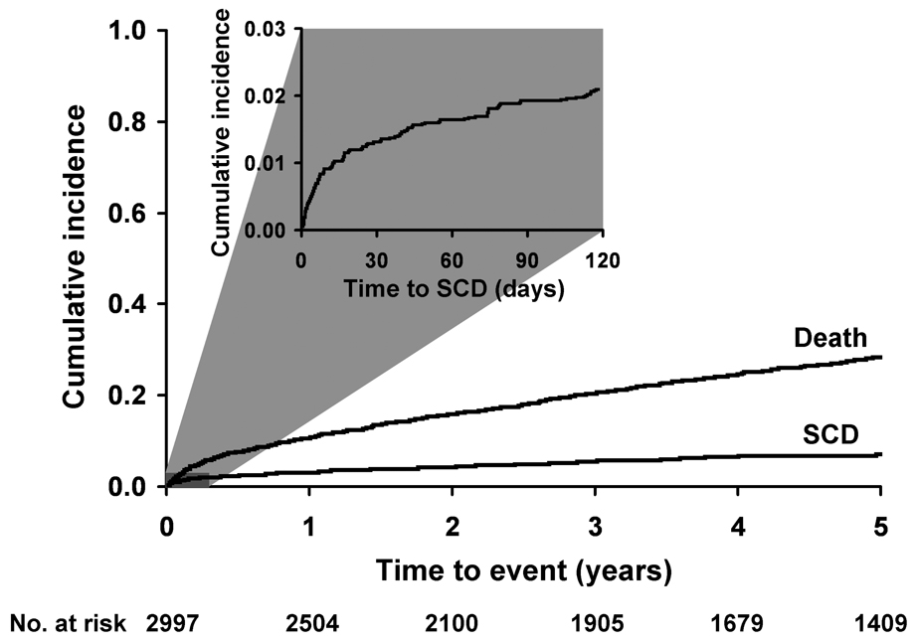
Risk of SCD after MI
The risk of cardiac arrest and SCD remains increased after MI and it is perceived to be highest in the first 30 days (1.2–2.3%), followed by a progressive decline until a plateau after a few months.
The MADIT-II (Multicenter Automatic
Defibrillator Implantation Trial II) study
showed a 31% survival benefit in MI
survivors with LVEF <30%, in whom
ICDs were implanted >1month after MI
(median of 60months), compared with
standard therapy alone.
JAMA 2008 Nov 5;300(17):2022-9.

Slide 15
48-h to 40-day period post MI
Despite data showing the highest risk for SCD within the first month of MI, a primary prevention with ICD failed to improve overall survival in two prospective randomized controlled trials as compared with optimal medical therapy alone (DINAMIT and IRIS).
In both RCTs, the reduction of SCDs in the ICD arm was offset by an unexpected increase in non-SCDs, presumably related to heart failure, ischemia, or both.
Other potential reasons for lack of ICD benefit are: only approximately 50% of SCDs post-MI are perceived to be arrhythmic; right ventricular pacing and ICD shocks may have deleterious myocardial effect and thus increase mortality in patients with left ventricle dysfunction, heart failure or both.

Slide 16
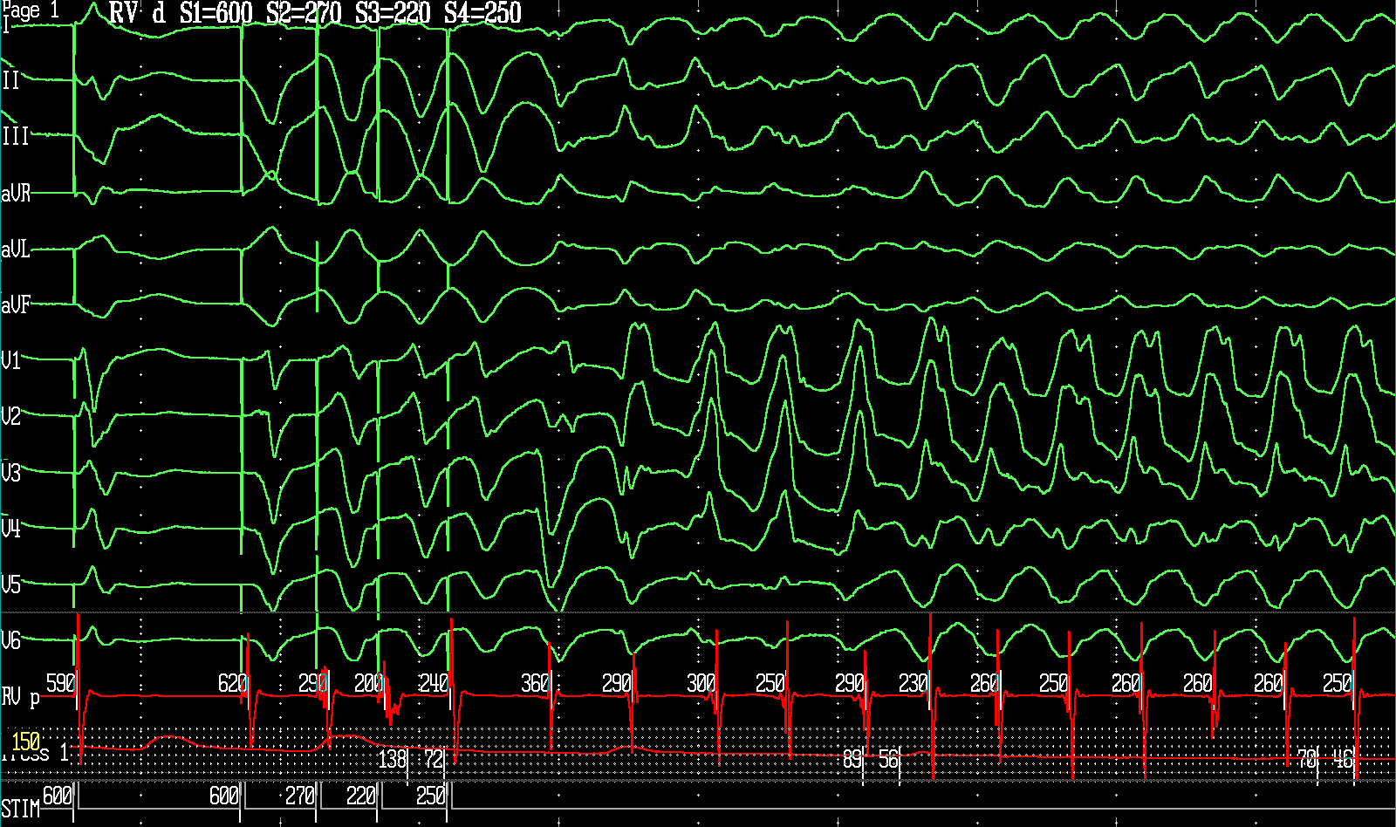
How to define the risk of patients > 40 days ?
Left ventricle ejection fraction is used routinely to assess the risk of post-MI VAs and SCD.
Electrophysiological study (EPS)
especially in patients with NSVT
due to prior MI and LVEF ≤40%
could demonstrate the presence
of a substrate for re-entrant
tachyarrhythmia.
Noninvasive tests such as Signal
Average ECG or Cardiac MRI have
been used for risk stratification.

Slide 17
ICD Primary Prevention
ICD Secondary Prevention

Slide 18
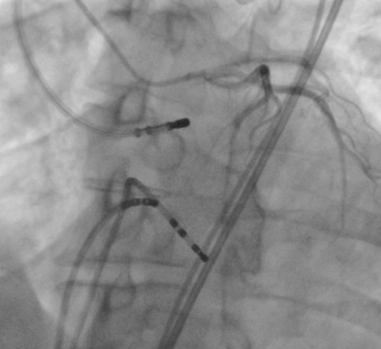
Other therapeutic options
The therapeutic options in scar-induced monomorphic VT are:
  Cardioverter-defibrillator
  Anti-arrhythmic drug therapy
  Anti-tachycardiac surgery
  Catheter ablation
Class IA and IC anti-arrhythmic drugs increased mortality after MI and should not be used.
Guideline-directed optimal medical therapy as a secondary prevention of MI is crucial in preventing cardiac adverse events including VAs and SCD.
  ACE-I (or, when intolerant ARBs, ? ARNI), beta-blockers and mineralocorticoid receptor antagonists

Slide 19
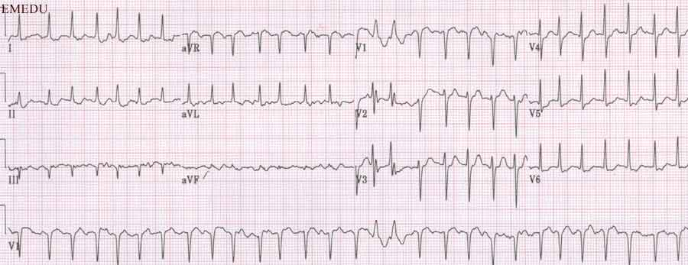
Atrial Fibrillation
Over 20% AMI patients may
have a history of AF, whereas
the new-onset arrhythmia
may occur in 9% patients
with STEMI.
About one in four patients
develop AF during follow-up.
The development of AF was
associated with a significant
increase in mortality (HR 3.8).
Interestingly, this association was not observed in patients developing AF within 2 days of their MI.
EHRA CONSENSUS DOCUMENT. Europace (2019) 21, 1603–1604

Slide 20
Treatment of AF
Clinically, most ACS patients tolerate AF well.
Should the rate be poorly controlled, beta-blocking agents are the first line medication in this context.
In hemodynamically compromised patients intravenous amiodarone or urgent cardioversion should be considered.
Most patients developing AF have high CHA2DS2-VASc scores and should probably be anti-coagulated, which leads at least to temporary triple therapy (ASA, Clopidogrel, NOAC) with an increased risk of bleeding events.
Long term management of these patients remains controversial.

Slide 21
Final Words
Both ventricular and supraventricular arrhythmias are common in ACS.
All clinicians involved in the management of patients with ACS should be familiar with the acute treatment of cardiac arrhythmias.
The arrhythmia diagnosis as well as the time of presentation are major determinants of the prognostic impact of arrhythmia.
Patients presenting with polymorphic VT or VF should be suspected of having acute myocardial ischemia whereas monomorphic VT is the typical presentation in patients with older fibrotic infarct areas.
Electrical cardioversion is still the most efficient way to convert tachycardia in patients with all types of acute tachycardia in unstable patients.

Slide 22

The Arrhythmia Center
WWW.IranEP.Center
info@IranEP.center

