Slide 1
Rhinoorbital and Breast Mucormycosis after COVID-19: A case report
Mahshid Talebi-Taher, MD,
School of medicine, IUMS
8 JUNE 2022

Slide 2
CASE REPORT:
A 51-year Afghan old lady who living in Iran, without history of diabetes mellitus, chemotherapy, surgery, and taking immunosuppressive dugs, was admitted to firoozabadi hospital, several weeks before this recent admission because of fever, cough, malaise, hypoxemia(Po2=90%) and short breathing.
A reverse-transcriptase polymerase chain reaction(RT-PCR) from a nasopharyngeal swab was positive for the SARS-COV-2 virus.
A spiral chest computed tomography showed multiple ground glass opacities in both lungs predominantly in peripheral distribution.

Slide 3
CONT’:
According to national guideline classification, patient suffered from severe COVID-19 and Remdesivir, Dexamethasone(6 mg/daily) and heparin was administered for five days and then she was discharged.
Two weeks later she returned to the hospital due to pain, swelling in the left eye and left cheek necrosis.
She was admitted again with a possible diagnosis of fungal orbital cellulitis and rhinosinusitis.
Skin biopsy was performed on the left cheek, amphotericin liposomal was administered and consultation with an ophthalmologist and ENT specialist was requested and she referred to the Rasool-E-Akram hospital.

Slide 4
On examination:
The patient was pale and unwell. The temperature was 37.5°C, the blood pressure was 145/85 mmHg, the heart rate 85 beats per minute, and the oxygen saturation 98% while she was breathing ambient air.
Lid edema, fixed left eye, left cheek necrosis, and swelling of left breast were remarkable. The Patient mentioned that the breast pain started a few days ago.
Brain and paranasal sinus CT scan was requested, a soft tissue swelling in the left preseptal, retrobulbar regions, left proptosis, ethmoid and maxillary opacities with air bubble was noted.

Slide 5
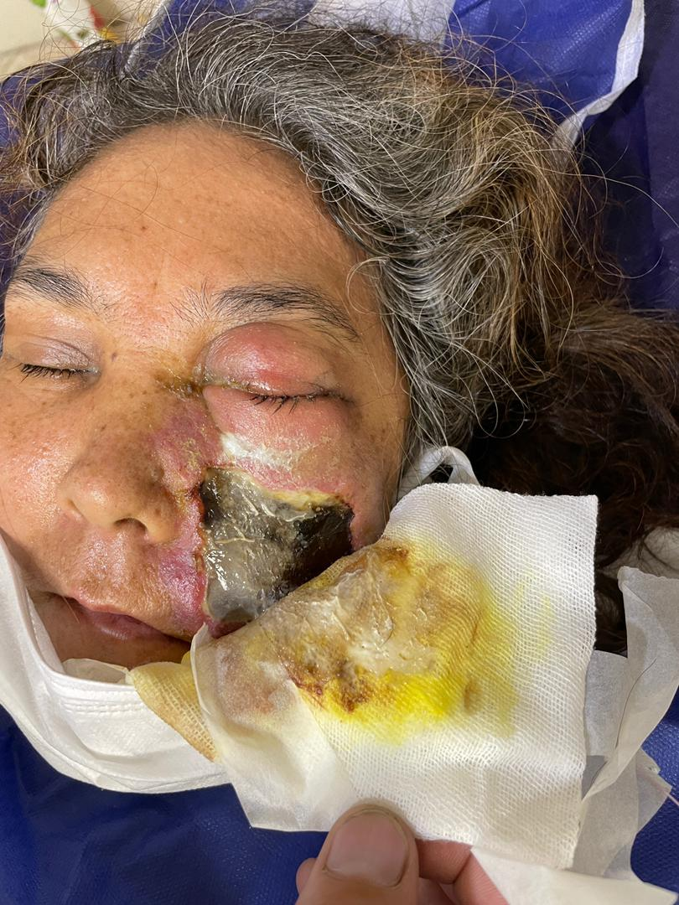
Left Cheek necrosis , periorbital edema and petosis

Slide 6
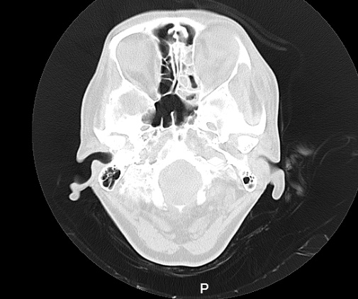
Infiltration of the left ethmoid, maxillary sinuses, and deformation of the posterior globe.

Slide 7
CONT’:
Functional Endoscopic Sinus Surgery(FESS) and mucosal biopsy was performed. Left Breast ultrasonography showed diffuse Skin thickening without collection. Amphotericin liposomal 300mg/daily was continued.
On the second day of hospitalization necrosis of the left breast tissue was significant and surgical consultation was requested.
Suspected of mucormycosis due to the severe extent of the infection, a simple mastectomy was performed and the patient was admitted to the surgical ICU with fair condition.

Slide 8
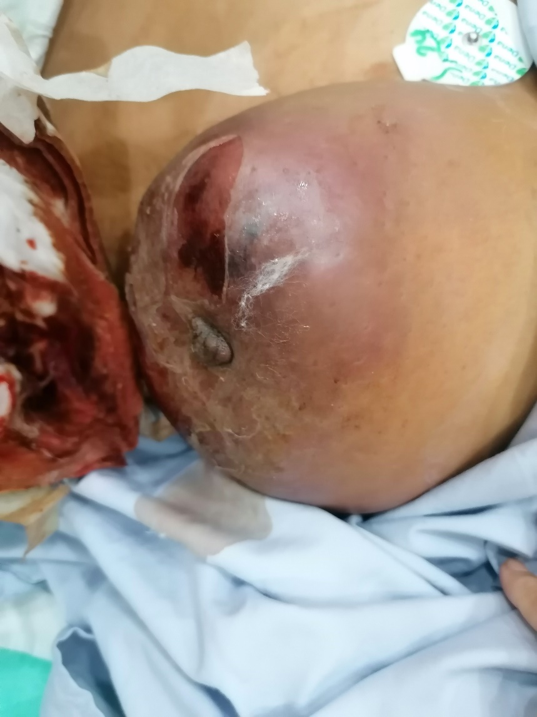
Left breast necrosis

Slide 9
PATHOLOGY:
The report of skin, sinus mucosa and breast pathology is as follows: scattered fungal elements including broad, irregular 8mm septate hyphae, focally angioinvasion is seen. Abscess formation and necrotic material is associated with fungal elements compatible with mucormycosis.

Slide 10
TREATMENT:
The patient was visited by Infectious disease specialist, Ophtalmologist and ENT specialist daily.
The left eye did not have vision, and according to ophthalmologist idea the patient did not need any ophthalmology intervention.
One week later sinus endoscopy was performed again. The report of sinus mucosa pathology was similar to the first sample and amphotericin liposomal continued.

Slide 11
TREATMENT:
Sinus endoscopy was repeated three weeks later and normal sinus mucosa was reported and there was no necrotic tissue. The patient was prescribed 12 grams of amphotericin liposomal and was discharged in good general condition without antifungal agent.
The surgery site is completely clean, without pain and swelling.
She was referred to plastic surgery clinic.

Slide 12
?
1-Why are patients with COVID-19 prone to fungal infections?
2-what are the most important symptoms of rhinocerebral mucormycosis?
3-what is the best approach to these patients?

Slide 13
DISCUSSION:
Rates of bacterial/fungal co-infection in patients presenting with COVID-19 is about 8%.
A complex interplay of factors, including preexisting diabetes mellitus, dysglycemia due to elevated IL-6, previous respiratory pathology, use of immunosuppressive therapy, the immune dysregulation associated with COVID-19, with reduced numbers of T lymphocytes, endotheliatis, and obesity are known risk factor for the development of mucormycosis.
Finally, using glucocorticoid, remdesivir and lopinavir-ritonavir can further worsen glucose control and predispose to mucormycosis.

Slide 14
cONT’
According to earlier research, about 9% of rhinocerebral mucormycosis patients were free of any predisposing factors.
The humid environment of the nose and paranasal sinuses fosters the multiplication and invasion of fugi.
COVID-19 patients receiving oxygen therapy in an ICU with a humidifier are susceptible to fungal infection due to moisture exposure.

Slide 15
Symptoms&signs:
India :
headache (63.7%),
Followed by facial swelling and numbness (45.5%) and periorbital swelling and redness/ptosis (45.5% each).
Vision loss , ophthalmoplegia
One of the most relevant findings in terms of public health was that the vast majority of patients (98.2%) were either unvaccinated or only partially vaccinated.
It can be argued that vaccination protects against severe COVID-19 and that, in moderate cases, steroid drugs are not required, reducing the risk of mucormycosis later on.

Slide 16
Warning signs:
The first 15-30 days after COVID-19 infection appear to be critical, during which patients and clinicians must be watchful and extra cautious for symptoms such as headaches, face swelling, numbness, periorbital symptoms, dental pain, and so on.

Slide 17
Case report1:
Authors conducted a study about mucormycosis superinfection in cases of COVID-19 in India, that the most commonly infection sites were rhinoorbital/ rhinocerebral mucormycosis and other sites were lungs, skin, and gastrointestinal tract.
They showed that the triad of severe COVID-19, corticosteroid use and hyperglycemia have been evident for significant increase in the incidence of angioinvasive maxillofacial mucormycosis.
Al-Tawfiq JA,et al.COVID-19 and mucormycosis superinfection: the perfect storm. Infection. 2021 Jul 24:1-21.

Slide 18
Case repoert2.
Isolated breast mucormycosis has been reported for the first time in a diabetic woman.
Patient was also receiving inhaled corticosteroids for chronic obstructive pulmonary disease.
Authors concluded that uncontrolled diabetes, old age and inhalational steroid acting as predisposing factors.
Thapar VK,. Isolated breast mucormycosis. J Postgrad Med 2006;52:134-5.

Slide 19
COVID-19-associated mucormycosis: An updated systematic review of literature 2021
99 cases of CAM reported till 14 May 2021.
The majority of the cases were reported from India.
Most of the patients were male with an underlying history of
diabetes mellitus and had received glucocorticoids for the manage-
ment of COVID-19.
Patients with CAM had a high mortality rate(34%).
the use of adjunct surgery for mucormycosis was associated with improved clinical outcomes.

Slide 20
Cont’
Clinical category of mucormycosis
Rhino-orbital (42%)
Nose/paranasal sinus (16%)
Rhino-cerebral (4%)
Rhino-orbito-cerebral (24%)
Oral (1%)
Pulmonary (10%)
Gastrointestinal (1%)
Cutaneous (1%)
Disseminated (1%)

Slide 21
Cont’
Regarding the management of CAM, we found that surgery
(sinonasal debridement in most cases) as an adjunct to antifungal
therapy was associated with higher survival rates.
The debridement surgery needs to be performed before the infection spreads to other adjoining areas, particularly the brain.
Thus, timely debridement is essential in improving patient outcomes in CAM; however, surgery may be challenging in a patient infected with SARS-CoV-2.

Slide 22
ANTIFUNGAL:
Liposomal amphotericin-B
Combination treatment of liposomal amphotericin B
+ isavuconazole
+echinocandins

Slide 23
Conclusion:
Our patient suffered from rhinoorbital and breast mucormycosis after recovering of COVID-19 that has not been reported yet.
Spores are likely to have gained entry to breast through unknown trauma and multiplied and invaded the breast tissue with systemic steroid acting as predisposing factor.
Due to the prevalence of fungal infection following COVID-19, care should be taken in prescribing drugs that weaken the immune system.
Also, a thorough clinical examination is very important to discover other foci of infection.

Slide 24


