Slide 1
Interactive Approach to COVID-19
Dr. Ilad Alavi Darazam Msc, M.D.
Assistant Professor
Clinical Fellowship in Immunodeficiency and Transplantation Infectious Diseases
Loghman Hakim Hospital
Shahid Beheshti University of Medical Sciences
2022 June

Slide 2
A 68 year-old man with fever, sore throat, malaise, headache, muscle pain, nausea since 5 days ago
Non-productive cough and shortness of breath, two days before
Exposure to his brother with flu-like illness: 11 days ago

Slide 3
PMH:
Hypertension since 10 years ago: Losartan/hydrochlorothiazide and Atorvastatin
Smoker: 30 pack-year
COVID-19 history: Negative
SARSCoV2 Vaccination: One dose Sinopharm 4 months ago

Slide 4
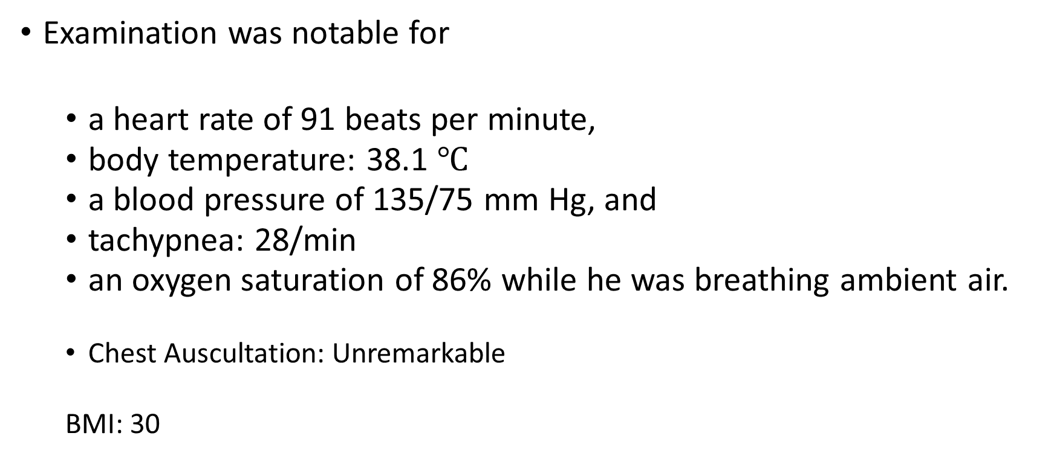
Examination was notable for
  a heart rate of 91 beats per minute,
  body temperature: 38.1 $℃$
  a blood pressure of 135/75 mm Hg, and
  tachypnea: 28/min
  an oxygen saturation of 86% while he was breathing ambient air.
  Chest Auscultation: Unremarkable
  BMI: 30

Slide 5
Next step?

Slide 6
COVID-19 Severity Spectrum

Slide 7
NIH Guidelines
Stage | Characteristics
Asymptomatic or presymptomatic infection | Positive virologic test for SARS-CoV-2 (ie, NAAT or antigen test) but no symptoms consistent with COVID-19
Mild illness | Varied symptoms (eg, fever, cough, sore throat, malaise, headache, muscle pain, nausea, vomiting, diarrhea, loss of taste or smell) but no shortness of breath, dyspnea, or abnormal chest imaging
Moderate illness | SpO₂ ≥94% and lower respiratory disease evidenced by clinical assessment or imaging
Severe illness | SpO₂ <94%, PaO₂/FiO₂ <300 mm Hg on room air, respiratory rate >30 breaths/ min, or lung infiltrates >50%
Critical illness | Respiratory failure, septic shock, and/or multiorgan dysfunction
Notes:
FiO₂, fraction of inspired oxygen; NAAT, nucleic acid amplification test; PaO₂, partial pressure of arterial oxygen; SpO₂, blood oxygen saturation.

Slide 8
FDA “High Risk” for Progression to Severe COVID-19
Older age (eg, ≥65 yr of age)
Obesity or being overweight
Pregnancy
CKD or diabetes
Immunosuppressive disease or treatment
Cardiovascular disease (including congenital heart disease) or hypertension
Chronic lung diseases
Sickle cell disease
Neurodevelopmental disorders/conditions conferring medical complexity
Medical-related technological dependence (eg, tracheostomy, gastrostomy, positive pressure ventilation)
Notes:
CKD, chronic kidney disease.

Slide 9
Age Is an Important Risk Factor for Severe COVID-19
COVID-19 Death Risk Ratio for
Select Age Group and Comorbid Conditions
EPIC-HR and MOVe-OUT High-Risk Criteria:
  ≥60 yr of age
  Chronic pulmonary disease
  Overweight or obese
  Chronic kidney disease
  Cardiovascular disease
  Neurodevelopmental disorders
  Medically related technologic dependence
  Tobacco smoker
  Immunosuppression
  Sickle cell disease
  Diabetes
  Active cancer
18-39
40-49
50-64
65-74
75-84
85+
1.0
2.2
Age, Yr
4.3
6.7
8.5
10.6
Obesity
Diabetes with complication
Chronic kidney disease
Chronic obstructive pulmonary
disease and bronchiectasis
Neurocognitive disorders
Coronary atherosclerosis and
other heart disease
1.3
1.3
1.2
Comorbidities
1.2
1.2
1.1
Ref (1.00)
cdc.gov/coronavirus/2019-ncov/hcp/clinical-care/underlyingconditions.html.
Hammond. NEJM. 2022;[Epub]. Bernal. NEJM. 2022;386:509.

Slide 10
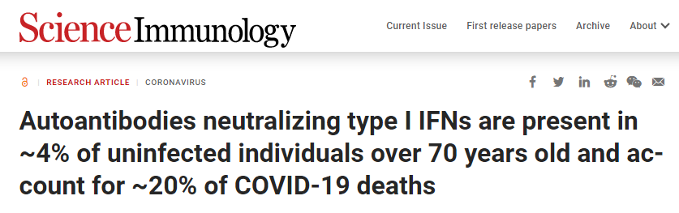
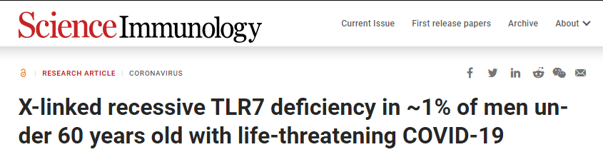

Slide 11
Which one?
LAB:
CBC, diff ?
BUN, Cr, …?
D-Dimer?
LDH, Ferritin, Ast, Alt, Alp, Bili ?
B/C?
CRP?
Imaging:
CXR?
CT scan?

Slide 12
Nontherapeutic Management of Severe COVID-19
Severe Pneumonia Treatment¹
Equip patient care areas with pulse oximeters, functioning oxygen systems, and disposable, single-use, oxygen-delivering interfaces
Provide immediate supplemental oxygen to patients with emergency signs during resuscitation (eg, obstructed/absent breathing, severe respiratory distress, central cyanosis, shock, coma/convulsions) and to stable hypoxemic patients
Monitor for clinical deterioration (eg, rapidly progressive respiratory failure, shock); provide immediate supportive care
Practice cautious fluid management in patients without tissue hypoperfusion and fluid responsiveness
Initial Evaluation¹
May include chest x-ray, ultrasound, or CT
Perform ECG if indicated
Obtain CBC with differential and metabolic profile including liver/renal function
Inflammatory markers (eg, CRP, D-dimer, ferritin) may be prognostically valuable
1. WHO. COVID-19 clinical management: living guidance. November 23, 2021.
2. NIH COVID-19 Treatment Guidelines. Clinical spectrum of SARS-CoV-2 infection. Last updated October 19, 2021.
Notes:
DDI, drug–drug interaction; SARI, severe acute respiratory infection.

Slide 13
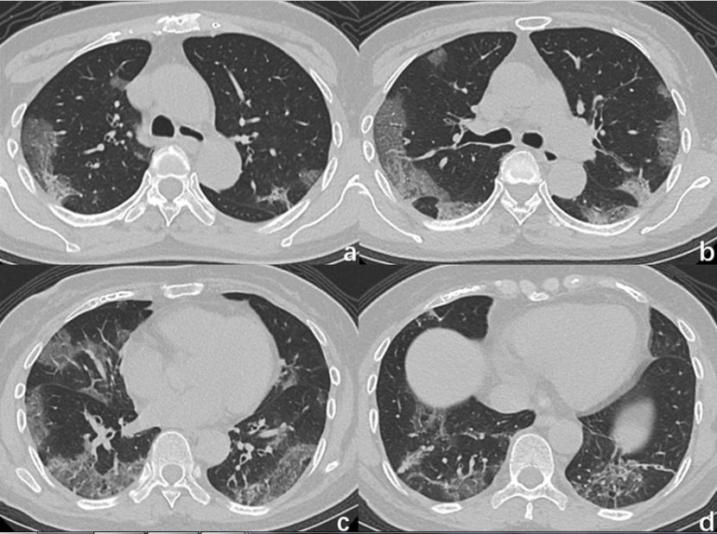

Slide 14
Laboratory test (unit) | Reference range | Result
WBC (10³/µL) Neutrophils (10³/µL) Lymphocyte ( 10³/µL) Monocyte ( 10³/µL) Basophil ( 10³/µL) Eosinophil ( 10³/µL) Hb (gr/dl) MCV (fL) PLT( 10³/µL) | 4-10 1.5-8 0.8-4.8 0.2-1 0-0.2 0-0.8 12-14 80-100 140-450 | 7.8 4 2.9 0.6 0 0.2 14.9 87.2 360

Slide 15
Test | Result
BUN Cr D-Dimer LDH Ferritin Ast Alt Alp Bili CRP Lactate | 46 1.6 - 456 620 46 38 245 1.6 84 18
On Admission

Slide 16
Treatment

Slide 17
IDSA: Recommendations FOR Treatment of Patients With COVID-19
IDSA Guidance | Patient Population | Treatment
Recommends | Hospitalized with critical* COVID-19 | Dexamethasone† vs none
Recommends in clinical trial only | Ambulatory with mild to moderate COVID-19 | Fluvoxamine Bebtelovimab
*Mechanical ventilation or ECMO. Includes end organ dysfunction (eg, ARDS). †If unavailable, methylprednisolone and prednisone acceptable at equivalent total daily doses.
IDSA. COVID-19 Guideline, Part 1: Treatment and Management. Version 8.0.0.
Notes:
ARDS, acute respiratory distress syndrome; ECMO, extracorporeal membrane oxygenation; IDSA, Infectious Diseases Society of America.

Slide 18
Meta-analysis of Systemic Corticosteroids in
Critically III Patients With COVID-19
Trial | Location | Eligibility | Treatment Arms | Dose | Outcome
 |  |  |  |  | Primary | Mortality
DEXA-COVID 19 | Spain | Intubation, mechanical ventilation, moderate to severe ARDS* | Dexamethasone vs usual care | 20 mg/day IV for 5 days, then 10 mg/day IV for 5 days | 60-day mortality | Day 28
CoDEX | Brazil | Intubation, mechanical ventilation, moderate to severe ARDS* | Dexamethasone vs usual care | 20 mg/day IV for 5 days, then 10 mg/day IV for 5 days | Ventilator-free days | Day 28
RECOVERY | UK | Intubation | Dexamethasone vs usual care | 6 mg/day PO or IV | 28-day mortality | Day 28
CAPE COVID | France | ICU/intermediate care unit, O₂ (≥6 L/min) | Hydrocortisone vs placebo | Continuous IV infusion 8-14 days with tapered dosing (200 mg/day to 50 mg/day) | 21-day treatment failure | Day 21
*Per Berlin Criteria.
WHO REACT Working Group. JAMA. 2020;324:1330.
Notes:
ARDS, acute respiratory distress syndrome.

Slide 19
Meta-analysis of Systemic Corticosteroids in
Critically III Patients With COVID-19
Trial | Location | Eligibility | Treatment Arms | Dose | Outcome
 |  |  |  |  | Primary | Mortality
COVID STEROID | Denmark | O₂ (≥10 L/min) | Hydrocortisone vs placebo | 200 mg/ day IV for 7 days | Days alive without life support at Day 28 | Day 28
REMAP-COVID | Australia, Canada, EU, New Zealand, UK, US | Admitted to ICU receiving high-flow nasal O₂ with FIO₂ ≥0.4 at ≥30 L/min, noninvasive or invasive ventilatory support, or receiving vasopressors | Hydrocortisone vs usual care | 50 mg IV every 6 hr for 7 days | Composite of hospital mortality and ICU organ support–free days to Day 21 | Day 28
Steroids-SARI | China | ICU with PaO₂:FIO₂ <200 mm Hg on positive pressure ventilation or high-flow nasal canulae >45 L/min | Methylprednisolone vs usual care | 40 mg IV every 12 hr for 5 days | Lower lung injury score at Day 7 and Day 14 | Day 30
WHO REACT Working Group. JAMA. 2020;324:1330.

Slide 20
Systemic Corticosteroids and 28-Day All-Cause
Mortality in Critically Ill Patients With COVID-19
Drug/Trial | Initial Dose | Deaths/n |  | Odds Ratio (95% CI) | P Value
 |  | Steroids | No Steroids
Dexamethasone
DEXA-COVID 19 | High: 20 mg/day IV | 2/7 | 2/12 | 2.00 (0.21-18.69)
CoDEX | High: 20 mg/day IV | 69/128 | 76/128 | 0.80 (0.49-1.31)
RECOVERY | Low: 6 mg/day PO or IV | 95/324 | 283/683 | 0.59 (0.44-0.78)
Subgroup fixed effect |  | 166/459 | 361/823 | 0.64 (0.50-0.82) | <.001
Hydrocortisone
CAPE COVID | Low: 200 mg/day IV | 11/75 | 20/73
COVID STEROID | Low: 200 mg/day IV | 6/15 | 2/14
REMAP-COVID | Low: 50 mg every 6 hr IV | 26/105 | 29/92
Subgroup fixed effect |  | 43/195 | 51/179 | 0.69 (0.43-1.12) | .13
Methylprednisolone
Steroids-SARI | High: 40 mg every 12 hr IV | 13/24 | 13/23 | 0.91 (0.29-2.87) | .87
Overall*
Overall (fixed effects) |  | 222/678 | 425/1025 | 0.66 (0.53-0.82) | <.001
Overall (random effects) |  | 222/678 | 425/1025 | 0.70 (0.48-1.01) | .053
Favors
Steroids
Favors No Steroids
Weight, %
0.92
18.69
57.00
76.60
6.80
1.39
11.75
19.94
3.46
100.00
*P = .31 for heterogeneity; I² = 15.6%.
0.2
1
4
Odds Ratio (95% CI)
WHO REACT Working Group. JAMA. 2020;324:1330.

Slide 21
Subgroup Analysis of Systemic Corticosteroids and
28-Day All-Cause Mortality in Patients With COVID-19
Subgroup | Deaths/n |  | Odds Ratio (95% CI)
 | Steroids | No Steroids
Invasive mechanical ventilation
No (I²= 0%) | 14/70 | 28/74 | 0.41 (0.19-0.88)
Yes (I²= 44.1%) | 208/608 | 397/951 | 0.69 (0.55-0.86)
O₂ treatment w/out IMV (RECOVERY) | 298/1279 | 682/2604 | 0.86 (0.73-1.00)
Taking vasoactive medication
No (I²= 0%) | 51/184 | 68/184 | 0.55 (0.34-0.88)
Yes (I²= 0%) | 76/169 | 74/158 | 1.05 (0.65-1.69)
Age, yr
≤60 (I² = 0%) | 72/338 | 141/483 | 0.67 (0.48-0.94)
>60 (I² = 49.7%) | 150/339 | 284/541 | 0.69 (0.51-0.93)
Sex
Female (I² = 0%) | 60/202 | 106/286 | 0.66 (0.43-0.99)
Male (I² = 14.7%) | 162/476 | 319/739 | 0.66 (0.51-0.84)
Symptomatic, days
≤7 (I² = 69.1%) | 51/130 | 99/211 | 0.63 (0.39-1.04)
>7 (I² = 0%) | 139/418 | 293/693 | 0.64 (0.49-0.83)
Favors
Steroids
Favors No Steroids
Weight, %
2.7
31.7
65.6
50.2
49.8
42.7
57.3
27.4
72.6
22.4
77.6
0.2
1
2
Odds Ratio (95% CI)
WHO REACT Working Group. JAMA. 2020;324:1330.
Slide credit: clinicaloptions.com

Slide 22
Systemic Corticosteroids and Serious
Adverse Events in Critically Ill Patients With COVID-19
Drug/Trial | Initial Dose | Serious Adverse Events/n |  | Odds Ratio (95% CI)
 |  | Steroids | No Steroids
Dexamethasone
DEXA-COVID 19 | High: 20 mg/day IV | 3/7 | 11/12 | 0.07 (0.01-0.86)
CoDEX | High: 20 mg/day IV | 7/128 | 15/128 | 0.44 (0.17-1.11)
Hydrocortisone
CAPE COVID | Low: 200 mg/day IV | 28/75 | 30/73 | 0.85 (0.44-1.65)
COVID STEROID | Low: 200 mg/day IV | 1/15 | 0/14 | 3.00 (0.11-79.91)
REMAP-COVID | Low: 50 mg every 6 hr IV | 2/105 | 1/92 | 1.77 (0.16-19.81)
Methylprednisolone
Steroids-SARI | High: 40 mg every 12 hr IV | 23/24 | 23/23 | 0.33 (0.01-8.61)
Favors
Steroids
Favors No Steroids
0.05
0.1
1
8
Odds Ratio (95% CI)
WHO REACT Working Group. JAMA. 2020;324:1330.

Slide 23
NIH/IDSA: Dexamethasone for COVID-19
NIH¹*
For those not hospitalized (AIII) or hospitalized but not requiring supplemental oxygen (AIIa), the Panel recommends against the use of dexamethasone
For those hospitalized and requiring supplemental oxygen, the Panel recommends remdesivir alone (BIIa), remdesivir + dexamethasone (BIII), or dexamethasone alone (BI)
For those hospitalized and requiring high-flow oxygen or noninvasive ventilation, the Panel recommends remdesivir + dexamethasone (BIII) or dexamethasone alone (AI)
For those hospitalized and requiring invasive mechanical ventilation or ECMO, the Panel recommends dexamethasone + tocilizumab (BIIa)
Dose: Dexamethasone 6 mg IV or PO for 10 days or until discharge; equivalent corticosteroid dose (eg, prednisone, methylprednisolone, or hydrocortisone) may be used if dexamethasone unavailable
IDSA²
For hospitalized patients with critical† COVID-19, the Panel recommends dexamethasone rather than no dexamethasone (Strong recommendation, Moderate certainty of evidence)
For hospitalized patients with severe‡ COVID-19, the Panel suggests dexamethasone rather than no dexamethasone (Conditional recommendation, Moderate certainty of evidence)
  Dose: Dexamethasone 6 mg IV or PO for 10 days (or until discharge) or equivalent glucocorticoid dose (eg, methylprednisolone 32 mg, prednisone 40 mg) may be substituted if dexamethasone unavailable
*Recommendation rating: A = Strong; B = Moderate; C = Optional. Evidence rating: I = ≥1 randomized trials without major limitations; IIa = Other randomized trials or subgroup analyses of randomized trials; IIb = Nonrandomized trials or observational cohort studies; III = Expert opinion. †Mechanical ventilation or ECMO. ‡Patients with SpO₂ ≤94% on room air, including those who require supplemental oxygen.
1. NIH COVID-19 Treatment Guidelines. Therapeutic management of adults with COVID-19. Last updated April 8, 2022.
2. IDSA. COVID-19 Guideline, Part 1: Treatment and Management. Version 8.0.0.
Notes:
ECMO; extracorporeal membrane oxygenation; IDSA, Infectious Diseases Society of America; NIH, National Institutes of Health; SpO₂, oxygen saturation.

Slide 24
NIH: Additional Considerations for Dexamethasone
Guidance
Unknown if other corticosteroids will have a similar benefit. Of note: dose equivalencies for dexamethasone 6 mg daily = prednisone 40 mg, methylprednisolone 32 mg, and hydrocortisone 160 mg
The RECOVERY trial included only hospitalized patients
Patients did not receive dexamethasone in the RECOVERY trial if risks deemed too great based on their medical history
It is unclear whether all patients in RECOVERY who received dexamethasone derived benefit from it or whether benefit is restricted to those requiring higher levels of supplemental oxygen or oxygen delivered through a high-flow device
Patients should be closely monitored for adverse effects, including hyperglycemia and secondary infections
Systemic corticosteroids may increase risk of reactivation of latent infections (HBV, herpes viruses, TB)
Dexamethasone is a moderate CYP3A4 inducer, which may reduce the concentration and efficacy of some medications; clinicians should review current medications to assess potential interactions
In other coronavirus outbreaks (MERS and SARS), corticosteroid use associated with delayed virus clearance
NIH COVID-19 Treatment Guidelines. Corticosteroids. Last updated December 16, 2021. RECOVERY Collaborative Group. NEJM. 2021;384:693.
Notes:
HBV, hepatitis B virus; MERS, middle eastern respiratory syndrome; NIH, National Institutes of Health; PK, pharmacokinetics; SARS, severe acute respiratory syndrome; TB, tuberculosis.

Slide 25
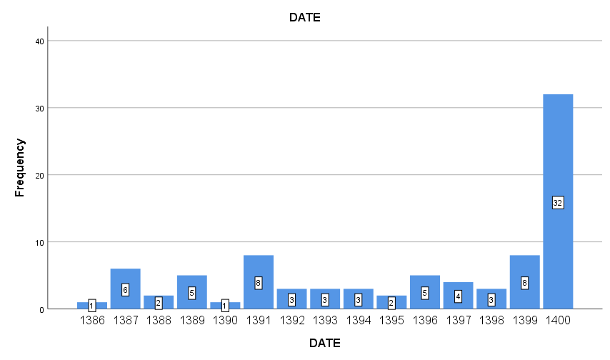
Mucormycosis Trend in Loghman Hakim Hospital during 15 years

Slide 26
Dexamethasone 6 mg daily IV was administered for our patient.
Does the patient need any other medications?

Slide 27
JAK Inhibitors

Slide 28



JAK1/2 Inhibitors
Elevated in blood
IL-1b, IL-2, IL-6, IL-7, IL-8,
IL-9, IL-10, IL-17, G-CSF, GM-CSF, IFNα, IFNγ, TNF-α, IP10, MCP1, MIP1A, MIP1B
Hyperinflammatory
Stage
Cytokine
R
R
Jak1
Jak2
JAK1/2 inhibitor
JAK1/2 inhibitor
P
STAT
P
STAT
STAT
P
IL6 mRNA
Stebbing. EMBO Mol Med. 2020;12:e12697.

Slide 29
Key Ongoing Trials Investigating JAK1/2 Inhibitors
Ne
Agent and Comparator | Trial | Phase | Primary Endpoint/Patient Population
Ruxolitinib vs placebo*¹ | RUXCOVID | III | Death, respiratory failure, or ICU admission; hospitalized patients with SARS-CoV-2 and either radiographic infiltrates by imaging, SpO₂ ≤94% on room air, requiring supplemental oxygen, increased respiratory rate, or PaO₂/FiO₂ <300 mm/Hg
Ruxolitinib vs placebo² | RUXCOVID-DEVENT | III | All-cause mortality; hospitalized patients with SARS-CoV-2 receiving mechanical ventilation
*Published results pending; did not meet its primary endpoint per press release on December 14, 2020.³
1. NCT04362137. 2. NCT04377620. 3. https://www.novartis.com/news/media-releases/novartis-provides-update-ruxcovid-study-ruxolitinib-hospitalized-patients-covid-19. Press release only, not peer reviewed.
Notes:
FiO₂, fraction of inspired oxygen; PaO₂, partial pressure of oxygen; SpO₂, oxygen saturation.

Slide 30
Baricitinib
Notes:
Janus kinase inhibitor approved as a DMARD for rheumatoid arthritis
Identified as a therapeutic candidate by artificial intelligence for both immunomodulatory and potential antiviral properties
Inhibits host proteins (P2-associated kinase 1 AAK1 and the cyclin G–associated kinase GAK)
May inhibit virus entry into cells and reduce inflammatory responses

Slide 31
Baricitinib and Immune Dysregulation in COVID-19
Observational study assessing baricitinib 4 mg BID for 2 days followed by QD for 7 days vs no baricitinib in patients hospitalized with COVID-19 pneumonia
IL-1β
IL-6
0.8
40
Baricitinib
Control
P = .62
0.6
30
0.4
pg/mL
20
pg/mL
P = .67
0.2
10
P = .02
P = .005
0.0
0
Outcomes | Baricitinib (n = 20) | No Baricitinib (n = 56) | P Value
Deaths, n (%) | 1 (5) | 25 (45) | <.001
ARDS, n (%) | 3 (15) | 15 (27) | .37
Median duration of hospitalization, days (range)* | 12 (5-24) | 11 (3-46) | .28
t0
t7
t0
t7
40
TNFα
60
IL-8
P = .76
30
P = .82
40
20
pg/mL
pg/mL
20
P = .95
10
P = .006
*Assessable in 19 patients in baricitinib arm and 31 patients in no baricitinib arm.
0
0
t0
t7
t0
t7
Bronte. J Clin Invest. 2020;130:6409.
Notes:
ARDS, acute respiratory distress syndrome.

Slide 32
NIAID ACTT-2: Results for Baricitinib + Remdesivir vs Remdesivir in Severe COVID-19
30% higher odds of improvement in clinical status at Day 15 (according to ordinal scale) with baricitinib + remdesivir vs placebo + remdesivir
  OR: 1.3 (95% CI: 1.0-1.6)
Outcome | Baricitinib + Remdesivir | Placebo + Remdesivir | Rate Ratio for Recovery or HR* (95% CI) | P Value
Median time to recovery (primary endpoint), days | 7 | 8 | 1.16 (1.01-1.32) | .03
In patients receiving high-flow oxygen or noninvasive ventilation at enrollment | 10 | 18 | 1.51 (1.10-2.08) | NR
28-day mortality, % | 5.1 | 7.8 | 0.65 (0.39-1.09) | NR
*Rate ratio for time to recovery endpoints, HR for mortality.
Primary endpoint: time to recovery by Day 29 defined as the first day patient satisfies 1 of these categories from ordinal scale: 1) hospitalized, not requiring supplemental oxygen or ongoing medical care; 2) not hospitalized, limitation on activities and/or requiring home oxygen; or 3) not hospitalized, no limitations on activities
Kalil. NEJM. 2021;384:795.
Notes:
NR, not reported; OR, odds ratio.

Slide 33
FDA EUA for Baricitinib
“. . . permit the emergency use of baricitinib for treatment of
coronavirus disease 2019 (COVID-19) in hospitalized adults and pediatric patients 2 years of age or older requiring supplemental oxygen, non-invasive or invasive mechanical ventilation, or extracorporeal membrane oxygenation (ECMO).”
Recommended dosage under EUA:
  Adults and pediatric patients ≥9 yr of age: 4 mg orally once daily
  Pediatric patients 2 yr to <9 yr of age: 2 mg orally once daily
  Optimal duration of treatment unknown; 14 days or until hospital discharge (if first) recommended
eGFR, aminotransferase levels, and CBC with differential must be determined before first dose
Baricitinib. EUA Fact Sheet for Healthcare Providers. Last updated December 2021.
Notes:
CBC, complete blood count; eGFR, estimated glomerular filtration rate; EUA, Emergency Use Authorization.

Slide 34
Baricitinib EUA: Contraindications and Warnings
No known contraindications
Hypersensitivity:
  If serious hypersensitivity occurs, discontinue baricitinib
Serious infections:
  Serious infections have occurred in patients receiving baricitinib
  Avoid use in cases of known active tuberculosis
  Weigh potential benefits vs risks in situations with active coinfections other than COVID-19
Thrombosis:
  In hospitalized patients with COVID-19, VTE prophylaxis recommended, unless contraindicated
Vaccinations:
  Avoid use of live vaccines with baricitinib
Abnormal laboratory values:
  Evaluate at baseline and thereafter according to management practice
  Dose adjustments for patients with abnormal renal, hepatic, and hematologic values
Baricitinib. EUA Fact Sheet for Healthcare Providers. Last updated October 2021.
Notes:
EUA, Emergency Use Authorization; VTE, venous thromboembolism.

Slide 35
Baricitinib EUA: Dose Adjustments
Renal Impairment
Lab Abnormalities
eGFR, mL/min/ 1.73 m² | Recommendation
 | ≥9 Yr of Age | 2-8 Yr of Age
≥60 | No adjustment needed | No adjustment needed
30 to <60 | (↓ to) 2 mg orally QD | (↓ to) 1 mg orally QD
15 to <30 | (↓ to) 1 mg orally QD | Not recommended
<15 | Not recommended | Not recommended
Lab Parameter | Recommendation
ALC <200 cells/mm³ | Consider interruption until ALC ≥200 cells/mm³
ANC <500 cells/mm³ | Consider interruption until ANC ≥500 cells/mm³
Elevated ALT or AST | If drug-induced liver injury (DILI) is suspected, interrupt until DILI diagnosis excluded
If lab abnormality likely due to underlying disease state, consider risks vs benefits of continuing baricitinib at same or reduced dose.
Baricitinib. EUA Fact Sheet for Healthcare Providers. Last updated December 2021.
Notes:
ALC, absolute lymphocyte count; ALT, alanine aminotransferase; ANC, absolute neutrophil count; AST, aspartate aminotransferase; eGFR, estimated glomerular filtration rate; EUA, Emergency Use Authorization.

Slide 36
NIH Guidelines on Baricitinib
“The Panel’s recommendations are based on data from the ACTT-2, COV-BARRIER, and STOP-COVID clinical trials.”
Add baricitinib to dexamethasone or dexamethasone + remdesivir if patient is recently hospitalized with increasing oxygen needs (high-flow oxygen or noninvasive ventilation) and systemic inflammation
“The Panel recommends against the use of JAK inhibitors other than baricitinib or tofacitinib for the treatment of COVID-19, except in a clinical trial (AIII).”
NIH COVID-19 Treatment Guidelines. Kinase inhibitors. Last updated December 16, 2021.
Notes:
EUA, Emergency Use Authorization

Slide 37
We did not add baricitinib.
What about IL-6R Inhibitors?

Slide 38
Anti–IL-6 Receptor Antibodies
Soluble IL-6 receptor
Anti–IL-6 receptor antibodies
IL-6
gp130
X
X
Signal transduction
Blocking signal transduction
Inflammatory storm
Calm inflammatory storm
Fu. J Translational Medicine. 2020;18:164.

Slide 39
IDSA: Suggestions FOR Treatment of Hospitalized Patients With COVID-19
IDSA Guidance | Patient Population | Treatment
Suggests | Hospitalized with severe‡ COVID-19 Hospitalized with progressive severe‡ or critical* COVID-19, elevated markers of inflammation Hospitalized with severe‡ COVID-19 Hospitalized with severe‡ COVID-19, elevated markers of inflammation, no invasive ventilation Hospitalized with severe‡ COVID-19, no invasive ventilation Hospitalized with severe‡ COVID-19 and corticosteroids contraindicated | Dexamethasone† vs none, baricitinib + SoC Tocilizumab + SoC (ie, steroids) vs SoC alone (if tocilizumab not available, use sarilumab) Remdesivir§ vs no antiviral Baricitinib vs none Tofacitinib vs none Baricitinib + remdesivir vs remdesivir alone
*Mechanical ventilation or ECMO. Includes end organ dysfunction (eg, ARDS). †If unavailable, methylprednisolone and prednisone acceptable at equivalent total daily doses. ‡SpO₂ ≤94% on room air, including those on supplemental oxygen. §5 days suggested.
IDSA. COVID-19 Guideline, Part 1: Treatment and Management. Version 8.0.0.
Notes:
ARDS, acute respiratory distress syndrome; ECMO, extracorporeal membrane oxygenation; IDSA, Infectious Diseases Society of America; SoC, standard of care; SpO₂, blood oxygen saturation.

Slide 40
IDSA: Recommendations AGAINST Treatment of Patients With COVID-19
IDSA Guidance | Patient Population | Treatment
Recommends against | COVID-19 Hospitalized with COVID-19 Hospitalized with COVID-19 Hospitalized with severe COVID-19 | (Hydroxy)chloroquine (Hydroxy)chloroquine + azithromycin Lopinavir/ritonavir Bamlanivimab monotherapy Convalescent plasma
Suggests against | Hospitalized with nonsevere* COVID-19 Hospitalized with COVID-19 Hospitalized with COVID-19, receiving invasive ventilation and/or ECMO or no need for supplemental oxygen (ie, SpO₂ >94%) | Glucocorticoids Routine remdesivir
Suggests against outside clinical trial | Hospitalized with severe COVID-19 Hospitalized with severe COVID-19 or an ambulatory with COVID-19 Ambulatory with mild to moderate COVID-19 | Famotidine Ivermectin Inhaled glucocorticoids
*SpO₂ >94%, no supplemental oxygen.
IDSA. COVID-19 Guideline, Part 1: Treatment and Management. Version 8.0.0.
Notes:
IDSA, Infectious Diseases Society of America; SpO₂, blood oxygen saturation

Slide 41
NIH Guidelines: Therapeutic Management of Nonhospitalized Adults With COVID-19
Disease Severity | Recommendation
Not requiring hospitalization or supplemental oxygen per ED, in-person, or telehealth visit | In order of preference: Nirmatrelvir + ritonavir Remdesivir Alternative agents: Bebtelovimab Molnupiravir Recommend against dexamethasone or other glucocorticoids
Discharged from inpatient setting in stable condition, no supplemental oxygen | Recommend against continuing baricitinib, dexamethasone, or remdesivir after discharge
Disease Severity | Recommendation
Discharged from inpatient setting, supplemental oxygen required | Insufficient data to recommend for or against continuing dexamethasone or remdesivir after discharge
Discharged from ED despite new or increasing need for supplemental oxygen | Dexamethasone 6 mg PO QD (up to 10 days) during supplemental oxygen therapy Since remdesivir is recommended for patients with similar oxygen needs who are hospitalized, it may be used in this setting
NIH COVID-19 Treatment Guidelines. Clinical management summary. Last updated April 8, 2022.
Notes:
ED, emergency department; NIH, National Institutes of Health.

Slide 42
NIH Guidelines: Therapeutic Management of Hospitalized Adults With COVID-19
Disease Severity | Recommendation
Hospitalized but does not require supplemental oxygen | Recommend against dexamethasone or other glucocorticoids Insufficient data to recommend for or against remdesivir; may be appropriate if high risk of disease progression
Hospitalized and requires supplemental oxygen | Use 1 of the following: Remdesivir* (eg, in case of minimal supplemental oxygen requirement) Remdesivir plus dexamethasone* (eg, with increasing need for supplemental oxygen) Dexamethasone (eg, if remdesivir cannot be used or is unavailable) For patients on dexamethasone with increasing oxygen needs, can add baricitinib or tocilizumab
Disease Severity | Recommendation
Hospitalized and requires high-flow oxygen or noninvasive ventilation | Use 1 of the following: Dexamethasone Dexamethasone + remdesivir Add baricitinib or tocilizumab if recently hospitalized with increasing oxygen needs and systemic inflammation†‡
Hospitalized and requires invasive mechanical ventilation or ECMO | Dexamethasone plus tocilizumab‡ if within 24 hr of ICU admission
*If patient progresses to requiring high-flow oxygen, noninvasive ventilation, mechanical ventilation, or ECMO, complete full remdesivir course
†Tofacitinib can be used instead of baricitinib
‡Sarilumab can be used instead of tocilizumab
NIH COVID-19 Treatment Guidelines. Clinical management summary. Last updated April 8, 2022.
Notes:
ECMO, extracorporeal membrane oxygenation.

Slide 43
On 4th day of hospitalization, he still felt chest tightness, SOB, increasing cough, and SO2 82-83%.
The trend of CRP after 4 doses of dexamethasone was increasing. (84→93→116)
Then:
Tocilizumab 600 mg was administered.

Slide 44
Supportive Management of Critical COVID-19: ARDS
Patients With ARDS | Recommendation
Any | Provide advanced oxygen/ventilatory support if patient in respiratory distress does not respond to standard oxygen therapy and develops acute hypoxemic respiratory failure Reserve performance of endotracheal intubation with airborne precautions for trained/experienced providers Reserve trials of HFNO and NIV for select patients with mild ARDS; monitor for deterioration
Mechanically ventilated | Use lower tidal volumes (4-8 mL/kg PBW), inspiratory pressures (plateau pressure <30 cmH₂O) Apply prone ventilation 12-16 hr/day in adults with severe ARDS Practice conservative fluid management if no tissue hypoperfusion and fluid responsiveness In case of moderate-to-severe ARDS, higher vs lower PEEP suggested with individualized titration and monitoring; avoid neuromuscular blockade by continuous infusion Avoid disconnecting ventilator; clamp endotracheal tube if transferring to transport ventilator Consider airway clearance techniques in patients with excessive secretions or difficulty clearing secretions, if deemed medically appropriate Consider ECMO referral if refractory hypoxemia persists despite lung-protective ventilation
WHO. COVID-19 clinical management: living guidance. November 23, 2021.
Slide credit: clinicaloptions.com
Notes:
ARDS, acute respiratory distress syndrome; ECMO, extracorporeal membrane oxygenation; HFNO, high-flow nasal oxygen; NIV, non-invasive ventilation; PEEP, positive end-expiratory pressure; PBW, predicted body weight; SARI, severe acute respiratory infection.

Slide 45
Supportive Management of Critical COVID-19:
Prevention of Complications
Attempted Outcome Reduction | Intervention
Days of invasive mechanical ventilation | Assess daily for readiness to breathe spontaneously Minimize sedation (continuous or intermittent) with specific titration targets in mind
Ventilator-associated pneumonia | Use oral vs nasal intubation in adolescents/adults Maintain semirecumbent patient positioning (ie, head of bed elevation 30-45°) Use closed suctioning system; drain condensate periodically Use new ventilator circuit per patient; exchange for same patient only if soiled/damaged Replace heat moisture exchanger if malfunctioning, soiled, or every 5-7 days
Thromboembolism | Monitor for signs/symptoms (eg, stroke, DVT, pulmonary embolism, acute coronary syndrome); standard vs therapeutic/intermediate anticoagulation dosing suggested for thromboprophylaxis
Catheter-related bloodstream infection | Use checklist and real-time observer to confirm steps for sterile insertion, as daily reminder to remove catheter if unneeded
Pressure ulcers | Turn patient every 2 hr
Stress ulcers and GI bleeds | Administer enteral nutrition within 24-48 hr of admission, H2RAs or PPIs if risk for GI bleed
Antimicrobial resistance | Use empiric antimicrobials for shortest period possible, de-escalating as soon as no evidence of infection and patient clinically stable; avoid antimicrobial use if low suspicion of bacterial infection
Side effects and DDIs | Consider pharmacokinetic and pharmacodynamic effects of all medications
WHO. COVID-19 clinical management: living guidance. November 23, 2021.
Slide credit: clinicaloptions.com
Notes:
DDI, drug-drug interactions; DVT, deep vein thrombosis; H2RA, histamine-2 receptor antagonist; PPI, proton-pump inhibitors

Slide 46
Supportive Management of Critical COVID-19:
Septic Shock
Diagnosis
Adults²: Infection suspected/confirmed, vasopressors required to maintain MAP ≥ 65 mm Hg, and lactate ≥2 mmol/L without hypovolemia
Children²: Any hypotension or ≥2 of the following—altered mental state, brady/tachycardia, prolonged capillary refill or feeble pulses, tachypnea, mottled/cold skin or petechial/purpuric rash, increased lactate, oliguria, hyper/hypothermia
Resuscitation Strategies²
Adults: Give buffered/balanced crystalloids; give vasopressors if shock continues during/after fluid resuscitation
Assess for fluid overload after each bolus; if present (or no response to fluid), reduce or discontinue fluid
Avoid hypotonic crystalloids, starches, or gelatins
Place arterial catheter for adult patients who require vasopressors
Consider dobutamine if poor perfusion and cardiac dysfunction persist after reaching MAP target
First-line vasopressors
  Norepinephrine for adults^{1,2}
  Epinephrine for children²
1. NIH COVID-19 Treatment Guidelines. Care of critically ill patients with COVID-19. Hemodynamics. Last updated July 8, 2021.
2. WHO. COVID-19 clinical management: living guidance. November 23, 2021.
Slide credit: clinicaloptions.com
Notes:
MAP, mean arterial pressure.

Slide 47
What about anti-coagulant therapy in this patient?
Prophylactic?
Therapeutics?
Low dose vs high dose?

Slide 48
Laboratory Predictors of Thrombosis in COVID-19
Median Value | No Thrombotic or Bleeding Complication (n = 347) | Thrombotic Complication (n = 38) | P Value
D-dimer, ng/mL Initial Minimum Peak | 891 760 1377 | 1538 1336 4001 | .0002 .0006 <.0001
Fibrinogen, mg/dL Initial Minimum Peak | 579 549 662 | 696 669 828 | .0045 .0028 .0001
CRP, mg/L Initial Minimum Peak | 63.3 35.4 130.3 | 124.7 94.2 277.7 | .0011 <.0001 <.0001
Median Value | No Thrombotic or Bleeding Complication (n = 347) | Thrombotic Complication (n = 38) | P Value
ESR, mm/hr Initial Minimum Peak | 38 36 56 | 47 43 91 | .020 .079 .0077
Ferritin, μg/L Initial Minimum Peak | 504 453 707 | 825 750 1182 | .015 .0056 .0020
Al-Samkari. Blood. 2020;136:489.
Notes:
CRP, C-reactive protein; ESR, erythrocyte sedimentation rate.

Slide 49
Endotheliitis
Postulated to be a central feature of pathophysiology¹
SARS-CoV-2 binds to host cells via the ACE2 receptor^{1,2}
High density of ACE2 receptors on endothelial cells^{1,2}
Endotheliitis and viral inclusions in endothelial cells have been reported in COVID-19 autopsy series²
1. Ackermann. NEJM. 2020;383:120. 2. Varga. Lancet. 2020;395:1417.
Notes:
ACE2, angiotensin-converting enzyme 2.

Slide 50
Treatment Dose Anticoagulation and
In-Hospital Survival Among Patients With COVID-19
Single-center, retrospective study at Mount Sinai Health System, New York, compared survival with treatment dose anticoagulation vs prophylactic dose or no anticoagulation in hospitalized patients with COVID-19, March 14 - April 11, 2020 (N = 2773)
  Median hospitalization duration:
  5 days
  Median anticoagulation duration:
  3 days
Longer duration of TDAC associated with reduced mortality risk (aHR*: 0.86/day; 95% CI: 0.82-0.89; P <.001)
Outcome | TDAC (n = 786) | No TDAC (n = 1987)
In-hospital mortality, % | 22.5 | 22.8
Median survival, days | 21 | 14
Mechanical ventilation, % In-hospital mortality, % Median survival, days | 29.8 29.1 21 | 8.1† 62.7 9
Major bleeding, % | 3 | 1.9
*Adjusted for age, sex, ethnicity, BMI, history of hypertension, heart failure, atrial fibrillation, type 2 diabetes, anticoagulation use prior to hospitalization, and admission date. †P <.001.
Paranjpe. JACC. 2020;76:122.
Notes:
aHR, adjusted HR; TDAC, treatment dose anticoagulation.

Slide 51
Prophylactic Dose vs Therapeutic Dose
Anticoagulation in COVID-19
Retrospective, 2-center, cohort study comparing in-hospital mortality with prophylactic vs therapeutic AC dosing of enoxaparin or heparin begun preemptively at admission, April 1-25, 2020 (N = 374)
  Excluded therapeutic AC for thrombotic indication; prophylactic AC group received only prophylactic dosing for whole inpatient duration
Outcome | Prophylactic Dose AC (n = 299) | Therapeutic Dose AC (n = 75)
In-hospital mortality, % | 14.4 | 38.7
Crude risk ratio (95% CI) P value | 2.7 (1.8-4.0) <.001
Adjusted risk ratio* (95% CI) P value | 2.3 (1.0-4.9) .04
*Full logistic model included AC dosage, age, ethnicity, diabetes, history of heart disease or cancer, hyperlipidemia, intensive care, peak CRP, mechanical ventilation, and antibiotic use.
Motta. Crit Care Explor. 2020;2:e0309.
Notes:
AC, anticoagulation; CRP, C-reactive protein.

Slide 52
Guidance on Thromboprophylaxis
Recommending Organization*
NIH¹ | ASH²
Hospitalized adults with COVID-19 should receive prophylactic dose anticoagulation Anticoagulant or antiplatelet therapy should not be used to prevent arterial thrombosis outside of the usual SoC for patients without COVID-19 Currently insufficient data to recommend for or against the use of thrombolytics or increasing anticoagulant doses for VTE prophylaxis in hospitalized COVID-19 patients outside of clinical trial Hospitalized patients should not be routinely discharged on VTE prophylaxis (extended VTE prophylaxis can be considered in patients with low bleeding risk and high VTE risk) | All hospitalized adults with COVID-19 should receive thromboprophylaxis with low-molecular-weight heparin over unfractionated heparin, unless bleeding risk outweighs thrombosis risk Fondaparinux is recommended in the setting of heparin-induced thrombocytopenia In patients in whom anticoagulants are contraindicated or unavailable, use mechanical thromboprophylaxis (eg, pneumatic compression devices) Full-dose, rather than prophylactic dose, anticoagulation should be used in patients with acute COVID-19 even if no suspected or confirmed VTE or other indication for anticoagulation
*Additional recommendations available from the International Society on Thrombosis and Haemostasis,³ and CHEST.⁴
1. NIH. COVID-19 Treatment Guidelines. Antithrombotic therapy in patients with COVID-19. Last updated February 24, 2022.
2. American Society of Hematology. COVID-19 and VTE/anticoagulation: FAQs. Last updated February 2, 2022.
3. Spyropoulos. J Thromb Haemost. 2020;18:1859. 4. Moores. Chest. 2020;158:1143.
Notes:
ASH, American Society of Hematology; NIH, National Institutes of Health; SoC, standard of care; VTE, venous thromboembolism.

Slide 53
The patient is relatively stable.
Does he need re-imaging?
When would the patient be discharged from hospital?
When would isolation be discontinued?

Slide 54
CDC: Discontinuation of Transmission-Based
Precautions for Patients With Confirmed SARS-CoV-2
Symptom-Based Strategy*
Test-Based Strategy
≥24 hr since resolution
of fever, last antipyretics
Could be considered for some patients
(eg, those who are moderately to severely immunocompromised) in consultation with local infectious diseases experts if concerns exist for the patient being infectious for more than 20 days
And
Improvement in symptoms
(eg, cough, shortness of breath)
And
≥10 days since symptom onset
for mild to moderate illness,
10-20 days for severe to critical illness
or those severely immunocompromised
*If patient is asymptomatic, not severely immunocompromised, precautions may be discontinued ≥10 days after positive viral test.
https://www.cdc.gov/coronavirus/2019-ncov/hcp/infection-control-recommendations.html
Slide credit: clinicaloptions.com

