Slide 1

Covid-19 questions
Zeynab yassin, MD.
Infectious Diseases Specialist, IUMS

Slide 2
Why are patients with COVID-19 prone to fungal infection?
Viral invasion…..release DAMPs(danger associated molecular pattern)…immune system exacerbation
immune system inhibition
epithelial barrier damage
widespread use of antibiotics
admission to an intensive care unit (ICU)
Mechanical ventilation
prolonged hospitalization
glucocorticoid therapy
immunosuppressive treatment
total parenteral nutrition
in-dwelling blood catheters
uncontrolled diabetes mellitus
malnutrition

Slide 3
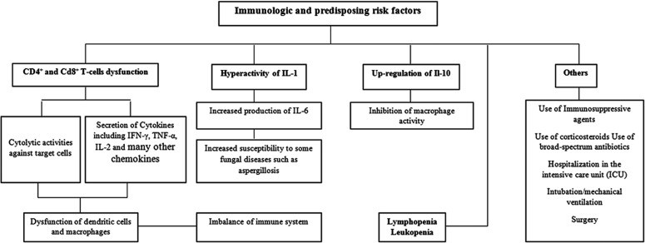
Immunological and predisposing risk factors for fungal co-infections in COVID-19 patients

Slide 4
What are the most important symptoms of rhino cerebral Mucormycosis?
Sinus pain
Congestion
Headache
Mouth or facial pain
Otologic symptoms
Hyposmia or anosmia
Necrotic eschar of nasal cavity
Necrotic lesion of hard palate
Bloody nasal discharge
Extension of sinus into contiguous structure
    Maxillary sinus……hard palate, nasal cavity
    Sphenoid sinus……cavernous sinus, internal carotid artery
    Ethmoid sinus……face, frontal lobe, orbit
    Frontal sinus……uncommon

Slide 5
Orbital extension: periorbital edema, ptosis, proptosis, chemosis, preseptal and orbital edema
Invasion of optic nerve: pain, blurring vision, loss of vision
Invasion of infra orbital nerve: infraorbital facial numbness
Cavernous sinus invasion: cranial nerve 3,4,6,5(v1,v2)
Intracranial complications: epidural and subdural abscess, meningitis

Slide 6
What is the best approach to this patients?
Diagnosis:
  Endoscopic evaluation
  Pathologic evaluation and calcofluor white staining
  CT scan to evaluate gauge sinus involvement
Treatment:
  Surgical debridement and antifungal treatment
  Rapid correction of predisposing conditions

Slide 7
Antifungal treatment
Initial therapy
  liposomal amphotericin B( 3-5 mg/kg/day)
  Amphotericin B( 1 to 1.5 mg/kg/day)
Step down therapy
  Posaconazole(tab 300mg Q12 h first day then daily)
  Isavuconazole(200 mg Q8h*6 doses then daily )

Slide 8
Treatment Duration
Near normalization of radiographic imaging, negative biopsy specimens, and cultures from the affected site and recovery from immunosuppression are indicators that a patient is a candidate for stopping antifungal therapy.

Slide 9


