Slide 1
به نام خداوند بخشنده مهربان

Slide 2

ACG Clinical Guideline: Management of Irritable Bowel Syndrome

Slide 3
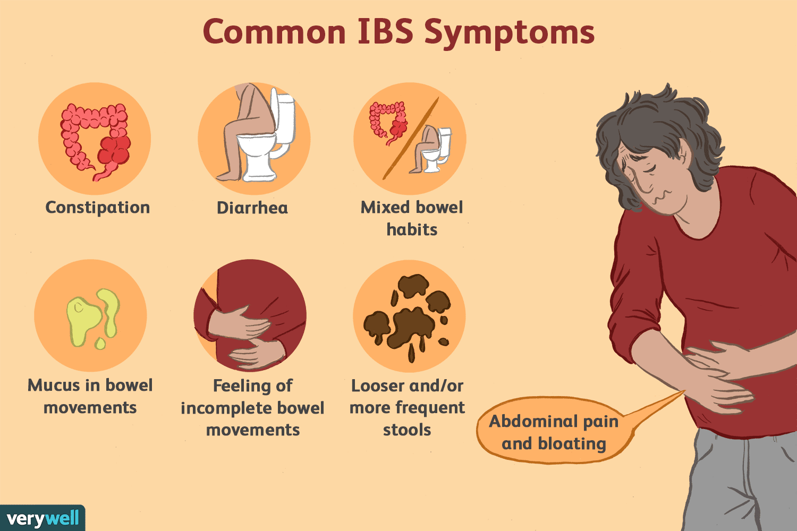
IBS

Slide 4
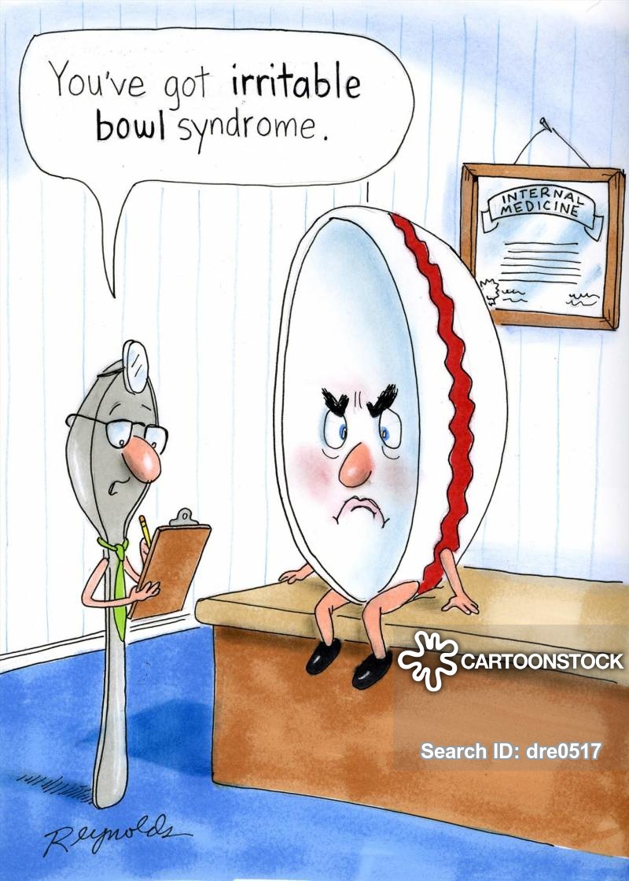

Slide 5

1-We suggest that soluble, but not insoluble, fiber be used to treat global IBS symptoms.
Strong recommendation; moderate quality of evidence.

Slide 6

A widely accepted definition describes dietary fiber as all carbohydrates that are neither digested nor absorbed in the small intestine and have a degree of polymerization of 3 or more monomeric units
Fiber offers a range of general health benefits,
and for this reason, most experts recommend
25–35 g of total fiber intake per day

Slide 7

Dietary fiber has diverse and incompletely understood effects in the GI tract involving the gut microbiome, metabolism, transit time, stool consistency, and bile acid absorption. Dietary fiber is frequently recommended to improve symptoms in patients with IBS, particularly when constipation is the predominant complaint.

Slide 8
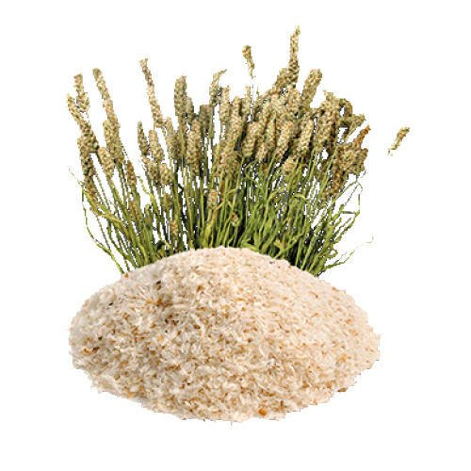
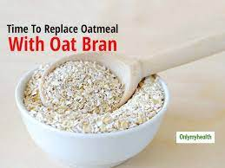
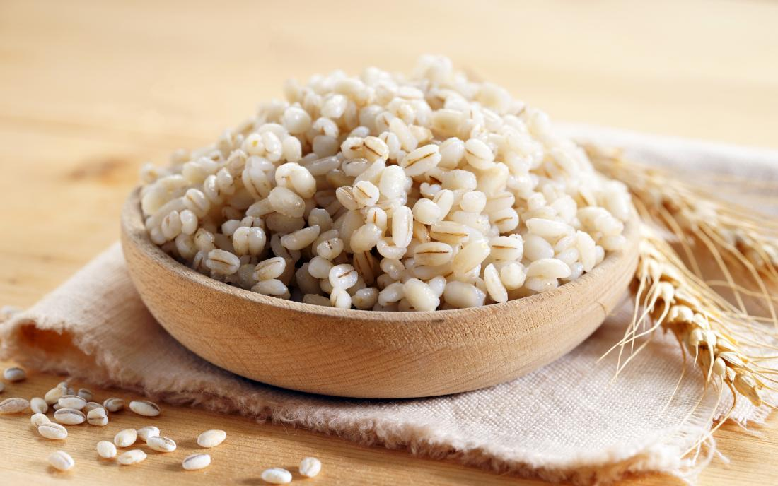
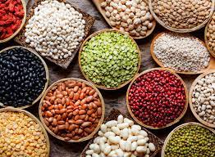
In general, different types of fiber can be distinguished on the basis of their solubility, viscosity, and ability to resist fermentation in the colon
Soluble fiber is found in psyllium, oat bran, barley, and beans.

Slide 9
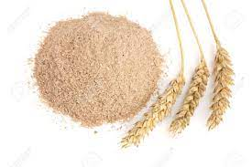


Insoluble fiber is found in wheat bran, whole grains, and some vegetables.
Fibers that exert laxative effects tend to increase stool water content and resist colonic fermentation. Conversely, fibers that ferment in the colon will lose their water-holding capacity and produce gas that could aggravate symptoms of bloating and flatulence.

Slide 10

In summary, soluble, viscous, poorly fermentable fiber may provide benefits in IBS. The apparent lack of significant side effects makes fiber a reasonable first line therapy for IBS patients with symptoms. The ability to improve stool viscosity and frequency logically argues for the use of fiber in patients with IBS-C, although the evidence base to support this contention is weak.

Slide 11
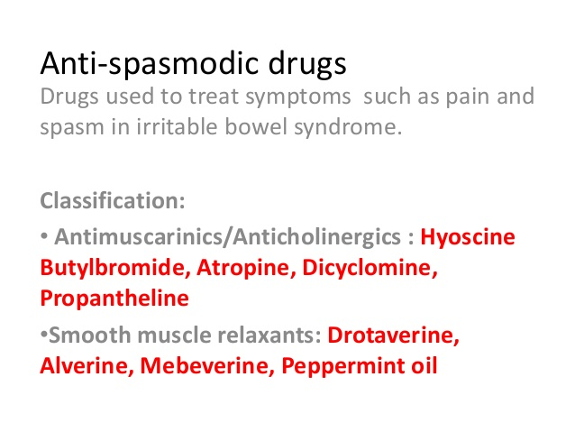
2-We recommend against the use of antispasmodics currently available in the United States to treat global IBS symptoms. Conditional recommendation; low quality of evidence.

Slide 12
Antispasmodics remain one of the most frequently used treatments for IBS. Assessing their efficacy on global IBS symptoms is difficult because the class includes multiple agents with different mechanisms of action. Broadly, antispasmodics relax intestinal smooth muscle thereby reducing GI motility. A myriad of different formulations are available, including direct smooth muscle relaxants, calcium antagonists, scopolamine derivatives, and combination agents. Historical recommendations supporting antispasmodics for treating global IBS symptoms have been predicated on systematic reviews and meta-analyses inclusive of all agents

Slide 13

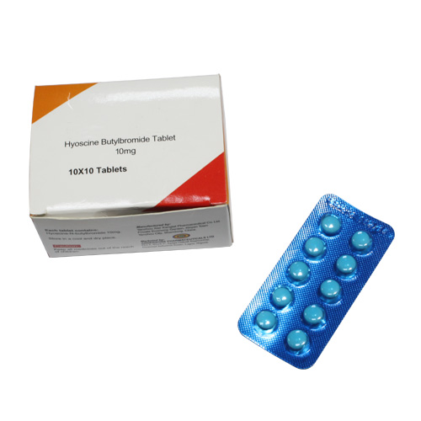
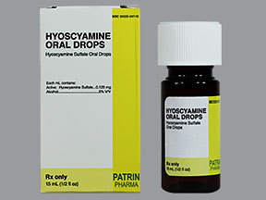
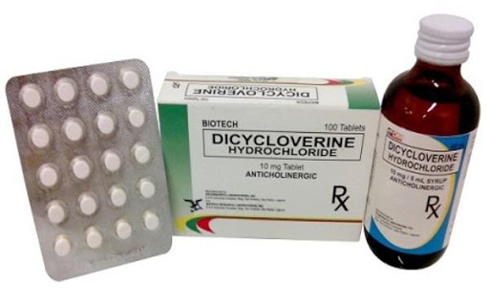
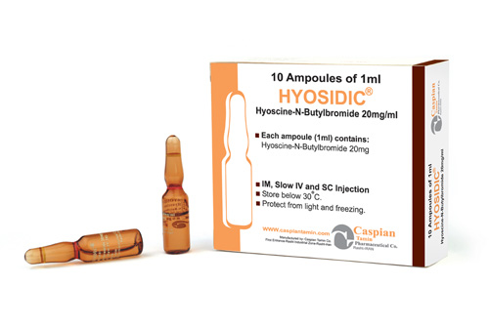
Three antispasmodics are commercially accessible—dicyclomine, hyoscyamine, and hyoscine—with a paucity of data supporting their efficacy.

Slide 14
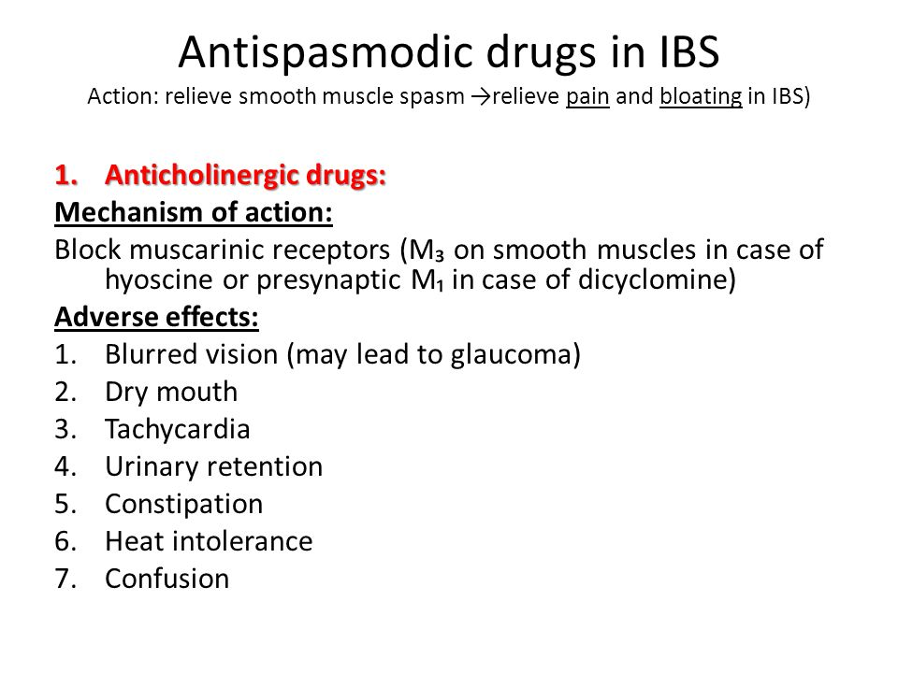
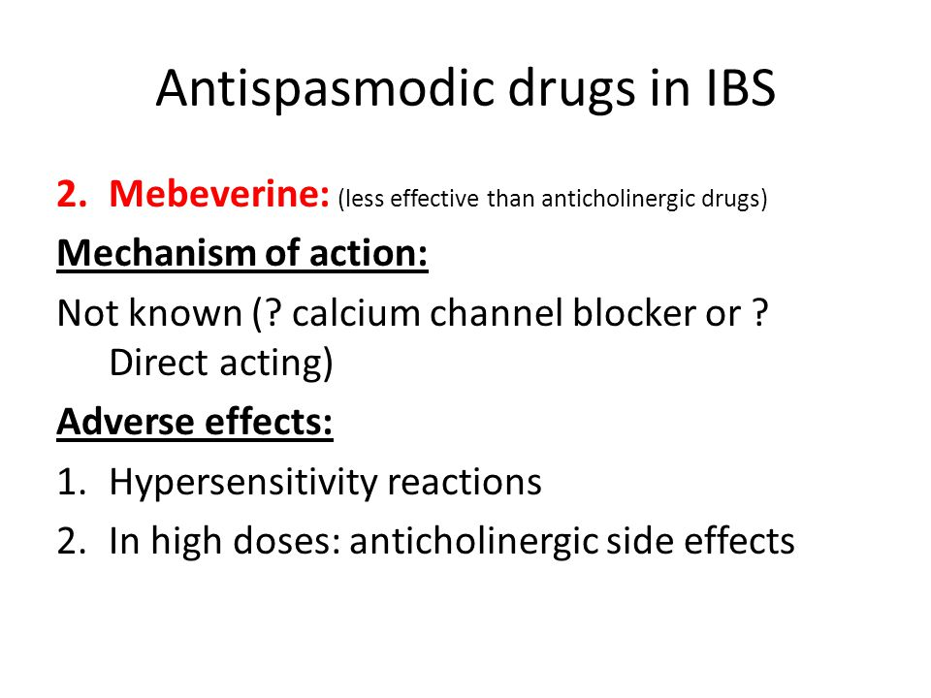
In summary, there are limited data supporting the use of antispasmodics available in the United States. The data are decadesold and of poor quality. Published studies are methodologically limited because of small sample size, lack of standardized enrollment criteria, different trial designs, and different endpoints. Side effects are common, particularly in the elderly, although anecdotal data suggest that these agents are relatively safe.

Slide 15


3-We suggest the use of peppermint to provide relief of global IBS symptoms.
Conditional recommendation; low quality of evidence.

Slide 16

Peppermint (Mentha piperita) is a popular natural/herbal remedy for IBS. Although the clinical benefits of peppermint oil for patients with IBS have most often been attributed to Lmenthol’s blockade of calcium channels and attendant smooth muscle relaxation, several other potential explanations are worthy of consideration including modulation of transient receptor potential voltage channels with effects on visceral sensation, direct antimicrobial and anti-inflammatory effects, and modulation of psychosocial distress. Translational studies have found that peppermint oil exerts effects on esophageal, gastric, small bowel, gallbladder, and colonic function.

Slide 17
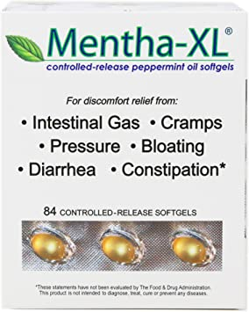

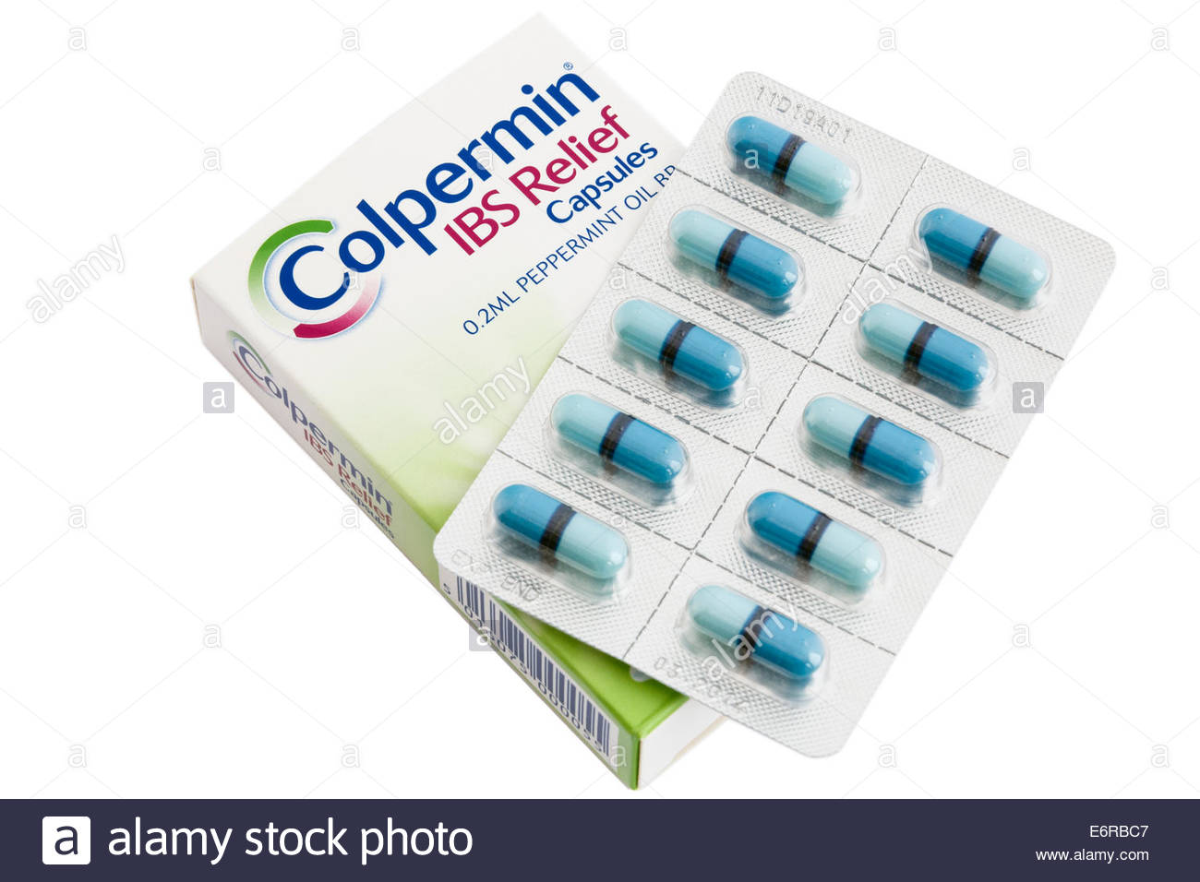
In summary, peppermint oil may offer benefit for overall symptoms and abdominal pain in patients with IBS. For the most part, peppermint oil has been well-tolerated in the available trials. That said, only a small number of commercially available peppermint oil supplements have undergone rigorous testing of efficacy and safety .

Slide 18

4-We suggest against probiotics for the treatment of global IBS symptoms. Conditional recommendation; very low level of evidence.

Slide 19
The use of probiotics as a potential treatment of IBS has increased in the past decade. Much of the enthusiasm is based on the growing literature supporting a role of the microbiome in this condition. However, assessing the merits of probiotics in the treatment of IBS is challenging for a number of reasons. For one, there are a myriad of probiotics each of which claim specific advantages over others. Furthermore, studies examining probiotics in IBS have included single or multiorganism cocktails and nearly universally these studies are small, single center, and do not follow the rigorous endpoint standards set out by the US FDA for the approval of pharmacologic therapies.

Slide 20



In summary, the use of probiotics in the treatment of IBS is an important area of research, given the importance of the intestinal microbiome in this condition. However, interpreting the existing literature is problematic because of small studies, the multiple types and strains of probiotics, the inconsistent benefits on individual symptoms, and the lack of rigorous trials based on US FDA endpoints. These challenges make meta-analysis difficult to perform and hard to interpret. Future trials incorporating yet unidentified gut microbiome biomarkers or metabolomic markers may improve probiotic efficacy

Slide 21
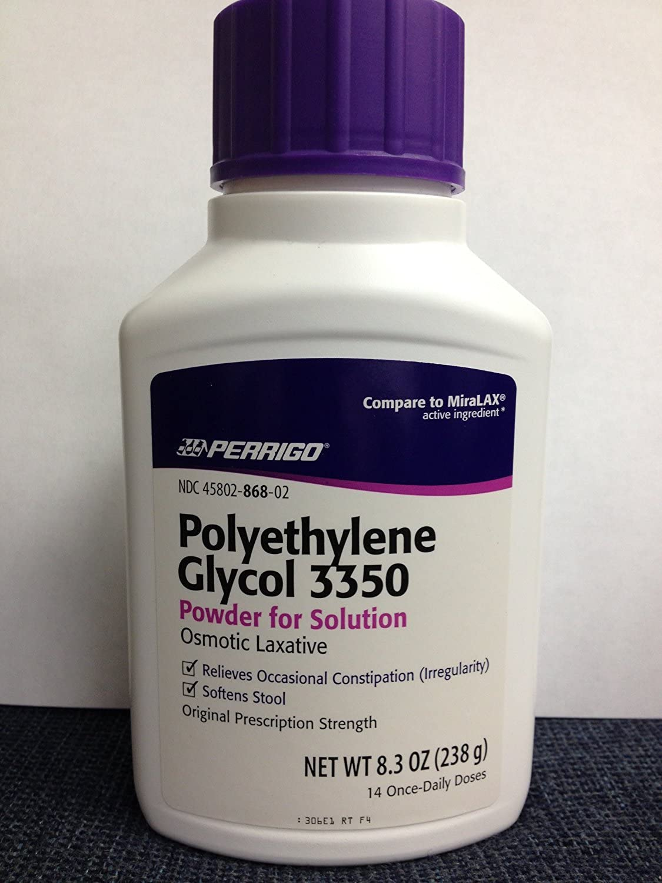
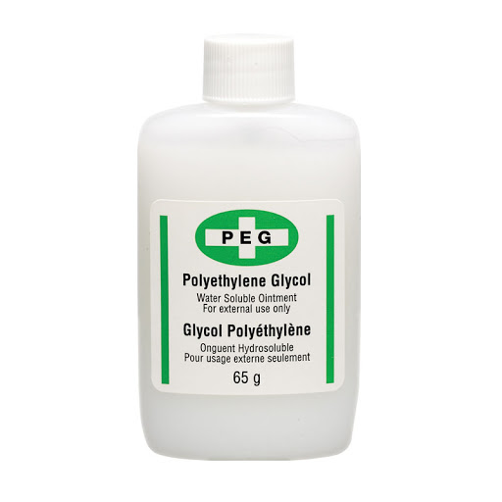
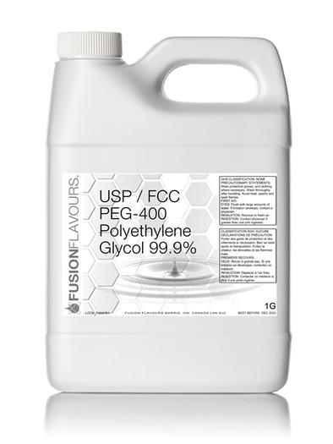
5-We suggest against the use of PEG products to relieve global IBS symptoms in those with IBS-C. Conditional recommendation; low quality of evidence
Polyethylene glycol (PEG) is a relatively inexpensive, widely available, nonprescription osmotic laxative that is US FDAapproved for occasional constipation based on several RCT studies .

Slide 22

In summary, despite the long-term safety and efficacy of PEG for the treatment of chronic constipation in even the most vulnerable subjects (elderly and children), there is no evidence that PEG alleviates abdominal pain and thus global symptoms in patients with IBS-C.We therefore recommend against use of PEG alone for the treatment of global IBS-C symptoms, although we recognize that clinicians may use PEG as first-line treatment of constipation in IBS, given its low cost and availability.

Slide 23
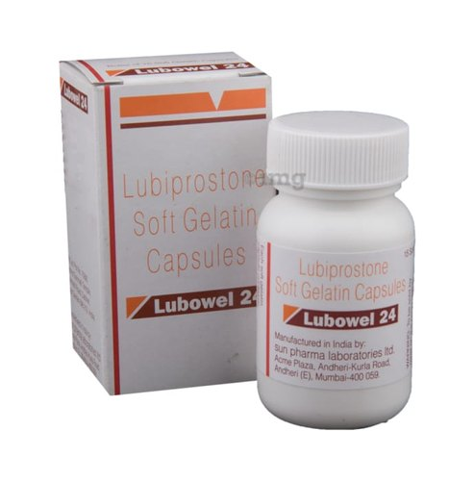
6- We recommend the use of chloride channel activators to treat global IBS-C symptoms. Strong recommendation; moderate quality of evidence.
Lubiprostone is a locally acting prostaglandin E1 analog with high affinity for type-2 chloride channels located in the apical membranes of intestinal epithelial cells (162). Activation of these receptors increases intestinal secretion and peristalsis. Lubiprostone is classified as a secretagogue.

Slide 24
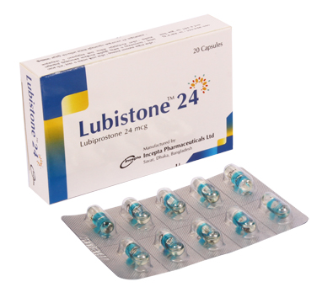
Lubiprostone is US FDA-approved for the treatment of adult women with IBS-C at a dosage of 8 mg twice daily.
In summary, 8 mg of lubiprostone twice daily seems effective for relieving global and individual symptoms in patients with IBSC. Although there may be a delay in initial response, improvement in global symptoms is maintained or increases over time. Lubiprostone exhibits an appropriate safety profile with the most common AEs being GI in nature. Nausea is dose-dependent, but may be reduced by consuming lubiprostone with meals.

Slide 25
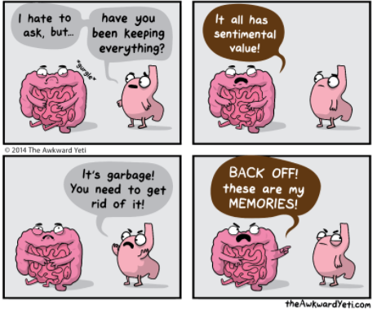
7-We recommend the use of guanylate cyclase activators to treat global IBS-C symptoms. Strong recommendation; high quality of evidence.
Guanylate cyclase-C (GC-C) agonists target GC-C receptors residing in the apical membranes of intestinal epithelial cells.

Slide 26
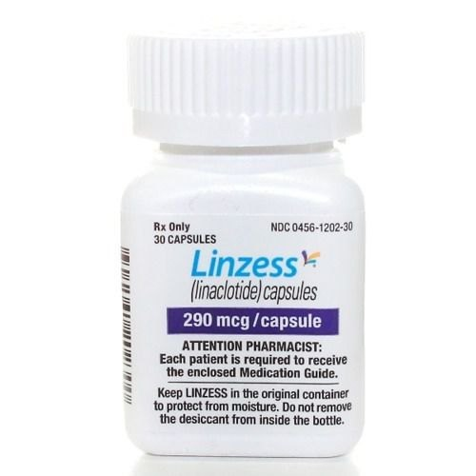
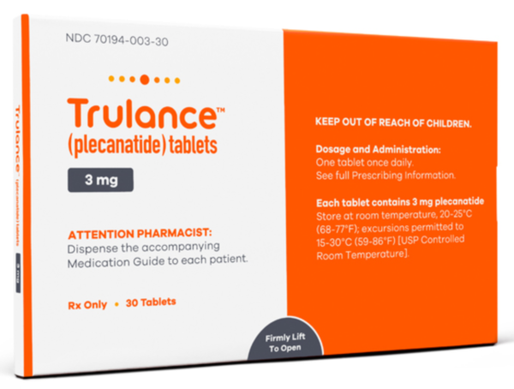
There are currently 2 US FDA-approved agents for the treatment of IBS-C—linaclotide 290 mg and plecanatide 3 mg. Both activate GC-C receptors, increasing intestinal fluid secretion and peristalsis, with preclinical trials identifying reduced activation of visceral nociceptive neurons . These agents are classified as secretagogues. These effects explain the global improvements experienced with linaclotide or plecanatide. Recent comparative analyses suggest that both are comparably effective, safe, and welltolerated .

Slide 27

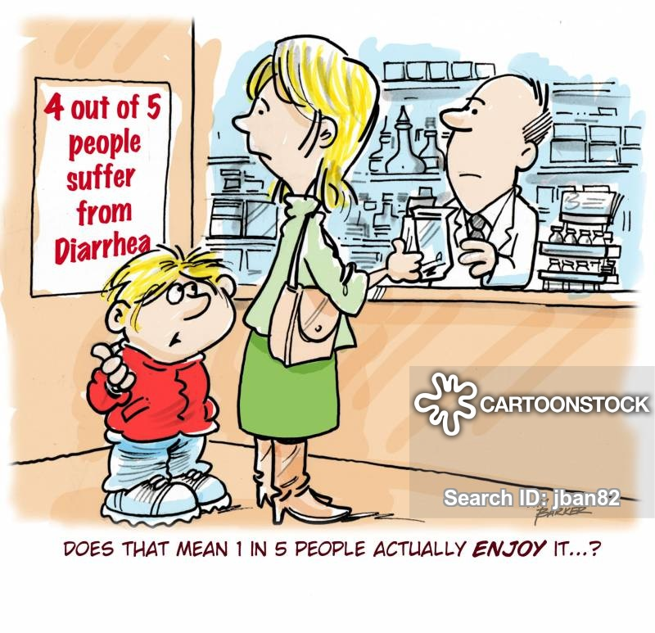
In summary, once-daily linaclotide (290 mg) and plecanatide (3 mg) seem effective for relieving overall and individual symptoms of IBS-C. Responses develop quickly and are maintained over time. Diarrhea is the most common AE experienced, but discontinuation rates due to diarrhea are low and both are welltolerated.

Slide 28
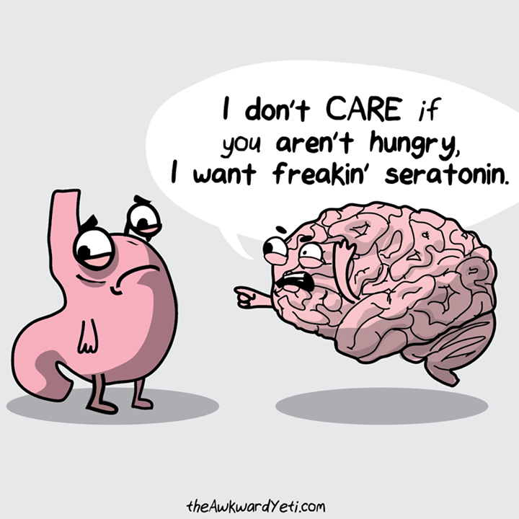
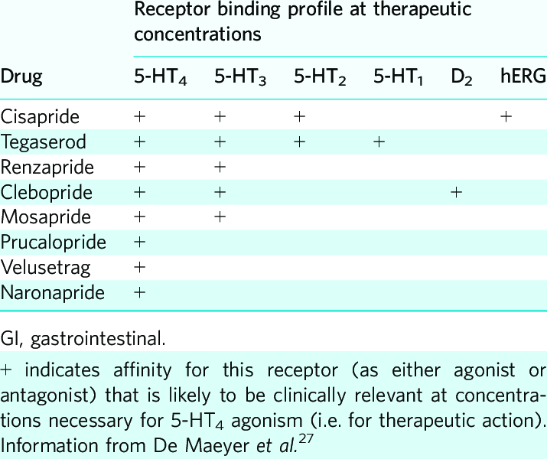
8- We suggest that the 5-HT4 agonist tegaserod be used to treat IBS-C symptoms in women younger than 65 years with #1 cardiovascular risk factors who have not adequately responded to secretagogues. Conditional recommendation; low quality of evidence.
Serotonin (5-HT) is a vital neurotransmitter that modulates GI motor and sensory function. Stimulation of the serotonin type-4 receptor (5-HT4) initiates the peristaltic reflex and accelerates GI transit . Reductions in visceral hypersensitivity have been identified in animal models, healthy volunteers (184–186), and individuals with IBS .

Slide 29
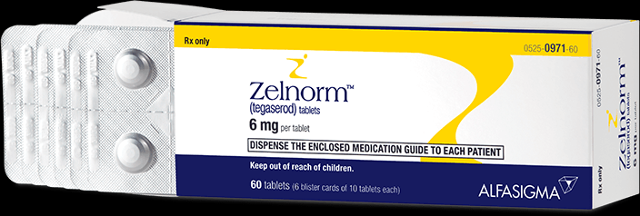
In summary, tegaserod is the only US FDA-approved 5-HT4 receptor agonist for the treatment of adult women younger than 65 years with IBS-C. It is contraindicated in patients with more than 1 CV risk factors.
Future studies should include large, prospective, head-to-head comparisons with other US FDA-approved therapies to provide clinically important information on efficacy and safety

Slide 30
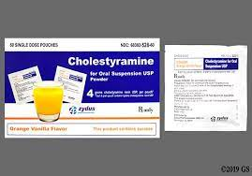
9- We do not suggest the use of bile acid sequestrants to treat global IBS-D symptoms. Conditional recommendation; very low level of evidence.
Bile acid malabsorption (BAM) is a condition characterized by an inability to reabsorb sufficient bile acids in the terminal ileum. Excessive bile acids in the colon are exposed to colonic flora leading to production of secondary bile acids which can increase colonic secretion of fluid, thereby resulting in diarrhea. This has led to investigations into the possibility of bile acid diarrhea contributing to symptoms in a subset of individuals with IBS-D.

Slide 31
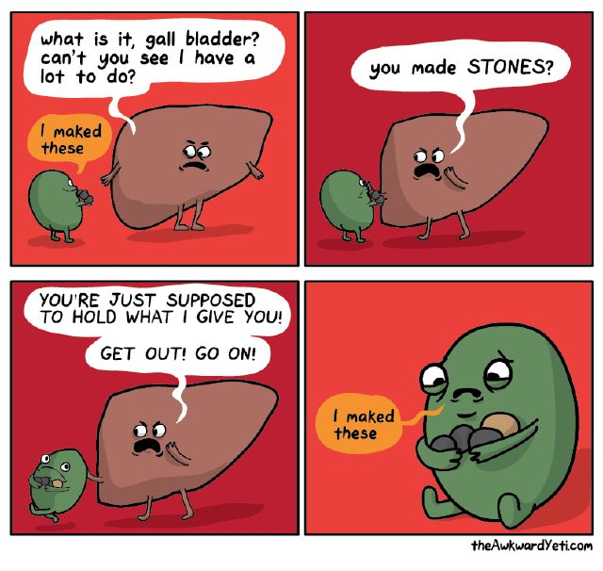
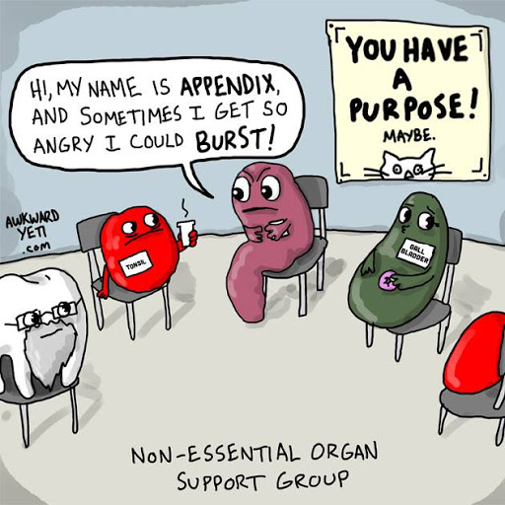
There are 3 potential mechanisms for bile acids to reach the colon . The first is the iatrogenic loss of the distal small bowel reducing the absorbing capacity of bile excreted by the biliary system during digestion. Another mechanism is cholecystectomy leading to a change in timing of bile delivery to the small intestine. This may be an important cause of worsening of IBS symptoms because there is an increased risk of cholecystectomy in patients with IBS . Finally, an idiopathic form possibly related to the differential potential for reabsorption of bile acids in given individuals has been identified.

Slide 32
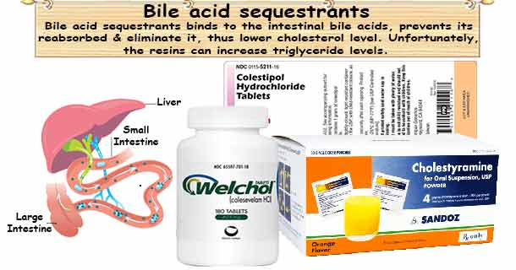
In summary, there seems to be a subset of IBS-D subjects with evidence of BAM. There is a need for methodologically rigorous, adequately powered trials of bile acid sequestrants in patients with IBS-D. Testing for BAM in the United States remains limited and incompletely validated. No study has evaluated the utility of testing and compared it with empiric therapy using a bile acid sequestrant, which is a reasonable course of action if BAM is suspected. In the absence of widely accessible, reliable testing, and given the lack of controlled trials of bile acid sequestrants in patients with IBS-D, the use of these therapies should be at the discretion of the clinician.

Slide 33
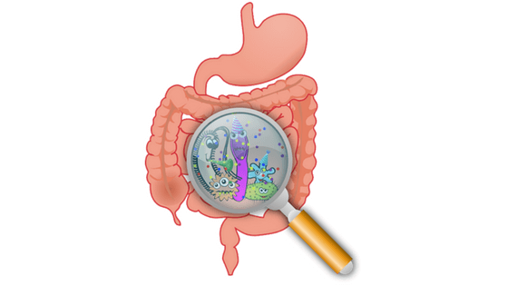
10-We recommend the use of rifaximin to treat global IBS-D symptoms. Strong recommendation; moderate level of evidence
Rifaximin is a nonabsorbed antibiotic which is US FDAapproved for the treatment of patients with IBS-D. Rifaximin treatment is based on the hypothesis that a portion of patients with IBS-D have an abnormal microbiome. The use of this drug is supported by multiple clinical trials.

Slide 34
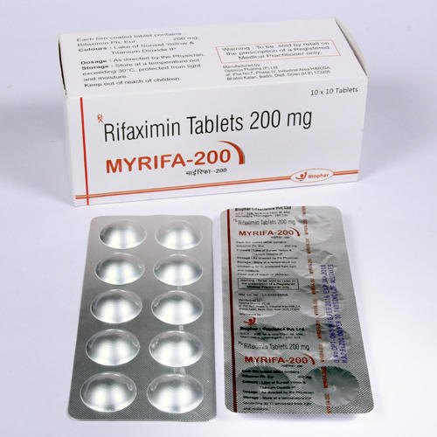
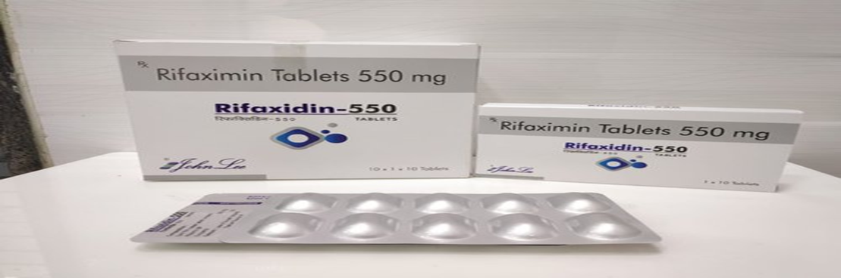
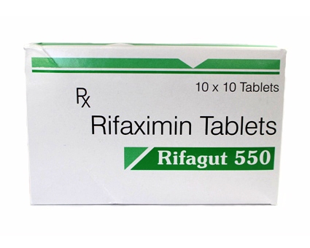
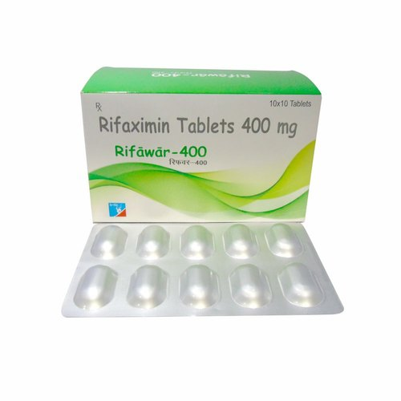
In summary, rifaximin is an effective, safe treatment choice for patients with IBS-D symptoms.

Slide 35
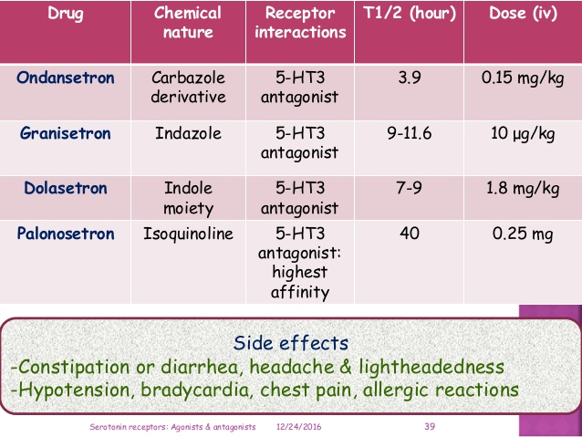
11-We recommend that alosetron be used to relieve global IBS-D symptoms in women with severe symptoms who have failed conventional therapy. Conditional recommendation; low quality of evidence.
Serotonin (5-hydroxytryptamine; 5-HT) plays an important role in modulating visceral sensation and motility . Alosetron is a 5-HT3 antagonist, and as such, the primary mechanism of action in the treatment of IBS-D is the slowing of intestinal transit

Slide 36
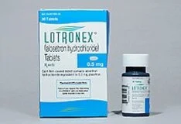
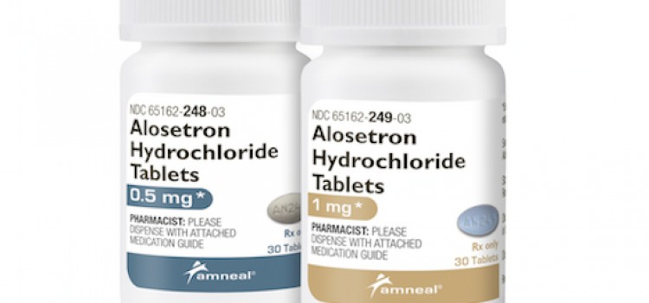
In summary, the current evidence supports using alosetron to relieve global symptoms in women with severe IBS-D when other interventions have failed. Within a small therapeutic window (0.5–1 mg b.i.d.), it seems safe and with low risk of the development of severe constipation or ischemic colitis.

Slide 37
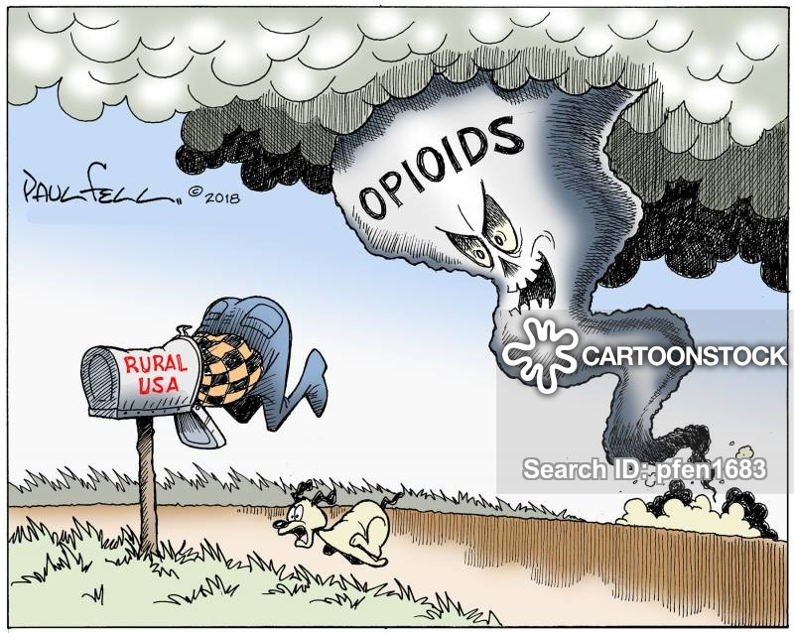
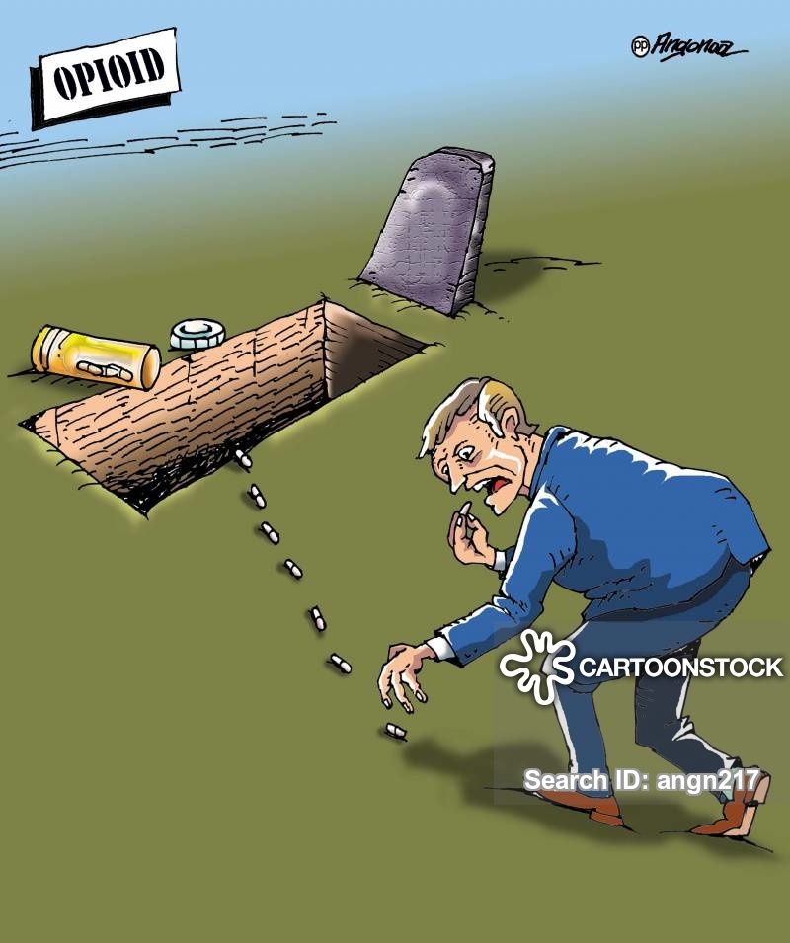
12-We suggest that mixed opioid agonists/antagonists be used to treat global IBS-D symptoms. Conditional recommendation; moderate quality of evidence

Slide 38
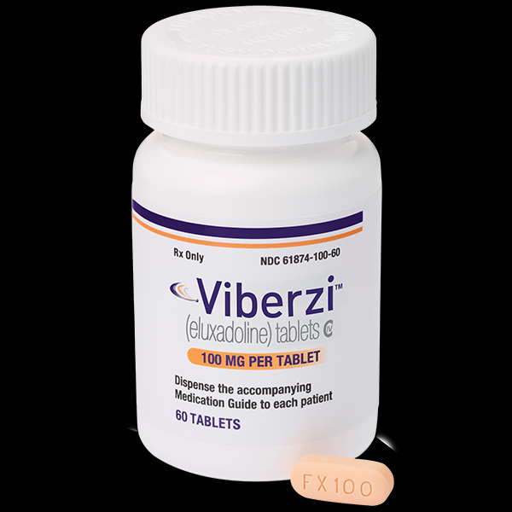
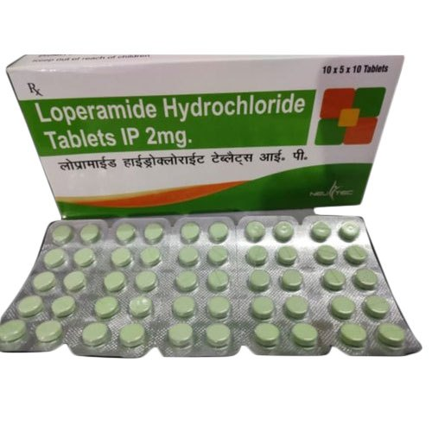
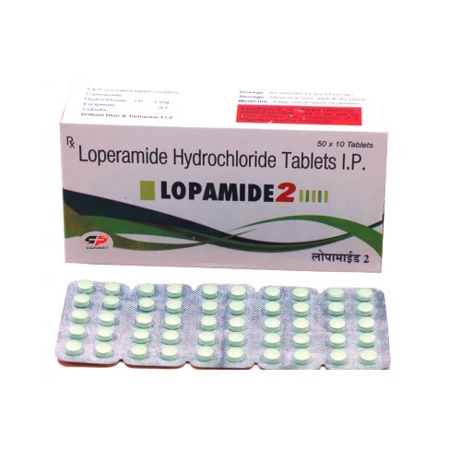
In summary, eluxadoline improves global IBS-D symptoms in men and women . A randomized, prospective study and a retrospective analysis have also shown that eluxadoline improves symptoms in patients with IBS-D who have failed previous trials of loperamide . Loperamide is not recommended as first-line therapy for treating IBS-D symptoms because it may improve diarrhea but not improve global IBS symptoms . Eluxadoline is contraindicated in some patients because of concerns over pancreatitis and sphincter of Oddi dysfunction .

Slide 39
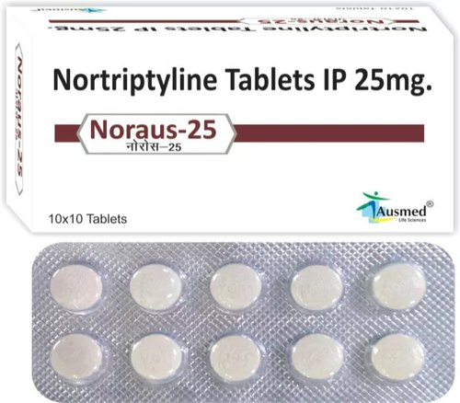
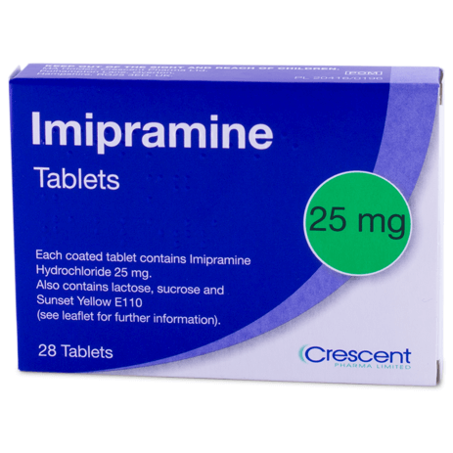
13- We recommend that TCAs be used to treat global symptoms of IBS. Strong recommendation; moderate quality of evidence. association with abnormal bowel habits of constipation, diarrhea, or both . Patients frequently report other bothersome symptoms including bloating and urgency . TCAs are a class of agents, now commonly referred to as neuromodulators, which include amitriptyline, nortriptyline, imipramine, and desipramine. These agents improve painful conditions such as fibromyalgia, chronic headaches, and diabetic neuropathy . TCAs are believed to improve visceral pain and central pain by acting on norepinephrine, and dopaminergic receptors, thus making them attractive candidates for the treatment of IBS-related abdominal pain . TCAs may also improve abdominal pain because of their anticholinergic effects and, at higher doses, can also slow GI transit, thereby improving symptoms of diarrhea in some patients . Coexisting psychological distress may also improve because of the effects on dopaminergic and norepinephrine receptors (Table 7).

Slide 40
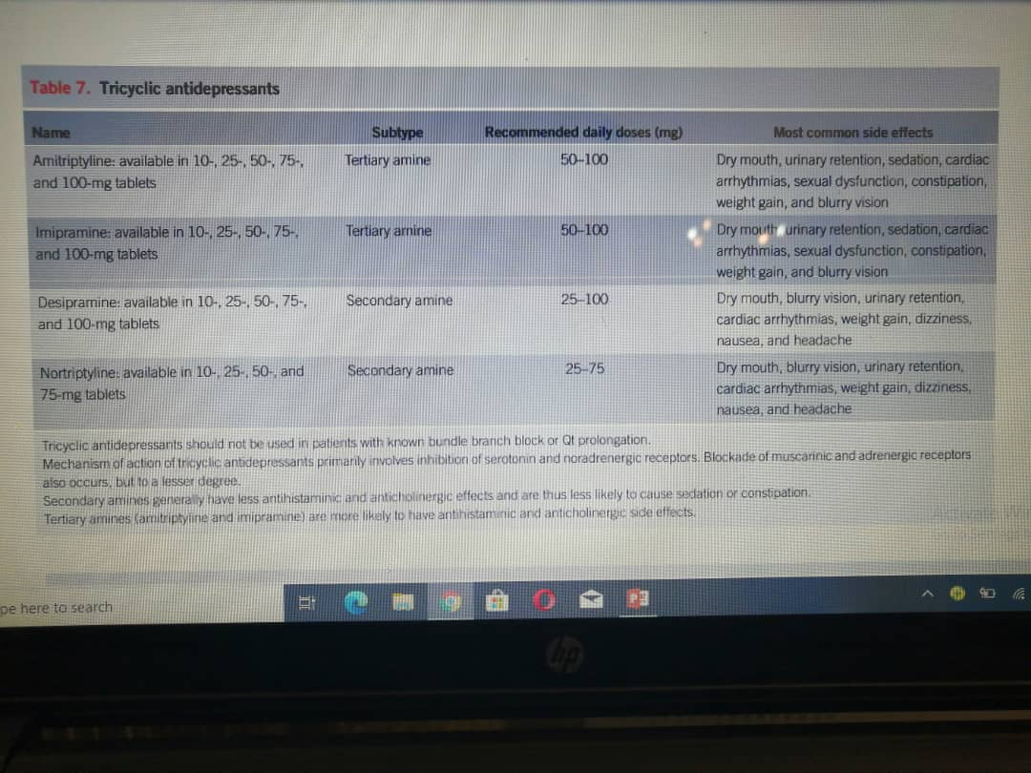

Slide 41
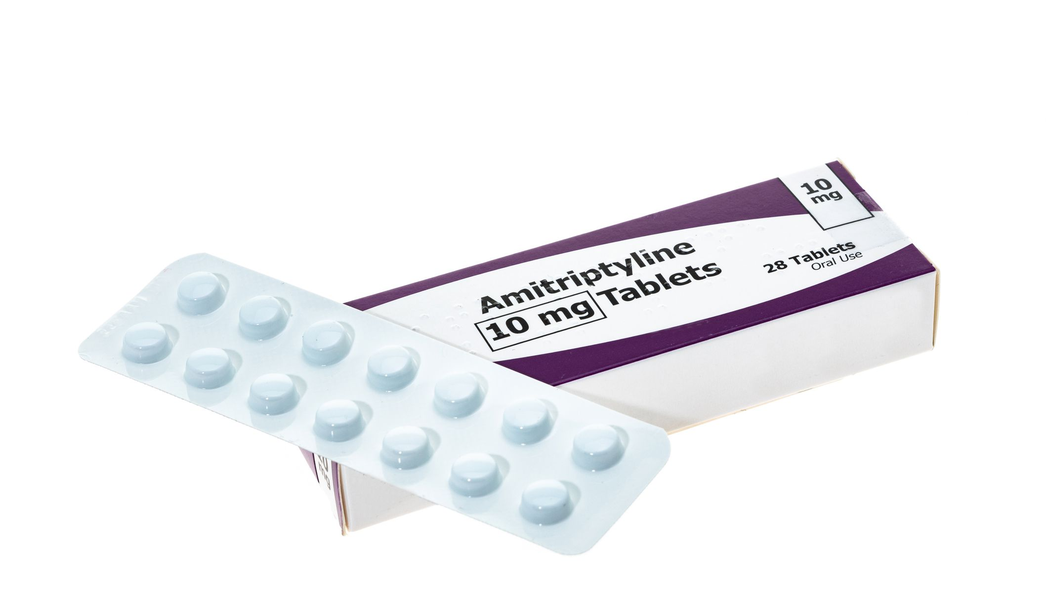
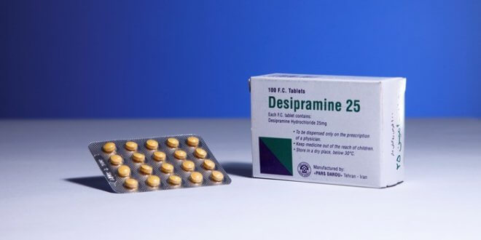
In summary, TCAs may improve global IBS symptoms. Data from large head-to-head trials comparing different TCAs for the treatment of patients with IBS are not available to provide recommendations on a specific TCA. We recommend that clinicians become familiar with the different types of TCAs to appreciate the differences in efficacy and adverse effects. Patients should be started on a low dose (e.g., 10-mg amitriptyline or 10 mg of desipramine) with gradual dose titration upward to achieve therapeutic relief of symptoms while minimizing side effects . Anecdotally, patients with IBS-D may respond better because of the anticholinergic properties of TCAs which may improve symptoms of urgency and diarrhea. However, caution should be directed toward potential side effects including dry mouth, dry eyes, urinary retention, constipation, and cardiac arrhythmias.

Slide 42


16- We suggest that gut-directed psychotherapies be used to treat global IBS symptoms. Conditional recommendations; very low quality of evidence.
Advances in our understanding of the brain-gut-microbiome axis, and the growth of the disciplines of cognitive neurosciences and behavioral intervention science have shown that psychotherapies effective in the treatment of depression, anxiety, and chronic pain can be adapted to manage core symptoms of IBS, including abdominal pain, altered bowel habits, and IBS-specific health-related quality of life.

Slide 43

In summary, we suggest the use of GDPs in conjunction with other IBS therapies for patients who are emotionally stable but who exhibit cognitive-affective drivers of IBS symptoms because (i) GDPs are low risk when used by qualified health professionals—no studies to date have reported serious AEs or negative outcomes; (ii) there are long-term benefits of these therapies even after they are discontinued; and (iii) GDPs are IBSsubtype agnostic and can address the large group of patients with IBS-M or
IBS-U for whom fewer pharmacological treatments are available.

Slide 44


17-We recommend against the use of fecal transplant for the treatment of global IBS symptoms. Strong recommendation; very low quality of evidence.

Slide 45

In summary, alterations in the gut microbiome may lead to the development of IBS symptoms in some patients. Changing the gut microbiome to improve IBS symptoms through FMT has innate appeal. However, evidence to support FMT for the treatment of IBS is limited and of very low quality and thus cannot be recommended at present. Large, multicenter, double-blind, placebo-controlled studies with endpoints similar to large pharmaceutical studies are required to determine the potential role of FMT for the treatment of IBS. In addition, research is needed to determine which is the most effective donor for FMT (e.g., fresh vs frozen; random donor vs universal donor) and which is the best technique for FMT (e.g., nasojejunal vs colonoscopy vs capsule).

Slide 46



This ACG Clinical Guideline was written with the goal of identifying, and answering, key diagnostic and clinical questions relevant to the field of IBS. This first-ever IBS Clinical Guideline used trained GRADE methodologists to analyze the published literature relevant to these 25 key questions to assess the quality of evidence and provide the strength of each recommendation.

