Slide 1



DR ELCHIAN

Slide 2
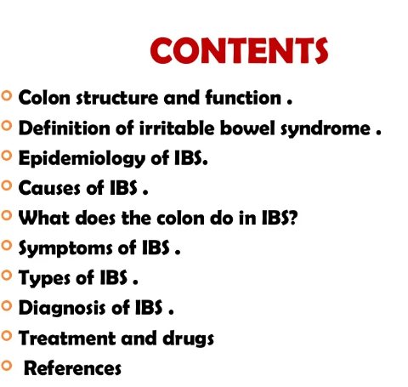
IBS

Slide 3
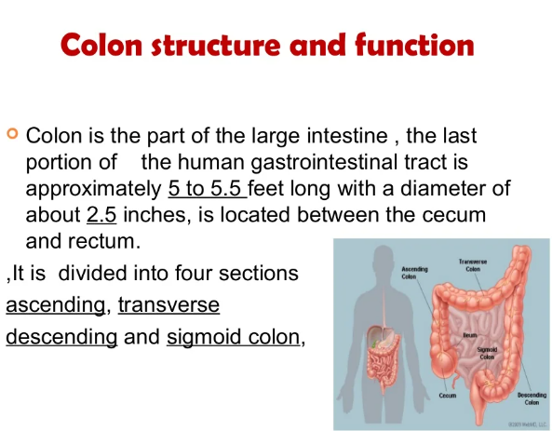
IBS

Slide 4
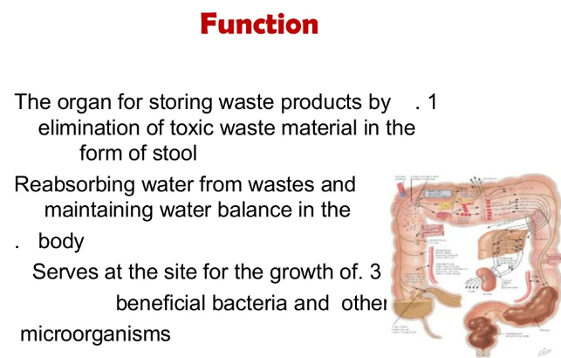
IBS

Slide 5
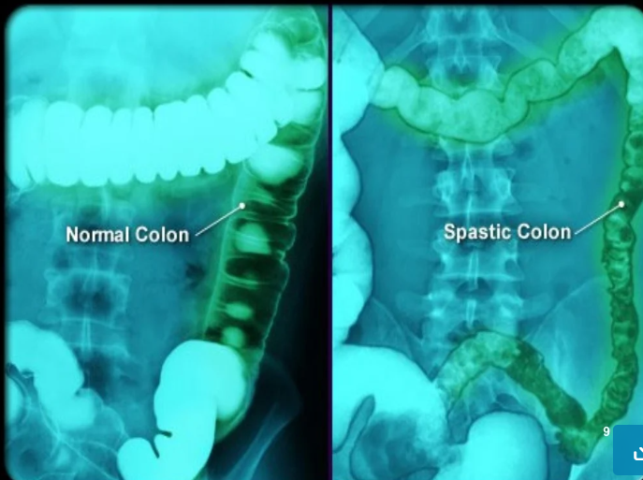
IBS

Slide 6

IBS

Slide 7

IBS

Slide 8
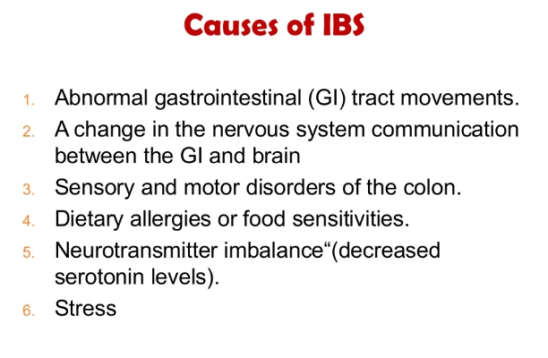
IBS

Slide 9

IBS

Slide 10
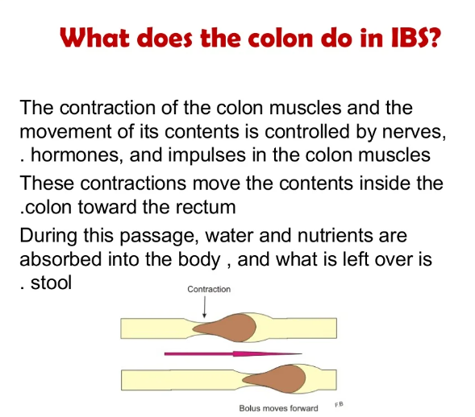
IBS

Slide 11
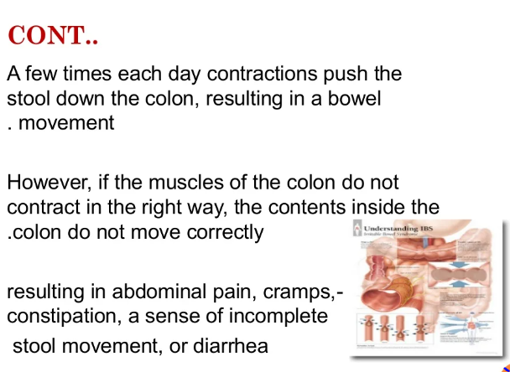
IBS
CONTENT

Slide 12
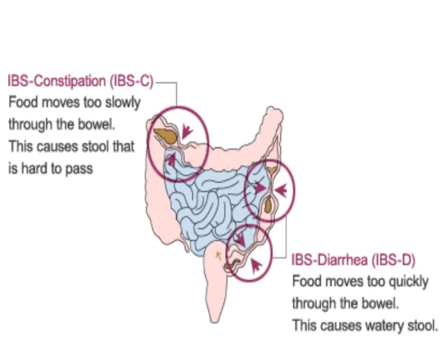
IBS

Slide 13

IBS

Slide 14

IBS

Slide 15

IBS

Slide 16
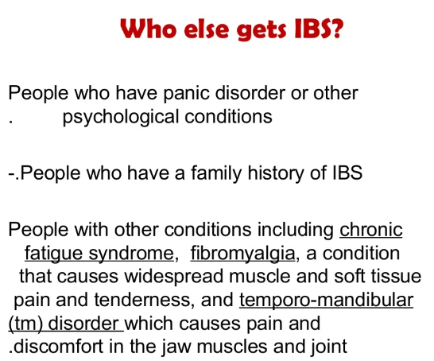
IBS

Slide 17
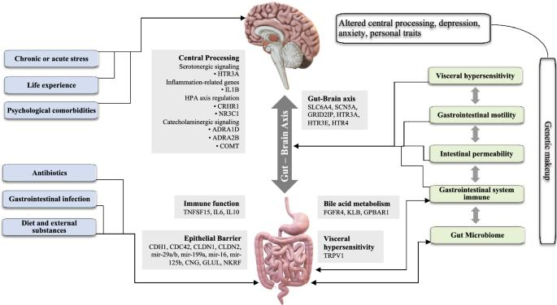
IBS

Slide 18
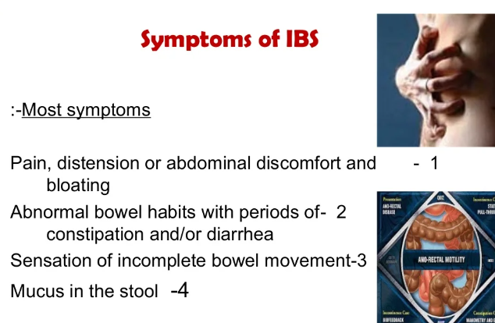
IBS

Slide 19

IBS

Slide 20
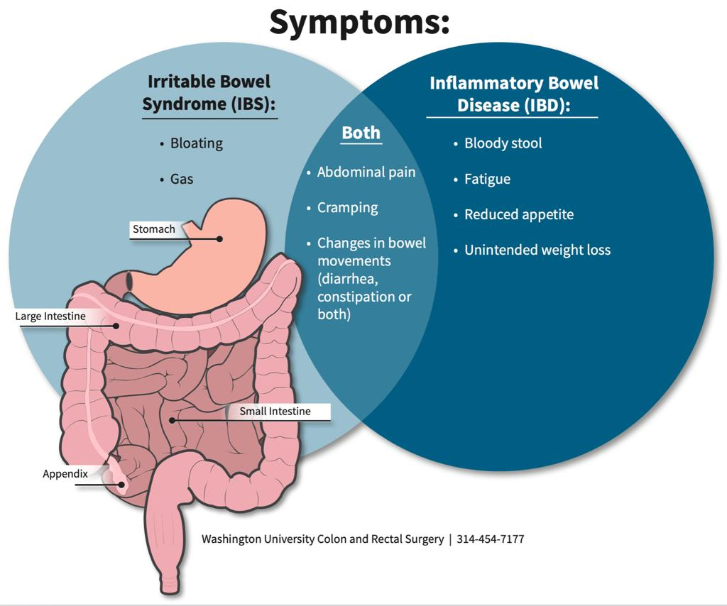
IBS

Slide 21
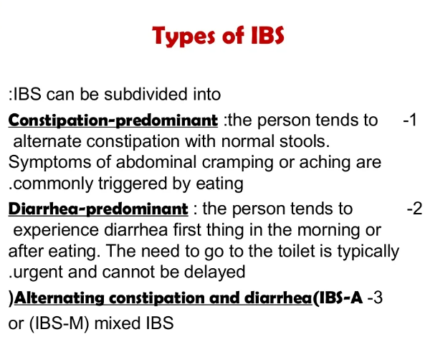
IBS

Slide 22
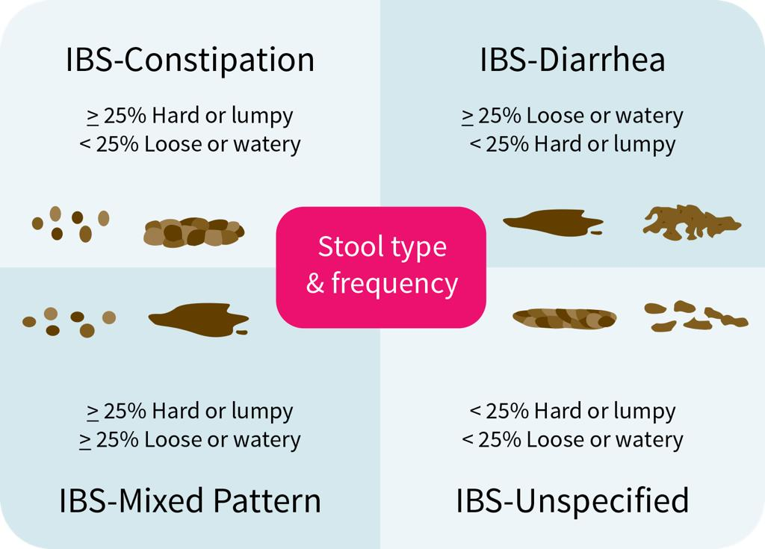
IBS

Slide 23
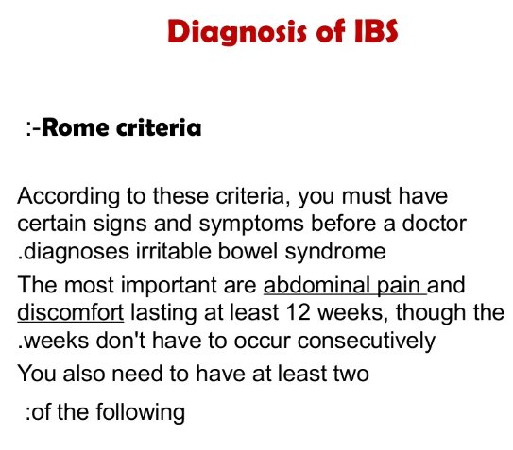
IBS

Slide 24
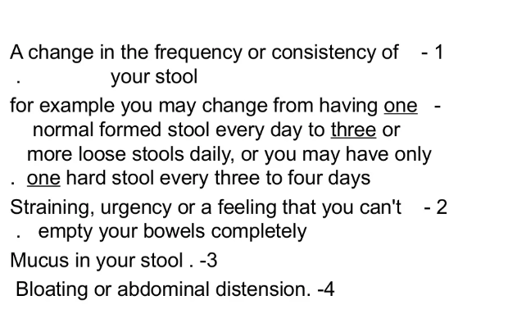
IBS

Slide 25
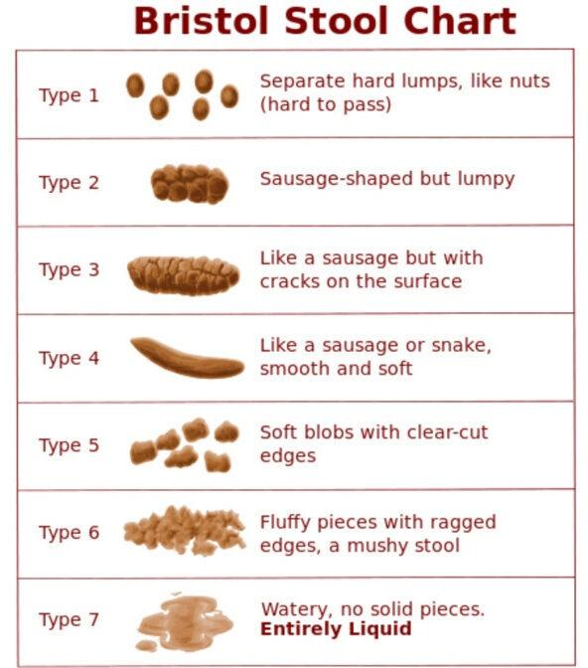
IBS

Slide 26
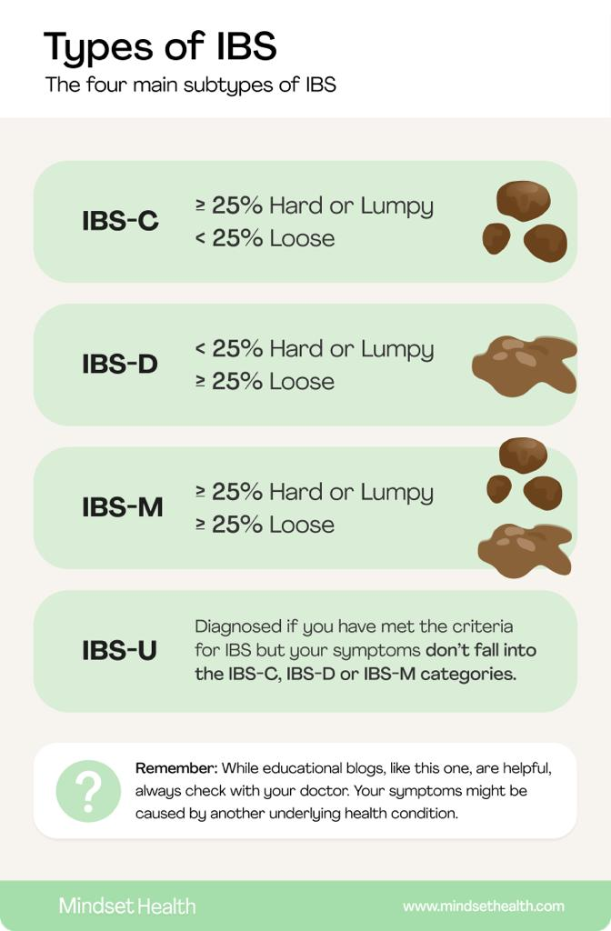
IBS

Slide 27

IBS

Slide 28

IBS

Slide 29
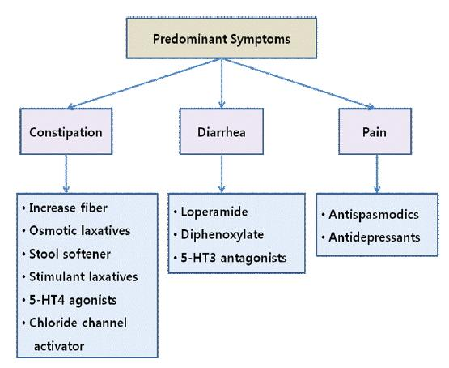
IBS

Slide 30

IBS

Slide 31
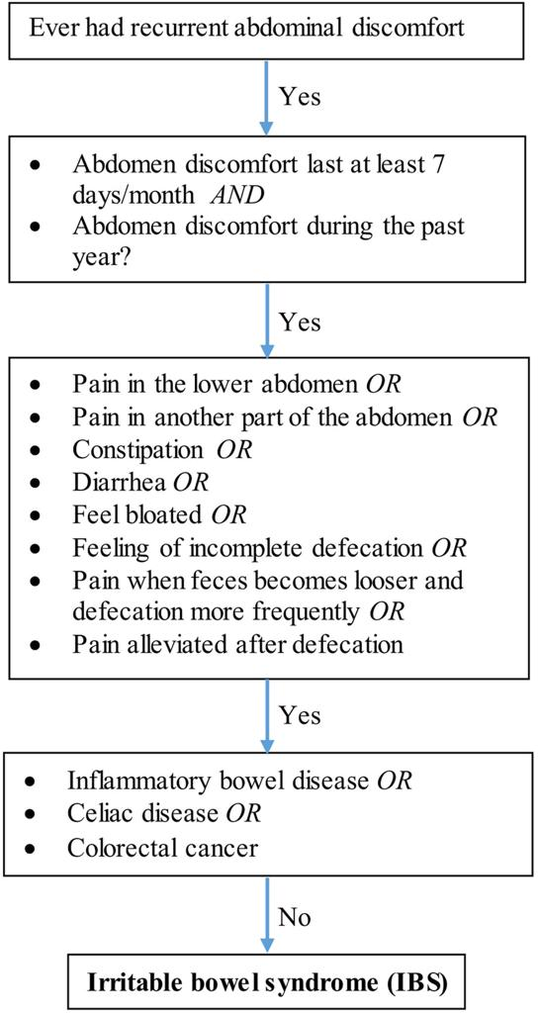
IBS

Slide 32
Your best quote that reflects your approach… “It’s one small step for man, one giant leap for mankind.”
- Neil Armstrong

