Slide 1
Asthma management
Taghi riahi
Pulmonologist
Associate professor of pulmonary medicine, IUMS

Slide 2
Disclaimer:
This webinar is organized by Iranian Society of Internal Medicine in collaboration with Cobel Darou.
The presentations are fully scientific and do not contain promotional contents.
I have not received any speaker fee for this presentation.
The CME responsibility is not with Cobel Darou.
The content liability is with Iranian Society of Internal Medicine
Adverse event reporting and Medical Information queries for Cobel Darou GSK marketed products will be sent to Cobel Darou via the link at the final slide.

Slide 3
معرفی بیمار
بیمار مرد 36 ساله متاهل راننده اسنپ به علت تشدید تنگی نفس و سرفه از پنج روز قبل مراجعه کرده است خلط وی بیشتر شده و در درمانگاه محل دگزامتازون وریدی دریافت و ازیترومایسین 500 میلی روزانه مصرف می کند
تا سه سال قبل مصرف سیگار داشته و گاهی مشروب استفاده می کند
اسپری سروفلو 250 از سال قبل دوره ای استفاده میکند
در فعالیت روزانه تنگی نفس دارد
خواب خوبی ندارد گاهی خرخر شبانه هم دارد سوزش سردل دارد
رینوره بخصوص در فصل بهار وی را ازار می دهد

Slide 4
معاینه بالینی
در معاینه ویز پراکنده سمع میشود
در مدارک همراه دو اسپیرومتری متقاوت یکی نرمال و دیگری الگوی انسدادی و خفیف دارد
سی تی اسکن ریه دو سال قبل کدورت پراکنده دو طرفه داشت که مربوط به ابتلای کرونا در تابستان دو سال قبل بود
در ازمایشات سال قبل یافته اختصاصی نداشت

Slide 5
مرور برخورد بالینی بیمار فوق:
ایا اسم دارد؟
عامل تشدید فعلی بیماری چیست؟
شدت اسم ریوی چقدر است؟
چه فنوتیپی از اسم دارد؟
بیماری همراه منجر به عدم کنترل بیماری دارد؟
درمان بیماری؟
عوارض درمان؟

Slide 6
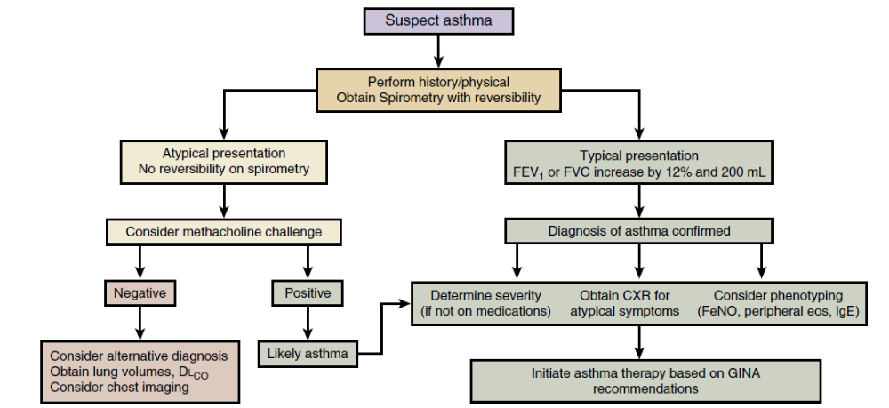

Slide 7
Definition of asthma
Asthma is a heterogeneous disease, usually characterized by chronic airway inflammation.
It is defined by the history of respiratory symptoms such as wheeze, shortness of breath, chest tightness and cough that vary over time and in intensity, together with variable expiratory airflow limitation.
GINA 2015

Slide 8
Diagnosis of asthma
The diagnosis of asthma should be based on:
  A history of characteristic symptom patterns
  Evidence of variable airflow limitation, from bronchodilator reversibility testing or other tests
Document evidence for the diagnosis in the patient’s notes, preferably before starting controller treatment
  It is often more difficult to confirm the diagnosis after treatment has been started
Asthma is usually characterized by airway inflammation and airway hyperresponsiveness, but these are not necessary or sufficient to make the diagnosis of asthma.
GINA 2015

Slide 9
Diagnosis of asthma – symptoms
Increased probability that symptoms are due to asthma if:
  More than one type of symptom (wheeze, shortness of breath, cough, chest tightness)
  Symptoms often worse at night or in the early morning
  Symptoms vary over time and in intensity
  Symptoms are triggered by viral infections, exercise, allergen exposure, changes in weather, laughter, irritants such as car exhaust fumes, smoke, or strong smells
Decreased probability that symptoms are due to asthma if:
  Isolated cough with no other respiratory symptoms
  Chronic production of sputum
  Shortness of breath associated with dizziness, light-headedness or peripheral tingling
  Chest pain
  Exercise-induced dyspnea with noisy inspiration (stridor)
GINA 2015

Slide 10
Diagnosis of asthma – variable airflow limitation
Confirm presence of airflow limitation
  Document that FEV₁/FVC is reduced (at least once, when FEV₁ is low)
  FEV₁/ FVC ratio is normally >0.75 – 0.80 in healthy adults, and
  >0.90 in children
Confirm variation in lung function is greater than in healthy individuals
  The greater the variation, or the more times variation is seen, the greater probability that the diagnosis is asthma
  Excessive bronchodilator reversibility (adults: increase in FEV₁ >12% and >200mL; children: increase >12% predicted)
  Excessive diurnal variability from 1-2 weeks’ twice-daily PEF monitoring (daily amplitude x 100/daily mean, averaged)
  Significant increase in FEV₁ or PEF after 4 weeks of controller treatment
  If initial testing is negative:
    Repeat when patient is symptomatic, or after withholding bronchodilators
    Refer for additional tests (especially children ≤5 years, or the elderly)
GINA 2015, Box 1-2

Slide 11
What is known about asthma?
Asthma can be effectively treated
When asthma is well-controlled, patients can
  Avoid troublesome symptoms during the day and night
  Need little or no reliever medication
  Have productive, physically active lives
  Have normal or near-normal lung function
  Avoid serious asthma flare-ups (also called exacerbations, or severe attacks)
GINA 2015

Slide 12
Assessment of asthma
Asthma control - two domains
  Assess symptom control over the last 4 weeks
  Assess risk factors for poor outcomes, including low lung function
Treatment issues
  Check inhaler technique and adherence
  Ask about side-effects
  Does the patient have a written asthma action plan?
  What are the patient’s attitudes and goals for their asthma?
Comorbidities
  Think of rhinosinusitis, GERD, obesity, obstructive sleep apnea, depression, anxiety
  These may contribute to symptoms and poor quality of life
GINA 2015, Box 2-1

Slide 13
Assessing asthma severity
How?
  Asthma severity is assessed retrospectively from the level of treatment required to control symptoms and exacerbations
When?
  Assess asthma severity after patient has been on controller treatment for several months
  Severity is not static – it may change over months or years, or as different treatments become available
Categories of asthma severity
  Mild asthma: well-controlled with Steps 1 or 2 (as-needed SABA or low dose ICS)
  Moderate asthma: well-controlled with Step 3 (low-dose ICS/LABA)
  Severe asthma: requires Step 4/5 (moderate or high dose ICS/LABA ± add-on), or remains uncontrolled despite this treatment
GINA 2015

Slide 14
Typical spirometric tracings
Flow
Volume
Normal
FEV₁
Asthma
(after BD)
Normal
Asthma
(before BD)
Asthma
(after BD)
Asthma
(before BD)
1
2
3
4
5
Volume
Time (seconds)
Note: Each FEV₁ represents the highest of three reproducible measurements

Slide 15
Assessment of risk factors for poor asthma outcomes
Risk factors for exacerbations include:
Ever intubated for asthma Uncontrolled asthma symptoms Having ≥1 exacerbation in last 12 months Low FEV₁ (measure lung function at start of treatment, at 3-6 months to assess personal best, and periodically thereafter) Incorrect inhaler technique and/or poor adherence Smoking Obesity, pregnancy, blood eosinophilia
Risk factors for fixed airflow limitation include:
No ICS treatment, smoking, occupational exposure, mucus hypersecretion, blood eosinophilia
Risk factors for medication side-effects include:
Frequent oral steroids, high dose/potent ICS, P450 inhibitors
GINA 2015, Box 2-2B (4/4)

Slide 16
GINA assessment of symptom control
A. Symptom control
In the past 4 weeks, has the patient had: | Well-controlled | Partly controlled | Uncontrolled
Daytime asthma symptoms more than twice a week? Yes No | None of these | 1-2 of these | 3-4 of these
Any night waking due to asthma? Yes No
Reliever needed for symptoms* more than twice a week? Yes No
Any activity limitation due to asthma? Yes No
Level of asthma symptom control
*Excludes reliever taken before exercise, because many people take this routinely
This classification is the same as the GINA 2010-12 assessment of ‘current control’, except that lung function now appears only in the assessment of risk factors
GINA 2015, Box 2-2A

Slide 17
There is component of asthma
It is exacerbation of asthma
A lot of comorbidities

Slide 18
Smoking
Reflux
Sinusitis
Sleep apnea?

Slide 19
Uncontrolled versus severe asthma

Slide 20


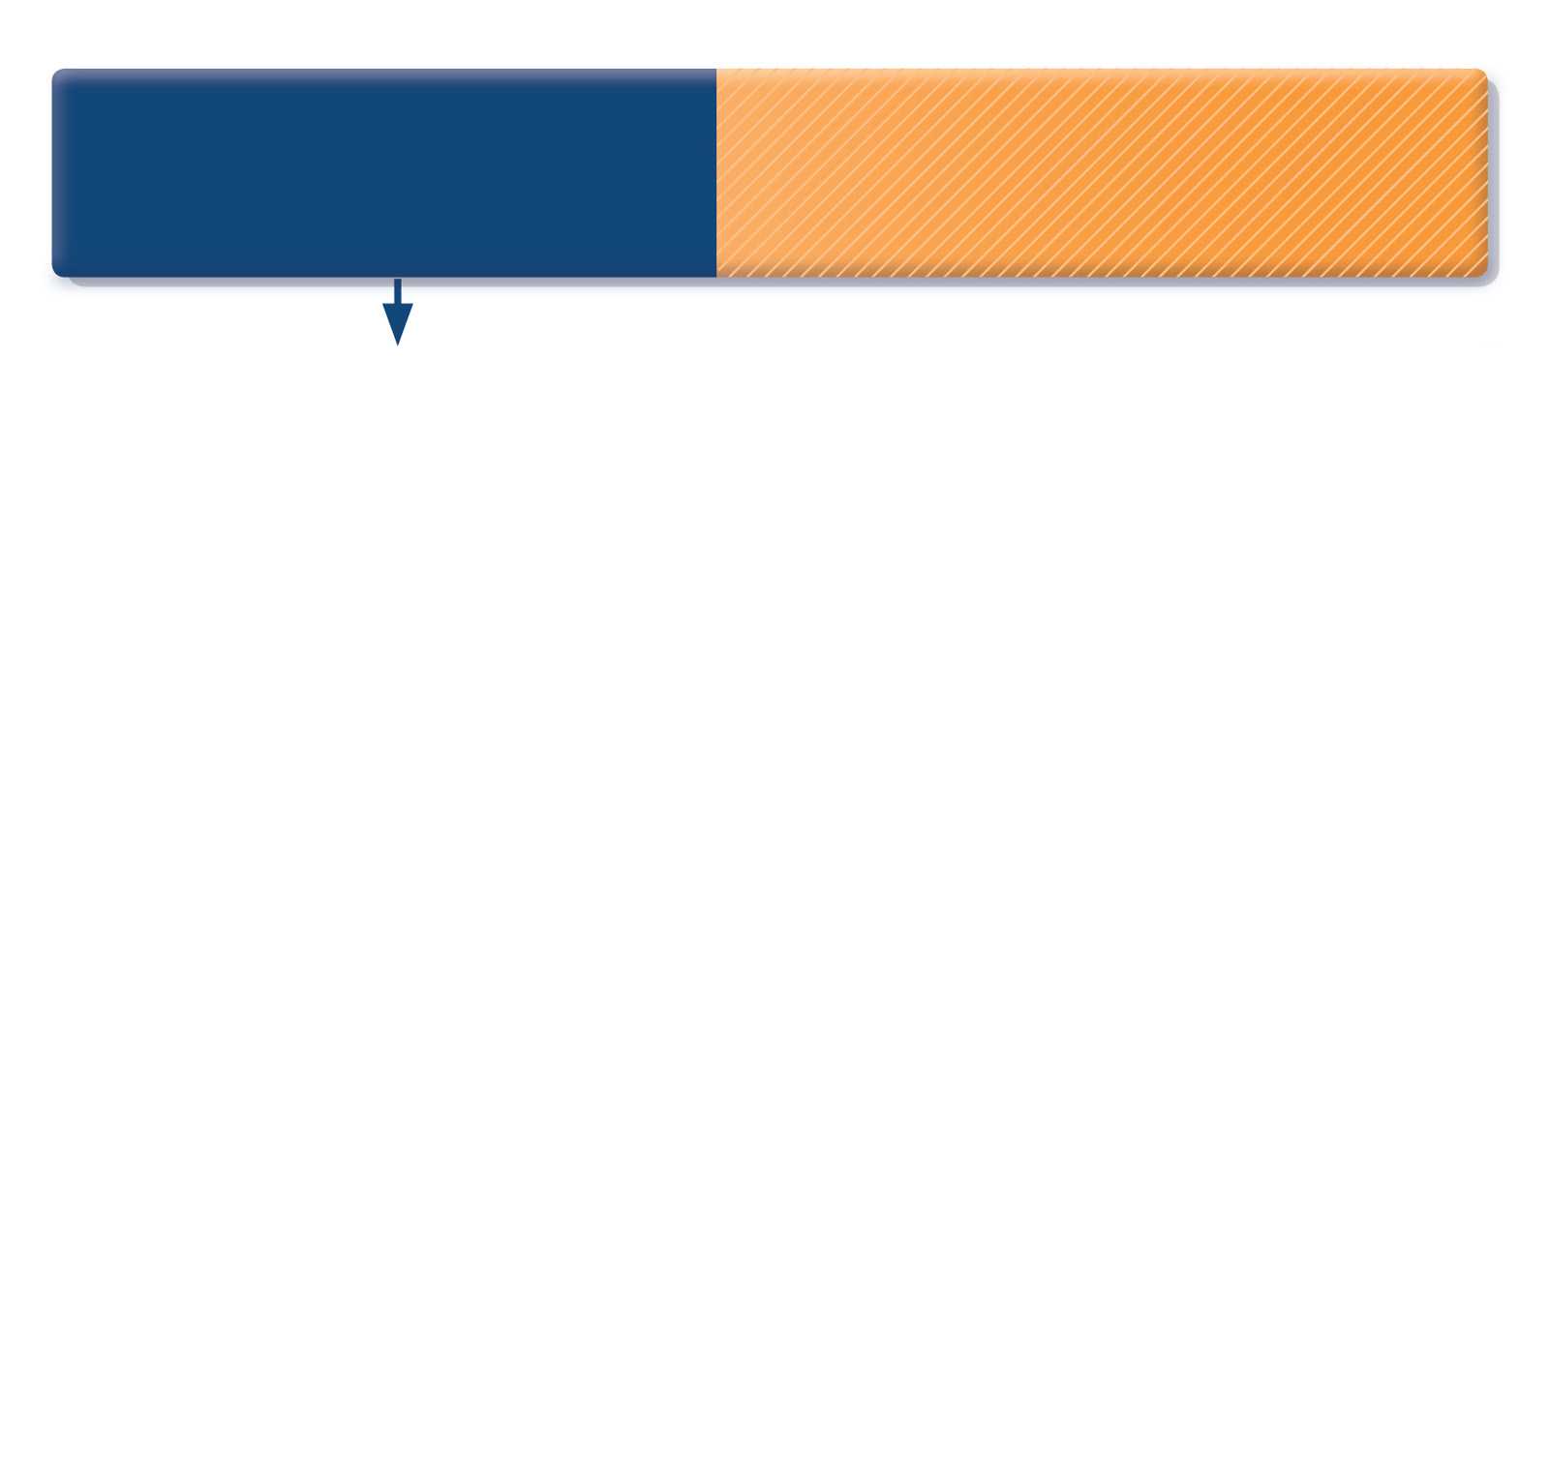
How to distinguish between uncontrolled and severe asthma
Watch patient using their
inhaler. Discuss adherence
and barriers to use
Compare inhaler technique with a device-specific checklist, and correct errors;
recheck frequently. Have an empathic discussion about barriers to adherence.
Remove potential
risk factors. Assess and
manage comorbidities
Consider treatment
step-up
IR/AST/2023/0010
Refer to a specialist or
severe asthma clinic
GINA 2015, Box 2-4 (1/5)
© Global Initiative for Asthma

Slide 21
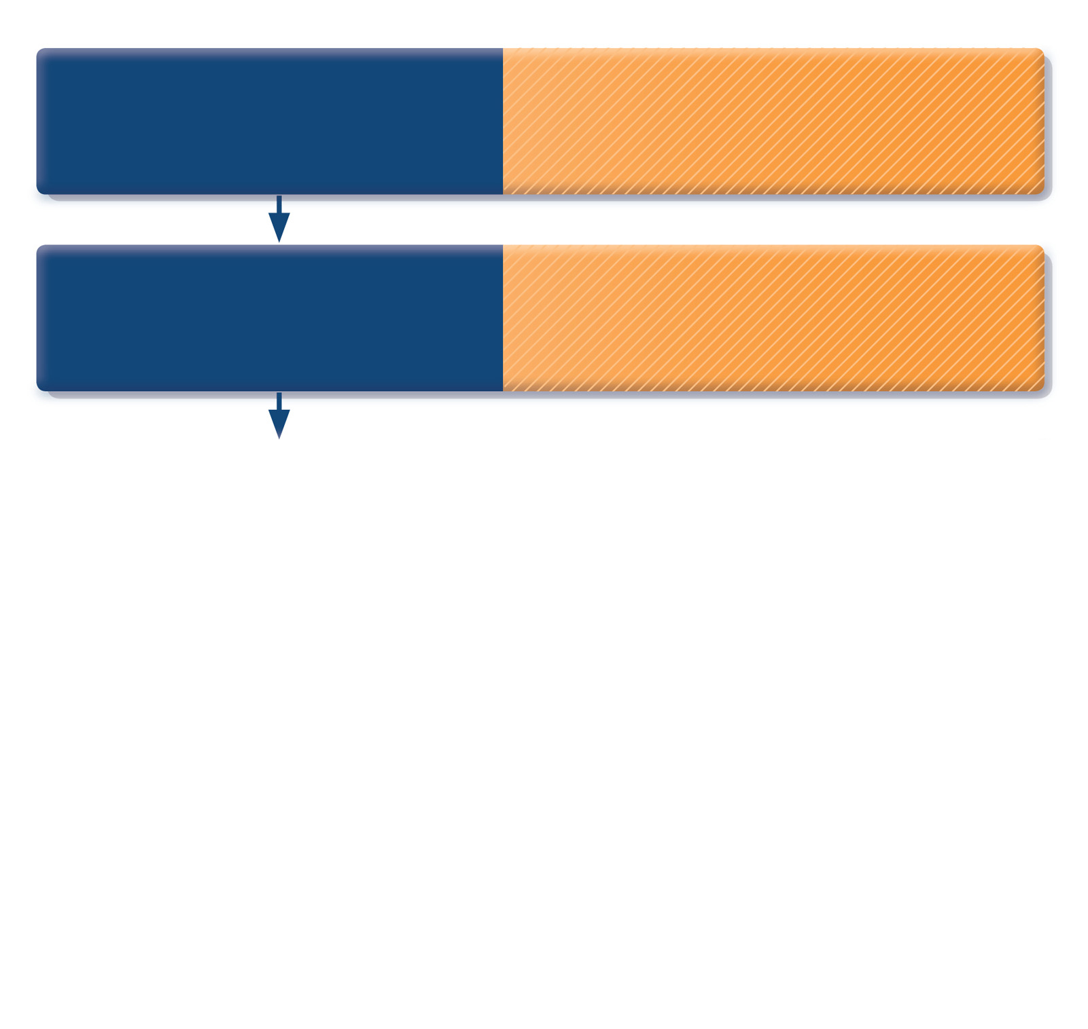
How to distinguish between uncontrolled and severe asthma
Watch patient using their
inhaler. Discuss adherence
and barriers to use
Compare inhaler technique with a device-specific checklist, and correct errors;
recheck frequently. Have an empathic discussion about barriers to adherence.
Confirm the diagnosis
of asthma
If lung function normal during symptoms, consider halving ICS dose and repeating
lung function after 2–3 weeks.
IR/AST/2023/0010
Refer to a specialist or
severe asthma clinic
GINA 2015, Box 2-4 (2/5)
© Global Initiative for Asthma

Slide 22
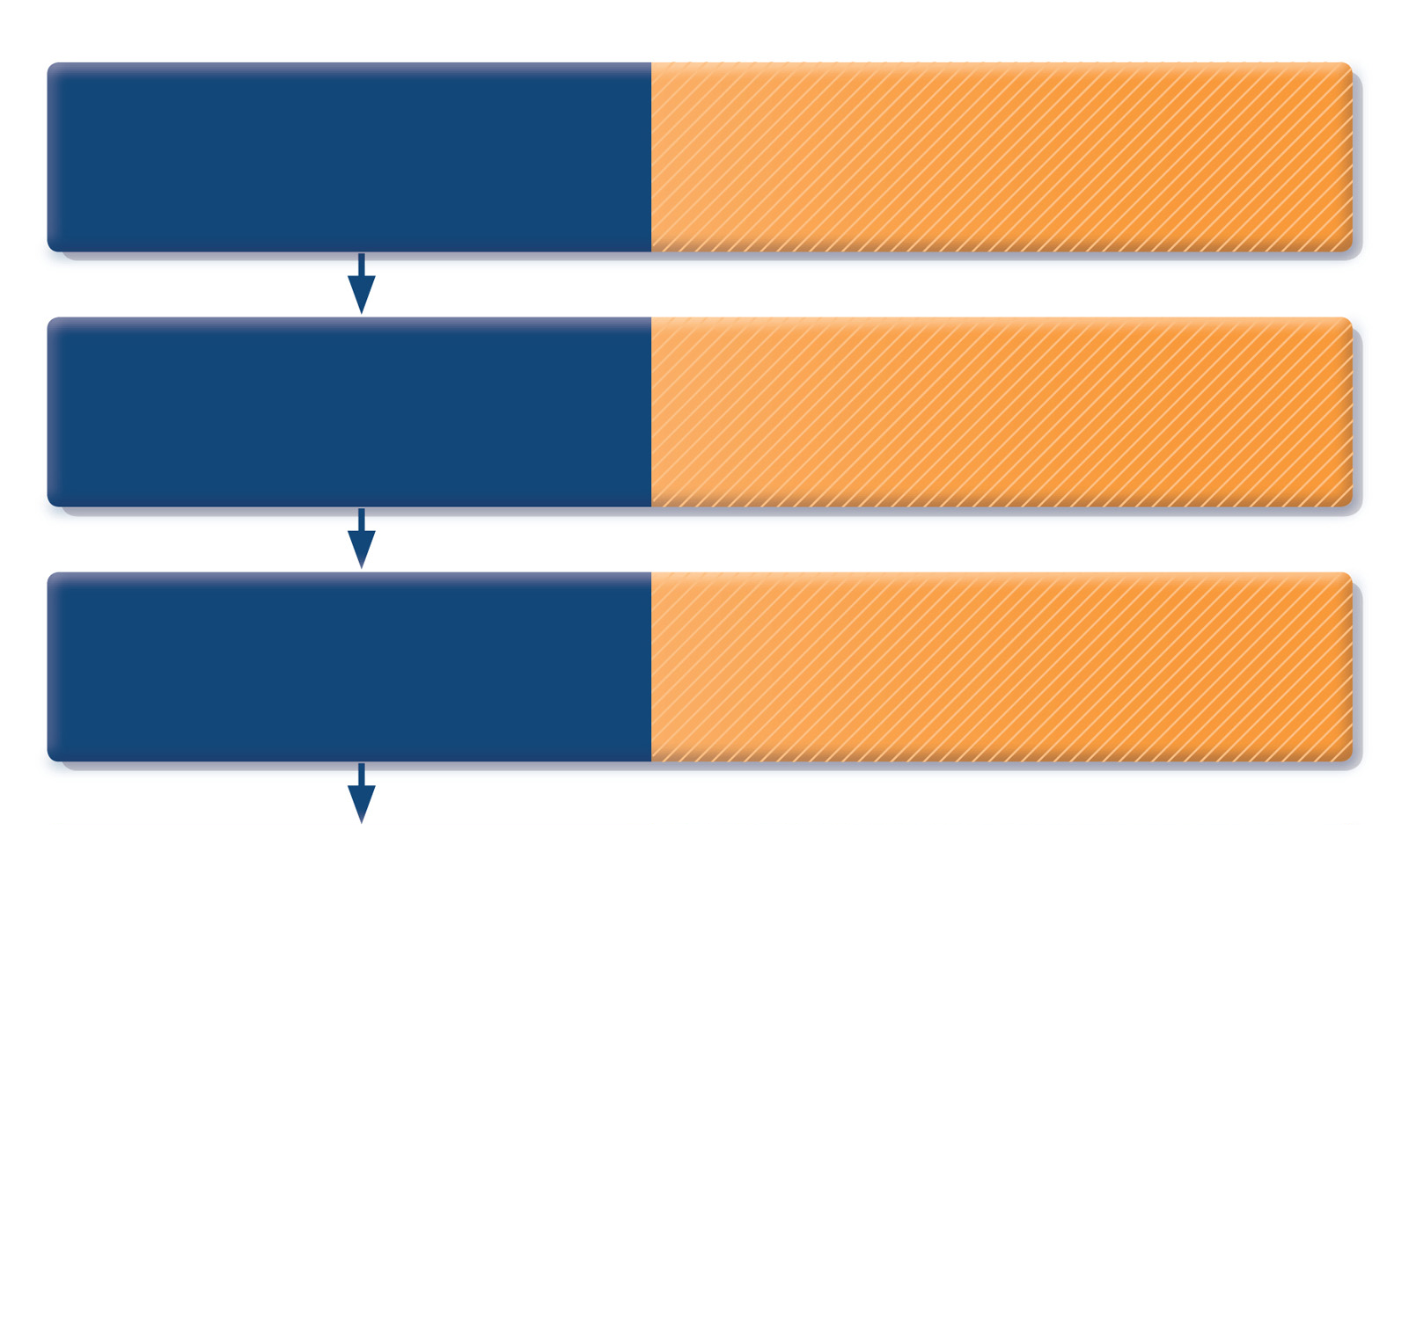
How to distinguish between uncontrolled and severe asthma
Watch patient using their
inhaler. Discuss adherence
and barriers to use
Compare inhaler technique with a device-specific checklist, and correct errors;
recheck frequently. Have an empathic discussion about barriers to adherence.
Confirm the diagnosis
of asthma
If lung function normal during symptoms, consider halving ICS dose and repeating
lung function after 2–3 weeks.
Remove potential
risk factors. Assess and
manage comorbidities
Check for risk factors or inducers such as smoking, beta-blockers, NSAIDs, allergen exposure. Check for comorbidities such as rhinitis, obesity, GERD, depression/anxiety.
Consider treatment
step-up
IR/AST/2023/0010
Refer to a specialist or
severe asthma clinic
GINA 2015, Box 2-4 (3/5)
© Global Initiative for Asthma

Slide 23
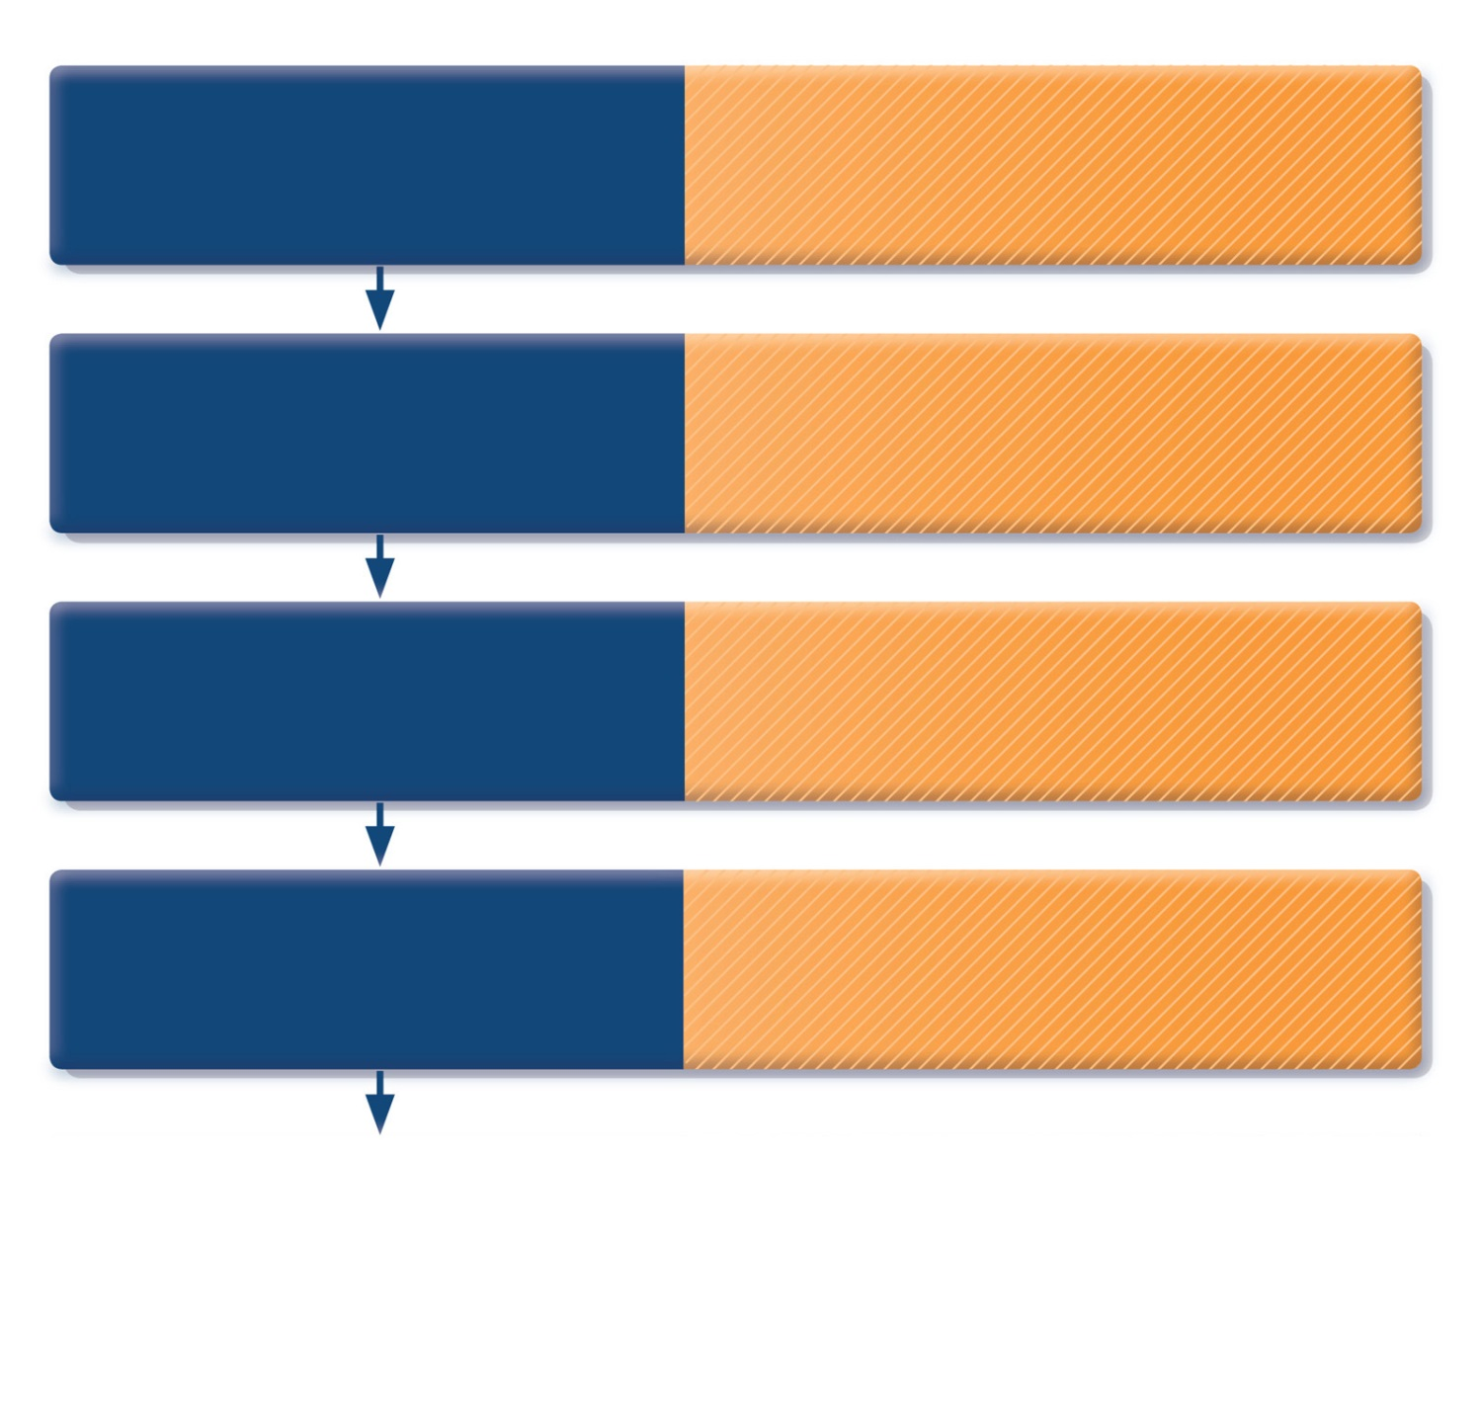
How to distinguish between uncontrolled and severe asthma
Watch patient using their
inhaler. Discuss adherence
and barriers to use
Compare inhaler technique with a device-specific checklist, and correct errors;
recheck frequently. Have an empathic discussion about barriers to adherence.
Confirm the diagnosis
of asthma
If lung function normal during symptoms, consider halving ICS dose and repeating
lung function after 2–3 weeks.
Remove potential
risk factors. Assess and
manage comorbidities
Check for risk factors or inducers such as smoking, beta-blockers, NSAIDs, allergen exposure. Check for comorbidities such as rhinitis, obesity, GERD, depression/anxiety.
Consider treatment
step-up
Consider step up to next treatment level.
Use shared decision-making, and balance potential benefits and risks.
IR/AST/2023/0010
Refer to a specialist or
severe asthma clinic
GINA 2015, Box 2-4 (4/5)
© Global Initiative for Asthma

Slide 24
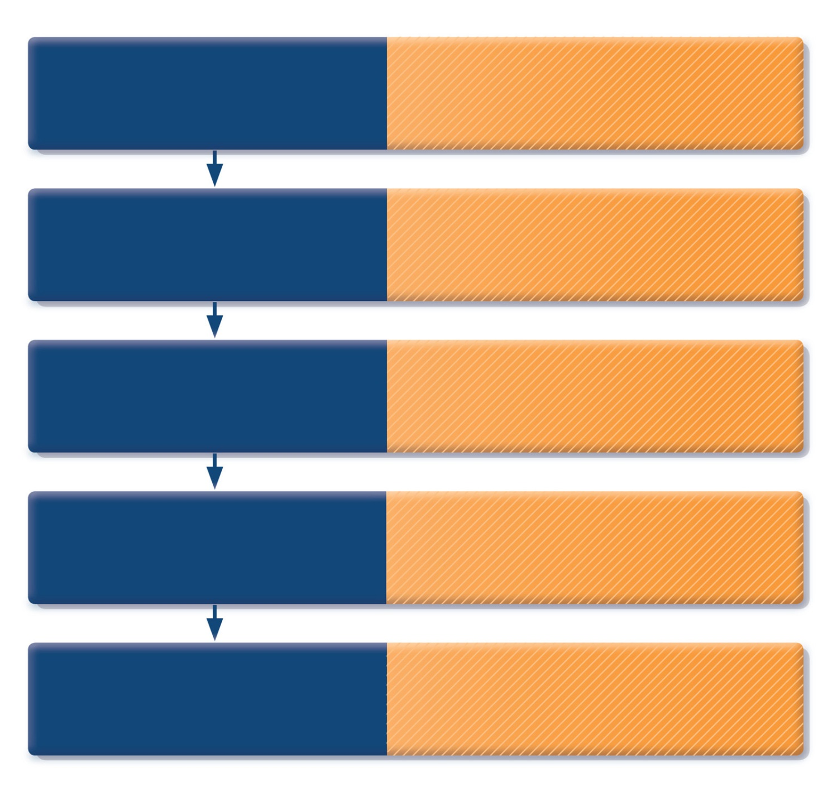
How to distinguish between uncontrolled and severe asthma
Watch patient using their
inhaler. Discuss adherence
and barriers to use
Compare inhaler technique with a device-specific checklist, and correct errors;
recheck frequently. Have an empathic discussion about barriers to adherence.
Confirm the diagnosis
of asthma
If lung function normal during symptoms, consider halving ICS dose and repeating
lung function after 2–3 weeks.
Remove potential
risk factors. Assess and
manage comorbidities
Check for risk factors or inducers such as smoking, beta-blockers, NSAIDs, allergen exposure. Check for comorbidities such as rhinitis, obesity, GERD, depression/anxiety.
Consider treatment
step-up
Consider step up to next treatment level.
Use shared decision-making, and balance potential benefits and risks.
IR/AST/2023/0010
Refer to a specialist or
severe asthma clinic
If asthma still uncontrolled after 3–6 months
on Step 4 treatment, refer for expert advice. Refer earlier if asthma symptoms severe,
or doubts about diagnosis.
GINA 2015, Box 2-4 (5/5)
© Global Initiative for Asthma

Slide 25
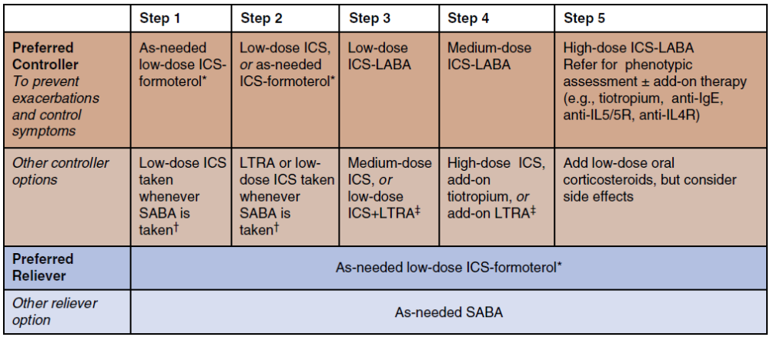

Slide 26
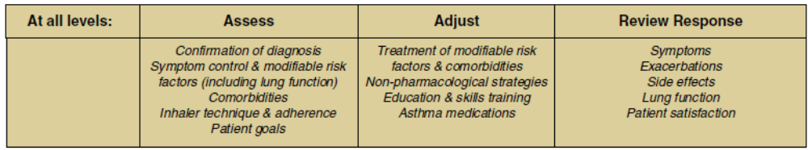

Slide 27
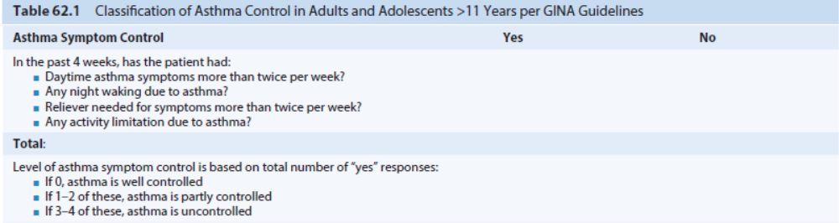

Slide 28
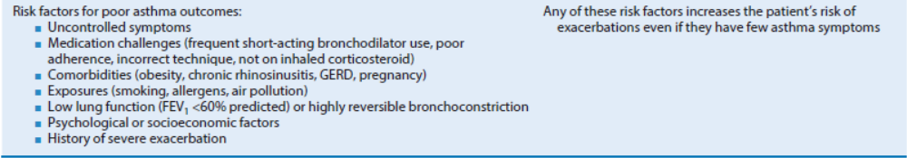

Slide 29
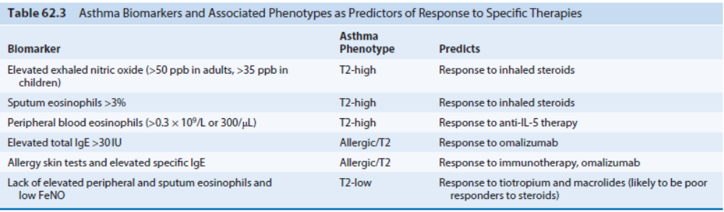

Slide 30
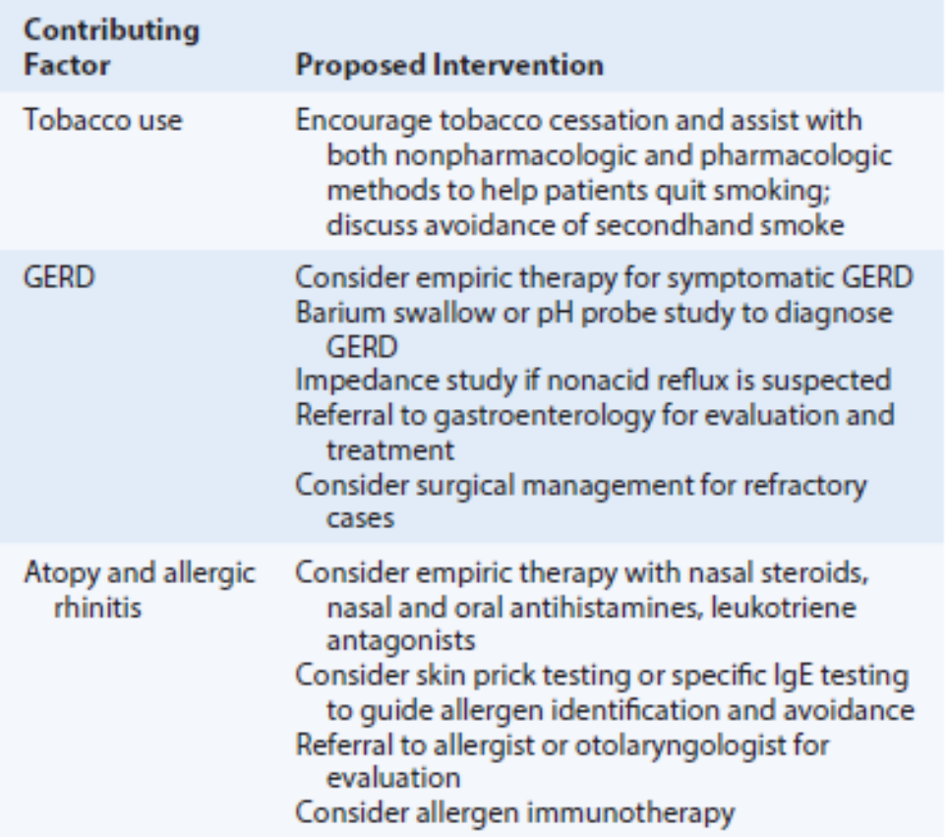

Slide 31
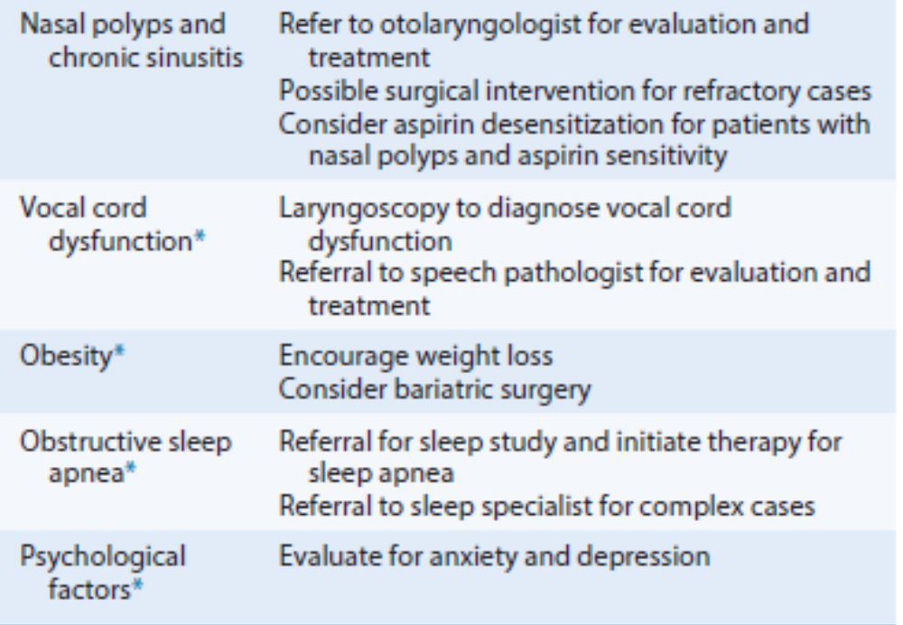

Slide 32
Vocal Cord Dysfunction
VCD presents more often in women than in men and is more common in persons 20 to 40 years old.
It is characterized by intermittent abnormal paradoxical adduction of the true vocal cords during breathing. Patients with VCD often experience shortness of breath, neck/chest tightness, stridor, wheezing, hoarseness, frequent throat clearing, and cough. VCD patients can have normal head and neck and lung examinations or abnormal examinations with upper airway noise or stridor.
Although many causes of VCD have been identified, most patients experience one of three subtypes: psychogenic VCD, exercise-induced VCD, or irritant associated VCD.

Slide 33
Difficulty in making the diagnosis is further complicated by the fact that up to 75% of asthmatics have coexistent VCD. Pulmonary function studies can reveal normal spirometry (without bronchodilator responsiveness) or an abnormal truncated inspiratory flow volume loop.
Methacholine challenge has been used as a provocative measure to recreate symptoms and induce paradoxical closure of the vocal cords. Flow volume loops before and after methacholine challenge in patients with VCD often demonstrate flattening of the inspiratory curve after methacholine challenge.

Slide 34
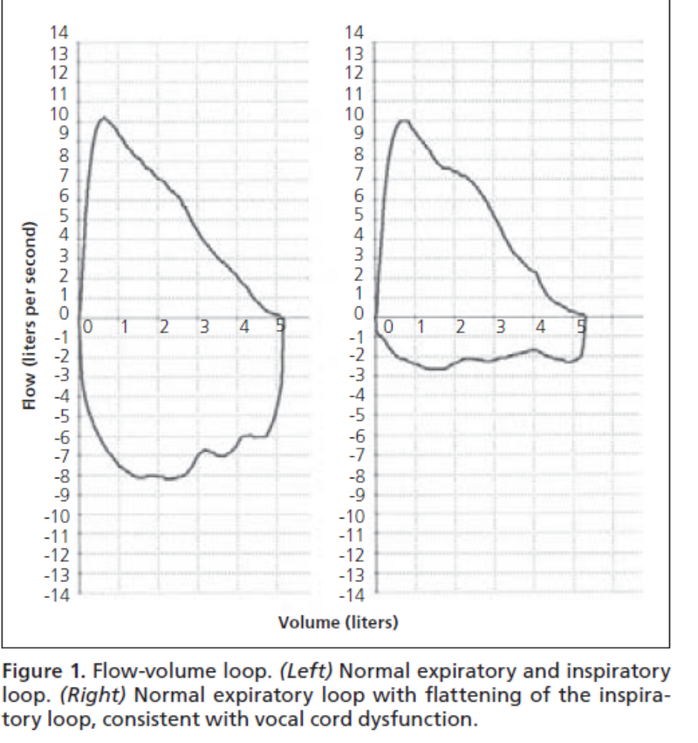

Slide 35
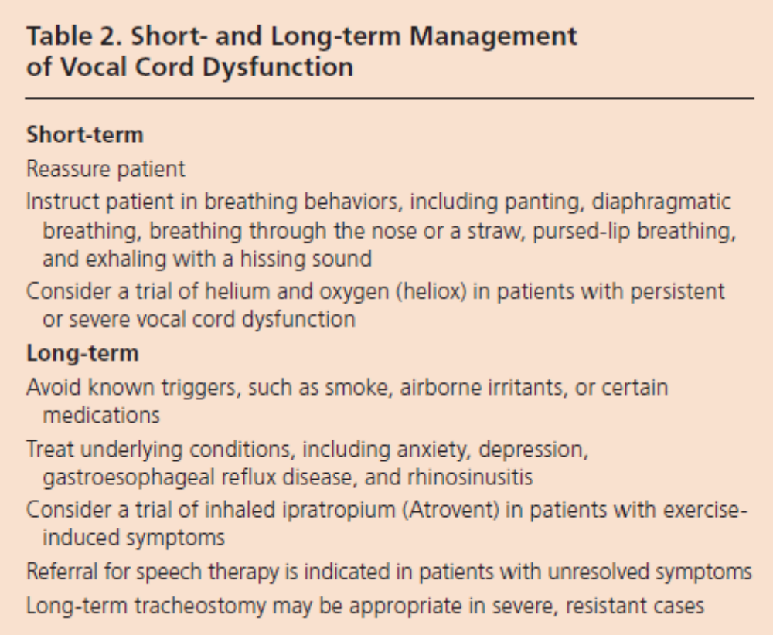

Slide 36
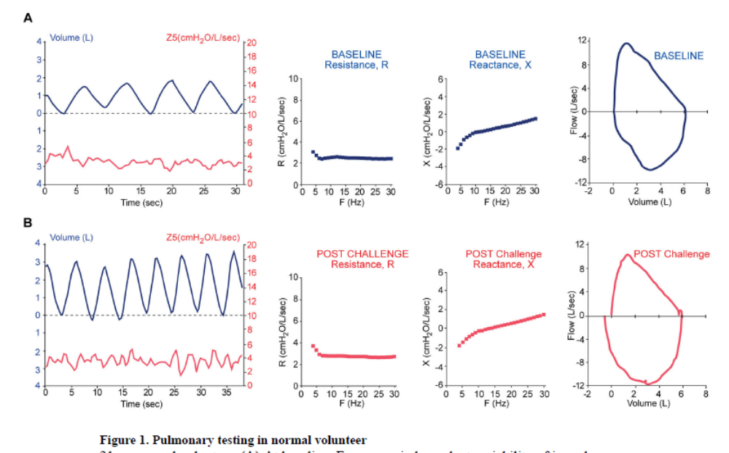

Slide 37
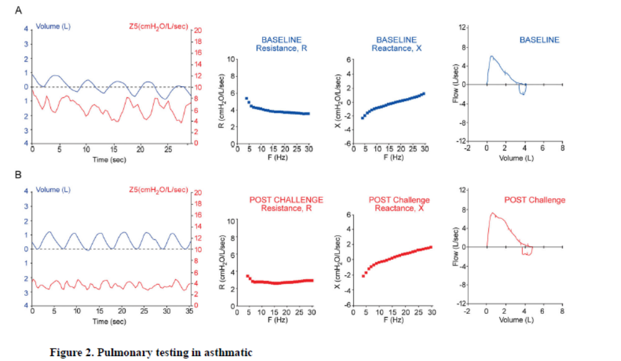

Slide 38
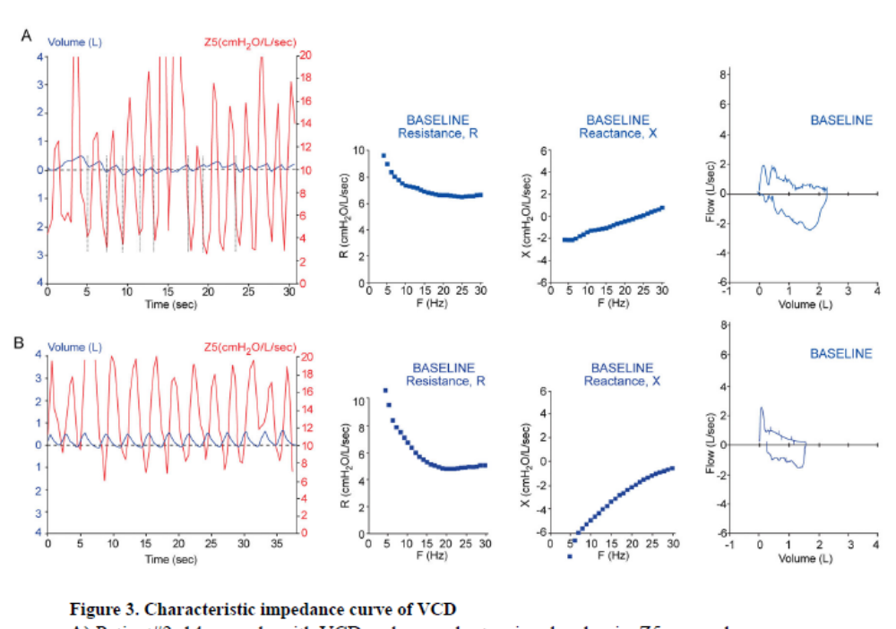

Slide 39
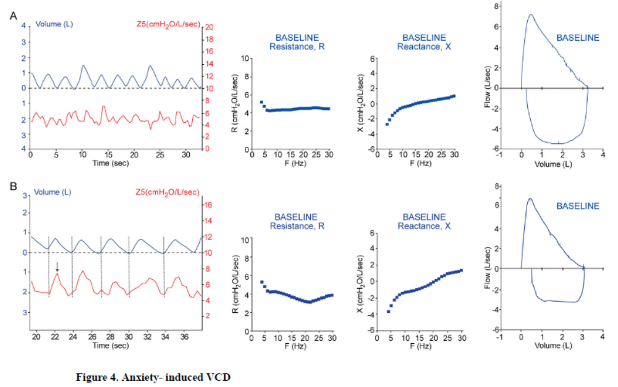

Slide 40

THANKS

Slide 41
For adverse events reporting of any GSK products, kindly call:
(021) 88664496 or (021) 88208129
or E-mail: pv@cobeldarou.com
For full Prescribing Information and any Medical Information queries please email: medinfo@cobeldarou.com

