Slide 1


Slide 2
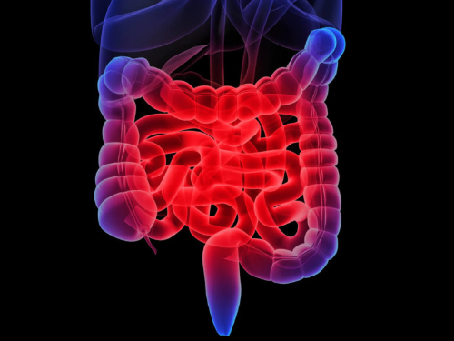
Inflammatory Bowel Disease

Slide 3
Faculty
Mohammad Taher, MD
Assistant Professor of Gastroenterology & Hepatology
Imam Khomeini Hospital Complex
Tehran University of medical Sciences

Slide 4
Learning Objectives
Apply evidence-based testing and tools to diagnose IBD
Discuss efficacy and safety of conventional and biologic therapies for IBD
Develop a health maintenance plan for a patient with IBD
IBD, inflammatory bowel disease.

Slide 5
Why Should Clinicians Be Concerned About IBD?

Slide 6
Scope of IBD in Iran
Physician visits: >11,000/year
Hospitalizations: 1,000/year
Estimated prevalence1
UC: 3.62 to 35.52 :100,000
CD: 1.06 to 5.03:100,000
Annual direct costs: ????
Malekzadeh M.M . 2016. Emerging epidemicss of inflammatory Bowel'isease in a Middle Income Country: A Nation-wide Study from Iran.
Notes:
Notes
The prevalence or ulcerative colitis appears stable while that for Crohn’s disease is increasing.
Although various phenotypes exist, in both UC and CD, intermittent flares occur, requiring medication adjustments, specialist visits, hospitalizations and also operations
50%-80% of CD patients ultimately requiring surgery for complications such as fistulas, strictures, abscesses and perforations [Bennet 2015]
Majority of IBD care occurs in the outpatient setting (30%-70%) [Bennett 2015]
Sources
Lichtenstein GR. Chapter 143: Inflammatory Bowel Disease. In: Goldman L, Schafer AI, eds. Goldman's Cecil Medicine. 24th ed. Philadelphia, PA: Elsevier Saunders; 2012:913-921.
Centers for Disease Control. Inflammatory Bowel Disease. Available at: http://www.cdc.gov/ibd/. Accessed November 2015.
Kappelman MD, Rifas-Shiman SL, Porter CQ, et al. Direct health care costs of Crohn's disease and ulcerative colitis in US children and adults. Gastroenterology. 2008;135(6):1907-1913

Slide 7
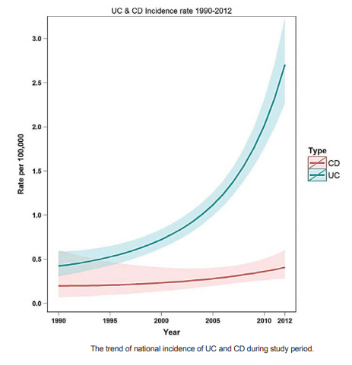

Slide 8
Clinical Consequences of Delayed IBD Diagnosis
Poor quality of life
Relapse rates
Increased cancer risk
Infection risk
Anemia
CD: Progressive disease w/strictures
CD: penetrating disease
Early referral to GI is important for effective treatment
Delayed diagnosis
↓
Delayed treatment
↓
Worse outcomes
GI, gastrointestinal.
Anderson NN, et al. JAMA. 2014;311:2406-2413.
Kotlyar D, et al. Gastroenterol. 2015; 13:847-858.
Lichtenstein GR, et al. Am J Gastroenterol. 2012;107:1409-1422.

Slide 9
What is the Role of Clinicians in IBD?
IBD patients do not receive preventive services at the same rate as general medical patients
Immunosuppressive and biological agents are being used earlier and for longer in the course of disease
  Potential to increase the risk of opportunistic and serious infections in IBD patients
IBD-Related Health Issues Addressed by Clinicians
Monitoring IBD-related complications | Pap smears
Osteoporosis | Smoking cessation
Iron deficiency | Dermatological evaluation
Cardiovascular disease | Psychosocial factors
Cancer | Sexual/reproductive health
Vaccination | Medication adherence
Monitoring laboratory studies | Recognition of IBD relapse and/or acute severe colitis
Sinclair JA, et al. Gastroentergology. 2012;41(2):325-337.
Bennett A, et al. World J Gastroenterol. 2015;21(15):4457-4465.
Gikas A. Int J Gen med. 2014;7:159-173
Notes:
Notes
During the last few years, the role of PCPs in the diagnosis and management of GI disorders such as IBD has been recognized as very important, and it has been suggested that they have all the available resources in order to ensure high standard of care for their patients. In particular, clearly articulated clinical practice guidelines, effective medications, accurate noninvasive investigations, and evidence-based primary care management plans are available to support PCPs who want to raise their threshold for referring patients with GI symptoms.

Slide 10
The Role of
Primary Care Clinicians in IBD
Initial recognition of signs + symptoms that warrant specialist investigation and diagnostic evaluation
Ongoing health maintenance for the IBD patient

Slide 11
Identifying IBD in Primary Care
Notes:
Notes
Because of the commonality of the non-specific symptoms of IBD, PCPs may have difficulty differentiating between innocent symptoms and serious, organic disease without subjecting patients to costly and invasive testing. Early recognition of red flags and timely referral for specialist evaluation is key.

Slide 12
Etiologic Theories in Inflammatory Bowel Disease
Mucosal Immune System
(Immuno-Regulatory Defect)
Genetic predisposition
IBD
Environmental Triggers
(luminal bacteria, infection, NSAIDs, smoking)
Notes:
4

Slide 13
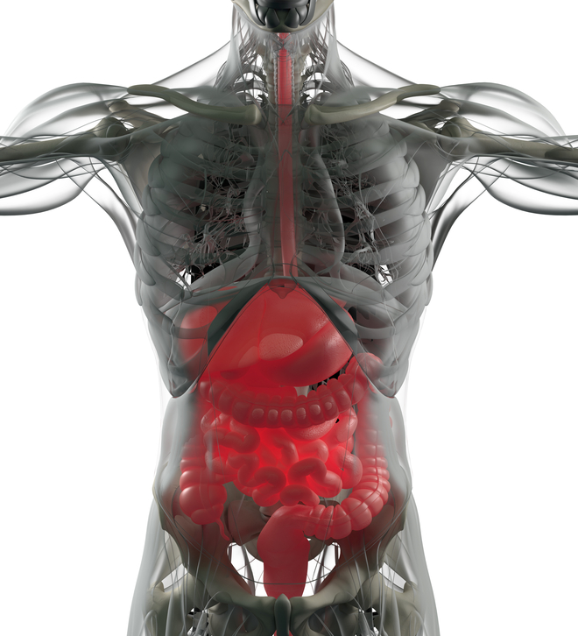
Clinical Features of Ulcerative Colitis
Colon only
Rectal involvement
Mucosal disease
Diffuse ulceration, granularity, friability, bleeding, exudate
No fistulas or granulomas
Non-smokers
No prior appendectomy
Notes:
Image source
http://media.istockphoto.com/photos/digestive-system-human-anatomy-xray-like-futuristic-scan-3d-picture-id542198076

Slide 14
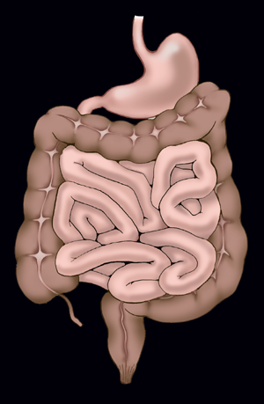
Symptomatology of Ulcerative Colitis
Altered bowel movements
  Increased stool frequency
  Decreased stool consistency
Abdominal pain
  LLQ cramping, relieved with defecation
  Tenesmus
Blood in stool
Notes:
Notes: Ulcerative Colitis
Patients with ulcerative colitis predominantly complain of increasing rectal bleeding with frequent stools and mucus discharge. In severe cases, purulent rectal discharge can result in lower abdominal pain and severe dehydration, especially in the elderly. Some patients also describe tenesmus.
Symptomatically, it presents with a loosening of the stool, progressing to bloody stool, severe urgency of bowel movements and possibly cramping abdominal pain. As the disease progresses, diarrhea may begin, and can be accompanied by loss of appetite and weight loss along with fatigue. As the disease moves from moderate to severe, skin lesions, joint pain, eye inflammation and liver disorders may occur.
Biopsy of the mucosa is recommended to identify the extent of the disease with respect to the thickness of the bowel wall. Histology may reveal crypt abscesses and mucosal inflammation.
Routine blood tests that should be performed include assays for C-reactive protein, anti-prothrombin, and serum albumin.
Plain abdominal radiographs are in the diagnosis of ulcerative colitis. The images may show colonic dilatation, suggesting toxic megacolon, evidence of perforation, obstruction, or ileus.
Patients with tenesmus should be queried for symptoms of rectal prolapse. Rectal prolapse may result in distal rectal inflammation suggestive of ulcerative proctitis.

Slide 15
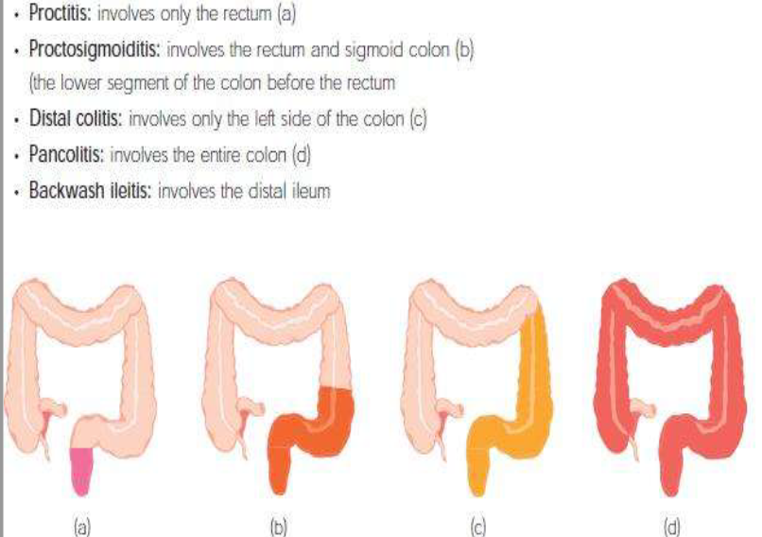

Slide 16
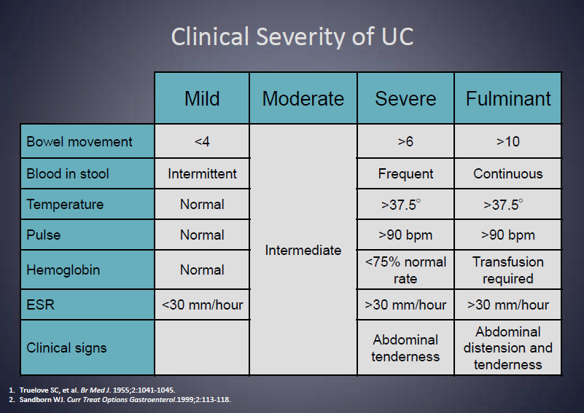

Slide 17
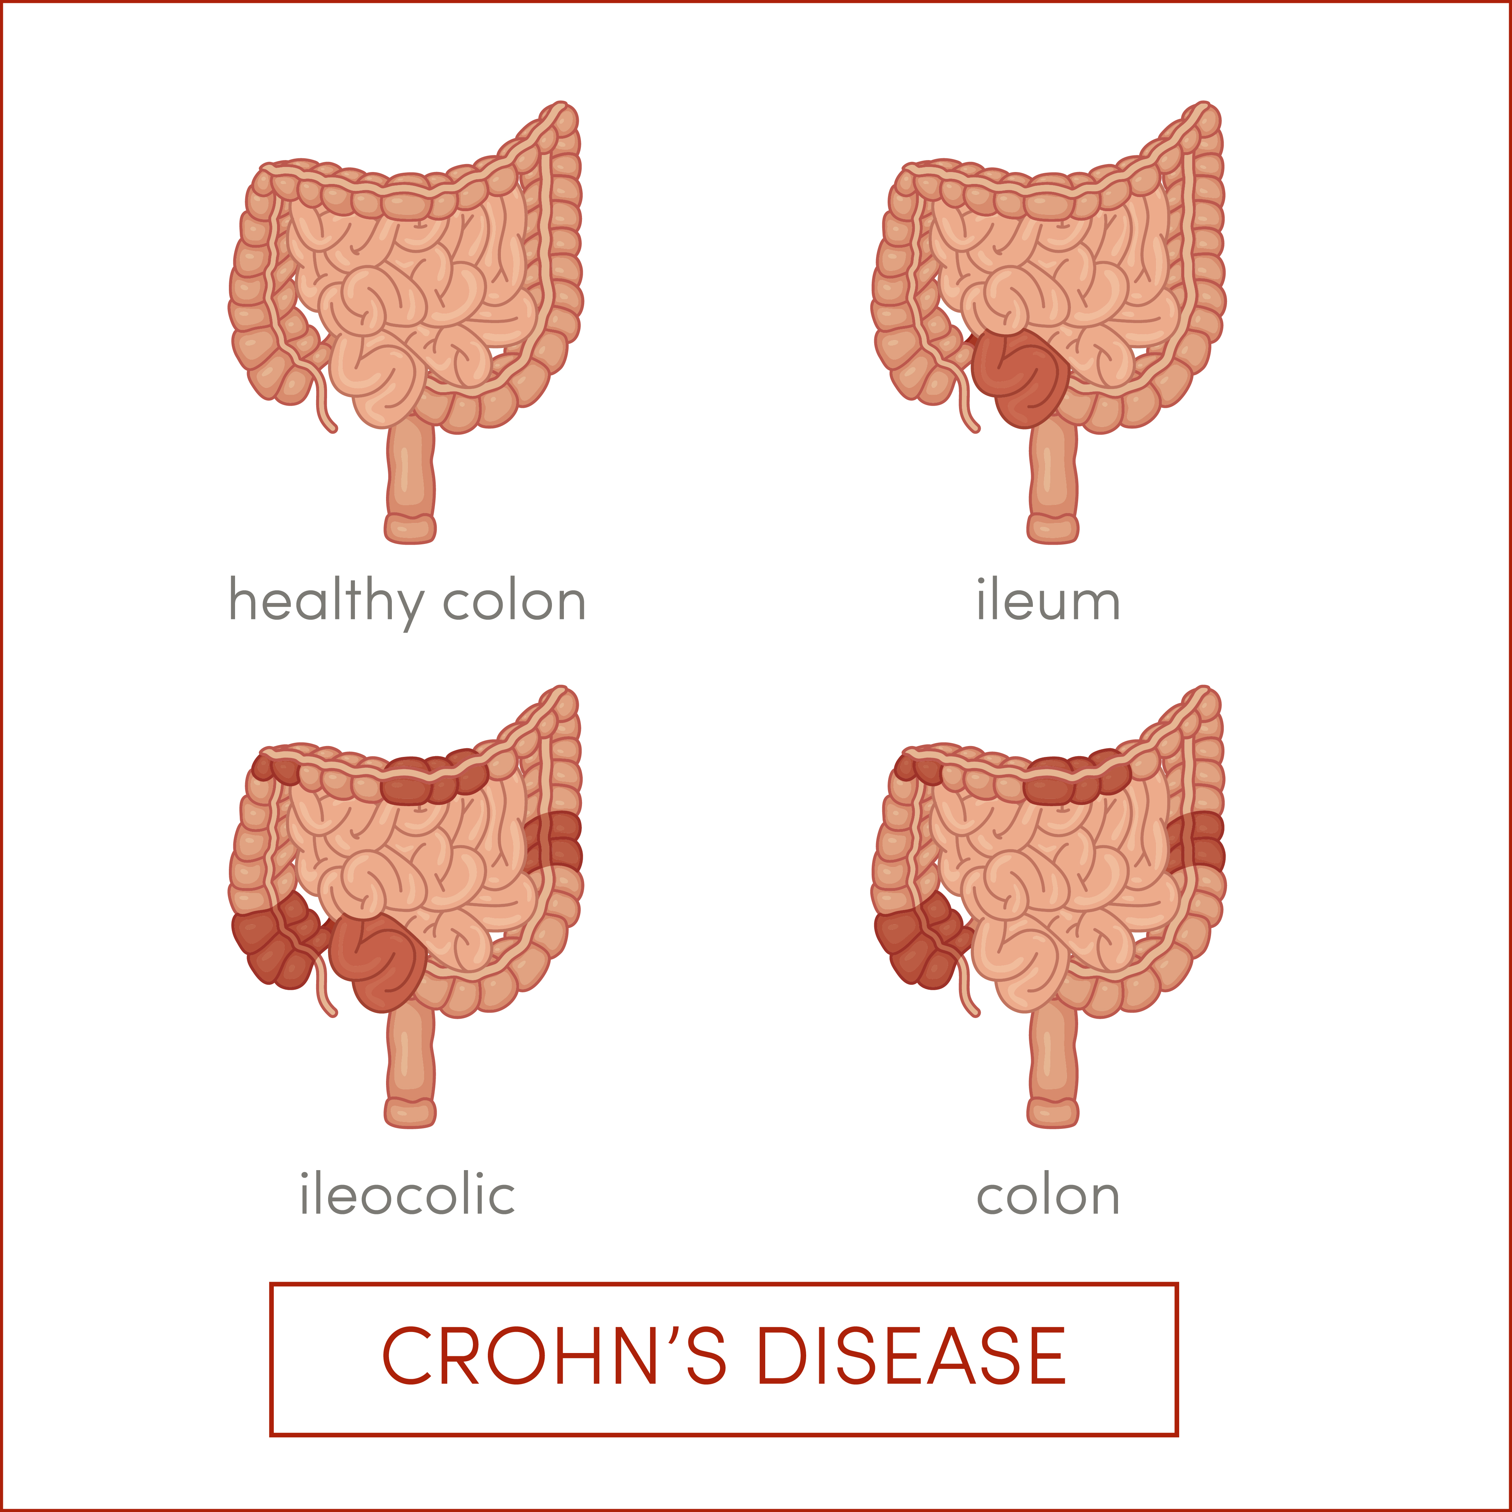
Clinical Features of Crohn’s Disease
Any segment
Rectal sparing
Skip lesions
Transmural
Aphthous ulcers, serpiginous ulcers, cobblestoning
Fistulae
Granulomas
Smokers
Notes:
Crohn’s disease = differentiated from UC in several ways.
Crohn's disease may involve any part of the gastrointestinal (GI) tract, but most frequently includes the distal small bowel and colon. Inflammation is typically transmural and can produce anything from a small ulcer over a lymphoid follicle (aphthoid ulcer) to transmural scarring and chronic inflammation.
there appears to be a genetic element to CD that is not seen in UC: people with a family history of CD are at significantly higher risk of developing the disease.
there are strong environmental risk factors as well, including the use of nonsteroidal anti-inflammatory drugs, antibiotics and oral contraceptives, along with a high fat diet.
One-third of cases have granulomas, and extracolonic sites such as lymph nodes, liver, and joints may also have granulomas. The transmural inflammation leads to the development of fistulas between loops of bowel and other structures.
Inflammation is typically segmental with uninvolved bowel separating areas of involved bowel. Crohn’s disease is more common in smokers than in nonsmokers.
Crohn’s disease may involve any part of the GI tract, but inflammation does not occur with equal frequency in all regions.
About 6% of patients have involvement of the region extending from the mouth to the stomach.
Approximately 32% have colitis, 45% have ileocolitis, and 22% have Ileitis.
Sources
McQuaid KR. Alimentary tract. In: Tierney LM, Jr., McPhee SJ, Papadakis MA, eds. Current Medical Diagnosis & Treatment 2003. 42nd ed. New York, NY: Lange Medical Books/McGraw-Hill; 2003:522-627.
Centers for Disease Control. Inflammatory Bowel Disease. Available at: http://www.cdc.gov/ibd/. Accessed November 2015.
Crohn’s & Colitis Foundation of America. Available at http://www.ccfa.org/what-are-crohns-and-colitis/what-is-crohns-disease/

Slide 18
Crohn’s Disease Symptomatology
Chronic or nocturnal diarrhea and abdominal pain
Postprandial RLQ abdominal pain, distension
Weight loss
Fever
Rectal bleeding
RLQ, right lower quadrant
Lichtenstein GR et al. Am J Gastroenterol 2009;104:465-83; quiz 464, 484.
Notes:
Lichtenstein GR, Hanauer SB, Sandborn WJ, Practice Parameters Committee of American College of G. Management of Crohn's disease in adults. Am J Gastroenterol 2009;104:465-83; quiz 464, 484.

Slide 19
Extraintestinal Manifestations of IBD
Joints
Skin
Eyes
Hepatobiliary
Hypercoagulable state
Renal
Peripheral arthritis
Ankylosing spondylitis and sacroiliitis
Kidney stones
Interstitial nephritis
Pyoderma gangrenosum
Erythema nodosum
Venous thrombosis
Episcleritis
Uveitis
Cataracts
  Sclerosing cholangitis
  Gallstones
Levine JS, et al. Gastroenterol Hepatol (N Y). 2011;7(4):235-241.
Notes:
Inflammatory bowel disease is also associated with a wide range of extra-intestinal manifestations, including peripheral arthritis, ankylosing spondylitis, sacroiliitis, pyoderma gangrenosum, erythema nodosum, episcleritis, uveitis, cataracts, sclerosing cholangitis, gallstones, venous thrombosis, kidney stones, and interstitial nephritis.

Slide 20
Components of IBD Diagnosis
History
Physical Examination
Labs
  CBC, CMP, ESR, CRP, iron studies, vitamin B12
Fecal calprotectin or lactoferrin
Stool
  C difficile toxin, culture, ova & parasites
Colonoscopy
EGD if CD suspected
  Wireless capsule endoscopy of small intestine
  CT and MRI enterography
  Barium small bowel follow through
  Device assisted balloon enteroscopy
Endoscopy
Histology
Radiography
Clinical course of symptoms
CBC, complete blood count; CMP, comprehensive metabolic panel; CRP, C-reactive protein;
EGD = esophagogastroduodenoscopy; ESR, erythrocyte sedimentation rate; CT, computed tomography; MRI, magnetic resonance imaging.
Mill J, Lawrence IC. WJG. 2014;20(29):9691-9698.
Kornbluth A, et al. Am J Gastroenterology. 2010;105(3):501-523.

Slide 21
Current Treatment Overview

Slide 22
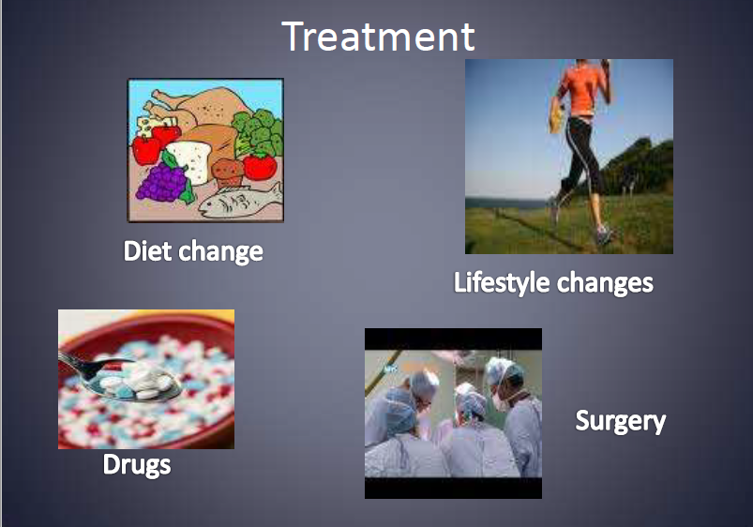

Slide 23
Treatment Goals
Induce clinical remission (absence of symptoms)
Avoid short- and long-term toxicity of treatment
Enhance quality of life
Maintain steroid-free remission
Avoid repeated courses of steroids!
Induce “deep” remission
Biologic remission (normalization of biomarkers)
Mucosal healing
Prevent complications (hospitalizations, surgery, etc)
Reduce cancer risk
Reenaers C, et al. World J Gastroenterol. 2012;18(29):3823-3827
Hommes D, et al. J Crohns Colitis. 2012;6(Suppl 2):S224-S234.
Notes:
Notes
Treatment paradigms and therapeutic options for IBD have evolved rapidly over the past decade, with the availability of several new biologics, an increased emphasis on dual therapy to reduce immunogenicity, improve efficacy and preserve durability, emerging use of therapeutic drug monitoring to optimize response and guide management of loss of response, and increased emphasis on mucosal healing as an important treatment goal as it correlates with surgical-free outcomes with minimal intestinal damage and patient disability.
1. Mucosal healing (i.e. absence of ulceration or erosion) is important in the clinical management of IBD—achieving mucosal healing has been unequivocally associated with better outcomes and has become an important treatment goal.
Neurath MF. New targets for mucosal healing and therapy in inflammatory bowel diseases. Mucosal Immunol. 2014;7:6-19
Ananthakrishnan AN, Kane SV. The Toronto consensus guidelines for nonhospitalized ulcerative colitis: a welcome update but not the end of the story. Gastroenterology. 2015;148(5):877-880.
Ho EY, Cominelli F, Katz J. Ulcerative Colitis: What is the Optimal Treatment Goal and How Do We Achieve It? Curr Treat Options Gastroenterol. 2015;13(1):130-142.
Moran GW, Dubeau MF, Kaplan GG, Panaccione R, Ghosh S. Novel concepts in inflammatory bowel disease. Br Med Bull. 2014;109:55-72.

Slide 24
Progression of Digestive Disease Damage and Inflammatory Activity
Stricture
Surgery
Inflammatory Activity
(CDAI, CDEIS, CRP)
Digestive Damage
Fistula/abscess
Stricture
Disease
onset
Diagnosis Early
disease
Pre-clinical
Clinical
Pariente B et al. Inflamm Bowel Dis 2011;17(6):1415-22
CDAI: Crohn's Disease Activity Index; CDEIS : Crohn’s Disease Endoscopic Index of Severity; CRP: C-Reactive Protein
Notes:
Notes
Treatment paradigms are shifting, based on advances in understanding the inflammatory activity in IBD

Slide 25
Risk Factors for a More Severe
Disease Course
Crohn’s Disease
Ulcerative Colitis
Early age at diagnosis (<40)
Perianal involvement
Severe deep ulcerations on endoscopy
Multiple areas of bowel involvement
Current tobacco use
Other
  Prior resections
  Stricturing or penetrating disease
  Early steroid treatment
Early age at diagnosis (<40)
Early steroid treatment
Extensive colitis
Hospitalization @ diagnosis
Elevated inflammatory markers
    CRP, ESR
  Low serum albumin
Peyrin-Biroulet L, et al. Clin Gastroenterol Hepatol. 2016;14(3):348-354.

Slide 26


Slide 27
Treatment Paradigm Shift:
Decision-Making in IBD
OLD = treat based on symptoms
But symptoms are insensitive and nonspecific for bowel inflammation
NEW = treat based on objective markers of inflammation
Serologic (CRP reduction)
Endoscopic (mucosal healing)
Radiographic (CTE/MRI improvement)
Notes:
Notes
treatment paradigms are shifting, based on advances in understanding the inflammatory activity in IBD

Slide 28
Conventional Approach to Induction Therapy: Step Up
Disease Severity
at Presentation
Investigational agent/
Surgery
Anti-TNF +/-IS
Anti-Integrin
Anti-TNF/Anti-Integrin
+/- IS
Severe
Moderate
Mild
Systemic
Corticosteroid
Thiopurine/
MTX
Budesonide
Budesonide
Induction
Maintenance
Therapy is stepped up according to severity at presentation or failure at prior step
Clinical approach to use “mildest” form of drug therapy to treat patients first
Move to next step in non-responders

Slide 29
Step Up Management
Patients attain remission with less toxic therapy
Potentially more toxic therapies reserved for severe or refractory disease
Minimizes risk of adverse events
Cost-sparing (short-term?)
Patients have to ‘earn’ most effective treatments
  ↓ QoL before patients obtain optimal therapy
High likelihood of surgery
Disease is not modified
Advantages
Disadvantages
Notes:
Patients have to "earn" most effective treatments decrease in quality-of-life before patients obtain optimal therapy
Likelihood of surgery is high
Disease is not modified

Slide 30
New Paradigm: Treating Beyond Symptoms
Early
“Top-Down Approach”
Severe
IMs + TNF antagonist
Anti-TNF Agents | UC | CD
Infliximab | + | +
Adalimumab | + | +
Golimumab | +
Certolizumab |  | +
Pegol |  | +
Anti-integin Agents
Vedolizumab | + | +
Natalizumab |  | +
TNF antagonist
+/- IMs
Corticosteroids
+/- IMs
Moderate
Corticosteroids
Conventional
”Bottom-Up Approach”
IMs, immunosuppressant; UC, ulcerative colitis; CD, Crohn’s disease.
D'Haens GR. Nat Rev Gastroenterol Hepatol. 2010 Feb;7(2):86-92.
Terdiman JP, et al. Gastroenterology. 2013 Dec;145(6):1459-63.
Sandborn WJ, et al. J Crohns Colitis. 2014;8(9):927-935. Amezaga AJ, et al. Curr Gastroenterol Rep. 2016 Jul. 18 (7):35.

Slide 31
Evolving Treatment Approach in UC
Current Approach
Emerging Approach
Assessment of prognosis
Optimization of AZA/6-MP dose or metabolites
Earlier adoption of biologic therapy when appropriate
Appreciation for the implications of mucosal healing
Newer therapies w/favorable safety + side-effect profiles
Individualized therapy based on genetics + physiology
Treatment to hard endpoints
  e.g. mucosal healing or its surrogates)
Disease monitoring to prevent relapse

Slide 32
Current Medications for Active Disease
5-Aminosalicylic acid derivatives
  sulfasalazine, mesalamine, balsalazide, olsalazine
Antibiotics
  metronidazole, ciprofloxacin, rifaximin
Corticosteroid agents
  hydrocortisone, prednisone, methylprednisolone, prednisolone, budesonide, dexamethasone
Immunomodulator agents
  azathioprine, 6-mercaptopurine, methotrexate, cyclosporine
Tumor necrosis factor inhibitors
  Infliximab
  Adalimumab
  certolizumab pegol
  golimumab
Anti-integrin agents
  natalizumab
  vedolizumab
Anti-IL-12/23 agents
  Ustekinumab
Notes:
Notes
Conventional therapies for CD (aminosalicylates, antibiotics, and topical and/or systemic steroids) have, until recently been atop a pyramid approach that delayed the incorporation of immunomodulating and immunosuppressive drugs until these initial therapies failed to provide relief of symptoms .,,
Biologic, specifically anti-tumor necrosis factor (TNF-α) therapy and other immunomodulating drugs have moved to the forefront for the treatment of IBD, and are so recognized in the most recent American Gastroenterological Association (AGA) guidelines. These drugs include infliximab, adalimumab, vedolizumab, golimumab (for UC only), natalizumab (for CD only) and certolizumab (for CD only).
Factors that inform when to initiate biologic therapy include steroid-dependent CD, corticosteroid-refractory CD, disease that is refractory to immunomodulator therapy or patient intolerance to immunomodulators, and complex-fistulizing CD. Other evolving factors are prevention of postoperative recurrence and those clinical predictors of a poor outcome at diagnosis.
Emerging agents that may be approved in the near future include:
Tofacitinib – an orally administered Janus kinase inhibitor now in late stage trials for both UC and CD and is showing a clinical response compared to placebo ,
Mongersen – an oral SMAD7 antisense oligonucleotide is now in Phase 2 trials for CD. Vader JP, Froehlich F, Juillerat P, et al. Appropriate treatment for Crohn’s disease: methodology and summary results of a multidisciplinary international expert panel approach—EPACT. Digestion. 2006;73:237-248.
Sources
Rutgeerts P, Diamond RH, Bala M, et al. Scheduled maintenance treatment with infliximab is superior to episodic treatment for the healing of mucosal ulceration associated with Crohn's disease. Gastrointest Endoscopy. 2006;63:433-442.
Rutgeerts P, Van Assche G, Sandborn WJ, et al. Adalimumab induces and maintains mucosal healing in patients with Crohn's disease: data from the EXTEND trial. Gastroenterology. 2012;142:1102-1111
Feagan BG, Rutgeerts P, Sands BE, et al. Vedolizumab as induction and maintenance therapy for ulcerative colitis. N Engl J Med. 2013;369:699-710.
Sands BE, Feagan BG, Rutgeerts P, et al. Effects of vedolizumab induction therapy for patients with Crohn's disease in whom tumor necrosis factor antagonist treatment failed. Gastroenterology. 2014;147:618-627.
Hanauer SB, Feagan B, Lichtenstein G, et al. Maintenance infliximab for Crohn's disease: the ACCENT I randomised trial. Lancet. 2002;359:1541-1549

Slide 33
Current Medical Therapies for Symptomatic Relief
Antidiarrheal agents
diphenoxylate and atropine, loperamide, cholestyramine
Anticholinergic antispasmodic agents
dicyclomine, hyoscyamine

Slide 34
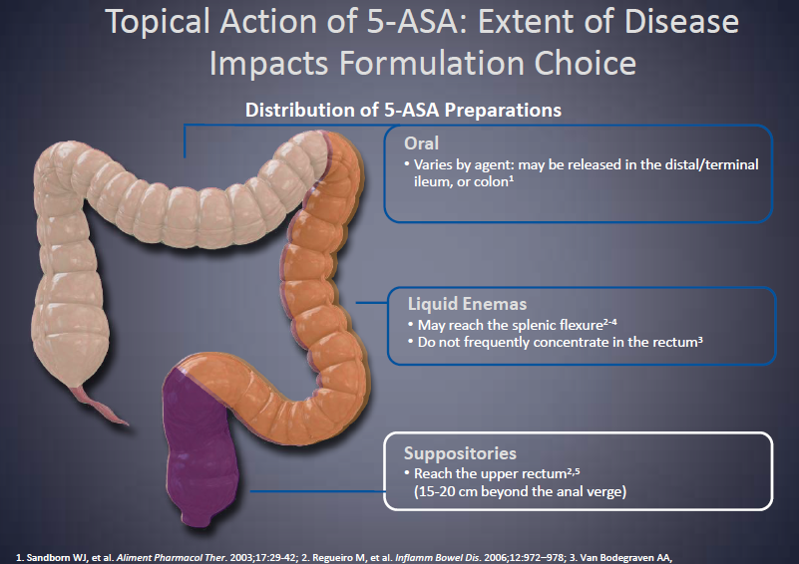

Slide 35
Serious Side Effects of Prolonged GCS Therapy
Hypertension <20%
Diabetes 2.33 relative risk for beginning insulin
Infection 13-20%
Osteoporosis <50%
Myopathy 7%
Cataracts 22% (dose-dependent)
Psychosis (3-5%)
*Overall GCS therapy (not only therapy for CD).
Sandborn W. Can J Gastroenterol. 2000;14(suppl C):17C-22C.
Notes:
Hypertension <20%
Diabetes 2.33 relative
risk for beginning insulin
Infection 13-20%
Osteonecrosis 5%
Osteoporosis <50%
Myopathy 7%
Cataracts 22% (dose-dependent)
Glaucoma? frequency (response genetically determined)
Psychosis 3-5%

Slide 36
Predictors of Serious Infection &
Death in CD
6273 patients in the TREAT registry; average follow-up: 5.2 years
Predictors of Serious Infection | HR |  | Predictors of Death | HR
Moderate to severe CD | 2.24 |  | Use of prednisone | 2.14
Use of narcotic pain relievers | 1.98 |  | Use of narcotic pain relievers | 1.79
Use of prednisone | 1.57
Use of IFX | 1.43
Abbreviations: IFX, infliximab; HR, hazard ratio. P < .05 for all.
Lichtenstein GR, et al. Am J Gastroenterol. 2012;107(9):1409-1422.
Notes:
Adverse events occur with every medication - Most serious adverse events are extremely rare (eg, lymphoma, MS, renal failure)
Recent findings from the TREAT registry indicate that neither IFX nor IM treatment was associated with an increased mortality risk.
The TREAT Registry was started in 1999 to evaluate the safety of various treatments for CD. It is an ongoing, prospective, observational, multicenter patient registry that receives reports from approximately 350 gastroenterologists in North America, in both community-based and academic practices. There is no defined treatment protocol.
When the registry was created, the minimum follow-up period was specified to be 5 years per patient. Therefore, although there have been previous reports on the registry, this is the principal analysis. It included 6273 patients who were followed for an average of 5.2 years. Disease severity varied among patients.
The slide shows the factors that significantly and substantially increased the risk of serious infection and/or death. Prednisone and narcotic pain relievers were the most risky medications with regard to these outcomes.
Reference
Lichtenstein GR, Feagan BG, Cohen RD, et al. Serious infection and mortality in patients with Crohn's disease: more than 5 years of follow-up in the TREAT registry. Am J Gastroenterol. 2012;107(9):1409-1422.

Slide 37
Safety and Toxicity Considerations
Mesalamine¹ | 5-ASA | AZA/6-MP⁴ | MTX⁵⁻⁶
Low incidence of adverse effects Diarrhea, headache, nausea most common Abdominal pain Dyspepsia Acute tolerance syndrome Nephrotoxicity Pancreatitis | Incidence of kidney impairment occurs in less than 1 in 200 (<0.5%) patients treated with 5-ASA² | Pancreatitis (4%) Allergy (2%) Bone marrow suppression (4%) Liver toxicity (9%) Serious infection (2%) | Nausea/vomiting Bone marrow suppression Liver scarring
 | Clinically important interstitial nephritis occurs in 1 in 500 patients―50% of cases occur in the first year, and others may occur many years later³ | Increased risk of lymphoma Nonmelanoma skin cancer Abnormal Pap smears | Contraindicated if attempting pregnancy
1. Feagan BG, et al. Cochrane Database Syst Rev. 2012;10:CD000544. 2. Gisbert JP, et al. Inflamm Bowel Dis. 2007;13(5):629-638. 3. World MJ, et al. Nephrol Dial Transplant. 1996;11(4):614-621. 4. Kotlyar D, et al, Clinical Gastroenterology and Hepatology. 2015;13:847–858. 5. Lichtenstein GR, et al. Am J Gastroenterol. 2009;104(2):465-483. 6. Methotrexate injection USP [package insert]. Lake Forest, IL: Hospira, Inc.; 2011.

Slide 38
Anti-TNF Drug Safety
Infection and malignancy
Black-box warning for serious infection and malignancy for all anti-TNF therapies¹⁻³
Black-box warning for HSTCL (ADA and IFX)^{1,2}
Reactivation of hepatitis B⁴
Skin cancer⁴
Psoriasis⁴
Autoimmunity (lupus-like syndrome <1%)⁴
Immunogenicity―antibodies to anti-TNF⁴
Demyelinating disorders, CHF, liver toxicity⁴
CHF, congestive heart failure;
HSTCL, hepatosplenic T-cell lymphoma
Remicade [package insert]. Horsham, PA: Janssen Biotech, Inc.; 2013.
Humira [package insert]. North Chicago, IL: AbbVie, Inc.; 2013.
Simponi [package insert]. Horsham, PA: Janssen Biotech, Inc; 2013.
Bongartz T, et al. JAMA. 2006;295(19):2275-2285.
Notes:
38
The faculty intent is to emphasize safety issues in patients receiving anti-TNF therapy.
All anti-TNF therapies carry a black-box warning for serious infection and malignancy.¹⁻³ ADA and IFX carry a black-box warning for hepatosplenic T-cell lymphoma.^{1,2}
Use of anti-TNF agents may increase the risk of reactivation of hepatitis B virus in patients who carry that virus. The risk of skin cancer and psoriasis is also increased in patients who receive anti-TNF therapy.⁴
Patients receiving regular therapy with an anti-TNF agent may develop an immune response that can lead to allergic reactions and loss of response. Thus, these agents are said to be “immunogenic.” Very rarely, a lupus-like syndrome may occur.⁴
Demyelinating disease has been seen in patients receiving anti-TNF therapy.⁴
Patients treated with anti-TNF therapy have an increased risk of worsening congestive heart failure (CHF), as well as new-onset CHF. Patients are also at increased risk of liver toxicity.⁴
References
Remicade [package insert]. Horsham, PA: Janssen Biotech, Inc; 2013.
Humira [package insert]. North Chicago, IL: AbbVie, Inc; 2013.
Simponi [package insert]. Horsham, PA: Janssen Biotech, Inc; 2013.
Bongartz T, Sutton AJ, Sweeting MJ, Buchan I, Matteson EL, Montori V. Anti-TNF antibody therapy in rheumatoid arthritis and the risk of serious infections and malignancies: systematic review and meta-analysis of rare harmful effects in randomized controlled trials. JAMA. 2006;295(19):2275-2285.

Slide 39
Anti-Integrin Drug Safety
Should not be used in patients:
With impaired immunity
Taking immunosuppressants (i.e Natalizumab)
Taking TNF inhibitors
Increased risk for progressive multifocal leukoencephalopathy (PML)
Headache, fatigue, depression, rash, nausea, abdominal discomfort, UTI, arthralgia, respiratory infection

Slide 40
Ongoing Therapeutic Monitoring
Mesalamines
Periodic kidney function w/urine + blood tests
Corticosteroids
Bone health issues
Thiopurines
TPMT, CBC, LFT during therapy
Methotrexate
CBC, LFT, renal function during therapy, alcohol avoidance, pregnancy prevention
Anti-TNF
Consider annual TB test
Coccidiomycosis + histoplasmosis testing for patients living or who have lived in high prevalence regions
Anti-Integrin
Monitor for PML, LFTs, TB screening according to local practice, infection, neurological symptoms
TPMT, thiopurine methyltransferase; CBC, complete blood count; LFT, liver function tests;
TB, tuberculosis; TNF, tumor necrosis factor.

Slide 41
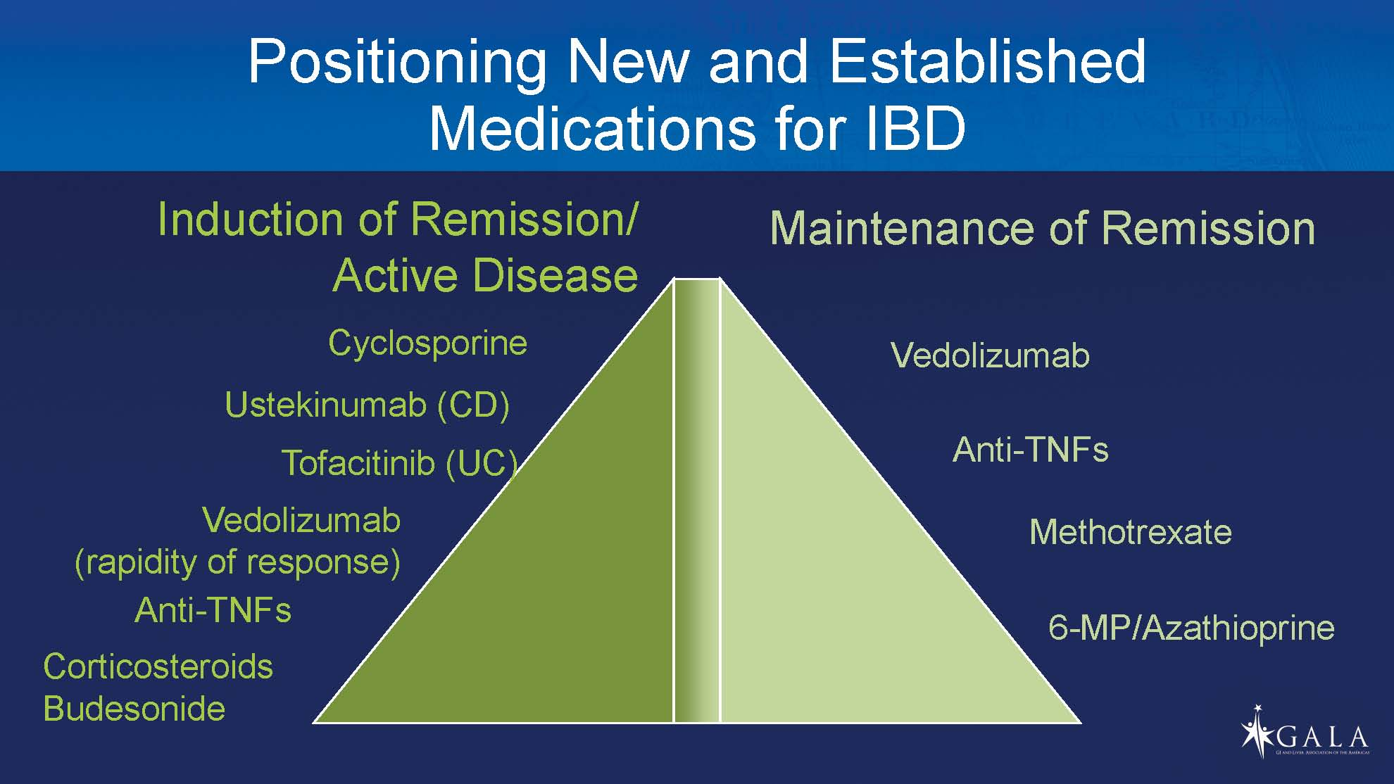

Slide 42
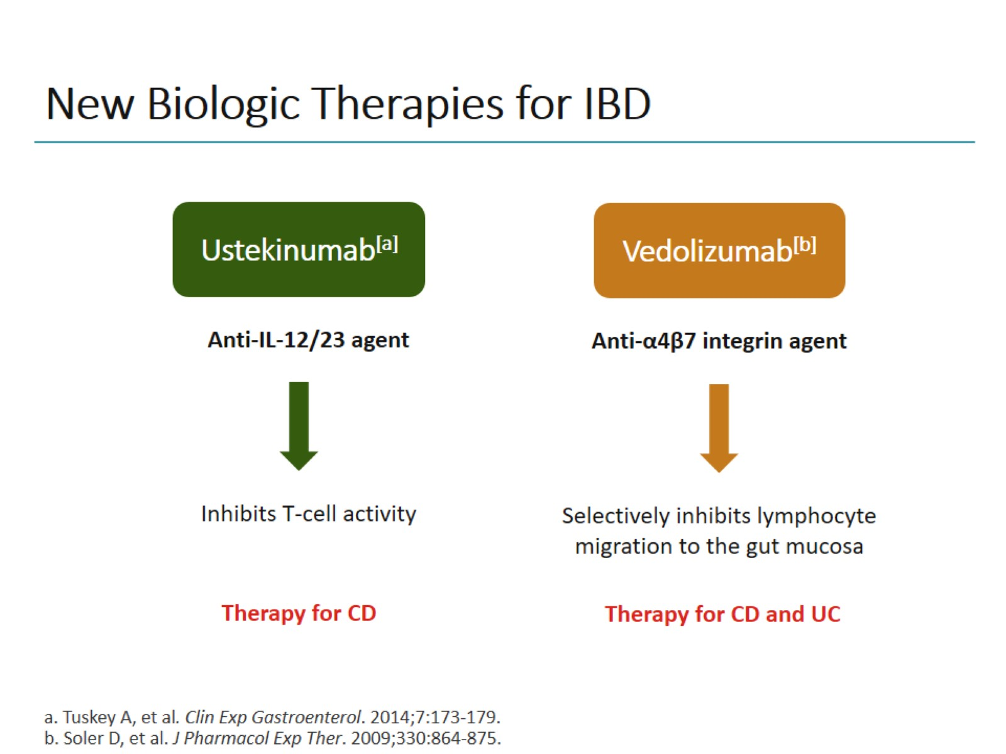
New Biologic Therapies for IBD

Slide 43
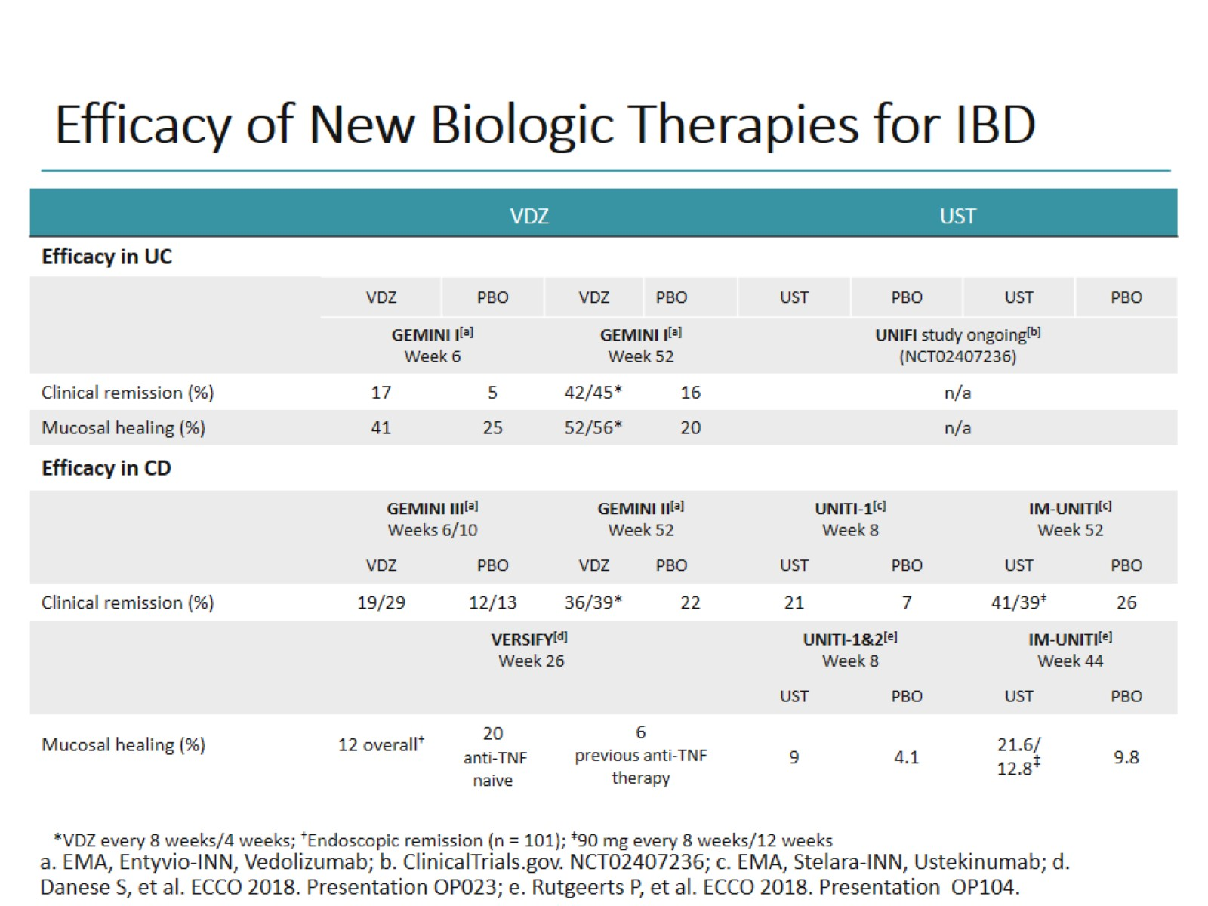
Efficacy of New Biologic Therapies for IBD

Slide 44
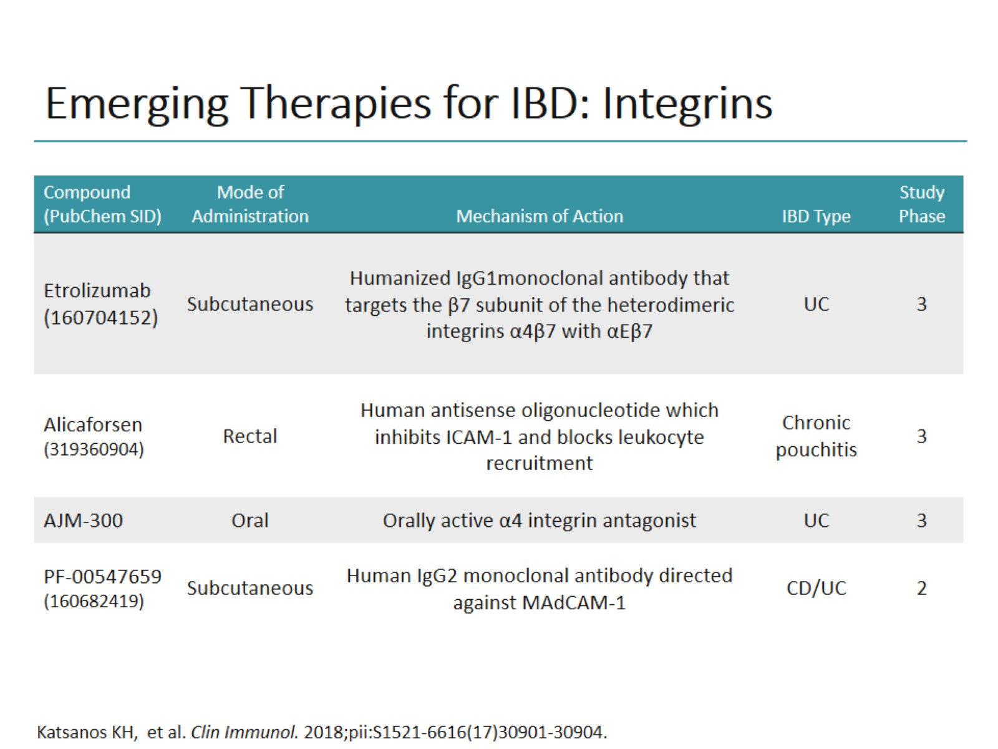
Emerging Therapies for IBD: Integrins

Slide 45
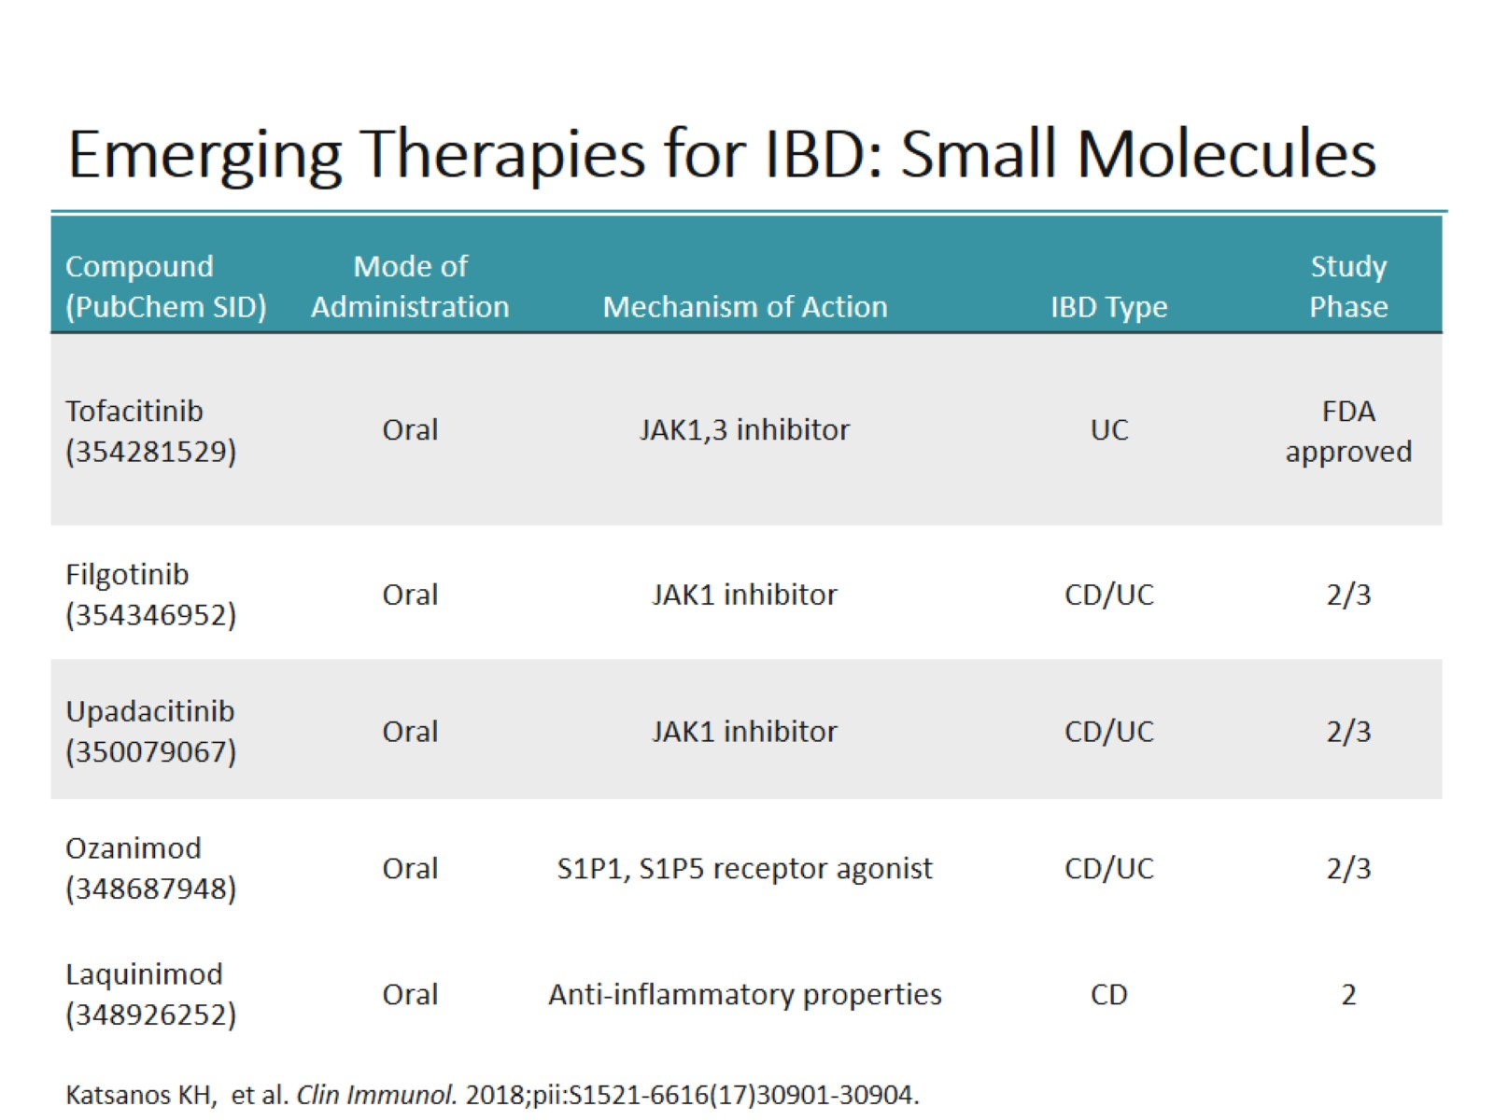
Emerging Therapies for IBD: Small Molecules

Slide 46
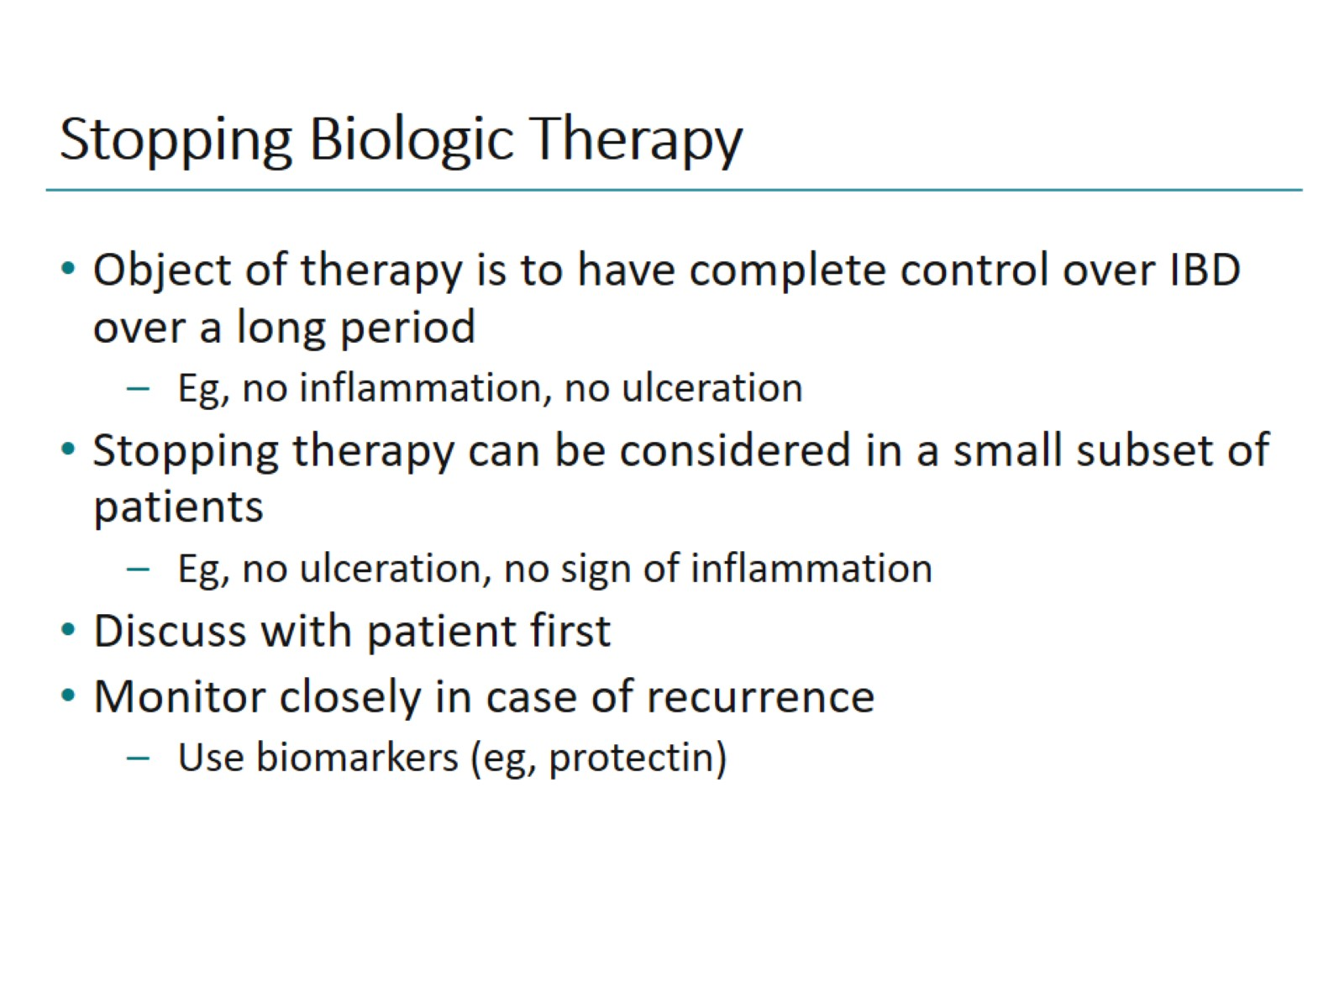
Stopping Biologic Therapy

Slide 47
Extraintestinal Manifestations and Comorbidities
Notes:
Tukey (BI)
CE may be better for known CD although probably adjunct to cross-sectional imaging

Slide 48
Immune-Mediated Inflammatory Disorders
Bacteria
Environmental factors
Genetics
Others
Immunological alterations of acquired + innate immunity
INFLAMMATION
Axial skeleton
Kidney
Gut
Eye
Peripheral joints
Liver
Skin
Levine JS, Burakoff R. Gastroenterol Hepatol (N Y). 2011;7(4):235-241.

Slide 49
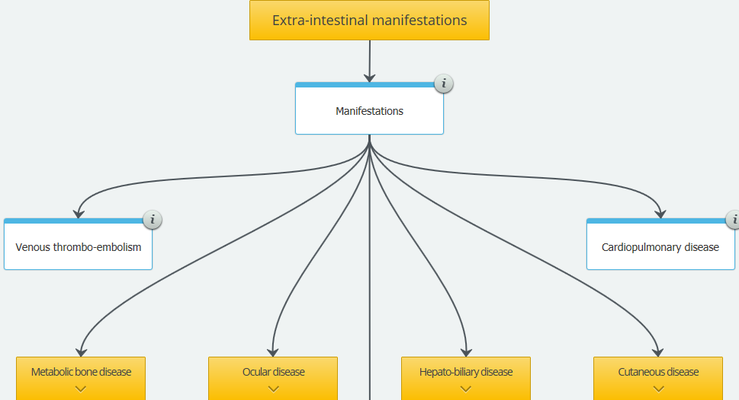


Slide 50
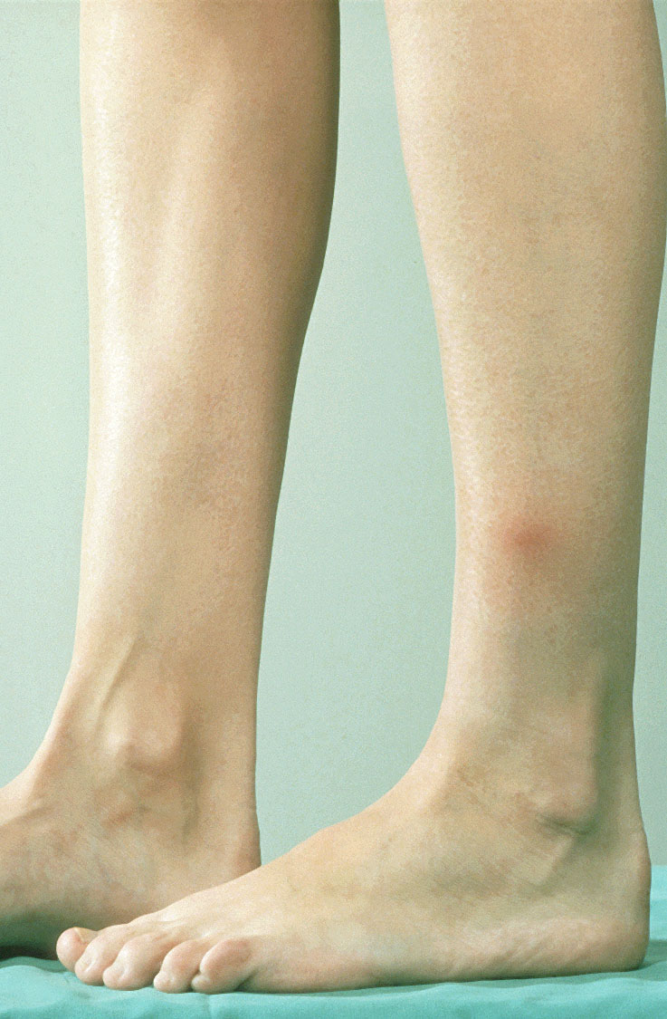
Dermatological Manifestations
Erythema nodosum:
  Most common skin manifestation
  Crohn’s disease >ulcerative colitis
  Up to 5% of patients
  Usually parallels disease activity
  Extensor surfaces of the extremities
Skin Cancer
  Sun protection
  Dermatology screening
Levine JS, Burakoff R. Gastroenterol Hepatol. 2011;7(4):235-241
Notes:
Erythema nodosum is the most common skin manifestation of IBD and it occurs in up to 5% of patients.
This condition occurs more often in patients with Crohn’s disease than in those with ulcerative colitis and the risk for its occurrence usually parallels disease activity.
Erythema occurs most often on extensor surfaces of the extremities.
Thiopurines increase risk of non-melanoma skin cancer
Sources
Long MD et al. Clin Gastro Hep. 2010
Peyrin-Biroulet et al. Gasatroenterology. 2011

Slide 51
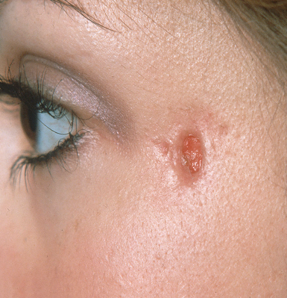
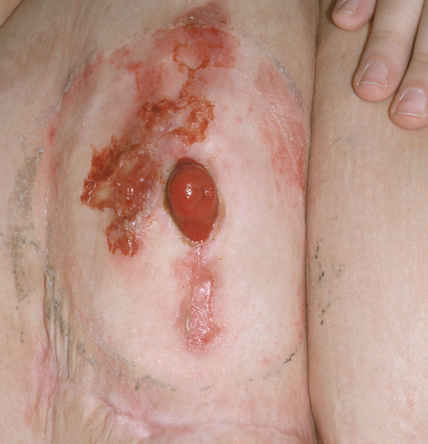
Dermatological Manifestations
Pyoderma gangrenosum:
  Ulcerative colitis ~2%, Crohn’s disease ~5 % of patients
  Destructive cutaneous lesion
  Most common site is the legs
  Independent of disease activity in 50% of patients
Other skin lesions:
  Psoriasis ~10% in Crohn’s disease
  Sweet’s syndrome
  Metastatic Crohn’s disease
Levine JS, Burakoff R. Gastroenterol Hepatol. 2011;7(4):235-241
Notes:
Patients with IBD may also have pyoderma gangrenosum. It occurs in about 2% of patients with ulcerative colitis and approximately 5% of those with Crohn’s disease.
Pyoderma gangrenosum is a destructive cutaneous lesion that occurs most often on the legs and is independent of disease activity in 50% of patients.
Psoriasis also occurs in about 10% of patients with Crohn’s disease.
Sweet’s syndrome may occur in patients with metastatic Crohn’s disease.

Slide 52
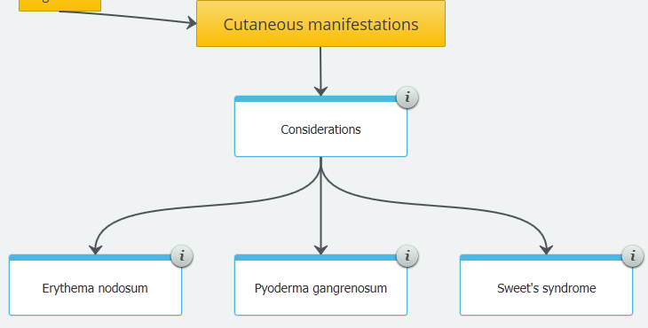

Slide 53
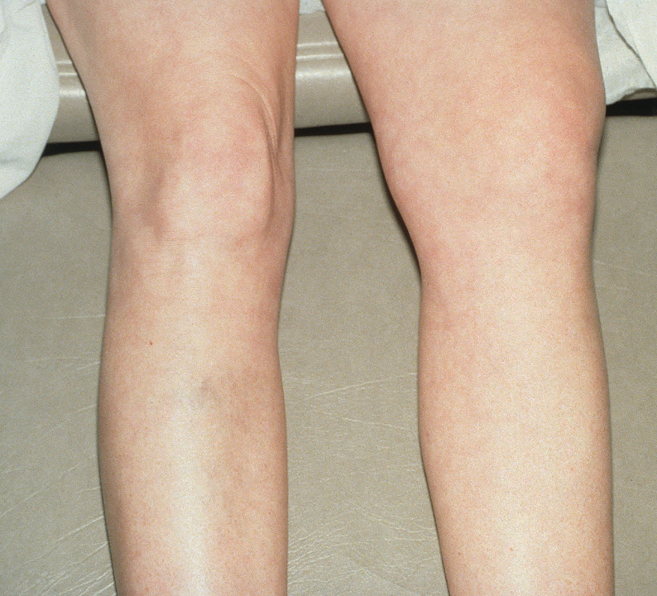
Musculoskeletal Manifestations
Peripheral arthritis:
  Occurs in 15% of patients
  Female:male ratio = 1:1
  Large joints, nondeforming, nonerosive
Spondylitis in 1-26%
  Male>female
Sacroilitis:
  Frequency varies with diagnostic modality:
    MRI pelvis
    X-ray: 4-18%
    Nuclear scan: up to 52%
Early diagnosis is key
Back pain + morning stiffness
Symptoms unrelated to IBD activity
Levine JS, Burakoff R. Gastroenterol Hepatol. 2011;7(4):235-241
Notes:
Arthritis is ost common extraintestinal manifestation
Types of joint involvement
Central
AS
Sacroiliitis
Peripheral arthropathies
Arthritis in IBD
May precede IBD onset
Activity may parallel IBD activity; may be unrelated
Musculoskeletal complications are also common in patients with IBD.
Peripheral arthritis occurs in about 15% of these patients with equal frequency in males and females. This condition primarily affects the large joints and is neither deforming nor erosive.
Type I- Pauciarticular (<5 joints involved)
Arthritic flares of variable duration
Parallels course of IBD
Associated with increased incidence of erythema nodosum and uveitis
Type II- Polyarticular (≥5 joints involved)
Persistent symptoms last a median of 3 years
Independent of IBD activity
Increased uveitis but not erythema nodosum
Spondylitis has been estimated to occur in 1-26% of patients with IBD and is more common in males than females.
Can occur without associated bowel disease
Less common than peripheral arthritis
Commonly starts in 2nd or 3rd decade of life
Associated with HLA-B27 phenotype
Male-to-female ratio 2 to 3:1
Etiology uncertain – includes genetic, immunologic, and environmental factors
Sacroiliitis also occurs in patients with IBD. This complication is revealed by X-ray in 4-18% of patients and by nuclear scans in up to 52%.
Early diagnosis important
Treatment before decreased mobility and deformity
Monitor spine for abnormal posture
Making the diagnosis
Complaints of back pain and morning stiffness
Symptoms unrelated to IBD activity
Physical exam: limited spinal flexion, reduced chest expansion
Radiographs of spine may initially be normal or show minimal sclerosis
Consider testing for HLA-B27

Slide 54
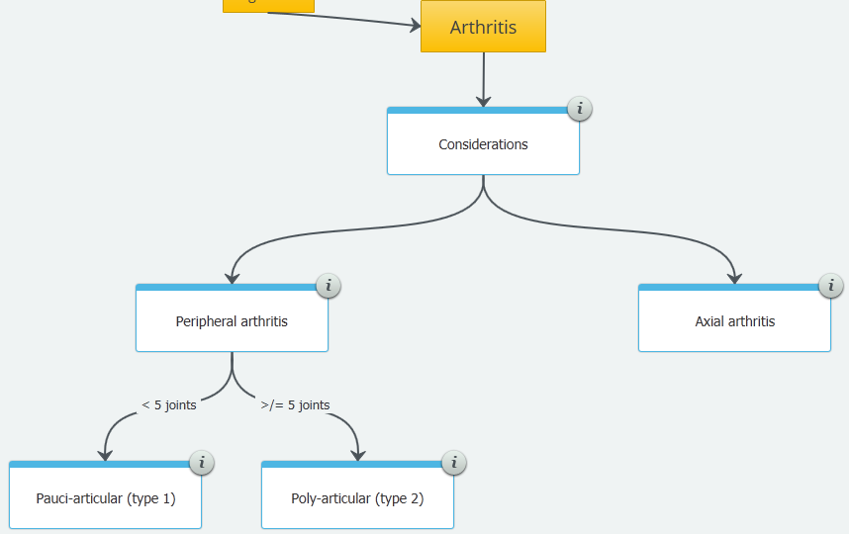

Slide 55
Assess Bone Mineral Density
BMD decreased by some medications
e.g. steroids, methotrexate, cyclosporine
Osteoporosis/
osteopenia
Measure BMD/DEXA
Repeat in 1 year if abnormal
2 years if normal + no change in status
1 year if normal + change in status
Bisphosphonates, calcium, vitamin D
www.ccfa.org
Bernstein CD, et al. Clin Gastro Hepo. 2006
Notes:
Bone mineral density decreased by some medications Osteoporosis
Osteopenia
Measuring BMD/DEXA
Repeat in 1 year if abnormal
2 years if normal + no change in status
1 year if normal + change in status
Treat w/bisphosphonates, calcium, vitamin D
Risk factors w/IBD:
chronic inflammatory activity
Chronic or recurrent corticosteroid use
Malnutrition
Low body weight
Low intake/absoprtion of Ca + vit D
Hypgastrogenemia
Crohn’s & Colitis Foundation of America. Available at http://www.crohnsandcolitis.ca/atf/cf/%7B403F6026-70BA-417C-A39B-7FBF23D5D690%7D/Journal-Winter02.pdf
Bernstein CD, et al. Clin Gastro Hepo. 2006

Slide 56
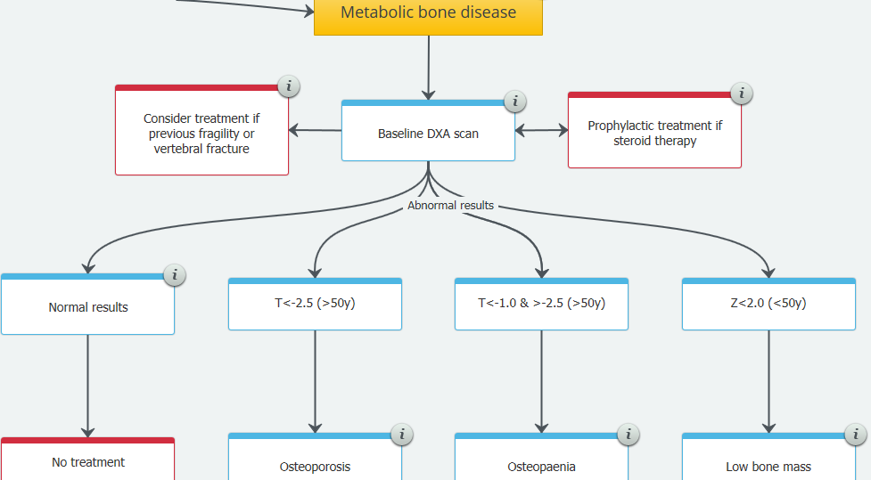


Slide 57
Ocular Manifestations
Affects 43% of IBD patients
Most commonly involve anterior chamber:
  Episcleritis: 2-5%
Posterior chamber:
  Uveitis 0.5-3%
  Female:male ratio = 4:1
  Bilateral
  75% have associated arthritis
  Requires immediate evaluation/emergency
From steroid treatment:
  Cataracts
Annual screening
Felekis T, et al. Inflamm Bowel Dis. 2009. Levine JS, Burakoff R. Gastroenterol Hepatol. 2011;7(4):235-241
Notes:
Ocular manifestations of IBD most often involve the anterior chamber of the eye with episcleritis occurring in 2-5% of patients.
Uveitis occurs in 0.5-3% of patients with IBD and is much more common in women than in men. This complication is usually bilateral and 75% of patients with posterior uveitis have associated arthritis.
Steroid treatment in patients with IBD also increases the risk for cataracts.
Source
Felekis T, et al. Inflamm Bowel Dis. 2009

Slide 58
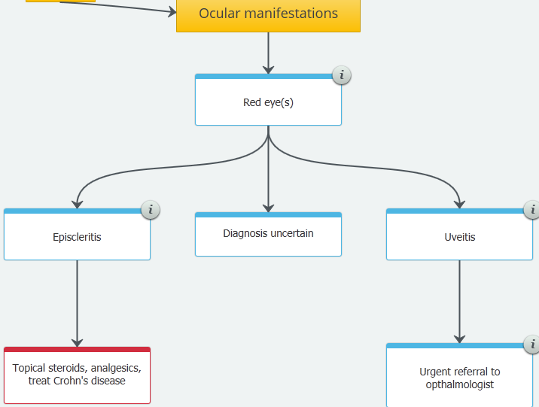

Slide 59
Hypercoagulable State
Thrombosis in IBD: 1.3-6.4%
Mostly follows disease activity
Multifactorial:
  Factor V Leiden deficiency
  Thrombocytosis
  Hyperhomocysteinemia
  Catheters
Owczarek D, et al. World J Gastroenterol. 2014;20(1):53-63.
Notes:
Hypercoagulability is a potentially serious complication of IBD. Thrombosis occurs in 1.3-6.4% of these patients and is correlated with higher disease activity.
This complication of IBD is multifactorial and involves factor V Leiden deficiency, thrombocytosis, hyperhomocysteinemia, and the requirement for catheter placement.

Slide 60
Hepatobiliary Complications
Primary sclerosing cholangitis:
  Occurs in 2% of ulcerative colitis patients
  90% of primary sclerosing cholangitis patients have ulcerative colitis
  Cholangiocarcinoma
Fatty liver
Effects of medications
Gallstones:
  ~33% of patients with ileal disease
Levine JS, Burakoff R. Gastroenterol Hepatol. 2011;7(4):235-241
Notes:
Primary sclerosing cholangitis occurs in 2% of ulcerative colitis patients, and it has been shown that 90% of primary sclerosing cholangitis patients have ulcerative colitis.
Other hepatobiliary complications of IBD include cholangiocarcinoma, fatty liver, and gallstones (in about 33% of patients with ileal disease).

Slide 61
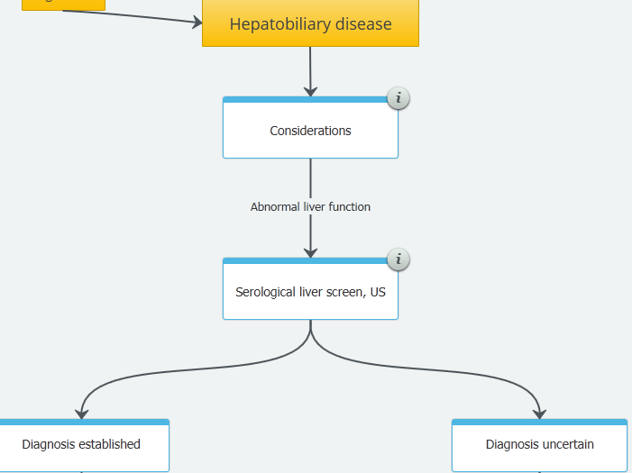
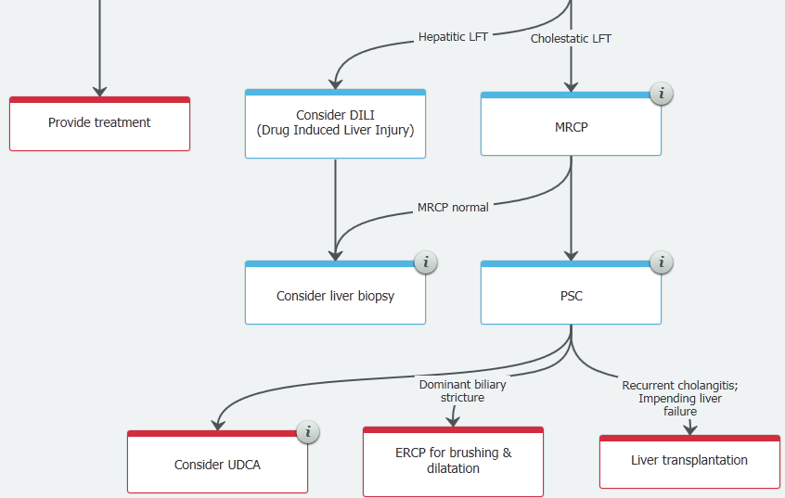

Slide 62
Aphthous Stomatitis
Most common oral lesion in IBD
Highly variable response to steroids and antibiotics
Need to consider nutritional deficiencies
  Folate
  Zinc
  Vitamin B₁₂
  Iron
Levine J. In: Kirsner JB, ed. Inflammatory Bowel Disease. 5th ed. 2000:397.
Su CG et al. Gastroenterol Clin North Am. 2002;31:307.

Slide 63
Renal Manifestations in IBD
Occur in 4% to 23% of patients
Nephrolithiasis most common
  Prevalence of 7% to 10%
  Multifactorial causes
  Usually calcium oxalate stones
    From hyperoxaluria
    Treatment includes calcium
  Also uric acid stones
Treat as any other kidney stone
Obstructive uropathy
  Especially in CD, may occur from intestinal inflammation pressing on ureter
  Treatment is surgery
Urinary tract fistulization
  May present as pneumaturia, fecaluria, or recurrent infection
  Successfully treated with immunomodulators, anti-TNF therapy
Su CG et al. Gastroenterol Clin North Am. 2002;31:307.

Slide 64
Health Maintenance in IBD
Vaccinations, Cancer screening
Notes:
Many infections are preventable with routine preventive immunizations
The disease itself, as well as its treatment with immune-modulating drugs place IBD patients at increased risk for infection, many of which are vaccine-preventable. While these patients, even more so than those in the general population, would benefit from vaccines including those for flu, pneumonia and measles et al in children, the rate of vaccines among these patients is low. Among the concerns in clinical practice regarding vaccines among IBD patients is conflicting evidence about the efficacy of these vaccines in immune-impaired patients. Alternatives for these immunocompromised patients are inactive vaccines, as well as modified dosing regimens.
Immunomodulators and biologics increase risk for infection = preventable
Sources
Gisbert JP, Chaparro M. Vaccination strategies in patients with IBD. Nat Rev Gastroenterol Hepatol. 2013 May;10(5):277-85.
Carrera E, Manzano R, Garrido E. Efficacy of the vaccination in inflammatory bowel disease. World J Gastroenterol. 2013 Mar 7;19(9):1349-53.
Marín AC, Gisbert JP, Chaparro M. Immunogenicity and mechanisms impairing the response to vaccines in inflammatory bowel disease. World J Gastroenterol. 2015 Oct 28;21(40):11273-81.
Domm S, et al Br J Derm. 2008;159:1217-1228
Kane et al. Am J Gastro 2008
Van Assen et al. Ann Rheum Dis. 2011
Lichtenstein GR, et al. Clin Gastroenterol Hepatol. 2006;4(5):621-630
Moscandrew M, et al. Inflamm Bowel Dis. 2009;15(9):1399-1409.

Slide 65
Recommended Immunization Schedule for Adults Aged 19 Years or Older, by Vaccine and Age Group
Consider vaccinating ALL susceptible IBD patients at diagnosis before immunosuppressed
”High-dose" flu vaccine available for people ≥65 years
Caution for patients on anti- TNF
  Check Varicella UNLESS
  on prednisone > 20 mg/day or on immunosuppressives (currently or recently discontinued within 3 months
Give to ALL patients (high, low or planned immune suppression) and once 5 years later
If non immune, then vaccinate.
If infected, treat prior to starting anti-TNF medications
Kim DK, et al. Ann Intern Med. 2016;164(3):184-194.

Slide 66
Will the Vaccinations Work in Immunosuppressed IBD Patients?
IBD patients receiving pneumovax, tetanus, influenza and HIB on azathioprine/6MP monotherapy had a normal response to vaccinations
Adult
  IBD patients receiving pneumococcal vaccine had poor response if on combination anti-TNF + immunomodulator therapy
Pediatric
  IBD patients receiving influenza vaccine had a poor response if on combination anti-TNF + immunomodulator therapy
In patients with juvenile systemic lupus, main predictor of LACK of response was a higher disease activity (not immune suppression)
Lu Y, et al. Am J Gastroenterol 2009;104:444-53.
Melmed GY. Gastroenterol Hepatol. 2008;4(12):859-861
Campos LM, et al. Arthritis Care Res 2013;65:1121-1127
Notes:
Lu Y, Jacobson DL, Ashworth LA et al. Immune response to influenza vaccine in children with inflammatory bowel disease. Am J Gastroenterol 2009;104:444-53.
Melmed GY. Vaccinations and the Utilization of Immunosuppressive IBD Therapy. Gastroenterology & Hepatology 2008;4:859-861.
Campos LM, Silva CA, Aikawa NE et al. High disease activity: an independent factor for reduced immunogenicity of the pandemic influenza a vaccine in patients with juvenile systemic lupus erythematosus. Arthritis Care Res (Hoboken) 2013;65:1121-7.

Slide 67
Colorectal Cancer Risk in IBD
Duration of disease >8 years
Family history of colorectal cancer increases risk
Primary sclerosing cholangitis (PSC)
Farraye FA, et al. Gastroenterology. 2010;138:746-774.e4.
Notes:
The risk for cancer is patients with IBD is increased by long disease duration, family history of colorectal cancer, and primary sclerosing cholangitis (PSC).
Possible chemopreventive agents for cancer in patients with IBD include 5-aminosalicylate (ASA), folic acid, ursodeoxycholic acid, and calcium.
Farraye FA, Odze RD, Eaden J, Itzkowitz SH. AGA Technical Review on the Diagnosis and Management of Colorectal Neoplasia in Inflammatory Bowel Disease. Gastroenterology;138:746-774.e4.
Annotation: p1643A; p1345A; p889A

Slide 68
Cancer Surveillance
Surveillance colonoscopy every 1-3 years to detect dysplasia with colectomy if positive
Screening colonoscopy 8-10 years after symptom onset to detect dysplasia
CRC, colorectal.
Farraye FA, et al. Gastroenterology. 2010;138:746-774.e4.
American Society for Gastrointestinal Endoscopy and American Gastroenterological Association. GIE. 2015;81(3):489-501
Notes:
Notes
optimal surveillance strategy in patients with IBD remains controversial regarding the sensitivity of the detection system, the predictive value of dysplasia for assessing the risk of CRC, and the cost. Optimal surveillance strategies for CRC in patients with inflammatory bowel disease (IBD) have not been established.

Slide 69
Health Maintenance in IBD
Smoking Cessation

Slide 70
Cigarette Smoking and IBD: Meta-Analysis
Ulcerative Colitis
Crohn’s Disease
13 studies, >11,000 patients for UC
Current smoking is protective of development of UC
  OR, 0.58 (95% CI, 0.45-0.75)
Quitting smoking is associated with UC
  OR, 1.79 (1.37-2.34)
9 studies, >10,000 patients for CD
Current smoking is associated with CD
  OR, 1.76 (95% CI, 1.40-2.22)
Former smoking is weakly associated with CD
  OR, 1.30 (0.97-1.76)
Effects of cessation: 65% lower risk of flare up vs continuing Lower needs for steroids + medications
Mahid SS, et al. Mayo Clin Proc. 2006;81(11):1462-1471.
Abbreviations: OR, odds ratio; CI, confidence interval.
Notes:
The faculty intent is to discuss the results of a large meta-analysis of the association between smoking and IBD.
A review of the literature identified 15 studies of the relationship between smoking and UC and/or CD.
Thirteen studies of UC (11,741 patients) indicated that current smoking decreased the risk of an UC diagnosis (odds ratio [OR], 0.58; 95% confidence interval [CI], 0.45-0.75). On the other hand, former smokers had an increased risk (OR, 1.79; 95% CI, 1.37-2.34).
Nine studies evaluated CD (10,610 patients) and found an increased risk of CD diagnosis with current smoking (OR, 1.76; 95% CI, 1.40-2.22) but a nonsignificant increase in risk among former smokers (OR, 1.30; 95% CI, 0.97-1.76).
Smoking cessation is always advised due to other negative health risks.
Reference
Mahid SS, Minor KS, Soto RE, Hornung CA, Galandiuk S. Smoking and inflammatory bowel disease: a meta-analysis. Mayo Clin Proc. 2006;81(11):1462-1471.

Slide 71
Effective Medications for Smoking Cessation
Nicotine replacement products
Over-the-counter (nicotine patch [which is also available by prescription], gum, lozenge)
Prescription (nicotine patch, inhaler, nasal spray)
Prescription non-nicotine medications: bupropion SR,² varenicline tartrate
Counseling and medication are both effective for treating tobacco dependence, and using them together is more effective than using either one alone
SR, sustained release.
http://www.cdc.gov/tobacco/data_statistics/fact_sheets/cessation/quitting/index.htm#methods

Slide 72
Depression Screening
Affects 15%-35% of IBD patients
  Relapsing nature of disease
  Chronic pain
  Steroids
American College of Preventive Medicine/USPSTF recommend screening
SCREENING QUESTIONS
Over the past month, have you felt down, depressed, or hopeless?
Over the past month, have you felt little interest or pleasure in doing things?
Siu AL, et al. JAMA. 2016;315(4):380-7
Notes:
Source
Siu AL, United States Preventive Services Task Force. Screening for Depression in Adults. JAMA. 2016;315(4):380-7

Slide 73
Self-Management in IBD
Self-management is critical to patient improvement
Entails clear goals, understanding of the disease, plan of action to reduce symptoms or prevent disease activity
Psychological issues, shared decision making, and individual patient characteristics should be discussed
Depends on a good patient/clinician relationship
Kennedy A, et al. Health Educ Res. 2005;20(5):567-578.
Bennett AL, et al. World J Gastroenterol. 2015;21(15):4457-4465.
Notes:
Notes
multi-disciplinary management and continued collaboration between all stakeholders is also crucial to optimal patient outcomes including induction and maintenance of remission and prevention of disease associated complications
Bennett AL, Munkholm P, Andrews JM. Tools for primary care management of inflammatory bowel disease: do they exist? World J Gastroenterol. 2015;21(15):4457-4465.

Slide 74
Summary

Slide 75
Health Maintenance Summary
DEXA Scan
All CD and UC patients with conventional risk factor for abnormal BMD
Refer to GI to attempt corticosteroid withdrawal
A multivitamin daily; folate, calcium
Colon cancer surveillance
After 8-10 years colonoscopy with biopsies [1-3 years] to assess for dysplasia
Annual Pap smears if immunocompromised
6-MP / AZA, MTX, anti-TNF , Anti-integrin therapy Anti- IL – 12/23
Vaccinations: influenza, pneumococcal pneumonia, zoster, Hep A, Hep B
DEXA, dual-energy X-ray absorptiometry; GI, gastrointestinal; AZA, MTX, TNF

Slide 76
Health Maintenance Summary
Beware of NSAIDs in IBD
Beware of other steroid side effects
Pregnancy
Ensure that medications are safe + disease is in remission
Diagnosis
In those with symptoms/signs, remember genetics
When EIM present, think of disease
Cataracts, hypogonadism, osteonecrosis, etc.
Frequent dermatological evaluation: melanoma/NMSC
Disease may flare, bleeding may occur
NMSC, non-melanoma skin cancer
NSAIDs, non-steroidal anti-inflammatory drugs; EIM, extraintestinal manifestations.

Slide 77

Thanks for your attention

