Slide 1
Rheumatology Drug
Methotrexate, Leflunamide, Azathioprine
Ali Mokhber
Assistant Professor of Rheumatology
Iran University of Medical Science

Slide 2
Methotrexate
MTX was introduced in the 1950s
(DMARD) of choice in the treatment of RA
Structural analogue of folic

Slide 3
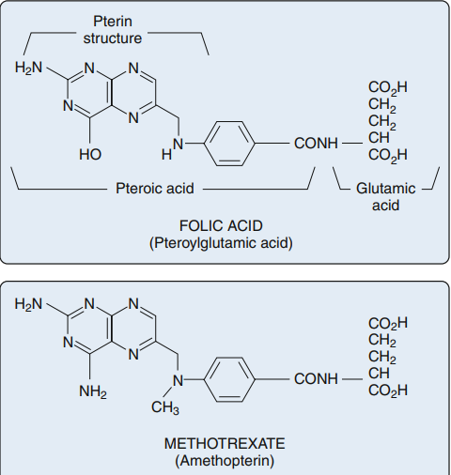

Slide 4
Actions of Methotrexate
It enters cells via a reduced folate carrier (RFC)
Folic acid enters cells via another group of transmembrane receptors called folate receptors (FRs)
Inside the cell MTX undergo polyglutamation
MTX-PG has several key inhibitory effects on intra-cellular enzymes: anti-inflammatory and anti-proliferative (immunosuppressive)

Slide 5
(1) inhibition of aminoimidazole carboxamide ribonucleotide (AICAR) transformylase (ATIC)
increased intra-cellular and extra-cellular adenosine
(2) Inhibition of thymidylate synhetase (TYMS)
Decreased pyrimidine synthesis
(3) Inhibition of dihydrofolate reductase (DHFR)
Inhibition of transmethylation reactions essential for cellular function

Slide 6
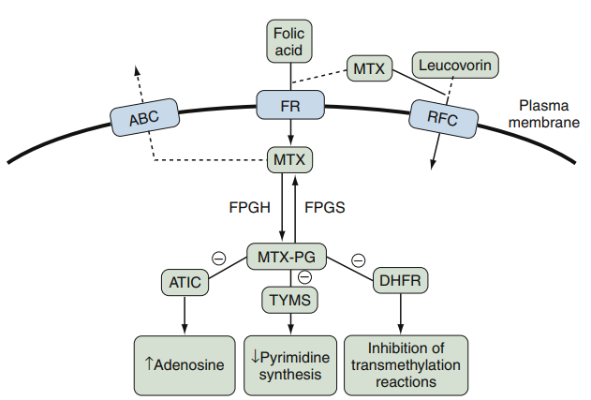

Slide 7
Pharmacology
Absorption and Bioavailability
Absorption is rapid
Absorption is not reduced by concomitant food intake, except for milk, which may be inhibitory
Systemic levels are higher for parentally route but have not been associated with any increase in toxicity
In high-dose oral MTX (median dose, 30 mg/week), mean bioavailability is improved by splitting the dose by 8 hours
The pharmacokinetics of subcutaneous MTX are equivalent to those of IM

Slide 8
Distribution and Half-Life
MTX is 50% to 60% bound to plasma proteins
Half-life of approximately 6 hours
MTX accumulates in third-space fluids
Caution should be used when administering MTX to patients with pleural effusions or ascites

Slide 9
Elimination
Most MTX is excreted in the urine within the first 12 hours after administration
MTX and metabolites are excreted by the kidney by glomerular filtration and proximal tubular secretion
Median half-life of elimination of MTX-PG is 3.1 weeks
MTX-PG is undetectable at 15 weeks

Slide 10
Indications
Rheumatoid Arthritis:
The results of multiple trials firmly established MTX as an effective therapy for the treatment of RA
MTX alone rarely induces remissions of RA, and it has become the cornerstone of combinations of DMARD therapies

Slide 11
Rheumatoid Arthritis–Related Conditions
Felty’s syndrome
Large granular lymphocyte syndrome
Adult-onset Still’s disease
Cutaneous vasculitis of RA
Juvenile Idiopathic Arthritis
MTX at a dose of 10.0 mg/m2 was superior to 5.0 mg/m2 or placebo
Psoriatic Arthritis (PsA)
MTX remains a commonly used systemic agent in the treatment of PsA

Slide 12
Systemic Lupus Erythematosus (SLE)
Cutaneous and/or articular manifestations of SLE
Extreme caution should be used in patients with renal disease
Vasculitis
Limited GPA: upper airway disease and mild renal disease
MTX has been efficacious in corticosteroid-resistant Takayasu’s arteritis
Relapsing polychondritis
Inflammatory Myopathies
Polymyositis (PMS)
Dermatomyositis (DMS)

Slide 13
Other Rheumatic Diseases
Systemic sclerosis: skin scores, pulmonary diffusion capacity
Corticosteroid-resistant multisystem sarcoidosis
Corticosteroid-sparing agent in inflammatory ocular disease

Slide 14
Dose and Drug Administration
MTX is available as 2.5, 5, 7.5, 10, and 15 mg tablets
Solution of 25 mg/mL for SQ or IM injection
In patients with normal renal function, the starting dose is usually 15 mg given as a single weekly dose
If the oral dose of MTX exceeds 15 mg, consideration should be given to splitting the dose, with each half given 6 to 12 hours apart

Slide 15
The dosage of MTX can be escalated, usually every 4 to 8 weeks to 25 mg/week to achieve the desired clinical response
Parenteral MTX is generally recommended if patients have active disease despite oral doses at approximately 20 mg weekly
MTX is not directly toxic to the kidneys
It is contraindicated in patients with a GFR less than 30 mL/minute
MTX may be used in patients with a GFR of 30 to 59 mL/minute

Slide 16
Concomitant administration of folic acid (1 to 3 mg/day) or folinic acid decreases the frequency of MTX side effects
GI toxicity: nausea, vomiting, abdominal pain
Stomatitis
Supplementation of folic or folinic acid is protective against elevated transaminase concentrations
Folic acid administration also decreases hyperhomocysteinemia in patients on MTX
In the case of overdose:
Intravenous leucovorin should be given at a dose of 5 to 10 mg every 12 hours

Slide 17
Geriatric Patients
Dosing recommendations:
Initial doses should be approximately 5 to 7.5 mg/ week and should not exceed 20 mg/wk
Dosage adjustments for CrCl:
CrCl of 61 to 80 mL/min, reduce the dose by 25%
CrCl of 51 to 60 mL/min, reduce the dose by 30%
CrCl of 30 to 50 mL/min, reduce the dose by 50% to 80%
CrCl less than 30 mL/min, avoid use

Slide 18
Toxicity
Gastrointestinal and Hepatic Side Effects
GI symptoms are common(20% to 70%)
Attenuated by adding folic acid / by changing to a parenteral dosing regimen
Elevated liver function tests (LFTs) were more likely in patients with PsA
Risk Factor: Alcohol consumption, α1–anti-trypsin deficiency, morbid obesity, diabetes, concomitant hepatotoxic drugs, and chronic hepatitis B or C

Slide 19
Hematologic Side Effects
BM toxicity, in most cases, is dose dependent
Pancytopenia, leukopenia, anemia, thrombocytopenia
Severe, life-threatening bone marrow toxicity can be treated with folinic acid (leucovorin) and, if necessary, granulocyte-stimulating factor (GSF)
Risk Factor: CKD, hypoalbuminemia, dosing errors, concomitant use of probenecid or trimethoprim/sulfamethoxazole

Slide 20
Pulmonary Side Effects
Acute interstitial pneumonitis (hypersensitivity pneumonitis)
Interstitial fibrosis
Noncardiogenic pulmonary edema
Pleuritis and pleural effusions
Pulmonary nodules
Sign & Symptom: shortness of breath, tachypnea, dry cough, fever
Chest radiographs most typically show a bilateral interstitial infiltrate
Infectious causes, including opportunistic organisms, must always be ruled out
If MTX pulmonary toxicity is suspected, MTX should be discontinued and supportive treatment initiated

Slide 21
Methotrexate “Flu”
common signs: Nausea, low-grade fevers, myalgias, and chills
Treatment: supplementation with folic acid, decreasing the dose, switching from oral to parenteral administration, changing the time of the dose
Nodulosis
The development of, or increase in the number or size of rheumatoid nodules
May occur in rheumatoid factor–negative patients, and in those in whom the synovitis is under excellent control
The mechanism of this nodule formation has been suggested to be the result of an increase in adenosine

Slide 22
Fertility, Pregnancy, and Lactation
Female: does not seem to adversely affect female fertility
Male: reversible sterility
Women and men should discontinue MTX for at least 3 months before attempting to conceive
MTX is contraindicated during pregnancy and during lactation

Slide 23
Toxicity Monitoring
Toxicities that require monitoring include myelosuppression, hepatotoxicity, and pulmonary toxicity
Baseline evaluation: CBC, hepatitis B and C serology in high-risk patients, liver transaminases, and creatinine
Chest radiograph is a reasonable approach

Slide 24
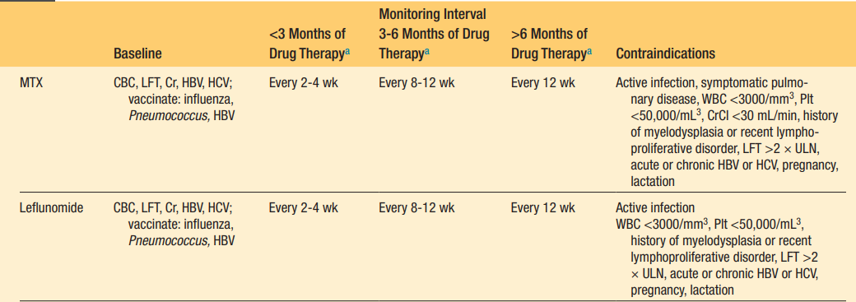
Safety Monitoring

Slide 25
Leflunomide

Slide 26
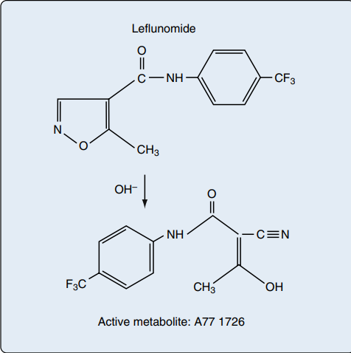
Chemical Structure
low-molecular-weight isoxazole compound
Leflunomide is a prodrug
Active metabolite is A77 1726 or
teriflunomide

Slide 27
Actions of Leflunomide
Leflunomide is immunomodulatory
Net effect being a reduction in activated T lymphocytes
In vitro mechanisms of action vary depending on concentration:
(1) At the concentration of the active metabolite (A77 1726) achieved in patients, its major effect appears to be reversible inhibition of the enzyme dihydroorotate dehydrogenase (DHODH), which results in inhibition of pyrimidine synthesis
(2) at higher concentrations, A77 1726 also inhibits tyrosine kinases, interfering with cell signal transduction

Slide 28
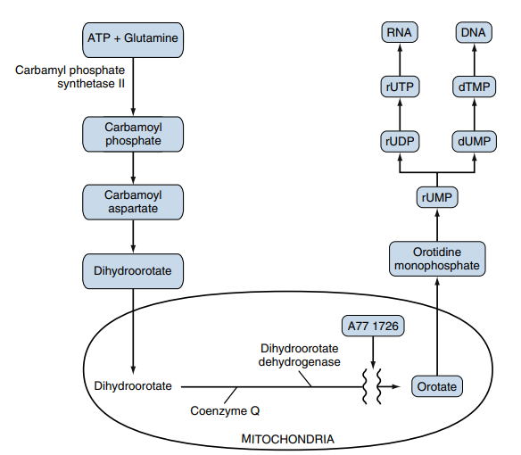

Slide 29
At higher concentrations, A77 1726 inhibits phosphorylation of tyrosine kinases that are critical for cell growth and differentiation of activated cells=anti-proliferative effects
Anti-inflammatory properties of leflunomide:
Block the activation of nuclear factor-κB (NF-κB)
Both leflunomide and MTX inhibit neutrophil chemotaxis
Alters the synthesis of cytokines:
augmenting the immunosuppressive cytokine-transforming growth factor-β1
suppressing the immunostimulatory cytokine IL-2

Slide 30
Pharmacology
Absorption and Bioavailability
The GI tract and the liver rapidly and completely convert ingested leflunomide into teriflunomide (A77 1726)
Food does not interfere with absorption
Circulating teriflunomide is highly bound (>99%) to plasma proteins, predominantly albumin
steady state is reached in 7 weeks after daily dosing

Slide 31
Distribution and Half-Life
Teriflunomide has a half-life of approximately 2 weeks
90% of teriflunomide is excreted by 28 days
Extensive enterohepatic recirculation
Can be detectable for much longer periods

Slide 32
Elimination
Kidney & Gut equally
Detectable teriflunomide may be present in the body months or years later
Oral administration of cholestyramine, 8 g three times daily for 11 days, can lower the apparent half-life of teriflunomide to 1 to 2 days
Activated charcoal, 50 g every 6 hours, can reduce plasma levels by 50% within 24 hours

Slide 33
Indications
Rheumatoid Arthritis: Both leflunomide and MTX also slowed radiographic progression of disease compared with the placebo group
SLE including lupus nephritis
PsA & Psoriasis: leflunomide was effective in treating peripheral arthritis, but axial symptoms did not improve
GPA: maintaining remission in granulomatosis with polyangiitis after successful induction with cyclophosphamide
leflunomide was superior to MTX in preventing relapse

Slide 34
Dose and Drug Administration
standard recommendation: loading dose of 100 mg daily for 3 days, then switch to the standard maintenance dose of 20 mg daily
Many clinicians no longer prescribe a loading dose because it is believed to increase the drug’s GI toxicity
It is common practice to decrease the dose to 10 mg daily if toxicity occurs
Some clinicians give leflunomide less often (three to five times per week)

Slide 35
Toxicity
Gastrointestinal and Hepatic Side Effects
The most common side effect that limits the use of leflunomide is diarrhea
Responds to dose reduction
Liver toxicity can occur
Leflunomide given in combination with MTX resulted in ALT/AST elevations greater than 1 × ULN in 31% and greater than 2 × ULN in 5% of patients
More commonly seen in patients with PsA

Slide 36
Cardiovascular Side Effects
Hypertension
Elevation of cholesterol levels
Dermatologic
Skin rashes have been reported, most commonly occurring between the second and fifth months of treatment and necessitating discontinuation of the drug
Severe skin reactions such as Stevens-Johnson syndrome or toxic epidermal necrolysis require leflunomide washout with cholestryramine
An increased incidence of alopecia

Slide 37
Pulmonary: leflunomide can cause interstitial lung disease (ILD), usually within 3 months of starting therapy
Hematologic: Rare cases of pancytopenia, not associated with lymphoproliferative disorders
Neurologic: dizziness, headaches, and parasthesias have been reported
Sensory axonal neuropathy: discontinuation of leflunomide, cholestyramine washout
Weight Loss: Significant weight loss has also been reported

Slide 38
Fertility, Pregnancy, and Lactation
FDA Pregnancy Category group X
Leflunomide should not be prescribed for women who are not practicing reliable birth control methods
A pregnancy test should be considered before therapy is initiated
Nursing mothers should not receive leflunomide

Slide 39
If a woman who has previously received leflunomide wishes to become pregnant, teriflunomide levels should be measured
Active elimination of leflunomide from the body should be considered for levels above 0.02 mg/L
This can be achieved by the oral administration of cholestyramine for 11 days (8 g, three times daily)
Before pregnancy is attempted, verification of levels below 0.02 mg/L should be confirmed on two separate occasions, at least 14 days apart, and the woman should then wait an additional three full menstrual cycles
Men wishing to father children should undergo the same washout procedure as women and should wait an additional 3 months after the second drug plasma level is verified to be below 0.02 mg/L

Slide 40
Contraindications
Leflunomide should not be used in patients with impaired liver function, severe renal impairment, bone marrow dysplasia, severe immunodeficiency, severe hypoproteinemia
Leflunomide is contraindicated in the setting of serious infection
Should be discontinued in patients with new or worsening pulmonary symptoms or rash
Absolutely contraindicated in pregnancy and breastfeeding

Slide 41
Azathioprine

Slide 42
Structure & Mechanisms of Action
Azathioprine is a prodrug that is converted to 6-mercaptopurine (6-MP)
6-MP is a purine analogue
Interferes with the synthesis of nucleotides, thereby inhibiting proliferation of lymphocytes
Thiopurine metabolites, such as thioguanine nucleotides, decrease the de novo synthesis of purine nucleotides
purine ribonucleotide interconversion and are incorporated into DNA and RNA
The incorporation of thioguanine nucleotides into the nucleic acids of cells is thought to mediate the cytotoxicity of azathioprine
Inhibition of purine synthesis may be more important in decreasing cellular proliferation

Slide 43
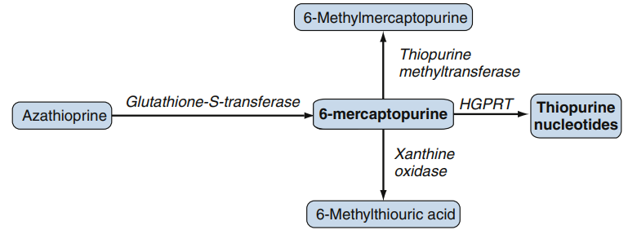
Pharmacology
Oral azathioprine is well absorbed and rapidly converted to 6-MP, which is further metabolized to 6-thiourate
The plasma half-life of azathioprine is less than 15 minutes, but it is 1 to 3 hours for the active derivative, 6-MP

Slide 44
Metabolism and Elimination
Two enzymes, xanthine oxidase and thiopurine S-methyltransferase (TPMT), shunt mercaptopurine metabolites to relatively inactive compounds
hypoxanthine-guanine-phosphoribosyl-transferase lead to the formation of cytotoxic thiopurine nucleotides
Low TPMT activity or inhibition of xanthine oxidase by drugs such as allopurinol leads to decreased detoxification and increased formation of cytotoxic metabolites

Slide 45
Increased toxicity can occur with renal impairment (creatinine clearance)
Modest dose reduction is usually necessary
The substantial interindividual variability in azathioprine disposition
TPMT activity are more important determinants of sensitivity to azathioprine than renal function
Azathioprine is only slightly dialyzable (10%)

Slide 46
Dosage
Azathioprine is often started at a dose of 1 mg/kg daily
If this dose is tolerated, it is increased to 2 to 2.5 mg/kg after 2 to 4 weeks

Slide 47
Clinical Indications
RA: less effective than methotrexate
Remains a treatment option for patients with RA who have refractory disease or as a glucocorticoid-sparing agent in patients with organ involvement
lupus nephritis: effective in maintenance therapy
Other manifestations of SLE: a glucocorticoid-sparing agent
Inflammatory muscle disease, inflammatory eye disease (including Behçet’s disease)
Psoriatic arthritis, reactive arthritis, various forms of vasculitis

Slide 48
Toxicity
Reversible myelosuppression is dose related, Low-dose azathioprine (1 to 2 mg/kg/day) rarely results in leukopenia or thrombocytopenia
Severe myelosuppression is uncommon and is caused by low or absent TPMT activity
Approximately 90% of subjects show high activity, 10% show intermediate activity
0.3% (the subjects homozygous for the poorly functional polymorphisms) show very low activity
The 1 in 300 subjects with low or absent TPMT activity are at great risk of severe azathioprine-induced myelosuppression
most commonly 4 to 10 weeks after azathioprine has been started

Slide 49
Malignancy
Contraversial
A 24-year retrospective study of 358 patients with SLE
No difference in malignancy rates between patients who had and had not received azathioprine, and no lymphoma
Infection is less common,
Herpes zoster and cytomegalovirus, may occur
Maculopapular or urticarial rashes can occur

Slide 50
Drug Interactions
Allopurinol dramatically increase the cytotoxic effects of azathioprine through inhibition of xanthine oxidase–mediated inactivation of mercaptopurine
Reduction of the dose of azathioprine by at least two-thirds in patients who also are receiving allopurinol is advocated
MMF has been substituted for azathioprine as an alternative immunosuppressant
The combination of azathioprine with sulfasalazine, ganciclovir, angiotensin-converting enzyme inhibitors, carbamazepine, co-trimoxazole, and clozapine, may also increase the risk of myelosuppression

Slide 51
Pregnancy and Lactation
FDA Pregnancy Category D drug
Although azathioprine is being used during pregnancy, it is better avoided during pregnancy and lactation if possible
In a prospective observational study in 189 pregnant women treated with azathioprine for various autoimmune conditions, the rate of major malformation was 3.5%, which was similar to that of the general population
Azathioprine may be considered in cases where the benefits of disease control in the mother give the best chances of term pregnancy and fetal survival

