Slide 1
بنام خدا
DR Keyvan Elchian
internist

Slide 2
Diabetic ketoacidosis

Slide 3
A 44-year-old Hispanic female with no prior history of diabetes and recent diagnosis of COVID-19 was brought into the emergency room by ambulance due to worsening fatigue and myalgias for the last three days. She reported that she tested positive for COVID-19 on reverse transcription-polymerase chain reaction (RT-PCR) assay three days prior to presentation and her condition had been progressively getting worse. She also reported subjective fever, chills, exertional dyspnea, and labored breathing. She did not seek medical care for COVID-19 up to that point. The patient also reported dry cough and extreme thirst over the past two to three days. She had been drinking cups and cups of water, but still felt very dehydrated. She denied chest pain and palpitation. She also denied abdominal pain, nausea, and vomiting

Slide 4
On arrival to the emergency department (ED), the patient was afebrile (98.5 F), tachycardia (heart rate 136/min), tachypneic (respiration rate 40/min), hypertensive (blood pressure 142/88 mm-Hg), and oxygen saturation was 94% on 3 liters nasal cannula. Physical examination revealed an age-appropriate female on oxygen supplementation via nasal cannula who was in moderate apparent respiratory distress. Lung examination showed bilateral diffuse rhonchi with decreased breath sounds at bases. The rest of the physical exam was unremarkable

Slide 5
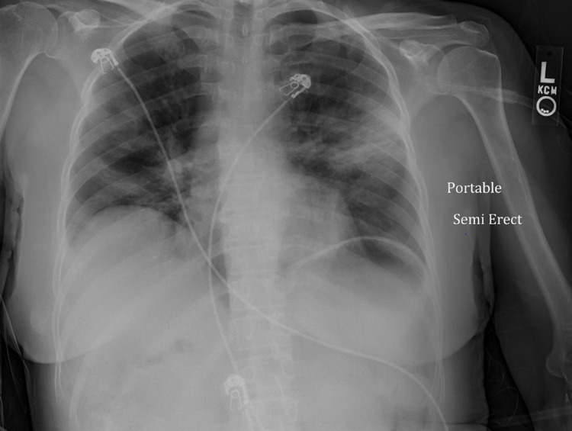

Slide 6
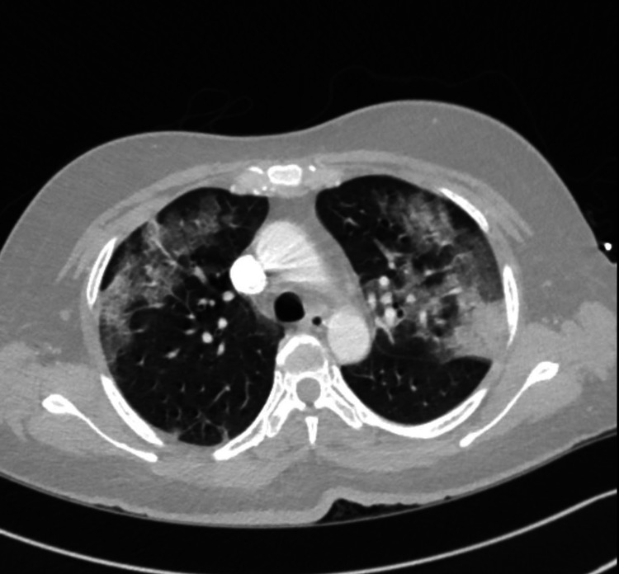

Slide 7
DKA
 | DKA | HHS
Pathophysiology | Insulin deficiency ► mobilize fatty acids ► ketogenesis | Hyperglycemia ► osmotic diuresis ► volume depletion
Glucose | >250 | >600
pH | <7.3 | >/= 7.3
AG | Positive | Variable
Bicarb | <18 | >18
Ketones | Positive in blood and urine | None to small
Serum Osm | Variable | >320

Slide 8
Laboratory investigations revealed random plasma glucose of 426 mg/dL, moderate acetone, anion gap 24 and potassium of 3.4 mmol/l(Table ​mmol/l(Table1).1). Venous blood gas analysis on a 3 L nasal cannula indicated severe metabolic acidosis (pH 6.93 and HCO 3-2.8 mmol/L) (Table ​(Table2).2). Urine ketones were present.

Slide 9
Table 1
Relevant laboratory values
Comprehensive metabolic panel | Reference range | Value on presentation
Creatinine | 0.4-1 mg/dl | 1.08
Urea Nitrogen | 8-20 mg/dl | 12
Glucose Level | 74-118 mg/dl | 426
Calcium Level | 8.9-10.3 mg/dl | 7.6
Albumin Level | 3.5-4.8 g/dl | 2.9
Sodium Level | 136-144 mmol/l | 139
Potassium Level | 3.6-5.1 mmol/l | 3.4
Chloride Level | 101-111 mmol/l | 110
Total Co2 | 22-32 mmol/l | 4
Anion GAP (AGAP) | 3-9 mmol/l | 24

Slide 10
Table 2
Table ​Table22 venous blood gas analysis
Arterial blood gas | Reference range | Value on presentation
Mode |  | BIPAP
Fio2 |  | 35%
IPAP |  | 10
EPAP |  | 5
PH | 7.35-5.45 | 6.93
PCO2 | 35-45 mmHg | 13
PO2 | >80 mmHg | 109
HOC3 | 22-26 mmol/L | 2.8
O2 saturation | >90 % | 98.2

Slide 11
Making the Diagnosis
The amount of ketones in the blood or urine should be checked if a person with diabetes has:
symptoms of DKA
fasting blood glucose levels above 14 mmol/L (252 mg/dL)
infection or illness
Ketone levels can be easily measured at home; a positive test may require immediate medical attention. A doctor or health care professional can show you how to measure the amount of ketones in your blood or urine and let you know at what levels you will need to contact your doctor or go to the emergency department.
Your doctor or health care provider may also take blood tests to measure levels of ketones, electrolytes (e.g., sodium and potassium), pH (a measure of how acidic your blood is), and glucose

Slide 12
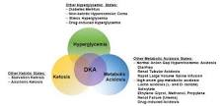
What is the triad of DKA?
The triad of DKA (hyperglycemia, acidemia, and ketonemia)

Slide 13
What are the signs and symptoms of a diabetic emergency?
hunger.
clammy skin.
profuse sweating.
drowsiness or confusion.
weakness or feeling faint.
sudden loss of responsiveness.

Slide 14
What is the first aid of DKA?
Drink extra water or sugar-free drinks to prevent dehydration. Wait 30 minutes after you take extra insulin or missed medicines. Then check your blood sugar again. If symptoms of high blood sugar get worse or your blood sugar level keeps rising, call your doctor or nurse advice line

Slide 15
What is the immediate intervention for DKA?
After initial stabilization of circulation, airway, and breathing as a priority, specific treatment of DKA requires correction of hyperglycemia with intravenous insulin, frequent monitoring, and replacement of electrolytes, mainly potassium, correction of hypovolemia with intravenous fluids, and correction of acidosis

Slide 16
What glucose level is an emergency?
A high blood sugar level of more than 240 with or without symptoms requires calling the doctor immediately. Healthcare providers will administer ER treatment to reduce the level and symptoms. After leaving the ER, follow the doctor's instructions to avoid another incident of DKA

Slide 17
DKA Signs and Symptoms
Fast, deep breathing.
Dry skin and mouth.
Flushed face.
Fruity-smelling breath.
Headache.
Muscle stiffness or aches.
Being very tired.
Nausea and vomiting

Slide 18

What are the 4 Ps of DKA?
People with diabetes often experience
one or more of the 4 Ps associated with the condition:
polyuria, polydipsia, polyphagia and polyneuropathy,
usually resulting from high blood glucose levels.
Proper management is crucial to avoid potential complications arising from
these symptoms

Slide 19
What is the glucose level for DKA?
Commonly accepted criteria for diabetic ketoacidosis are blood glucose greater than 250 mg/dl, arterial pH less than 7.3, serum bicarbonate less than 15 mEq/l, and the presence of ketonemia or ketonuria. The normal anion gap is 12 mEq/l

Slide 20
What happens during DKA?
DKA is caused by an overload of ketones present in your blood. When your cells don't get the glucose they need for energy, your body begins to burn fat for energy, which produces ketones. Ketones are chemicals that the body creates when it breaks down fat to use for energy

Slide 21
Why does DKA cause vomiting?
As ketones accumulate in the blood, more ketones will be passed in the urine, taking sodium and potassium salts out with them. Over time, levels of sodium and potassium salts in the body become depleted, which can cause nausea and vomiting. The result is a vicious cycle. Dehydration is another complication of DKA

Slide 22
DKA may occur with insulin deficiency, under the following circumstances:
during an infection or illness (e.g., urinary tract infection or pneumonia)
after stressful events or trauma (including heart attack, stroke, or surgery)
inadequate insulin treatment (e.g., when someone is not yet diagnosed, or someone who is diagnosed but misses a dose of insulin or does not give themselves enough insulin, or someone is using a faulty insulin pump)
Some medications have been associated with increasing your risk of DKA, including steroids, thiazide diuretics (e.g., hydrochlorothiazide), sympathomimetics (e.g., amphetamine, pseudoephedrine), and a class of medications used in diabetes called SGLT2-inhibitors (e.g., canagliflozin, dapagliflozin, empagliflozin)

Slide 23
Dehydration is another complication of DKA
. High levels of ketones are associated with high sugar levels in the blood and urine. More water is drawn into the urine, resulting in frequent urination. Combined with vomiting – from an upset stomach, or possibly due to a bout of flu or illness – the body quickly loses too much water and electrolytes

Slide 24
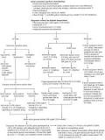
How can I treat DKA?
The major treatment of this condition is initial rehydration (using isotonic saline) with subsequent potassium replacement and low-dose insulin therapy. The use of bicarbonate is not recommended in most patients

Slide 25
What IV solution is best for DKA?
Normal saline (0.9%) has been the traditional fluid of choice, for both, volume resuscitation and deficit replacement in DKA. However, the risk of AKI with its liberal chloride content remains a contentious issue

Slide 26
What is the most common complication of DKA?
Hypoglycemia is the most common complication of diabetic ketoacidosis while being treated, occurring in an estimated 5–25% of patients with DKA. [37] Acute adverse outcomes of hypoglycemia include seizures, arrhythmias, and cardiovascular events. Hourly blood sugar monitoring is needed in the acute phase of treatment

Slide 27
Symptoms and Complications
High levels of ketones usually build up in the blood and urine, causing the symptoms of DKA:
abdominal pain (especially in children)
confusion
decreased perspiration
deep and laboured breathing (a later symptom)
dry, cool skin
excessive thirst and urination
fatigue
high blood glucose
nausea and vomiting
presence of ketones in the blood or urine
rapid weight loss
sweet, fruity odour on the breath (it may smell like nail polish remover)

Slide 28
What are the long-term effects of diabetic ketoacidosis?
"DKA also has long-term consequences," Rewers says. "It changes brain development and brain functioning for a long time. Kids who had DKA can show memory and learning problems going on for several years

Slide 29
What is the most common cause of mortality in DKA?
Cerebral edema is the predominant cause for mortality in children with DKA from developed countries, while recent data from developing countries has shown higher incidence of cerebral edema, sepsis, shock and renal failure as the cause for death in

Slide 30
What are 4 potential complications from deteriorating DKA
Four potential complications from deteriorating DKA include Kussmaul's respirations (deep, rapid breaths), fruity acetone-like breath, dry skin and nausea and vomiting

Slide 31
Which drugs cause DKA?
Drugs which have been involved in episodes of lethal DKA include methadone and cocaine^{8,9} in addition to β-blockers (such as propranolol, metoprolol and atenolol), thiazide diuretics, second-generation antipsychotics (particularly olanzapine and clozapine), corticosteroids, calcineurin inhibitors and protease

Slide 32
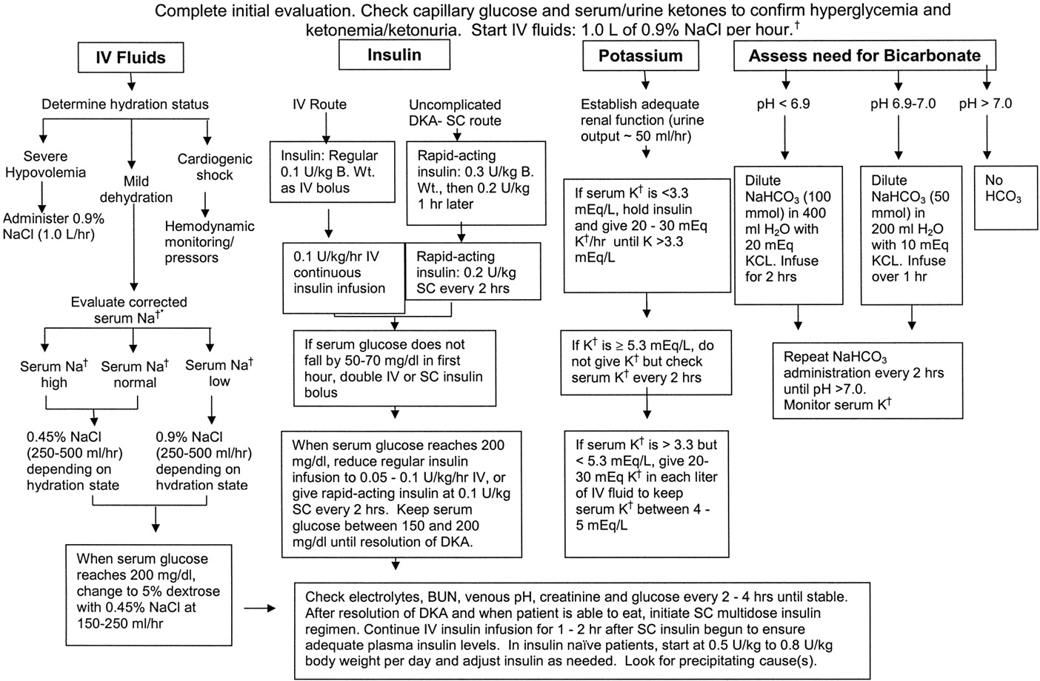

Slide 33
What are your symptoms?
When did your symptoms develop? Are they getting worse?
Have you been diagnosed with diabetes?
Have you recently checked your blood sugar level?
Have you recently checked your ketone level?
Have you lost your appetite?
Can you keep fluids down?
Are you having trouble breathing?
Do you have chest pain?
Have you had a recent illness or infection?
Have you had recent stress or trauma?
Have you recently used alcohol or recreational drugs?
How closely have you been following your diabetes treatment plan?
How well have you been managing your diabetes just before these symptoms started?

Slide 34
بنام خدا
DR Keyvan Elchian
internist

Slide 35
Diabetic ketoacidosis

Slide 36
A 44-year-old Hispanic female with no prior history of diabetes and recent diagnosis of COVID-19 was brought into the emergency room by ambulance due to worsening fatigue and myalgias for the last three days. She reported that she tested positive for COVID-19 on reverse transcription-polymerase chain reaction (RT-PCR) assay three days prior to presentation and her condition had been progressively getting worse. She also reported subjective fever, chills, exertional dyspnea, and labored breathing. She did not seek medical care for COVID-19 up to that point. The patient also reported dry cough and extreme thirst over the past two to three days. She had been drinking cups and cups of water, but still felt very dehydrated. She denied chest pain and palpitation. She also denied abdominal pain, nausea, and vomiting

Slide 37
On arrival to the emergency department (ED), the patient was afebrile (98.5 F), tachycardia (heart rate 136/min), tachypneic (respiration rate 40/min), hypertensive (blood pressure 142/88 mm-Hg), and oxygen saturation was 94% on 3 liters nasal cannula. Physical examination revealed an age-appropriate female on oxygen supplementation via nasal cannula who was in moderate apparent respiratory distress. Lung examination showed bilateral diffuse rhonchi with decreased breath sounds at bases. The rest of the physical exam was unremarkable

Slide 40
DKA
 | DKA | HHS
Pathophysiology | Insulin deficiency ► mobilize fatty acids ► ketogenesis | Hyperglycemia ► osmotic diuresis ► volume depletion
Glucose | >250 | >600
pH | <7.3 | >/= 7.3
AG | Positive | Variable
Bicarb | <18 | >18
Ketones | Positive in blood and urine | None to small
Serum Osm | Variable | >320

Slide 41
Laboratory investigations revealed random plasma glucose of 426 mg/dL, moderate acetone, anion gap 24 and potassium of 3.4 mmol/l(Table ​mmol/l(Table1).1). Venous blood gas analysis on a 3 L nasal cannula indicated severe metabolic acidosis (pH 6.93 and HCO 3-2.8 mmol/L) (Table ​(Table2).2). Urine ketones were present.

Slide 42
Table 1
Relevant laboratory values
Comprehensive metabolic panel | Reference range | Value on presentation
Creatinine | 0.4-1 mg/dl | 1.08
Urea Nitrogen | 8-20 mg/dl | 12
Glucose Level | 74-118 mg/dl | 426
Calcium Level | 8.9-10.3 mg/dl | 7.6
Albumin Level | 3.5-4.8 g/dl | 2.9
Sodium Level | 136-144 mmol/l | 139
Potassium Level | 3.6-5.1 mmol/l | 3.4
Chloride Level | 101-111 mmol/l | 110
Total Co2 | 22-32 mmol/l | 4
Anion GAP (AGAP) | 3-9 mmol/l | 24

Slide 43
Table 2
Table ​Table22 venous blood gas analysis
Arterial blood gas | Reference range | Value on presentation
Mode |  | BIPAP
Fio2 |  | 35%
IPAP |  | 10
EPAP |  | 5
PH | 7.35-5.45 | 6.93
PCO2 | 35-45 mmHg | 13
PO2 | >80 mmHg | 109
HOC3 | 22-26 mmol/L | 2.8
O2 saturation | >90 % | 98.2

Slide 44
Making the Diagnosis
The amount of ketones in the blood or urine should be checked if a person with diabetes has:
symptoms of DKA
fasting blood glucose levels above 14 mmol/L (252 mg/dL)
infection or illness
Ketone levels can be easily measured at home; a positive test may require immediate medical attention. A doctor or health care professional can show you how to measure the amount of ketones in your blood or urine and let you know at what levels you will need to contact your doctor or go to the emergency department.
Your doctor or health care provider may also take blood tests to measure levels of ketones, electrolytes (e.g., sodium and potassium), pH (a measure of how acidic your blood is), and glucose

Slide 45
What is the triad of DKA?
The triad of DKA (hyperglycemia, acidemia, and ketonemia)

Slide 46
What are the signs and symptoms of a diabetic emergency?
hunger.
clammy skin.
profuse sweating.
drowsiness or confusion.
weakness or feeling faint.
sudden loss of responsiveness.

Slide 47
What is the first aid of DKA?
Drink extra water or sugar-free drinks to prevent dehydration. Wait 30 minutes after you take extra insulin or missed medicines. Then check your blood sugar again. If symptoms of high blood sugar get worse or your blood sugar level keeps rising, call your doctor or nurse advice line

Slide 48
What is the immediate intervention for DKA?
After initial stabilization of circulation, airway, and breathing as a priority, specific treatment of DKA requires correction of hyperglycemia with intravenous insulin, frequent monitoring, and replacement of electrolytes, mainly potassium, correction of hypovolemia with intravenous fluids, and correction of acidosis

Slide 49
What glucose level is an emergency?
A high blood sugar level of more than 240 with or without symptoms requires calling the doctor immediately. Healthcare providers will administer ER treatment to reduce the level and symptoms. After leaving the ER, follow the doctor's instructions to avoid another incident of DKA

Slide 50
DKA Signs and Symptoms
Fast, deep breathing.
Dry skin and mouth.
Flushed face.
Fruity-smelling breath.
Headache.
Muscle stiffness or aches.
Being very tired.
Nausea and vomiting

Slide 51
What are the 4 Ps of DKA?
People with diabetes often experience
one or more of the 4 Ps associated with the condition:
polyuria, polydipsia, polyphagia and polyneuropathy,
usually resulting from high blood glucose levels.
Proper management is crucial to avoid potential complications arising from
these symptoms

Slide 52
What is the glucose level for DKA?
Commonly accepted criteria for diabetic ketoacidosis are blood glucose greater than 250 mg/dl, arterial pH less than 7.3, serum bicarbonate less than 15 mEq/l, and the presence of ketonemia or ketonuria. The normal anion gap is 12 mEq/l

Slide 53
What happens during DKA?
DKA is caused by an overload of ketones present in your blood. When your cells don't get the glucose they need for energy, your body begins to burn fat for energy, which produces ketones. Ketones are chemicals that the body creates when it breaks down fat to use for energy

Slide 54
Why does DKA cause vomiting?
As ketones accumulate in the blood, more ketones will be passed in the urine, taking sodium and potassium salts out with them. Over time, levels of sodium and potassium salts in the body become depleted, which can cause nausea and vomiting. The result is a vicious cycle. Dehydration is another complication of DKA

Slide 55
DKA may occur with insulin deficiency, under the following circumstances:
during an infection or illness (e.g., urinary tract infection or pneumonia)
after stressful events or trauma (including heart attack, stroke, or surgery)
inadequate insulin treatment (e.g., when someone is not yet diagnosed, or someone who is diagnosed but misses a dose of insulin or does not give themselves enough insulin, or someone is using a faulty insulin pump)
Some medications have been associated with increasing your risk of DKA, including steroids, thiazide diuretics (e.g., hydrochlorothiazide), sympathomimetics (e.g., amphetamine, pseudoephedrine), and a class of medications used in diabetes called SGLT2-inhibitors (e.g., canagliflozin, dapagliflozin, empagliflozin)

Slide 56
Dehydration is another complication of DKA
. High levels of ketones are associated with high sugar levels in the blood and urine. More water is drawn into the urine, resulting in frequent urination. Combined with vomiting – from an upset stomach, or possibly due to a bout of flu or illness – the body quickly loses too much water and electrolytes

Slide 57
How can I treat DKA?
The major treatment of this condition is initial rehydration (using isotonic saline) with subsequent potassium replacement and low-dose insulin therapy. The use of bicarbonate is not recommended in most patients

Slide 58
What IV solution is best for DKA?
Normal saline (0.9%) has been the traditional fluid of choice, for both, volume resuscitation and deficit replacement in DKA. However, the risk of AKI with its liberal chloride content remains a contentious issue

Slide 59
What is the most common complication of DKA?
Hypoglycemia is the most common complication of diabetic ketoacidosis while being treated, occurring in an estimated 5–25% of patients with DKA. [37] Acute adverse outcomes of hypoglycemia include seizures, arrhythmias, and cardiovascular events. Hourly blood sugar monitoring is needed in the acute phase of treatment

Slide 60
Symptoms and Complications
High levels of ketones usually build up in the blood and urine, causing the symptoms of DKA:
abdominal pain (especially in children)
confusion
decreased perspiration
deep and laboured breathing (a later symptom)
dry, cool skin
excessive thirst and urination
fatigue
high blood glucose
nausea and vomiting
presence of ketones in the blood or urine
rapid weight loss
sweet, fruity odour on the breath (it may smell like nail polish remover)

Slide 61
What are the long-term effects of diabetic ketoacidosis?
"DKA also has long-term consequences," Rewers says. "It changes brain development and brain functioning for a long time. Kids who had DKA can show memory and learning problems going on for several years

Slide 62
What is the most common cause of mortality in DKA?
Cerebral edema is the predominant cause for mortality in children with DKA from developed countries, while recent data from developing countries has shown higher incidence of cerebral edema, sepsis, shock and renal failure as the cause for death in

Slide 63
What are 4 potential complications from deteriorating DKA
Four potential complications from deteriorating DKA include Kussmaul's respirations (deep, rapid breaths), fruity acetone-like breath, dry skin and nausea and vomiting

Slide 64
Which drugs cause DKA?
Drugs which have been involved in episodes of lethal DKA include methadone and cocaine^{8,9} in addition to β-blockers (such as propranolol, metoprolol and atenolol), thiazide diuretics, second-generation antipsychotics (particularly olanzapine and clozapine), corticosteroids, calcineurin inhibitors and protease

Slide 66
What are your symptoms?
When did your symptoms develop? Are they getting worse?
Have you been diagnosed with diabetes?
Have you recently checked your blood sugar level?
Have you recently checked your ketone level?
Have you lost your appetite?
Can you keep fluids down?
Are you having trouble breathing?
Do you have chest pain?
Have you had a recent illness or infection?
Have you had recent stress or trauma?
Have you recently used alcohol or recreational drugs?
How closely have you been following your diabetes treatment plan?
How well have you been managing your diabetes just before these symptoms started?

