Slide 1
Hypocalcemia and hypercalcemia
Nazanin Alaei
MD
EM Specialist
Assistant Professor
Iran University of Medical sciences

Slide 2
Case Presentation 1
The patient is a 45-year-old female with a history of hypothyroidism and chronic kidney disease. She has been on levothyroxine for the past 10 years and has been undergoing regular hemodialysis for the past 5 years.
Present Illness:
The patient presents to the emergency department with complaints of muscle cramps, tingling in her fingers and toes, and frequent episodes of numbness. She also reports experiencing fatigue and weakness over the past few days. On further questioning, she mentions that she has been feeling more irritable and anxious than usual.
Physical Examination:
On physical examination, the patient appears fatigued and slightly pale. Her blood pressure is 130/80 mmHg, heart rate is 90 beats per minute, and respiratory rate is 18 breaths per minute. Upon palpation, her muscles are found to be tender to touch. Chvostek's sign is positive, with facial twitching elicited upon tapping the facial nerve just anterior to the ear. Trousseau's sign is also positive, with carpal spasm induced by inflating a blood pressure cuff on her arm.
Laboratory Findings:
Laboratory tests reveal a serum calcium level of 7.5 mg/dL (normal range: 8.5-10.5 mg/dL), along with low levels of albumin at 3 g/dL (normal range: 3.5-5 g/dL). The patient's serum phosphorus level is elevated at 6 mg/dL (normal range: 2.5-4.5 mg/dL), while her parathyroid hormone (PTH) level is low at 15 pg/mL (normal range: 15-65 pg/mL).

Slide 3
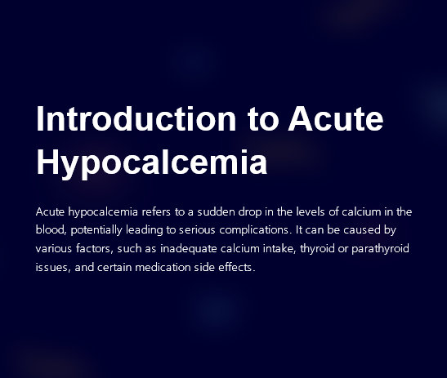

Slide 4
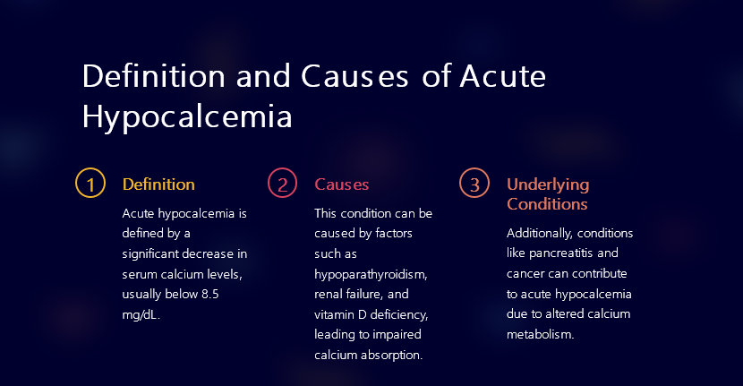

Slide 5
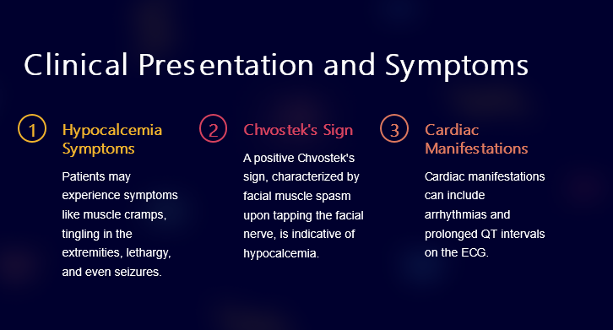

Slide 6
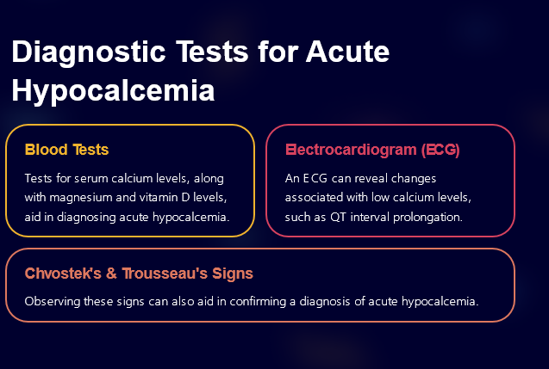

Slide 7
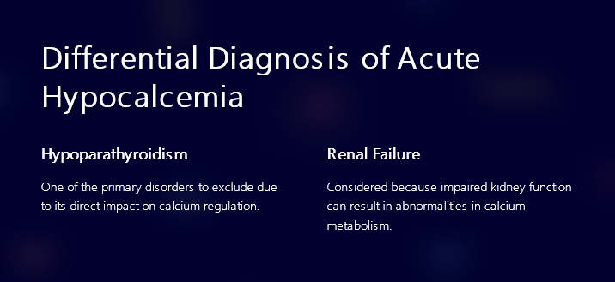

Slide 8
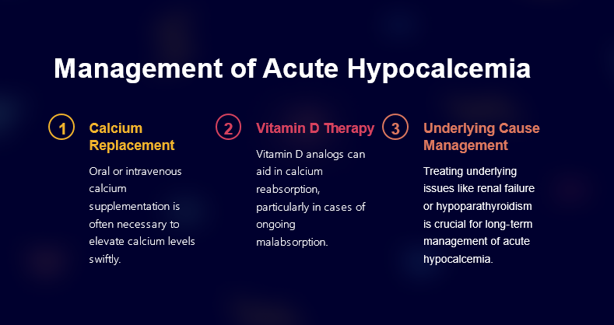

Slide 9
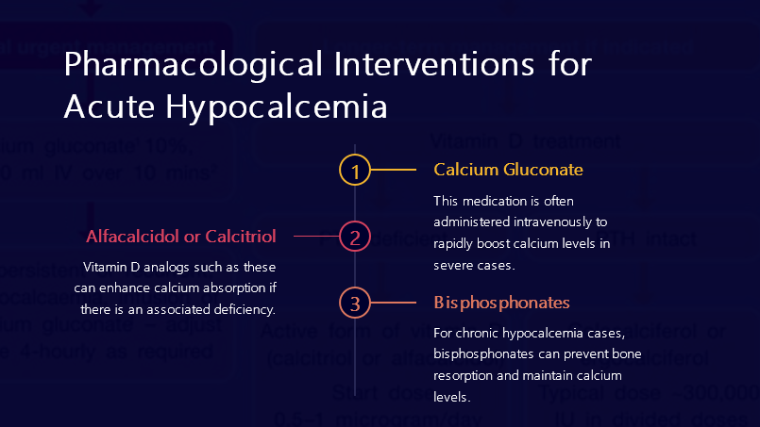

Slide 10
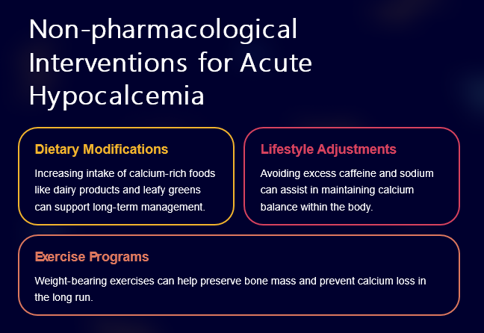

Slide 11
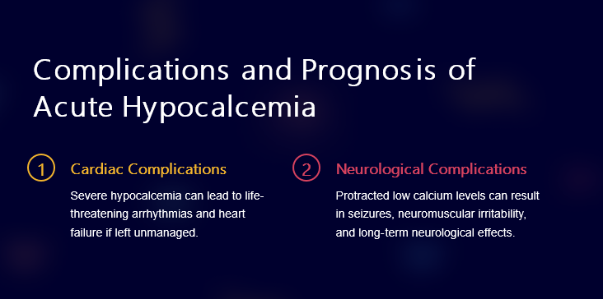

Slide 12
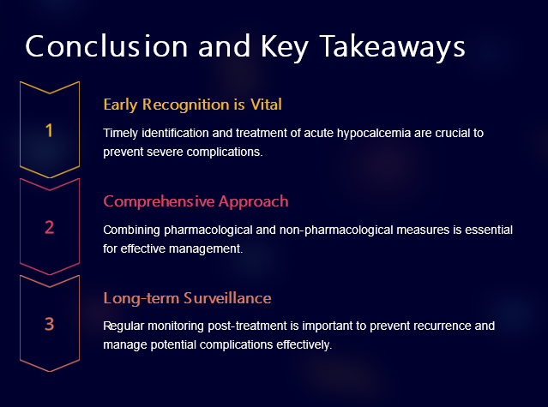

Slide 13
Case Presentation 2
The patient is a 55-year-old male with a history of hypertension and chronic kidney disease. He has been on medication for his hypertension for the past 10 years and has been undergoing regular monitoring for his kidney function.
Present Illness:
The patient presents to the emergency department with complaints of fatigue, weakness, and frequent urination. He also reports experiencing nausea and constipation over the past several days. On further questioning, he admits to having bone pain and difficulty concentrating. His family members have also noticed a change in his behavior, describing him as being more irritable than usual.
Physical Examination:
Upon physical examination, the patient appears lethargic and dehydrated. His blood pressure is elevated at 160/90 mmHg, and he has a rapid pulse of 110 beats per minute. There are no signs of respiratory distress, but he appears pale. Upon palpation of his abdomen, there is tenderness in the epigastric region. His neurological examination reveals decreased deep tendon reflexes and confusion.
Laboratory Findings:
Laboratory investigations reveal an elevated serum calcium level of 12 mg/dL (normal range: 8.5-10.2 mg/dL). His creatinine level is also elevated at 2.5 mg/dL (normal range: 0.6-1.3 mg/dL), indicating impaired kidney function. The patient's parathyroid hormone (PTH) level is low at 15 pg/mL (normal range: 15-65 pg/mL), suggesting primary hyperparathyroidism as the cause of hypercalcemia.

Slide 14
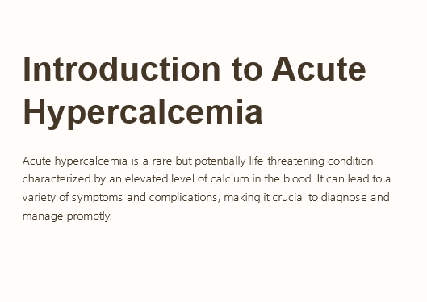

Slide 15
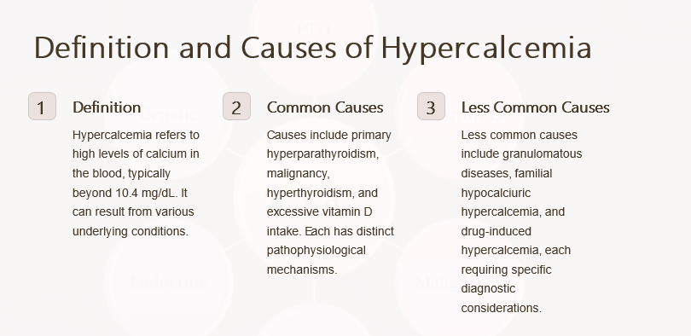

Slide 16
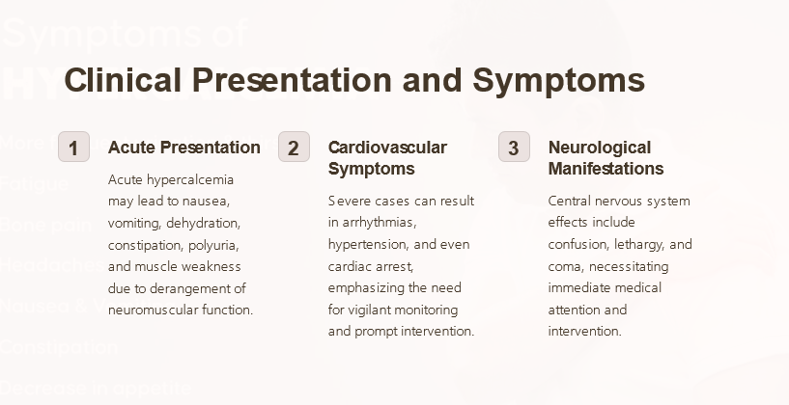

Slide 17
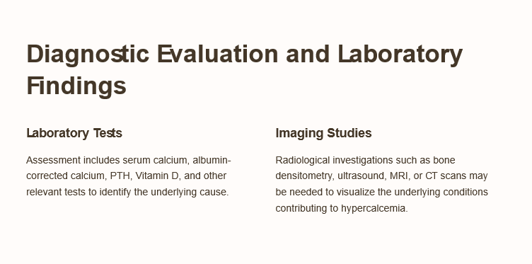

Slide 18
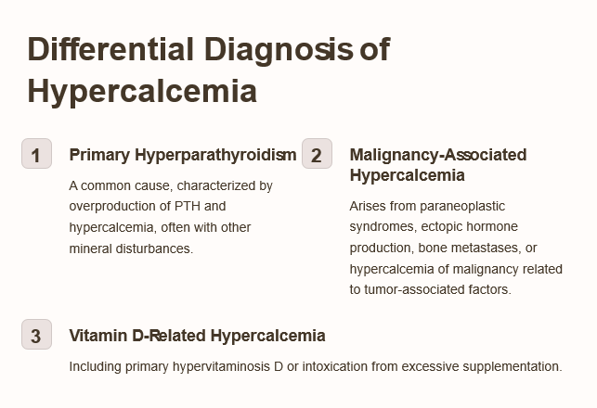

Slide 19
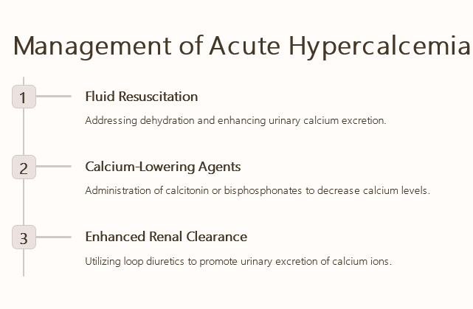

Slide 20
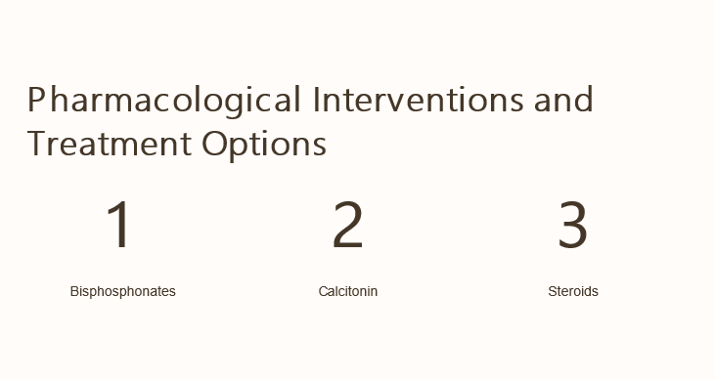

Slide 21
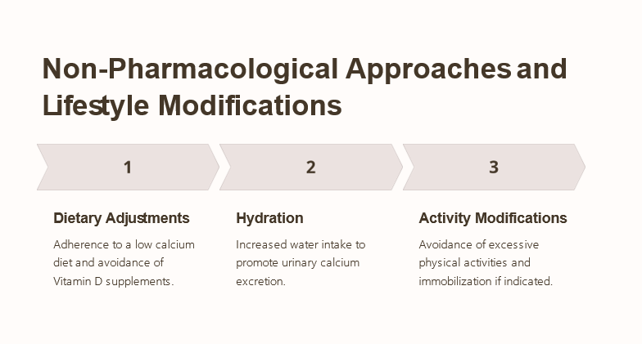

Slide 22
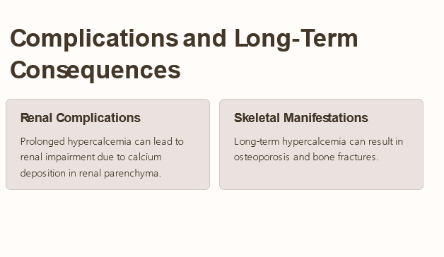

Slide 23
