Slide 1
In the name of GOD

Slide 2
Cases on PFT

Slide 3
Case 1
A 52-year-old female, Caucasian. Heavy smoker. History of chronic dyspnea.

Slide 4
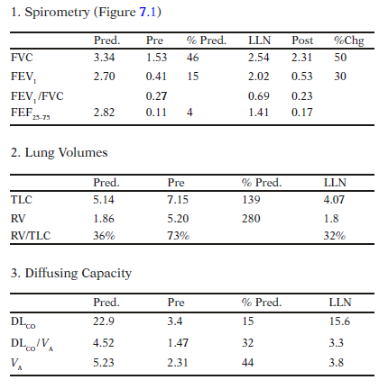

Slide 5
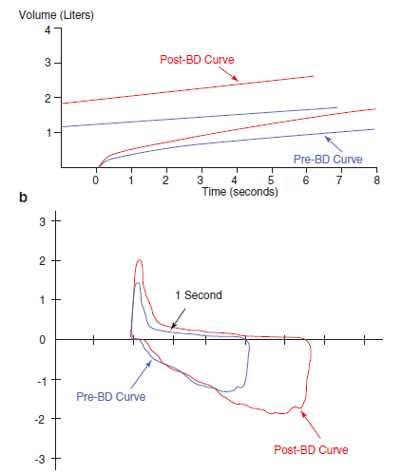

Slide 6
Questions
Q1: Interpret this PFT.
Q2: What are the most likely diagnoses?
Q3: How can you estimate the volume of trapped air?

Slide 7
Answers
Spirometry is obstructive:
– VT curve:
Is flattened, suggesting obstructive defect. Notice that the FET (16 seconds) is prolonged which supports the obstructive nature of the disorder.
(b) The post bronchodilator curve shows a better morphology indicating a degree of bronchodilator response that needs to be defined numerically.

Slide 8
• Lung volume study is obstructive
– TLC and RV are ↑ with a very ↑ RV/TLC ratio suggesting
emphysema with hyperinflation and air-trapping
(in asthma TLC is usually normal)
(Based on spirometry and lung volumes, both support obstruction,but COPD (emphysema) is the most likely as in asthma TLC is usually normal. DLCO will be of help)
• DLCO
– DLCO is extremely low suggesting a gas exchange abnormality,
favoring emphysema.
• Conclusion: very severe obstructive disorder with significant
reversibility and impaired gas exchange suggesting emphysema.

Slide 9
Case 2
A 54-year-old male, Caucasian

Slide 10
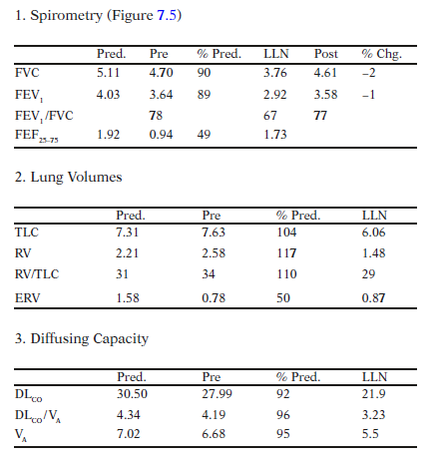

Slide 11
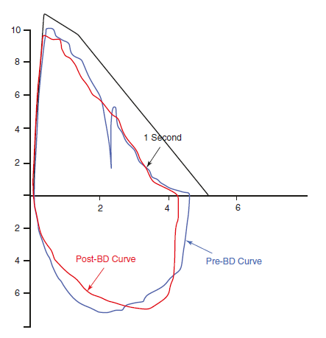

Slide 12
Questions
Q1: Interpret this PFT.
Q2: What is the most likely diagnosis?

Slide 13
Answers
Spirometry is normal:
– FV loop:
The pre-BD curve is interrupted by a cough in its 1st second. The study is not reproducible.
(b) The curve looks normal and slightly smaller than the predicted one. FVC and the ratio look normal.
(c) Post-BD curve is smaller than the pre-BD curve indicating lack of response to BDs.

Slide 14
– Spirometric data:
(a) FVC, FEV1 and the ratio are normal with no response to BD.
(b) ↓ FEF75 (nonspecific and may be seen in obesity)
• Lung volume study is normal except for an isolated reduction in ERV suggesting obesity.
– DLCO and DLCO/VA are normal indicating that there is no gas exchange abnormality.
• Conclusion: Normal PFT with isolated reduction in ERV suggestive of obesity. The patient’s weight at the time of the test was 108 kg with a BMI of 33.

Slide 15
Case 3
A 48-year-old female with chronic dyspnea.

Slide 16
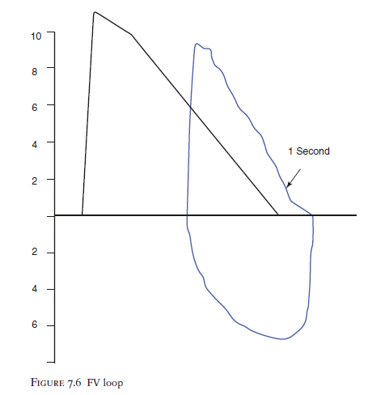

Slide 17
Question
Q1: Interpret this FV loop

Slide 18
Answer
• FV loop morphology looks acceptable.
• It is small and has a steep slope (witch’s hat)
• Its width (FVC) is low with normal ratio suggesting
restriction.
• It is shifted to the right compared to the predicted indicating
decreased TLC and RV which is consistent with a restrictive
defect secondary to a lung disease with reduced compliance
such as interstitial lung disease.
• This patient was found to have interstitial fibrosis secondary
to sarcoidosis.

Slide 19
Case 4
A 61-year-old female, Caucasian. Unexplained SOB.

Slide 20
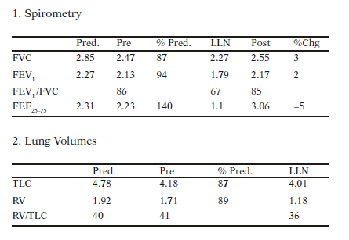

Slide 21
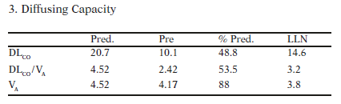

Slide 22
Questions
Q1: Interpret this PFT.
Q2: What are the most likely diagnoses?

Slide 23
Answers
• Spirometry is normal with no response to bronchodilators.
• Lung volume study is normal.
• DLCO is extremely low suggesting a gas exchange abnormality.
• Conclusion: Isolated reduction in the diffusing capacity indicating
an early parenchymal lung disease, pulmonary vascular
disease or anemia.
• This patient has a pulmonary artery systolic pressure of
74 mmHg i.e. pulmonary hypertension.

Slide 24
Case 5
A 55-year-old male, Caucasian, weight 84 kg; history of shortness of breath.

Slide 25
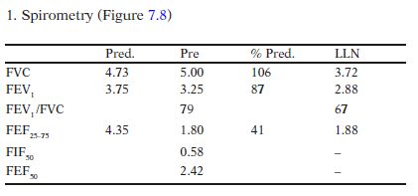

Slide 26
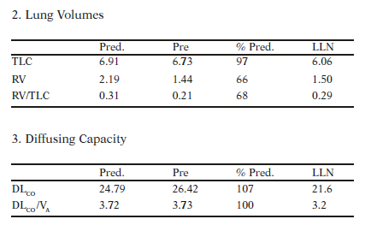

Slide 27
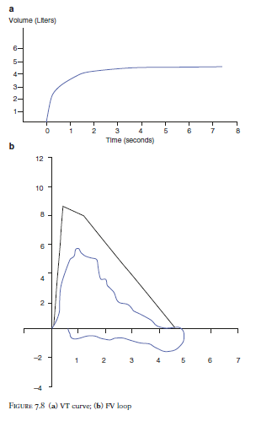

Slide 28
Question
Q1: Interpret this PFT.

Slide 29
Answer
• VT curve looks normal (no predicted curve to compare with).
• FV loop:
– Curve quality looks suboptimal which could be due to a disease state.
– Curve is small with a flat inspiratory component. This suggests a variable extrathoracic upper airway obstruction.
– The expiratory component of the curve is not significantly abnormal.
• Spirometric data:
– Normal FVC, FEV1 and FEV1/FVC ratio.
– ↓ FEF25–75 is nonspecific.
– FIF50/FEF50 is much less than 1 indicating a variable extrathoracic upper airway obstruction.
• Lung volume study:
– Normal TLC with low RV.
• DLCO and DLCO/VA are normal.
• Conclusion: The only significant abnormality is the flattened inspiratory component of FV loop and a very low FIF50/FEF50 ratio indicating a variable extrathoracic upper airway obstruction. This patient has laryngeal stenosis.

Slide 30
Case 6
A 22-year-old male, Caucasian, weight 81 kg; history of shortness of breath.

Slide 31
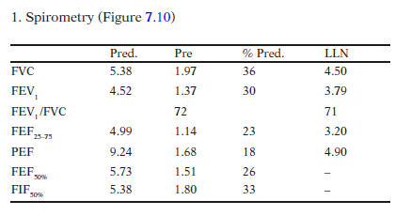

Slide 32
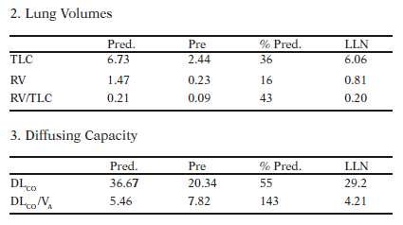

Slide 33
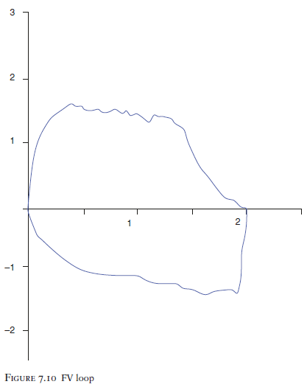

Slide 34
Question
Q1: Interpret this PFT.

Slide 35
Answer
• FV loop:
– Is small and flat at both inspiratory and expiratory components, suggesting fixed upper airway obstruction.
• Spirometric data:
– Reduced FVC and FEV1 with a normal FEV1/FVC ratio suggesting a restrictive disease.
– Reduced PEF, FEF50 and FIF50. FIF50/FEF50 ratio is around 1 which is indicating a fixed upper airway obstruction.
• Lung volume study:
– Lung volumes are all significantly reduced confirming severe restriction.
• DLCO is also low which overcorrects when VA is taken into consideration, which possibly indicates that there is no significant parenchymal abnormality.
• Conclusion: fixed upper airway obstruction with severe restriction.
This patient has lymphoma with significant paratracheal lymphadenopathy compressing the trachea. He was also found to have significant bilateral pleural effusions related to his lymphoma causing this significant restriction.

Slide 36
Case 7
A 78-year-old male, Caucasian, weight 80 kg.

Slide 37
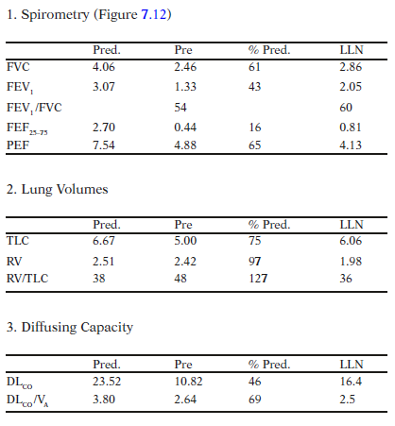

Slide 38
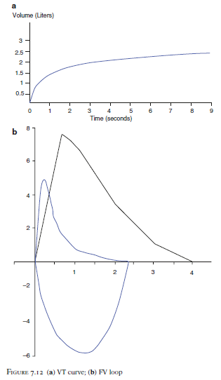

Slide 39
Question
Q1: Interpret this PFT.

Slide 40
Answer
• Spirometry is obstructive:
– VT curve looks flat. FET is 9 seconds.
– FV loop:
(a) The expiratory curve is small and scooped out, suggesting an obstructive disorder.
• Spirometric data:
– Reduced FVC and FEV1 with a reduced FEV1/FVC ratio , suggesting a severe obstructive disorder. FEF25–75 is reduced going with an obstructive disorder.

Slide 41
• Lung volume study is restrictive:
– Mildly reduced TLC with a normal RV and increased RV/TLC ratio. The reduced TLC indicates a restrictive disorder.
• DLCO is reduced which may be seen in restrictive or pulmonaryvascular disorders.
• Conclusion: Severe obstructive disorder with a mild restriction.
This patient has COPD (emphysema) and lung
resection.

