Slide 1


Slide 2
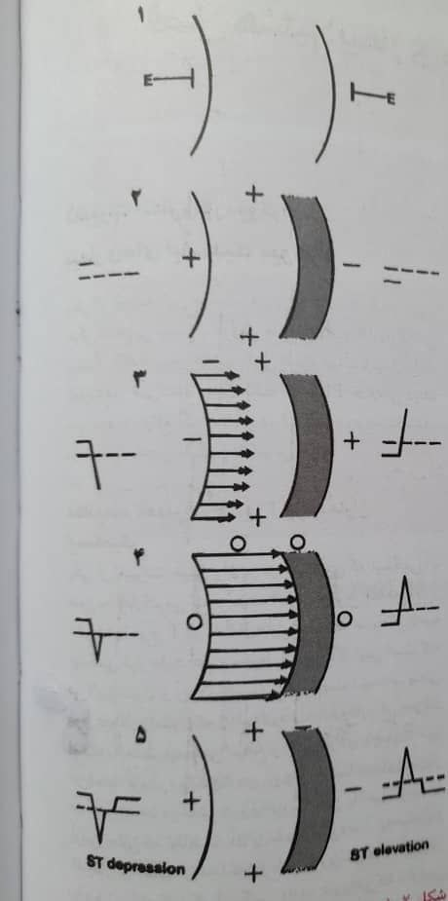

Slide 3
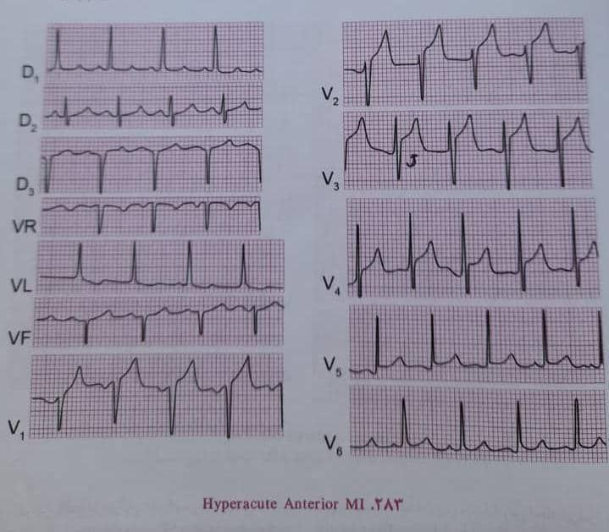
J Pointبالا رفتن

Slide 4
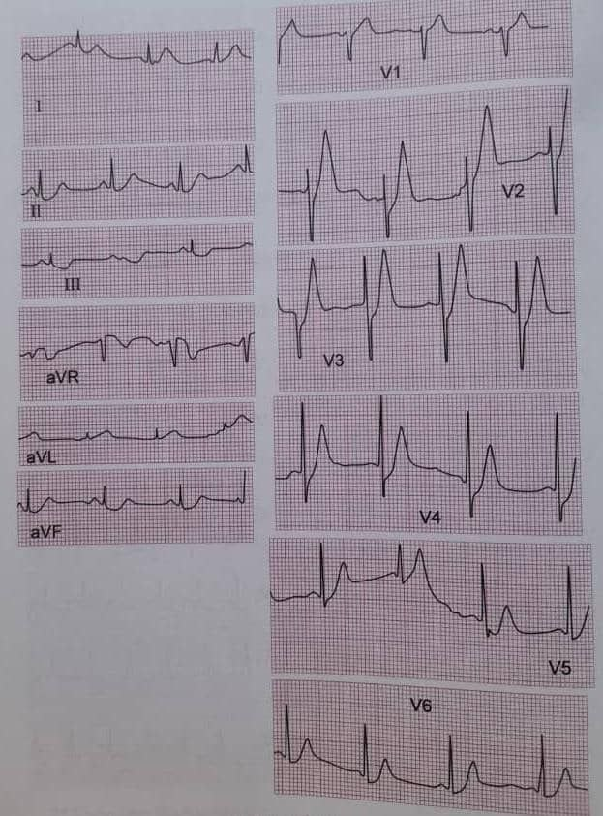
T tall

Slide 5
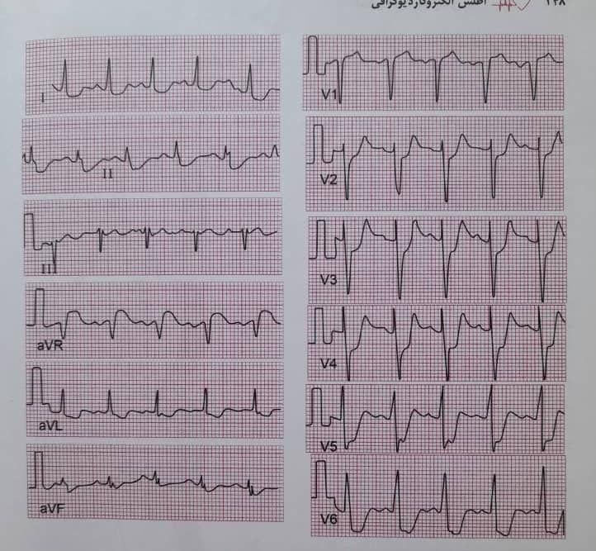
S t elevation in aVr

Slide 6
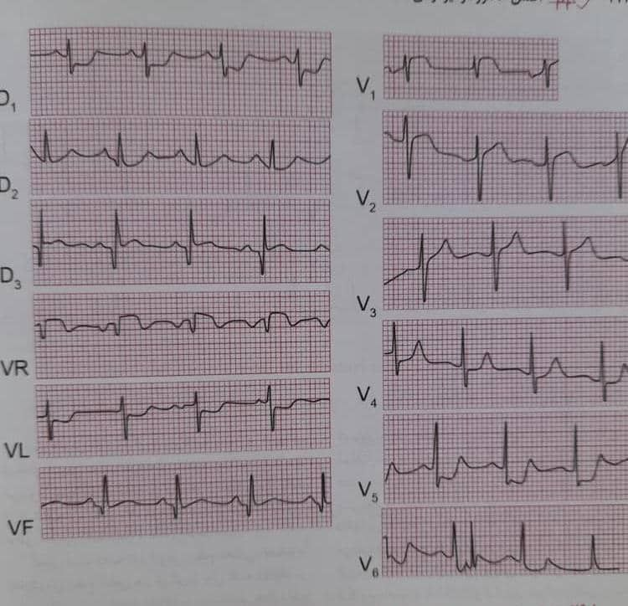
Posterior Wall mi

Slide 7
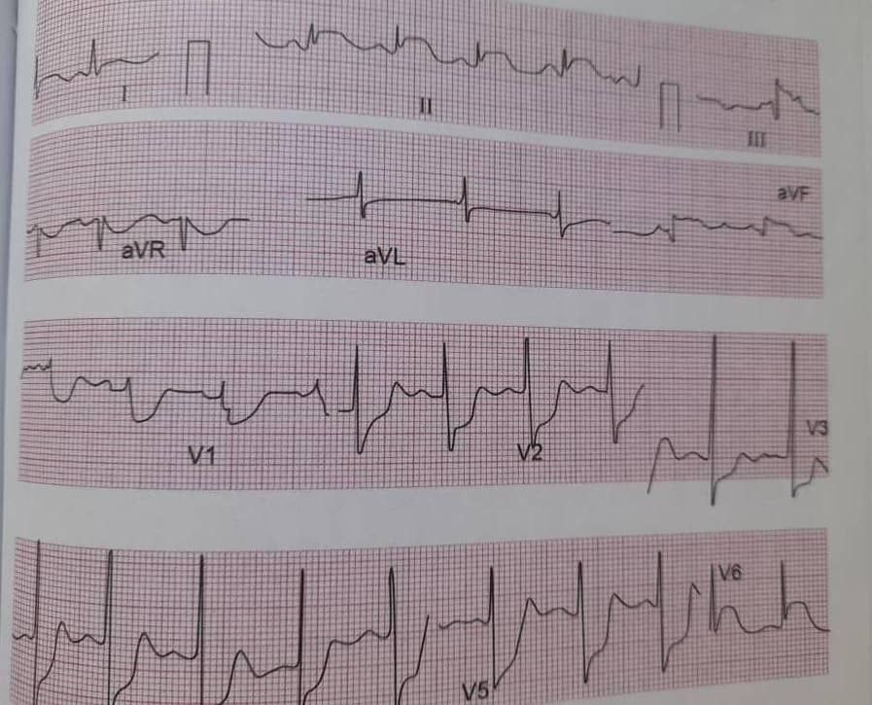
Significant St Depression in V1 Till V6

Slide 8
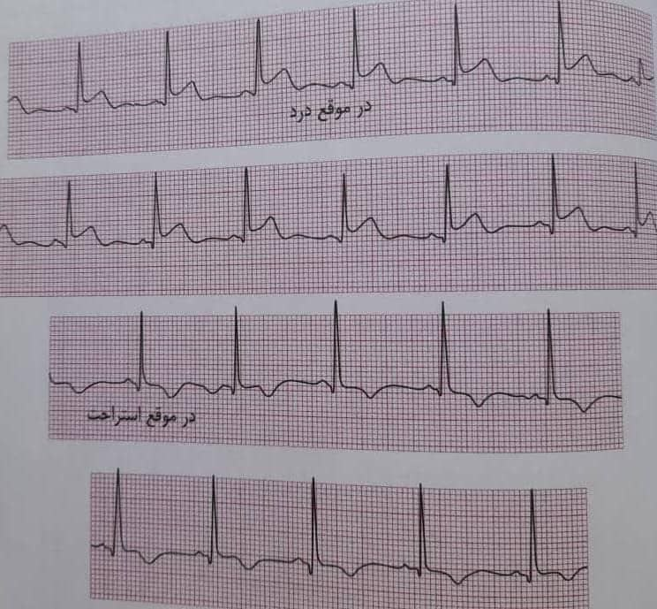

Slide 9
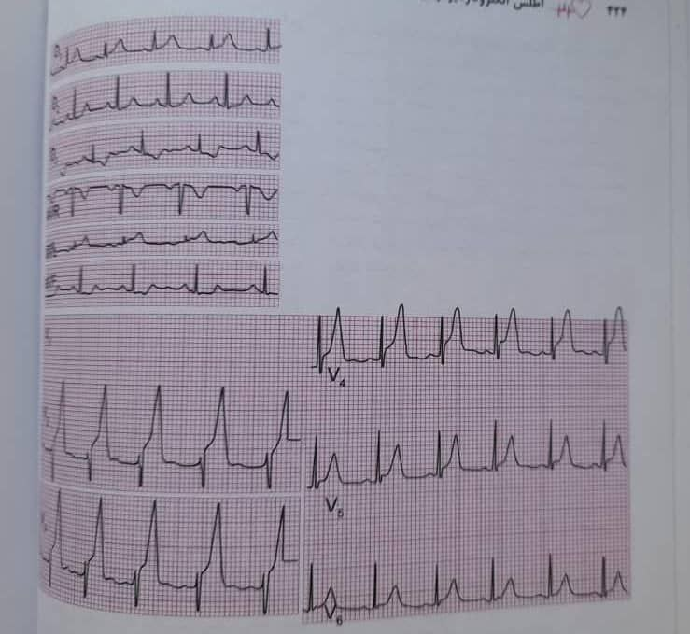
Hyper acute mi

Slide 10
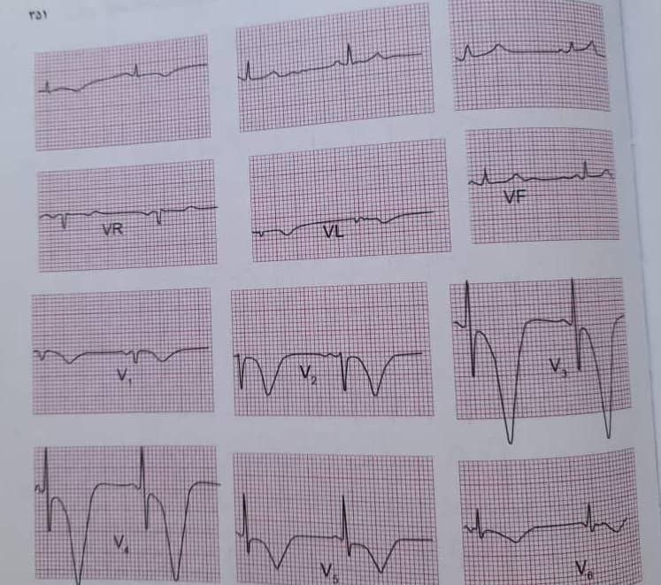
Wellenz criteria

Slide 11
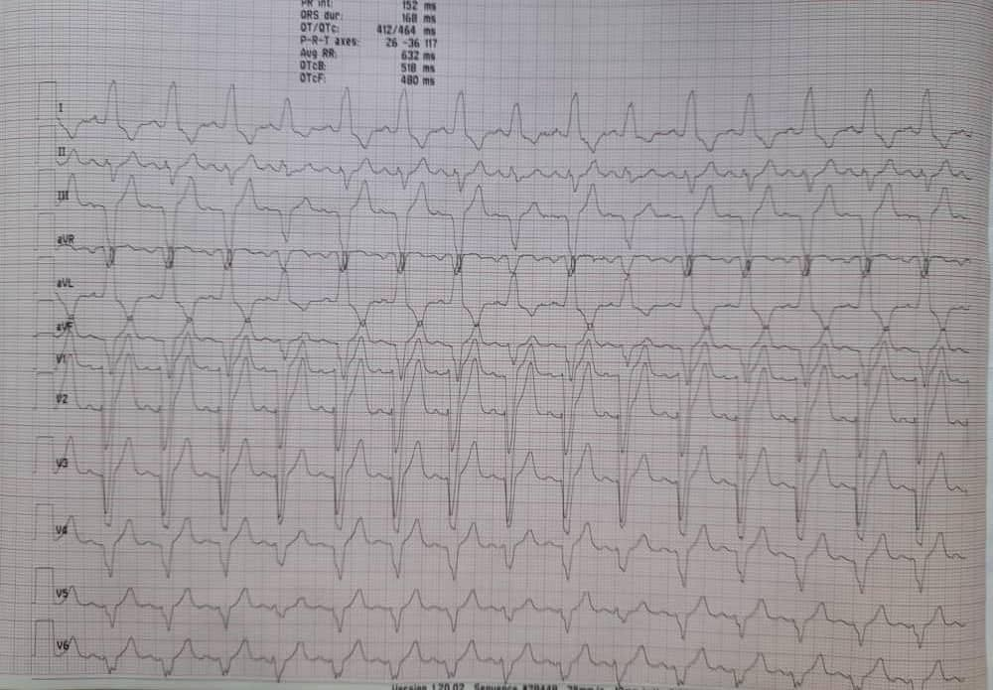
Elena Sgarbossa criteria

Slide 12
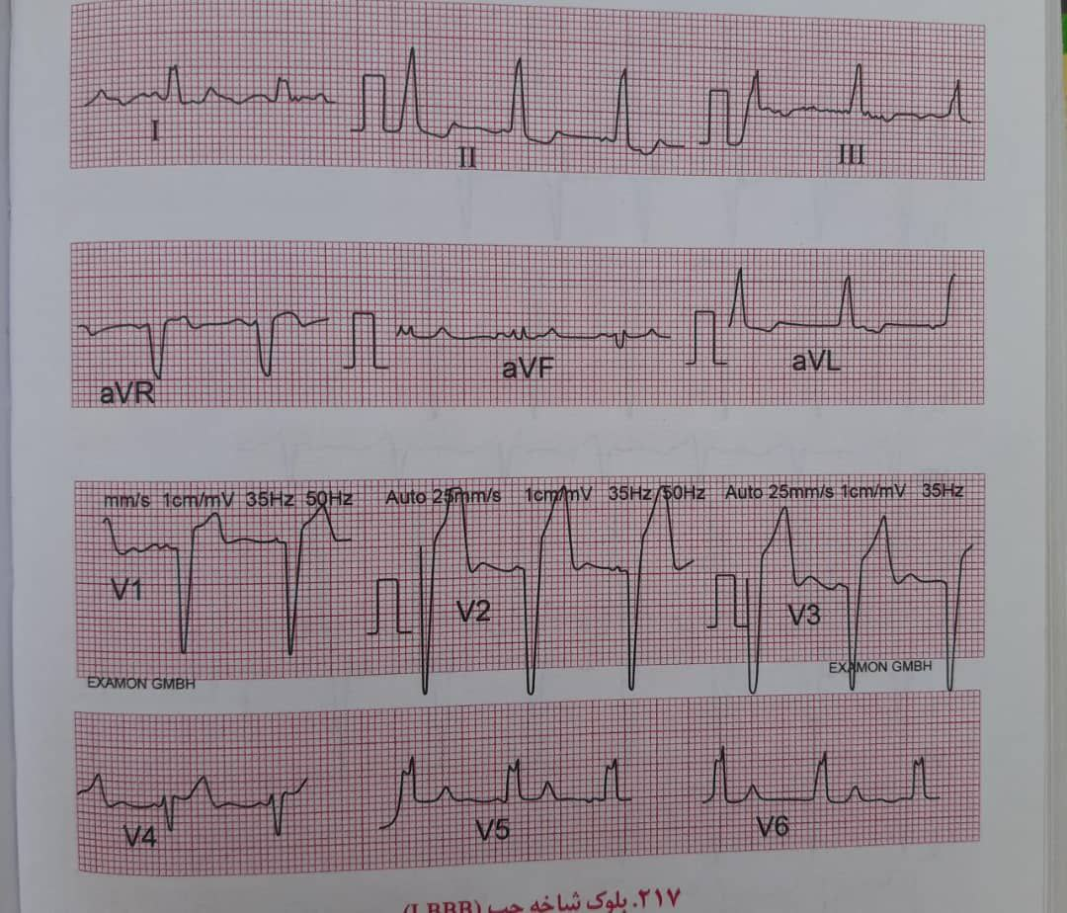
Sgarbossa criteria

Slide 13
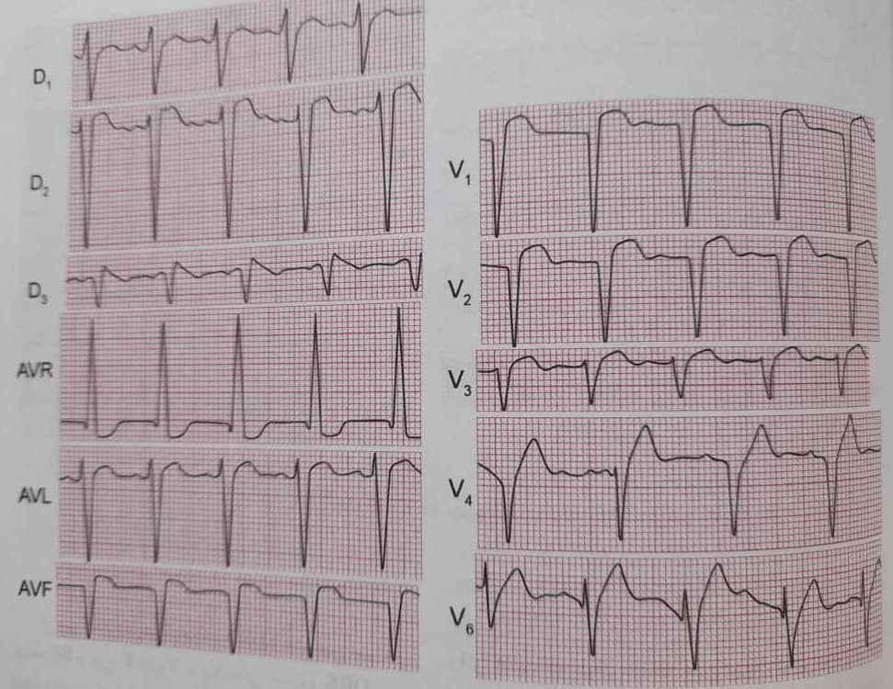
Sgarbossa criteria

Slide 14
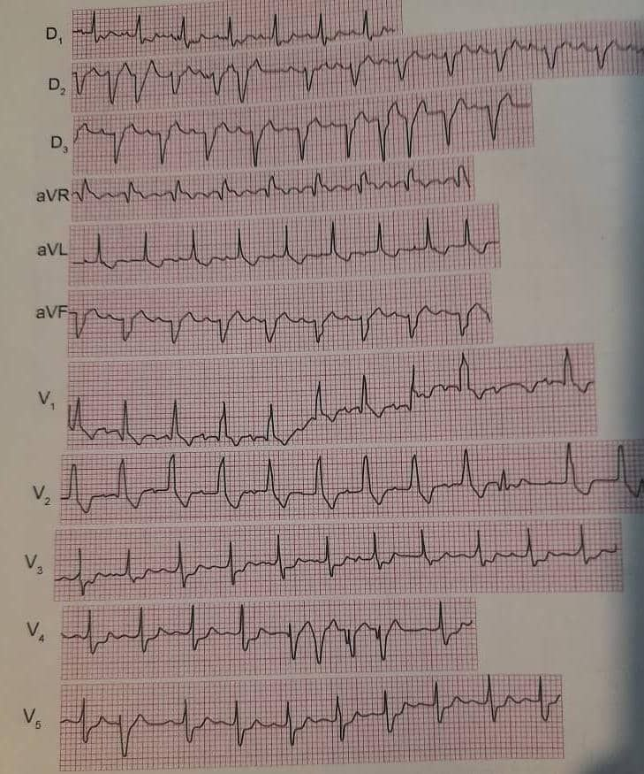
RBBB+LAHB

Slide 15
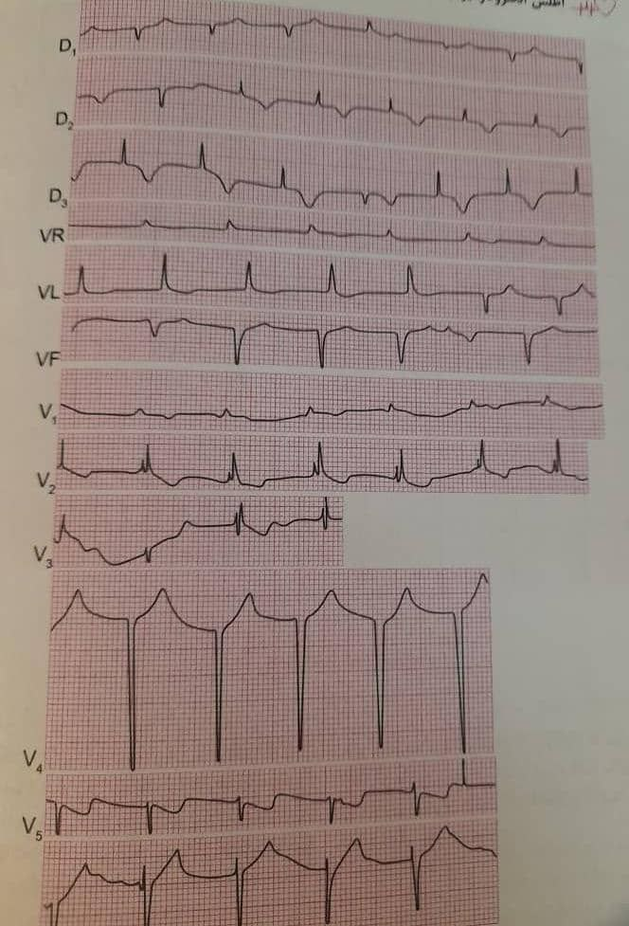
RBBB+LPHB

Slide 16
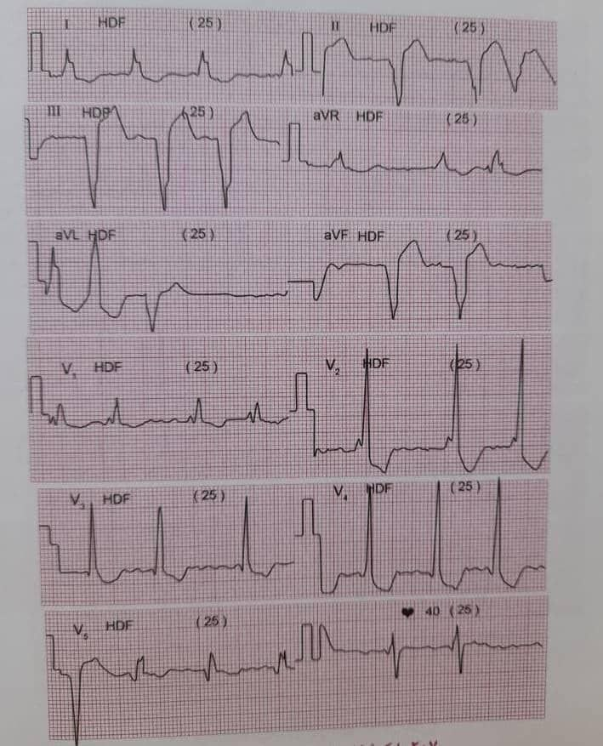
LBBB+RBBB

Slide 17
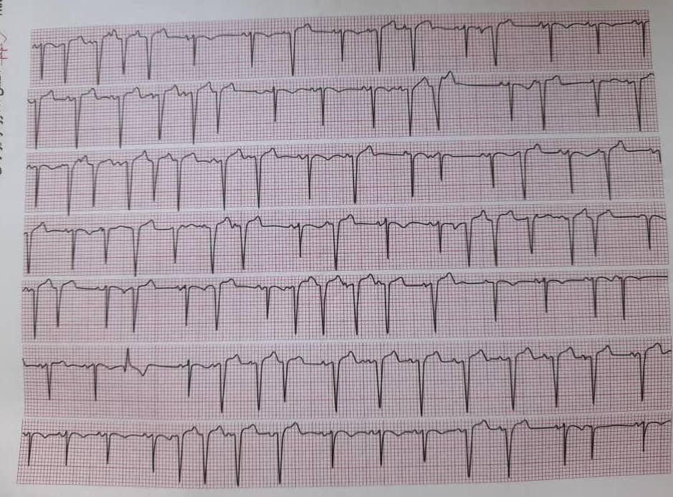
Intermittent LBBB

Slide 18
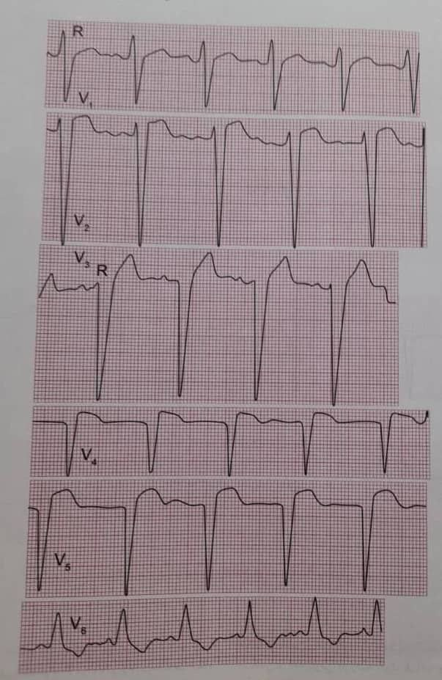
Low progression R Wave

