Slide 1
Spirometry

Slide 2
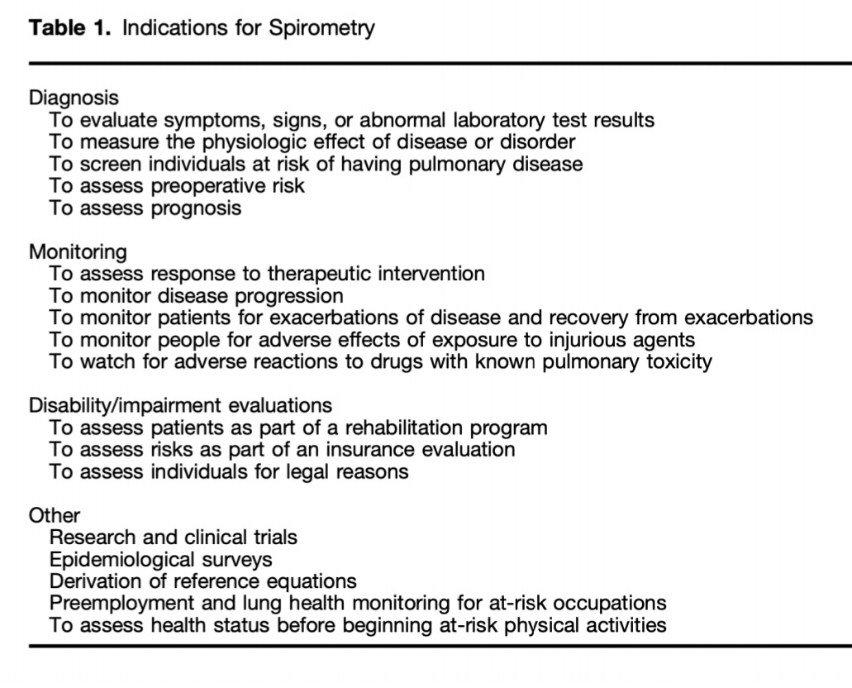

Slide 3
Spirometry is used to measure forced expiratory flow rates and volumes. It is the most commonly used pulmonary function test and is useful in the evaluation of patients with respiratory symptoms (eg, dyspnea, cough, wheeze), and the monitoring of lung function in patients with lung disease, being treated with drugs that can affect lung function, or at risk of lung disease (eg, smoking, occupational exposures, family history).

Slide 4
In the office setting, spirometry is typically used to detect, confirm, and monitor obstructive airway diseases (eg, asthma, chronic obstructive pulmonary disease [COPD]) and monitor known restrictive lung disease.
In this setting, the clinician must be knowledgeable about issues related to equipment, performance of the forced expiratory maneuver, and interpretation of the data to obtain reliable and clinically useful information.

Slide 5
EQUIPMENT
Office spirometers should meet equipment specifications as described in international guidelines. The majority of spirometers manufactured since 1990 are accurate, although some flow-sensing office spirometers can produce falsely high results.
To avoid cross-contamination between patients when using permanent flow sensors, it is preferable to employ single use disposable flow sensors that practically eliminate the risk of inhalational cross contamination. Disposable one-way mouthpieces may also be used; otherwise, patients should be instructed not to inhale from the spirometer when only forced exhalation maneuvers are being obtained.
Volume sensing spirometers maintain accuracy over many years but are more difficult to clean and are rarely used for office spirometry.

Slide 6
QUALITY CONTROL
Office spirometers should accurately measure the forced expiratory volume in one second (FEV₁), forced expiratory volume in six seconds (FEV₆), and forced vital capacity (FVC) and also provide quality checks and error messages. A survey of 17 spirometers used in primary care offices found only 1 of 17 met accuracy criteria; clearly manufacturers and practitioners need to be aware of potentially significant quality issues related to office spirometry [19].
In addition to internal calibration performed by the device, daily calibration checks with a three liter syringe are recommended [10]. When performing a calibration check, the three-liter syringe should be discharged into the spirometer three times. The volumes read by the machine should be within 3 percent of three liters. If the spirometer reading remains outside these limits after replacing the flow sensor, the device should be removed from use until checked by the manufacturer.
It is also essential that the nurse or technician enter correct values for age, height, and sex at birth, as these values are used to generate the appropriate predicted values for the individual patient. Height should be measured with shoes off, preferably using a stadiometer, rather than relying on the patient's stated height. Percent predicted values that are unexpectedly higher or lower than expected are a clue that an incorrect age or height value may have been entered. Waist circumference, while not used to calculate predicted normal values, can also be measured because abdominal obesity is a common cause of mildly low values for FEV₁ and FVC.

Slide 7
Holding bronchodilator medications
In preparation for PFTs, bronchodilator medications are typically held so that bronchodilator response can be assessed after baseline spirometry. As examples, short-acting inhaled beta agonists (eg, albuterol, salbutamol) should not be used for four to six hours prior to testing [6].
The short-acting muscarinic antagonist ipratropium should be held for 12 hours.
Long-acting beta agonist bronchodilators (eg, salmeterol, formoterol) should be held for 24 hours prior to testing.
The ultra-long-acting beta agonists (eg, indacaterol, olodaterol, vilanterol) should be held for 36 hours, and the long-acting muscarinic antagonists (also called anticholinergic agents) glycopyrrolate (glycopyrronium), tiotropium, aclidinium, and umeclidinium should be held for 36 to 48 hours.

Slide 8
PROCEDURE
Patients are usually seated during spirometry, unless otherwise noted. Nose clips or manual occlusion of the nares help to prevent air leakage through the nasal passages, although spirometry can be performed without nasal occlusion .The deep inhalation should occur before the mouthpiece is placed in the mouth. Immediately after the deep inhalation, the mouthpiece is placed just inside the mouth between the teeth. The lips should be sealed tightly around the mouthpiece to prevent air leakage during maximal forced exhalation. The patient should then be instructed to blast out the air without hesitation (within two seconds of reaching full inflation). Exhalation should last until a plateau in exhaled volume is reached, or a maximum of 15 seconds. However, if measuring FEV₆ as a surrogate for FVC, then exhalation need only last at least six seconds. To fully evaluate flow volume loops, it is necessary to perform a complete inspiratory maneuver at the end of the test. The maximal inspiration at the end of test requires vigorous coaching to achieve good quality results and patients should be informed that this aspect of the maneuver feels somewhat uncomfortable.
The patient is allowed to rest for several seconds and the procedure is repeated. Usually, three maneuvers are performed, although additional tests may be needed if one or more of the curves are unacceptable.

Slide 9
COACHING THE PATIENT
The most important task of the technician or person performing the test is to obtain maximal, reproducible efforts from the patient.
Even with the use of accurate instruments, office spirometry results may be misleading if the patient's efforts are submaximal. Unlike most other medical tests in which the patient remains passive, accurate spirometry results require significant exertion on the part of the patient.
The technician must instruct and encourage the patient to perform the breathing maneuvers in three phases (figure 1):
●Phase 1: Coach the patient to take as deep a breath as possible
●Phase 2: Strongly prompt the patient to blast out the air into the spirometer without hesitation after reaching a full inspiration
●Phase 3: Encourage the patient to continue exhaling until a plateau in exhaled volume or 15 seconds is reached, unless just measuring FEV₆ in which case the exhalation should last at least six seconds (three seconds for children)
Patients in whom a flow volume loop is needed will need to perform an additional phase of deep and forceful inspiration to total lung capacity immediately after phase 3.

Slide 10
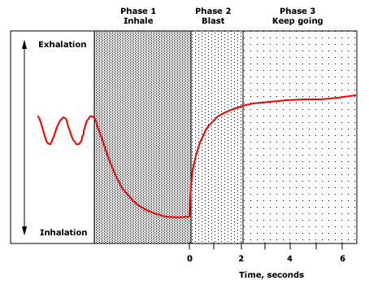

Slide 11
ADEQUACY OF TEST
An adequate test usually requires three acceptable and repeatable forced vital capacity (FVC) maneuvers [10]. The clinician and technician must learn to recognize the patterns of acceptable and unacceptable efforts, since poorly performed maneuvers often mimic disease patterns. Detection of poorly performed maneuvers requires direct inspection of both flow-volume curves and volume-time spirograms (figure 2) [14,22].
An acceptable maneuver requires a sharp peak in the flow curve and an expiratory duration that reaches a plateau of exhaled volume or 15 seconds, or greater than six seconds if measuring FEV₆ instead of FVC (figure 3). At least three acceptable maneuvers should be available for analysis.
Repeatability is determined by comparing the FVC and FEV₁ values of the maneuvers. The two highest values for FVC and for FEV₁ should be within 0.15 L of each other (for adults; the limit is 0.10 L for children) [10,23].
The grading system for the quality of spirometry factors in the number of acceptable maneuvers and the degree of repeatability for FEV₁ and FVC separately (table 1) [10]

Slide 12
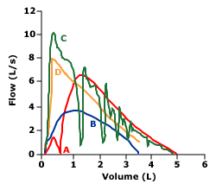
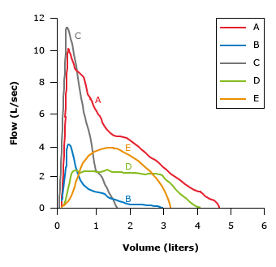

Slide 13
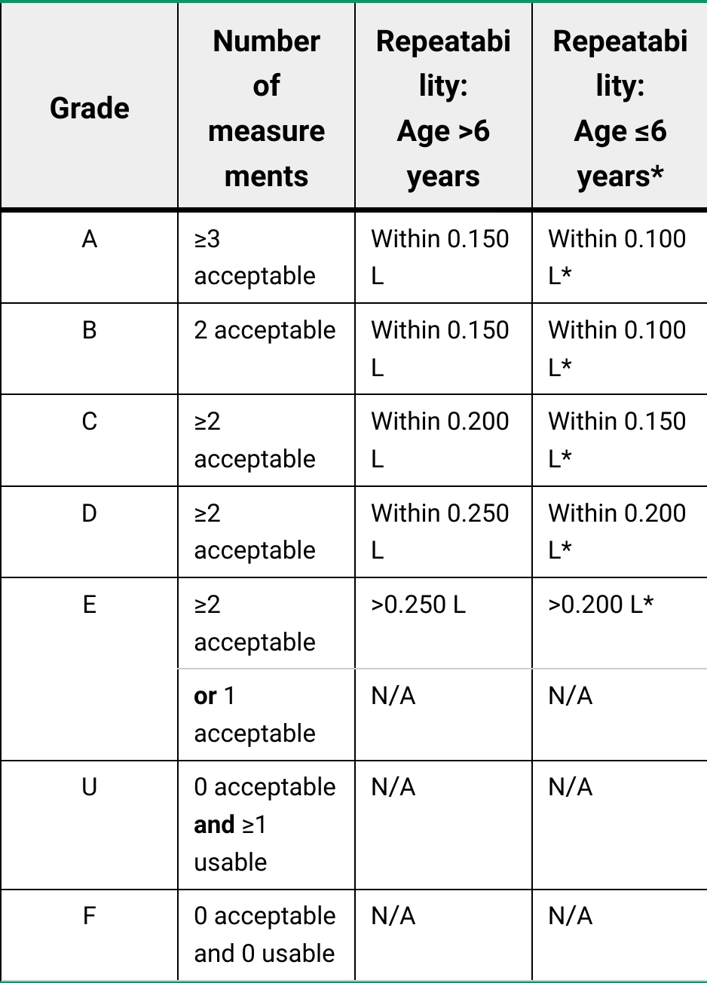

Slide 14
INTERPRETATION
All tracings from the forced expiratory maneuvers should be examined for acceptability and repeatability, according to the criteria mentioned above. The study should then be classified as normal or abnormal, the latter showing an obstructive, a possible restrictive, or a possible mixed pattern. Lung volumes are necessary to confirm whether or not the patient has a restrictive deficit. The severity of the ventilatory impairment is then assessed, according to the algorithm

Slide 15
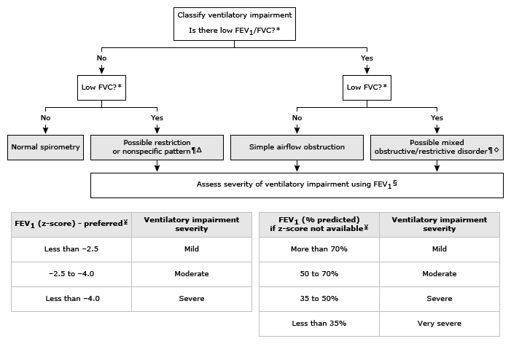

Slide 16
Forced vital capacity
The forced vital capacity (FVC) (also known as the forced expiratory volume) is the maximal volume of air exhaled with a maximally forced effort from a position of full inspiration and is expressed in liters [10]. The highest FVC from the three acceptable forced expiratory maneuvers is used for interpretation [10].
The FVC may be reduced by suboptimal patient effort, airflow limitation, restriction (eg, from lung parenchymal, pleural, or thoracic cage disease), or a combination of these (algorithm 1). In general, a low FVC needs further evaluation with full pulmonary function tests to determine whether lung restriction is present [24]. Patients with obstruction and low FVC frequently demonstrate air trapping or failure to complete a full exhalation rather than an additional restrictive process.

Slide 17
Due to these potential problems with air trapping and incomplete exhalation, FVC is not used to grade restriction severity. We prefer to assess the severity of restrictive deficits by applying the z-score approach to total lung capacity measurements, when available.
The slow vital capacity (SVC) is the maximal volume of air exhaled after a maximal inspiration, but without a forced effort. The SVC is rarely measured outside of hospital-based pulmonary function labs. For normal subjects, the slow and forced vital capacities are very close, whereas patients with airflow limitation tend to have a lower FVC than SVC.

Slide 18
Forced expiratory volume in six seconds
The forced expiratory volume in six seconds (FEV₆) is sometimes used as a surrogate for FVC .
The FEV₆ has the advantage of being more reproducible than the FVC and less physically demanding for the patient.

Slide 19
Forced expiratory volume in one second
The forced expiratory volume in one second (FEV₁) is the maximal volume of air exhaled in the first second of a forced exhalation that follows a full inspiration, expressed in liters [21]. The FEV₁ reflects the average flow rate during the first second of the FVC maneuver. The FEV₁ is the most important spirometric variable for assessment of the severity of airflow obstruction.
The highest FEV₁ from the three acceptable forced expiratory maneuvers is used for interpretation, even if it does not come from the maneuver with the highest FVC [10].
In patients with asthma, the FEV₁ typically declines with clinical worsening of airways obstruction and increases with successful treatment of airways obstruction. The FEV₁ should be used for determining the degree of obstruction (mild, moderate, or severe) and for serial comparisons when following patients with asthma or chronic obstructive pulmonary disease (COPD).
FEV₁ may also be used to grade the severity of restrictive or mixed obstructive/restrictive disorders once restriction has been confirmed by lung volumes; however, we prefer to grade pure restriction using total lung capacity when this measurement is available

Slide 20
As a rough guideline, the predicted FEV₁ for a 50-year-old of average height is about 4 L for a male and 3 L for a female.
When predicted values have not been calculated, patients with severe COPD generally have an FEV₁ less than one liter, while those with moderate COPD have an FEV₁ between 1 and 1.5 liters.
Individuals with an FEV₁ ≤75 percent of predicted are more likely to report dyspnea, wheezing, or cough, than those with an FEV₁ >75 percent predicted.

Slide 21
Ratio of FEV1/FVC
The FEV₁/FVC ratio is the fraction of the forced vital capacity that can be exhaled in the first second. It is the most important parameter for detecting airflow obstruction in diseases like asthma and COPD.
However, once it has been determined that a patient has airways obstruction, the FEV₁/FVC ratio is not useful for gauging severity of disease, since the FVC often decreases with increasing obstruction due to air trapping or premature termination of exhalation. The FEV₁, not the FEV₁/FVC ratio, should be used to monitor patients with asthma or COPD.
The use of z-score <-1.645 or the fifth percentile LLN for FEV₁/FVC to detect airway obstruction reduces the misclassification associated with using a fixed threshold of 0.7.

Slide 22
If FEV₁/FVC is low, but FEV₁ is normal, this is still considered indicative of mild airflow obstruction. In some cases, a low FEV₁/FVC in the presence of a normal FEV₁ is classified as reflecting dysanapsis, or airways size being too small relative to lung volume size. While dysanapsis may be a physiologically normal variant, it has also been associated with COPD [37], bronchodilator responsiveness, and [38] severe asthma in children with obesity [39].
If FEV₁/FVC is normal, but FEV₁ is low, this may represent restriction, which should be evaluated by lung volumes. When lung volumes are not available, this pattern has also been labeled "Preserved Ratio Impaired Spirometry", or PRISm. It is unclear if PRISm is a distinct phenotype of lung disease, but multiple studies have demonstrated that PRISm is associated with increased cardiopulmonary disease and mortality.

Slide 23
Other flow measures
The transition from normal function to moderate airflow obstruction is generally gradual. Physiologists have searched for a test that is more sensitive than the FEV₁ for detection of airflow obstruction in its early stages. None has proven to be as reliable as the index obtained by dividing the FEV₁ by the FVC. The forced expiratory flow between 25 and 75 percent of the FVC (also known as FEF25-75 or maximal mid-expiratory flow rate) should not be used to detect "small airways disease" in adults, due to poor specificity and reproducibility.

Slide 24
Flow-volume loops
The flow-volume loop is a plot of inspiratory and expiratory flow (on the Y-axis) against volume (on the X-axis) during the performance of maximally forced inspiratory and expiratory maneuvers. Changes in the contour of the loop can detect upper airway obstruction.

Slide 25
Post-bronchodilator spirometry
In patients who have evidence of airflow limitation on baseline spirometry, and no prior diagnosis of asthma or COPD, post-bronchodilator spirometry may be useful. If post-bronchodilator spirometry is normal, COPD is less likely.
Note, however, that a bronchodilator response alone does not distinguish asthma from COPD [48]. If the change in spirometry post-bronchodilator does not support a diagnosis of obstructive lung disease, referral for bronchial challenge testing (eg, with methacholine or exercise) may be helpful.

Slide 26
LIMITATIONS
Abnormal spirometry results have little if any value in prompting smokers to quit [50-54]. All patients who smoke should be advised to stop smoking and provided smoking cessation assistance.
●In a patient with asthma, which is characterized by variability in clinical symptoms and airflow obstruction, normal airflow at the time of office visits does not exclude airflow obstruction at other times.
●Patients with early interstitial lung disease may have normal spirometry and need further testing of gas transfer with a diffusing capacity of the lungs for carbon monoxide (DLCO) and/or exercise oximetry to identify the cause of dyspnea [55].
●Misclassification rates due to suboptimal spirometry performance or interpretation are relatively high in the office setting [7,19,56]. Among eight general practices, rates for successfully meeting American Thoracic Society (ATS) quality standards were below 80 percent [7]. In 16 primary care offices involving 17 different spirometers, only 60 percent of patients had spirometry that met acceptability criteria [19]. Therefore, continuous quality review and feedback to nurses and technologists performing office spirometry are necessary and results should be verified by repeat testing in a Pulmonary Function Test (PFT) laboratory when important clinical decisions will be made based on the results [57,58].

Slide 27
There are multiple barriers to performing in-office spirometry. One comprehensive survey identified multiple barriers including lack of knowledge about how to interpret spirometry, lack of resources (equipment, personnel, skills, time), and lack of belief in importance of results. Most of the barriers identified were also true for out-of-office (ie, hospital) spirometry, indicating that implementing spirometry in general faces many challenges.

Slide 28
RISKS
Spirometry is a low-risk procedure and has few side effects [14]. During the test, some patients may experience dizziness. The forced expiratory maneuver causes an increase in the pressure in the chest, abdomen, head, and eyes. In general, patients who have recently (eg, less than six weeks) had abdominal, intracranial, or eye surgery or a pneumothorax should not perform spirometry, although data are limited.
Spirometry requires exertion and should be avoided in patients with unstable angina or a recent myocardial infarction.
Rarely, performance of a forced expiratory maneuver will precipitate acute bronchoconstriction. This seems more likely to occur when a patient's asthma or COPD is poorly controlled. Treatment includes administering inhaled albuterol and supplemental oxygen.

Slide 29
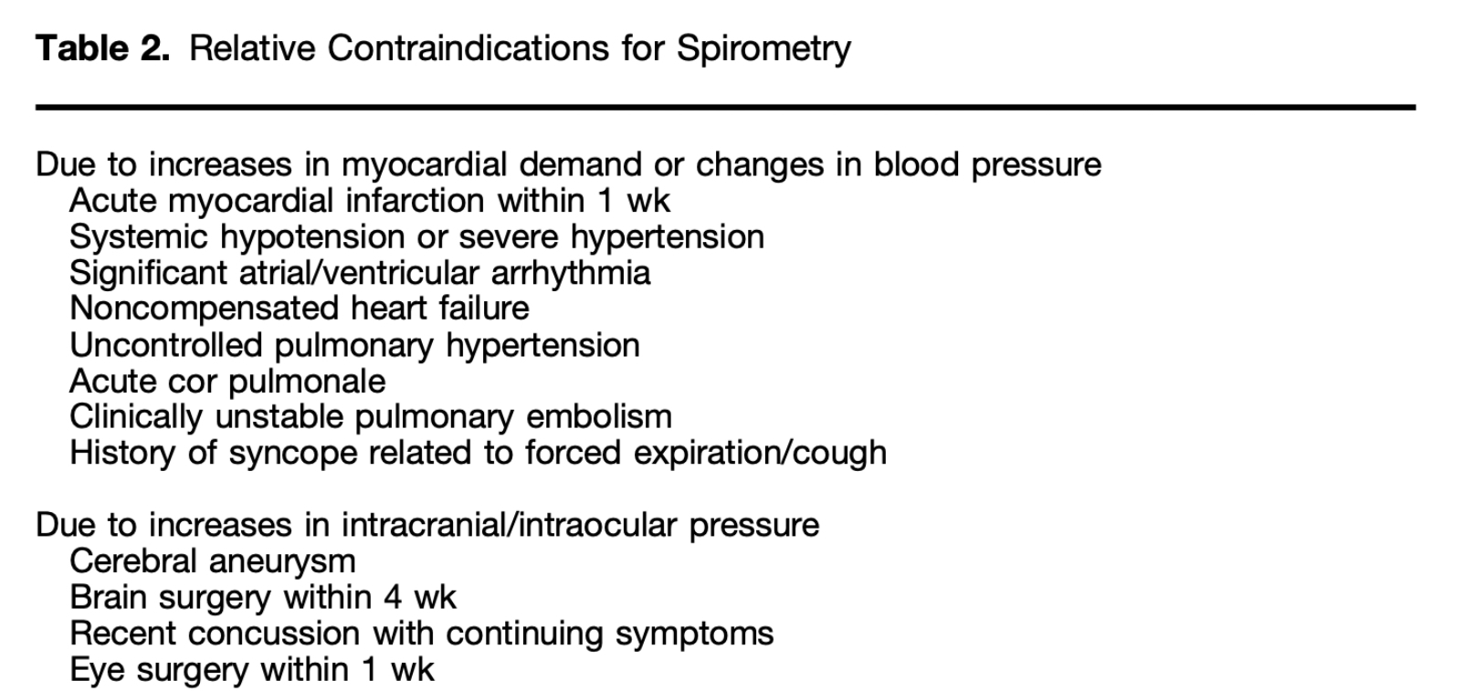

Slide 30
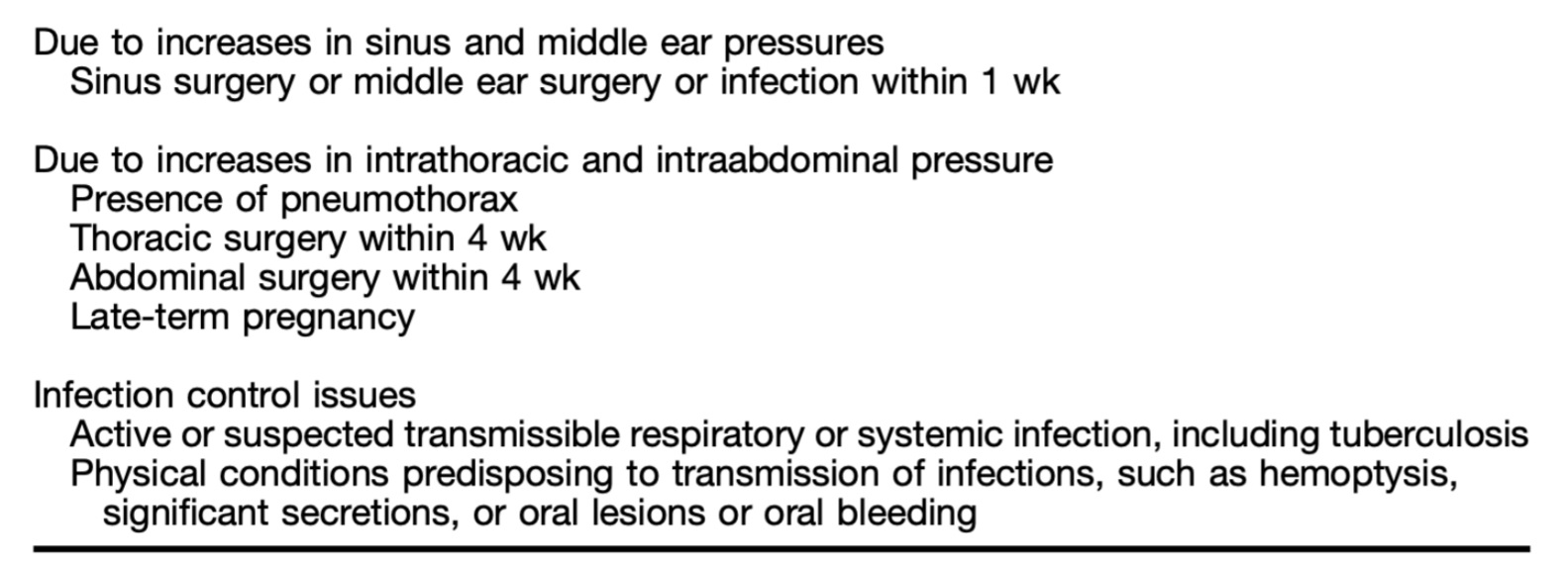

Slide 31
MONITORING
Office spirometry is also useful for monitoring control of asthma The National Asthma Education and Prevention Program advises the following frequencies for spirometry testing when caring for patients with asthma:
●At the time of initial assessment
●After treatment is initiated and symptoms and peak flow have stabilized
●During periods of progressive or prolonged loss of asthma control
●At least every one to two years
For patients with chronic obstructive pulmonary disease (COPD), repeat spirometry is advised whenever there is a substantial increase in symptoms or decrease in exercise tolerance.

Slide 32
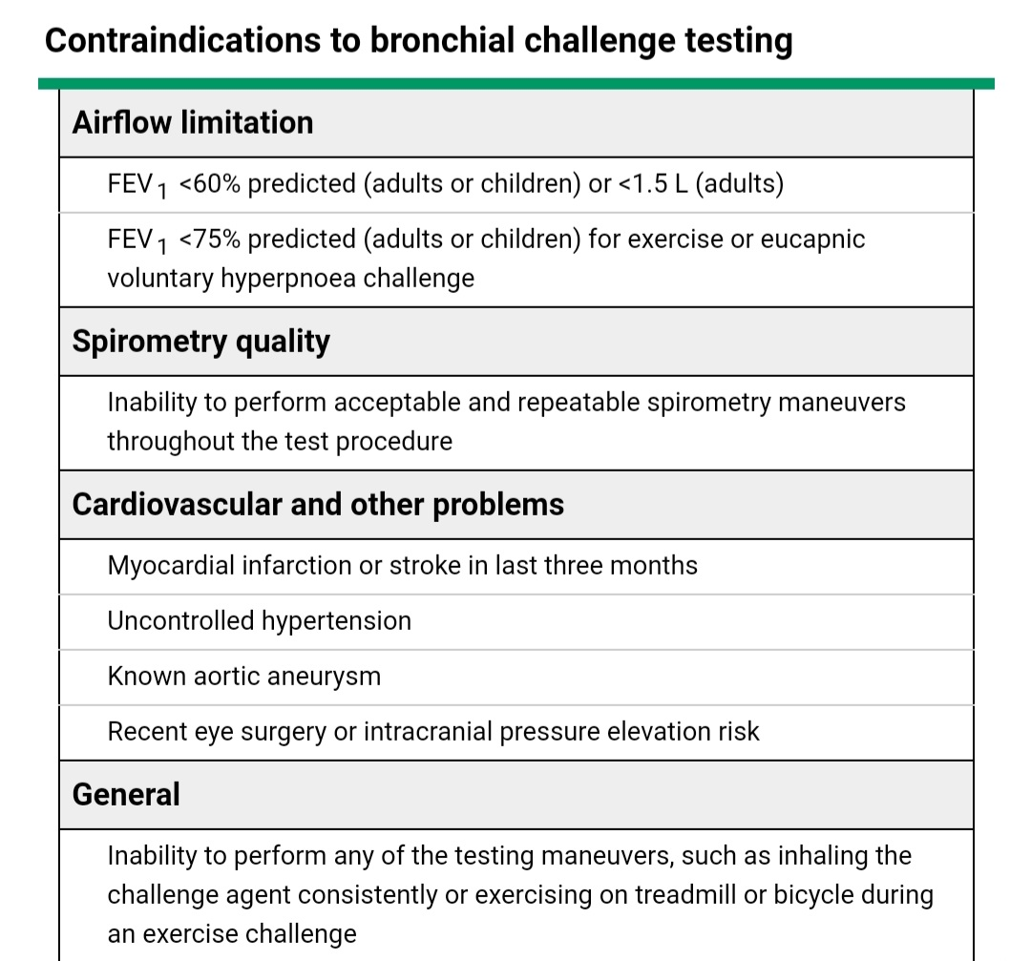

Slide 33
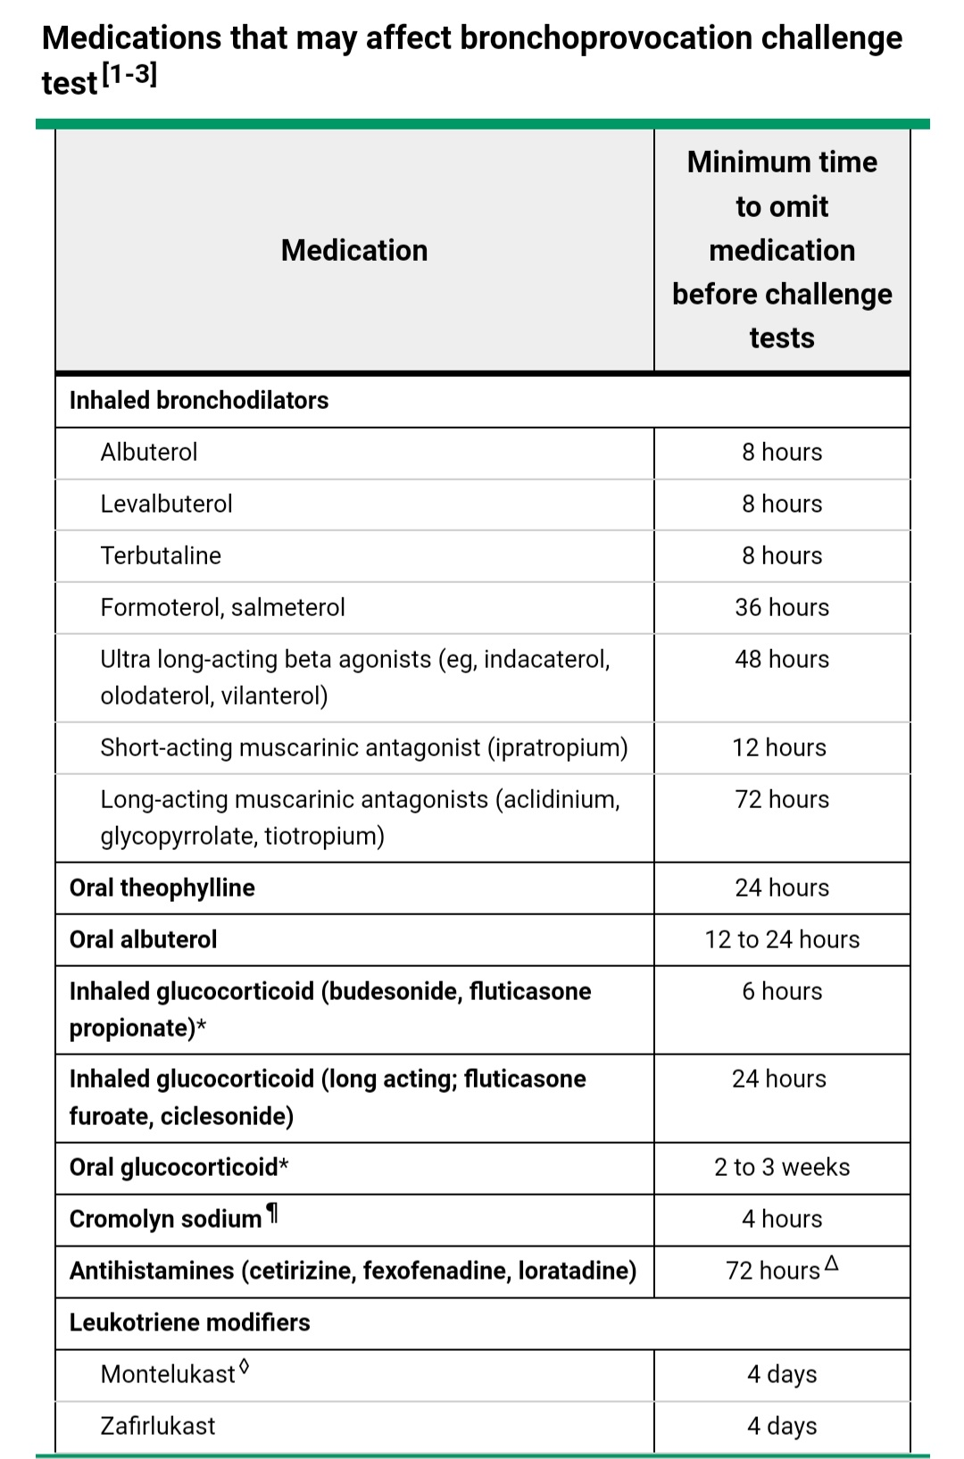

Slide 34
Examples

Slide 35
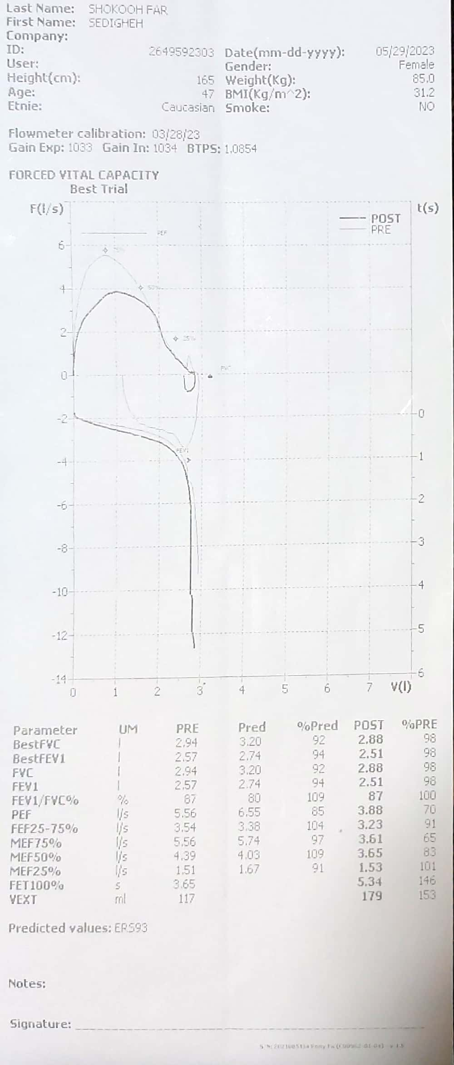

Slide 36
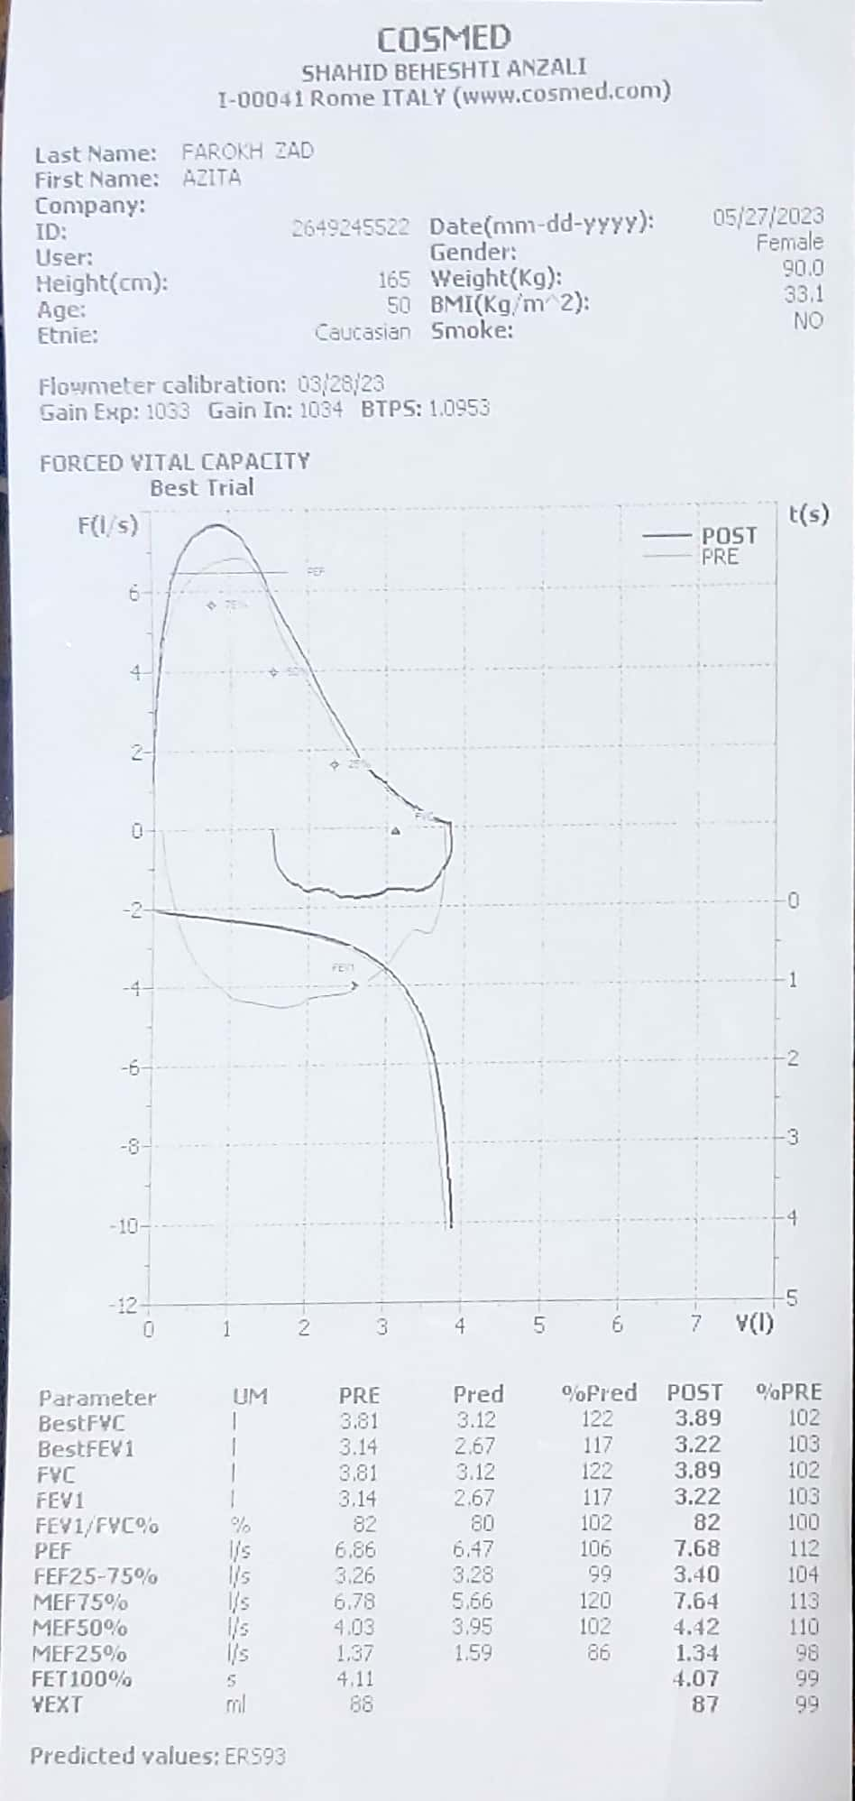

Slide 37
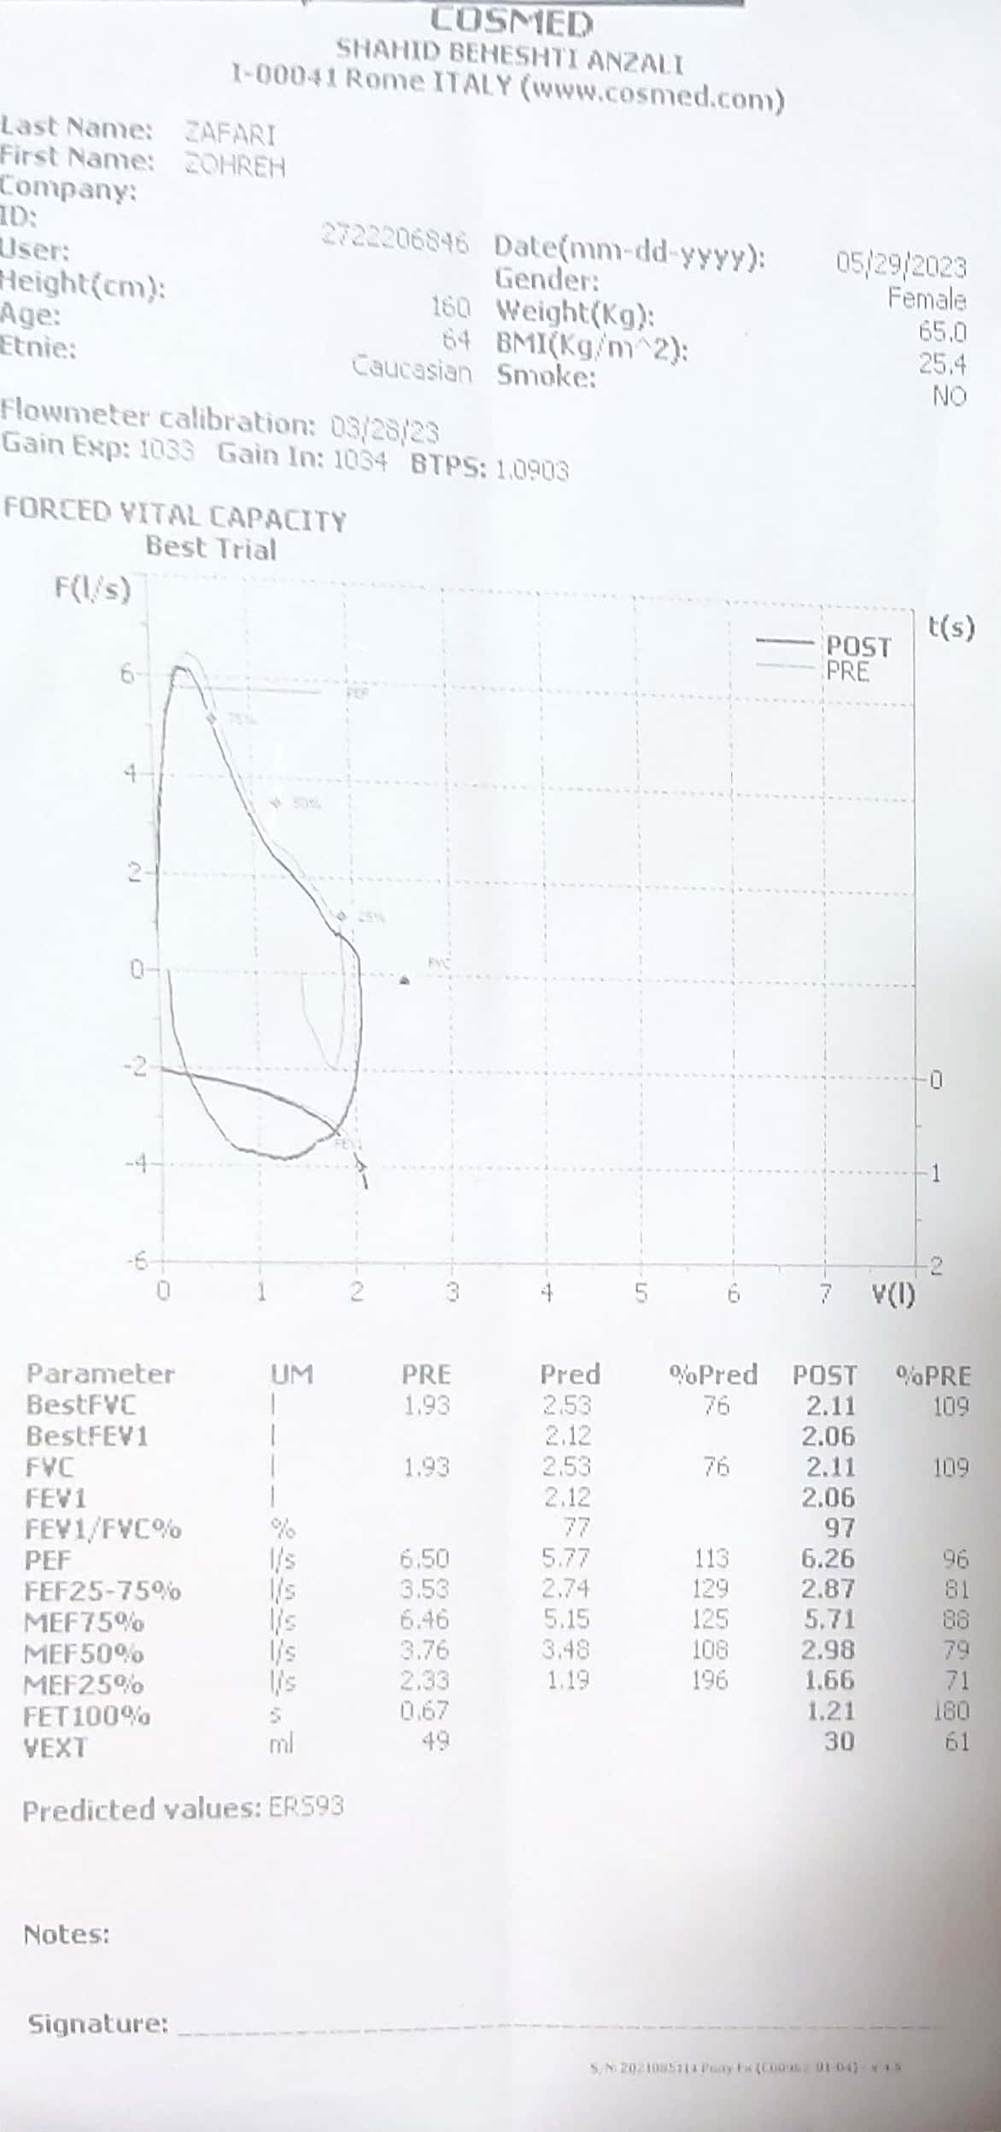

Slide 38
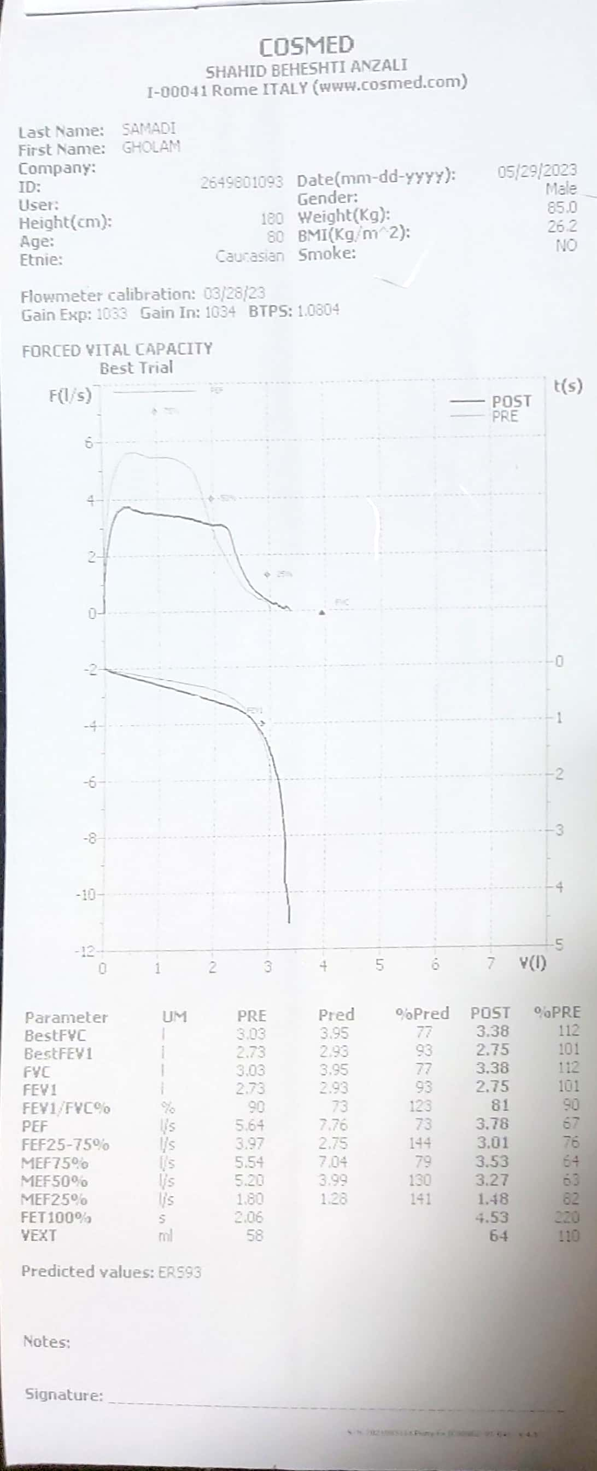

Slide 39
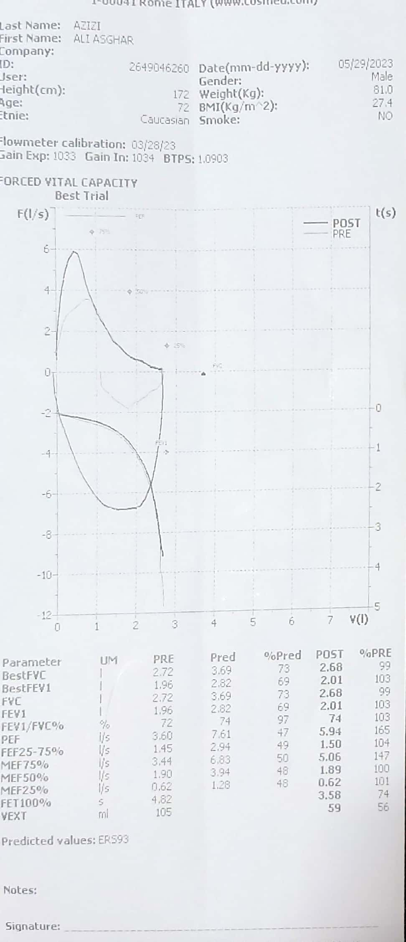

Slide 40
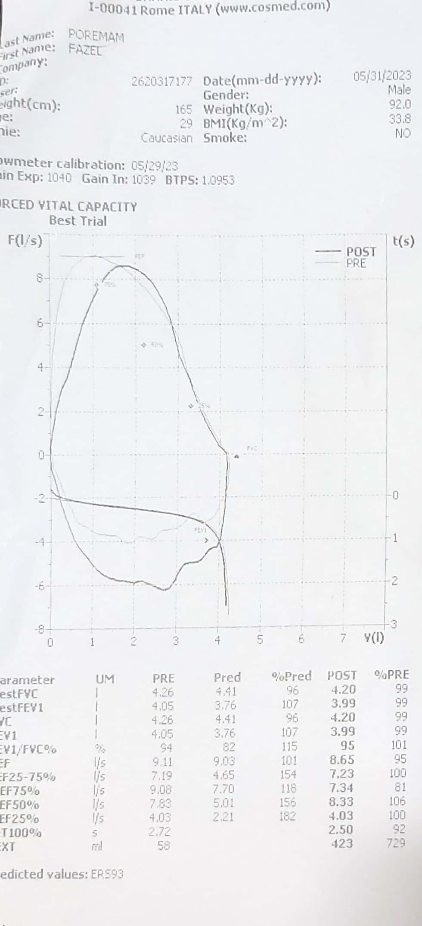

Slide 41
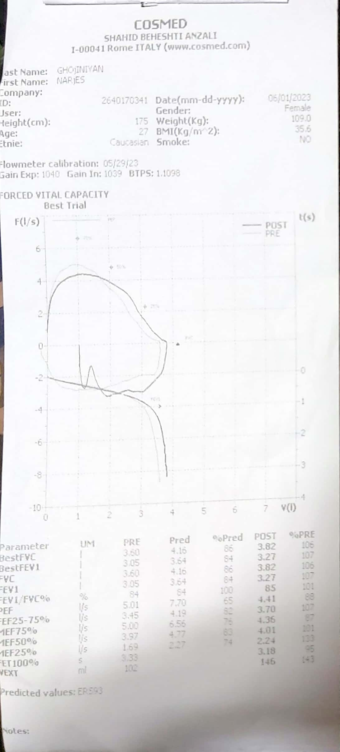

Slide 42
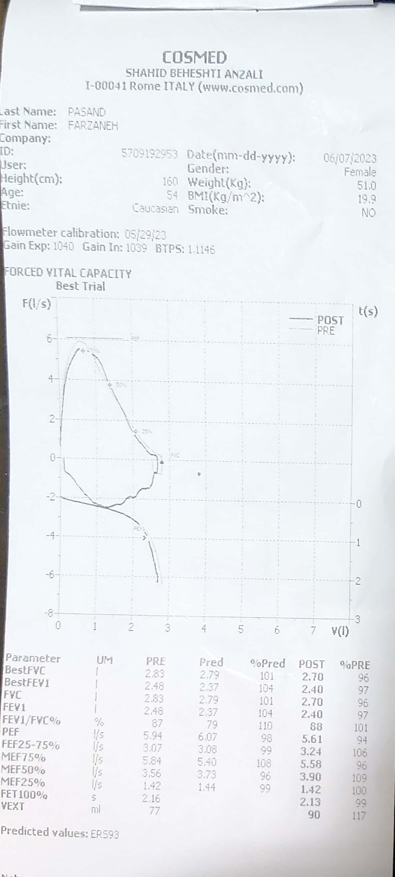

Slide 43
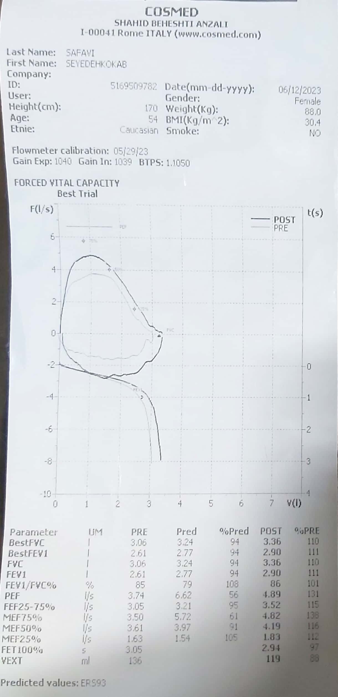

Slide 44
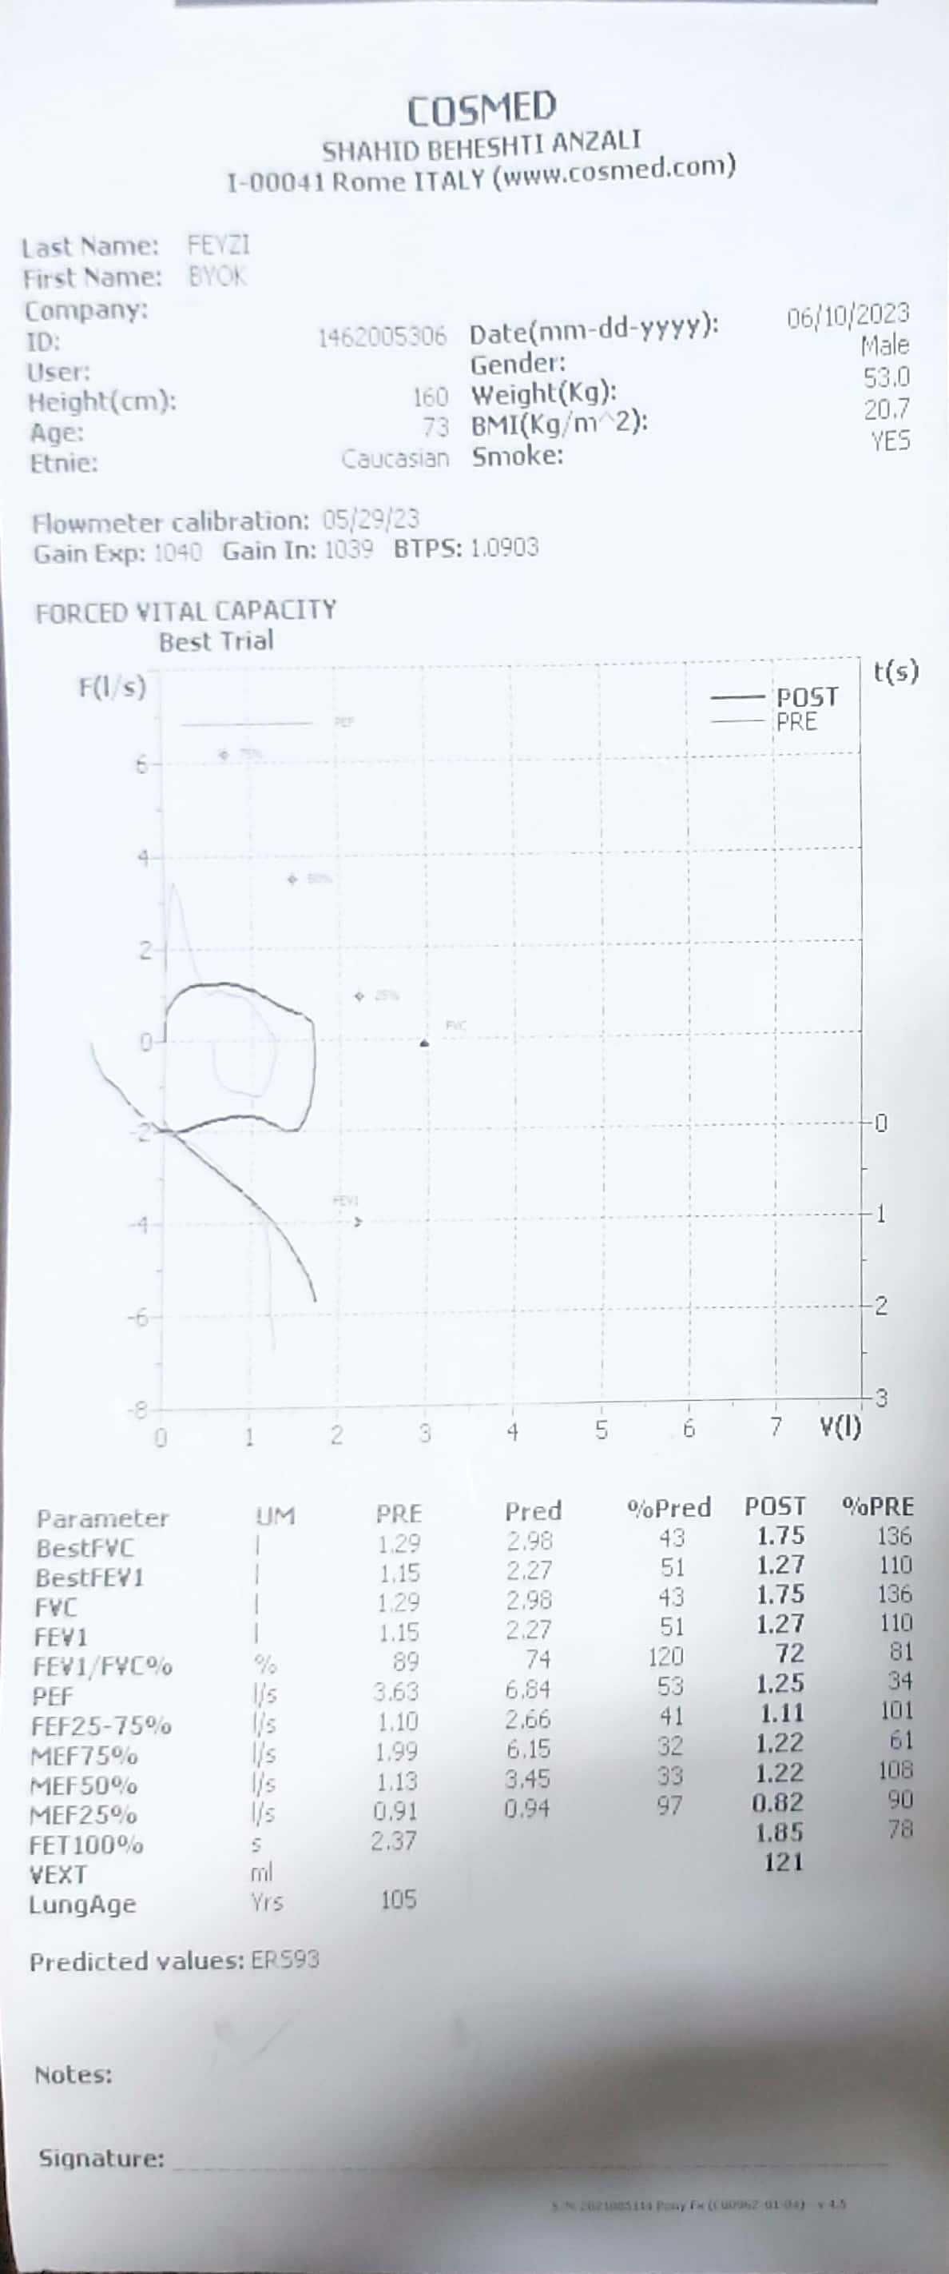

Slide 45
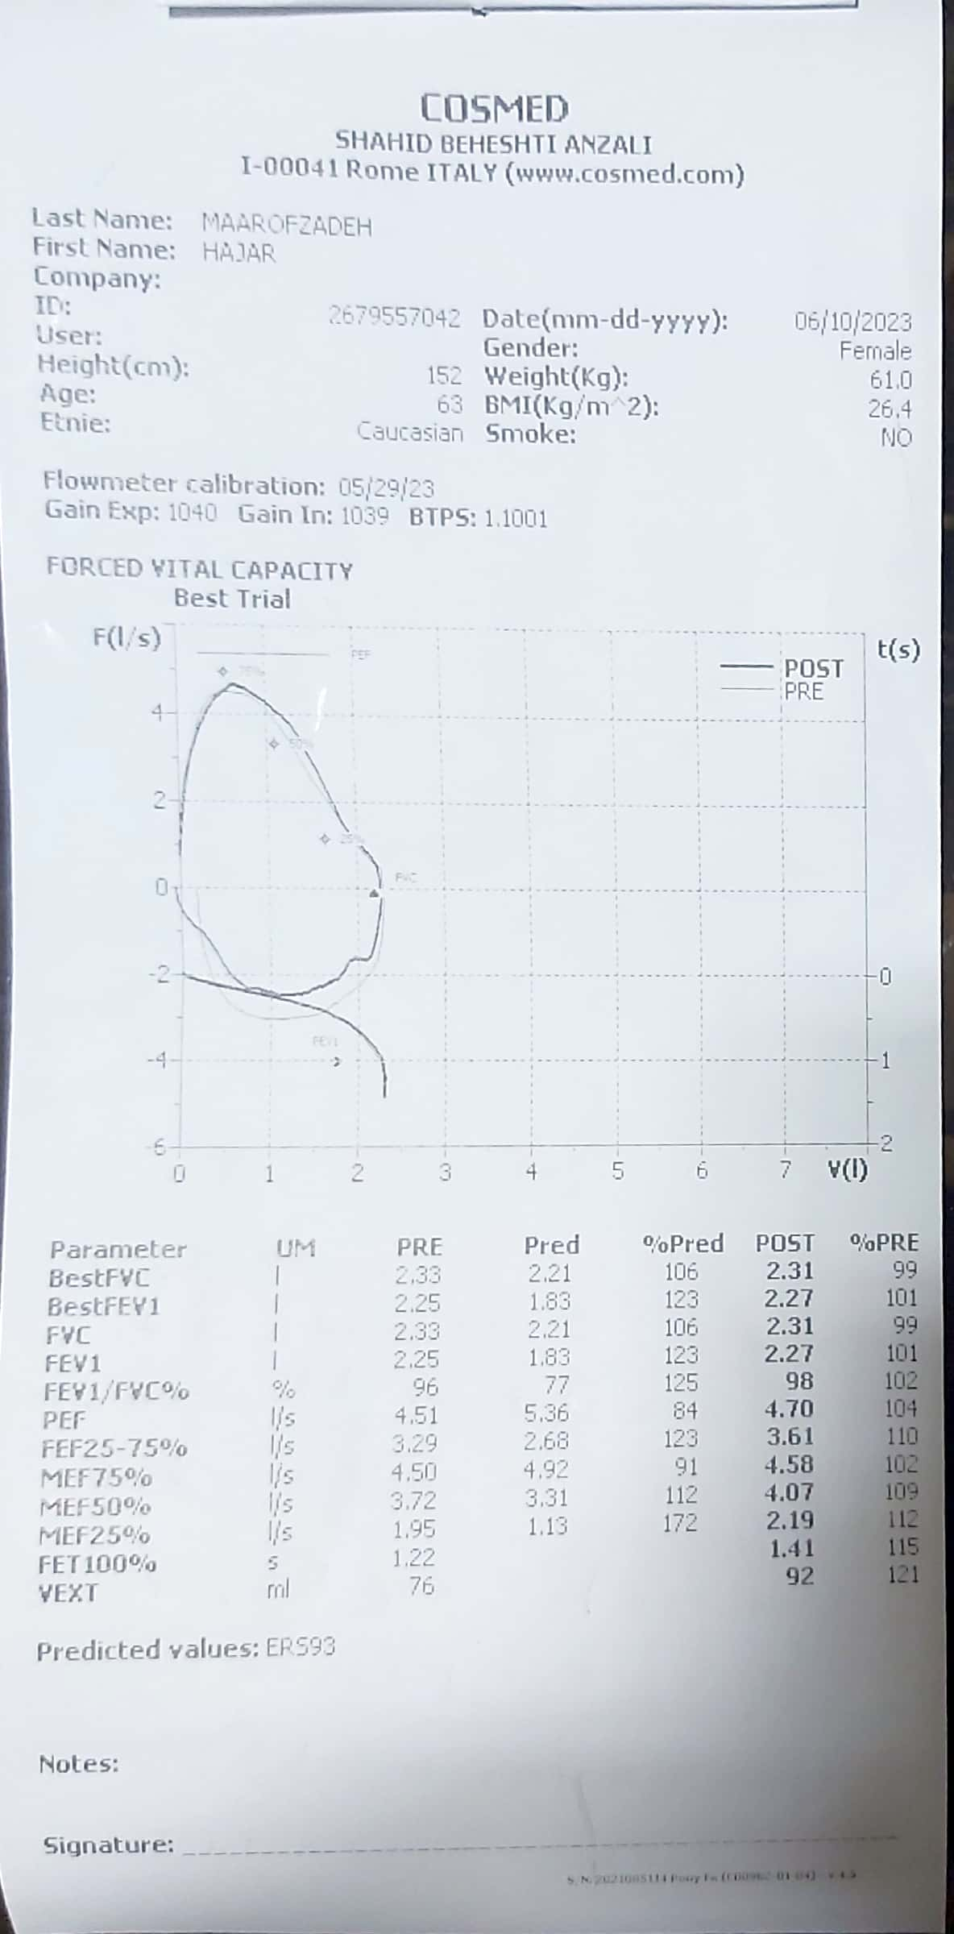

Slide 46
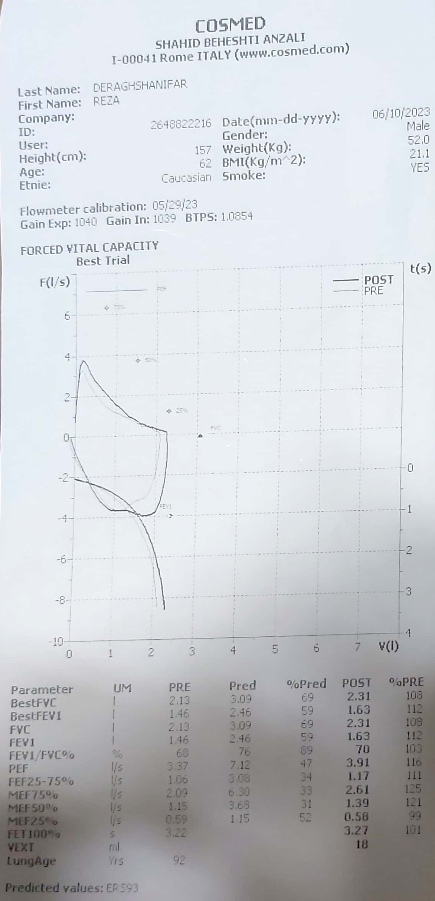

Slide 47
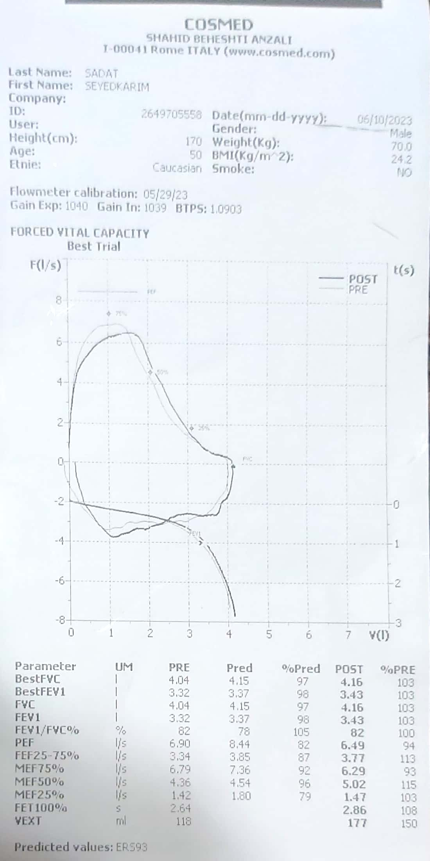

Slide 48
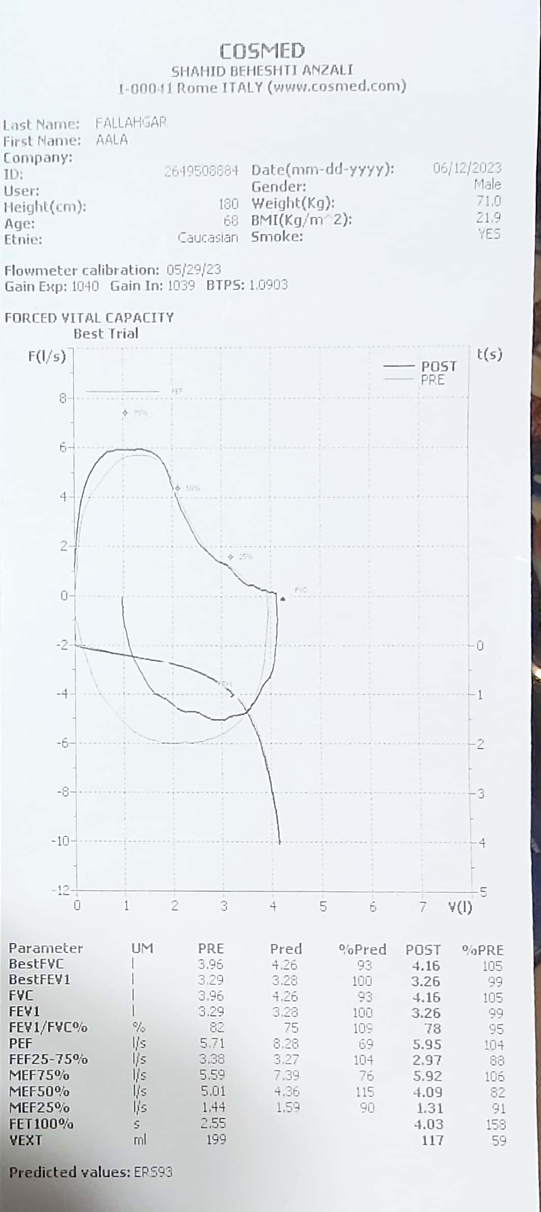

Slide 49
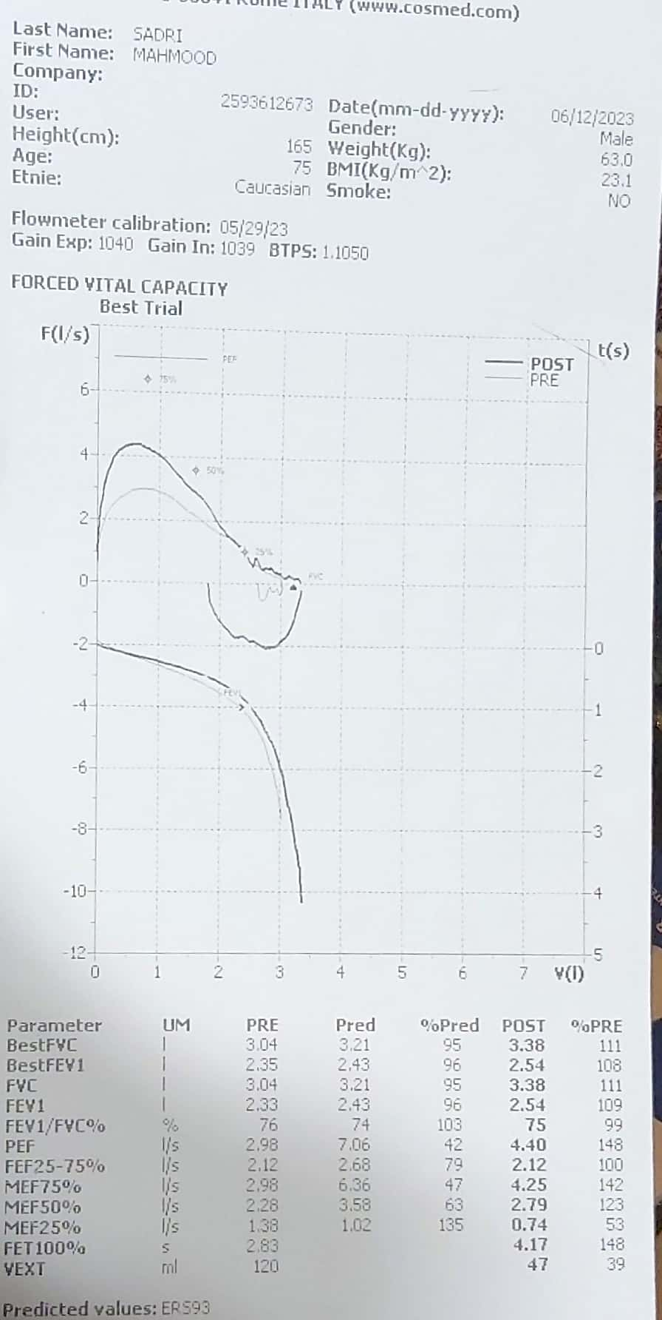

Slide 50
