Slide 1
Motor neurone disease
h.d. kasmaei
neurologist

Slide 2
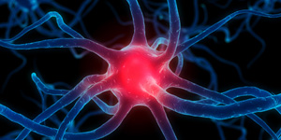
What is motor neurone disease?
Motor Neurone Disease (MND) is an uncommon disease that affects the brain and nerves
In MND your motor nerves become damaged and eventually stop working and you gradually lose your strength
There is currently no cure for Motor Neurone Disease

Slide 3
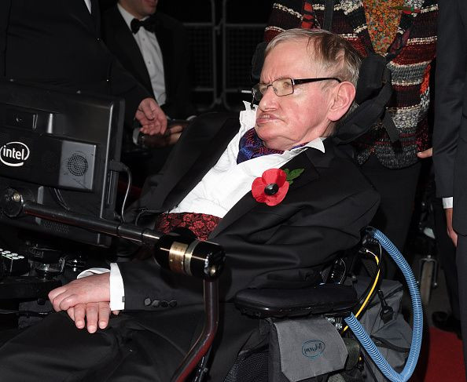
stephen hawking

Slide 4

Who gets it and why?
Motor Neurone Disease is an uncommon disease that can affect adults and children
Although it is uncommon it can affect anyone at any time
2 people in everyone 100,000 will develop Motor Neurone Disease each year

Slide 5
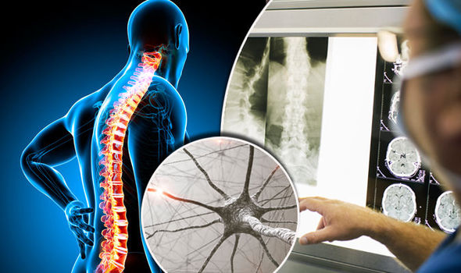
What happens to your body?
The physical effects of Motor Neuron Disease include:
Muscle aches, cramps and twitching
Weakness in arms and legs
Slurred speech, difficulty swallowing and chewing
50% of people with MND can experience changes in personality, behaviour, and language

Slide 6
Motor neurones are cells in the brain and spinal cord that allow us to move, speak, swallow and breathe by sending commands from the brain to the muscles that carry out these functions

Slide 7
Their nerve fibers are the longest in the body, a single axon can stretch from the base of the spinal cord all the way to the toes.

Slide 8
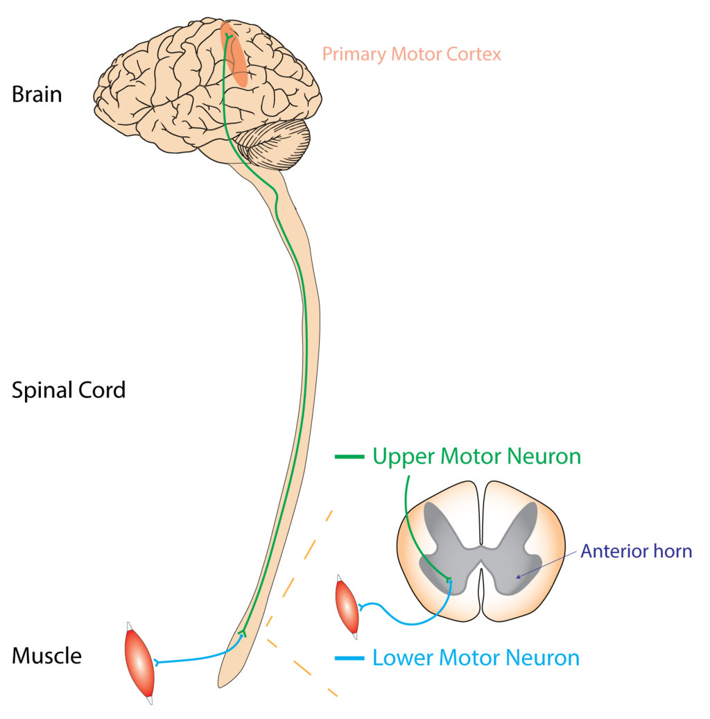

Slide 9
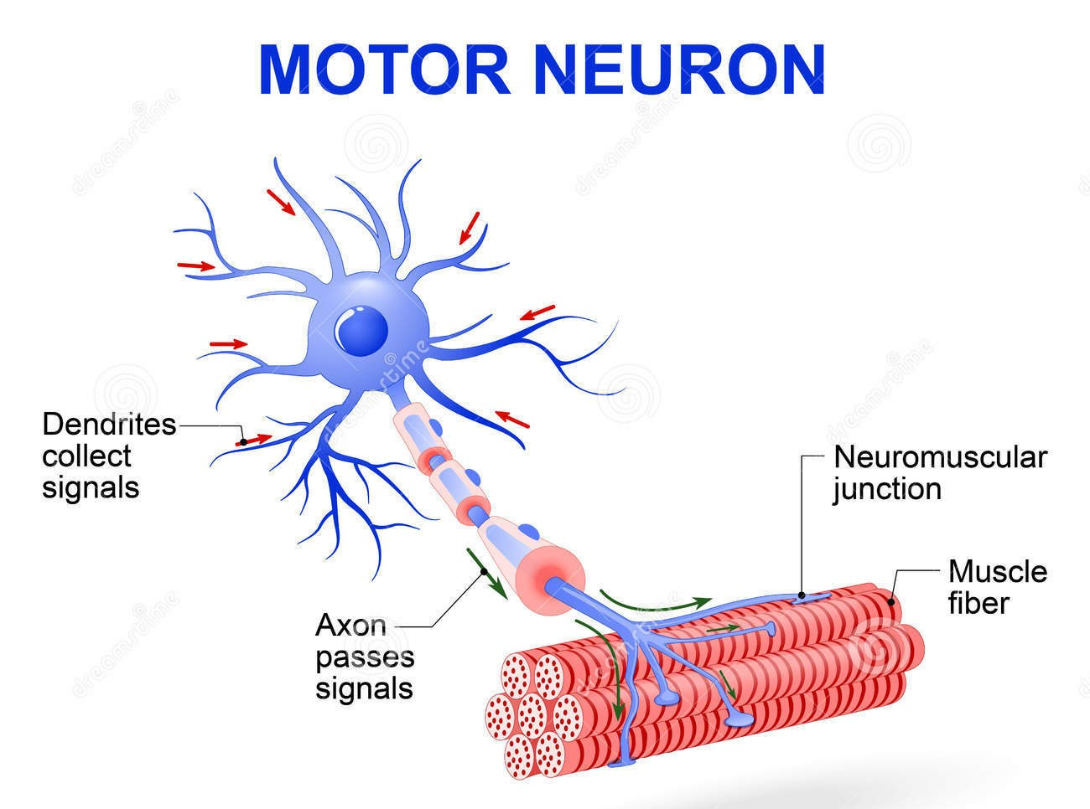

Slide 10
Motor neurons divided into either upper or lower motor neurones, forming various tightly controlled, complex circuits throughout the body. This controls both voluntary and involuntary movements through the innervation of effector muscles and glands. The upper and lower motor neurons form a two-neuron circuit.

Slide 11
Upper and Lower motor neurons utilize different neurotransmitters to relay their signals.
Upper motor neurons use glutamate
Lower motor neurons use acetylcholine.

Slide 12
Types of motor neuron diseases

Slide 13
Amyotrophic lateral sclerosis (ALS), formerly known as Lou Gehrig's disease, can affect the upper and/or lower motor neurons. It causes rapid loss of muscle control and eventual paralysis.

Slide 14
Spinal muscular atrophy (SMA) refers to a group of hereditary diseases that affect lower motor neurons. The most common form is caused by a mutated or missing gene known as the survival motor neuron gene 1 (SMN1), which causes the neurons to deteriorate, producing muscle weakness and wasting.

Slide 15
Spinal muscular atrophy with respiratory distress type 1 (SMARD1) is a very rare form of SMA caused by mutations in the IGHMBP2 (immunoglobulin helicase μ-binding protein 2) gene. Symptoms appear during infancy, between ages 6 weeks and 6 months. Children with SMARD1 suddenly may be unable to breathe due to diaphragm paralysis and may develop weakness in the muscles of their hands and feet.

Slide 16
Congenital SMA with arthrogryposis is a rare disorder that appears at birth. Symptoms include severe joint contractures, making babies unable to extend or flex the affected joints. In most children, both the arms and legs are affected. Other symptoms include scoliosis (curvature of the spine), chest deformity, respiratory problems, unusually small jaw, and drooping eyelids

Slide 17
Progressive bulbar palsy (PBP), also known as progressive bulbar atrophy, is due to injury of the upper motor neurons in the brainstem or the lower motor neurons connected to the brainstem. The brainstem controls the muscles needed for swallowing, speaking, chewing, and other functions.

Slide 18
Because they have difficulty swallowing, people with PBP are at risk of choking and inhaling food and fluids, including saliva, into the lungs. They may also laugh or cry at inappropriate times, called pseudobulbar affect or pathological laughing and crying. Some symptoms of stroke and myasthenia gravis are similar to those of progressive bulbar palsy (e.g. slurring of the speech and choking) and must be ruled out prior to diagnosis.

Slide 19
Primary lateral sclerosis (PLS) affects only the upper motor neurons, causing difficulty and slowness in the movements of the arms, legs, and face. Symptoms include weakness, muscle stiffness and spasticity, clumsiness, slowing of movement, and problems with balance and speech. The disorder often affects the legs first, followed by the torso, arms and hands, and, finally, the muscles used for swallowing, speaking, and chewing

Slide 20
PLS is more common in men than in women, with an onset that generally occurs between age 40 and 60. PLS progresses slowly over years or even decades. Extensive testing is required to rule out other disorders before diagnosing PLS. A neurologist may need to track the person’s symptoms for several years before making a diagnosis

Slide 21
Progressive muscular atrophy (PMA) is an uncommon subtype of ALS marked by slow but progressive damage to the lower motor neurons. It affects men more often than women, and usually at symptoms begin later in life than typical ALS. People with PMA usually notice weakness in their hands or feet followed by spreads into other body regions. They may have weakness in the torso muscles and may have trouble breathing. Exposure to cold can worsen the person’s symptoms. Other symptoms may include muscle wasting or shrinking, clumsy hand movements, twitches, and muscle cramps.

Slide 22
Kennedy's disease is an inherited lower motor neuron disorder that affects men. The onset of symptoms varies, but usually begins between the ages of 20 and 40. Kennedy’s disease is also known as spinal and bulbar muscular atrophy (SBMA), bulbo-spinal muscular atrophy, or X-linked spinal and bulbar muscular atrophy. It is caused by mutations in the gene for the androgen (male sex hormone) receptor. Daughters of people with Kennedy's disease have a 50% chance of having a son affected with the disease.

Slide 23
Kennedy's disease is slowly progressive., muscleEarly symptoms include tremor of the hands when they are outstretched, muscles cramps with exertion, and fasciculations. Eventually, individuals develop weakness in their arms and legs. Weakness of the facial and tongue muscles may occur later in the disorder and often leads to difficulty swallowing, slurred speech, and repeated cases of pneumonia. Some people develop gynecomastia and low sperm count or infertility. Others may develop diabetes.

Slide 24
Post-polio syndrome (PPS) usually occurs 15-40 years after a person has polio, an infectious viral disease. PPS is believed to be the result of deterioration of the motor neurons over many years that leads to loss of muscle strength and dysfunction. It is not contagious and only someone who has had polio can develop PPS. Not everyone who has had polio will develop PPS.

Slide 25
Who is more likely to have motor neuron diseases?
MNDs occur in both adults and children. In children, MNDs are typically caused by specific gene mutations, as in spinal muscular atrophy. Symptoms may be present at birth or appear in early childhood. In adults, MNDs are more likely to be sporadic,. Symptoms typically appear after age 50, though onset of disease can occur at any age.
While some MNDs are inherited, the causes of most MNDs are not known. In sporadic or non-inherited MNDs, environmental, viral, and/or other factors may play a role in the development of the disease

Slide 26
How are motor neuron diseases diagnosed and treated?
To diagnose MNDs, a doctor will obtain a thorough medical history and perform a physical exam followed by an extensive neurological exam to assess motor and sensory function, hearing and speech, vision, coordination and balance, thinking, and changes in mood or behavior

Slide 27
Laboratory tests of blood, urine, or cerebrospinal fluid can rule out other disorders that may have symptoms similar to MNDs.
On MRI it is characterized by a hyperintensity on T2-weighted imaging along the corticospinal tracts.
Muscle or nerve biopsy can help diagnose muscle or nerve disease; however, it is an invasive procedure and many experts do not believe it is needed to diagnose MND

Slide 28
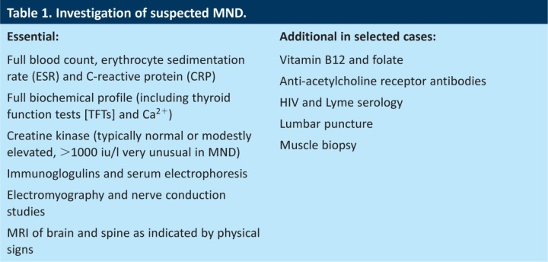

Slide 29
Emg-ncs help to confirm the diagnosis

Slide 30
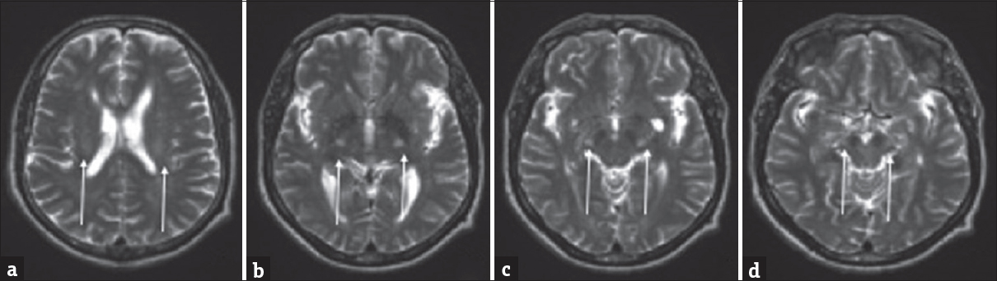
A 52-year-old male with progressive weakness with findings consistent with amyotrophic lateral sclerosis (ALS). (a-d) Axial T2-weighted images involving the corona radiata (a), posterior limb of the internal capsules (b), cerebral peduncles (c), and midbrain (d).

Slide 31
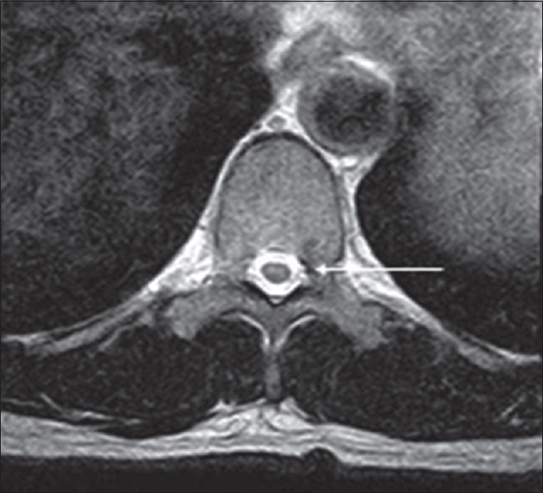
Adult male with acute-onset weakness compatible with progressive muscular atrophy. There are faint symmetric T2 hyperintensities within the anterior horns of the spinal cord

Slide 32
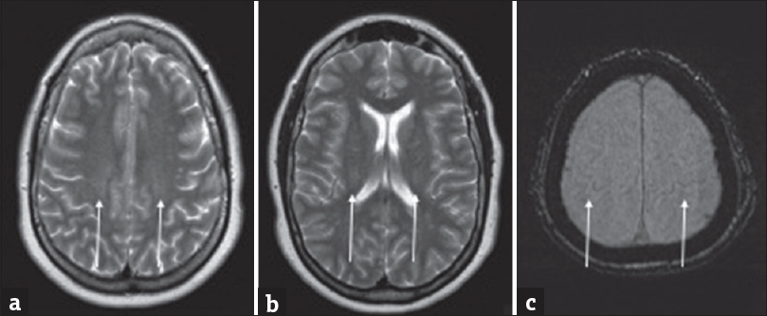
A 43-year-old male with excess fatigue compatible with primary lateral sclerosis. (a and b) Axial and sagittal FLAIR images demonstrate faint hyperintensities adjacent to the precentral gyri and along the corticospinal tracts. (c) Axial SWI image with susceptibility signal loss along the precentral gyrus.

Slide 33
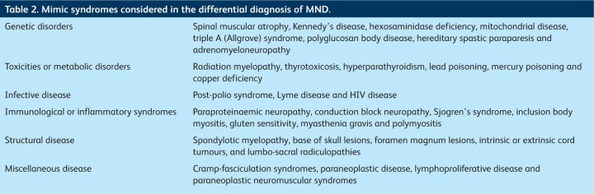
MND DDX

Slide 34
Treating MNDs
There is no cure for most MNDs, although new treatments are under development. The outlook for individuals with MNDs varies depending on the type and the age the person’s symptoms begin. Some MNDs, such as PLS or Kennedy's disease, are usually not fatal and progress slowly. The symptoms in people with SMA type III may be stable for long periods. Some forms of MND, such as the severe form of SMA and ALS, are fatal.

Slide 35
Several medications have been approved to treat MNDs. Some of these medications can slow progression of ALS and others target the gene mutations in SMA and genetic forms of ALS . People with MND may be prescribed muscle relaxers to reduce muscle stiffness and help with muscle spasms. They may also receive botulinum toxin injections to treat muscle stiffness by weakening overactive muscles or decrease drooling. Excessive saliva also can be treated with medications such as amitriptyline, glycopyrrolate, and atropine

Slide 36
Non-invasive ventilation (NIV) is the primary treatment for respiratory failure in ALS and was the first treatment shown to improve both survival and quality of life. NIV uses a face or nasal mask connected to a ventilator that provides intermittent positive pressure to support breathing. Continuous positive pressure is not recommended for people with ALS because it makes breathing more difficul

Slide 37
Supportive therapies for MNDs
People with MNDs may also benefit from supportive therapies and assistive devices to help them adapt to changes brought on by the disorders and maintain strength and function for as long as possible.
Physical and occupational therapy and rehabilitation may help the person improve their posture, prevent joint immobility, and slow muscle weakness and atrophy. Stretching and strengthening exercises can help reduce stiffness and increase range of motion and circulation. Some individuals may benefit from speech therapy to improve speech, chewing, and swallowing.

Slide 38
Riluzole has been found to modestly prolong survival by about 2–3 months. It may have a greater survival benefit for those with bulbar-onset ALS. It may work by decreasing release of the excitatory neurotransmitter glutamate from pre-synaptic neurons. The most common side effects are nausea and a lack of energy (asthenia).People with ALS should begin treatment with riluzole as soon as possible following their diagnosis. Riluzole is available as a tablet, liquid, or dissolvable oral film

Slide 39
Edaravone has been shown to modestly slow the decline in function in a small group of people with early-stage ALS. It may work by protecting motor neurons from oxidative stress. The most common side effects are bruising and gait disturbance. Edaravone is available as an intravenous infusion or as an oral suspension

Slide 40
AMX0035 (Relyvrio) is a combination of sodium phenylbutyrate and taurursodiol, which was initially shown to prolong the survival of patients by an average of six months. Relyvrio was withdrawn by the manufacturer in April 2024following the completion of the Phase 3 PHOENIX trial which did not show substantial benefit to ALS patients.

Slide 41


