Slide 1
Multiple Sclerosis :
A review for internists
September - 2024
Dr.N,Beladi Moghadam
Shahid Beheshti University of Medical Sciences

Slide 2
A leading cause of neurological disability.
MS is a prevalent neurological disorder that significantly impacts public health across .
Multiple sclerosis (MS) is a chronic, inflammatory and neurodegenerative disorder of the central nervous system (CNS), affecting over 2.9 million people worldwide.
It typically starts between 20 years and 40 years, with a female preponderance and an overall ratio of 3:1 for females to males.
While up to 10% of patients experience the first clinical disease manifestation before the age of 18 years , recent epidemiological evidence indicates an increasing incidence of the disease after the age of 50 years.

Slide 3
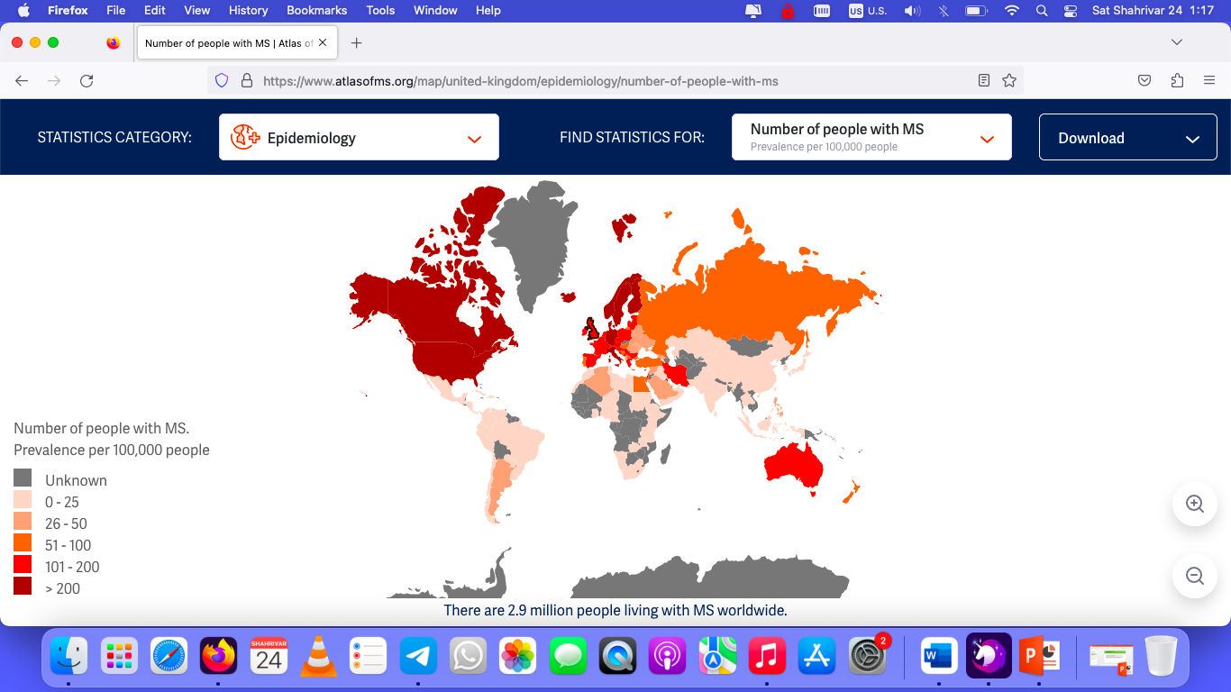
The epidemiology of MS :
A multifactorial etiology involving both environmental and genetic factors
The highest regional prevalence was reported in the Scottish Highlands–376 cases per 100,000
Countries in Southern Europe tend to have lower rates, as seen in Greece with a prevalence of 43.6 per 100,000 inhabitants.

Slide 4
Incidence, or the number of new cases diagnosed annually, also exhibits regional disparities. Longitudinal studies have documented an increase in MS incidence.
which seems to have stabilized around 2000.
Higher incidence rates have been reported in Northern Europe, including Scotland and Scandinavia, compared to Southern and Eastern Europe.

Slide 5
The geographical distribution of MS : a “latitudinal gradient
Interestingly, several studies revealed that migration in early life can affect the risk of developing MS, as individuals acquire the same risks as the host population, whereas individuals who migrate after the age of 15 years retain the disease risk of their native country.
Although latitude seems to influence prevalence more than incidence, this pattern implicates a predominant role of environmental factors such as EBV infection, sunlight exposure and vitamin D levels in the development of MS, in addition to genetic predispositions

Slide 7
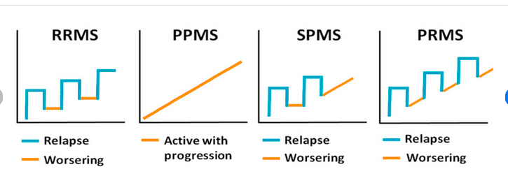
Highly heterogenous clinical phenotype:
Relapsing - Remitting (RR)
Primary Progressive (PPMS) onset.
RRMS is the more common phenotype, affecting 85–90% of patients, while PPMS occurs in 10–15% of patients, and is characterized by insidious, relentless accumulation of neurological disability, usually without relapses.
Over time, most people with RRMS may develop a progressive course, known as secondary progressive (SP MS ) , characterized by a gradual accumulation of disability with or without relapses.
Progression independent of relapse activity (PIRA), which refers to disability accrual in the absence of relapses and “inflammatory activity,” is present even in the early stages of relapsing MS and often goes undetected due to the limitations of clinical and paraclinical measures.

Slide 8
An attack ( Relapse ) is defined as :
A neurologic disturbance .
It can be documented by subjective report or by objective observation, but it must last for at least 24 hours.
Pseudoattacks and single paroxysmal episodes must be excluded.
To be considered separate attacks, at least 30 days must elapse between onset of one event and onset of another event.

Slide 9
MS symptoms : vary by location and severity of the lesions occurring within the CNS.
Optic neuritis,
Lhermitte sign
Sensory loss or altered sensations,
Motor weakness,
Fatigue,
Urinary dysfunction,
Cognitive dysfunction,
Incoordination, and walking difficulties.
Patients with PPMS most often present clinically with progressive myelopathy, although sensory ataxia, cerebellar ataxia, cognitive symptoms, and progressive visual loss have been reported as well

Slide 10
Clinically Isolated Syndrome (CIS)
In recent years, clinically isolated syndrome (CIS), was added to the established classifications as an additional MS phenotype.
CIS is diagnosed with the first episode of symptoms typical of MS that lasts longer than 24 hours; however, patients with CIS do not meet diagnostic criteria for RMS.
Up to 80% of patients diagnosed with CIS who have abnormal MRI findings will develop MS in the future, compared with 20% of patients with CIS who have normal MRI findings.

Slide 11
Radiologically Isolated Syndrome ( RIS)
Indicates a preclinical prodromal stage of the disease, that can precede symptom onset for years.
No history of clinical symptoms typical of MS but have CNS WM lesions that are highly suggestive of inflammatory demyelination based on their size, number, shape, and location, possibly reflecting individuals with subclinical and prodromal stages of MS.
Incidence : (0.8 cases of RIS per 100,000 person-years in Sweden), but approximately 51% of individuals will develop clinical symptoms of MS within 10 years after being deemed RIS, most often with a RR course.
In 2017, it was suggested that the 2017 McDonald criteria for DIS and DIT in MS could be used in RIS.
An individual could be classed as having RIS if they have one or two DIS locations associated with two of the three following features:
≥1 spinal cord lesions,
presence of CSF-specific OCBs,
DIT (i.e., new T2-hyperintense or Gd-enhancing lesions) on the follow-up MRI

Slide 12
RIS : Predictors of a first clinical event at 5 and 10 years :
Younger age (<35 years) at the time of RIS identification,
male sex,
CSF-restricted OCBs or elevated CSF immunoglobulin G (IgG) index,
Abnormal visual evoked potentials,
Higher serum neurofilament light chain levels,
Infratentorial, spinal cord or Gd- enhancing lesions on MRI.
==================================================
The presence of a higher number of spinal cord lesions is associated with a higher risk of a PPMS course.

Slide 13
DIAGNOSTIC WORKUP
1- A focal demyelinating pathology affecting at least two distinct central nervous system (CNS) areas (i.e., dissemination in space ( DIS)
2- Occurring at separate times (i.e., dissemination in time (DIT)
3- The exclusion of alternative diagnoses
The McDonald criteria, which were developed in 2001 by an international expert panel and revised several times, most recently in 2017, provide recommendations on the diagnosis of MS, including diagnosis after a single attack.
The criteria consist of a combination of clinical, imaging, and paraclinical tests (ie, CSF, evoked potentials)

Slide 14
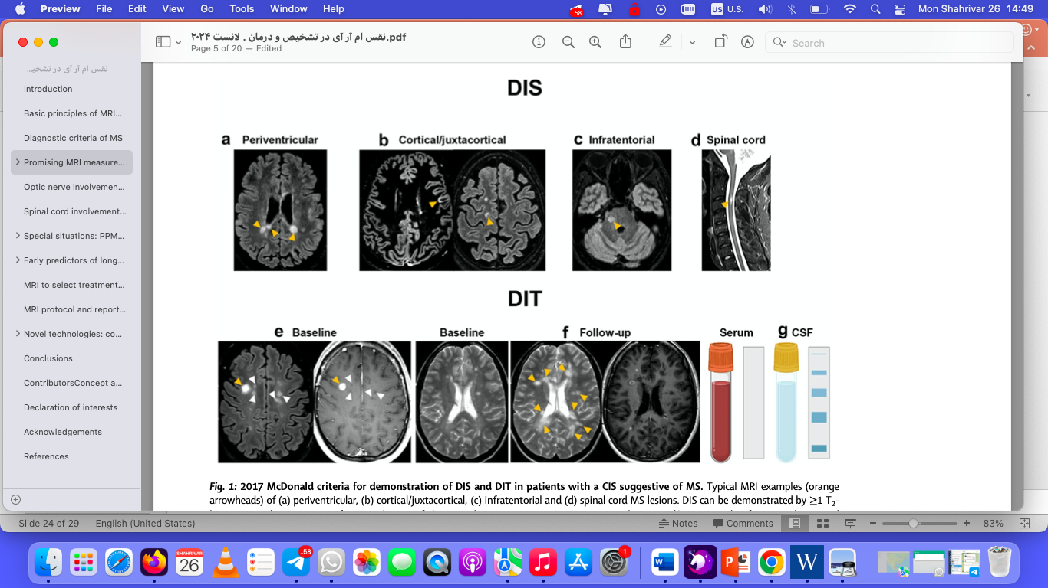
The McDonald criteria : 2017
For the current dissemination-in space criteria, MS lesions must be seen in at least two of the following four locations:
1- cortical/juxtacortical,
2- periventricular,
3- infratentorial,
4- and spinal cord
Radiological dissemination in time (DIT) can be achieved through the :
simultaneous presence of gadolinium-enhancing and nonenhancing lesions on one scan, or by presence of new lesions on follow-up scans , or presence of CSF-specific OCBs
New changes are coming soon !
Central Vein Sign ( CVS )
Paramagnetic rim lesions

Slide 15
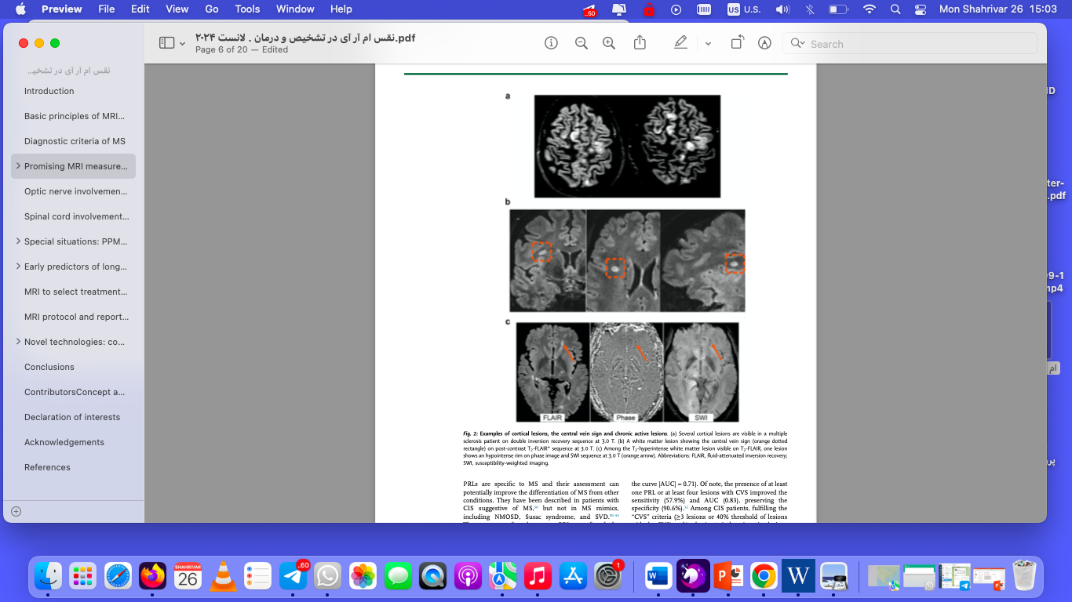
Examples of cortical lesions, the central vein sign and chronic active lesions.
(a) Several cortical lesions are visible in a multiple sclerosis patient on double inversion recovery sequence at 3.0 T.
(b) A white matter lesion showing the central vein sign (orange dotted rectangle) on post-contrast T2-FLAIR* sequence at 3.0 T.
(c) Paramagnetic rim lesions : Among the T2-hyperintense white matter lesion visible on T2-FLAIR, one lesion shows an hypointense rim on phase image and SWI sequence at 3.0 T (orange arrow). They can be visualized with susceptibility-based imaging as lesions showing an hypointense rim (i.e., paramagnetic rim lesions [PRLs]) since they are usually surrounded by activated microglia, which are rich in iron

Slide 16
The proposed criteria changes : September 2024
To make diagnosing MS "faster and easier."
optic neuritis is the first manifestation of MS in 25%-35% of cases with clinically isolated syndrome (CIS)
Optic nerve serve as the "fifth topography" or a fifth anatomical location to demonstrate dissemination in space (DIS) if there's no better explanation for optic nerve pathology.
** At least one lesion in at least 2 of the 5 topographies after including the optic nerve.
Most patients with RIS will develop MS within 10 years.
Demonstrating DIS alone, without the need for DIT or positive cerebrospinal fluid (CSF), may be sufficient for an MS diagnosis. Currently, both DIS and DIT are required.
** The following criteria are sufficient for an MS diagnosis:
1- fulfilling both DIS and DIT;
2- fulfilling DIS and the presence of oligoclonal bands (OCBs) in the cerebrospinal fluid;
3- fulfilling DIS along with six or more central vein signs (CVS).
The addition of CVS and paramagnetic rim lesions, which are MRI markers of chronic active lesions, as optional tools for MS diagnosis in certain situations. Demonstration of CVS by MRI can increase specificity
Evidence also suggests that kappa free light chains (KFLCs) could serve as a valid, simpler, and rater-independent alternative to detecting OCBs. Because KFLCs are interchangeable with OCBs, they can be used in place of OCBs for diagnosing MS through CSF analysis.
Stricter Criteria :
Stricter criteria for confirming an MS diagnosis in those over age 50 or individuals with headache or vascular disorders. In such patients, they strongly recommend additional features such as a spinal cord lesion, positive CSF, and CVS select 6 (six positive lesions).
The panel is also recommending laboratory tests (MOG-IgG Ab) to confirm a diagnosis in children and adolescents
The presence of CVS in about 50% of T2 lesions strongly suggests MS in this population.

Slide 17
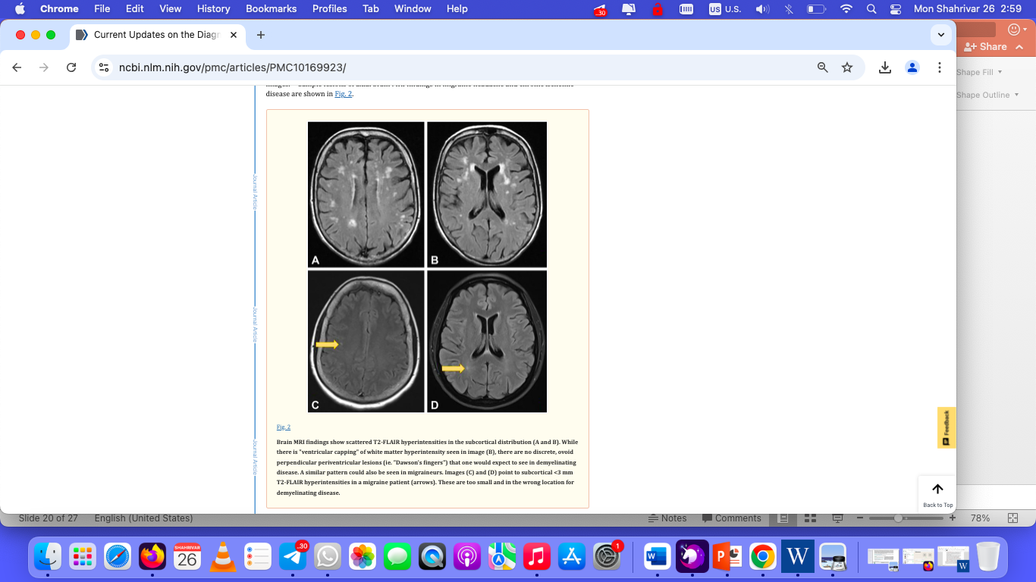
Mimics of MS include :
CNS vasculitis
Neurosarcoidosis
Neuroborreliosis
Neuromyelitis optica (NMO)
Myelin oligodendrocyte glycoprotein antibody disease (MOGAD)
Autoimmune glial fibrillary acidic protein (GFAP) astrocytopathy

Slide 18
MRI & Early predictors of long-term outcome :
A higher number of brain T2-hyperientense WM lesions
A higher number of infratentorial lesions
At disease onset, spinal cord lesions : Lesion activity,
Either the number of Gd-enhancing lesions or short- term changes in T2-hyperintense WM lesion number and load during the first 1–5 years of the disease

Slide 19
MRI protocol and report in MS diagnosis
The 2021 MAGNIMS–CMSC–NAIMS international consensus recommendations offer revised guidelines on the use of MRI in MS :
Even though 3.0 T MRI scanners are preferred since they improve brain lesion detection and may reduce acquisition times, those with 1.5 T are still sufficient for lesion detection.
For diagnosis, :
Brain sequences include T2-weighted 3D-FLAIR, axial T2-weighted, and post-Gd T1-weighted , sagittal T2-weighted 3D-FLAIR sequence,
Gd-based contrast agents dose : is 0.1 mmol/kg body weight and the time delay between contrast administration and T1-weighted acquisition should not be shorter than 5 min.
Spinal cord MRI :
Acute optic neuritis: Orbital MRI + Fat suppression + Gd
MRI may be performed at the lumbosacral spine :
Dedicated optic nerve MRI is not recommended except for differential diagnosis with NMOSD, MOGAD and in patients with atypical clinical features
Report :

Slide 20
Disease monitoring by MRI :
3–6 months after the treatment onset , followed by annual brain MRI without gadolinium contrast while the patient is undergoing DMT.
Consider longer intervals in clinically stable patients after the first few years of treatment, particularly if safety monitoring is not required.
Spinal cord MRI is not routinely recommended to detect subclinical activity

Slide 21
Acute Relapse Management :
The use of intravenous (IV) corticosteroids (e.g., 1,000 mg of IV methylprednisolone daily for 3–5 days) may shorten the flare duration, but this does not impact the overall disability outcome.
One exception is optic neuritis, for which the Optic Neuritis Treatment Trial found that patients treated with high-dose steroids had better visual outcomes at 6 months.
Oral prednisone at 1,250 mg daily can be a substitute for 1 g of IV methylprednisolone.
Plasma exchange can be considered for patients with symptoms that are refractory to IV steroids.
IV immunoglobin monotherapy can be considered in cases of acute MS relapse in patients with contraindications to plasmapheresis and IV steroid therapy, although there is less evidence supporting this.

Slide 22
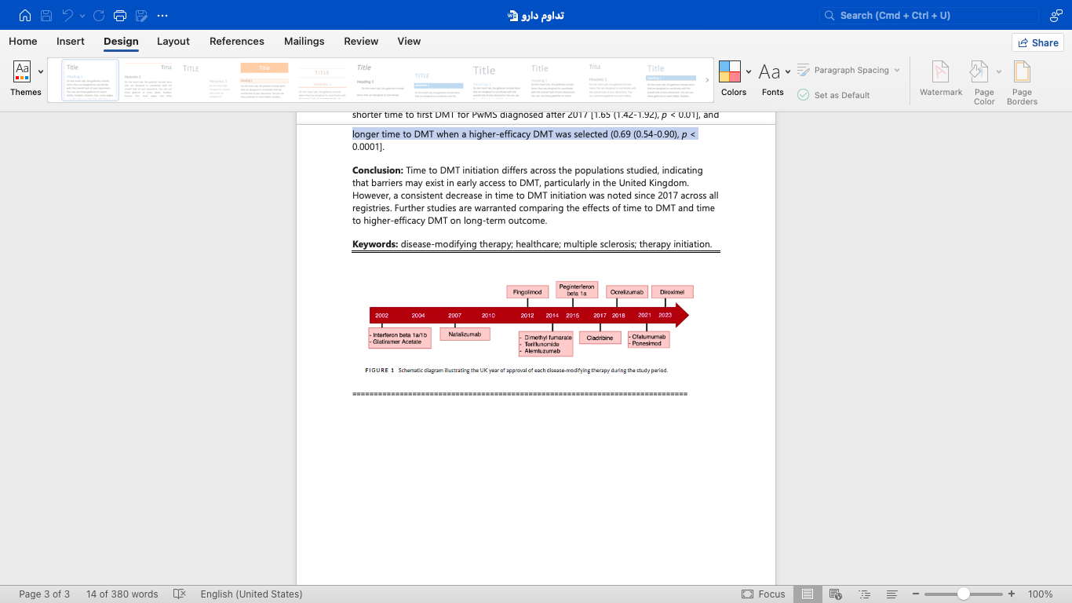
Appropriate selection of MS therapies (DMTs) :
Since approval of the first DMT—interferon-beta-1b—in 1993, many more medications that lower relapse rates, reduce new disease activity, and delay disease progression have been approved by the FDA.
The treatment landscape for multiple sclerosis : Has dramatically grown in terms of available options and complexity.
Various mechanisms of action and safety profiles :

Slide 23
Appropriate selection of MS therapies : is critical to maximize patient benefit.
1993 : Interferon-beta-1b
2002-2004 : Interferon-beta-1a – Glatiramer Acetate
2007 : Natalizumab ( Tysabri)
2012-2014 : Oral : Fingolimod- Dimethyl fumarate – Teriflunomide
2014 : Alemtuzumab (Lemtrada )
2015 : Pegi Interferon-beta-1a
2017 : Cladribine ( Mavenclad)
2018 : Ocrelizumab
2019 : Siponimod ( Mayzent )
2020 : Ozanimod ( ZEPOSIA)
2021 : Ofatumumab ( KESIMPTA ) – Ponesimode ( Ponvory )
2023 : Diroximel
2023 : Ublituximab (BRIUMVI )

Slide 24
DMT Selection ?
The traditional, or escalation, approach :
Beginning with a low-/modest-efficacy DMT and switching to a higher efficacy DMT when breakthrough disease occurs as evidenced by a clinical relapse or new radiologic activity (for example, new or enhancing lesions).
The early aggressive, or induction, approach :
Bypassing the low-/modest-efficacy DMTs and starting with a high-efficacy DMT. Each approach has its rationales and challenges, but it is known that many of the currently approved high-efficacy DMTs have superior long-term clinical benefit to the less or modestly effective DMTs, both in and out of clinical trials.
Treatment selection for each MS patient is typically influenced by many factors, including :
Demographic features (i.e., sex and age)
Relapse ( severity , rate, brain stem or spinal cord onset)
lesion load and location
level of disability
Progressive disease course
Family planning
Comorbidities
MRI prognostic factors
Compliance
Socio economic condition
Concerns about the DMT safety profile or potential long-term adverse reactions
1993 : Interferon-beta-1b
2002-2004 : Interferon-beta-1a – Glatiramer Acetate
2007 : Natalizumab ( Tysabri)
2012-2014 : Oral : Fingolimod- Dimethyl fumarate – Teriflunomide
2014 : Alemtuzumab (Lemtrada )
2015 : Pegi Interferon-beta-1a
2017 : Cladribine ( Mavenclad)
2018 : Ocrelizumab
2019 : Siponimod ( Mayzent )
2020 : Ozanimod ( ZEPOSIA)
2021 : Ofatumumab ( KESIMPTA ) – Ponesimode ( Ponvory )
2023 : Diroximel
2023 : Ublituximab (BRIUMVI )

Slide 25
Pulsed immune reconstitution therapies :
Maintenance/escalation therapy do not maintain their beneficial effect after cessation of therapy, some new highly effective therapies can show prolonged treatment effects after a short treatment course
Or pulsed immunosuppressive therapies : typical representatives are alemtuzumab and cladribine.
Autologous haematopoietic stem cell transplantation(aHSCT) could be considered as the strongest immune reconstitution therapy.

Slide 26
Symptomatic therapy :
Bladder dysfunction : Oxybutinin – Sulifenacin – Toltrodine
Spasticity : Botulinum toxin , Tizanidine – Baclofen
Depression : SSRI – SNRI – TCA ..
Fatigue: Amantadine – Modafinil
Paresthesia and Dysesrhesia : Pregabalin – Gabapentin – TCA – Duloxetine
Tremor : Propranolol – Levethiracetam
Pain : Pregabalin – Gabapentin – TCA – Duloxetine
Walking : Dalfampridine
Paroxysmal events : Carbamazepine ..

