Slide 1
Cardiology in practice
Digoxin
Motahareh Hatami MD,MPH
Assistant Professor of Cardiology
Tehran University of Medical Sciences
Tehran Heart Center

Slide 2
Objectives:
Mechanism of action
Indication for DIG administration
Dosing
Monitoring
sign of toxicity
Toxicity management

Slide 3
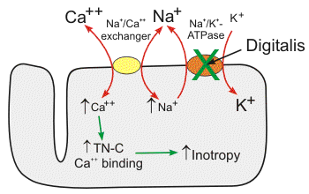
MECHANISM OF ACTION

Slide 4
Mechanism of action:
inhibiting the Na+,K+-ATPase pump in cell membranes
sensitize Na+,K+-ATPase activity in vagal afferent nerves, leading to an increase in vagal tone
Inhibits Na+,K+-ATPase activity in the kidney and therefore may blunt renal tubular resorption of sodium

Slide 5
INDICATION:
ATRIAL FIBRILLATION
HFREF
Right sided HF

Slide 6
ATRIAL FIBRILLATION
1st line treatment in EF<40
2nd line of treatment in EF>40 after BB and NDCCB
2nd line of treatment for acute rate control in ED

Slide 7
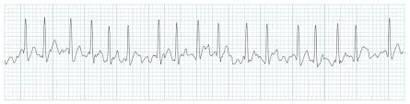
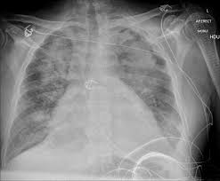
WHAT is your opinion?
Rate or rhythm control of AF RVR in acute decompensated heart failure?

Slide 8
Answer:
Braunwald:

Slide 9
Answer:
Uptodate:
  The initial strategy is to treat the HF with diuretics, vasodilators, and other agents while slowing the ventricular response of the AF to less than 120 beats per minute.
  Rate control strategy:
    Amiodarone or digoxin,try agent for 1 or 2 days.
  Rhythm control strategy:
    We rarely consider an initial cardioversion for treatment of patients with acute decompensated HF
      Initial attempts to decrease pulmonary congestion with diuretics, vasodilators, and rate control have failed
      AF is thought to be the cause of acute HF decompensation.
      Patients with persistent evidence of myocardial ischemia.

Slide 10
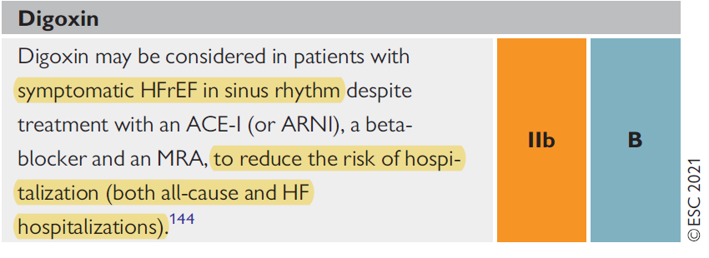
HFREF IN SINUS RHYTHM:
Braunwald:
  Withdrawal trials: PROVED and RADIANCE
  DIG trial: Although the DIG trial showed that digoxin had a neutral effect on the primary endpoint of mortality, digoxin reduced hospitalizations (including 30-day readmission for HF)12 and favorably affected the combined endpoints of death or hospitalization due to worsening HF
ESC 2021& AHA 2022:

Slide 11
Right sided HF
NO GUIDELINE based recommendation
Small trials showed some benefit
Meta analysis showed no overall benefit

Slide 12
Dosing:
LOADING
MAINTENANCE

Slide 13
LOADING
HEART FALURE
Generally no need for loading
IV: 0.75-1.5 mg/24h
LOADING
Atrial fibrillation
Oral:1-1.5 mg/24h
How to choose the best dose for initial loading:
Severe CKD
REDUCE 50 PERCENT
K,mg,ca,TFT
K, mg ,ca hypothyroidism
Reduce 50 percent
Lean body weight
<45:0.75mg
45-70:0.75-1mg
70-90:1-1.5 mg
IV:0.25-0.5 mg IV stat then 0.25 mg every 6 hour
oral:0.5 mg oral stat then 0.25 mg every 6 hour

Slide 14
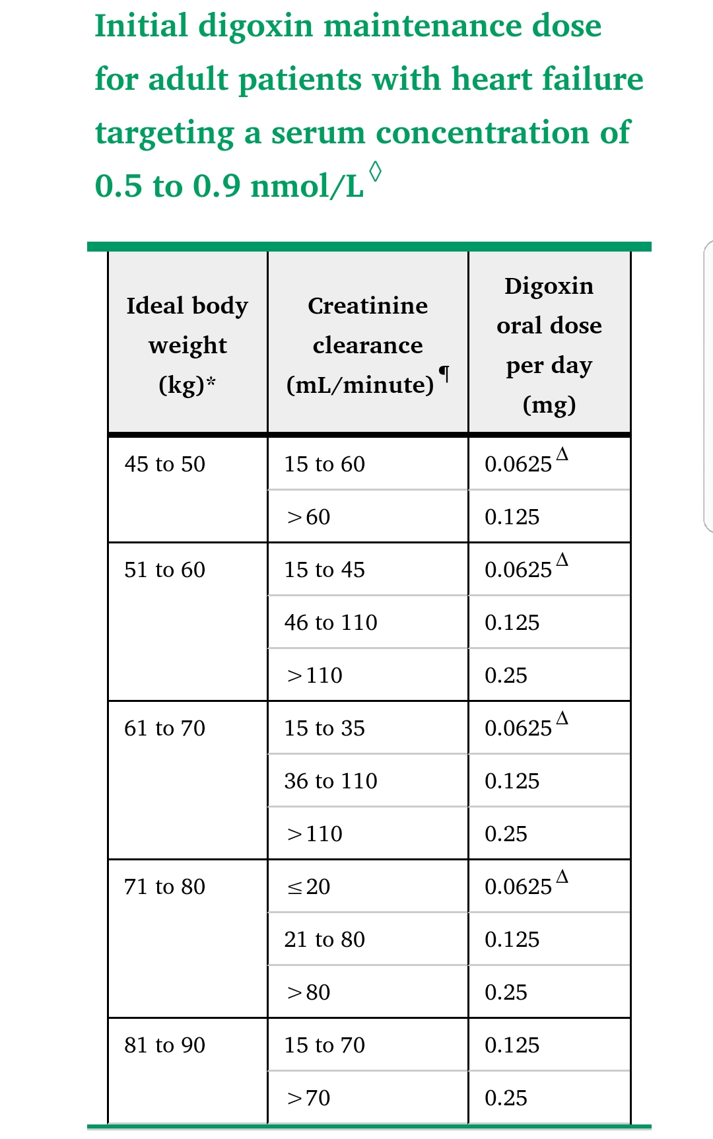
MAINTENANCE
CRCL
Ideal body weight
Other drug:amiodarone,propafenone,diuretic
AF:0.125-0.25 mg/day
HF:lower maintenance dose than AF
In contrast to digoxin use for heart failure, there is no particular serum digoxin level which is targeted, as the medication should be adjusted to maintain optimal ventricular rate control

Slide 15
MAINTENANCE
CRCL
Ideal body weight
Other drug:amiodarone,propafenone,diuretic
AF:0.125-0.25 mg/day
HF:lower maintenance dose than AF
In contrast to digoxin use for heart failure, there is no particular serum digoxin level which is targeted, as the medication should be adjusted to maintain optimal ventricular rate control

Slide 16
MAINTENANCE
CRCL
Ideal body weight
Other drug:amiodarone,propafenone,diuretic
AF:0.125-0.25 mg/day
HF:lower maintenance dose than AF
In contrast to digoxin use for heart failure, there is no particular serum digoxin level which is targeted, as the medication should be adjusted to maintain optimal ventricular rate control

Slide 17
Monitoring: do we need for routine monitor?
Routinely monitoring is controversy in HF but not AF
Suspicion of dig toxicity
Fluctuating or worsening renal failure
Initiation of interacting medication such as amiodarone
Worsening of heart failure symptom with suspicion of low medication compliance

Slide 18
monitoring
Trough level should be obtained:Blood samples should be obtained at least 6 hours, but optimally 12 hours, after administration of digoxin to ensure completion of distribution from the blood to the tissues. In patients with advanced kidney disease or who are on hemodialysis, the digoxin level should be checked at least 12 to 24 hours after the prior dose
there is a linear relationship between digoxin dose and serum concentration

Slide 19
Interval for monitoring in HF patient:
1 to 6 week after initial prescription ,in severe CKD 1 week after initiation
Then every 6 month
Therapeutic range :0.5 -0.8 ng/ml

Slide 20
DIG TOXICITY
Cardiac arrhythmia
Clinical manifestation
management

Slide 21
DIG toxicity:
Advanced age
• Hypokalaemia
• Hypomagnesaemia
• Hypercalcaemia
• Renal insufficiency
• Dehydration
•drug :amiodarone ,verapamil , spironolactone, flecainide, propafenone

Slide 22
CLINICAL MANIFESTATION
CARDIAC ARRHYTHMIA
  The cardiac manifestations of cardiac glycoside toxicity can include virtually any
  type of arrhythmia, with the exception of rapidly conducted atrial arrhythmias
Peripheral vasculature
Electrolite abnormality
  Hyperkalemia is an important marker of and prognostic indication for acute toxicity
  Hypokalemia more prevalent in chronic intoxication
GI
  anorexia, nausea, vomiting, and abdominal pain
CNS
  confusion and weakness
Visual change
  (chromatopsia), diplopia, photophobia, decreased visual acuity, photopsia, scotomas, or blindness,xanthopsia

Slide 23


xanthopsia

Slide 24
Diagnosis:
Serum digoxin concentration:
  obtain a serum concentration measurement on presentation and approximately six hours after the ingestion.
  Life-threatening digoxin-induced arrhythmias and other toxic manifestations occur at substantially increasing frequency as the plasma digoxin concentration rises above 2.0 ng/mL
  clinicians should be aware that signs of toxicity may occur at levels below 1.3 to 1.5 ng/mL (1.7 to 1.9 nmol/L), and such toxicity is more likely in the presence of one or more comorbid conditions (eg, hypokalemia, hypomagnesemia, hypercalcemia, myocardial ischemia)

Slide 25
Diagnosis:
Serum potassium concentration:
  hyperkalemia is an important marker of acute cardiac glycoside toxicity
  In the setting of chronic toxicity, hypokalemia is of greater concern
Renal function test:

Slide 26
Diagnosis:
Following an acute overdose, the patient may remain asymptomatic for several hours and then manifest a number of symptoms and signs, including cardiac (arrhythmia), gastrointestinal (anorexia, nausea, vomiting, and abdominal pain), and neurologic findings (confusion, weakness, delirium).

Slide 27
Cardiac arrhythmia
bradyarrhythmia
tachyarrhythmia
Vagal activity
Calcium accumulation leading to triggered activity arrhythmia
Changing resting membrane potential leading to enhanced automaticity in cardiac cells
Changing in refractory period and conduction velocity leading to reentrant arrhythmia

Slide 28
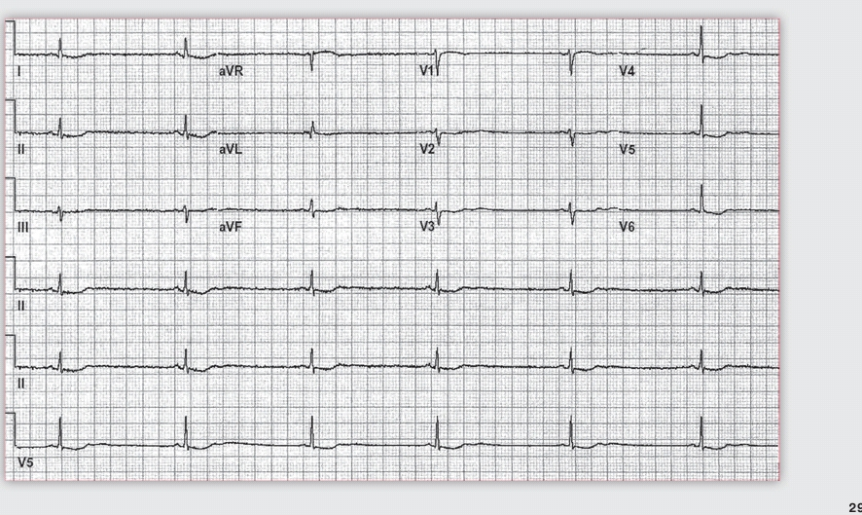
SA node:

Slide 30
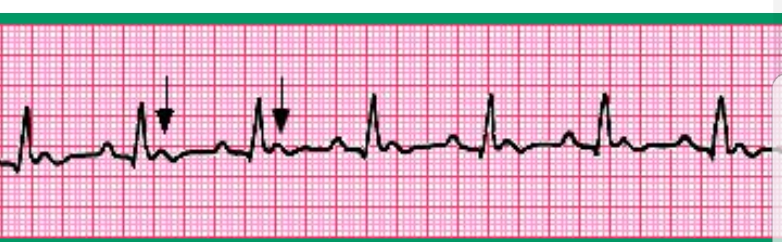

Slide 31
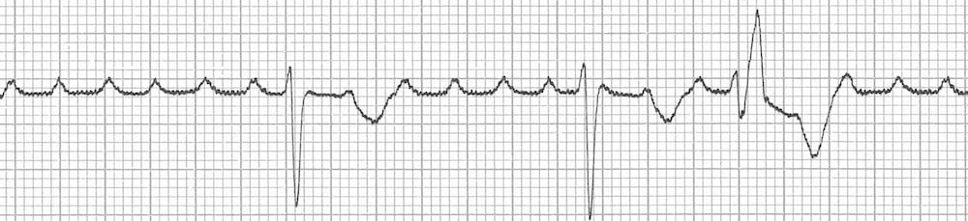

Slide 32
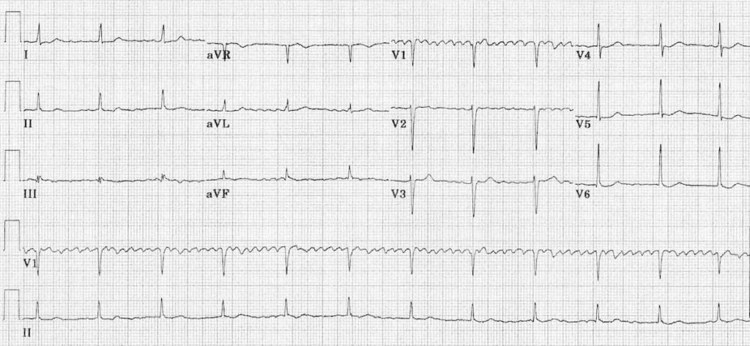

Slide 33
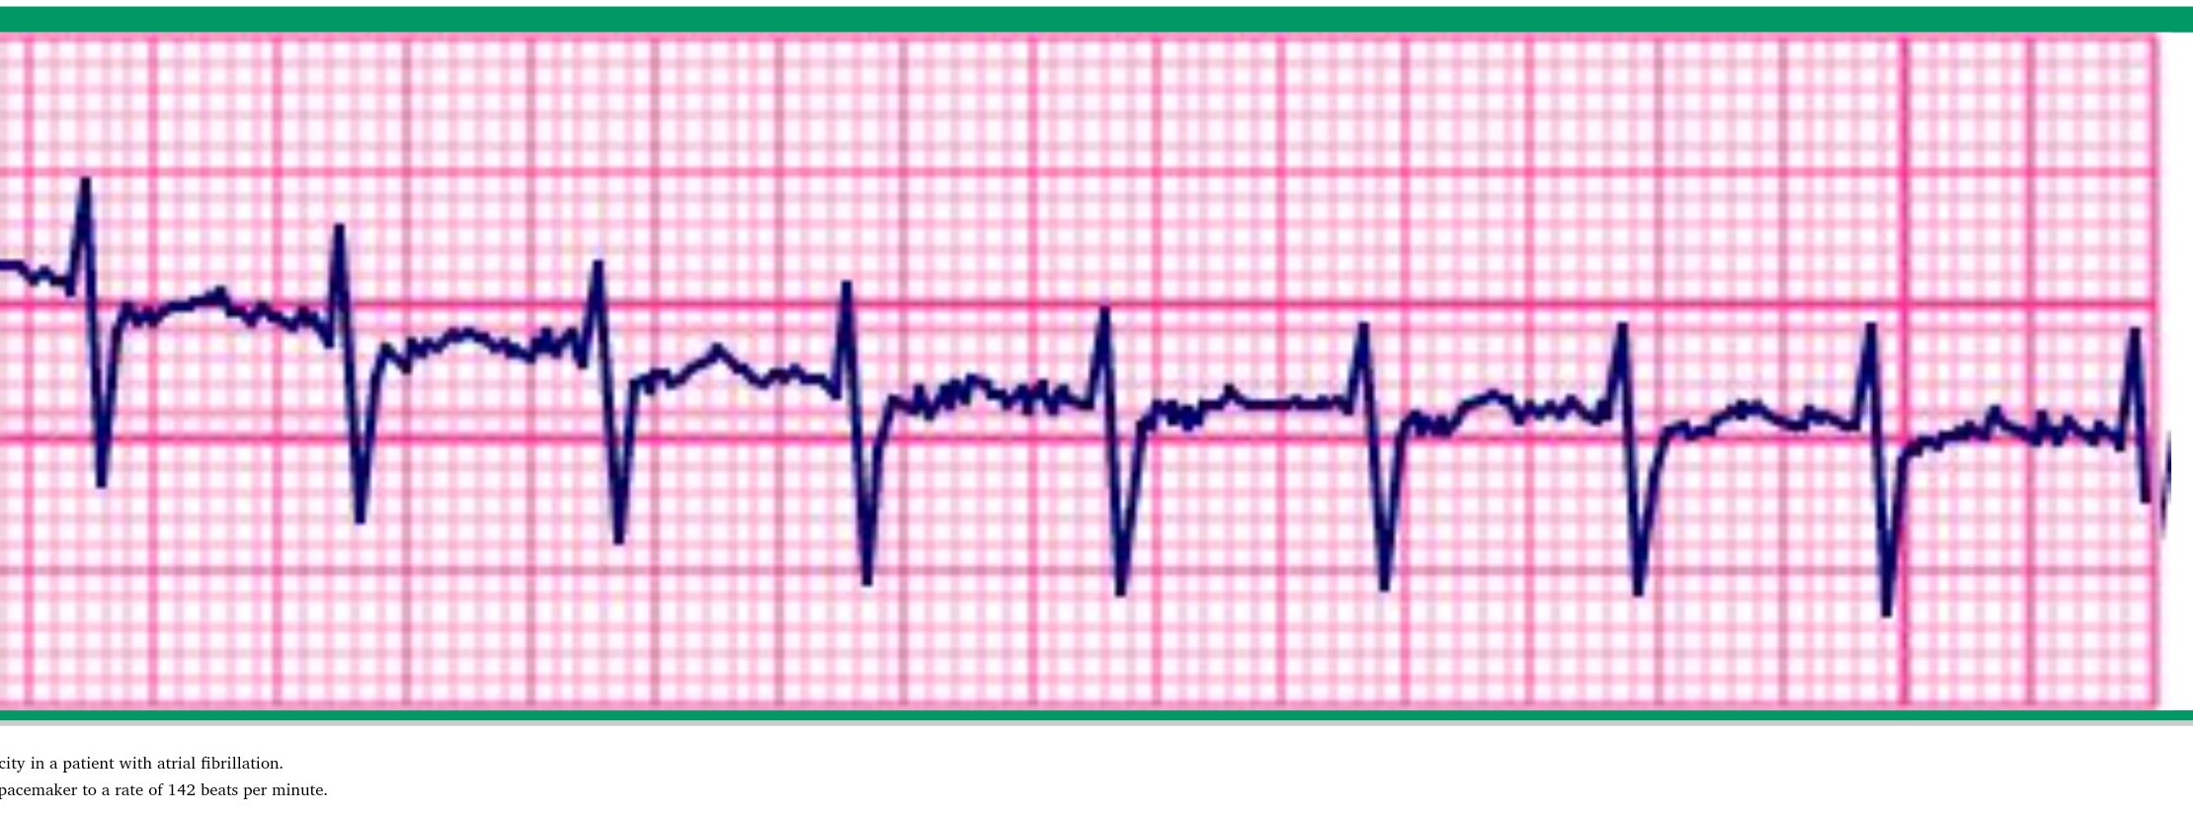

Slide 36
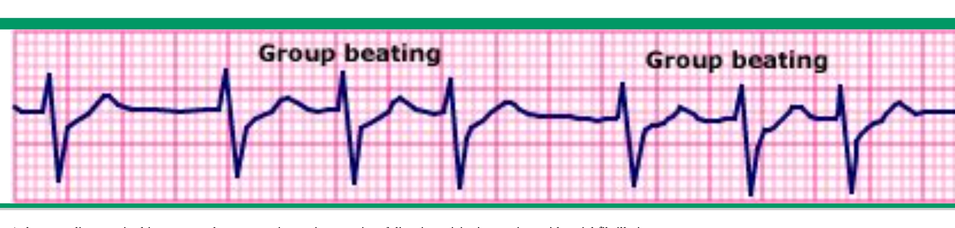

Slide 37
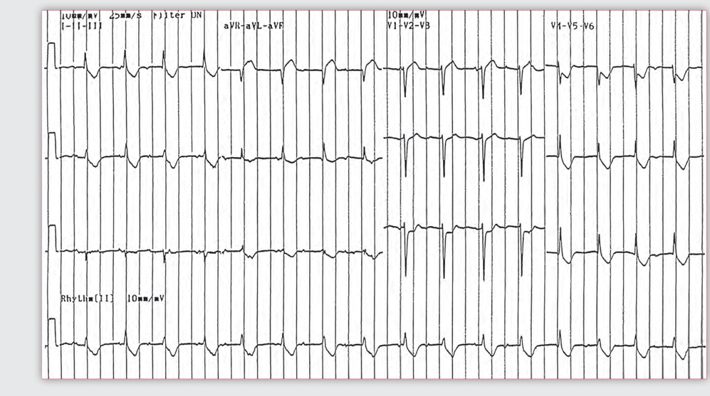

Slide 38
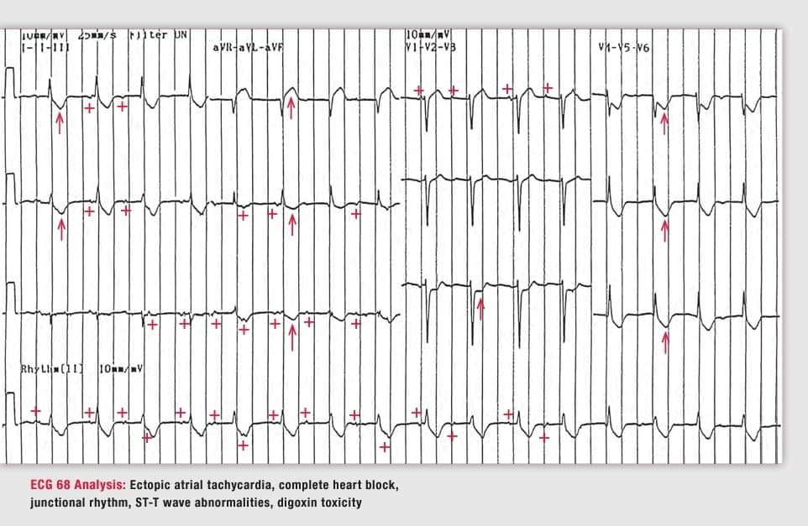

Slide 39
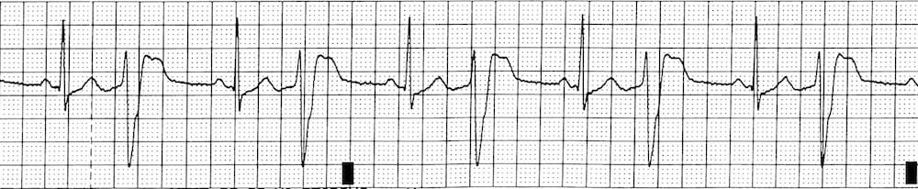

Slide 40
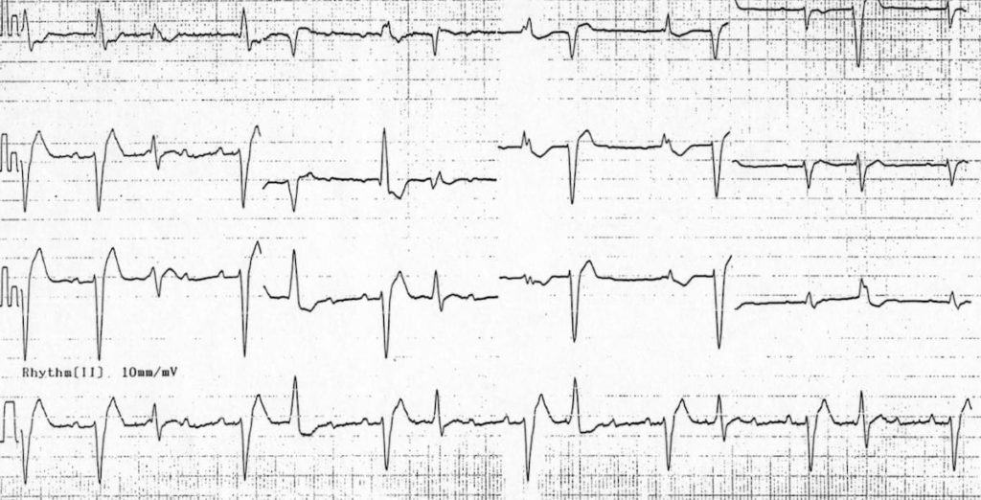

Slide 41
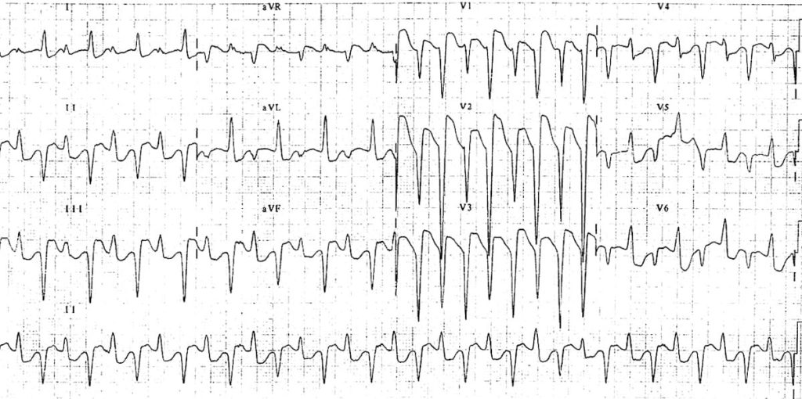

Slide 42
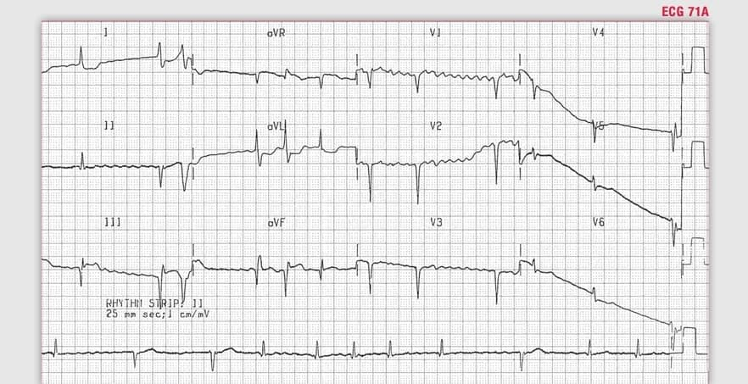

Slide 43
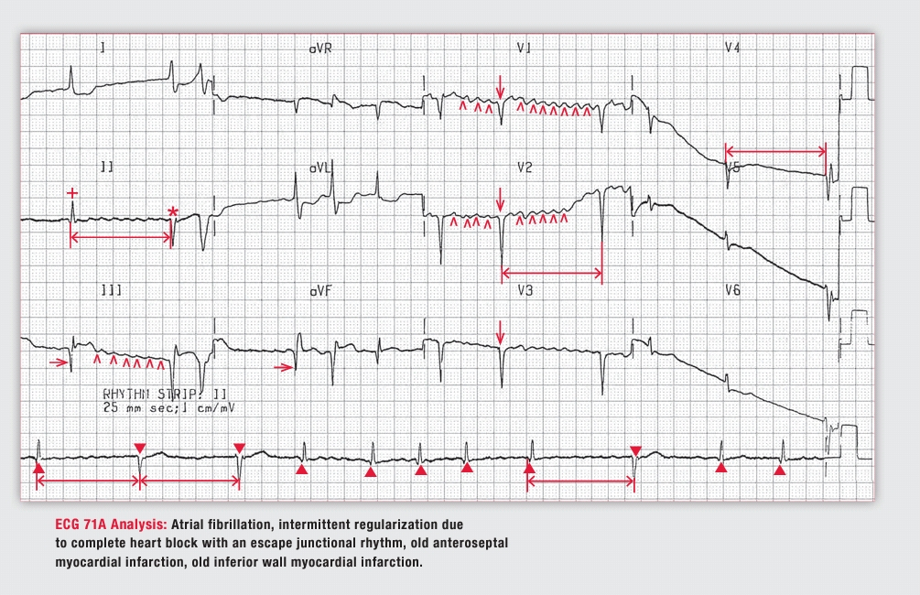

Slide 44
Brady arrhythmia
Sinus brady
Non respiratory sinus arrhythmia
Sinus exit block
Sinus arrest
AV block
AF +AV block +escape rhythm+exit block
Tachy arrhythmia:
Junctional tachy cardia
PVC
AT with AV block
VT
Bidirectional VT
Parasystole

Slide 45
Treatment-general consideration:
Assess airway, breathing, and circulation
Place the patient on continuous cardiac and pulse oximetry monitors
Establish intravenous (IV) access
Obtain an electrocardiogram (ECG)
Obtain a fingerstick glucose measurement if there is any alteration in mental status
Administration of activated charcoal in cases of ingestion less than 2 hours

Slide 46
Treatment-general consideration:
Antidotal therapy with antibody (Fab) fragments:
  Life-threatening or hemodynamically unstable arrhythmia (eg, ventricular tachycardia; ventricular fibrillation; asystole; complete heart block; Mobitz II heart block; symptomatic bradycardia)
  Hyperkalemia (serum potassium >5 to 5.5 meq/L [>5 to 5.5 mmol/L])
  Evidence of end-organ dysfunction from hypoperfusion (eg, renal failure, altered mental status)

Slide 47
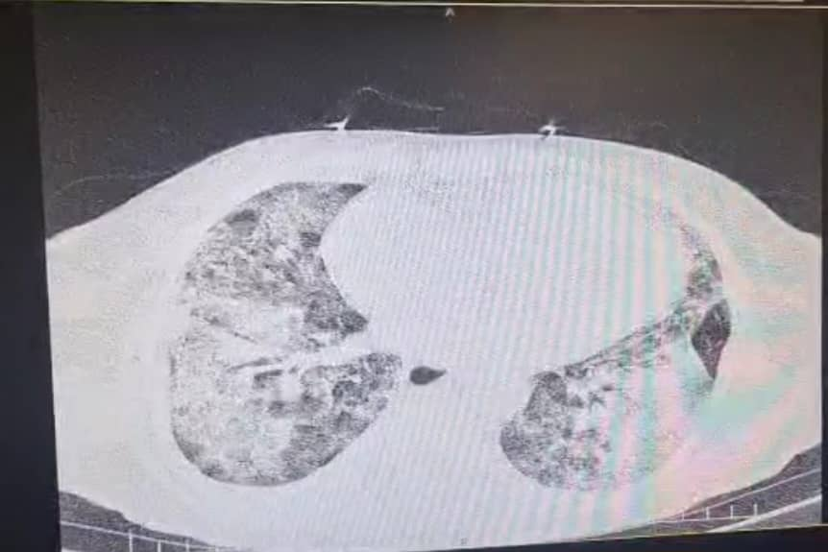
Lets study a real case!
80 years old lady came to ED with fatigue and altered mental status
History of dig consumption for AF
History of recent flue

Slide 48
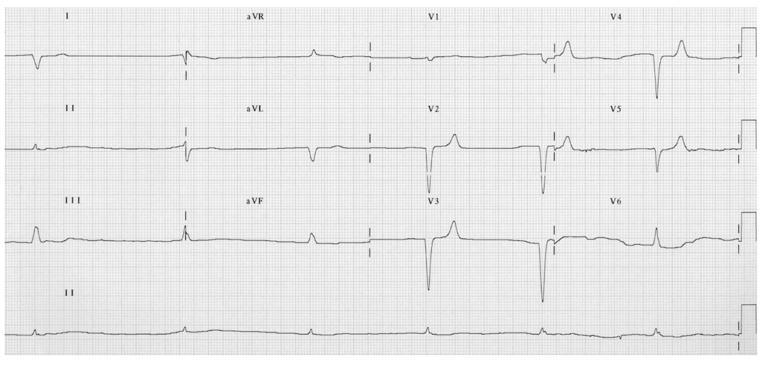
Lets study a real case!

Slide 49
Treatment-general consideration:
ELECTROLYTE Abnormality:
Hyperkalemia
  Calcium problem
Hypokalemia

Slide 50
Treatment of cardiac arrythmia
  Hemodynamically stable brady arrhythmia and svt observation
  Hemodynamically stable pvc observation
  Hemodynamically unstable pvc lidocaine
  Ventricular arrhythmia lidocaine
  Supra ventricular arrhythmia phenytoin(100 mg every 10 min up to 15 mg/kg)
  Magnesium sulfate
  Electrical cardioversion
    Use 100 mg lidocaine
    Use min dose of shock(10-25 j/50-100 j)

