Slide 1
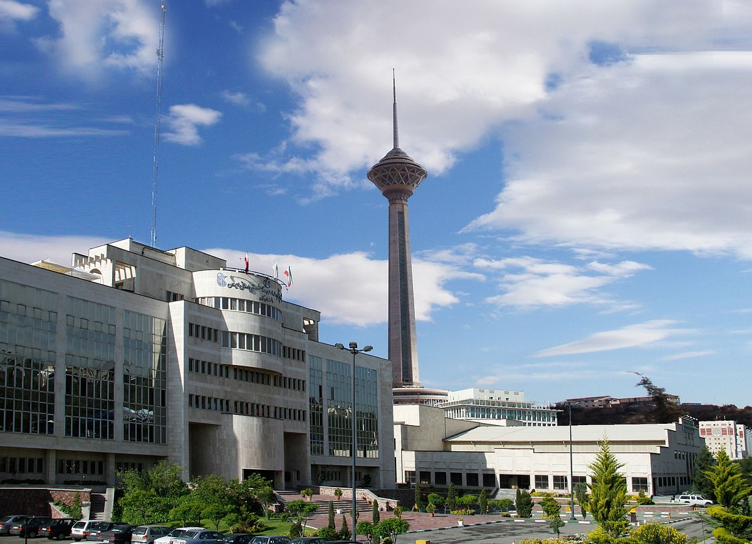
Acute bacterial meningitis
M.Talebi-Taher MD
Infectious diseases specialist
Scchool of medicine,IUMS
19 Dec 2024

Slide 2
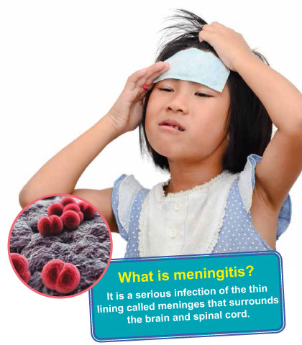
Case 1:
A 16-year- old girl was admitted at hospital following fever and headache nausea, vomiting since 2 days ago in spring.
Past medical HX.-
General appearance was good.
Neck stiffness +
LP:
WBC 250/ 80% Lymphocyte
Gl 80(BS=110), protein 75 mg /dl
Smear (-)

Slide 3
Viral meningitis:
Immunocompetent adult patients with viral meningitis usually present with headache, fever, and signs of meningeal irritation coupled with an inflammatory CSF profile.
Headache is almost invariably present and often characterized as frontal or retroorbital and frequently associated with photophobia and pain on moving the eyes.

Slide 4
Cont’
Nuchal rigidity is present in most cases but may be mild and present only near the limit of neck anteflexion.
Constitutional signs can include malaise, myalgia, anorexia, nausea and vomiting, abdominal pain, and/or diarrhea.

Slide 5
Cont’
Profound alterations in consciousness, such as stupor, coma, or marked confusion, do not occur in viral meningitis and suggest the presence of encephalitis or other alternative diagnoses.
Similarly, seizures or focal neurologic signs or symptoms or neuroimaging abnormalities indicative of brain parenchymal involvement are not typical of viral meningitis and suggest the presence of encephalitis or another CNS infectious or inflammatory process.

Slide 6
Etiology:
PCR
The most important agents are enteroviruses (including echoviruses and coxsackieviruses in addition to numbered enteroviruses),varicella-zoster virus (VZV), HSV (HSV-2 > HSV-1), HIV,and arboviruses .

Slide 7
CSF:
The typical profile is a pleocytosis, a normal or slightly elevated protein concentration (0.2–0.8 g/L [20–80 mg/dL]), a normal glucose concentration.
The total CSF cell count in viral meningitis is typically 25–500/Μl.
The CSF glucose concentration is typically normal in viral infections, although it may be decreased in 10–30% of cases due to mumps or LCMV.

Slide 8
Treatment:
Treatment of almost all cases of viral meningitis is primarily symptomatic and includes use of analgesics, antipyretics, and antiemetics.
Fluid and electrolyte status should be monitored

Slide 9
Case 2:
A 45- year -old man presented at hospital with fever, headache, nausea, vomiting, seizure and confusion.
He was in healthy situation until 2 days ago.
Past medical HX.: acute sinusitis
Neck stiffness, Kernig’s sign
Physical examination: unremarkable

Slide 10
Cont’
Brain CT scan: normal
PNS CT scan: pansinusitis(thickening mucosa)
LP:
WBC=1200(95% PMN)
Gl =25mg/dl(BS=90)
Pro=160mg/dl
Smear: -

Slide 11
Diagnosis:
Blood culture
Empirical treatment
Brain imaging? head trauma, malignancy, Icp, focal neurologic deficit, papilledeama, decreased level of consciousness, seizure.

Slide 12
Lp
White blood cells 10/μL to 10,000/μL; neutrophils predominate
Red blood cells Absent in nontraumatic tap
Glucose <2.2 mmol/L (<40 mg/dL)
CSF/serum glucose <0.4
Protein >0.45 g/L (>45 mg/dL)
Gram’s stain Positive in >60%
Culture Positive in >80%
PCR Detects bacterial DNA

Slide 13
Acute bacterial meningitis:
Bacterial meningitis is an acute purulent infection within the subarachnoid space (SAS).
It is associated with a CNS inflammatory reaction that may result in decreased consciousness, seizures, raised intracranial pressure (ICP), and stroke.
The meninges, SAS, and brain parenchyma are all frequently involved in the inflammatory reaction(meningoencephalitis).

Slide 14
Etiology:
Streptococcus pneumonia (~50%), Neisseria meningitidis (~25%), group B streptococci (~15%), and Listeria monocytogenes (~10%). Haemophilus influenzae type b accounts for <10% of cases of bacterial meningitis in most series.
N.meningitidis is the causative organism of recurring epidemics of meningitis 8–12 years.

Slide 15
Cont’
Gram-negative bacilli cause meningitis in individuals with chronic and debilitating diseases such as diabetes, cirrhosis, or alcoholism and in those with urinary tract infections.
Gram-negative meningitis can also complicate neurosurgical procedures, particularly craniotomy, and head trauma associated with CSF rhinorrhea or otorrhea.

Slide 16
Cont’
Generalized seizure activity and status epilepticus may be due to hyponatremia, cerebral anoxia, or, less commonly, the toxic effects of antimicrobial agents.
Raised ICP is an expected complication of bacterial meningitis and the major cause of obtundation and coma in this disease.
More than 90% of patients will have a CSF opening pressure >180 mmH2O.

Slide 17
Cont’
Otitis, mastoiditis, and sinusitis are predisposing and associated conditions for meningitis due to Streptococcus spp., gram-negative anaerobes, Staphylococcus aureus, Haemophilus spp., and Enterobacteriaceae.

Slide 18
Cont’
Group B Streptococcus, or Streptococcus agalactiae , was previously responsible for meningitis predominantly in neonates, but it has been reported with increasing frequency in individuals aged >50 years, particularly those with underlying diseases.

Slide 19
Pathophysiology:
The most common bacteria that cause meningitis, S. pneumoniae and N. meningitidis, initially colonize the nasopharynx.
Bacteria are able to multiply rapidly within CSF because of the absence of effective host immune defenses.
Normal CSF contains few white blood cells (WBCs) and relatively small amounts of complement proteins and immunoglobulins.

Slide 20
Cont’
A critical event in the pathogenesis of bacterial meningitis is the inflammatory reaction induced by the invading bacteria.
Many of the neurologic manifestations and complications of bacterial meningitis result from the immune response to the invading pathogen rather than from direct bacteria-induced tissue injury.
As a result, neurologic injury can progress even after the CSF has been sterilized by antibiotic therapy.

Slide 21
Cont’
The lysis of bacteria with the subsequent release of cell-wall components into the SAS is the initial step in the induction of the inflammatory response and the formation of a purulent exudate in the SAS.
Much of the pathophysiology of bacterial meningitis is a direct consequence of elevated levels of CSF cytokines and chemokines.

Slide 22
Clinical manifestation:
The classic clinical triad of meningitis is fever, headache, and nuchal rigidity, and these features each occur in >80% of adult cases of acute bacterial meningitis.
A decreased level of consciousness occurs in >75% of patients and can vary from lethargy to coma.
Nausea, vomiting, and photophobia are also common complaints.

Slide 23
Cont’
Seizures occur as part of the initial presentation of bacterial meningitis or during the course of the illness in 15–40% of patients.
Focal seizures are usually due to focal arterial ischemia or infarction, cortical venous thrombosis with hemorrhage, or focal edema.

Slide 24
Cont’
Signs of increased ICP include a deteriorating or reduced level of consciousness, papilledema, dilated poorly reactive pupils, sixth nerve palsies, decerebrate posturing, and the Cushing reflex (bradycardia, hypertension, and irregular respirations).
The most disastrous complication of increased ICP is cerebral herniation.
The incidence of herniation in patients with bacterial meningitis has been reported to occur in as few as 1% to as many as 8% of cases.

Slide 25
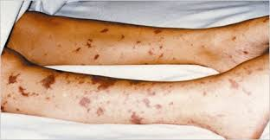
Specific clinical features:
The most important of these clues is the rash of meningococcemia, which begins as a diffuse erythematous maculopapular rash resembling a viral exanthem; however, the skin lesions of meningococcemia rapidly become petechial.
Petechiae are found on the trunk and lower extremities, in the mucous membranes and conjunctiva, and occasionally on the palms and soles.

Slide 26
D.DX:
ICH
hypersensitivity meningitis; chemical meningitis due to rupture of tumor contents into the CSF (e.g., from a cystic glioma or craniopharyngioma epidermoid or dermoid cyst); carcinomatous or lymphomatous meningitis.
Meningitis associated with inflammatory disorders such as sarcoid, systemic lupus erythematosus (SLE), and Behcet’s syndrome; pituitary apoplexy.

Slide 27
Treatment:
Preterm infants to infants <1 month : Ampicillin + cefotaxime
Infants 1–3 months Ampicillin + cefotaxime or ceftriaxone
Immunocompetent children >3 months and adults <55 Cefotaxime, ceftriaxone, or cefepime + vancomycin

Slide 28
Cont’
Adults >55 and adults of any age with alcoholism or other debilitating illnesses:
Ampicillin + cefotaxime, ceftriaxone, or cefepime +vancomycin

Slide 29
ADJUNCTIVE THERAPY
Dexamethasone?
The results of clinical trials of dexamethasone therapy in meningitis due to H. influenzae, S. pneumoniae, and N. meningitidis have demonstrated its efficacy in decreasing meningeal inflammation and neurologic sequelae such as the incidence of sensorineural hearing loss.

Slide 30
Prophylaxis:
N. meningitidis
Close contact: prolonged contact >8hr+<3feets
Exposed to the patient’s oral secretions
Within 1 week before the onset of the patient’s symptoms until 24 hrs after initiation of antibiotic.
Rifampin:600 mg bd for 2 days

Slide 31
Cont’
H.influenza
Household/ child younger than 48 mo
Rifampin 600 mg /d for 4 days

Slide 32


