Slide 1
Management of Nephrotic syndrome
Bahareh Marghoob. MD
Assistant professor of Nphrology
HKC-IUMS

Slide 2
Nephrotic syndrome
1- Presence of greater than 3 to 3.5 g per day of proteinuria,
2- Hypoalbuminemia
3- Edema
4- Hyperlipidemia
Managing nephrotic syndrome involves a multifaceted approach that includes symptom management, treatment of the underlying renal pathology, and prevention or treatment of complications

Slide 3
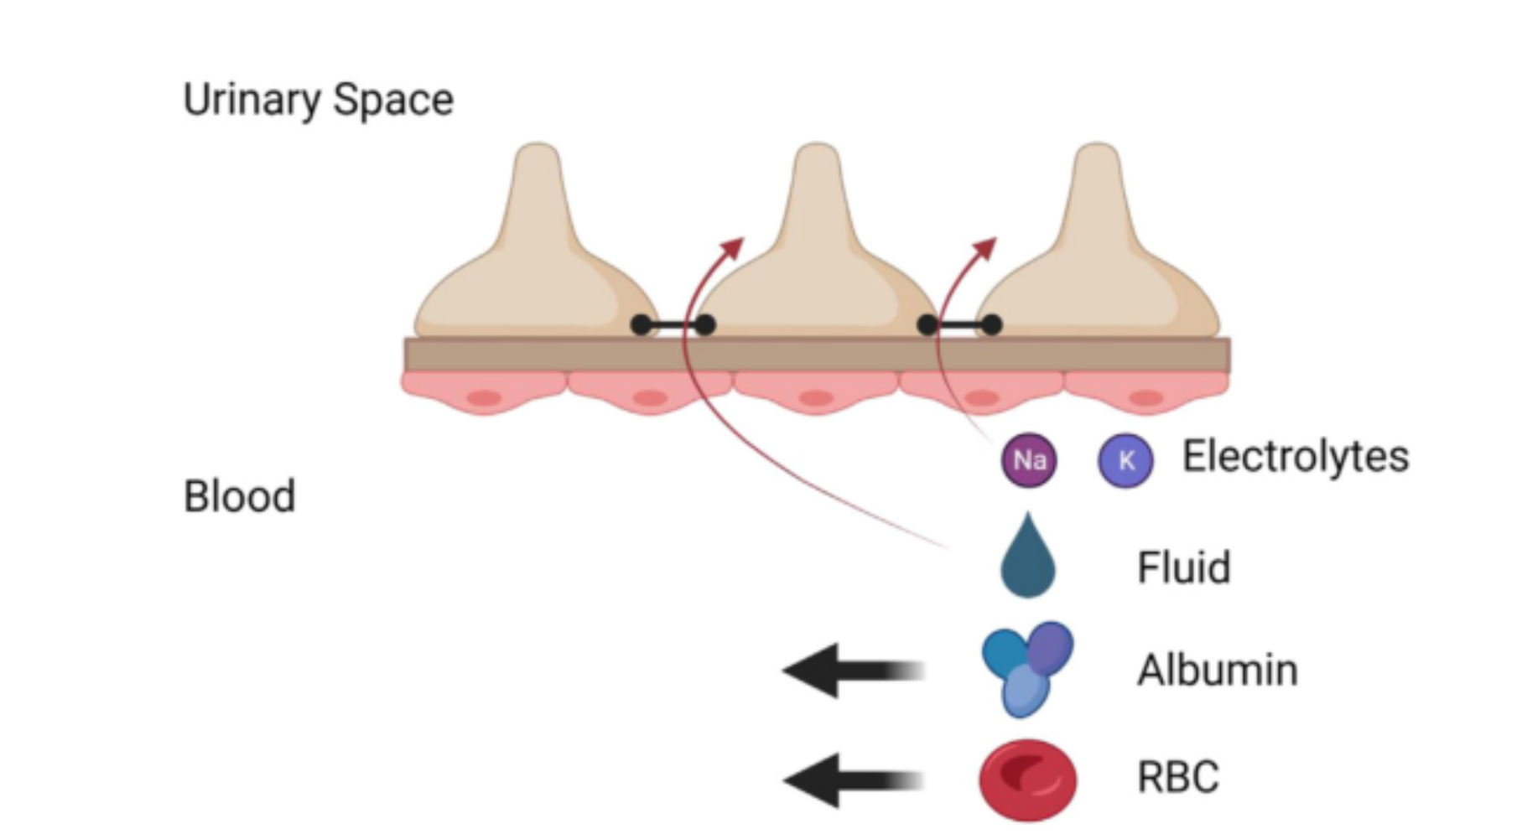
Pathophysiology
NS occurs due to a disruption of the glomerular filtration barrier which consists of three layers:
Fenestrated endothelial capillary cells
Basement membrane
Epithelial cells known as podocytes
The structure is both size- and charge-selective, favoring passage of smaller or cationic molecules over larger or anionic molecules.
Important proteins, such as albumin, immunoglobulins, and coagulation enzymes are preserved under normal conditions

Slide 4
CAUSES OF NEPHROTIC SYNDROME
Minimal change disease ( MCD )
Membranous nephropathy ( MGN )
Focal segmental glomerulosclerosis (FSGS)
Each pattern of injury can be primary (or idiopathic), secondary to a systemic disease or exposure, or genetic, meaning that the underlying genetic abnormality has been identified.
Amyloidosis
Diabetic nephropathy

Slide 5
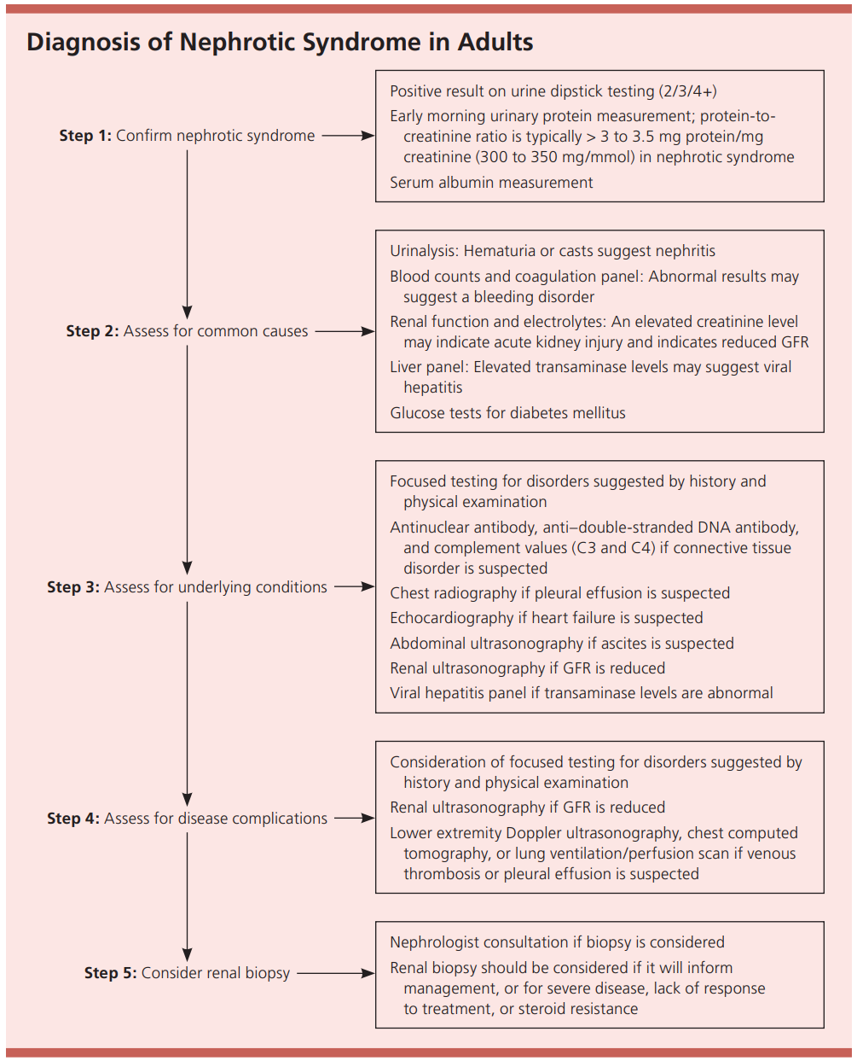

Slide 6
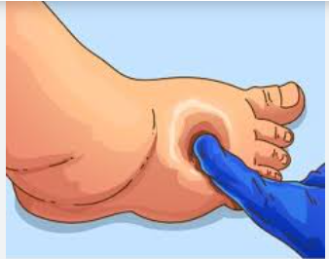
Complication and Pathophysiology
Edema
Edema is the most defining feature of NS going back to even its earliest descriptions.
Hippocrates described a state of generalized edema with the observation “when bubbles settle on the surface of the urine, it indicates a disease of the kidney and that the disease will be protracted.

Slide 7
Pathophysiology of edema
“underfill” hypothesis:
Low serum albumin leads to leakage of fluid out of the vessels and into the interstitial space. This leads to low intravascular pressure and reduced renal perfusion, which stimulates the renin-angiotensin aldosterone (RAAS) system and causes sodium retention and edema. Although physiologically appealing, this hypothesis does not seem to fully explain the edema observed in NS.

Slide 8
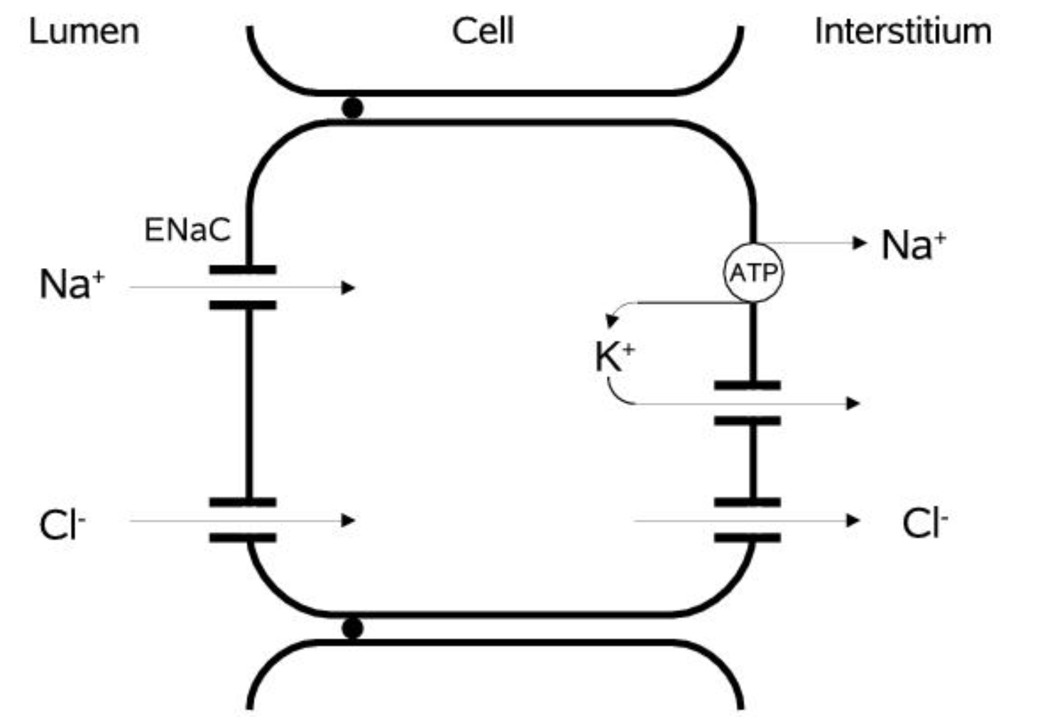
Pathophysiology of edema
The “overfill” hypothesis, in contrast, explains fluid retention in NS by direct changes to sodium handling by the kidney level of the epithelial sodium channel (ENaC) in the nephron.
According to the “overfill” hypothesis, a primary increase in ENaC activity drives increased sodium retention.

Slide 9
Hypercoagulability
Arterial and venous thrombosis represents an important complication of NS. Increased incidence of arterial and venous thrombosis ( 10-40% ) of patients particularly in proteinuria more than 10 gr,day
Asymptomatic or in acute onset with flank pain, gross hematuria and decline in GFR
Membranous nephropathy carrying the highest risk of thromboembolic events.
Renal vein thrombosis, arterial clots, deep vein thrombosis, and pulmonary emboli.

Slide 10
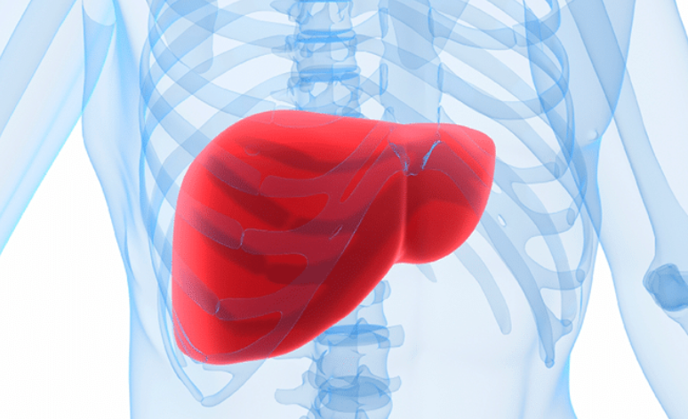
Hypercoagulability
The pathophysiology of hypercoagulability in NS has classically been explained by urinary loss of important anticoagulant and fibrinolytic proteins, such as antithrombin and plasminogen, that alter the balance of prothrombotic to antithrombotic proteins .
Increased hepatic synthesis of procoagulant factors, such as factors V and VIII.
The particularly high risk for renal vein thrombosis may relate to local clot formation promoted by glomerular inflammation and to glomerular hemodynamic changes in NS

Slide 11
Infection
Infection risk in NS is best described in the pediatric population.
The infection risk is multifactorial, related to both the underlying pathophysiology and the use of immune suppressive treatments.
Urinary losses of immune proteins such as immunoglobulin G and reduced function of immune cells (T cells, phagocytes) are contributors to decreased immunity

Slide 12
Hyperlipidemia and Cardiovascular Risks
Hyperlipidemia is a hallmark laboratory finding of NS. It has classically been explained by increased hepatic synthesis of lipoproteins triggered by hypoalbuminemia.
There is also evidence for decreased clearance of lipoproteins relating to changes in catabolism.

Slide 13
Hyperlipidemia and Cardiovascular Risks
A population-based study of 907 patients with primary NS with matched healthy adults showed a significantly elevated risk of cardiovascular events.
This study demonstrated an adjusted hazard ratio of 2.58 (95% Cl 1.89-3.52) for acute coronary syndrome and an adjusted hazard ratio of 3.01 (95% Cl 2.16-4.19) for heart failure.”
The increased cardiovascular risk likely reflects effects from hyperlipidemia, hypercoagulability, generalized inflammation, and kidney injury.

Slide 14
Kidney Injury
Acute kidney injury (AKI)
Chronic kidney disease (CKD)
Progression to end-stage kidney disease (ESKD)
Etiologies for AKI include abrupt changes in renal perfusion, acute interstitial nephritis from exposure to antibiotics and diuretics, acute tubular necrosis, and rapidly progressive glomerular injury

Slide 15
Kidney Injury
CKD can develop from recurrent AKI, treatments such as calcineurin inhibitors (CNIs), and primary glomerular injury
Rates of progression to ESKD are broadly variable based on the underlying histopathology and treatment course.
The risk of progression to ESKD is highest among patients with FSGS, followed by membranous nephropathy and then minimal change disease.

Slide 16
Management
Management of NS is devided to supportive and disease-specific therapy.
The main goal of treatment is to get the disease under remission and avoid progression to ESKD.
This involves the use of immunosuppressive agents directed by a nephrologist.
However, supportive treatment should be started by the primary care physician (PCP). It is preferable to avoid immunosuppression therapy before evaluation as this could affect the diagnosis and cause unnecessary toxicity.

Slide 17
Initial Evaluation
The evaluation of a patient with NS requires a thorough history and physical examination to assess for potential causes. It is essential to quantify the degree of proteinuria. This can be done by obtaining a 24-hour urine collection for protein quantification or a spot protein to creatinine ratio.
An evaluation of serum albumin level and lipid profile is also important.
Kidney biopsy remains the gold standard for diagnosis, as it will also guide therapy and provide prognostic information. It is usually preferable to get a kidney biopsy before starting management; however, preemptive treatment can be considered in specific clinical conditions.

Slide 18
Supportive Management
Edema
Loop diuretics are the preferred agents to treat edema.
There is no evidence to guide the selection of diuretics and the starting dose.
Intravenous (IV) administration is recommended in cases of severe or refractory edema.
Response to diuretics is usually measured based on the change in daily weight and urine output.
The goal weight loss is 2 to 4 pounds per day to avoid complications.

Slide 19
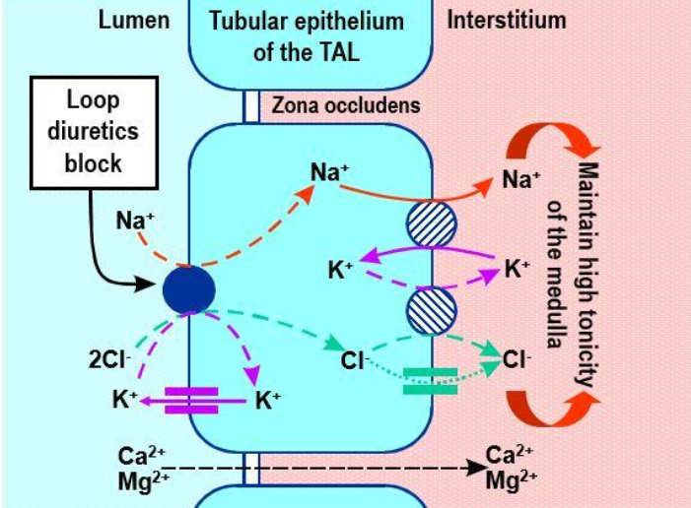
Supportive Management (Edema)
loop diuretics with titrated dose.
when loop diuretics are not sufficient, a thiazide or thiazide-like diuretic can be used to augment diuresis.
Diuretics need to reach an adequate concentration inside the tubules. This can be particularly challenging in patients with NS due to diffusion of diuretic into the extracellular space, reduced concentration inside the tubules, and binding of loop diuretics to albumin in the tubular fluid.

Slide 20
Supportive Management (Edema)
Most patients have some degree of gut edema that limits absorption, hence the preference for lV administration or longer-acting loop diuretics with increased bioavailability.
In patients with severe hypoalbuminemia ( Alb < 2 mg/l ) the combination of albumin infusion and loop diuretics may enhance diuresis.

Slide 21
Lifestyle changes
Patients with proteinuria and kidney disease should be on a sodium restricted diet ( < 1500 -2000 mg/d )
Protein restriction to less than 0.8 g/kg/d does not offer any additional advantages.
KDIGO 2021 guidelines suggest that based on the kidney function and degree of proteinuria, dietary protein restriction should be considered up to 0.8 g/kg/d, with 1 g of daily protein added per gram of urinary loss.
Dietary modifications and regular physical activity are recommended to normalize body mass index (BMI), reduce central obesity, and decrease cardiovascular risk factors.

Slide 22
Hypertension
Goal systolic blood pressure (BP) is less than 120 mm Hg with angiotensin receptor blockers (ARB) or angiotensin-converting enzyme inhibitors (ACEis) as first choice.
ARBs and ACEi should be increased to the maximal tolerated dose.
Adding a mineralocorticoid receptor antagonist has been shown to offer further improvement in lowering BP and proteinuria.

Slide 23
Hypertension
Dual-RAAS blockade is avoided for control of proteinuria alone due to the risk of hyperkalemia.
If hyperkalemia develops while on RAAS blockade, a potassium-wasting diuretic can be used as tolerated.
Loop diuretics are indicated just in volume overload.

Slide 24
Proteinuria
Reducing the amount of proteinuria has been shown to reduce the progression of kidney disease.
ARB and ACEi are the mainstay of treatment. These medications should be initiated even in the absence of hypertension to the maximum tolerated doses.
SGLT2is are beneficial in treating patients with diabetes and proteinuria as well as in delaying progression of kidney disease in patient with and without proteinuria.

Slide 25
Proteinuria
Possible beneficial effect of SGLT2is in lowering proteinuria and delaying progression of CKD in patients with nephrotic range proteinuria.
Currently, SGLT2is are not recommended for treatment of proteinuria in NS outside of diabetic nephropathy.

Slide 26
Anticoagulation recommendations for NS
The thrombotic risk in NS correlates with the degree of hypoalbuminemia
In patients with MGN and Albumin < 3 g/dl and low risk of bleeding start antigoagulation
In other nephrotic syndromes anticoagulation should be start if Albumin is < 2g/dl
serum albumin is less than 2.0 to 2.9 g/dL with additional risk factors for thrombosis
Proteinuria >10 g
BMI >35
Genetic predisposition to thromboembolic events
Heart failure IlI-IV
Recent major surgery
Prolonged immobilization

Slide 27
Anticoagulation
Anticoagulation should be LMWH or warfarin and in high risk patient for bleeding ASA.
DOAC is not supported in nephrotic syndrome.
Aspirin can be considered in patients with high risk for thromboembolism who are not a candidate for anticoagulation due to bleeding risk.
Patients should not start anticoagulation before evaluation by a nephrologist as this could delay biopsy.

Slide 28
Hyperlipidemia
Treatment of dyslipidemia should be initiated in patients with NS, particularly in those with additional cardiovascular risk factors.
Statins are the first-line pharmacologic agents to be used along with lifestyle modifications.
Non-statin medications can be added if statins are not tolerated or if goal is not achieved with maximally tolerated statin doses.
An additional benefit of statin therapy is their anti-proteinuric effect.

Slide 29
Infections
Patients with impaired immunity should be up to date with vaccinations.
Practice guidelines recommend pneumococcal, herpes zoster, and influenza vaccination for patients with NS.
Screening for syphilis, hepatitis C virus (HCV), hepatitis B virus (HBV), human immunodeficiency virus (HIV), and tuberculosis is suggested in clinically appropriate patients.
Pneumocystis jiroveci pneumonia prophylaxis should be prescribed for patients receiving high-dose steroids and other immunosuppressive therapy.

Slide 30
Disease specific management
Treatment varies with the underlying histopathology and etiology.
In all types of NS, secondary causes are managed by treating the underlying disease or removing the offending agent.

Slide 31
Focal Segmental Glomerulosclerosis ( FSGS )
Patients with primary FSGS and in some cases genetic FSGS require immunosuppressive therapy.
High-dose steroids remain the first line of treatment (Grade 1D per KDIGO 2021)
In patients not responding to or intolerant to steroids, a trial of CNIs is recommended (Grade 1C)
RAAS inhibition is the cornerstone of treatment to avoid progression of CKD.
Thiazide diuretics and a low sodium diet may potentiate the antiproteinuric effect of RAAS inhibition.

Slide 32
Minimal Change Disease
The management of minimal change disease in adults is composed of RAAS blockade, low sodium intake, and glucocorticoids.
The optimal steroid regimen is not well-defined. High-dose glucocorticoids should not be given for more than 16 weeks.
Tapering should start 2 weeks after remission is achieved.
If there are contraindications to glucocorticoids or if the patient has relapsing disease, further immunosuppressive treatment options include cyclophosphamide, CNI, mycophenolate, and rituximab.

Slide 33
Membranous Nephropathy
Primary membranous nephropathy patients should be risk-stratified before receiving immunosuppressive therapy.
Low-risk patients are treated with symptom management and risk modification only.
Patients at moderate risk of kidney disease progression can be managed conservatively or with immunosuppression (rituximab or CNIs and glucocorticoids).
For patients at high risk, immunosuppressive therapy with rituximab, cyclophosphamide and steroids, or CNIs and rituximab is recommended.
Patients at very high risk for progression to ESKD are managed primarily with cyclophosphamide and steroids.

Slide 34
Amyloidosis
The management of amyloidosis with renal involvement is multidisciplinary, involving hematology/oncology and nephrology. RAAS blockade should be used cautiously in patients with amyloid light chain (AL) cardiac amyloidosis due to the risk of hypotension.
Disease-targeted therapy should be directed by specialists and will vary depending on the type of amyloid.

Slide 35
Diabetic Nephropathy
Patients with diabetes and proteinuria should be initiated on RAAS blockade, even in the absence of hypertension, titrated up to the highest tolerated dose.
The kidney function and potassium level should be monitored 2 to 4 weeks after initiation or dose changes.
Increase in the serum creatinine is expected and RAAS blockade should not be stopped unless it rises by greater than 30% and there are no other causes of AKI.

Slide 36
Diabetic Nephropathy
SGLT2is are particularly important tools in the management of type 2 diabetic nephropathy.
SGLT2i should be considered in all patients with eGFR greater than 20 mL/min/1.73 m.
Because of normoglycemic ketoacidosis, it is reasonable to hold SGL2i during times of high stress, prolonged fasting, or critical medical illness.

Slide 37
Thank you for your attention

